Slide 1
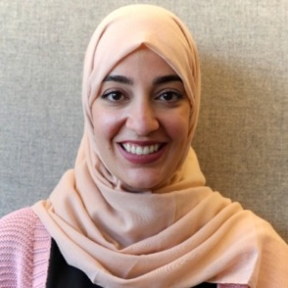
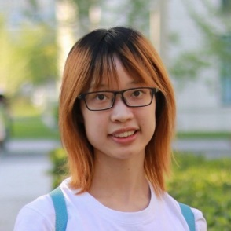
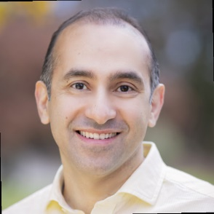
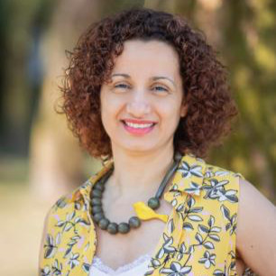


Continual-GEN: Continual Group Ensembling for Domain-agnostic Skin Lesion Classification
Nourhan Bayasi¹
Siyi Du¹
Ghassan Hamarneh²
Rafeef Garbi¹
Eighth ISIC Skin Image Analysis Workshop @ MICCAI 2023
October 12, 2023
1
2

Slide 2
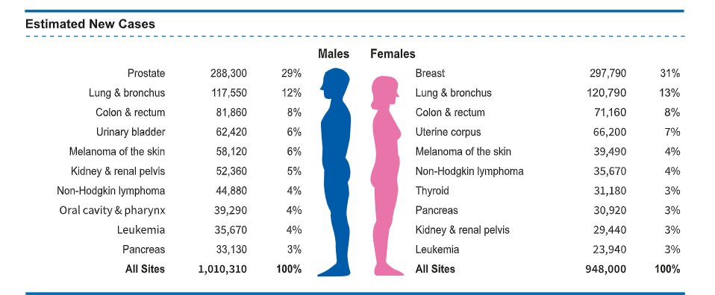
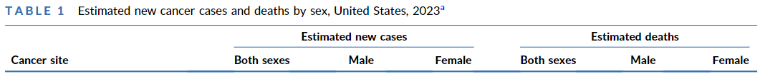








Skin Cancer Statistics 2023
Siegel, Rebecca L., et al. "Cancer statistics, 2023." Ca Cancer J Clin 73.1 (2023): 17-48.

Slide 3
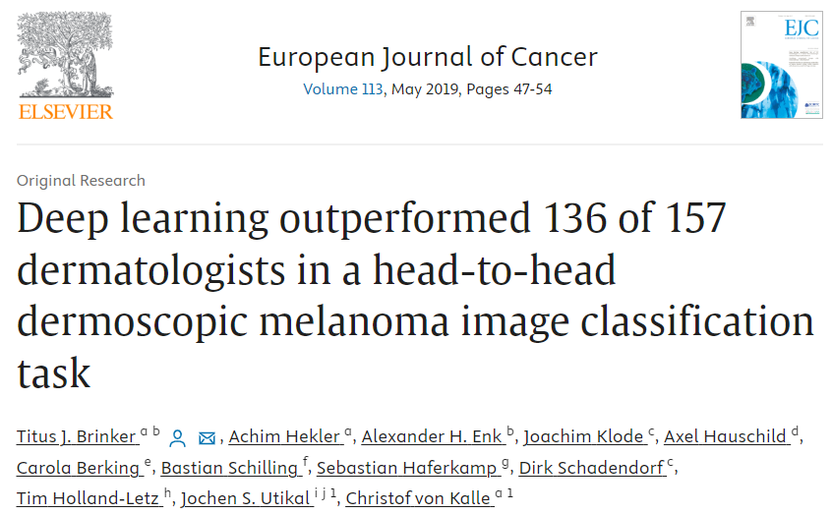
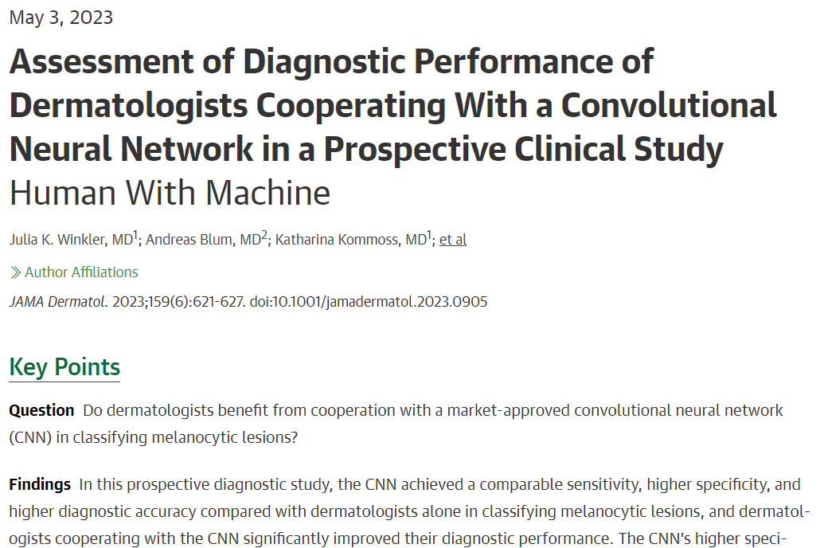
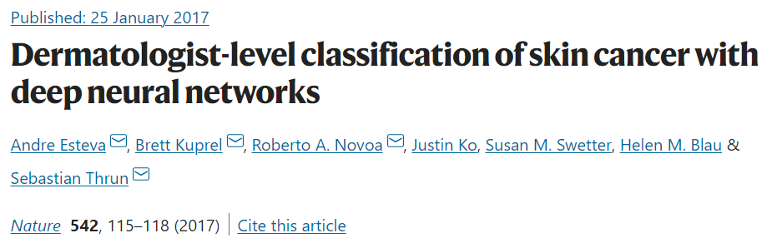
Skin Cancer Classification with Deep Learning

Slide 4
A Tale about Deep Learning
One upon a time, a lot of data was collected.
The data was fed into a deep learning model.
The model was then able to properly process the data, and when new similar data arrived at the model, it can correctly handle it.
What’s wrong with this?
Nothing! It’s just how DL works!
And it works wonderfully!

Slide 5

The Antagonists of Our Tale
… a lot of data was collected.
Is it always possible?
Do we have all the training datasets at the same time?
How to store it?
Can we store it?
What about the training time?
… when new similar data arrived at the model, it can correctly handle it.
What if dissimilar data arrives at the model?
What if I want to adapt the model to new data?
What if I want to continually train the model?

Slide 6
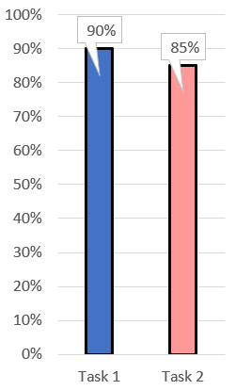
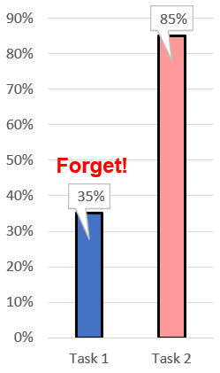
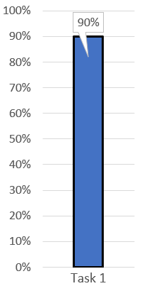
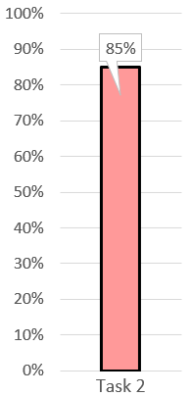
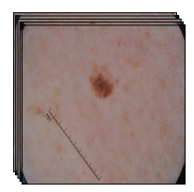
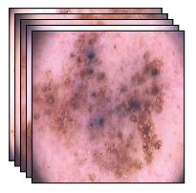


The Main Villain of DL: Catastrophic Forgetting
Continual Learning (CL) studies the problem of learning from a stream of datasets stemmed from changing input domains.
Task 1
“HAM dataset”
Task 2
“PH2 dataset”
CL methods alleviate the problem of catastrophic forgetting
HAM vs PH2:
- Demographics
- Image acquisition devices
- Artifact distribution-
- Artifact characteristics-
- Class distribution
time
Catastrophic forgetting is the tendency of a deep network to completely and abruptly forget previously learned information upon learning new information

Slide 7
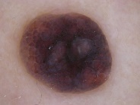
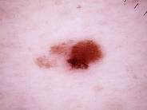
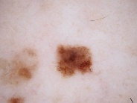
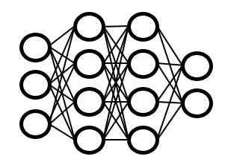


Culprit Prune Net (CPN)
We proposed Culprit-Prune-Net, a fixed-sized network to learn multiple domains (datasets) sequentially over time without catastrophic forgetting.
We identified a “winning” subnetwork to learn each task separately.
$$D_{1} D_{t} D_{N}$$
… …
Time
$$f_{t}^{e}$$
$f_{N}^{e}$
culpability-based pruning
… …
Free units Reserved units
1st domain subnetwork $t^{th}$domain subnetwork ${ T}^{th}$ domain subnetwork
Nourhan BAYASI, Ghassan Hamarneh, and Rafeef Garbi. "Culprit-prune-net: Efficient continual sequential multi-domain learning with application to skin lesion classification." MICCAI 2021

Slide 8
Limitation in Culprit Prune Net (CPN)
$$D_{1} D_{t} D_{N}$$
… …
Time
Hey!
This is a new domain
$$D_{1} D_{t} D_{N}$$
… …
Time
Domain identity is usually unknown.
- The anonymization process in the medical field may erase the domain identity information.
e.g. source of data or the specific device used for data generation

Slide 9
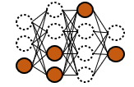
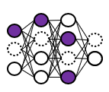
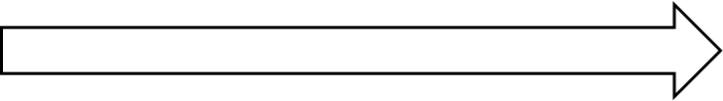







Continual-GEN: Domain-agnostic Version of CPN
The network decides if it’s going to create a new or update an existing subnetwork with every new domain.
For the 1st domain ($D_{1}$), a subnetwork ($f_{1}$) is created.
For a new batch of data ($D_{2}$) …
$$D_{1}$$
Time
$$D_{1}$$
$$D_{2}$$
are the two domains similar?
Time
YES
NO
$$f_{1}$$
$$f_{2}$$
Finetune $f_{1}$

Slide 10





How to Assess Similarity?
$$D_{2}$$
Distance in the embedding space
Ensemble of groups
$$D_{1}$$

Slide 11





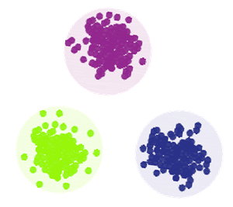
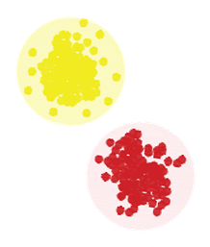




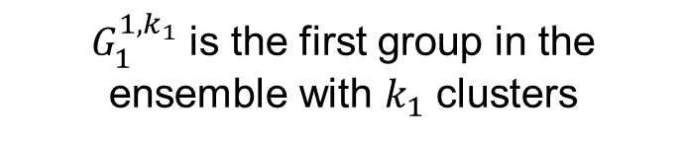
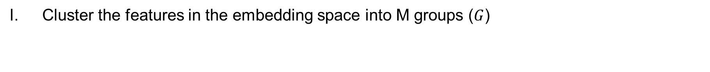







Ensemble of Groups
Cluster the features in the embedding space into M groups ($G$)
$$G_{1}^{Ensemble}$$
$G_{1}^{1,k_{1}}$ is the first group in the ensemble with $k_{1}$ clusters
$$G_{1}^{1,k_{1}}$$
$$G_{1}^{2,k_{2}}$$
$$z_{1}$$
$$z_{2}$$
$$z_{N}$$
…
$$D_{1}$$
…
Cluster
$$G_{1}^{M,K_{M}}$$

Slide 12



















Steps to Assess Similarity
II. Compute ensemble similarity score (ESS)
$$z_{1}$$
$$G_{2}^{Ensemble}$$
$$z_{2}$$
$$z_{N}$$
…
$$G_{2}^{1,k_{1}}$$
$$G_{2}^{2,k_{2}}$$
…
$$G_{2}^{M,K_{M}}$$
$$D_{2}$$
$$z_{1}$$
$$S_{1,1}$$
$$S_{1,2}$$
$$S_{1,M}$$
$$z_{2}$$
$$z_{N}$$
$$D_{1}$$
…
$$G_{1}^{1,k_{1}}$$
$$G_{1}^{2,k_{2}}$$
…
$$G_{1}^{M,K_{M}}$$
$$G_{1}^{Ensemble}$$

Slide 13





Steps to Assess Similarity
IND vs OOD decision making
$$D_{1}$$
$$D_{2}$$
are the two domains similar?
Time
ESS > γ
ESS < γ
$$f_{1}$$
$$f_{2}$$
Finetune $f_{1}$

Slide 14
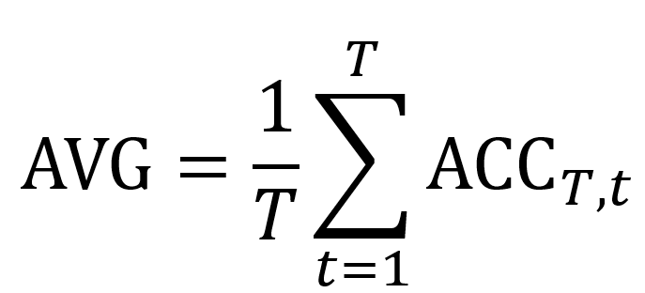
Experiments and Results
Datasets
In our experimental setup, we consider a total of 6 sequentially presented domains:
HAM10000 (set-1), HAM10000 (set-2), HAM10000 (set-3) [as in (1)], Dermofit (DMF), Derm7pt (D7P), and MSK
Implementation details
Pruning ratio: 80%
Number of groups in an ensemble: 8
Clustering techniques: Groundtruth clustering, GMM with 1, 3, 5, 7, 10, 15 and 20 clusters.
Evaluation metric:
Fogelberg, Katharina, et al. "Domain shifts in dermoscopic skin cancer datasets: Evaluation of essential limitations for clinical translation." New Biotechnology 76 (2023): 106-117.

Slide 15
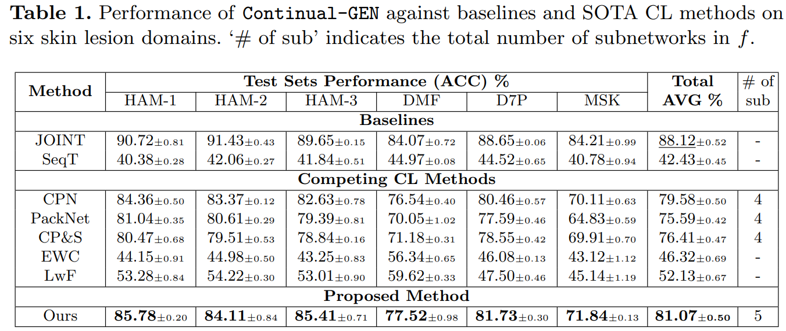

Experiments and Results

Slide 16
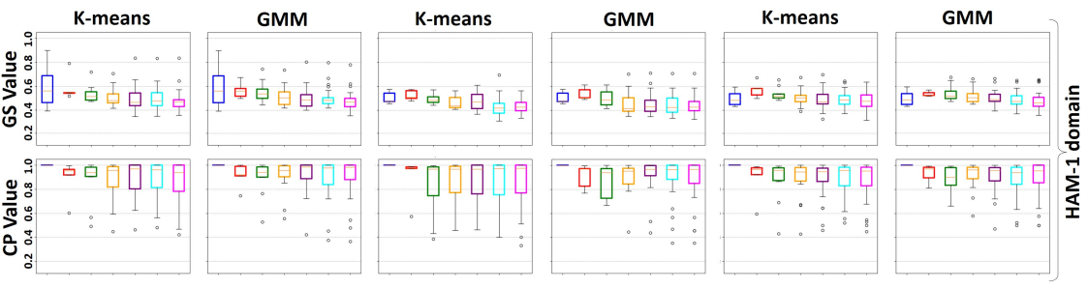




Experiments and Results
Clustering techniques
Cluster quality measures
Training methods

Slide 17
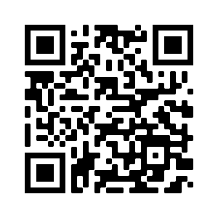
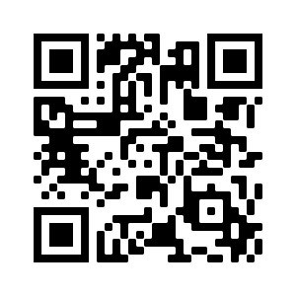
Please refer to our paper Continual-GEN: Continual Group Ensembling for Domain-agnostic Skin Lesion Classification for more experiments and ablation studies!
Paper is available at
Code is available at
Thank you!
Contact us: {nourhanb}@ece.ubc.ca

