Slide 1


Topology-Aware Deep Models for Skin Lesion Classification
Sayoni Chakraborty^{*,1}, Philmore Koung^{*,1,2}, Baris Coskunuzer²
¹Department of Biostatistics and Data Science, O’Donnell School of Public Health, UT Southwestern Medical Center
²Department of Mathematics, The University of Texas at Dallas
* = equal contribution

Slide 2
Outline
Introduction
Persistent Homology
Sublevel Filtration
Interpretability
Model Architecture
Datasets
Results

Slide 3
Introduction
In this work we introduce a new framework using topological deep learning to classify skin lesions
By capturing global shape and connectivity, topological features enhance both robustness and interpretability in deep learning

Slide 4
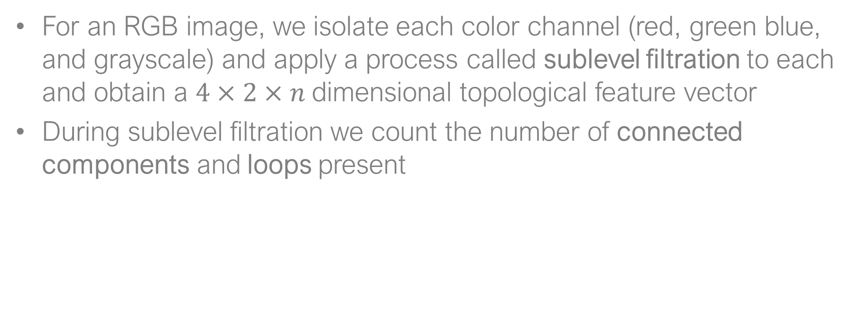
Persistent Homology
For an RGB image, we isolate each color channel (red, green blue, and grayscale) and apply a process called sublevel filtration to each and obtain a $4×2×n$dimensional topological feature vector
During sublevel filtration we count the number of connected components and loops present

Slide 5
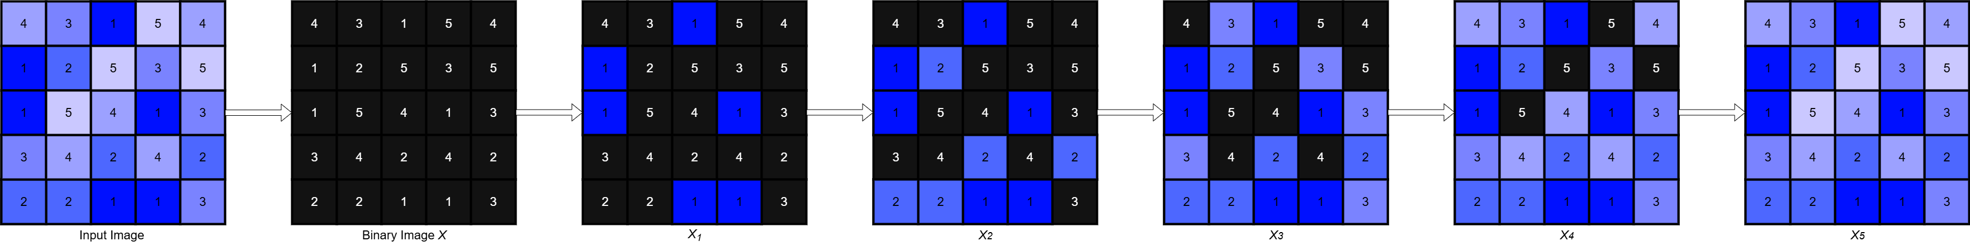
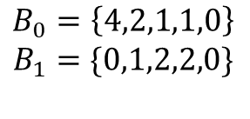
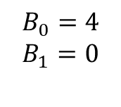
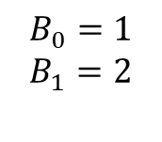
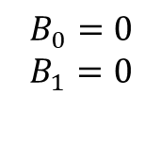
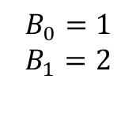
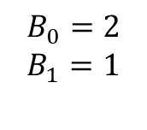
Sublevel Filtration
Loop
$$B_{0}=4$$
$$B_{1}=0$$
$$B_{0}=2$$
$$B_{1}=1$$
$$B_{0}=1$$
$$B_{1}=2$$
$$B_{0}=1$$
$$B_{1}=2$$
$$B_{0}=0$$
$$B_{1}=0$$
$$B_{0}=\left\{4,2,1,1,0\right\}$$
$$B_{1}=\{0,1,2,2,0\}$$

Slide 6
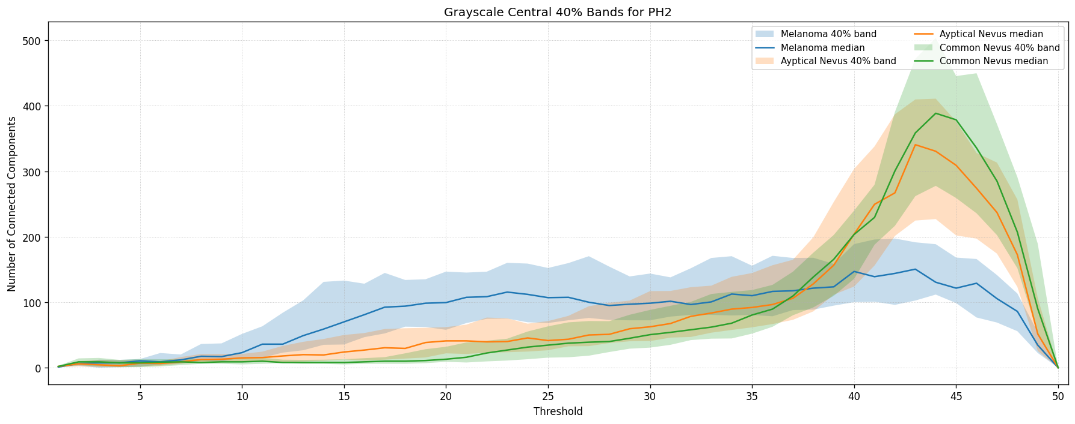
Interpretability

Slide 7
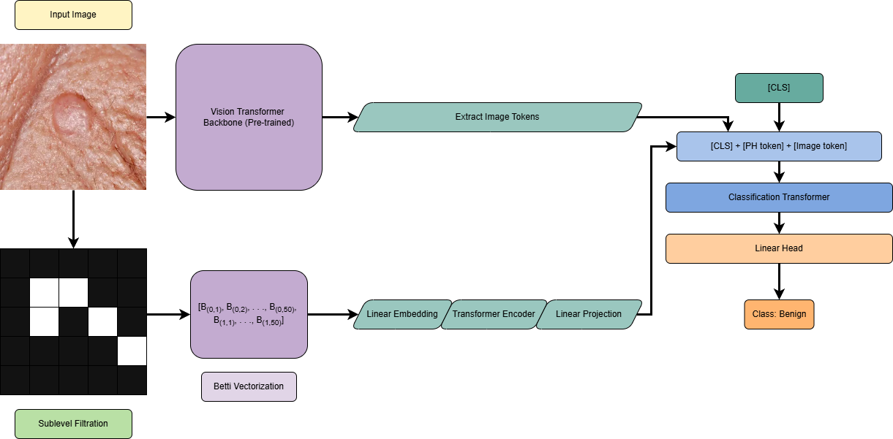
Model Architecture

Slide 8
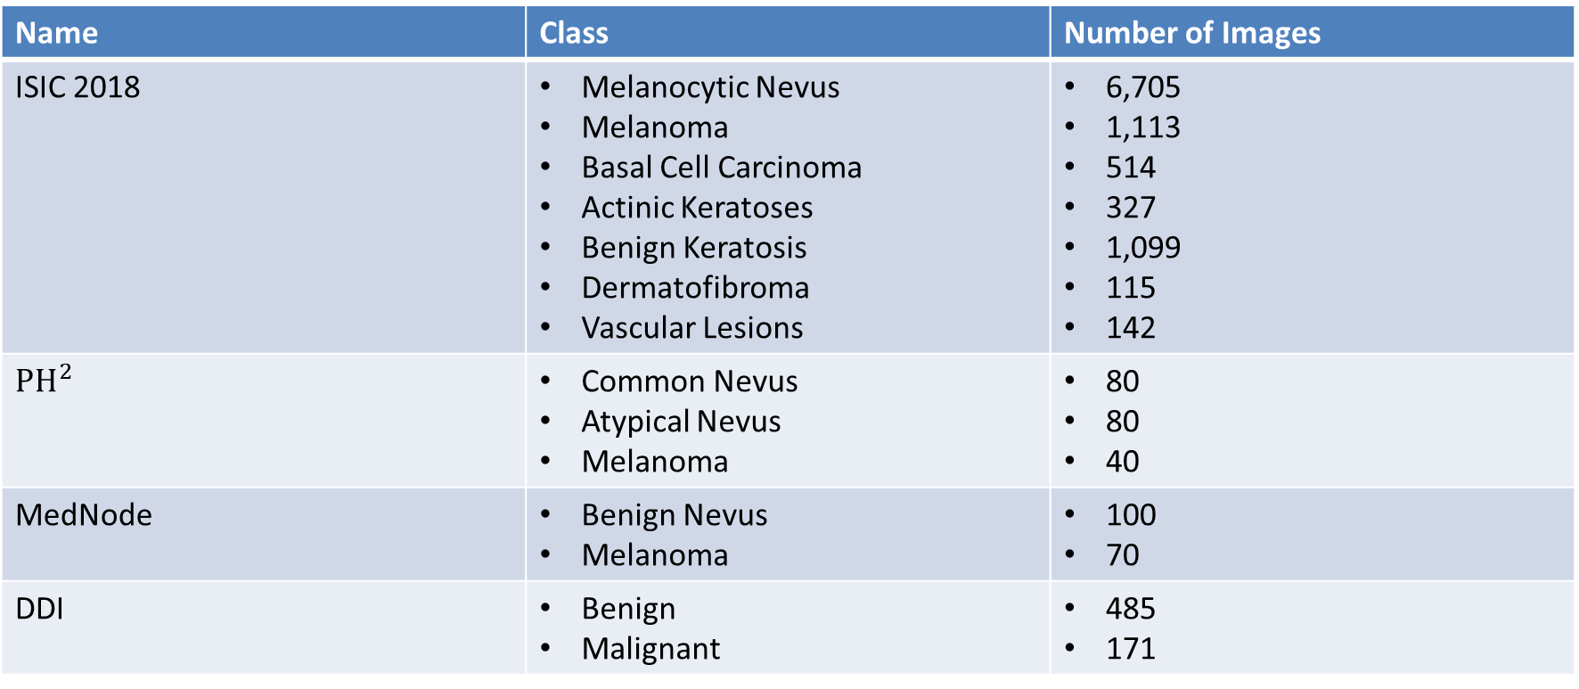
Datasets
Name | Class | Number of Images
ISIC 2018 | Melanocytic Nevus Melanoma Basal Cell Carcinoma Actinic Keratoses Benign Keratosis Dermatofibroma Vascular Lesions | 6,705 1,113 514 327 1,099 115 142
$${PH}^{2}$$ | Common Nevus Atypical Nevus Melanoma | 80 80 40
MedNode | Benign Nevus Melanoma | 100 70
DDI | Benign Malignant | 485 171

Slide 9
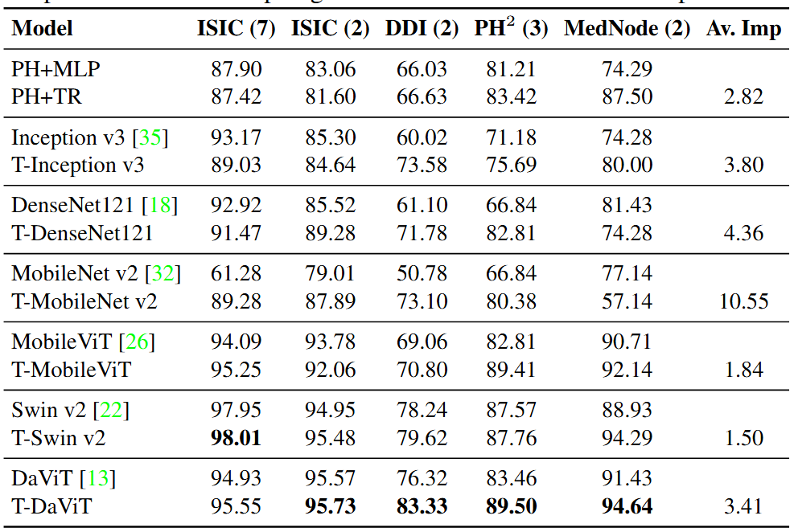
AUC Results

Slide 10
Conclusion
We demonstrate that topological signatures alone are competitive in performance
Their integration with deep models consistently improve accuracy across diverse skin lesion types
Enhance model robustness and interpretability

Slide 11
Future Work
Integrate multimodal data such as EHR
Explore end-to-end differentiable topological layers
Validate our approach through prospective clinical studies

Slide 12

Thank you!

