Slide 1




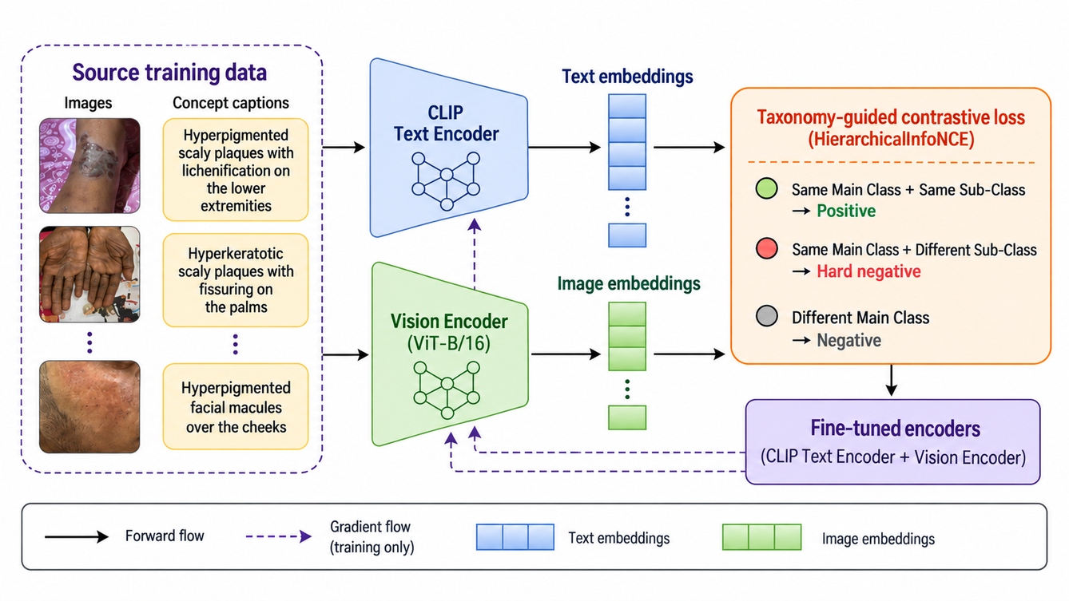
MICCAI ISIC Skin Image Analysis Workshop 2026
Language tells the representation what clinical evidence to retain; taxonomy tells it which sibling diagnoses to separate.
Taxonomy-Guided Language Supervision
for Hierarchical Skin Disease Classification
Anjali Deepu¹ and Swarnava Dey² ³
1. Ocean Engineering and Naval Architecture, Indian Institute of Technology Kharagpur
2. Department of Artificial Intelligence, Indian Institute of Technology Kharagpur
3. TCS Research, Tata Consultancy Services Limited
1
Notes:
Open with the core story, not the loss function. Emphasize that the work is about using language as a training signal for visual classification, and using taxonomy to target clinically confusable sibling conditions.
‹#›

Slide 2

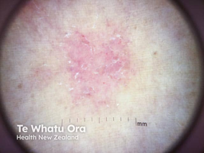


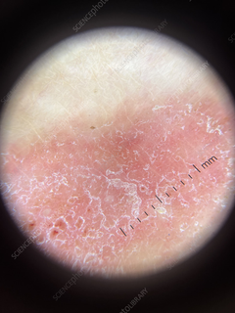
Why hierarchy matters in dermatology
A useful representation must preserve both shared disease-family structure and fine -grained subclass evidence
What must be learned simultaneously?
Shared parent-level
cues
Subclass-specific
evidence
Eczema
(child)
Inflammatory
(parent)
  erythema
  scaling
  plaque-like appearance
  Morphology
  location
  texture
  descriptors
Psoriasis
(child)
The clinical decision is often parent-first, but the
useful representation cannot stop at the parent
1
2
Fine-grained seperation determination the
specific condition
Coarse categories organize diagnosis.
Taxonomy-guided language supervision for hierarchical skin disease classification
2
Notes:
Explain the simple taxonomy tree. The point is not that hierarchy is new; the point is that the representation must encode both parent-level similarity and sibling-level separation.
‹#›

Slide 3
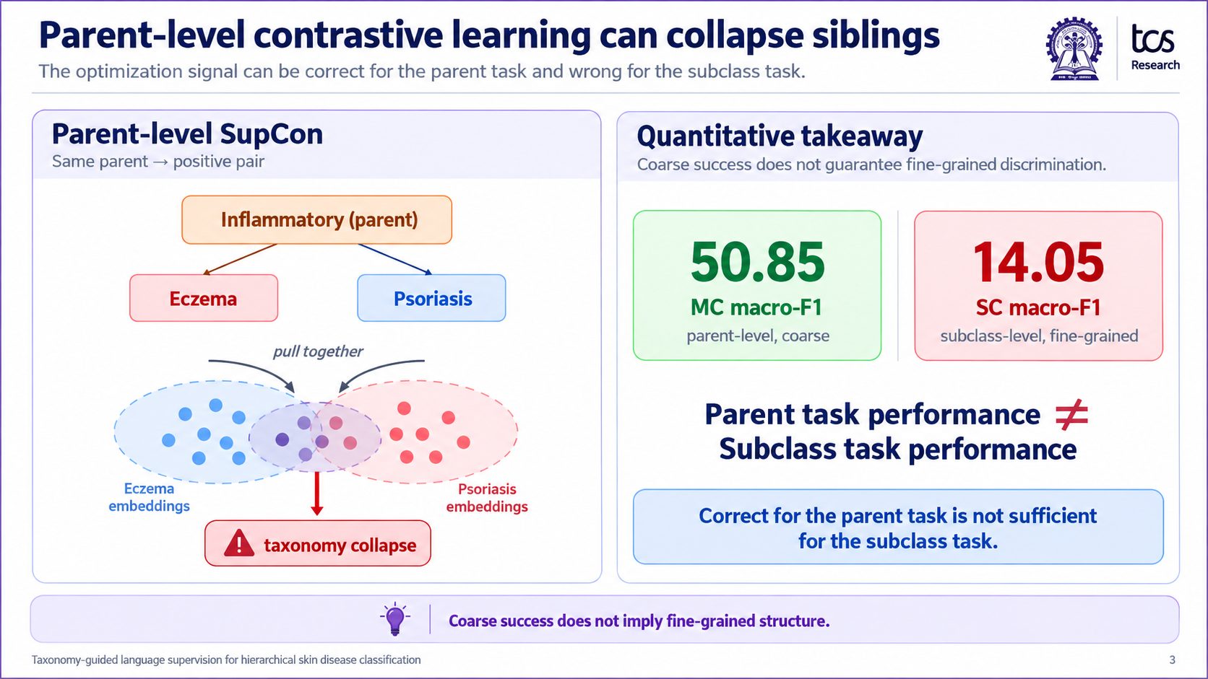
Problem: parent-level contrastive learning can collapse siblings
The optimization signal can be correct for the parent task and wrong for the subclass task.
14.05
50.85
MC macro-F1 after parent-level SupCon
SC macro-F1 remains low
≠
coarse success is not fine-grained success
Taxonomy-guided language supervision for hierarchical skin disease classification
3
Notes:
This is the key motivation slide. Say: the training rule is not stupid; it optimizes the parent category. But the same optimization is insufficient for subclasses. This is what we call taxonomy collapse in the parent-supervised setting.
‹#›

Slide 4










Related work and positioning
Existing families solve important pieces; the paper joins them inside representation learning.
Hierarchical classifiers
Concept Bottlenecks
Concept Bottlenecks
Hard negatives / prototypes
What they do
What they do
What they do
What they do
Use label trees, sequential
decisions, semantic distances,
or constrained outputs.
Make clinically meaningful
attributes explicit before
classification
Align images with reports, literature, prompts, or concepts.
Use informative negatives or textual class prototypes.
Gap
Gap
Gap
Gap
Often act at prediction/head
level.
Concepts become an intermediate prediction pathway.
Not necessarily targeting sibling subclass geometry.
Usually not jointly tied to clinical concepts and disease taxonomy.
Our positioning
Structured descriptors become language supervision; the disease hierarchy determines which sibling diagnoses receive extra separation; the resulting embedding drives prototype classification and gallery replacement.
Taxonomy-guided language supervision for hierarchical skin disease classification
4
Notes:
Use this slide to answer: How are we different from prior hierarchical methods, CBMs, medical VLMs, and prototype methods? We do not claim each ingredient is new. The contribution is the functional combination.
‹#›

Slide 5





Contribution summary: what changes technically?
Language specifies evidence; taxonomy specifies local separation.
1
Multi-positive clinical language supervision
3
Prototype gallery instead of fixed output head
Multiple captions generated from existing labels, morphology, location, symptoms, and descriptors teach the visual space what clinical evidence to retain.
After training, labelled captions are averaged into class prototypes. Image - prototype similarities become class scores.
2
Taxonomy-guided sibling negatives
4
Gallery replacement for new vocabularies
Same subclass → positive
Same parent + different subclass → weighted negative
Different parent → ordinary negative
The encoders stay frozen; replacing the caption gallery changes the disease vocabulary available for prediction.
Inventive mechanism: concept-derived language and taxonomy-guided pair weighting act during representation learning, not only after feature extraction.
Taxonomy-guided language supervision for hierarchical skin disease classification
5
Notes:
This is the contribution slide. Keep the explanation simple and categorical. These four pieces are the architecture of the idea; the first two are training, the last two are inference/deployment.
‹#›

Slide 6
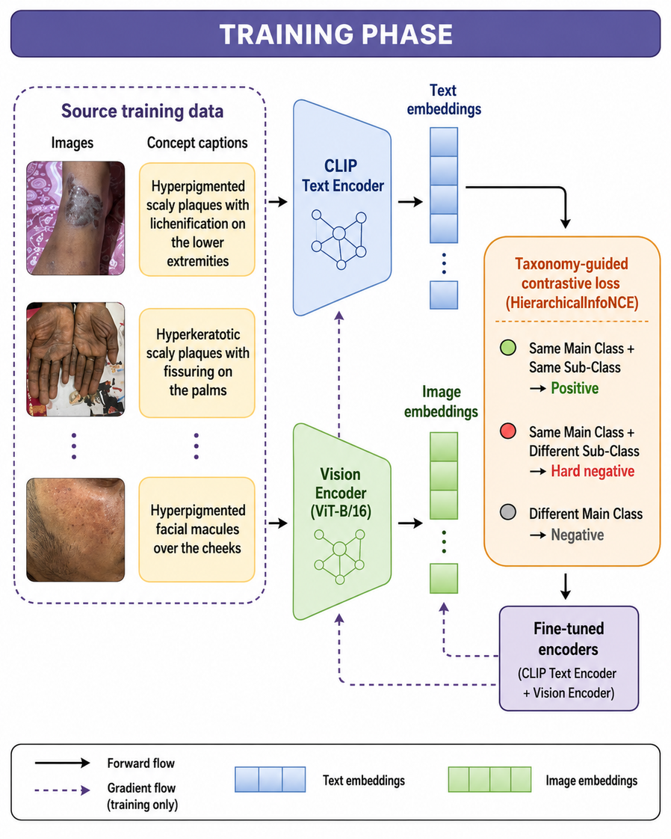
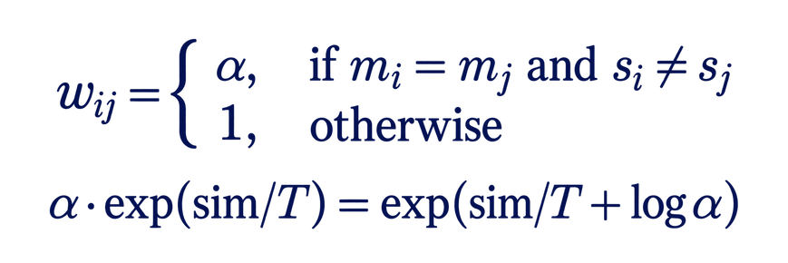

Method I: taxonomy-guided training
Clinical captions provide positives; the disease taxonomy chooses weighted negatives.
Pair semantics used by HierarchicalInfoNCE
Same subclass Positive pair
Same parent, different subclass Weighted pair
Different parent Ordinary negative
Loss Idea
Loss idea
A sibling diagnosis is not assumed to be always visually hardest. It is structurally important because it shares the parent but differs in the required diagnosis.
Interpretation
Taxonomy-guided language supervision for hierarchical skin disease classification
6
Notes:
Walk through the training image. Stress that Qwen captions verbalize existing annotations; they do not invent new clinical labels. Then explain the three pair types and the weighting rule.
‹#›

Slide 7


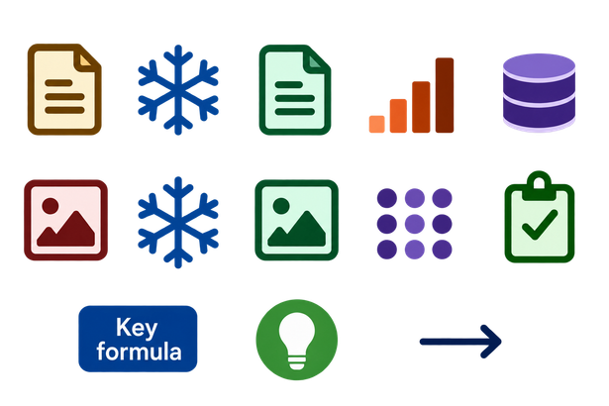
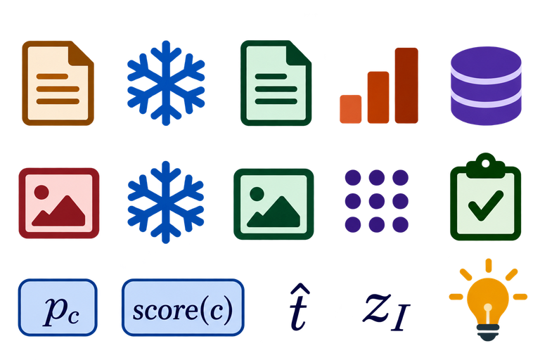
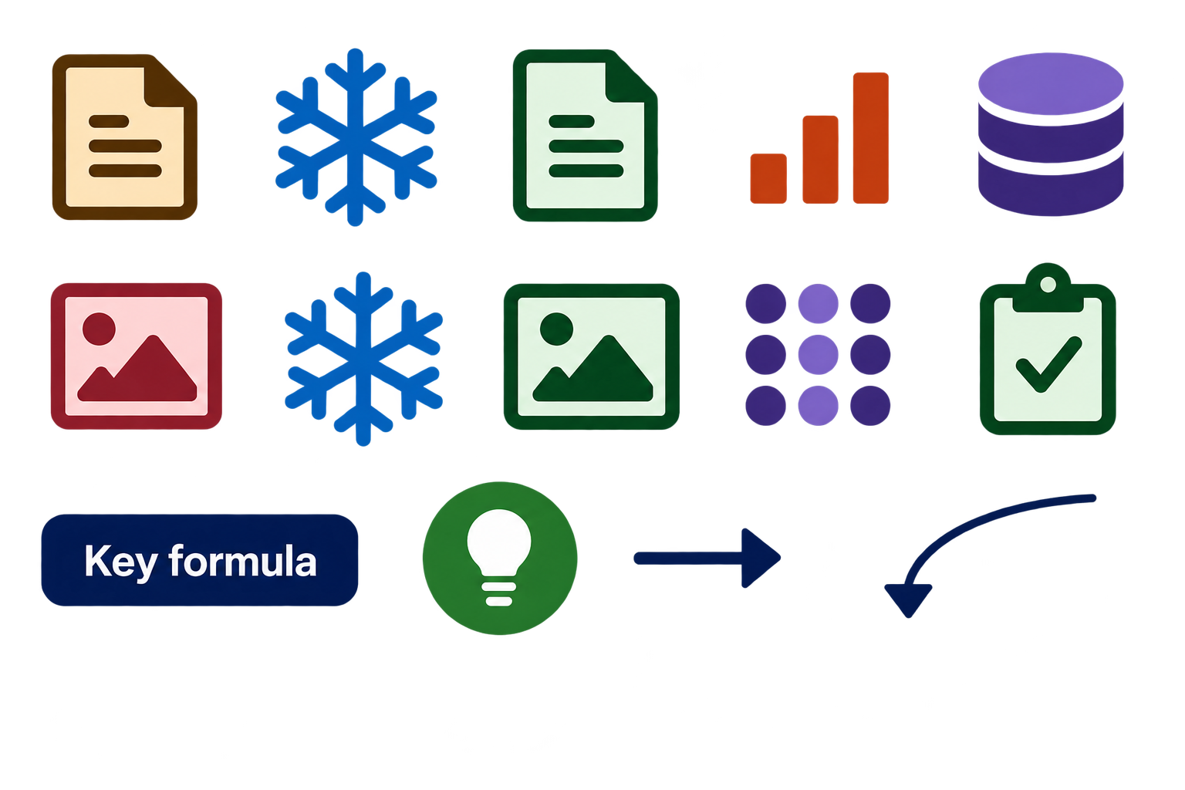

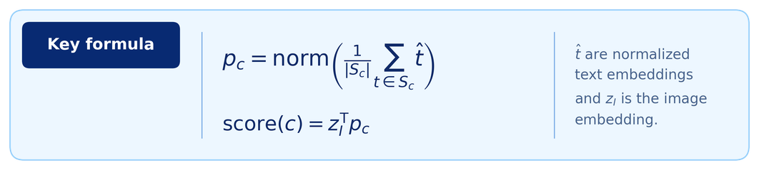
Method II: prototypes turn embeddings into class scores
The network does not output disease logits; the labelled gallery creates the classifier.
Protoypes are computed after encoder training; they are not learned output neurons.
1
Prototype construction (from labelled gallery)
Caption
embeddings
Average by class
+ normalize
Class Prototype
Labelled gallery
captions
Frozen text
encoder
2
Inference (test image)
Test skin image
Caption
embeddings
Cosine Similarities
(class scores)
Frozen image
encoder
MC predictions
restricted SC prediction
Interpretation
The class label comes from the labelled captions used to build each prototype - not from a learned output neuron.
Taxonomy-guided language supervision for hierarchical skin disease classification
7
Notes:
This slide should remove confusion about prototypes. A conventional network has output neurons tied to classes. Here the encoder makes an embedding, and the labelled caption gallery maps that embedding to class scores.
‹#›

Slide 8
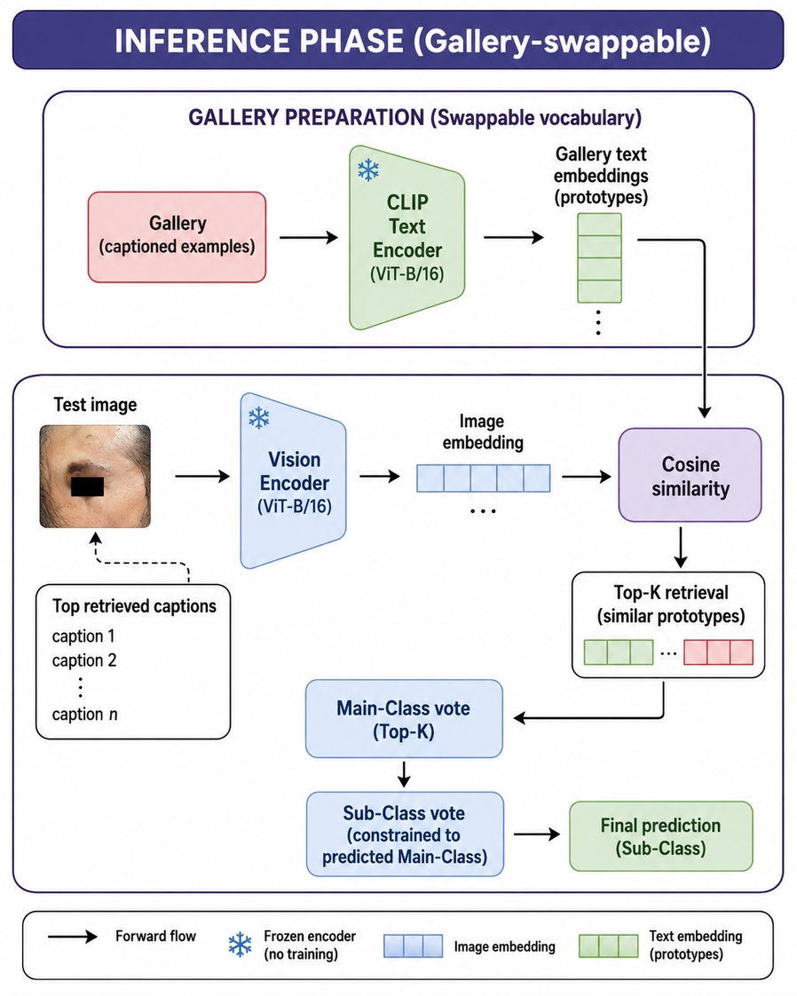


Method III: gallery replacement changes the label vocabulary
The same frozen encoders can operate over a new disease vocabulary through new prototypes.
Source -trained encoders
Replace caption gallery
Build new prototypes
Prediction over disjoint vocabulary
What stays fixed?
  Image encoder
  Text Encoder
  Temperature and learned parameters
Taxonomy-guided language supervision for hierarchical skin disease classification
8
Notes:
Make the deployment distinction clear: we are not claiming label-free transfer. The target gallery uses labelled target training captions, but there are no gradient updates to the encoders.
‹#›

Slide 9
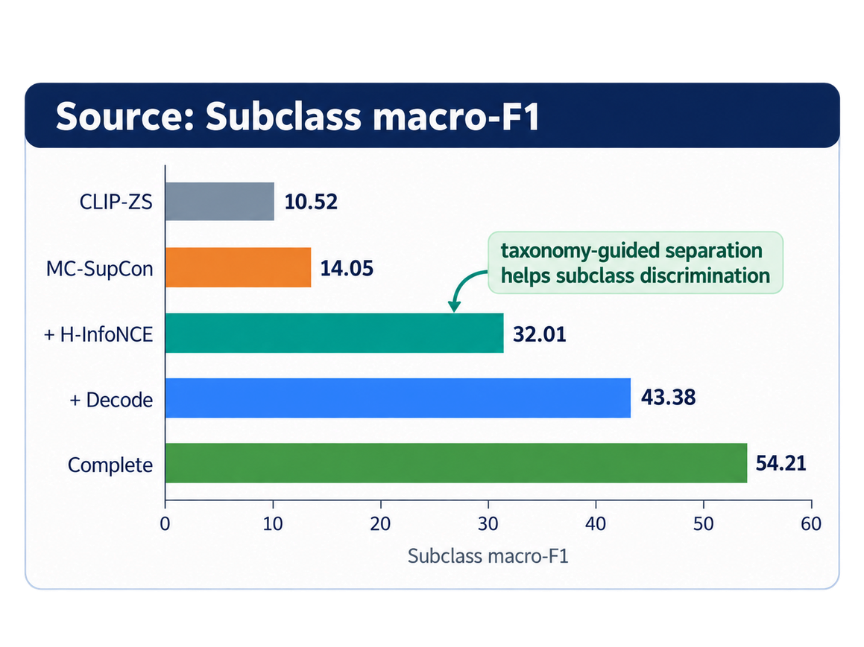




Results: representation learning + controls
Two reviewer-requested baselines make the conclusions sharper.
Transfer: PAD-UFES-20 disjoint vocabulary
Method
F1
BAcc
CLIP-ZS / class prompts
18.40
22.70
CLIP + same gallery
12.13
23.86
Ours + same gallery
24.38
31.33
Target-trained ResNet-50
67.8
58.3
Matched-gallery control
With the same target captions and prototypes, the learned representations still wins
Linear probe control
Source-domain context
Our method achieves the strongest MC accuracy and AUC. Hierarchical CBM retains strong MC F1 and similar SC F1, but relies on explicit concept bottlenecks and fixed necks.
20.21 SC F1
Generic CLIP features + classifier are not enough.
Same gallery, Better representation.
Taxonomy-guided language supervision for hierarchical skin disease classification
9
Notes:
This is the only results slide, so be disciplined. Start with the ablation: 14.05 to 32.01 to 54.21. Then highlight two controls: CLIP linear probe and matched-gallery CLIP. End with the nuanced comparison against CBM/Swin-B.
‹#›

Slide 10






Camera-ready responses to the main reviews
The final paper is clearer, fairer, and better positioned.
Reviewer concern
Camera-ready response
Added Barata et al., HAC-LF, LightDPH, HGCLIP, and DermaCon-IN hierarchical CBM positioning.
Hierarchical prior art missing
Clarified Qwen2 verbalizes existing annotations only; no image-based guessing of age, sex, location, or findings.
Caption provenance unclear
Added vanilla CLIP with identical target gallery, split, prototypes, and frozen-encoder protocol.
Transfer comparison unfair
Added frozen-CLIP linear probes for MC and SC classification.
Need classifier baseline
Clarified pair sets, shared embedding dimension, denominator weighting, and how labelled galleries become class prototypes.
Equations / prototypes
unclear
Resulting posture
We do not overclaim universal superiority; we show a focused representation-learning mechanism that is strong, interpretable, and adaptable.
Taxonomy-guided language supervision for hierarchical skin disease classification
10
Notes:
This slide is useful if the session has questions. It shows that the paper has been refined carefully, not merely defended. Each reviewer concern led to a precise manuscript improvement or control.
‹#›

Slide 11





Conclusion: language supervision can reshape visual classifiers
The broader contribution is not a new prompt; it is a new training signal for hierarchical visual recognition.
Takeaway 1
Parent-level contrastive learning can improve coarse classification while leaving fine subclass structure weak.
Takeaway 2
Clinical language and taxonomy are complementary: language says what evidence matters; taxonomy says which sibling distinctions matter.
Takeaway 3
A prototype gallery decouples the representation from a fixed output head, enabling encoder-retraining-free vocabulary replacement.
Future direction
Explore language-guided representation learning for other core dermatology vision tasks: retrieval, segmentation, severity assessment, and out-of-distribution recognition.
Language supervision is not only for multimodal outputs — it can improve how visual classifiers learn clinically meaningful structure.
Taxonomy-guided language supervision for hierarchical skin disease classification
11
Notes:
End with the broad thesis. Do not get stuck in the implementation. The lasting contribution is that structured clinical language can be a training signal for visual representations, and taxonomy can direct local separation.
‹#›

