Slide 1

I2M2Net: Inter/Intra-modal Feature Masking
Self-distillation for Incomplete Multimodal
Skin Lesion Diagnosis
Ke Wang¹, Linwei Qiu¹, Yilan Zhang²,Fengying Xie^{1*}
Image Processing Center, School of Astronautics, BeiHang University
King Abdullah University of Science and Technology (KAUST)

Slide 2
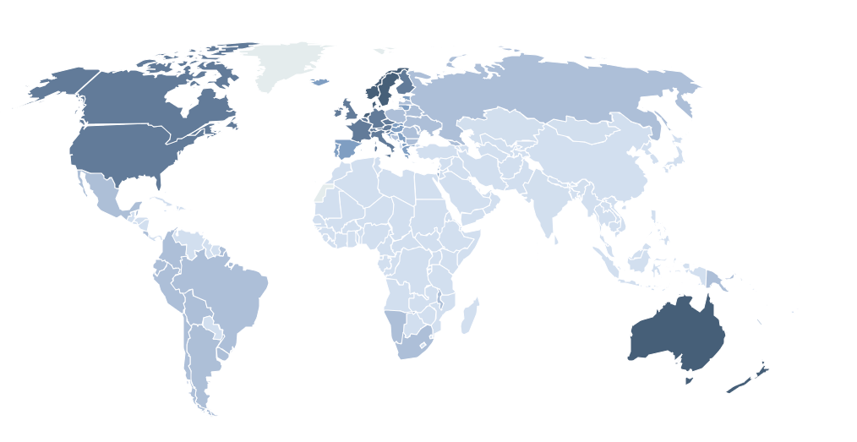




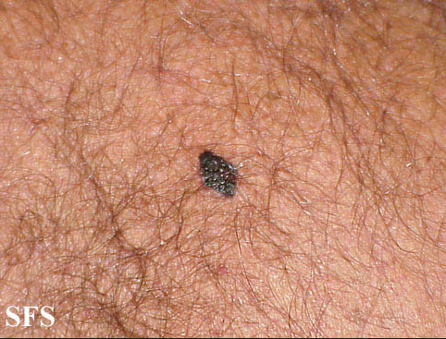
Background
Skin lesion is a major global health concern, with skin cancer being one of the most common and dangerous types of cancer.
Computer-aided diagnosis (CAD) for skin lesion diagnosis
— Single modality
— Multiple modality
Dermoscopy image
<=2.0
Clinic image
>=21.7
No data
sex, location,
elevation…
Meta data
Melanoma skin cancer incidence
Age-standardized rate (world) per 100,000, both sexes, 2018

Slide 3






Challenges
Der
Clin
Meta
Female,
Head neck,
Nodular…
?
?
?
A unified framework
Share & Specific
Imbalanced modality combinations
Modality missing

Slide 4










Proposed Method
Inter/Intra-modal Feature Masking Self-distillation
Image encoder
$$Z_{0}$$
Fusion block
c
$$F$$
$$ℒ_{CE}$$
Clinic image
Mask generator
Shared
$$ℒ_{SD}$$
$$M_{g}$$
$$F′$$
Fusion block
$$ℒ_{CE}^{′}$$
Image encoder
d
Dermoscopy image
Inter-modal feature masking
1. Location
2. Sex
……
5. Management
Text encoder
$$Z_{1}$$
Intra-modal feature masking
m
Masked modality combination
Meta data
Inter-modal feature masking
combination-share semantics

Slide 5





Proposed Method
Inter/Intra-modal Feature Masking Self-distillation
Image encoder
$$Z_{0}$$
Fusion block
c
$$F$$
$$ℒ_{CE}$$
Clinic image
Mask generator
Shared
$$ℒ_{SD}$$
$$M_{g}$$
$$F′$$
Fusion block
$$ℒ_{CE}^{′}$$
Image encoder
d
Dermoscopy image
Inter-modal feature masking
1. Location
2. Sex
……
5. Management
Text encoder
$$Z_{2}$$
Intra-modal feature masking
m
Masked modality combination
Meta data
Intra-modal feature masking
combination-specific semantics
Notes:
模态缺失问题
统一的框架
训练不平衡
问题都讲出来

Slide 6





Proposed Method
Combination-based Curriculum Learning
Missing modality combinations
Difficulty measurer + Training scheduler
Complete multimodal features
$$f_{0}$$
$$p\left(E>\text{E}N\right)$$
Mask generator
GAP
Softmax
$$f_{1}$$
L_{con}
Mask
generated
$$f_{K}$$
s
$$p\left(E≤E_{N}\right)$$
Sampling
$$q$$
dynamically balance the training of imbalanced modality combinations

Slide 7
Proposed Method
Modality Deficiency-aware Fusion
Transformer block with Masked self-attention $×L$
Output Tokens
Input Tokens
+ Learnable Fusion tokens
QKV | KV | KV | KV | KV
Q | √ | √ | √ | ×
Q | √ | √ | √ | ×
Q | √ | √ | √ | ×
Q | × | × | × | ×
FFN
Classification
Q
Derm
K
Clinic
V
Meta*
adaptively fuse available modal information

Slide 8
Experiments
Dataset :
Derm7pt — Dermoscopy image, Clinic image, Patient meta data
— 1011 (413 for training, 203 for validation, 395 for testing)
Evaluation Metrics :
Accuracy , F1 score
Loss Function:
Cross entropy loss + MSE loss

Slide 9
Results
Comparison results on Derm7pt datasets (seven modality combinations + average)

Slide 10
Results
Comparison results on Derm7pt datasets

Slide 11
Results
Ablation results on Derm7pt datasets
3.24%

Slide 12
Results
Ablation results on Derm7pt datasets

Slide 13
Conclusion
We proposed a novel and effective framework named I2M2Net for incomplete multimodal learning
We first incorporate inter-modal and intra-modal feature masking self-distillation technology to enhance combination-share and combination-specific representations, thus improving overall robustness to incomplete multimodal data.
Taking imbalanced modality combinations into consideration, we design a combination-based curriculum learning strategy to assist the network in adapting to weak and challenging modality combinations
Extensive experiments demonstrate the effectiveness and superiority of I2M2Net

Slide 14
Thank you
xfy_73@buaa.edu.cn
wang_ke@buaa.edu.cn
Notes:
If any questions, please feel free to contact through the following email address

