Slide 1
Multi-Dataset Diagnostic Utility of Clinical Visual Concepts in AI Systems for Dermatology
Linda Wermelinger, Simone Lionetti, Fabian Gröger, Nipun Ranasekara, Philippe Gottfrois, Ludovic Amruthalingam, Labelling Consortium, Marc Pouly, Alexander A. Navarini

Slide 2
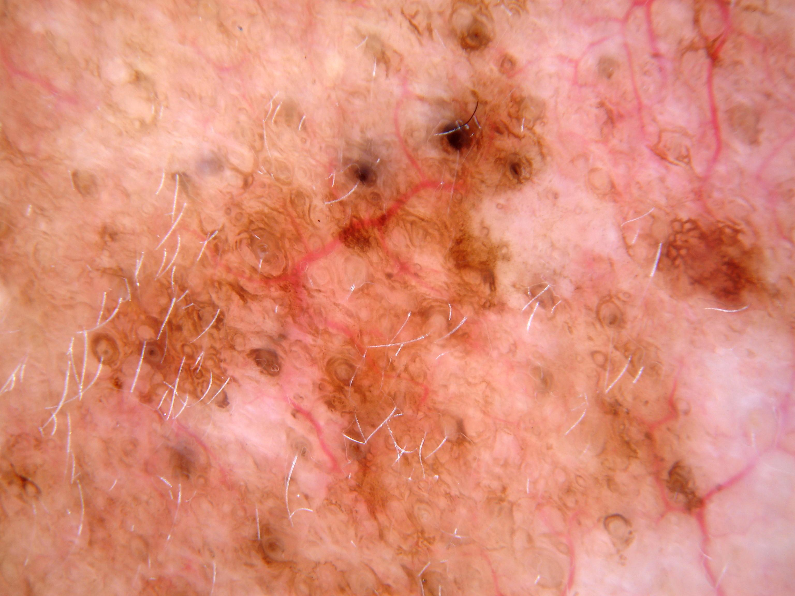
Which answer do you as a clinician trust more?
Diagnosis: Melanoma in situ
Present: Macule, Erythema
Absent: Ulcer, Crust, Warty/Papillomatous, Purple
Diagnosis: Melanoma in situ
Source: ISIC Archive (ISIC_0023763) / CC-0

Slide 3
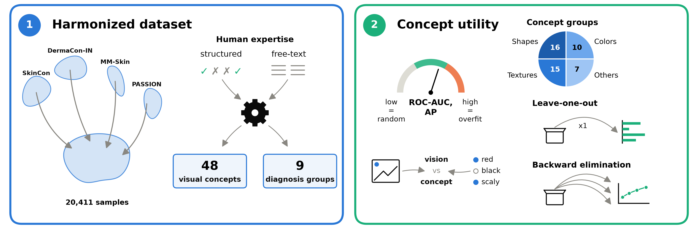
What hinders the progress of concept-based models?
Diagnosis groups: Inflammatory, Malignant Epidermal, Genodermatoses, Benign Dermal, Benign Epidermal, Benign Melanocyte, Malignant Cutaneous Lymphoma, Malignant Melanoma, Malignant Dermal

Slide 4
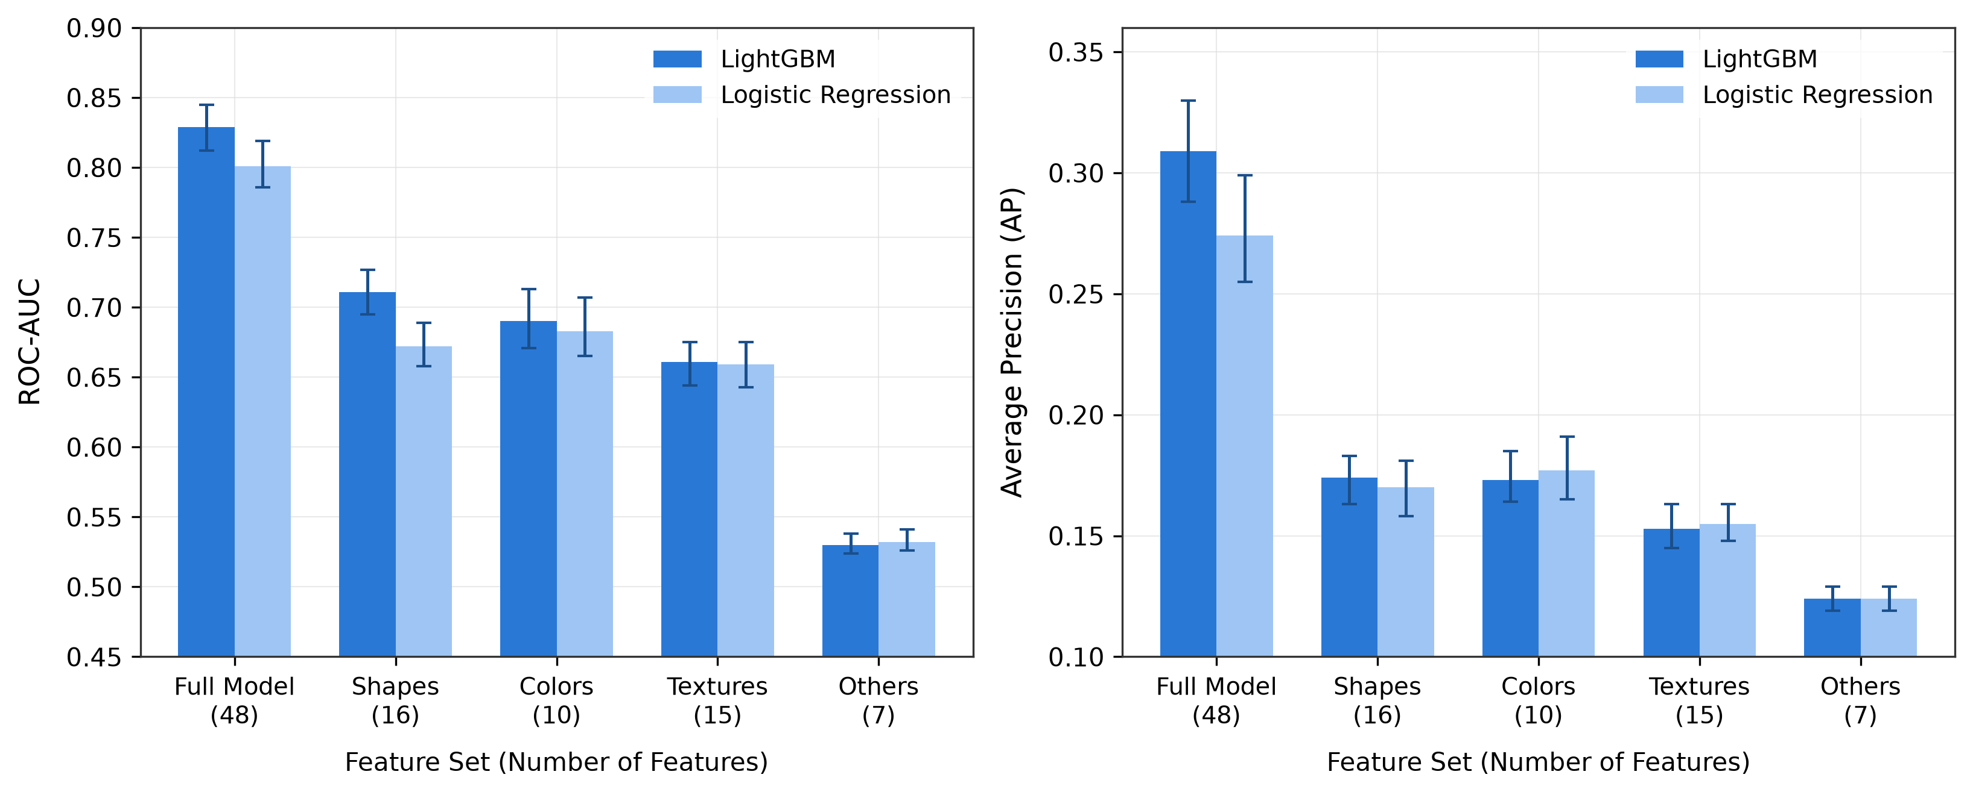
Concept Groups & Predictive Utility
Model performance across full and restricted concept groups. Metrics report median and [95% CI] estimated with 100 validation bootstraps

Slide 5
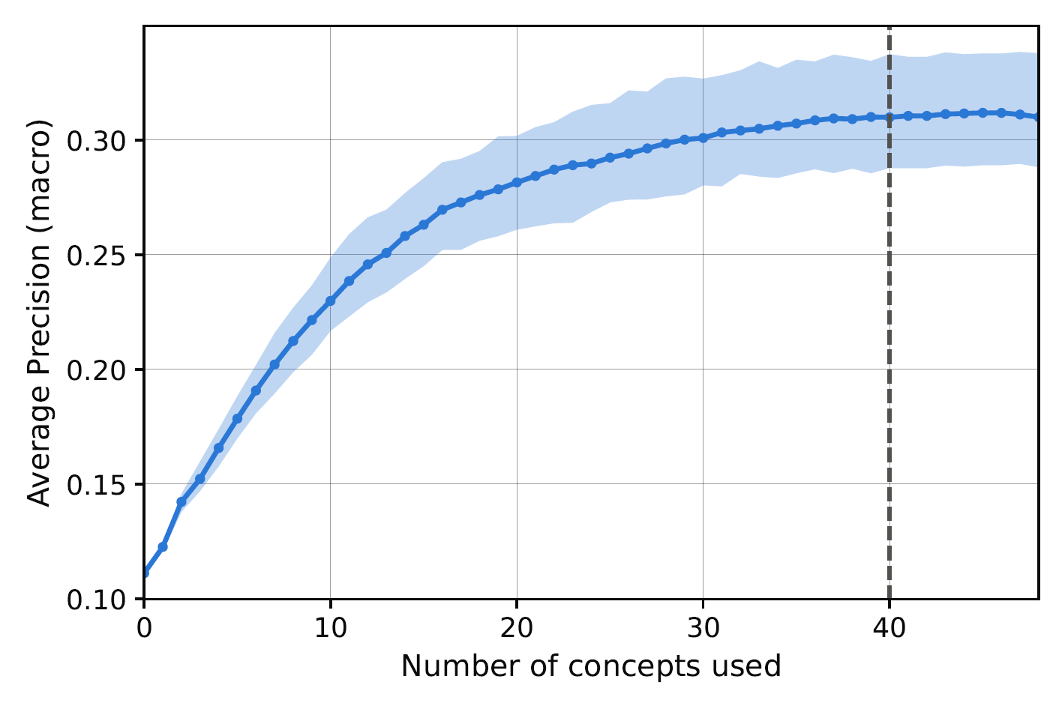
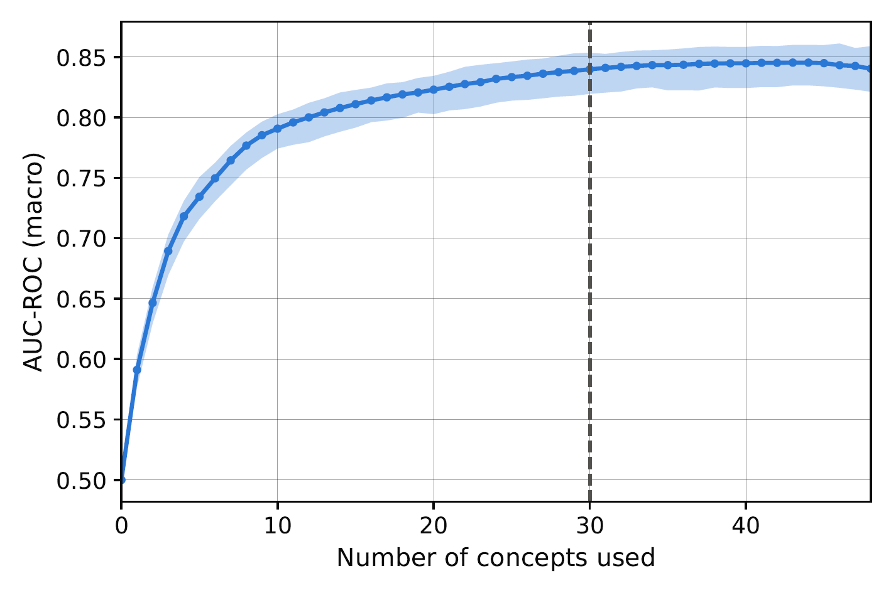
Concept Sensitivity & Redundancy
Median and 95% CI of LightGBM macro AP and ROC-AUC across the number of concepts used, using 100 bootstraps of training and validation sets. The dashed line indicates the highest number of used concepts where a paired one-sided Wilcoxon signed-rank test indicates lower performance than the full set.

Slide 6
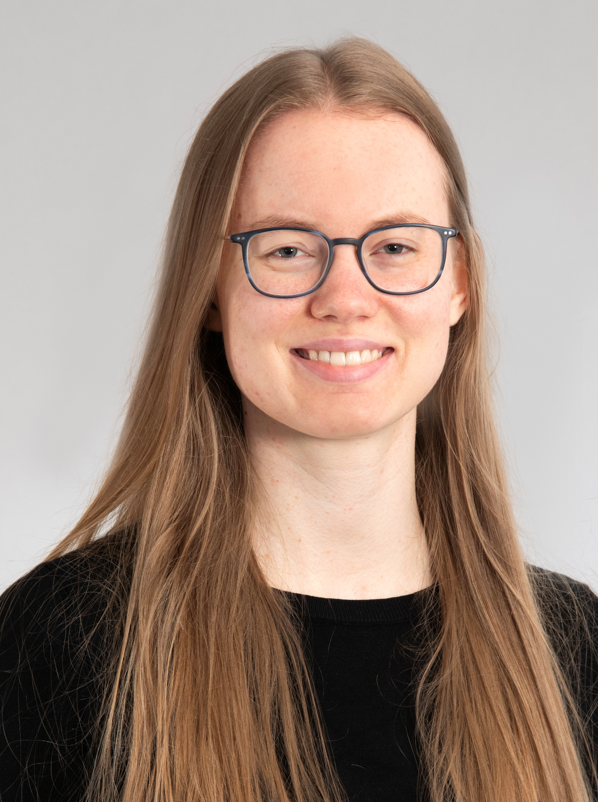

Hochschule Luzern
Informatik
Applied AI Research Lab
Linda Wermelinger
Research Associate, PhD Student
linda.wermelinger@unibas.ch

