Slide 1



Conformal Aware Training for Imbalanced Medical Image Classification
Anum Fatima¹, Moi Hoon Yap¹, Neil D. Reeves², Michael Odling-Smee³, David C. Bond³, and Connah Kendrick¹
¹School of Computing and Mathematics, Manchester Metropolitan University, UK
²Medical School, Faculty of Health and Medicine, Lancaster University, UK
³Aire Innovate Limited, UK
Notes:
A model may see thousands of examples of a common condition, but only a few examples of a rare one. So even if its overall performance looks good, is it equally reliable across those classes

Slide 2
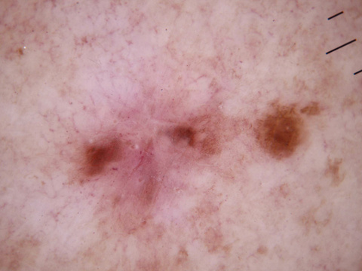
From Image to Point Prediction
Logits
z
Class probabilities
p
0.02
0.10
Classifier
Predicted Class:
Softmax
Preprocessing
0.70
{Dermatofibroma}
0.05
.....
Input Image
Standard classification output: one image ⟶ one predicted label

Slide 3
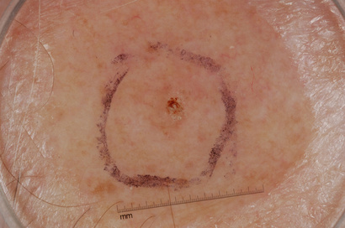
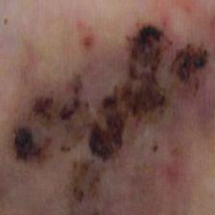
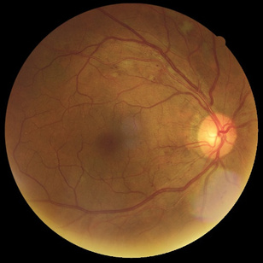







Why Point Prediction Is Not Enough
Skin Lesion Classification
Diabetic Foot Classification
Retinopathy Classification
Dermoscopy image of a skin lesion
Clinical image of diabetic foot ulcer
Retinal Fundus Image
Predicted Probabilities
Predicted Probabilities
Predicted Probabilities
BKL (Benign Keratosis)
0.42
Infection
0.40
Mild DR
0.44
BCC (Basal cell ca.)
0.38
Ischaemia
0.36
Moderate DR
0.39
NV (Naevus)
0.15
Both
0.18
No DR
0.12
MEL (Melanoma)
0.05
None
0.06
Severe DR
0.05
Point Prediction
Point Prediction
Point Prediction
Benign Keratosis
Infection
Mild DR
Single predicted label hides uncertainty and plausible diagnosis

Slide 4
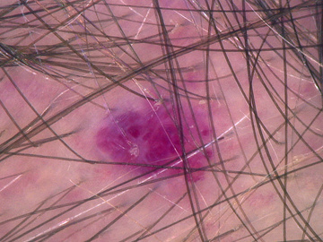
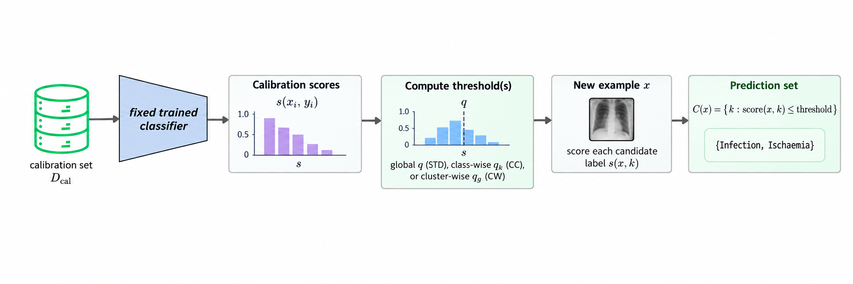
Conformal Prediction
Standard Classifier
Logits
z
Class probabilities
p
0.02
0.10
Classifier
Softmax
0.20
Predicted Class:
0.60
MEL
0.05
Input Image
.....
Standard Classifier + Conformal Prediction
Scoring function
(Softmax/APS/ RAPS)
Prediction Set Generator
Classifier
Prediction Set
{BCC, MEL, VASC}
^
Input Image
quantile

Slide 5
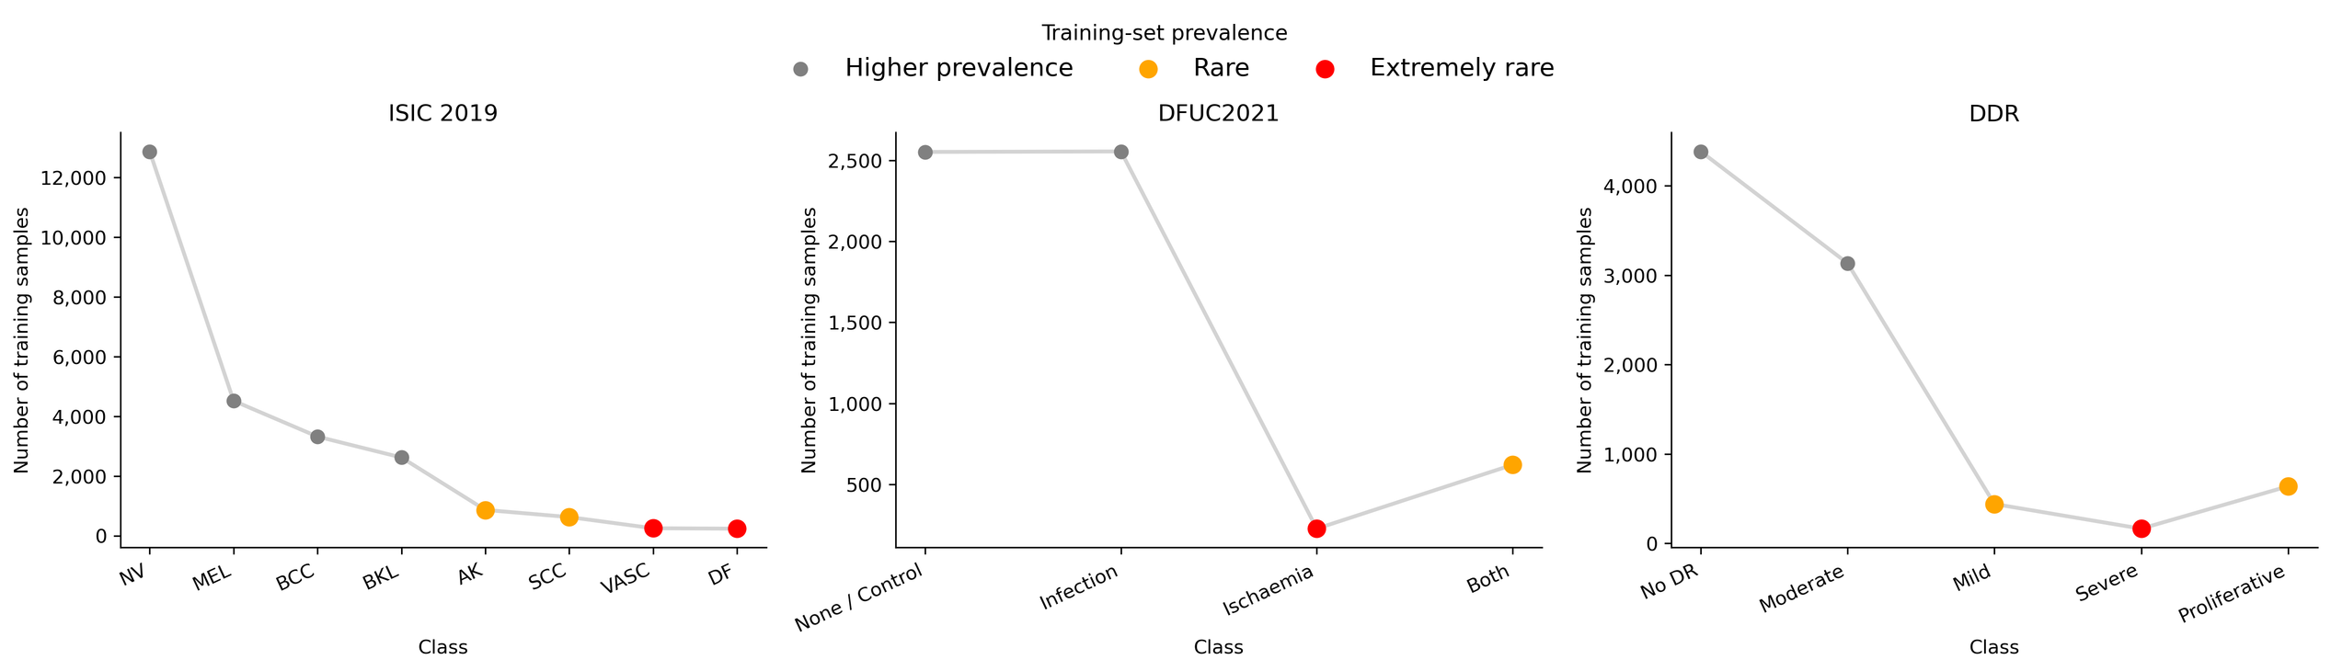
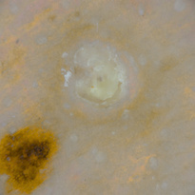
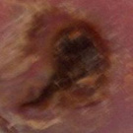
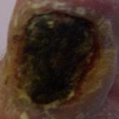
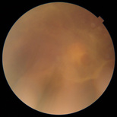
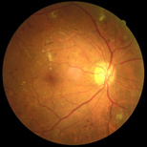
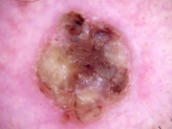
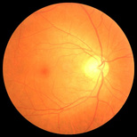
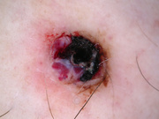
Challenge in Imbalanced Medical Data
Skin Lesions
Diabetic Foot Ulcer
Diabetic Retinopathy
Not all classes are equally represented

Slide 6
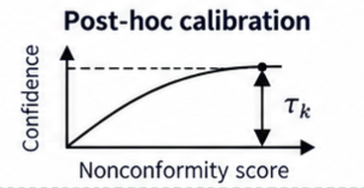

Standard Training + Post Hoc Conformal Prediction
Class probabilities
Ground truth: BKL
0.02
Ground truth: Ischaemia
Post-hoc calibration
0.10
Prediction set
Classifier
Softmax
0.20
{Class A, Class B, Class C}
0.60
Prediction set
{BKL, BCC, NEV, SCC }
0.05
Prediction set
{infection, both}
Training data
.....
large / less meaningful pred set
true class not in pred set
  Learns standard confidence scores
  Can produce unequal class-wise confidence distributions

Slide 7


Proposed Conformal Aware Training
controls how strongly each penalty influences training
Cross entropy loss
Coverage penalty
Efficiency Penalty
  Cross-entropy: Encourages the model to predict the correct class.
  Coverage Penalty: Encourages the model to assign sufficient confidence to the true class.
  Efficiency penalty: Discourages the model from making too many classes plausible.
Conformal Aware Loss
update class-specific thresholds
(at end of each epoch using calib set)
Cross entropy
coverage penalty
efficiency penalty
guided training
Class probabilities
Ground truth: BKL
Ground truth: ischaemia
0.02
post-hoc calibration
Prediction set
0.10
Classifier trained with conformal aware loss
0.20
{Class B, Class C}
0.60
0.05
.....
Prediction set
{BKL, BCC}
Prediction set
{ischaemia, both}
Training data
coverage-aware prediction sets
precise/ more meaningful pred set
true class in pred set
  Shapes class-wise confidence while training
  Improves class-wise coverage while controlling prediction-set size.

Slide 8
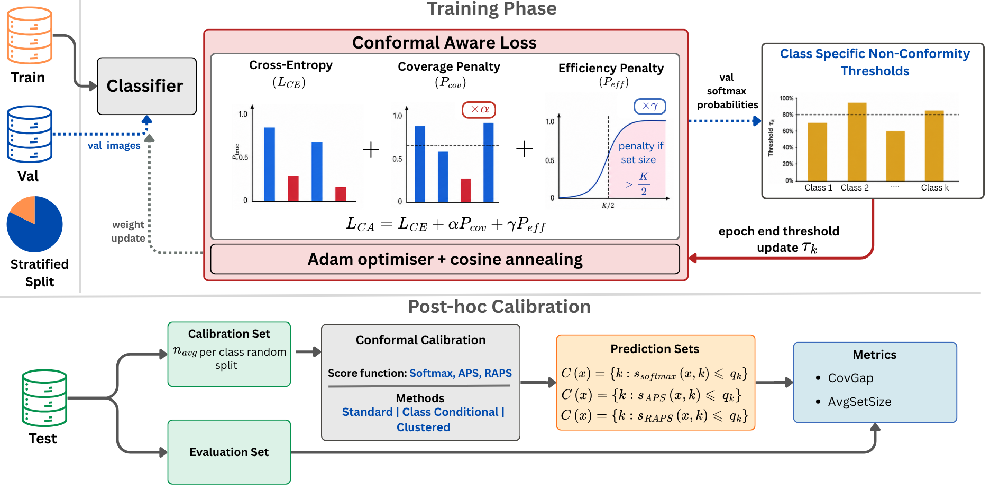



Proposed Conformal Aware Framework
0.02
Conformal Calibration
(three methods)
Split Test set
Prediction set for each sample
Evaluation
0.10
Standard CP (STD)
Trained
Classifier
Calibration Set
0.30
per class random
(one global threshold)
include class if
Coverage Gap
split
Class-Conditional CP (CC)
0.70
(per-class threshold)
Average Prediction
Set Size
0.05
Evaluation Set
Test data
(held-out
set)
.....
(remaining samples)
(set of plausible labels)
Clusterwise CP (CW)
(per-cluster threshold)

Slide 9
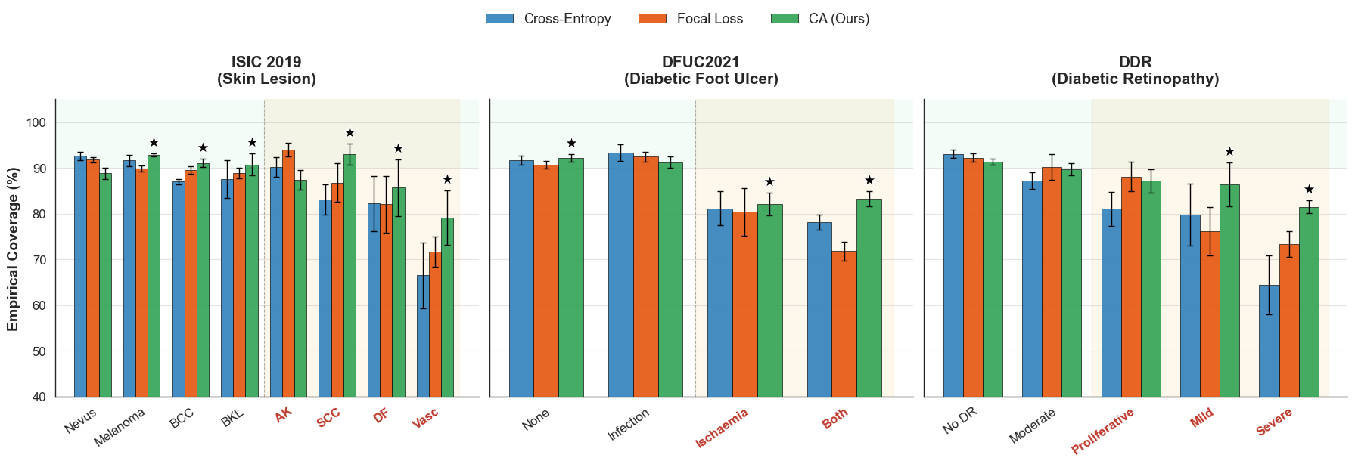
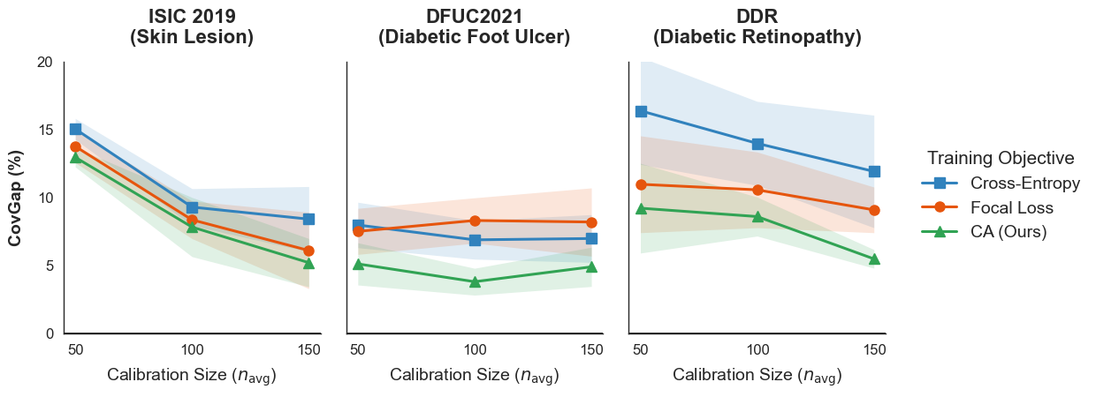
Results
↓ Lower CovGap = better
The largest coverage gains occur in under-represented classes
Our conformal aware approach shows lowest coverage gap

Slide 10
Results: Improved coverage across imbalanced datasets
Dataset | Calibration | Coverage Gap ↓ |  |  | Set size: CE / Focal / Ours ↓
 |  | CE (%) | Focal (%) | Ours (%)
ISIC2019 | Standard | 19.2 | 16.9 | 15.7 | 2.2 / 2.0 / 2.0
 | Class-conditional | 3.9 | 3.6 | 3.2 | 4.1 / 3.5 / 3.5
 | Clusterwise | 8.4 | 6.1 | 5.2 | 3.1 / 2.9 / 3.1
DFUC2021 | Standard | 8.7 | 10.6 | 5.5 | 1.9 / 2.0 / 1.9
 | Class-conditional | 2.9 | 3.2 | 2.1 | 2.2 / 2.2 / 2.1
 | Clusterwise | 7.0 | 8.2 | 4.9 | 1.9 / 2.0 / 1.9
DDR | Standard | 17.1 | 13.7 | 8.8 | 1.4 / 1.5 / 1.4
 | Class-conditional | 3.6 | 4.2 | 3.1 | 2.6 / 2.4 / 2.2
 | Clusterwise | 11.9 | 9.1 | 6.5 | 1.7 / 1.8 / 1.7
Training with conformal-aware loss improves class-wise coverage across all three datasets

Slide 11

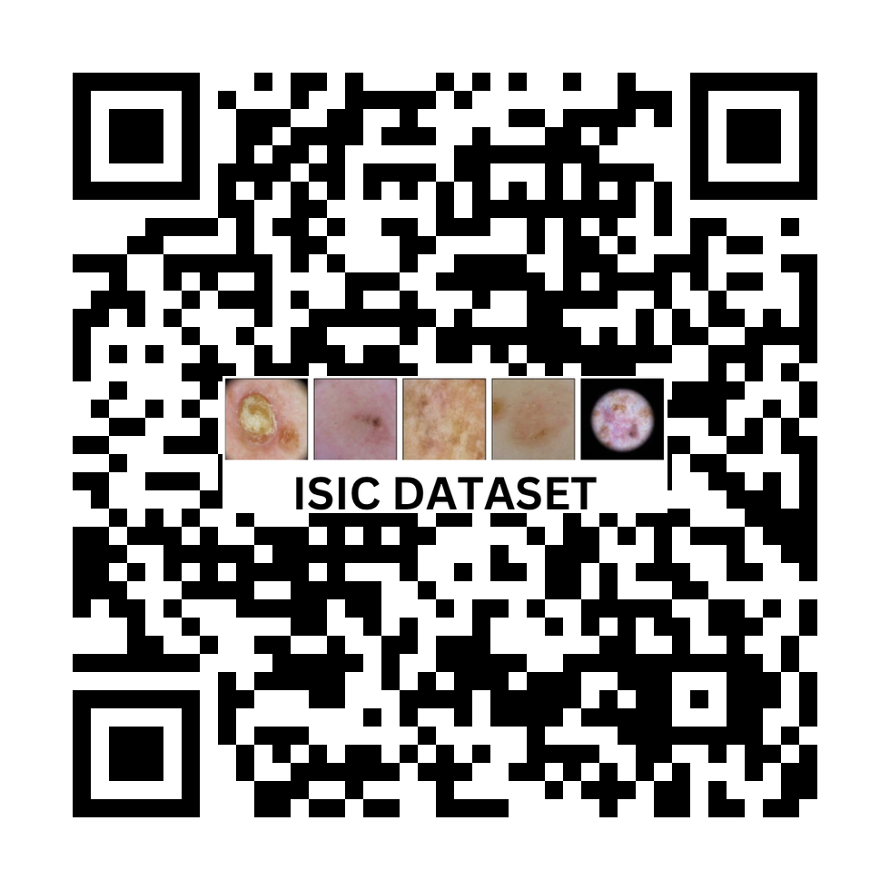
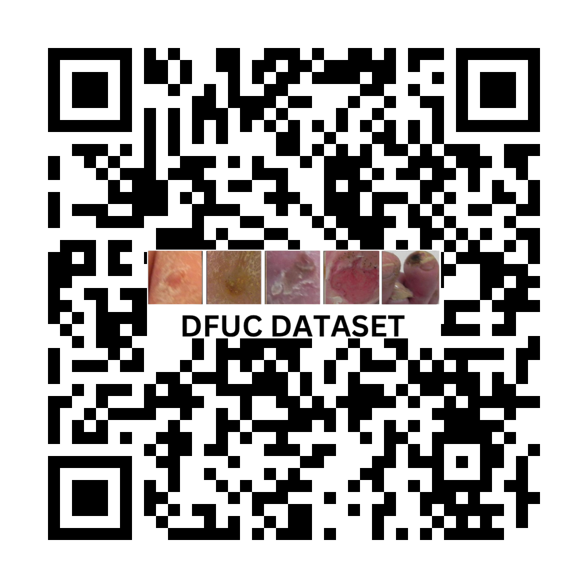
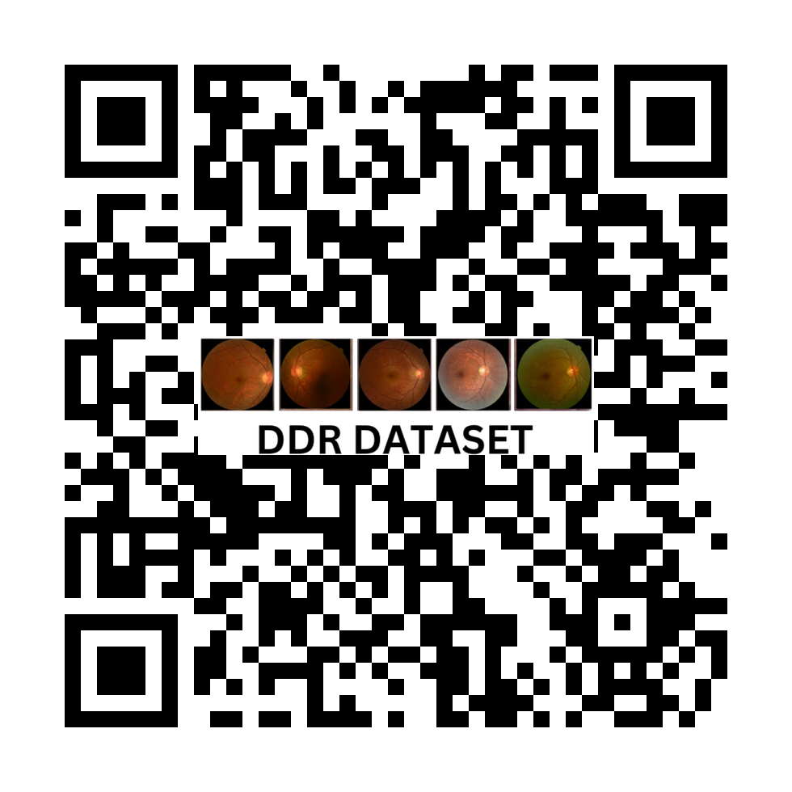

Thank you
MICCAI 2026
Questions & discussion
ISIC Workshop
GitHub
Datasets
ISIC 2019
DFUC2021
DDR
Code repository
Anum Fatima
Manchester Metropolitan University
a.fatima@mmu.ac.uk
Notes:
Resource links supplied by the presenter:
https://github.com/anumfatima427/cp-under-imbalance
https://challenge.isic-archive.com/data/#2019
https://dfu-challenge.github.io/dfuc2021.html
https://huggingface.co/datasets/ctmedtech/DDR-dataset

