Slide 1
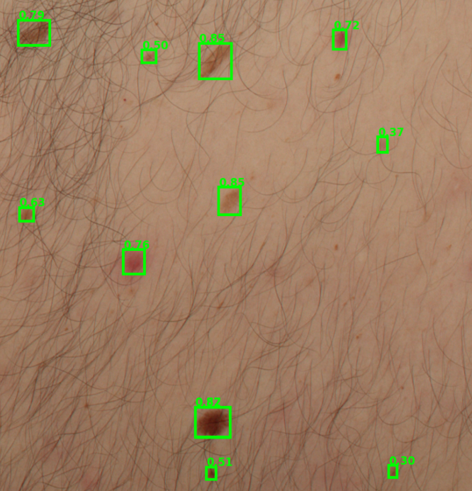



TOTAL BODY PHOTOGRAPHY · LESION DETECTION
Automated Skin Lesion Detection in Total Body Photography
A multi-architecture benchmark and mechanistic analysis of modern detectors
M. Yamin¹, P. K. Murali¹, A. Das¹, H. Rajani¹, A. Saha¹, S. A. Wahid², S. C. Nwafor¹, S. Nazari¹, F. Nuria¹, L. S. García³, C. Lenoir³, N. Gracias¹, J. Malvehy³, R. Garcia¹
1. Computer Vision and Robotics Research Institute, University of Girona, Spain
2. University of the Algarve, Faro, Portugal
3. Dermatology Department, Hospital Clinic Barcelona, Universitat de Barcelona, Spain and CIBER de Enfermedades Raras, Instituto de Salud Carlos III, Barcelona, Spain
Notes:
Good morning. This talk is about a step that comes before classification in dermatology AI: finding lesions in total body photography (TBP). We benchmark seven modern real-time detectors on the iToBoS dataset, and we go beyond a leaderboard to ask how and why each detector succeeds or fails. (Right-hand image is a schematic illustration, not real patient data.)

Slide 2





INTRODUCTION & MOTIVATION
Why early, scalable detection matters
Rising melanoma burden
98%+
Incidence is rising globally, and melanoma causes most skin-cancer deaths.
Early detection saves lives
Early diagnosis significantly improves treatment success and survival.
five-year survival when melanoma is caught while still localised
Manual exams don't scale
Skin checks are time-consuming, depend on clinician expertise and vary between observers.
TBP automates capture
Survival falls sharply once the disease spreads.
Total body photography records the entire skin surface in a single session.
AI-assisted diagnosis
Intelligent tools support clinicians with faster, more accurate risk assessment.
Automated Skin Lesion Detection in TBP
2
Notes:
Melanoma accounts for most skin-cancer deaths despite its low incidence, and outcomes depend on timing: five-year survival exceeds 98% for localised disease but drops sharply after spread. Routine skin checks are slow and vary between clinicians. TBP addresses this by documenting the whole skin surface in one automated session, giving hundreds of standardised, high-resolution images per patient. AI can help clinicians assess those images faster and more consistently.

Slide 3
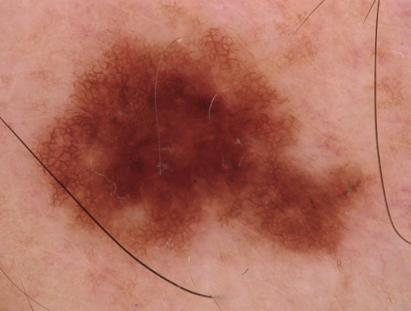
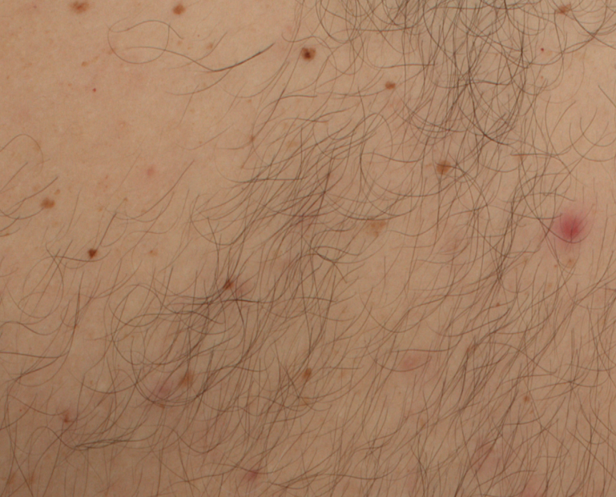
BACKGROUND
Detection is the missing first step
What most dermatological AI assumes
What TBP actually presents
Tens of cm² of skin per patch
Normal anatomy, variable texture
Hair, shadows, imaging artefacts
The lesion is already isolated: a pre-cropped, lesion-centred image to classify.
Lesions must first be localised among normal anatomy, then classified.
Detection itself remains largely unexplored, mainly because annotated data has been lacking.
Automated Skin Lesion Detection in TBP
3
Notes:
Most dermatological AI, from the classic dermoscopy classification work onward, assumes the lesion has already been cropped and centred. TBP breaks that assumption: lesions sit inside large patches of skin with normal anatomy, hair, shadows and imaging artefacts. So detection is a prerequisite for both screening and longitudinal monitoring, and it has been largely unexplored because annotated data was missing. (Tiles are schematic illustrations.)

Slide 4


SOLUTION
Closing the gap with iToBoS
The enabler: iToBoS dataset
Our open-source benchmark
Bounding-box annotations from a clinical TBP system close the data gap and let lesion detection be studied directly.
A multi-architecture benchmark for lesion detection in TBP, with thorough error analysis and profiling for clinical deployment.
7
14
4
1
architectures
configurations
diagnostics beyond mAP
reproducible protocol
Automated Skin Lesion Detection in TBP
4
Notes:
The recent iToBoS release provides a large-scale collection of bounding-box-annotated skin images from a clinical TBP system, which finally lets us study detection directly. Our contribution is an open-source, multi-architecture benchmark: 7 architectures, 14 configurations, one reproducible protocol, and four diagnostics beyond mAP (error decomposition, AP across IoU, a confidence x NMS sweep, and saliency). Code and models will be released at github.com/CIRS-Girona/tbp_lesion_detection.

Slide 5
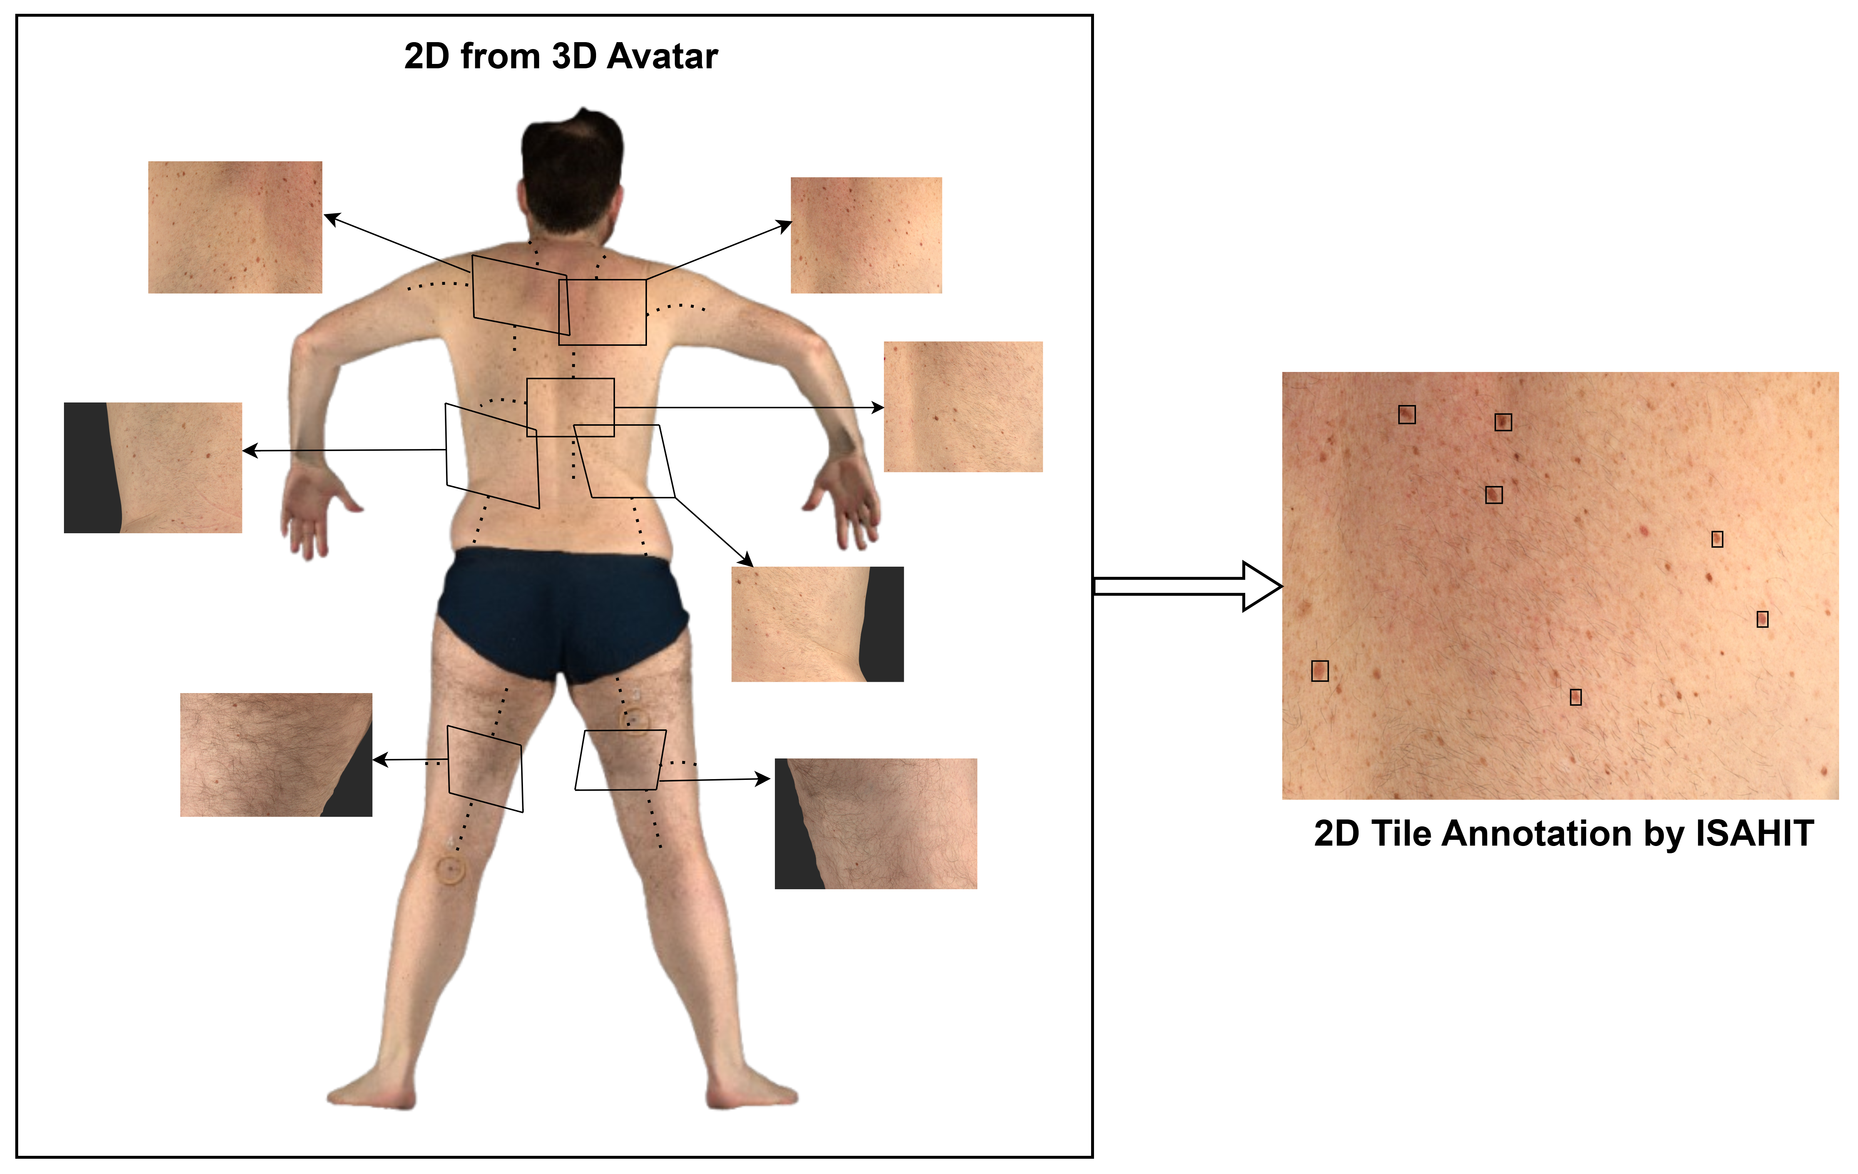
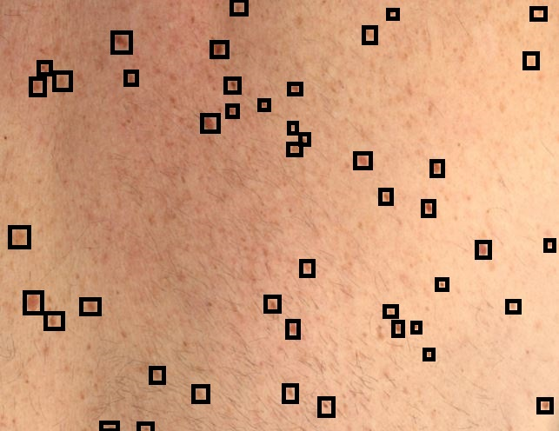
ITOBOS DATA
A large-scale TBP detection dataset
8,473
29,403
49
1024² px
images
bounding-box annotations
distinct patients
per image, no resizing
Dataset details
Preprocessing
Acquired with a clinical VECTRA WB360 TBP system (2D tiles)
Single class: lesion vs. background
About 3.5 annotated lesions per image on average
Publicly released challenge partition, for reproducibility
1
Blur the background
Gaussian blur on scanner frame and room surfaces to suppress environmental noise
2
Keep skin at full quality
The patient skin surface is left untouched
3
Feed 1024² px images
No spatial resizing applied
Automated Skin Lesion Detection in TBP
6
Notes:
iToBoS provides 8,473 images and 29,403 bounding boxes from 49 patients, acquired on a VECTRA WB360 system; that is roughly 3.5 lesions per image. We use the publicly released challenge partition so results are reproducible. Preprocessing: a Gaussian blur on detected background regions such as the scanner frame and room surfaces, with the skin kept at full quality. All images are 1024 by 1024 pixels and no resizing is applied. Detection is single-class: lesion versus background.

Slide 6


ITOBOS DATA
A large-scale TBP detection dataset
8,473
29,403
49
1024² px
images
bounding-box annotations
distinct patients
per image, no resizing
Dataset details
Preprocessing
Acquired with a clinical VECTRA WB360 TBP system (2D tiles)
Single class: lesion vs. background
About 3.5 annotated lesions per image on average
Publicly released challenge partition, for reproducibility
1
Blur the background
Gaussian blur on scanner frame and room surfaces to suppress environmental noise
2
Keep skin at full quality
The patient skin surface is left untouched
3
Feed 1024² px images
No spatial resizing applied
Automated Skin Lesion Detection in TBP
6
Notes:
iToBoS provides 8,473 images and 29,403 bounding boxes from 49 patients, acquired on a VECTRA WB360 system; that is roughly 3.5 lesions per image. We use the publicly released challenge partition so results are reproducible. Preprocessing: a Gaussian blur on detected background regions such as the scanner frame and room surfaces, with the skin kept at full quality. All images are 1024 by 1024 pixels and no resizing is applied. Detection is single-class: lesion versus background.

Slide 7
ARCHITECTURES
Seven real-time detectors, one protocol
Model | Family | Params (M) | GFLOPs | NMS | Main regression / prediction mechanism
YOLOv8s [7] | CNN / YOLO | 11.2 | 28.6 | Yes | Distribution Focal Loss
YOLOv11s [6] | CNN / YOLO | 9.4 | 21.6 | Yes | Distribution Focal Loss
YOLOv12s [22] | CNN / YOLO + attention | 9.1 | 19.4 | Yes | Distribution Focal Loss + attention
YOLO-26s [21] | CNN / YOLO | 9.5 | 20.9 | No | Distribution Focal Loss; NMS-free head
MS-DETR [15] | Transformer / DETR | — | — | No | Hungarian set prediction
RT-DETRv2-S [24] | Transformer / DETR | ~20 | — | No | Hungarian set prediction
D-FINE-S [11] | DETR / distribution refinement | 10 | 25 | Yes | Fine-Grained Distribution Loss; iterative refinement
YOLOv8s is the architecture of the Kaggle challenge winner. Highlighted: YOLOv12s (blue) and D-FINE-S (orange), the two leading models. All models perform single-class detection.
Automated Skin Lesion Detection in TBP
7
Notes:
Seven detectors, all real-time small variants. Four CNN-based YOLO models: YOLOv8s, the Kaggle challenge-winning architecture; YOLOv11s; YOLOv12s, which adds attention blocks to relate spatially distant regions; and the NMS-free YOLO-26s. Two transformer set-prediction detectors, MS-DETR and RT-DETRv2-S, which are NMS-free by construction through Hungarian matching. And D-FINE-S, which recasts box regression as iterative refinement of per-coordinate distributions and still uses NMS.

Slide 8
RESULTS & ANALYSIS · OVERVIEW
D-FINE-S leads on precision, YOLOv12s on recall
Model (Full-Aug) | Precision | Recall | F1
YOLOv12s | 0.680 | 0.604 | 0.640
D-FINE-S | 0.707 | 0.583 | 0.639
YOLO-26s | 0.680 | 0.593 | 0.634
RT-DETRv2-S | 0.703 | 0.576 | 0.633
YOLOv8s (Kaggle baseline) | 0.656 | 0.609 | 0.632
YOLOv11s | 0.657 | 0.606 | 0.630
YOLOv8s (ours) | 0.629 | 0.625 | 0.627
MS-DETR | 0.643 | 0.588 | 0.614
0.674
D-FINE-S: highest mAP50
0.707
D-FINE-S: highest precision
0.604
YOLOv12s: highest recall
+0.17 pp
D-FINE-S F1 gain from augmentation, vs +0.8–1.9 pp for the others
Held-out test set, IoU 0.7, each model at its operating confidence threshold. F1 = 2PR/(P+R). Bold = best in column.
Automated Skin Lesion Detection in TBP
8
Notes:
At each model's operating point, YOLOv12s has the best F1 (0.640), while D-FINE-S is a hair behind at 0.639 but leads on mAP50 (0.674) and precision (0.707). The augmentation result matters too: full augmentation helps six of seven architectures by 0.8 to 1.9 points of F1, but D-FINE-S gains only 0.17. Even without augmentation, D-FINE-S (F1 0.637) beats every other no-augmentation model. The reason is likely its Fine-Grained Distribution Loss, which supplies implicit regularisation. Table values here are precision and recall read from the error-trade-off figures; F1 is computed from them.

Slide 9
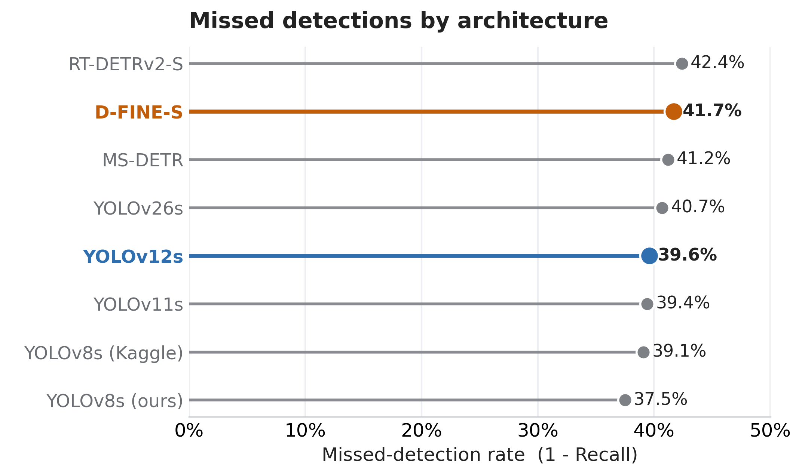
RESULTS & ANALYSIS · MISSED DETECTIONS
Every model misses 37–42% of lesions
37.5–42.4%
of annotated lesions missed, across all models
YOLOv8s (ours) misses the fewest (37.5%); YOLOv12s follows at 39.6%
D-FINE-S (41.7%) and RT-DETRv2-S (42.4%) miss the most, at a stricter conf = 0.50 gate versus 0.20 for YOLO
Recall is the limiting factor: decision support, not autonomous screening.
Automated Skin Lesion Detection in TBP
9
Notes:
Missed-detection rate is one minus recall. Across all models it sits between 37.5% and 42.4%, so even the best detector misses more than a third of annotated lesions. YOLOv8s trained by us misses the fewest, YOLOv12s is next at 39.6%. D-FINE-S and RT-DETRv2-S miss the most because they operate at a stricter calibrated confidence of 0.50 instead of 0.20 for YOLO. The message: at this data scale, recall is the limiting factor, so these tools should flag candidates for clinician review rather than screen autonomously. Note: D-FINE-S has a low TIDE Miss value (1.02), meaning many true candidates are retained across the confidence range, but at its operating point it still misses 41.7%.

Slide 10
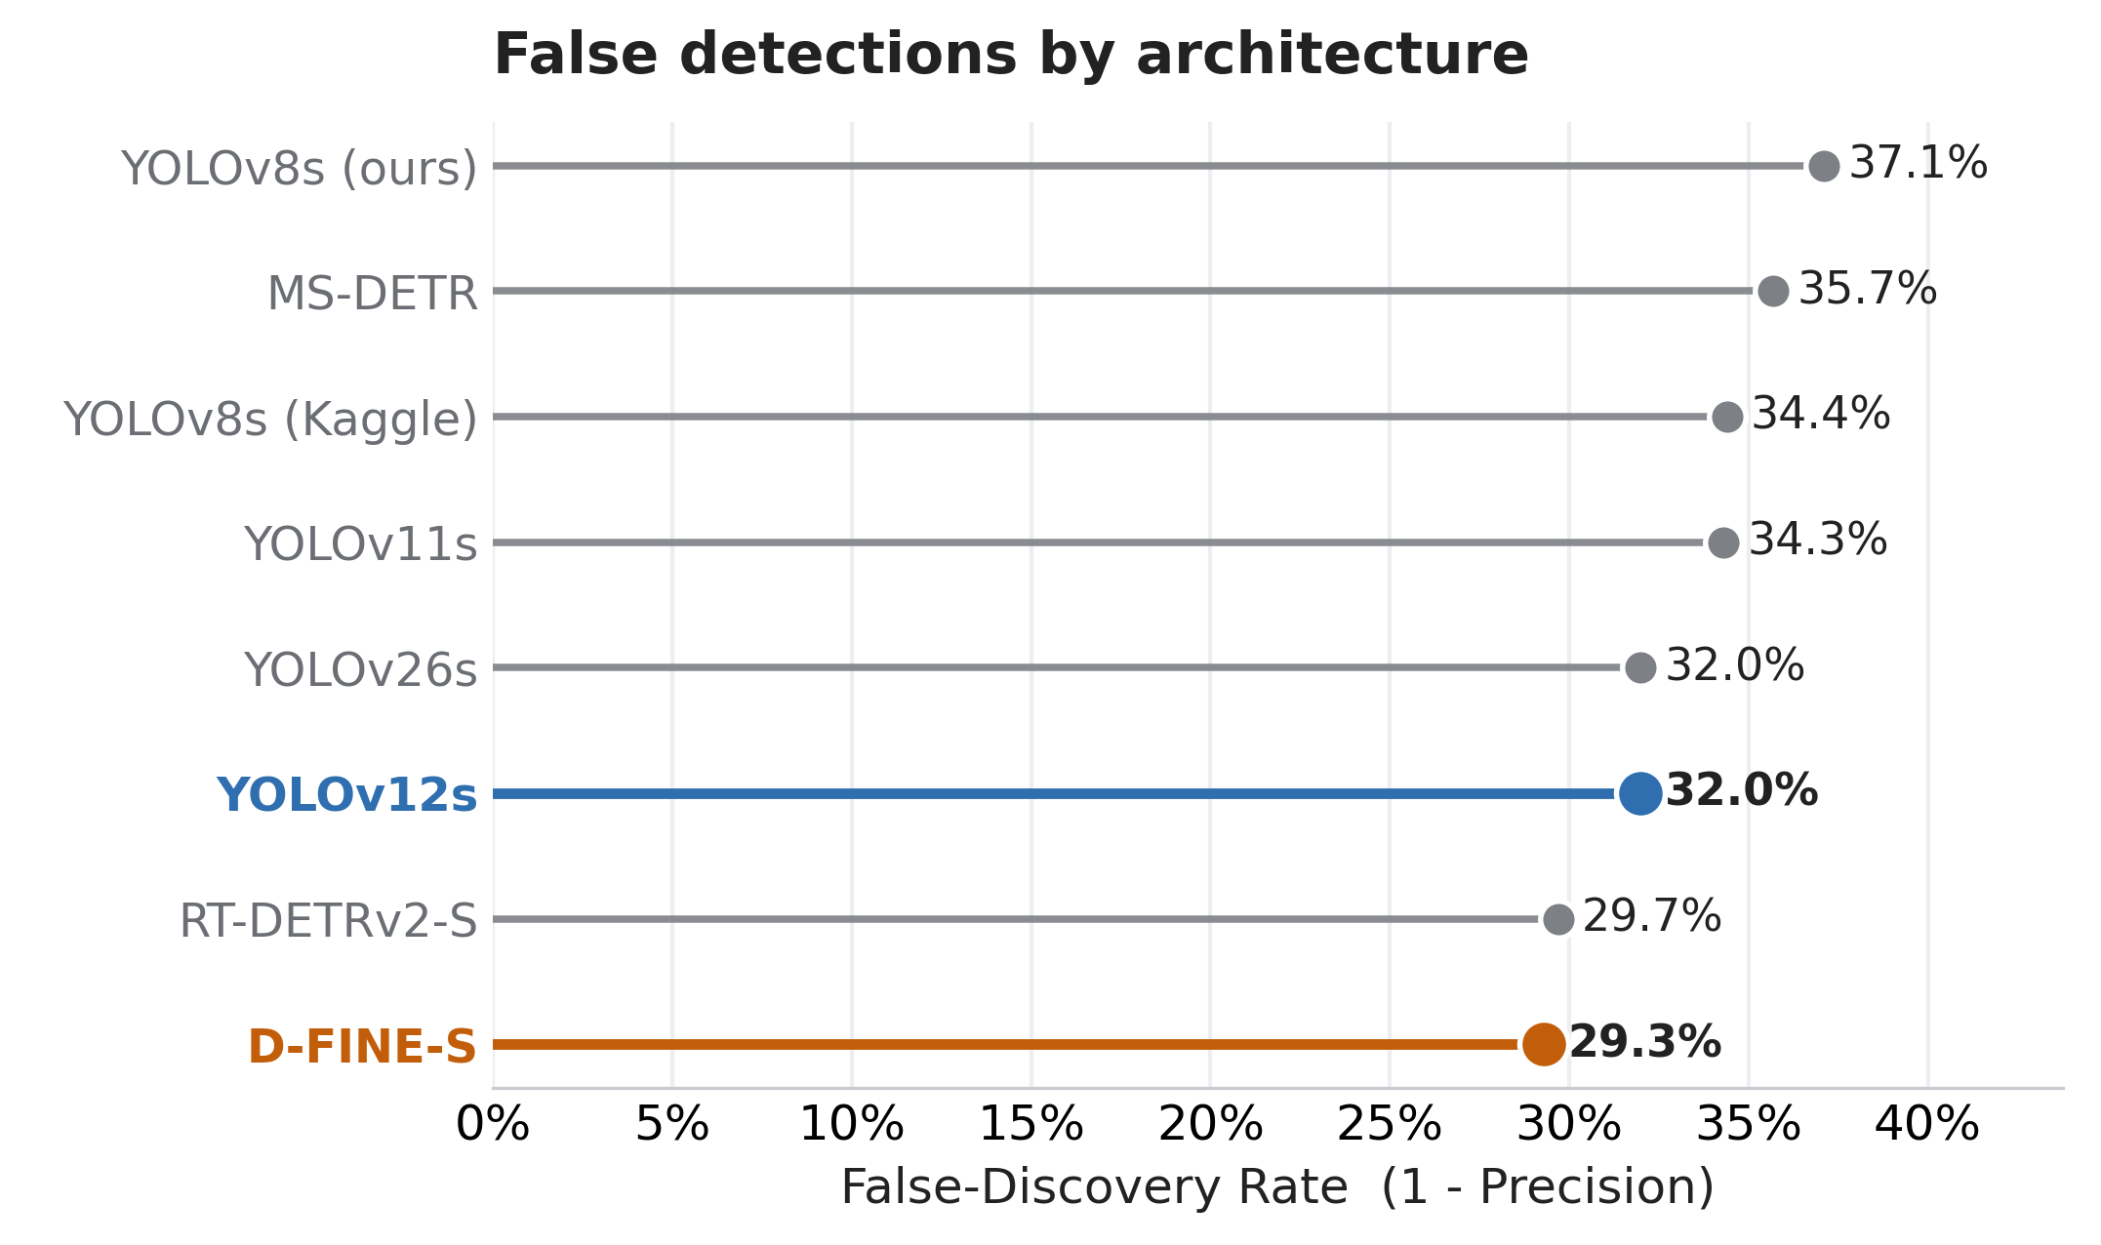
RESULTS & ANALYSIS · FALSE DETECTIONS
D-FINE-S raises the fewest false alarms
29.3%
false-discovery rate for D-FINE-S, the lowest (precision 0.707)
RT-DETRv2-S is close behind (29.7%); YOLOv12s and YOLO-26s tie at 32.0%
YOLOv8s (ours) is worst at 37.1%, followed by MS-DETR at 35.7%
Even the best model still flags about 3 false boxes in every 10.
Automated Skin Lesion Detection in TBP
10
Notes:
False-discovery rate is one minus precision: the share of predicted boxes that are not lesions. D-FINE-S is lowest at 29.3%, with RT-DETRv2-S close at 29.7%. The two lowest-FDR models are the two that use a calibrated 0.50 confidence gate. The YOLO models sit at 32 to 37%. Even the best model produces roughly three false boxes in ten, which matters because each one is a candidate a clinician has to dismiss.

Slide 11
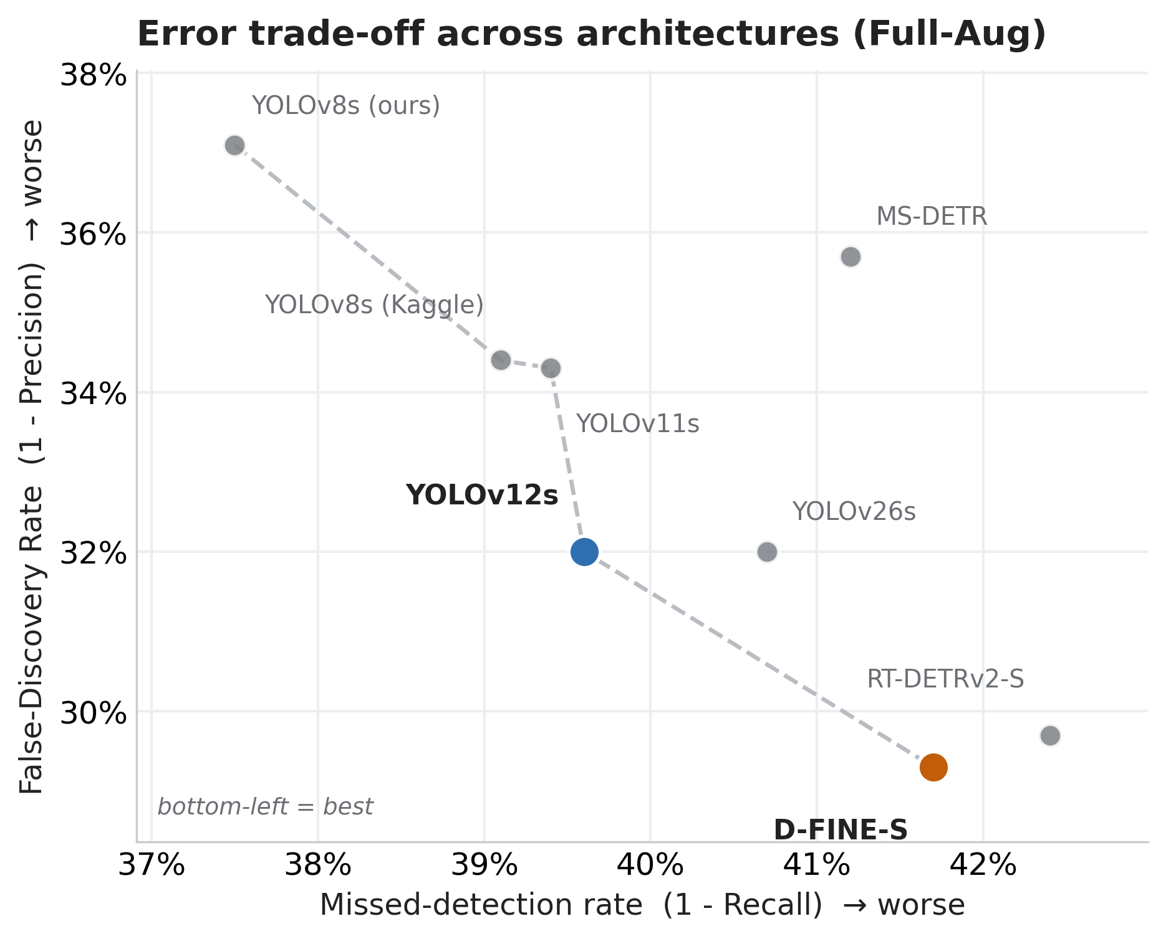
RESULTS & ANALYSIS · ERROR TRADE-OFF
Two models define the error trade-off
Recall-first: YOLOv12s
Precision-first: D-FINE-S
Misses 39.6%
False alarms 32.0%
F1 0.640
Misses 41.7%
False alarms 29.3%
mAP50 0.674
Bottom-left is best; the dashed line traces the best available trade-offs
YOLO-26s, MS-DETR and RT-DETRv2-S sit behind it, matched or beaten on both axes
Primary model: D-FINE-S. Choose YOLOv12s when minimising missed lesions is the overriding priority.
Automated Skin Lesion Detection in TBP
11
Notes:
Plotting both error types together shows the trade-off. Bottom-left is best. YOLOv12s sits at the recall-first end of the frontier, D-FINE-S at the precision-first end. YOLO-26s, MS-DETR and RT-DETRv2-S are each matched or beaten by one of those two on both axes. EigenCAM adds the clinical-reliability angle: D-FINE-S activations concentrate on lesion sites, while YOLOv12s shows signs of relying on surrounding context, a Clever Hans effect that box-overlap metrics cannot reveal. That is why we recommend D-FINE-S as the primary model, and YOLOv12s only where minimising misses at a fixed threshold is the overriding priority.

Slide 12
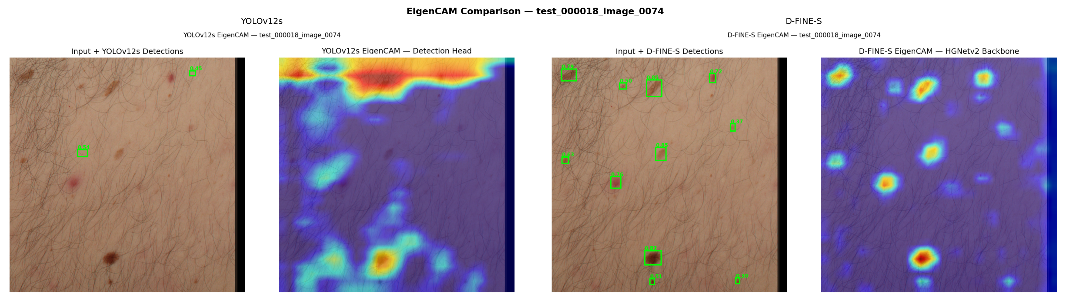
RESULTS & ANALYSIS · EIGEN-CAM
XAI tells a different story
D-FINE-S activations are lesion-focused; YOLOv12s shows signs of the Clever Hans effect
Automated Skin Lesion Detection in TBP
11
Notes:
Plotting both error types together shows the trade-off. Bottom-left is best. YOLOv12s sits at the recall-first end of the frontier, D-FINE-S at the precision-first end. YOLO-26s, MS-DETR and RT-DETRv2-S are each matched or beaten by one of those two on both axes. EigenCAM adds the clinical-reliability angle: D-FINE-S activations concentrate on lesion sites, while YOLOv12s shows signs of relying on surrounding context, a Clever Hans effect that box-overlap metrics cannot reveal. That is why we recommend D-FINE-S as the primary model, and YOLOv12s only where minimising misses at a fixed threshold is the overriding priority.

Slide 13
CONCLUSION
D-FINE-S sets the bar for TBP detection
1
Primary model: D-FINE-S
2
Operating point is architectural
Highest mAP50 (0.674) and precision (0.707), lesion-focused EigenCAM, and the least reliance on augmentation (+0.17 pp F1).
YOLO plateaus at conf 0.20, MS-DETR is threshold-invariant, RT-DETRv2-S and D-FINE-S are calibrated at 0.50, so no per-site guessing.
3
Complementary failure modes
4
Rethink tight-IoU scoring
TIDE: background false positives for D-FINE-S, missed detections for YOLOv12s. This should govern how each is operated.
AP falls from 67.4% (AP50) to 34.5% (AP75) with annotation variability, so centroid- or region-level agreement suits TBP triage.
Recall remains the limiting factor: these detectors are decision support that flags candidate lesions for clinician review.
Automated Skin Lesion Detection in TBP
12
Notes:
To close. D-FINE-S is our recommended primary model and the performance threshold for future methods to beat, without compromising the meaningfulness of the attribution maps. Three findings carry clinical weight. First, the confidence operating point is an architectural property, so it need not be guessed per site. Second, TIDE shows complementary failure modes, so each model should be operated according to its weakness. Third, the steep AP drop at tight IoU reflects annotation variability rather than localisation failure, so centroid- or region-level agreement is the better target for TBP triage. Above all, recall is still the limiting factor, so these are decision-support tools, not autonomous screens.

Slide 14


Thank you
Questions?
Code and trained models
github.com/CIRS-Girona/tbp_lesion_detection
Supported by the European Academy of Dermatology and Venereology (EADV) through the project HARMONY (PPRC-20250011).
Notes:
Thank you. The benchmark, code and trained models will be released at the GitHub link on screen. This work was supported by EADV through the HARMONY project. Happy to take questions.

Slide 15
ONGOING WORK
What’s next?
Distilling the findings of this work into a new detector architecture and training pipeline.
Release of a lesion detection toolkit and leaderboard, reporting evaluation metrics, error analysis and deployment profiling.
A diffusion-based study on the effect of hair removal on lesion classification.
Physics-informed temporal modelling for early melanoma detection.
An interpretable decision-support system, introducing a vision-language framework for clinically grounded diagnosis with structured reasoning.
Automated Skin Lesion Detection in TBP
12
Notes:
To close. D-FINE-S is our recommended primary model and the performance threshold for future methods to beat, without compromising the meaningfulness of the attribution maps. Three findings carry clinical weight. First, the confidence operating point is an architectural property, so it need not be guessed per site. Second, TIDE shows complementary failure modes, so each model should be operated according to its weakness. Third, the steep AP drop at tight IoU reflects annotation variability rather than localisation failure, so centroid- or region-level agreement is the better target for TBP triage. Above all, recall is still the limiting factor, so these are decision-support tools, not autonomous screens.

