Slide 1
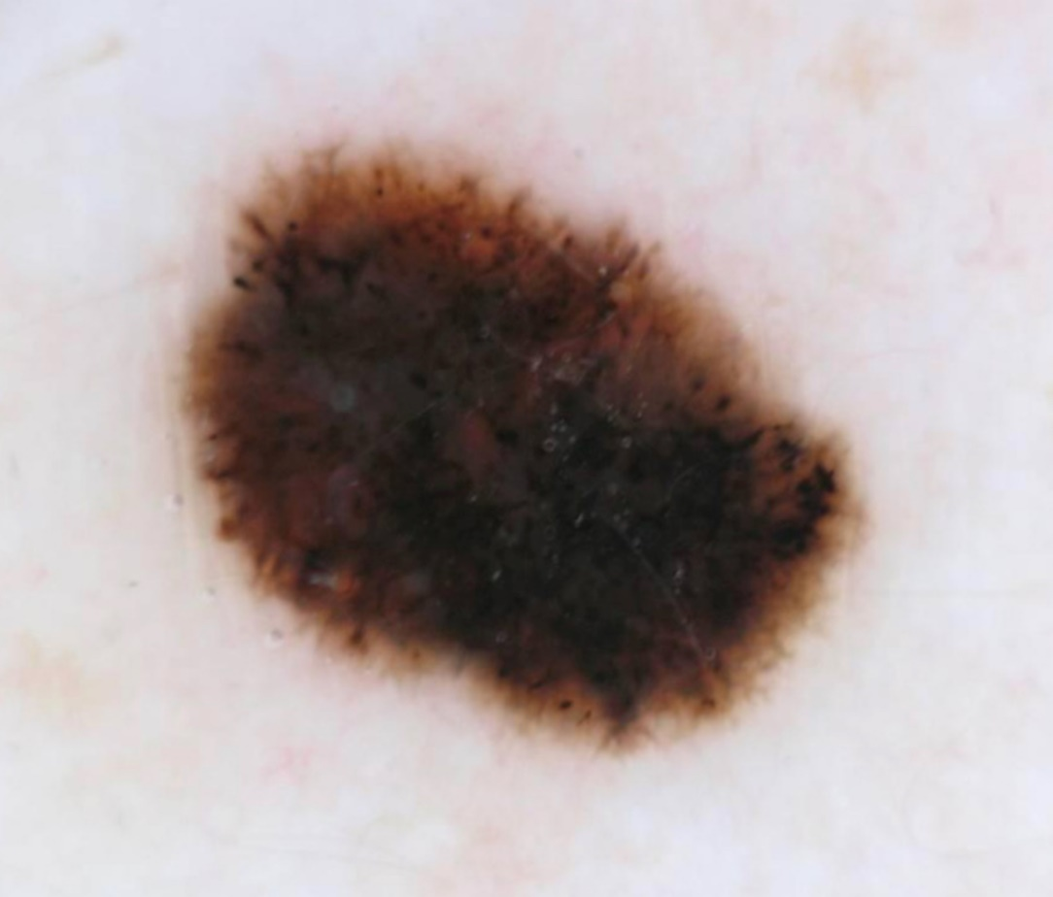

Eleventh ISIC Skin Image Analysis Workshop @MICCAI 2026
Organizers:
M. Emre Celebi
Kumar Abhishek
Catarina Barata
Allan Halpern
Philipp Tschandl
Marc Combalia
Yuan Liu
Joanna Jaworek-Korjakowska
Moi Hoon Yap

Slide 2
ISIC Challenges & Workshops
Skin Lesion Analysis Towards Melanoma Detection/Skin Image Analysis
Organizers: Celebi, Abhishek, Barata, Codella, Combalia, Dana, Gutman, Halpern, Helba, Jaworek-Korjakowska, Kittler, Liu, Rotemberg, Tschandl, Yap, etc.
IEEE Int. Symp. on Biomedical Imaging (ISBI 2016, 2017)
Int. Conf. on Medical Image Computing & Computer Assisted Intervention (MICCAI 2018, 2019, 2020, 2023, 2024, 2025, 2026)
IEEE/CVF Conf. on Computer Vision & Pattern Recognition (CVPR 2019, 2020, 2021)
European Conference on Computer Vision (ECCV 2022)

Slide 3
Workshop Statistics
38 submissions received
7 submissions accepted (≈18%)
30 reviewers
≈3.6 reviews per submission
≈2.3 submissions per reviewer

Slide 4
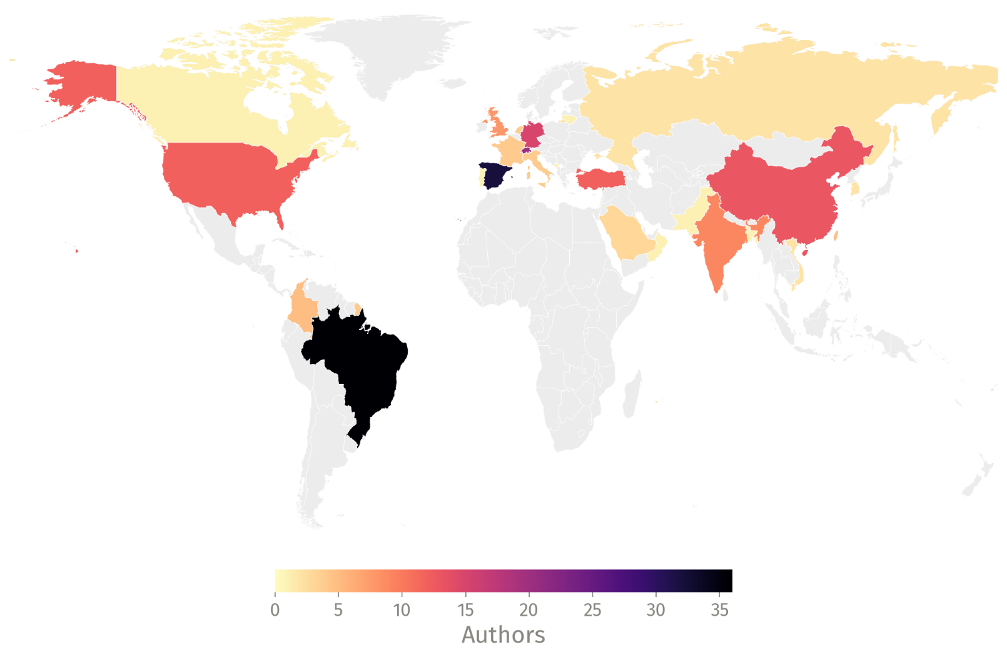
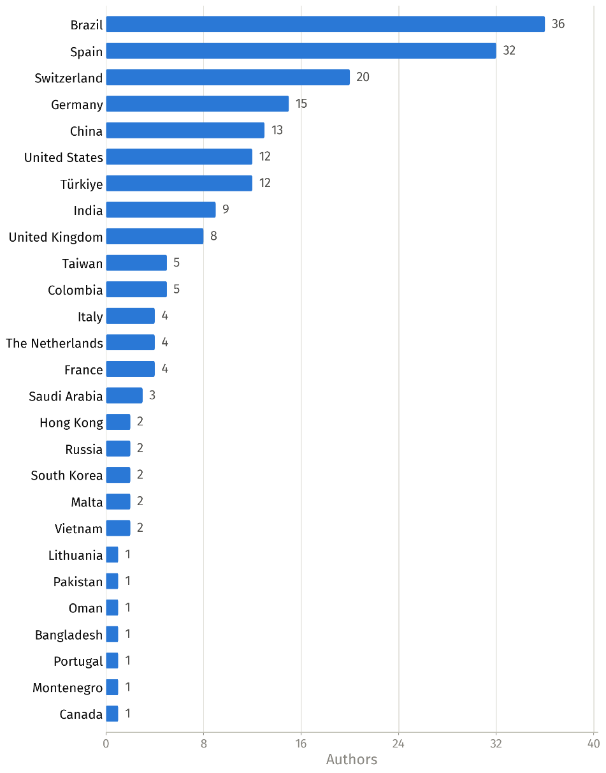
Workshop Statistics: Submitting Authors

Slide 5
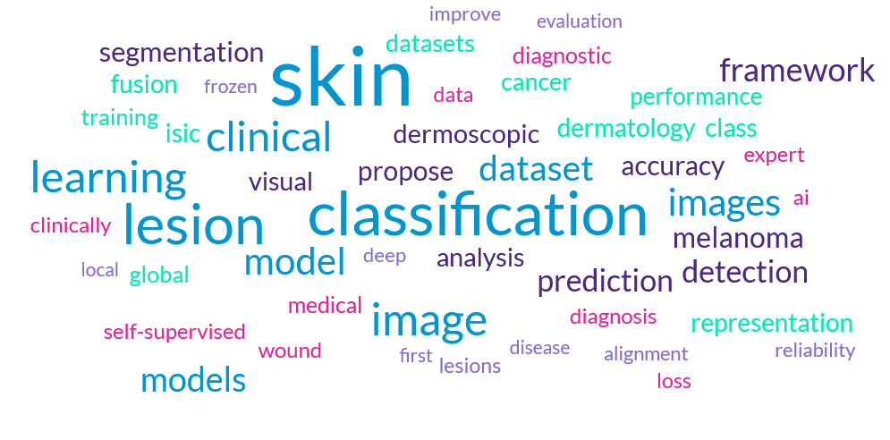
Workshop Statistics: Keywords

Slide 6

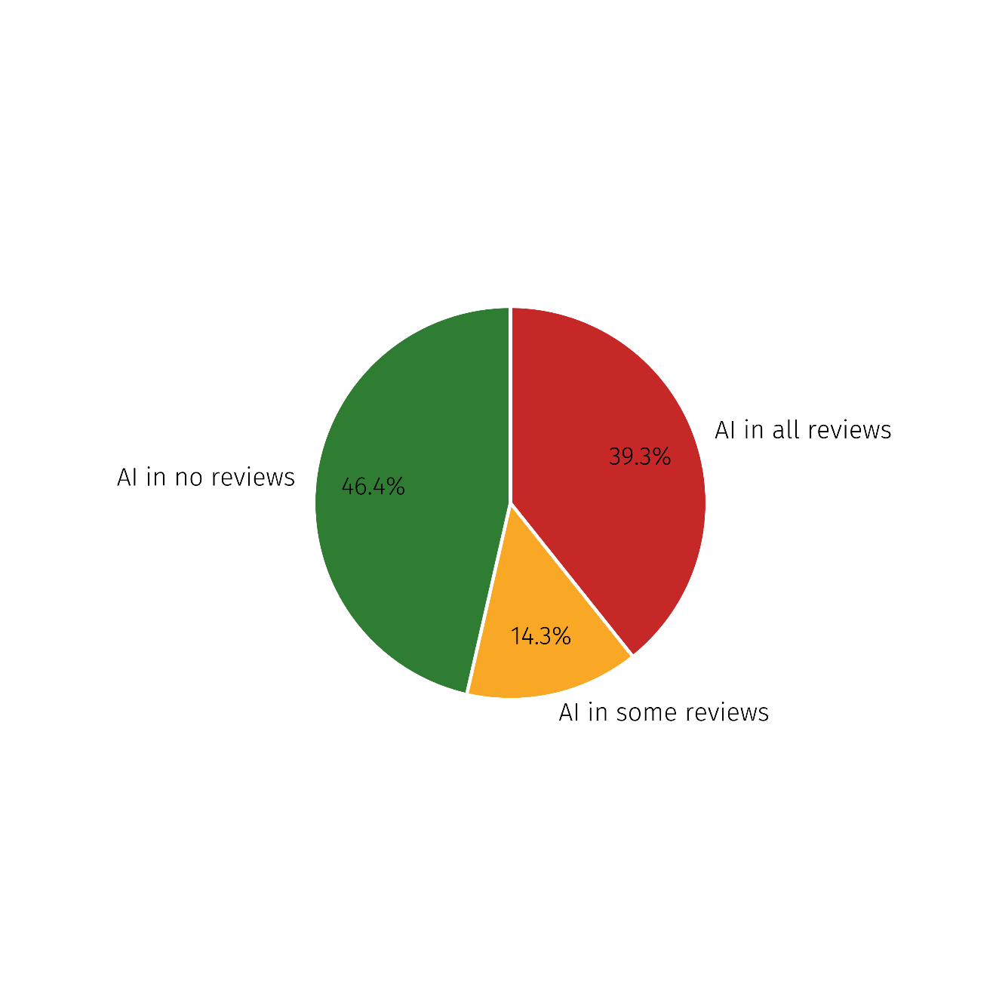
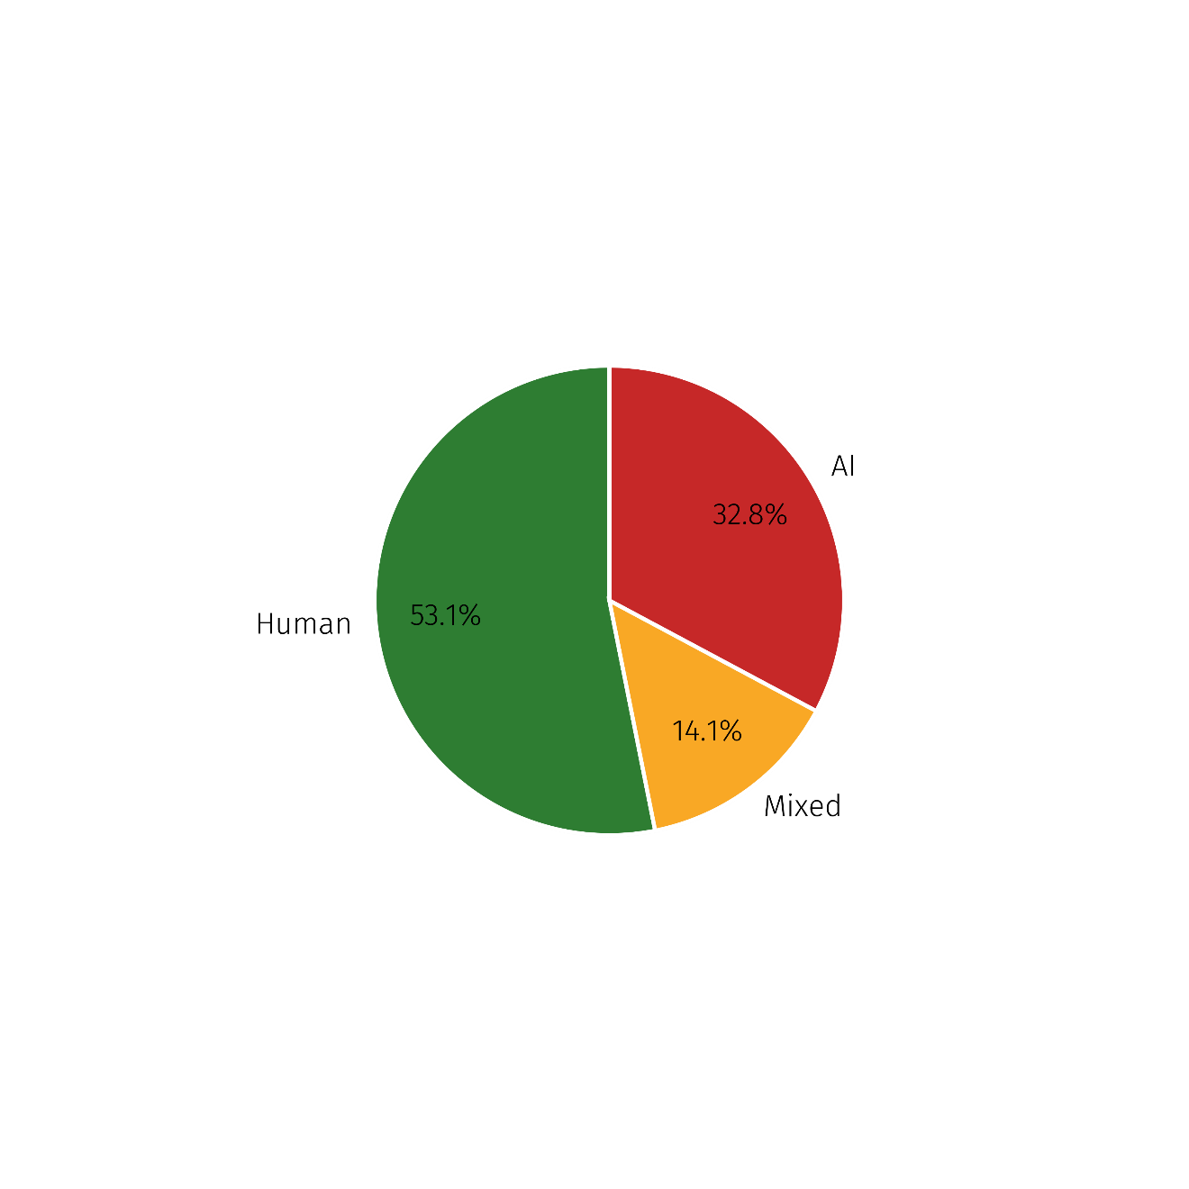
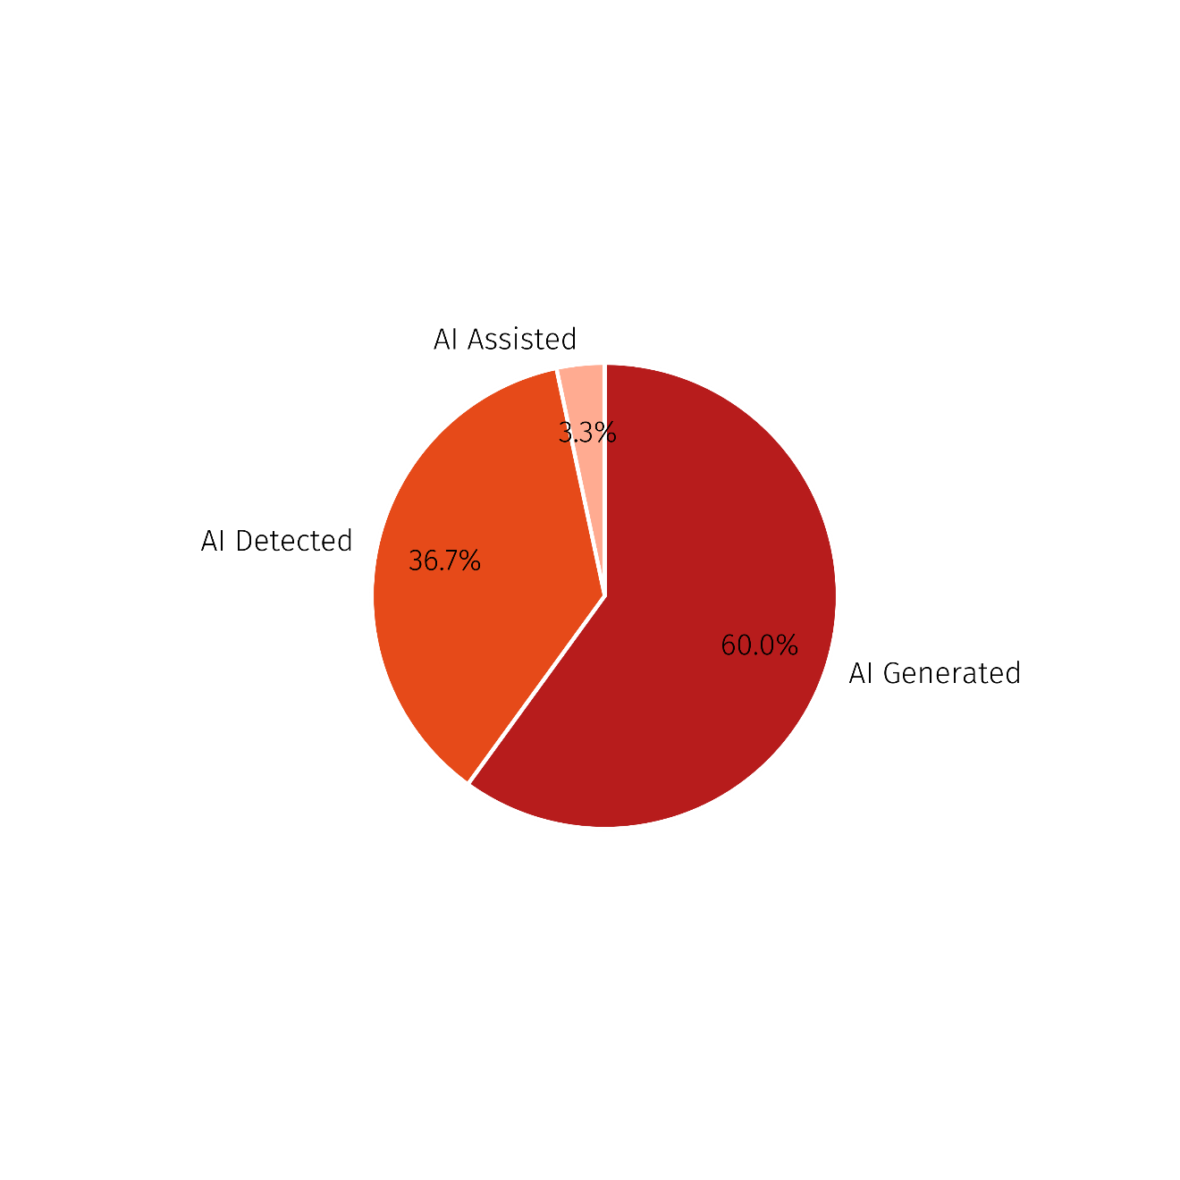
AI Usage in Peer-Reviewing
Did reviewers use AI in any of their review?
Breakdown of AI usage
in reviews
Extent of AI usage
in flagged reviews

Slide 7
Workshop Program
Opening Rmks. (1:30−40) Inv. Talk 1 (1:40−2:10)
Oral Pres. 1 (2:10−25) Short Break 1 (2:25−55)
Oral Pres. 2 (2:55−3:10) Spotlight Pres. 1 (3:10−3:20)
Spotlight Pres. 2 (3:20 −3:30) Coffee Break (3:30−4:30)
Oral Pres. 3 (4:30−4:45) Spotlight Pres. 3 (4:45−4:55)
Spotlight Pres. 4 (4:55 −5:05) Panel Discussion (5:05−5:50)
Closing Rmks. (5:50−6:00)

