Slide 1

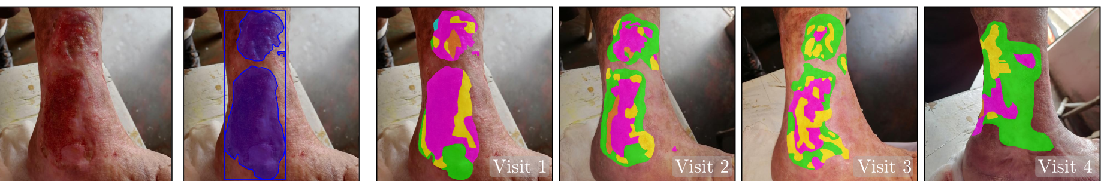
ISIC Workshop @ MICCAI 2026 · Strasbourg, France · 27 September 2026
LUTSeg: A Longitudinal Multi-Expert Dataset
for Ulcer Tissue Segmentation
Karen Sanchez¹, Carlos Hinojosa¹, Albert Alejandro Ávila², Andrea C. Riano-Rojas³,
Diego H. Romero², Jenny C. Páez², Martina Llinás², Bernard Ghanem¹
¹ King Abdullah University of Science and Technology (KAUST), Saudi Arabia · ² Subred Norte E.S.E, Hospital Simón Bolívar, Colombia ·
³ Universidad del Rosario, Bogotá, Colombia
One patient, four follow-up visits — raw image, expert wound mask, and pixel-level tissue masks.
Code & data: github.com/carlosh93/TiSage
Notes:
[0:00 – 0:25] ~25 s
Good morning. I'm Karen Sanchez from KAUST. I'll present LUTSeg — a longitudinal, multi-expert dataset for ulcer tissue segmentation — and TiSage, the semi-supervised benchmark we built on it. Joint work with KAUST, Hospital Simon Bolivar in Bogota, and Universidad del Rosario.
The strip at the bottom is the paper in one picture: one patient, four visits, expert tissue labels every time.
[Click]

Slide 2
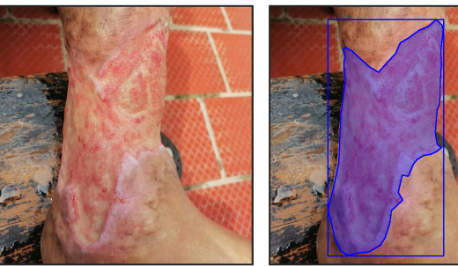
CLINICAL MOTIVATION
Why a longitudinal, multi-expert tissue dataset?
1
Composition, not just the boundary
The spatial distribution of epithelial, slough, granulation and necrotic tissue encodes inflammation, infection risk and healing progression — the information clinicians actually act on.
2
Annotation is the bottleneck
Dense pixel-level tissue labelling is labour-intensive, costly and inherently subjective — even among specialised wound-care experts.
Chronic leprosy-related ulcer: raw smartphone image and the expert-delineated wound mask.
The clinical question
3
Neglected diseases are worst served
How is the tissue mix inside this wound changing between visits?
Leprosy needs systematic longitudinal monitoring, yet expert annotation resources for it are scarce; most work stops at wound-boundary segmentation or coarse grading.
LUTSeg · ISIC Workshop @ MICCAI 2026
2
Notes:
[0:25 – 0:55] ~30 s
Managing a chronic ulcer isn't only about finding the wound — it's about what's inside it. The mix of epithelial, slough, granulation and necrotic tissue encodes inflammation, infection risk and healing progression. That's the signal clinicians act on.
The problem is supervision: dense tissue annotation is expensive and, as I'll quantify, genuinely subjective. And it bites hardest where monitoring matters most — neglected diseases like leprosy. Most prior work therefore stops at the wound boundary.
[Click]

Slide 3
MOTIVATION - RELATED DATASETS
Why a longitudinal, multi-expert tissue dataset?
Wound tissue datasets | Availability | Tissue labels
Kabir et al. (2025) | Private | 6 classes
DFUTissue (2024) | Public | 4 classes
ComplexWoundDB (2022) | Public | yes
CO2Wounds-V2 (2024) leprosy | Public | none
LUTSeg (ours) | Public | 5 classes
Every public alternative is missing at least one of: tissue labels, repeat visits of the same wound, or more than one annotator.
Why that matters: without repeat visits we cannot measure whether a wound is healing; without several annotators we cannot know how reliable the labels we measure it with actually are.
LUTSeg · ISIC Workshop @ MICCAI 2026
3
Notes:
[0:55 – 1:19] ~24 s · CUT THIS SLIDE IF RUNNING LONG
Kabir and colleagues built a six-class tissue dataset, but it's private. DFUTissue is public — diabetic foot ulcers, four classes, with an unlabeled portion for semi-supervised learning — but single-visit. ComplexWoundDB is small-scale. And CO2Wounds-V2 is the closest setting, leprosy patients, but wound masks only.
So: no public dataset with longitudinal, pixel-level, multi-expert tissue labels for a neglected tropical disease.
[Click]

Slide 4
CONTRIBUTIONS
Three contributions
1
2
3
LUTSeg dataset
Annotation protocol
& inter-rater study
TiSage benchmark
A longitudinal, multi-expert, pixel-level wound tissue segmentation dataset for leprosy-related skin ulcers — an underrepresented neglected-disease setting.
A structured protocol with wound masks and tissue masks, plus a quantification of inter-rater variability on a gold-standard subset annotated by five clinicians.
A semi-supervised method that injects superpixel-based semantic priors from a frozen medical vision-language model into a teacher–student framework.
141 images · 39 patients
21 months of follow-up
5 tissue categories
46-image gold standard
ICC(3,1) on tissue proportions
460 pairwise Dice comparisons
Multi-scale log-space fusion
Confidence-gated pseudo-labels
Gains in 6 of 7 low-label settings
LUTSeg · ISIC Workshop @ MICCAI 2026
4
Notes:
[1:19 – 1:41] ~22 s
Three contributions. The LUTSeg dataset. A structured annotation protocol plus an inter-rater study on a gold-standard subset labelled independently by all five clinicians. And TiSage, an initial benchmark: a semi-supervised method that brings priors from a frozen medical vision-language model into a teacher-student framework.
The five categories follow clinical practice, including an explicit "Other" class.
[Click]

Slide 5
THE DATASET
LUTSeg at a glance
141
39
21
3.6 ± 1.7
5
46
images of leprosy-related ulcers
patients
months of routine wound care
follow-up visits per patient
tissue categories
gold-standard images (9 patients)
Acquisition
Ethics & governance
Splits
Captured by medical staff with smartphone cameras during routine wound-care sessions.
Each image corresponds to one follow-up visit; intervals vary with clinical scheduling and treatment plans.
In-the-wild conditions: free-hand framing, uncontrolled lighting and backgrounds.
Acquisition adhered to the Declaration of Helsinki; all data anonymised.
Written informed consent obtained from every participant.
Approved by the Ethics Committee of the Sanatorio de Contratación ESE hospital, Colombia (Act 05–21).
Dataset splitting performed at the patient level — images from one patient never cross subsets.
Prevents leakage between annotation and evaluation subsets.
Fully supervised reference uses all 111 labeled training images.
LUTSeg · ISIC Workshop @ MICCAI 2026
5
Notes:
[1:41 – 2:15] ~34 s
141 images of leprosy-related ulcers, 39 patients, collected during routine wound care over 21 months. On average 3.6 visits per patient — so genuinely longitudinal. Five tissue categories, and a 46-image gold standard from 9 patients labelled by all five clinicians.
Images were taken by medical staff on ordinary smartphones, one per visit, with intervals set by clinical scheduling. So: in-the-wild data.
Ethics: Declaration of Helsinki, anonymised, written informed consent, approved under Act 05-21. And all splitting is at the patient level, so no leakage.
[Click]

Slide 6
ANNOTATION
A two-stage, five-clinician protocol
1
Stage 1 — Wound boundary
Gold-standard subset
The wound boundary is delineated to produce a binary wound mask for each image.
46 images from 9 patients, selected for higher tissue diversity and multiple follow-up visits.
Independently annotated by all five specialised physicians.
The remaining patients were distributed among the annotators for separate labeling.
2
Stage 2 — Tissue composition
All visible tissue regions inside the wound area are segmented at pixel resolution into the five predefined categories. Annotators may assign “Other” when the appearance does not clearly correspond to a predefined class.
Five tissue categories
Epithelial
Slough
Granulation
Necrotic
Other
Consensus reference mask
For each image, annotators voted for the most clinically accurate mask; ties were resolved via fixed-seed random selection — yielding a single reference mask per gold-standard image.
Who annotated
Five specialised clinicians with expertise in complex wound care and skin tissue management; each image annotated independently through a standardised Label Studio interface with quality control.
LUTSeg · ISIC Workshop @ MICCAI 2026
6
Notes:
[2:15 – 2:53] ~38 s
Two stages. First the wound boundary, giving a binary wound mask. Then every visible tissue region inside it, segmented at pixel resolution into the five categories.
Because tissue typing is hard, annotators could assign "Other" when the appearance didn't clearly match a class, rather than forcing a guess. Remember that — it matters in two slides.
Five wound-care specialists annotated every image independently in Label Studio. On the gold-standard subset, all five labelled the same 46 images; the reference mask is the one they voted most clinically accurate, with ties broken by fixed-seed random selection.
[Click]

Slide 7
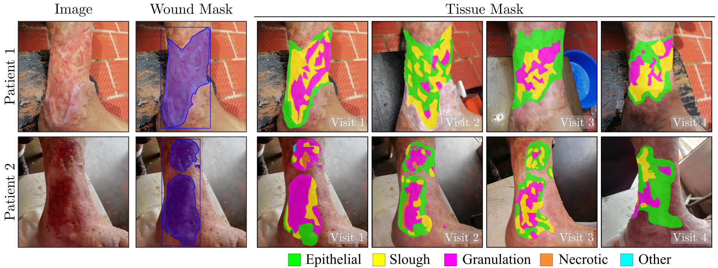
DATASET SAMPLES
LUTSeg: Wound masks, tissue masks, and follow-up visits
Fig. 1 — First-visit image, its binary wound mask, and pixel-level segmentation into five tissue categories for each visit image.
Longitudinal
Heterogeneous
In the wild
The same wound is re-annotated at every visit, so tissue proportions can be tracked over time.
Tissue types are interleaved in fine, irregular patterns — not compact regions.
Lighting, viewpoint and background change between visits of the same patient.
LUTSeg · ISIC Workshop @ MICCAI 2026
7
Notes:
[2:53 – 3:21] ~28 s
Two patients, four visits each: raw image, wound mask, then the tissue masks.
It's genuinely longitudinal — look at patient one, magenta granulation giving way to green epithelium as the wound closes.
The tissue is heterogeneous: these aren't compact regions, they interleave in fine irregular patterns, which is what makes annotation hard.
And it's in the wild — lighting, viewpoint and background all change between visits of the same patient.
[Click]

Slide 8
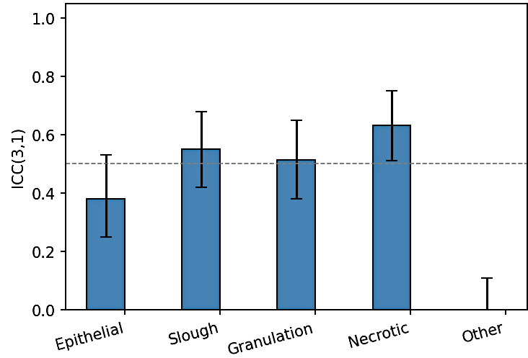
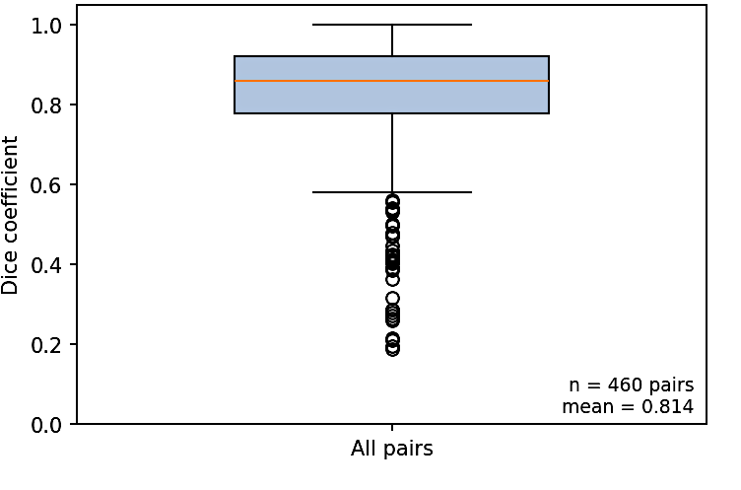
INTER-RATER AGREEMENT
How much do five experts actually agree?
ICC(3,1) on tissue proportions
Pairwise Dice on tissue vs. background.
Gold standard
Necrotic
Slough
Granulation
Epithelial
Other
0.63
0.55
0.51
0.38
≈ 0
95% CI 0.51 – 0.75
0.42 – 0.68
0.38 – 0.65
0.25 – 0.53
−0.08 – 0.11
460 pairs · mean Dice 0.814 · median 0.860 · minimum 0.187.
Experts agree on where the wound is, but not on what the tissue is → benchmarks must be uncertainty-aware.
LUTSeg · ISIC Workshop @ MICCAI 2026
8
Notes:
[3:21 – 4:07] ~46 s · KEY SLIDE — do not rush
This is the most important slide in the dataset half.
Left: ICC(3,1), two-way mixed effects, single measure — the right model because the same five raters annotated everything. Per image and rater we took each tissue's proportion of wound area, then computed ICC per category.
Agreement on composition is only moderate: Necrotic 0.63, Slough 0.55, Granulation 0.51, Epithelial just 0.38. "Other" sits at zero with a CI spanning zero — confirming its role as the bin for ambiguous regions.
Right: spatial overlap. Pairwise Dice on tissue-versus-background, 460 comparisons. High — mean 0.814 — but the minimum is 0.187.
So experts agree on where the wound is, much less on what's in it. That's what motivates TiSage.
[Click]

Slide 9
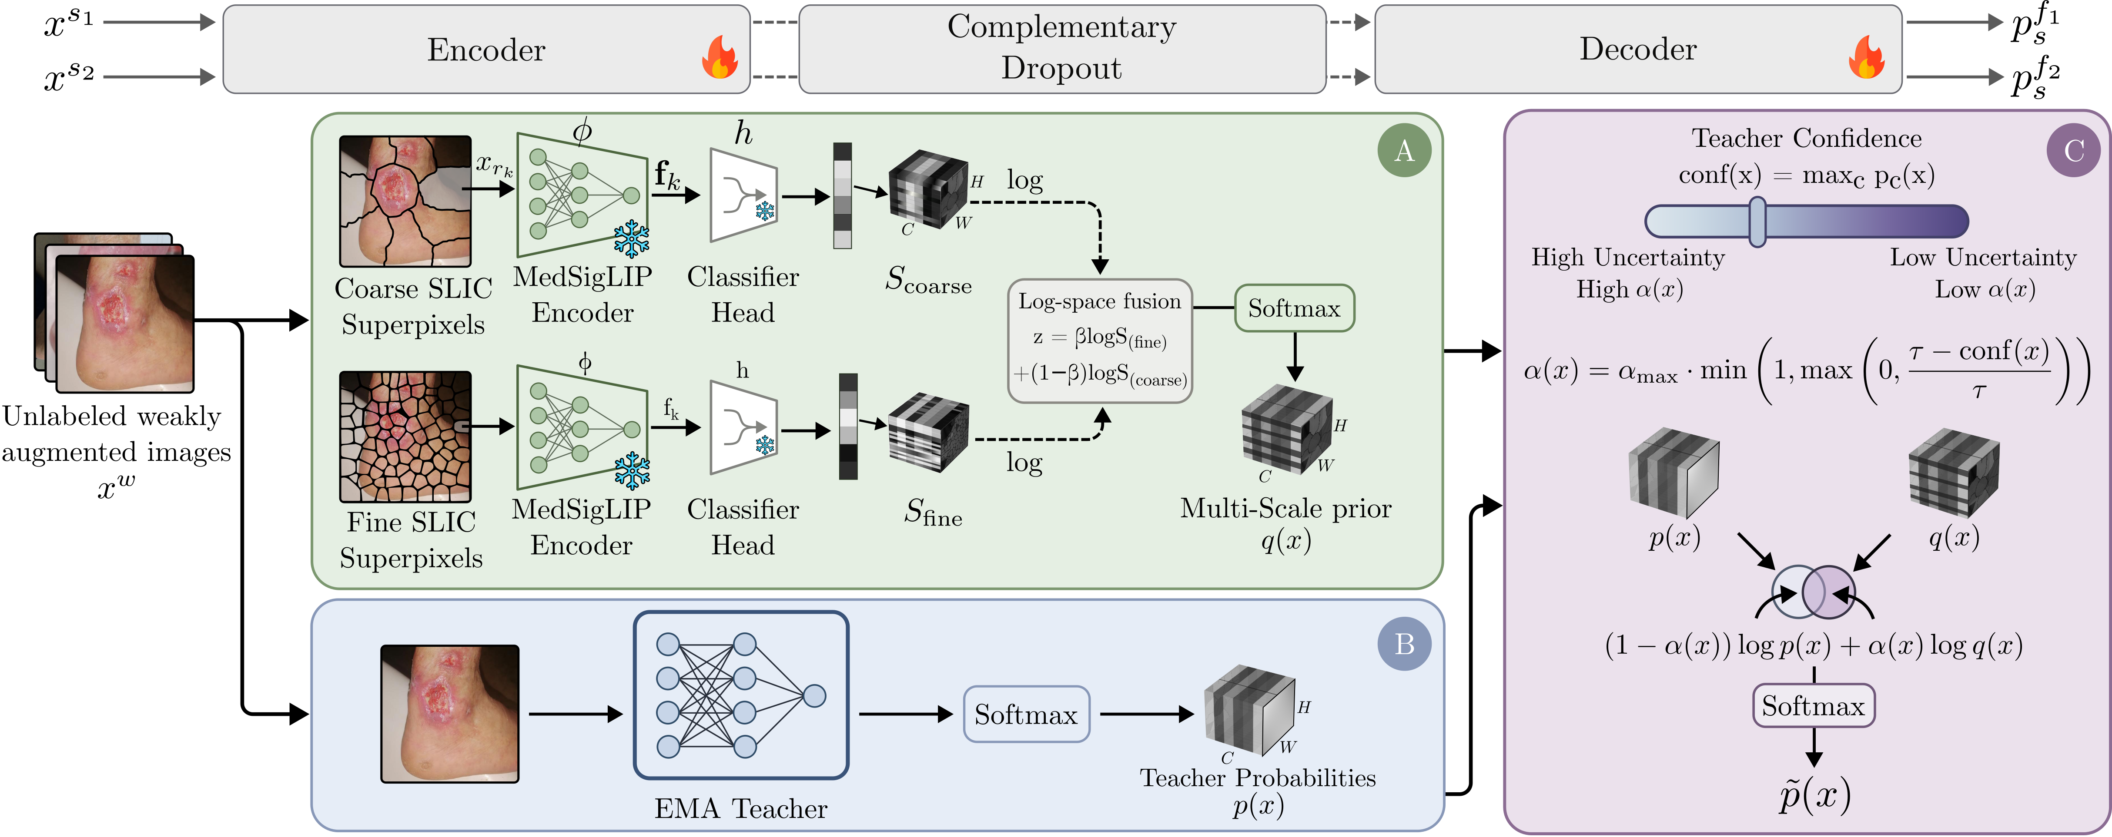
METHOD
TiSage — semantic priors for label-efficient tissue segmentation
A
Multi-scale semantic prior
B
EMA teacher
C
Pixel-adaptive fusion
Coarse and fine SLIC superpixels encoded by a frozen MedSigLIP encoder, classified, and fused in log space into a prior q(x).
Pixel-wise class probabilities p(x) predicted by the EMA teacher from weakly augmented images.
p(x) and q(x) are fused according to teacher confidence, yielding calibrated pseudo-labels p̃(x).
LUTSeg · ISIC Workshop @ MICCAI 2026
9
Notes:
[4:07 – 4:44] ~37 s
The backbone is a teacher-student pipeline built on UniMatch-V2.
We add three things. Block A: a multi-scale semantic prior — coarse and fine SLIC superpixels encoded by a frozen MedSigLIP encoder, classified, and fused in log space into a dense prior q of x.
Block B is the usual EMA teacher, giving pixel probabilities p of x from the weak view.
Block C is the novelty: instead of trusting the teacher blindly, we fuse p and q with a weight driven by the teacher's own confidence. Let me unpack A and C.
[Click]

Slide 10
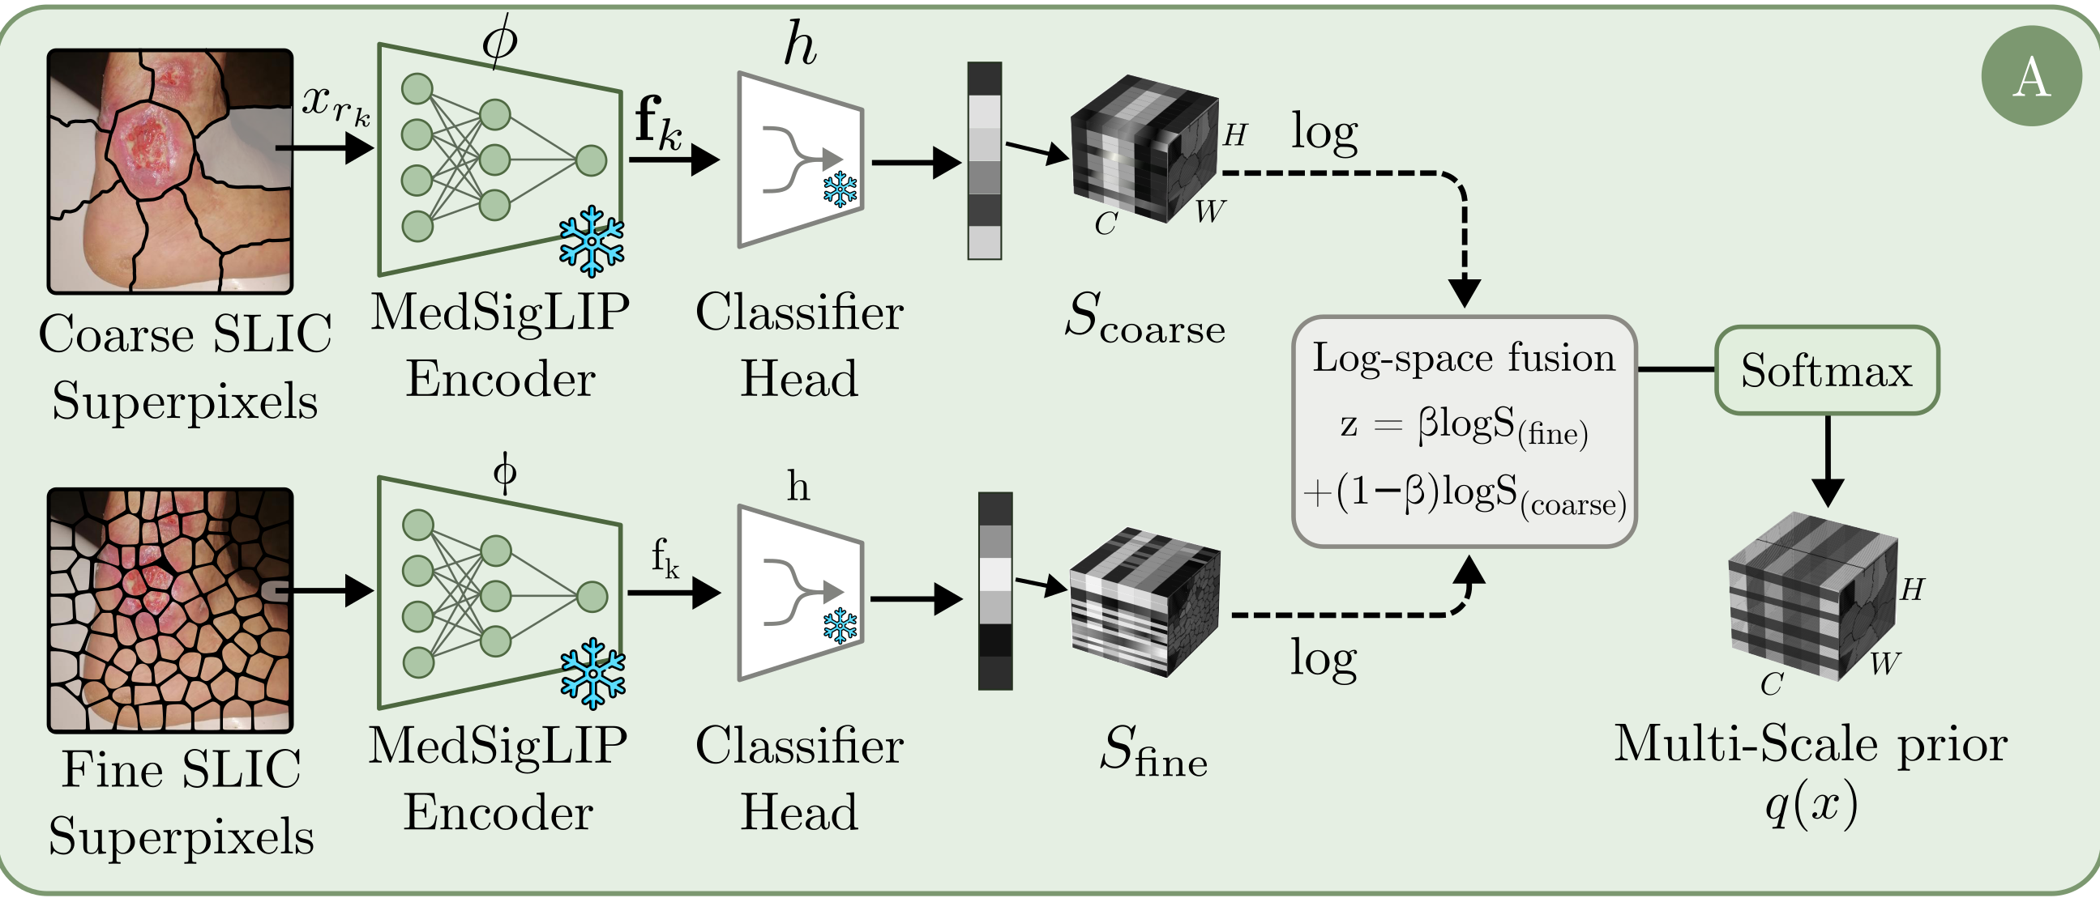
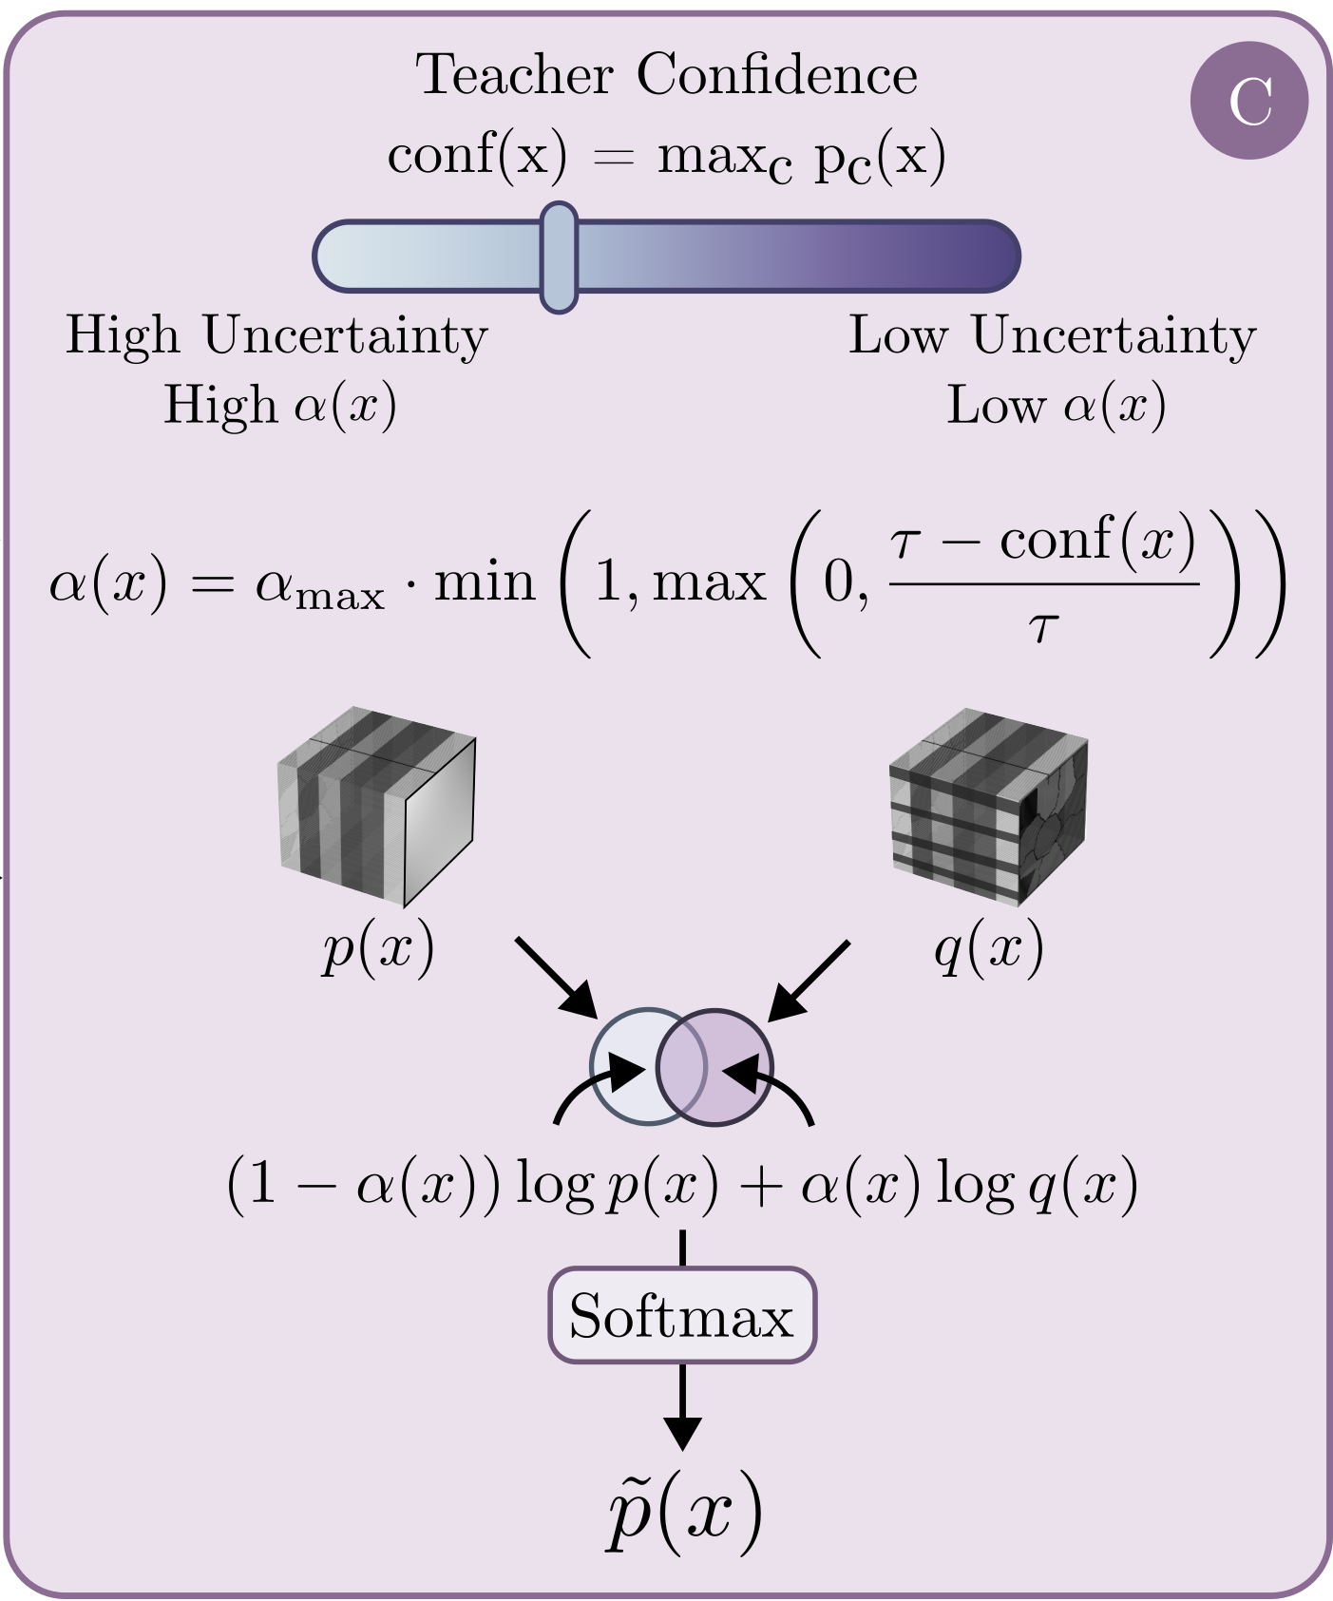
METHOD · HOW IT WORKS
Fuse two scales, then gate on teacher confidence
A · Superpixels at two scales, embedded by a frozen MedSigLIP encoder; a linear head trained once on labeled regions turns each into a class distribution.
C · The prior is applied in proportion to how unsure the teacher is.
q = softmax( β·log S_fine + (1−β)·log S_coarse )
(2)
α(x) = α_max · min(1, max(0, (τ − conf(x))/τ))
(3)
p̃ = softmax( (1−α)·log p + α·log q )
(4)
coarse is smooth, fine is precise — log-space fusion keeps both
α = 0 where the teacher is confident; α_max = 0.25
a weighted product of experts, per pixel
Training: confidence-masked CE + an entropy-weighted KL, so ambiguous pixels count less instead of being discarded — the single most important component (−0.60 mIoU without it).
LUTSeg · ISIC Workshop @ MICCAI 2026
6
Notes:
[4:00 – 5:27] ~87 s
Two mechanisms.
On the left, block A. SLIC at two granularities; each region is padded, resized to 448, and encoded by a frozen MedSigLIP. Classes come from the labeled set by majority vote over the ground-truth pixels in each region, and a single linear head — class-balanced, because Necrotic and Other are rare — is trained once and then frozen. So the prior is almost free at training time.
Equation 2 is why we use two scales: coarse superpixels are smooth but blur borders, fine ones are precise but noisy. Fusing in log space keeps both — 52.11 mIoU fused versus 48.05 and 44.70 for either scale alone.
On the right, block C. Confidence is just the max class probability. Equation 3: above tau the prior is ignored entirely; below it, alpha ramps up to at most 0.25 — so the prior never fully overrides the teacher. Equation 4 fuses them in log space, a weighted product of experts. The method is robust here: at most 0.35 mIoU of variation for tau between 0.80 and 0.95.
And the loss: alongside the usual masked cross-entropy we weight a KL term by one minus the normalised entropy of the pseudo-label. Ambiguous pixels count less, but nothing is thrown away. In the ablation that is the single most important component.
[Click]

Slide 11
RESULTS
Supervised vs. semi-supervised across label regimes
Method | DFUTissue |  |  |  |  |  |  |  | LUTSeg
 | Fixed |  | 1/4 |  | 1/8 |  | 1/16 |  | 1/4 |  | 1/8 |  | 1/16
 | mIoU | F1 | mIoU | Dice | mIoU | Dice | mIoU | Dice | mIoU | Dice | mIoU | Dice | mIoU | Dice
Supervised methods
DeepLabV3+–R50 | 70.02 | 81.12 | 65.22 | 77.14 | 58.32 | 70.52 | 48.38 | 58.87 | 19.89 | 23.17 | 20.79 | 24.18 | 21.25 | 25.34
DINOv2–DPT | 68.71 | 80.21 | 66.23 | 78.03 | 64.68 | 76.57 | 52.83 | 65.02 | 28.38 | 35.19 | 20.47 | 23.55 | 24.47 | 30.15
Semi-supervised methods
FixMatch | 68.91 | 80.19 | 67.17 | 78.80 | 66.90 | 78.40 | 60.14 | 71.30 | 27.70 | 33.00 | 27.26 | 33.91 | 27.42 | 34.33
UniMatch-V2 | 69.94 | 80.96 | 68.17 | 79.67 | 67.28 | 78.85 | 61.80 | 73.24 | 26.13 | 30.55 | 27.60 | 34.24 | 27.35 | 32.24
TiSage (Ours) | 72.36 | 83.05 | 69.77 | 81.00 | 67.93 | 79.28 | 61.33 | 73.17 | 28.73 | 34.50 | 31.70 | 39.25 | 28.55 | 34.04
“Fixed” = DFUTissue's official SSL split. Supervised rows use only the labeled portion; semi-supervised rows also use the unlabeled images. Mean over three seeds.
+4.10 mIoU
+2.42 / +1.60
6 of 7 settings
on LUTSeg 1/8 over UniMatch-V2 (31.70 vs 27.60); Dice +5.01
mIoU on DFUTissue Fixed and 1/4 — the largest public-benchmark gains
improved over UniMatch-V2; DFUTissue 1/16 trails by only 0.47 mIoU
LUTSeg · ISIC Workshop @ MICCAI 2026
13
Notes:
[6:56 – 7:45] ~49 s
Two datasets, four label regimes, four baselines. Ours is the bottom row.
The largest gain is on our own dataset: LUTSeg one-eighth, 31.70 mIoU against 27.60 — plus 4.10 mIoU, plus 5 points of Dice. It transfers to the public benchmark too: plus 2.42 on DFUTissue fixed, plus 1.60 at one-quarter.
Six of seven settings improve. The exception is DFUTissue one-sixteenth, trailing by 0.47 — with the fewest labels the prior's own head is trained on very little data, so the prior is weakest where it's needed most. An honest limitation.
For calibration: fully supervised on LUTSeg with all 111 labels gives 31.37 mIoU. TiSage at one-eighth gives 31.70. Absolute numbers are low for everyone here, but the label efficiency is real.
[Click]

Slide 12
ANALYSIS
Where the gains come from
Minority classes benefit most
Slough +9.8 IoU and Granulation +12.7 IoU — precisely the classes with higher inter-rater variability and lower baseline performance.
Ablations
Prior alone is not enough
Prior-only segmentation, without the encoder–decoder, reaches 26.28 mIoU on LUTSeg and 52.11 on DFUTissue — useful evidence, not a segmenter.
Log-space fusion validated
Fused prior beats every single-scale variant: 52.11 vs 48.05 (fine), 44.70 (coarse), 45.67 (single-scale SLIC), 34.70 (zero-shot) on DFUTissue.
Every module contributes
On DFUTissue 1/8, entropy-weighted KL has the largest impact: −0.60 mIoU when removed.
Robust hyper-parameters
≤ 0.35 mIoU variation for τ ∈ [0.80, 0.95]; best result at α_max = 0.25.
LUTSeg · ISIC Workshop @ MICCAI 2026
14
Notes:
[7:45 – 8:27] ~42 s
Per-class IoU on LUTSeg at one-eighth.
The gains are in the minority and ambiguous classes. Slough, 5.6 to 15.4 — nearly triple. Granulation, 39.7 to 52.4. On DFUTissue the same pattern: Fibrin gains 10.3.
Notice which classes those are — exactly where our clinicians showed only moderate agreement and the baseline was weak. Semantic guidance helps under both scarcity and ambiguity, which is what it was designed for.
Being honest: Necrotic and Other stay near zero for both methods — too rare in LUTSeg.
On ablations: the prior alone is not a segmenter, the fused prior beats every single-scale variant, and the hyper-parameters aren't fragile.
[Click]

Slide 13
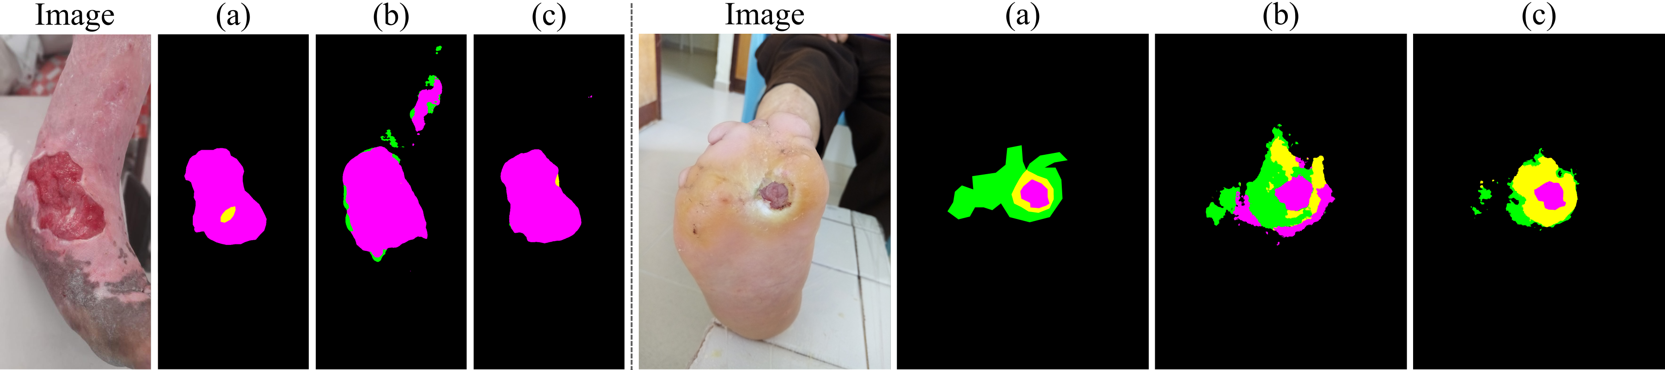
QUALITATIVE RESULTS
TiSage produces more coherent boundaries
Fig. 4 — Two random LUTSeg samples. (a) Ground truth (b) UniMatch-V2 (c) TiSage (ours)
Epithelial
Slough
Granulation
Necrotic
Other
Fewer fragmented predictions
More coherent boundaries
Better in ambiguous regions
UniMatch-V2 scatters spurious granulation and epithelial blobs outside the wound (left example); TiSage suppresses them.
Superpixel-derived priors are region-consistent by construction, so tissue borders follow image structure instead of pixel noise.
In the right-hand example, TiSage recovers the slough ring around the granulation core that the baseline over-segments as epithelial.
LUTSeg · ISIC Workshop @ MICCAI 2026
15
Notes:
[8:27 – 8:47] ~20 s
Ground truth, UniMatch-V2, TiSage.
The baseline scatters fragmented predictions — on the left it hallucinates a second blob of granulation above the wound. TiSage suppresses that, and boundaries are more coherent because superpixel-derived priors are region-consistent by construction. On the right, TiSage recovers the slough ring the baseline over-segments as epithelium.
[Click]

Slide 14

TAKE-HOME
Conclusions
1
A multi-tissue dataset
LUTSeg: longitudinal, multi-expert, pixel-level tissue labels for leprosy-related ulcers — the first for a neglected tropical disease.
2
Expert disagreement is measurable
ICC(3,1) of 0.38 – 0.63 on tissue composition versus a mean pairwise Dice of 0.814 on tissue extent: experts agree on where, not on what. Benchmarks for this task should be uncertainty-aware.
Code & data
github.com/carlosh93/TiSage
3
TiSage sets the initial benchmark
karen.sanchez@kaust.edu.sa
Frozen medical-VLM superpixel priors, multi-scale log-space fusion and confidence-gated pixel-adaptive pseudo-labels improve over supervised and semi-supervised baselines in six of seven low-label settings — +4.10 mIoU on LUTSeg 1/8, driven by minority classes.
Questions welcome
Thank you.
16
Notes:
[8:47 – 9:31] ~44 s
To close.
LUTSeg is the first longitudinal, multi-expert, pixel-level tissue dataset for a neglected tropical disease.
Second — the part worth carrying away — expert disagreement here is real and measurable: ICC 0.38 to 0.63 on composition, against a mean Dice of 0.814 on extent. Experts agree on where, not on what. Benchmarks on this data should be built with that ambiguity in mind.
Third, TiSage shows that frozen medical vision-language priors, gated by teacher confidence, help most exactly where ambiguity is highest.
Open problems: absolute performance is low for every method, and the rare classes remain unsolved.
Code and data are public. Thank you — happy to take questions.
[End]

Slide 15
BACKUP
Prior-only performance (Table 3, val split)
Prior setup | DFUTissue |  | LUTSeg
 | Pixel Acc (%) | mIoU (%) | Pixel Acc (%) | mIoU (%)
Zero-shot (single-scale SLIC) | 76.24 | 34.70 | 67.94 | 16.39
Classifier (single-scale SLIC) | 79.40 | 45.67 | 80.06 | 24.02
Classifier (coarse only) | 74.71 | 44.70 | 77.48 | 23.38
Classifier (fine only) | 81.55 | 48.05 | 81.00 | 25.44
Classifier (fused) — used in TiSage | 80.92 | 52.11 | 81.77 | 26.28
Evaluates the MedSigLIP prior alone, without the TiSage encoder–decoder: the prior is informative but insufficient for high-quality segmentation on its own.
Training the region-level classifier on labeled superpixels is far better than zero-shot MedSigLIP (LUTSeg 24.02 vs 16.39 mIoU; DFUTissue 45.67 vs 34.70).
Multi-scale log-space fusion beats every single-scale variant on both datasets (DFUTissue 52.11 mIoU; LUTSeg 26.28 mIoU), validating Eq. (2).
Component ablations on DFUTissue 1/8 confirm each TiSage module contributes; entropy-weighted KL has the largest impact (−0.60 mIoU when removed).
LUTSeg · ISIC Workshop @ MICCAI 2026
backup
17
Notes:
BACKUP — Table 3 of the paper (prior-only, val split). Use if asked how much of the gain comes from the prior itself, or why log-space fusion rather than averaging probabilities.
Talking point: zero-shot MedSigLIP on superpixels gives only 16.39 mIoU on LUTSeg; training the linear region classifier lifts that to 24.02; fusing the two scales reaches 26.28. The prior is informative evidence, not a segmenter.

Slide 16
BACKUP
Per-class IoU, both datasets (Table 2, 1/8 label regime)
Method | DFUTissue |  |  |  |  | LUTSeg
 | Bg | Fibrin | Gran. | Callus | mIoU | Bg | Epi | Slough | Gran. | Necr. | Other | mIoU
UniMatch-V2 | 88.3 | 47.3 | 86.9 | 57.2 | 69.94 | 94.8 | 25.4 | 5.6 | 39.7 | 0.0 | 0.0 | 27.60
TiSage (Ours) | 88.3 | 57.6 | 86.9 | 56.6 | 72.36 | 95.7 | 26.5 | 15.4 | 52.4 | 0.1 | 0.0 | 31.70
Gains concentrate on ambiguous, low-baseline classes. DFUTissue Fibrin +10.3 IoU; LUTSeg Slough +9.8 and Granulation +12.7 IoU. Dominant classes (Bg; Gran. on DFUTissue) are maintained, and Callus drops only slightly (−0.6). Necrotic and “Other” remain near zero on LUTSeg for both methods — they are simply too rare in the current dataset, and “Other” is by construction the bin for visually ambiguous regions on which the five annotators themselves showed essentially no agreement (ICC ≈ 0). Together with the inter-rater analysis, this says the remaining headroom on LUTSeg is concentrated in exactly the regions where the ground truth is least certain.
LUTSeg tissue categories
Epithelial
Slough
Granulation
Necrotic
Other
LUTSeg · ISIC Workshop @ MICCAI 2026
backup
18
Notes:
BACKUP — Table 2 of the paper, both datasets. Use if asked which classes drive the mIoU gain, or about the small Callus regression on DFUTissue (57.2 to 56.6).
Talking point: the gains are concentrated where the ground truth is least certain — Slough and Granulation on LUTSeg, Fibrin on DFUTissue. Necrotic and "Other" are unsolved for both methods.

Slide 17
METHOD · BLOCK A
Multi-scale semantic prior from a frozen medical VLM
Construction
SLIC superpixels at two scales over the image.
Each region rₖ is padded to a square and resized to 448 × 448.
Frozen MedSigLIP encoder φ gives an ℓ₂-normalised embedding fₖ = φ(x_rₖ) / ‖φ(x_rₖ)‖₂.
On labeled data, each superpixel gets a class by majority vote over ground-truth pixels in the region.
A lightweight linear head h is trained once with class-balanced cross-entropy, then kept frozen during SSL training.
πₖ = softmax(h(fₖ)) is broadcast to every pixel of rₖ → dense per-pixel prior S(x).
S(x) ∈ [0,1]^(C×H×W), Σ_c S_c(x; u,v) = 1 ∀ (u,v)
(1)
z = β·log S_fine + (1−β)·log S_coarse ; q = softmax(z)
(2)
Why two scales?
Single-scale superpixels trade spatial smoothness against boundary precision: coarse regions are smooth but blur tissue borders, fine regions are precise but noisy. Fusing the two priors in log-probability space — a product of experts weighted by β ∈ [0,1] — keeps both properties. Empirically the fused prior beats either scale alone (52.11 vs 48.05 / 44.70 mIoU on DFUTissue).
LUTSeg · ISIC Workshop @ MICCAI 2026
10
Notes:
[4:44 – 5:39] ~55 s
Block A. The goal is class evidence that doesn't come from the segmentation network itself, so it can't echo the teacher's mistakes.
SLIC at two granularities. Each region is padded to a square, resized to 448, and passed through a frozen MedSigLIP encoder for an L2-normalised embedding.
Classes come from the labeled set: each superpixel is labelled by majority vote over its ground-truth pixels. A linear head is trained once with class-balanced cross-entropy — balanced because Necrotic and Other are very rare — then frozen, so the prior is almost free at training time. Region probabilities are broadcast to every pixel — equation 1.
Equation 2 is the fusion. Coarse superpixels are smooth but blur borders; fine ones are precise but noisy. Fusing in log space keeps both: 52.11 mIoU, versus 48.05 and 44.70 for either scale alone.
[Click]

Slide 18
METHOD · BLOCK C
Pixel-adaptive teacher–prior fusion
Teacher confidence
conf(x) = max_c p_c(x) — p(x) are the EMA-teacher pixel probabilities on the weakly augmented view; q(x) is the multi-scale prior on the same view.
α(x) = α_max · min( 1 , max( 0 , (τ − conf(x)) / τ ) )
(3)
p̃(x) = softmax( (1 − α(x))·log p(x) + α(x)·log q(x) )
(4)
A weighted product of experts in log-probability space: the prior has greater influence where the teacher is uncertain, and negligible influence where it is confident.
α_max = 0.25
τ ∈ [0.80, 0.95]
Confidence-gated
best setting — the prior never fully overrides the teacher
performance varies by ≤ 0.35 mIoU on LUTSeg 1/8 — robust
directly answers the inter-rater finding: ambiguity gets external evidence, not blind self-training
LUTSeg · ISIC Workshop @ MICCAI 2026
11
Notes:
[5:39 – 6:22] ~43 s
Block C connects back to the inter-rater study.
Normally pseudo-labels come from the teacher alone — and in ambiguous regions, exactly where our clinicians disagreed, the teacher propagates its own errors.
So we gate the prior on teacher confidence — the max class probability at that pixel. Equation 3: above tau, alpha is zero and the prior is ignored; below tau it ramps up linearly to alpha-max. Equation 4 fuses them in log space: a weighted product of experts.
Two numbers: alpha-max of 0.25 works best, so the prior never fully overrides the teacher; and performance varies by at most 0.35 mIoU for tau in 0.80 to 0.95.
[Click]

Slide 19
METHOD · OBJECTIVES
Training objectives and experimental setup
Loss functions
Experimental setup
Supervised (labeled data)
Datasets
ℒ_sup = CE( y , p_s )
DFUTissue (public; 4 tissue classes, standard splits) and LUTSeg (5 classes).
Unsupervised blend
(5) β_soft = 0.5
Framework
ℒ_unsup = (1 − β_soft)·ℒ_CE^hard + β_soft·ℒ_KL^soft
Built on UniMatch-V2; MedSigLIP used only as a frozen encoder for superpixel embeddings.
Hard term — confidence-masked CE
(6) ŷ(x) = argmax_c p̃_c(x)
Low-label regimes
ℒ_CE^hard = Σ_x m(x)·CE( ŷ(x) , p_s(x) ), m(x) = 1[ max_c p̃_c(x) ≥ γ ]
1/4, 1/8 and 1/16 labeled splits, plus DFUTissue's official fixed SSL split.
Soft term — entropy-weighted KL
(7)
Metrics
mean IoU and Dice; values reported for the EMA teacher at inference, following prior work.
w(x) = 1 − H(p̃(x)) / log C ; ℒ_KL^soft = Σ_x w(x)·KL( p̃(x) ‖ p_s(x) )
Protocol
Overall: ℒ = ℒ_sup + ℒ_unsup
Identical backbone and training schedule for all methods; mean over three seeds (0, 1, 2).
LUTSeg · ISIC Workshop @ MICCAI 2026
12
Notes:
[6:22 – 6:56] ~34 s · COMPRESS IF RUNNING LONG
Standard cross-entropy on labeled data. On unlabeled data, pseudo-labels from the weak view supervise the strong views, blending a hard and a soft term with beta-soft at 0.5.
The hard term is UniMatch-V2's confidence-masked cross-entropy. The soft term avoids thresholding entirely: a KL weighted by one minus the normalised entropy, so confident pixels count more but nothing is discarded. That's the single most important module — removing it costs 0.60 mIoU.
Setup on the right: identical backbone and schedule throughout, averaged over three seeds.
[Click]

Slide 20
RELATED DATASETS
The landscape - and the gap LUTSeg fills
Kabir et al. (2025)
DFUTissue (2024)
Six-class wound tissue dataset with a comprehensive evaluation.
Diabetic foot ulcers; four tissue classes, a small labeled subset plus a larger unlabeled portion for SSL.
Private — not released
Public, but single-visit
ComplexWoundDB (2022)
CO2Wounds-V2 (2024)
Covers diverse wound etiologies for complex-wound tissue categorisation.
Extended chronic-wound dataset from leprosy patients — the closest setting to ours.
Small-scale
Wound masks only, no tissue labels
The gap
No public dataset provides longitudinal, pixel-level, multi-expert tissue labels for a neglected tropical disease. LUTSeg does — and quantifies how much five specialists actually disagree.
LUTSeg · ISIC Workshop @ MICCAI 2026
3
Notes:
[0:55 – 1:19] ~24 s · CUT THIS SLIDE IF RUNNING LONG
Kabir and colleagues built a six-class tissue dataset, but it's private. DFUTissue is public — diabetic foot ulcers, four classes, with an unlabeled portion for semi-supervised learning — but single-visit. ComplexWoundDB is small-scale. And CO2Wounds-V2 is the closest setting, leprosy patients, but wound masks only.
So: no public dataset with longitudinal, pixel-level, multi-expert tissue labels for a neglected tropical disease.
[Click]

