Slide 1
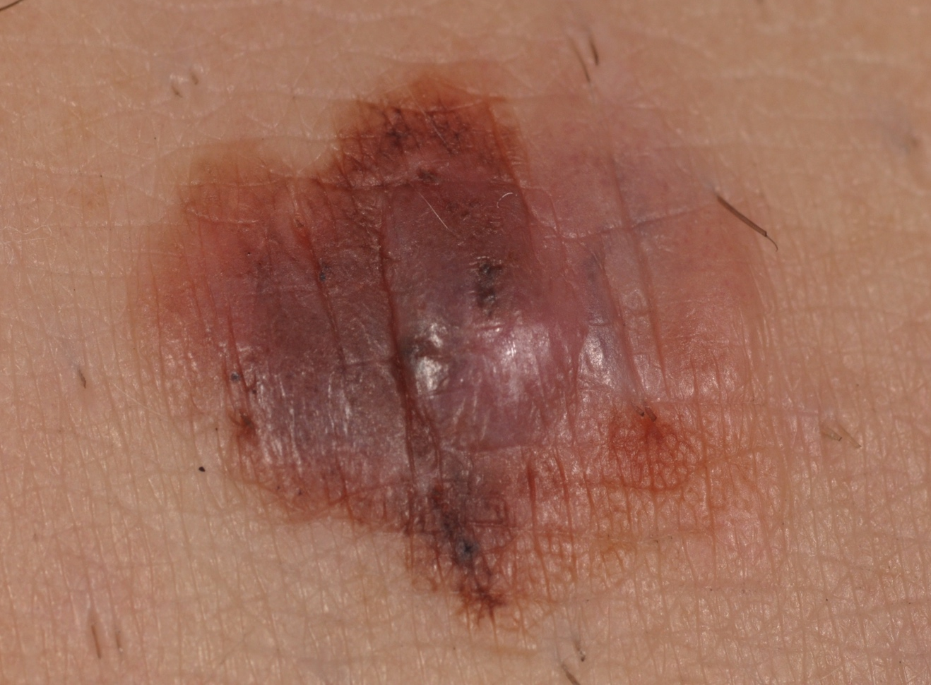
What is Melanoma?

Slide 2
Melanoma is the deadliest form of skin cancer
Melanoma originates in the cells of the skin that make pigment, called melanocytes.
Melanomas look like moles on the skin
When diagnosed early, melanoma is easily cured by simple outpatient surgical excision
If permitted to progress, melanomas that are less than an ½ inch across on the surface of the skin can spread (metastasize) and lead to death

Slide 3
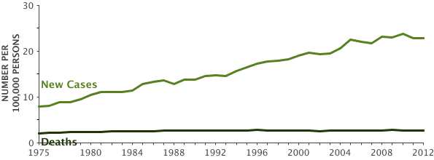
Melanoma is a big and growing problem
The number of people getting and dying of melanoma keeps growing
There are over 100,000 new cases of melanoma in the U.S. each year and over 9,000 melanoma deaths
With earlier detection, the majority of people diagnosed with melanoma can be cured

Slide 4
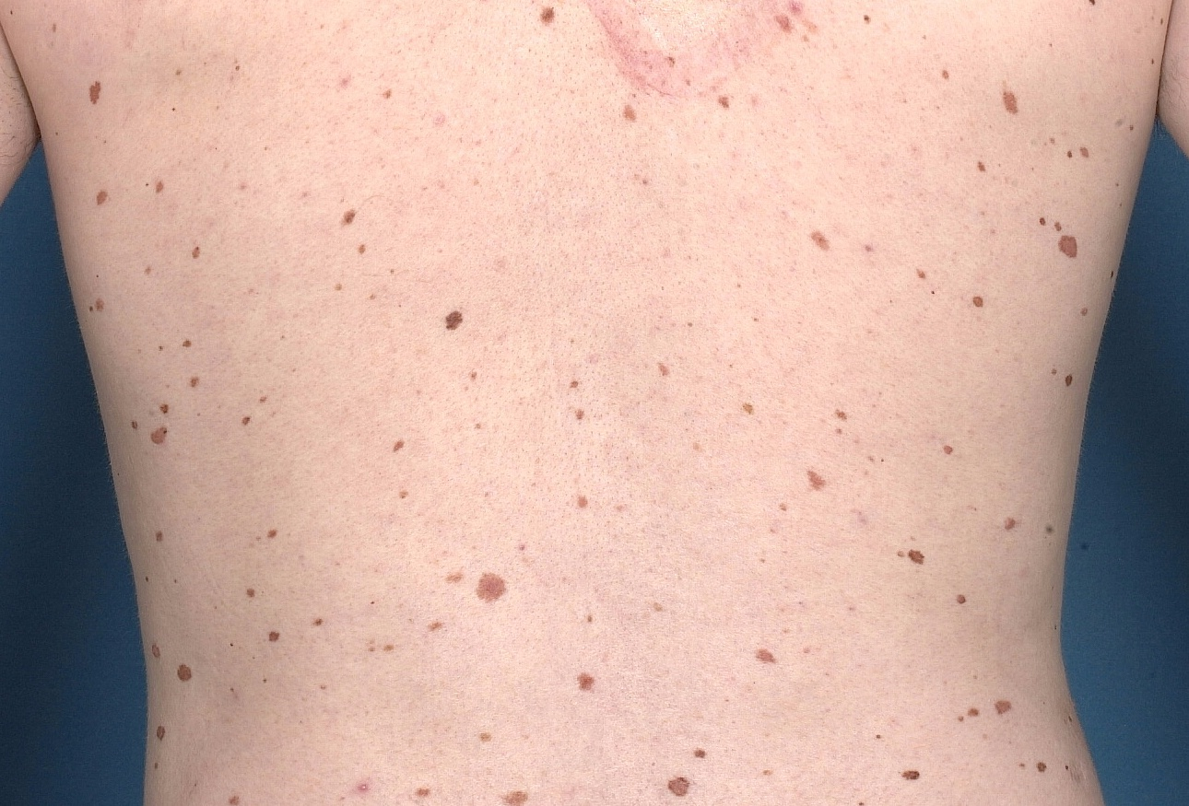
Discriminating melanoma from benign moles can be challenging- especially in patient with lots of moles and ‘atypical’ moles

Slide 5
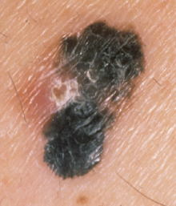
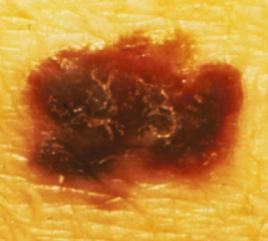
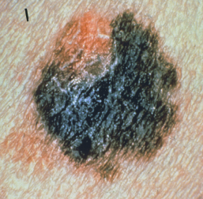
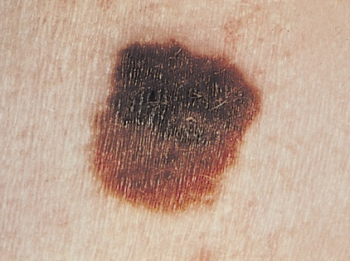
The ABCDEs of Clinical (i.e., simple naked eye examination) Melanoma Diagnosis
Asymmetry
One half of the lesion is shaped differently than the other
Border
The border of the lesion is irregular, blurred, or ragged
Color
Inconsistent pigmentation, with varying shades of brown and black
Diameter
>6mm, or a progressive change in size
Evolution
The history of change in the lesion
Photos courtesy of the American Cancer Society.
Notes:
Cutaneous melanoma is potentially one of the most easily diagnosed malignancies given the fact that the tumor can be directly visualized. The ABCD rule (asymmetry, border, color variation, diameter) is a widely accepted guideline for the diagnosis of melanoma,¹ and increased public awareness of these signs of disease has resulted in early diagnosis of the majority of melanomas.
It is also important to examine melanocytic lesions for changes in size, elevation, hue, scaling, itching, or bleeding—all of which are signs of melanoma. Other pigmented cutaneous lesions should be excluded, such as granulomas, basal cell carcinomas, melanocytic nevi, solar lentigines, ephilides, and seborrheic keratoses.^{1,4}
Any cutaneous lesion that raises suspicion in the physician’s mind or that is associated with an unacceptable degree of worry to the patient should be excised for histopathologic examination. A full-thickness biopsy into the subcutaneous tissue must be made to permit accurate staging. The typically used diagnostic procedure is an elliptical excisional biopsy with a 2-mm margin of normal skin.⁴
Rigel DS, Carucci JA. Malignant melanoma: prevention, early detection, and treatment in the 21st century. CA Cancer J Clin. 2000;50:215-236.
4. Lang PG. Current concepts in the management of patients with melanoma. Am J Clin Dermatol. 2002;3:401-426.

Slide 6
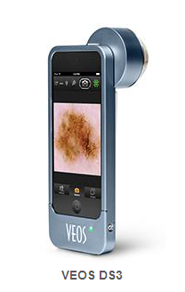
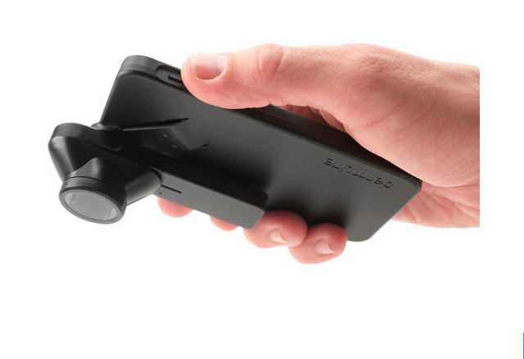
DERMOSCOPY is a digital technique that improves melanoma diagnosis

Slide 7
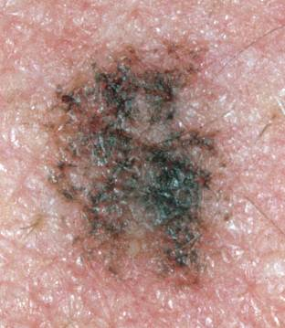
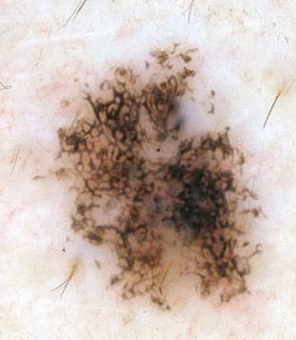
Dermoscopy permits visualization of features that are not evident on simple visual inspection
Clinical Image v. Dermoscopy image
For the same lesion

Slide 8
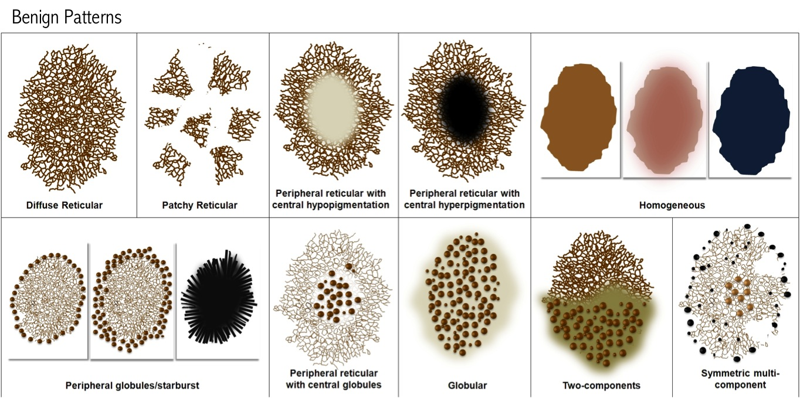
Benign lesions tend to have symmetric patterns of dermoscopic features

Slide 9
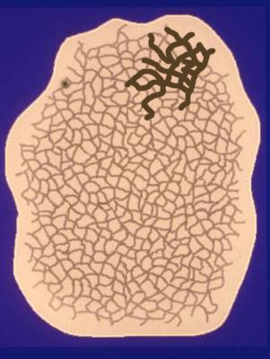
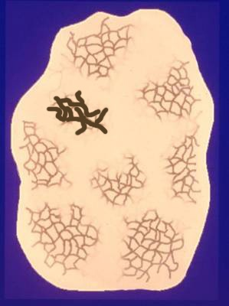
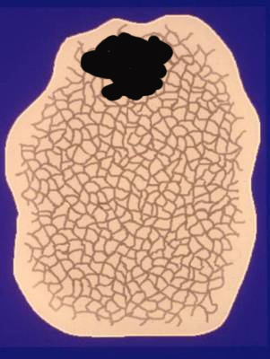
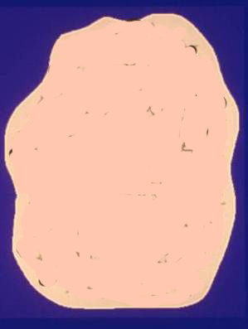
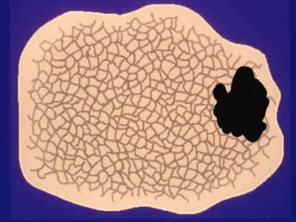
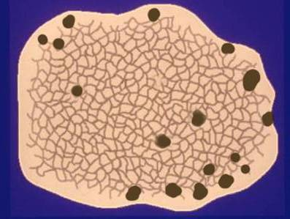
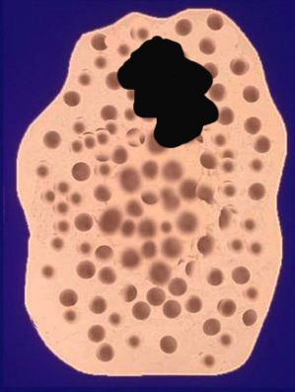
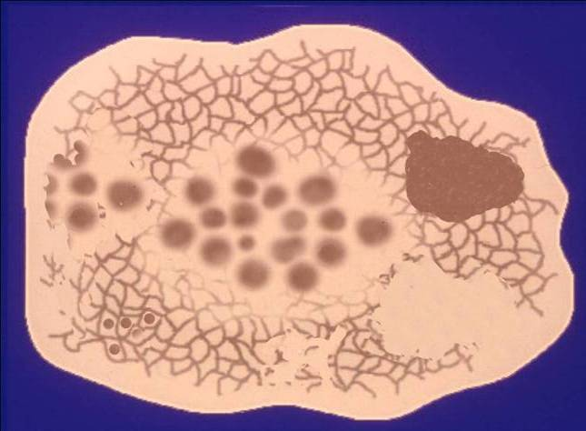
Melanomas tend to have asymmetric patterns of dermoscopic features

