Slide 1
Early Detection of Malignant and Pre-malignant
DNA Image Cytometry
Jianying Li

Slide 2
Outline
Understanding the data format and challenge
Proposing Expert Guided Data Cleaning and Reconstruction (ExGCRn)
Stretching the prediction models
Balancing between sensitivity and specificity
Future goals

Slide 3
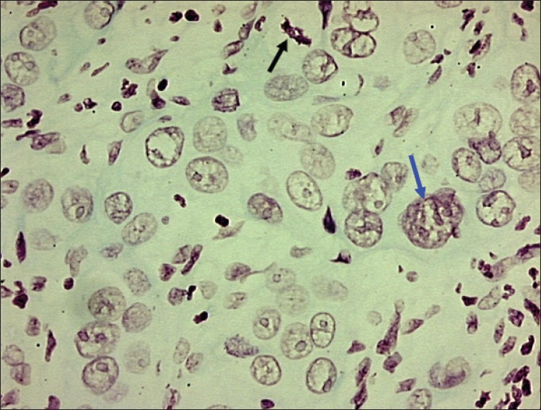
Photomicrograph of moderately well differentiated OSCC showing large tumor nucleus
with multiple prominent nucleoli (blue arrow) and abnormal mitotic figure (black arrow)
DB Nandini and RV Subramanyam, 2011, Nuclear features in oral squamous
cell carcinoma: A computer-assisted microscopic study, V.15:2, 177-181,JOMFP

Slide 4
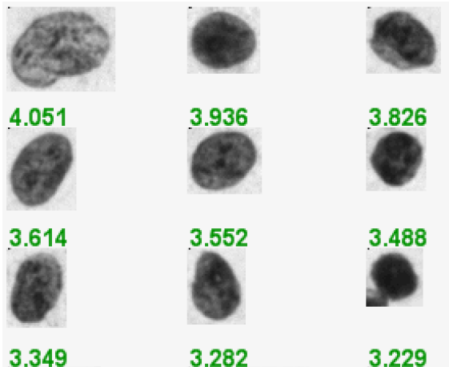
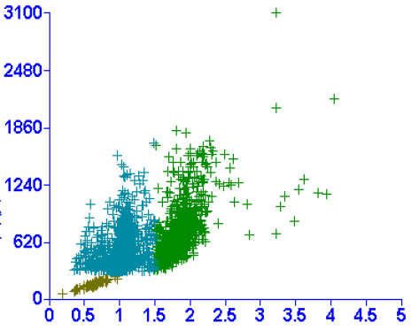
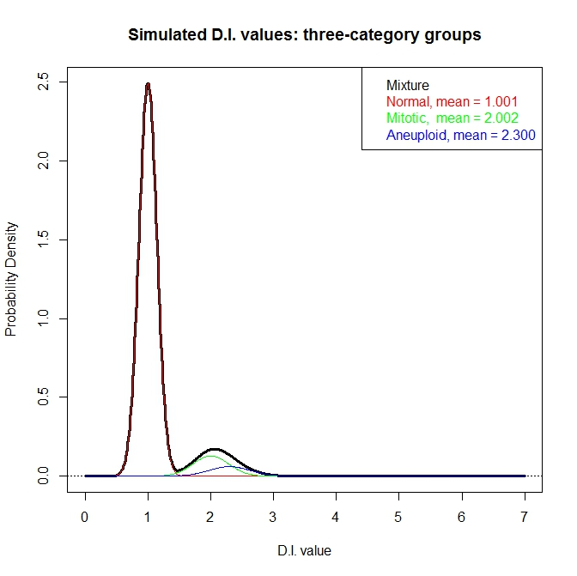
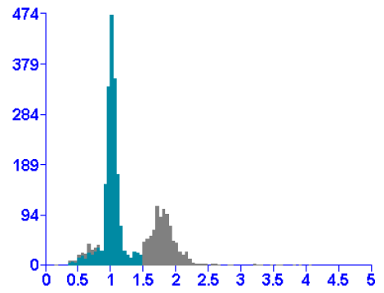
Need fix here
Notes:
Figure 1 DNA imaging data

Slide 5
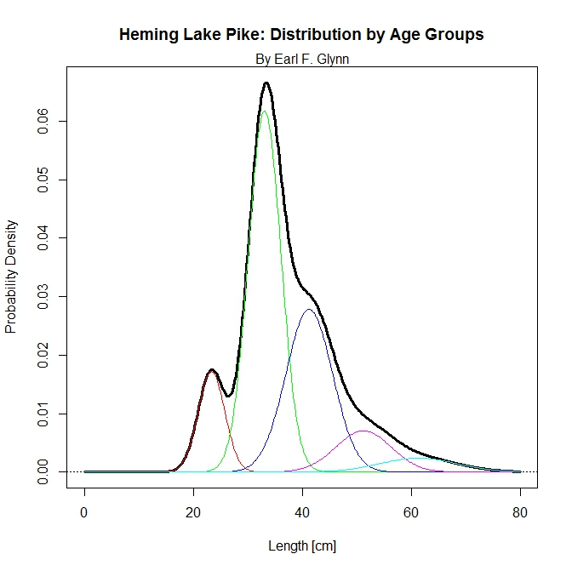
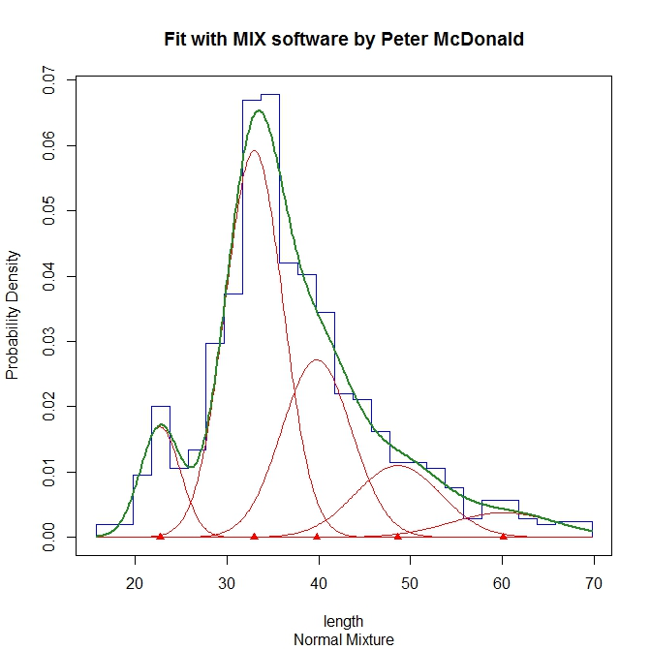
A well fit mixture of distributions

Slide 6
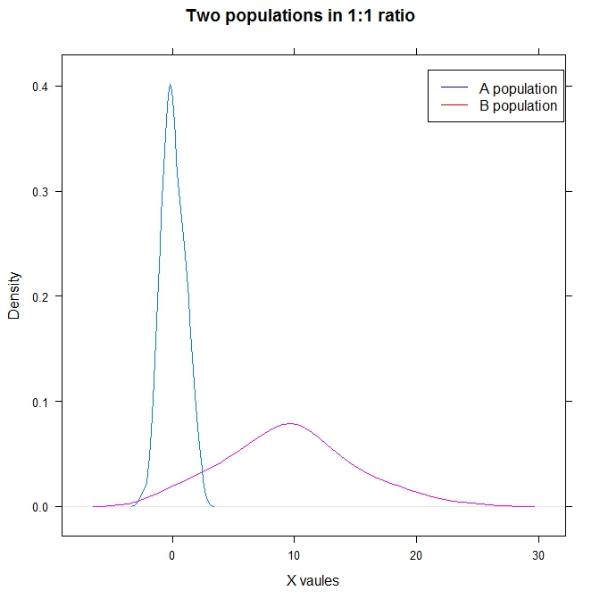

Slide 7
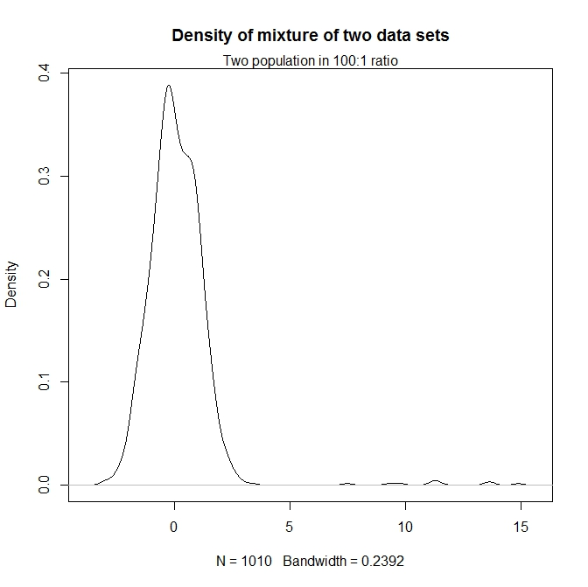

Slide 8
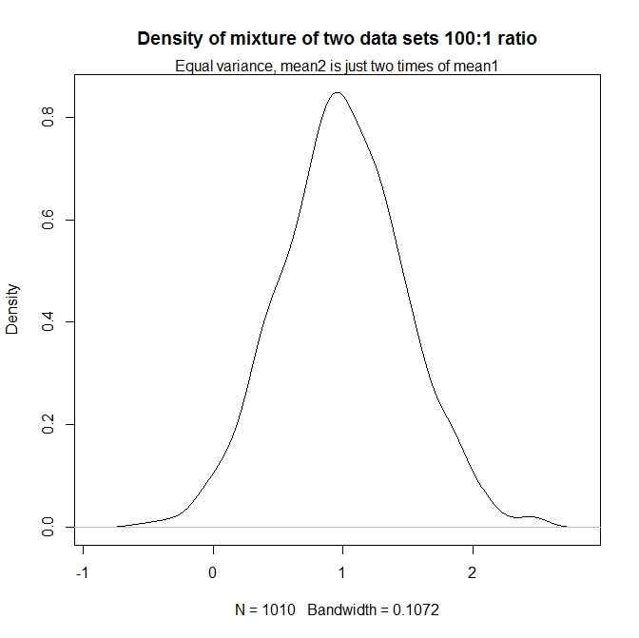
This is what we are dealing with

Slide 9
Challenge in the data analysis
Mixture of three cell populations
Normal cell population (diploid)
Mitotic cell population (4n)
Carcinoma (aneuploidy cell)
Two non-informative cell populations take the main density
Signal is largely washed out/saturated
Extreme challenge with “OLK” samples

Slide 10
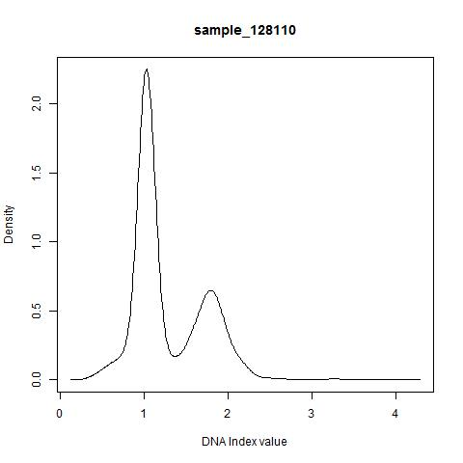
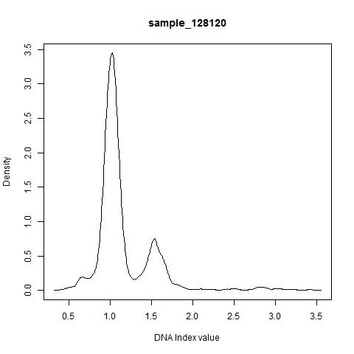
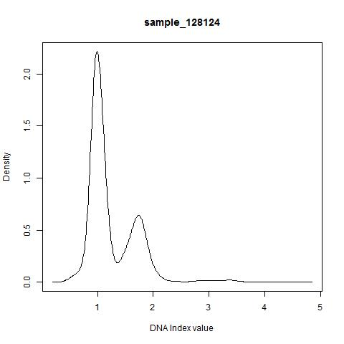
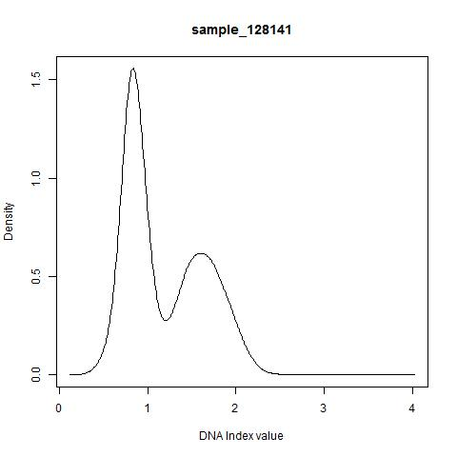

Slide 11
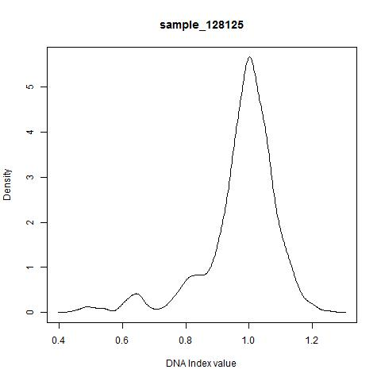
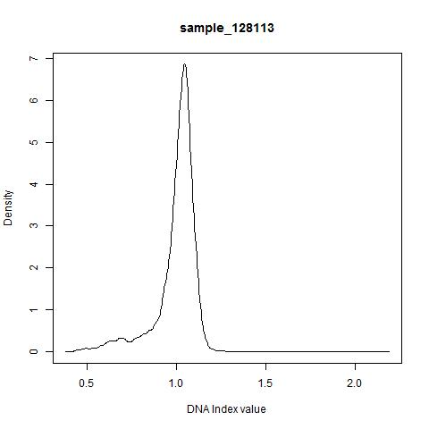
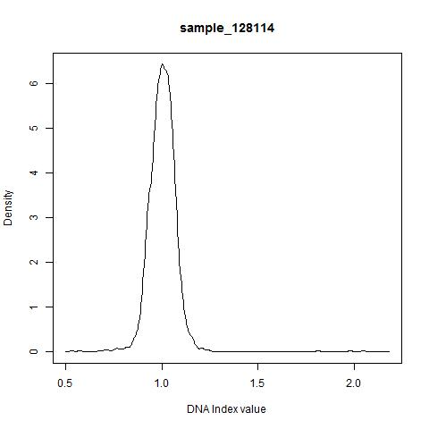
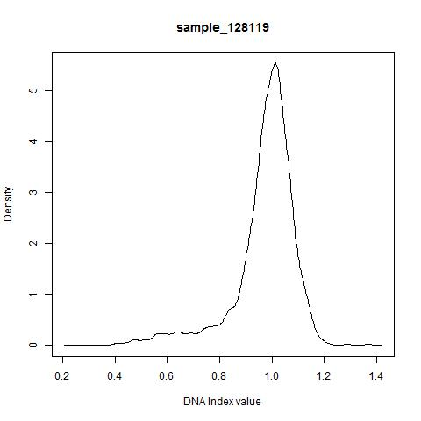

Slide 12
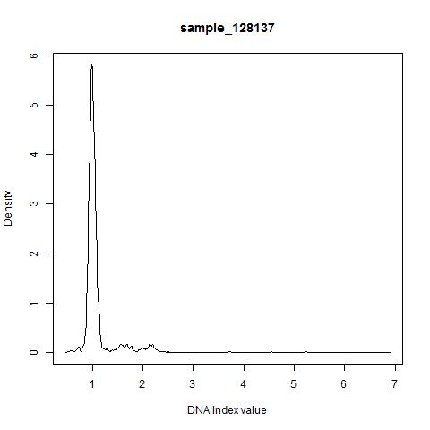
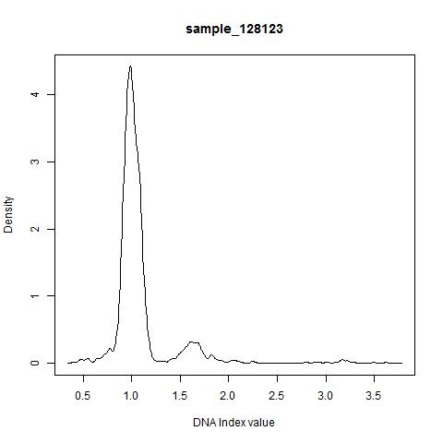
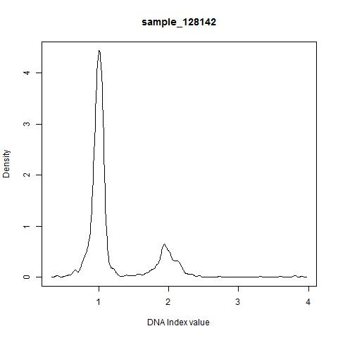
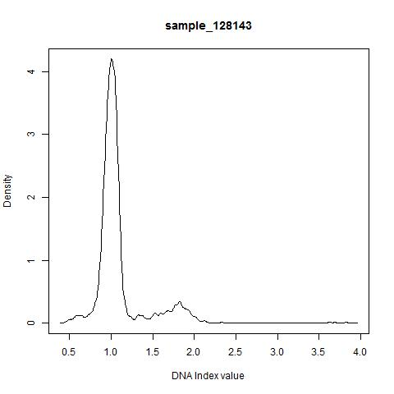

Slide 13
Expert Guided Data Cleaning and Reconstruction (ExGCRn)
Expert input
Param1: Threshold for aneuploidy D.I.
Param2: Mean D.I. value for mitotic cell population
Param3: Standard deviation for mitotic and aneuploidy cell populations
Param4: Ratio of normal cell (both normal and mitotic) vs. aneuploidy when three populations observed
Param5: Ratio of normal cell (both normal and mitotic) vs. aneuploidy when no aneuploidy population observed
Param6: Ratio of normal cell vs. mitotic population when no aneuploidy population observed

Slide 14
Expert Guided Data Cleaning and Reconstruction (ExGCRn) –cont.
Stripping the normal population
Step 1 Derive the probability density function with kernel density estimation smoothing
Step 2 Determine the mode of the normal cell population
Step 3
(a) Use the data to the left side of the mode
(b) Estimate the mean and standard deviation of the normal population
Step 4 Remove the data point to the left the mode
Step 5
(a) Find the symmetric subset of the data on the right of the mode
(b) Break the data on the right into equal n parts according to the KDE density
Foreach interval
Derive the theoretical number of data points
Randomly select candidate data points to be filtered
Recover missing data points due to rounding errors
End of foreach loop
Step 6 --> go back to step 1 and evaluate the stripping efficiency
If the first left most mode is less than the threshold
Redo step 2 – step 6
Else
Finish stripping the normal population
Compute the mean and standard deviation from the stripped first population only
Store number of data points filtered
Stripping the mitotic population
Follow similar steps in “stripping the normal population”, strip out the mitotic population
Compute the mean and standard deviation from the stripped first population only
Store number of data points filtered

Slide 15
Expert Guided Data Cleaning and Reconstruction (ExGCRn) –cont.
Data reconstruction
The reconstruction was handled according to the number of populations determined in the cleaning steps
Step 1 If three populations were determined, a cap of “8” was applied for the D.I. values
Step 2 Parameters either from the expert input or derived from the data itself were used
Step 3 A heuristic cumulated density function was derived and used to guide the “random sampling” of the data points
Step 4 The dataset was stretched/binned between [0, 8] on the D.I. axis.
The density within each bin will be recorded as the measurement of that “variable”
Any missing values were replaced with 0.00001

Slide 16
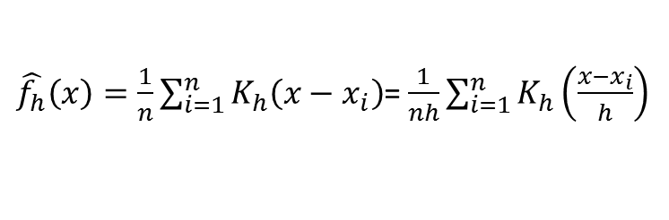
Kernel density estimation
Getting the estimated probability density function for unknown random variable
Where K(.) is the kernel normally
Uniform
Triangular
Normal
Etc.
Standard normal was used as the kernel
Smoothing approach
$\hat{f_{h}}\left(x\right)=\frac{1}{n}\sum_{i=1}^{n}{K_{h}\left({x−x}_{i}\right)}$= $\frac{1}{nh}\sum_{i=1}^{n}{K_{h}\left(\frac{{x−x}_{i}}{h}\right)}$

Slide 17
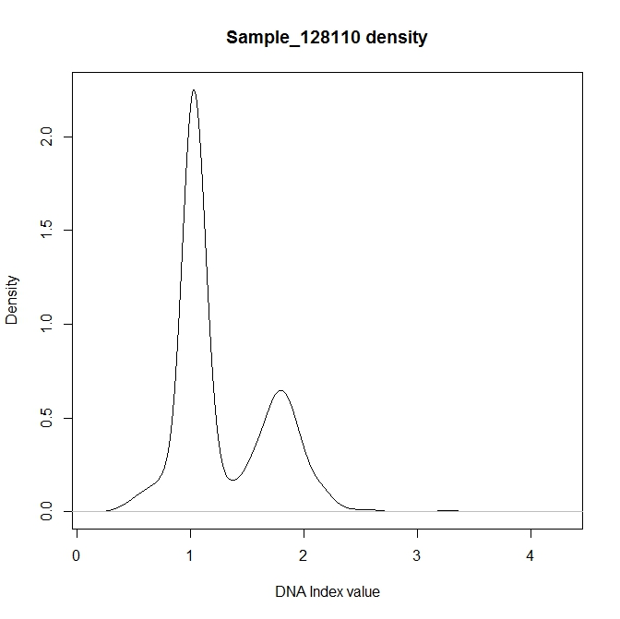
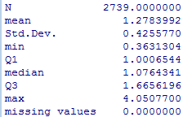
Alleviate the impact from the “normal” cell population

Slide 18
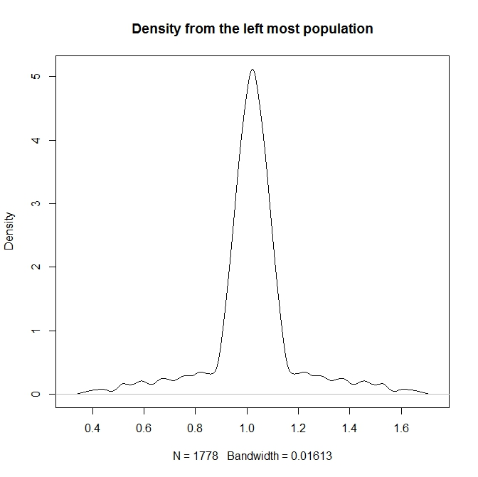
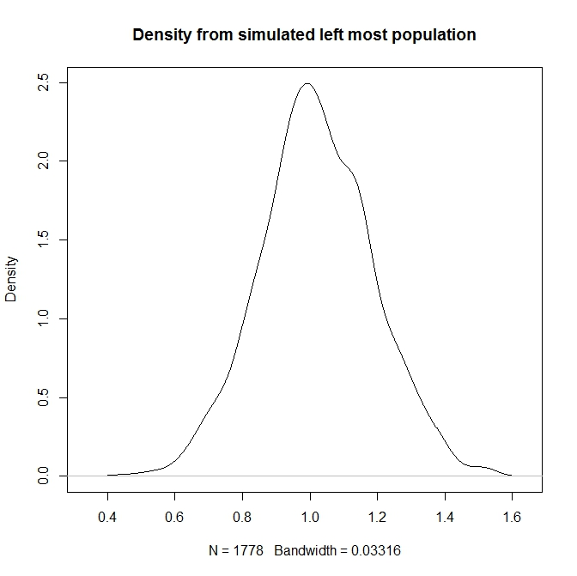
The left-most population

Slide 19
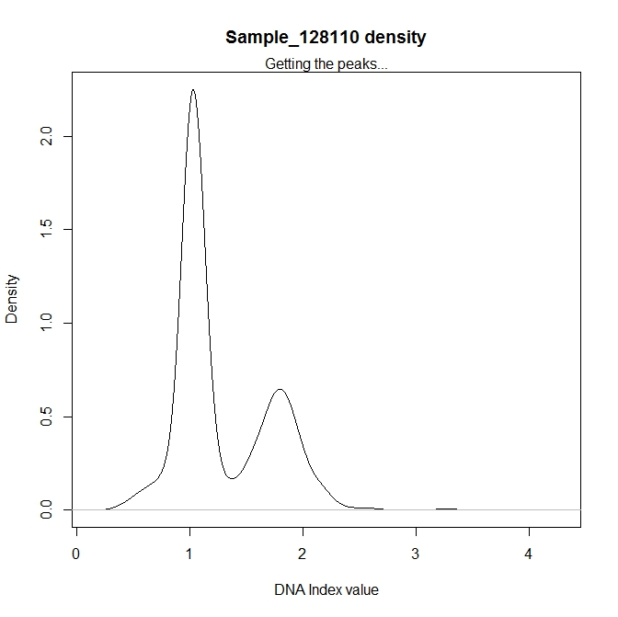
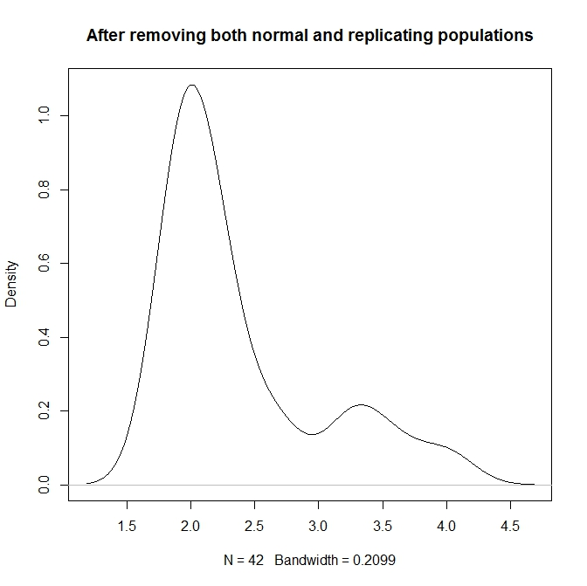
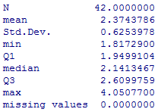
1.02
2.00
1.79
1788
3.33
3.25, 3.57, 3.99
Notes:
Figure 4 Data cleaning results from ExGCRn procedure

Slide 20
Predicting the clinical outcome
Newly formulated dataset (ExGCRn)
Four sets of parameter setting:
Expert guided summary statistics for mitotic and aneuploidy population
Sufficient weight provided when the aneuploidy population exists
Missing values imputation
Balance for mitotic population
Stretched statistical models
Support Vector Machine
K Nearest Neighbor
Random Forest
Neural Network
NaiiveBayes
All models built with Caret (an open source R package)
Comparing the prediction results
Clinical outcome and further implementation

Slide 21
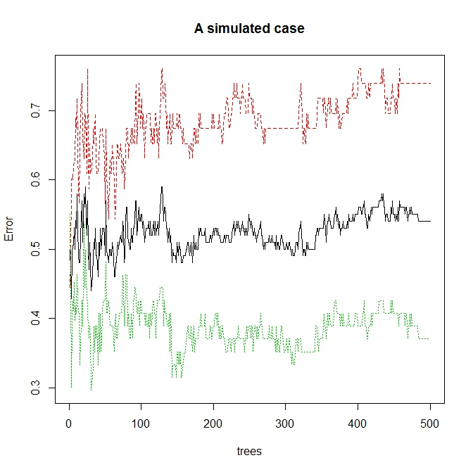
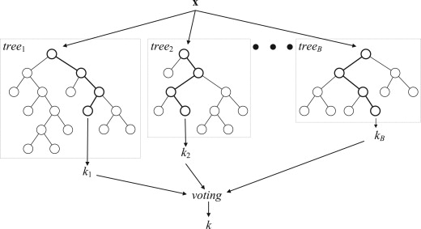
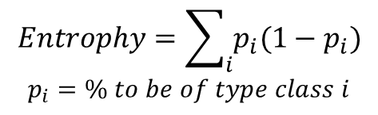
Random forest
$$Entrophy=\sum_{i}{p_{i}(1−p_{i})}$$
$$p_{i}=\% to be of type class i$$

Slide 22
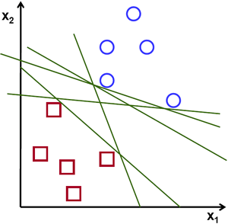
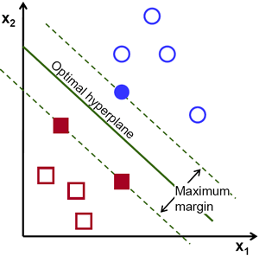
SVM – maximize the margin

Slide 23
Sensitivity
Classes | Class ratio(1)
 | SVM | NeuralNetwork | NaiveBayes | RandomForest | RegulatedRandomForest | knn | CANB
Normal | 0.7667 | 0.8333 | 0.8667 | 0.5333 | 0.7667 | 0.5333
OLK | 0.4583 | 0.2917 | 0.4167 | 0.5417 | 0.5 | 0.5
OSCC | 0.9259 | 0.8889 | 0 | 0.9259 | 0.9259 | 0.8519
Classes | Class ratio(2)
 | SVM | NeuralNetwork | NaiveBayes | RandomForest | RegulatedRandomForest | knn | CANB
Normal | 0.8 | 0.6333 | 0.9 | 0.6667 | 0.6333 | 0.8667
OLK | 0.4167 | 0.4167 | 0.375 | 0.5 | 0.5 | 0.125
OSCC | 0.9259 | 0.9259 | 0 | 0.9259 | 0.9259 | 0.9259
Classes | Class ratio(3)
 | SVM | NeuralNetwork | NaiveBayes | RandomForest | RegulatedRandomForest | knn | CANB
Normal | 0.6667 | 0.8667 | 0.8667 | 0.6 | 0.6 | 0.6
OLK | 0.4167 | 0.5 | 0.25 | 0.375 | 0.4583 | 0.375
OSCC | 1 | 0.963 | 0 | 0.9259 | 0.9259 | 0.9259
Classes | Class ratio(4)
 | SVM | NeuralNetwork | NaiveBayes | RandomForest | RegulatedRandomForest | knn | CANB
Normal | 0.6667 | 0.8667 | 0.8667 | 0.6 | 0.6 | 0.5
OLK | 0.4167 | 0.5 | 0.25 | 0.375 | 0.4583 | 0.375
OSCC | 1 | 0.963 | 0 | 0.9259 | 0.9259 | 0.9259

Slide 24
Specificity
Classes | Class ratio(1)
 | SVM | NeuralNetwork | NaiveBayes | RandomForest | RegularizedRandomForest | knn | CANB
Normal | 0.7451 | 0.6275 | 0.4706 | 0.7843 | 0.7647 | 0.7843
OLK | 0.8421 | 0.9123 | 0.6824 | 0.7193 | 0.7193 | 0.7018
OSCC | 1 | 0.9815 | 1 | 1 | 1 | 0.963
Classes | Class ratio(2)
 | SVM | NeuralNetwork | NaiveBayes | RandomForest | RegulatedRandomForest | knn | CANB
Normal | 0.7059 | 0.7255 | 0.549 | 0.7467 | 0.7647 | 0.6275
OLK | 0.8947 | 0.7719 | 0.614 | 0.7895 | 0.7719 | 0.9649
OSCC | 0.9815 | 1 | 1 | 1 | 1 | 0.8889
Classes | Class ratio(3)
 | SVM | NeuralNetwork | NaiveBayes | RandomForest | RegulatedRandomForest | knn | CANB
Normal | 0.7843 | 0.7451 | 0.451 | 0.7059 | 0.7451 | 0.7059
OLK | 0.8947 | 0.9474 | 0.6316 | 0.7719 | 0.7719 | 0.7719
OSCC | 0.8704 | 0.9815 | 1 | 0.9815 | 0.9815 | 0.9259
Classes | Class ratio(4)
 | SVM | NeuralNetwork | NaiveBayes | RandomForest | RegulatedRandomForest | knn | CANB
Normal | 0.7843 | 0.7451 | 0.451 | 0.7059 | 0.7451 | 0.7059
OLK | 0.8947 | 0.9474 | 0.6316 | 0.7719 | 0.7719 | 0.7719
OSCC | 0.8704 | 0.9815 | 1 | 0.9815 | 0.9815 | 0.9259

Slide 25
Prediction on OSCC
Sensitivity
Specificity

Slide 26
Prediction on normal
Sensitivity
Specificity

Slide 27
Prediction on OLK
Sensitivity
Specificity

Slide 28
Summary statistics
Group | Mean1 | SD1 | Mean2 | SD2 | Mean3 | SD3
normal1 | 0.96 | 0.155 | 1.961 | 0.22 | 2.321 | NA
normal2 | 0.878 | 0.178 | 1.675 | 0.361 | 2.355 | NA
normal3 | 0.925 | 0.153 | 1.642 | 0.349 | NA | NA
normal4 | 1.001 | 0.088 | 1.878 | 0.237 | NA | NA
normal5 | 0.96 | 0.133 | 1.778 | 0.267 | 2.307 | 0.009
normal6 | 0.974 | 0.1 | 1.588 | 0.32 | NA | NA
normal7 | 0.888 | 0.182 | 1.407 | 0.278 | 2.391 | 0.046
normal8 | 0.963 | 0.155 | 1.71 | 0.256 | NA | NA
normal9 | 0.995 | 0.085 | 1.434 | 0.294 | NA | NA
OLK1 | 0.751 | 0.137 | 1.578 | 0.172 | 3.675 | NA
OLK2 | 0.959 | 0.117 | 1.718 | 0.368 | NA | NA
OLK3 | 0.94 | 0.14 | 1.938 | 0.19 | NA | NA
OLK4 | 0.992 | 0.074 | 1.66 | 0.172 | 3.2 | 0.261
OLK5 | 0.912 | 0.155 | 1.818 | 0.272 | 3.366 | 0.808
OLK6 | 0.949 | 0.138 | 1.798 | 0.315 | 2.332 | NA
OLK7 | 0.95 | 0.129 | 1.771 | 0.27 | NA | NA
OLK8 | 0.925 | 0.15 | 1.696 | 0.358 | 2.42 | 0.057
OLK9 | 0.898 | 0.172 | 1.54 | 0.391 | 2.483 | NA
OSCC1 | 0.979 | 0.096 | 1.959 | 0.278 | 2.41 | 0.289
OSCC2 | 0.911 | 0.128 | 1.604 | 0.193 | 3.185 | 0.734
OSCC3 | 0.88 | 0.14 | 1.564 | 0.327 | 2.393 | 0.127
OSCC4 | 0.989 | 0.147 | 1.848 | 0.179 | 2.613 | 0.442
OSCC5 | 0.991 | 0.091 | 1.596 | 0.123 | 2.772 | 0.396
OSCC6 | 0.955 | 0.955 | 1.855 | 0.299 | 2.441 | 0.233
OSCC7 | 0.983 | 0.099 | 1.579 | 0.148 | 3.2 | 0.265
OSCC8 | 0.871 | 0.211 | 1.402 | 0.121 | 2.743 | 0.263
OSCC9 | 0.884 | 0.104 | 1.694 | 0.225 | 2.605 | 0.238

Slide 29
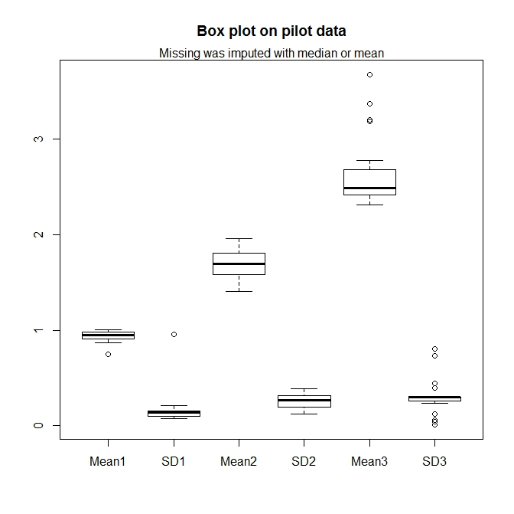

Slide 30
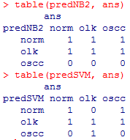
Two prediction model fitting
Data was randomly separated to training and testing (7:2)
Two models were tested
NaïveBayes
SVM
Prediction was applied on the testing data
And, the results

Slide 31
Prediction on OLK
Sensitivity
Specificity

Slide 32
Challenge in OLK prediction
Biologically, it could go both way
Could progress become OSCC eventually
Or, just fine
Need to address if predominately mitotic population
Statistically, it presents
An overlap situation
A mixture of three populations

Slide 33
On-going effort
Further pruning the parameters for data process
Tweaking the parameters for existing prediction
Explore two more statistical strategies handling overlapping cases
Hierarchical classifiers
Modified NaiveBayes method

Slide 34
Conclusion
Sufficient data cleaning and reconstruction with (ExGCRn)
Improved clinical endpoints prediction
On-going optimization for OLK patient
Time-line for research progress evaluated
Patent filing vs. publication

Slide 35
Future plan – tier 1
Extend dichotic to continuous endpoints
Extend single to multi-dimensional measurement
Extend to include enzymatic analysis
Extend cellular characteristics to molecular anchoring
Incorporation of molecular information
Gene expression profiling
Epigenetic evidences

Slide 36
Future plan – tier 2
Extend to a database driven approach
Relational data base for data storage and management
Prediction model optimization
Analytical feedback adjustment
Extend to an integrated system
Imaging data IO
Desktop GUI application
Extend prediction endpoints to clinical inferences
Extend statistic modeling to clinical protocol
Extend research to clinical standard
Extent to an automated/standardized reporting

Slide 37
Future plan – tier 3
Leveraging molecular biology and NGS platform
Empowering the patient
Moving toward the standardization
Clinical implementation
Recommendation of further lab analysis
Recommendation of clinical follow-up
Recommendation of therapeutically planning
Extending from static to mobile

Slide 38
Future plan – tier 4
Promote a GMP equivalent analytical protocol
Samples collection
Sample analysis
Data acquisition
Data analysis
Clinical reporting system

Slide 39

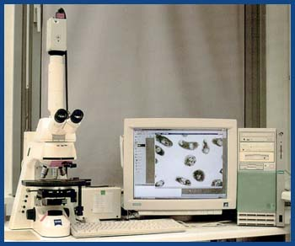
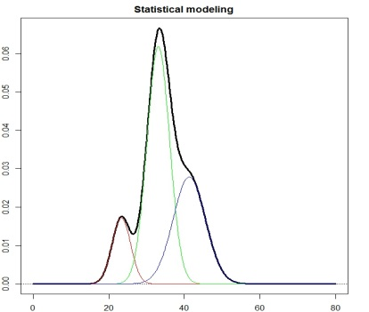
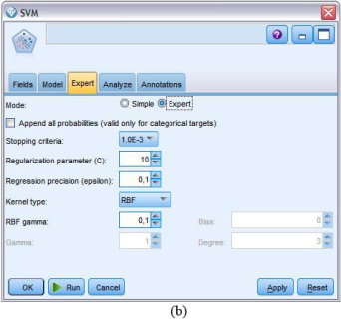

Raw dataDB
Feedback system
Model optimization

Slide 40
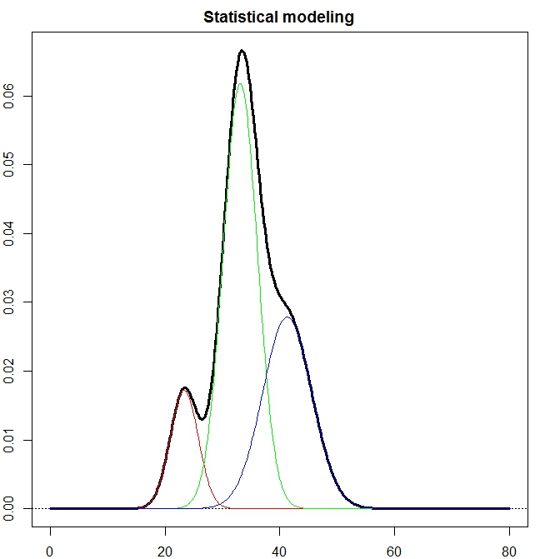


Slide 41
Extra slides here and on

Slide 42
Theoretical slides one or two

Slide 44
Objectives
Understanding and unveiling the biological mechanism of oral squamous cell carcinoma
Leveraging nuclei stain imaging technology (Feulgen staining)
Extracting the determining digitized information
Developing data processing protocol
Building predicting model for detecting abnormal cell dividing – cancer diagnosis
Establishing the standard for oral cancer early diagnosis

Slide 45
Our hurdle
Too much information from “normal” cluster
Possible to detect the “mitotic” stage
Impossible to detect “aneuploidy” stage
Need to strip out the “normal” information first, but how?
Don’t know
Don’t know
Don’t know

Slide 46
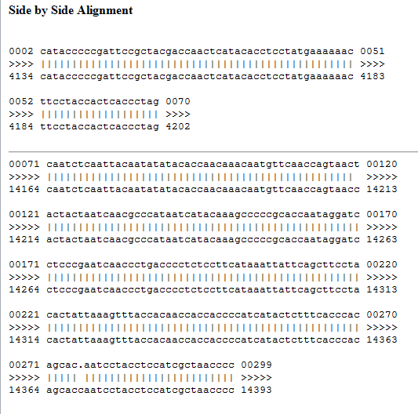
Deletion is clearly shown

Slide 47
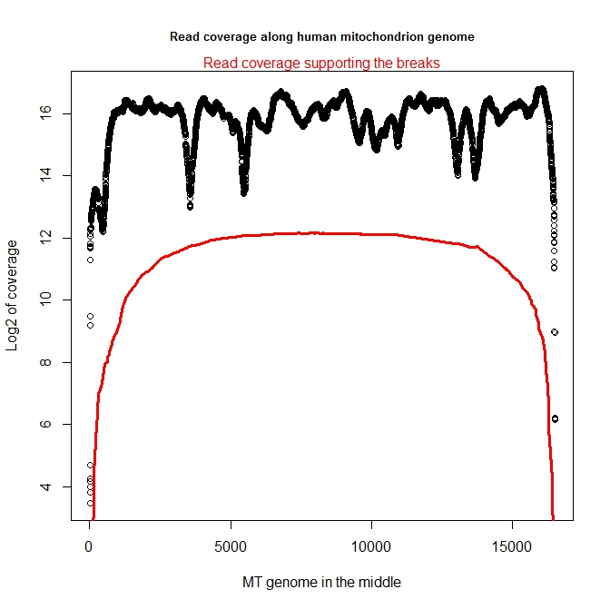
5-7%

Slide 48
Need a work flow chart

Slide 49
The real challenge
Predication on OLK suffers from
Balance between sensitivity and specificity

