Slide 1
Mixture of Gaussian distribution
Simulating D.I. values

Slide 2
Objectives
Understanding and unveiling the biological mechanism of oral squamous cell carcinoma
Leveraging nuclei stain imaging technology (Feulgen staining)
Extracting the determining digitized information
Developing data processing protocol
Building predicting model for detecting abnormal cell dividing – cancer diagnosis
Establishing the standard for oral cancer early diagnosis

Slide 3
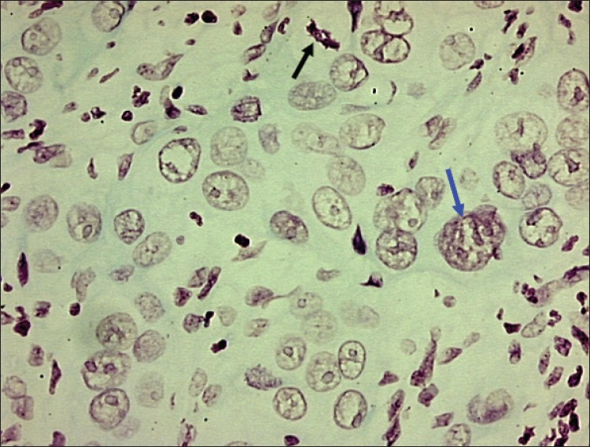
Photomicrograph of moderately well differentiated OSCC showing large tumor nucleus
with multiple prominent nucleoli (blue arrow) and abnormal mitotic figure (black arrow)
DB Nandini and RV Subramanyam, 2011, Nuclear features in oral squamous
cell carcinoma: A computer-assisted microscopic study, V.15:2, 177-181,JOMFP

Slide 4

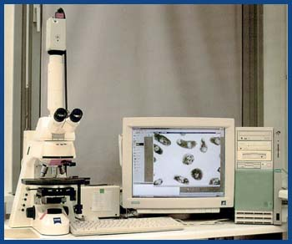
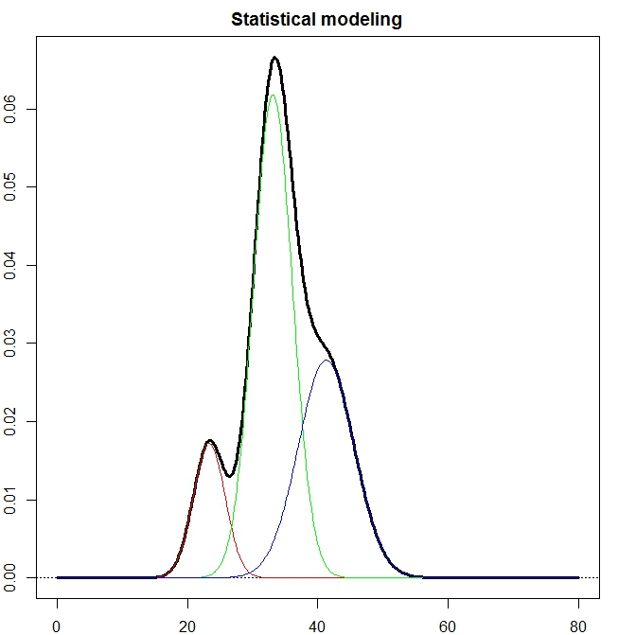
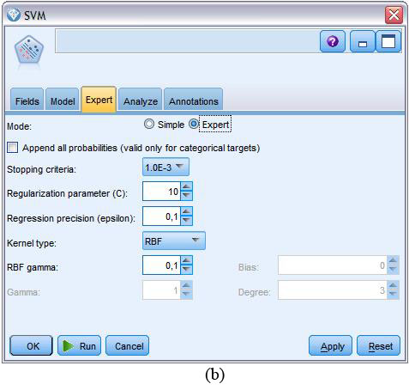

Raw dataDB

Slide 6
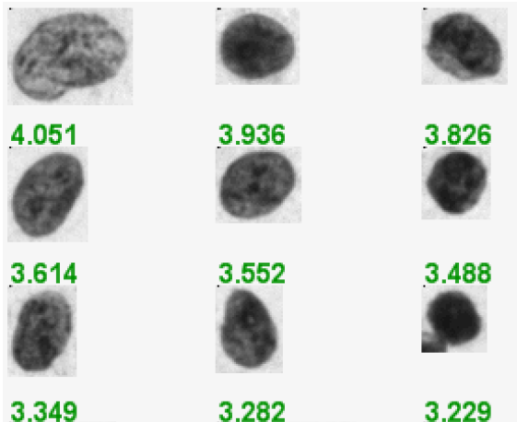
Abnormal nucleus image (D.I. value)
Papanicolaou (Pap) smears and nucleus was stained with Feulgan stain

Slide 7
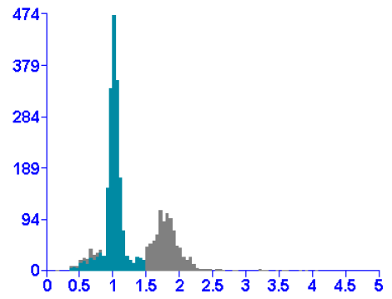
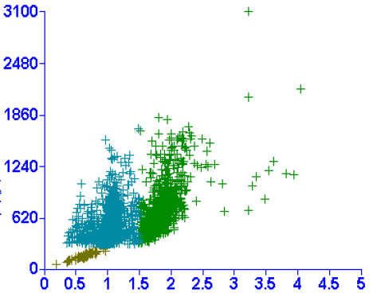
Cell population distribution

Slide 8
Summary statistics
Group | Mean1 | SD1 | Mean2 | SD2 | Mean3 | SD3
normal1 | 0.96 | 0.155 | 1.961 | 0.22 | 2.321 | NA
normal2 | 0.878 | 0.178 | 1.675 | 0.361 | 2.355 | NA
normal3 | 0.925 | 0.153 | 1.642 | 0.349 | NA | NA
normal4 | 1.001 | 0.088 | 1.878 | 0.237 | NA | NA
normal5 | 0.96 | 0.133 | 1.778 | 0.267 | 2.307 | 0.009
normal6 | 0.974 | 0.1 | 1.588 | 0.32 | NA | NA
normal7 | 0.888 | 0.182 | 1.407 | 0.278 | 2.391 | 0.046
normal8 | 0.963 | 0.155 | 1.71 | 0.256 | NA | NA
normal9 | 0.995 | 0.085 | 1.434 | 0.294 | NA | NA
OLK1 | 0.751 | 0.137 | 1.578 | 0.172 | 3.675 | NA
OLK2 | 0.959 | 0.117 | 1.718 | 0.368 | NA | NA
OLK3 | 0.94 | 0.14 | 1.938 | 0.19 | NA | NA
OLK4 | 0.992 | 0.074 | 1.66 | 0.172 | 3.2 | 0.261
OLK5 | 0.912 | 0.155 | 1.818 | 0.272 | 3.366 | 0.808
OLK6 | 0.949 | 0.138 | 1.798 | 0.315 | 2.332 | NA
OLK7 | 0.95 | 0.129 | 1.771 | 0.27 | NA | NA
OLK8 | 0.925 | 0.15 | 1.696 | 0.358 | 2.42 | 0.057
OLK9 | 0.898 | 0.172 | 1.54 | 0.391 | 2.483 | NA
OSCC1 | 0.979 | 0.096 | 1.959 | 0.278 | 2.41 | 0.289
OSCC2 | 0.911 | 0.128 | 1.604 | 0.193 | 3.185 | 0.734
OSCC3 | 0.88 | 0.14 | 1.564 | 0.327 | 2.393 | 0.127
OSCC4 | 0.989 | 0.147 | 1.848 | 0.179 | 2.613 | 0.442
OSCC5 | 0.991 | 0.091 | 1.596 | 0.123 | 2.772 | 0.396
OSCC6 | 0.955 | 0.955 | 1.855 | 0.299 | 2.441 | 0.233
OSCC7 | 0.983 | 0.099 | 1.579 | 0.148 | 3.2 | 0.265
OSCC8 | 0.871 | 0.211 | 1.402 | 0.121 | 2.743 | 0.263
OSCC9 | 0.884 | 0.104 | 1.694 | 0.225 | 2.605 | 0.238

Slide 9
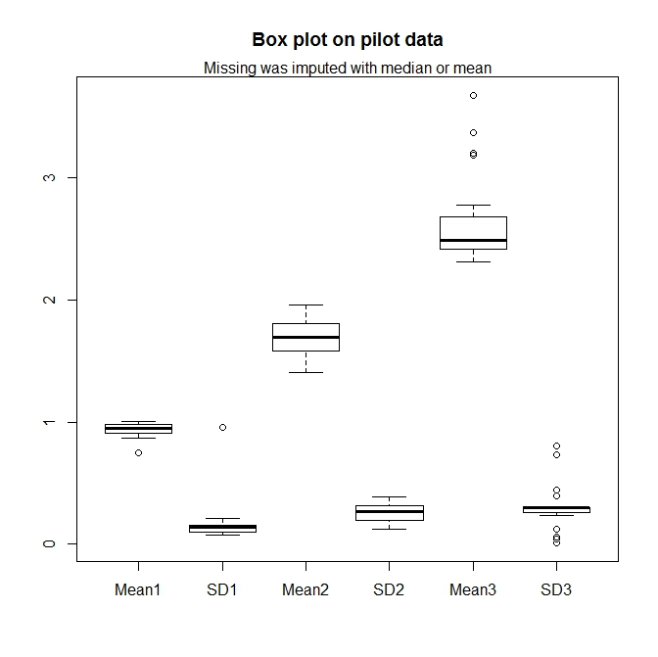

Slide 10
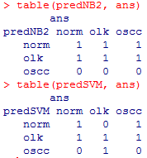
Two prediction model fitting
Data was randomly separated to training and testing (7:2)
Two models were tested
NaïveBayes
SVM
Prediction was applied on the testing data
And, the results

Slide 11
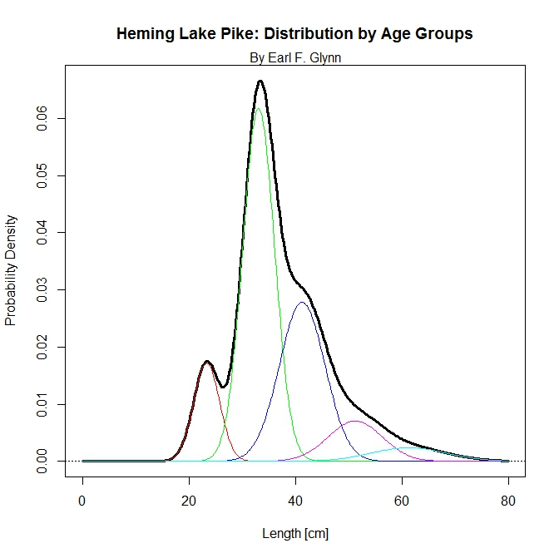
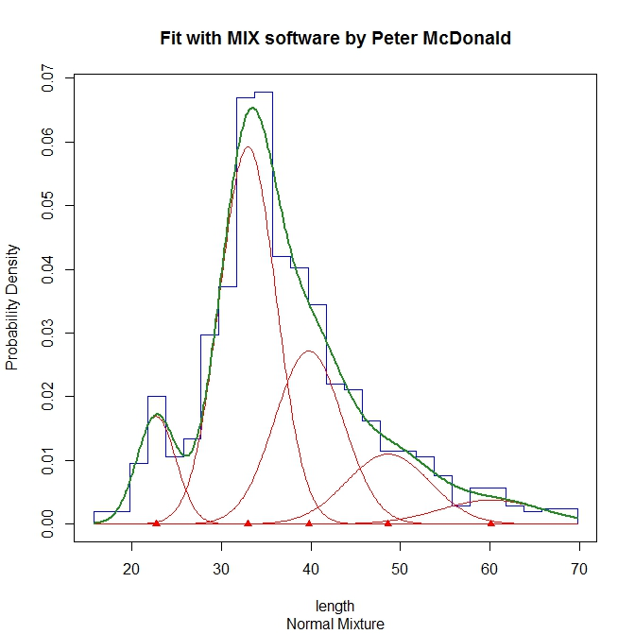
Mixture of five group data

Slide 12
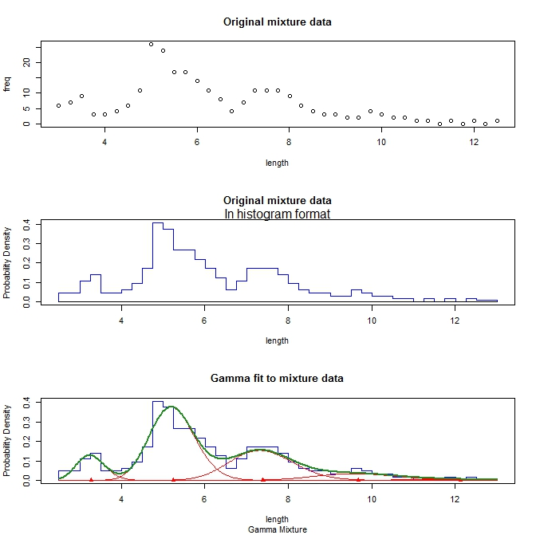

Slide 13
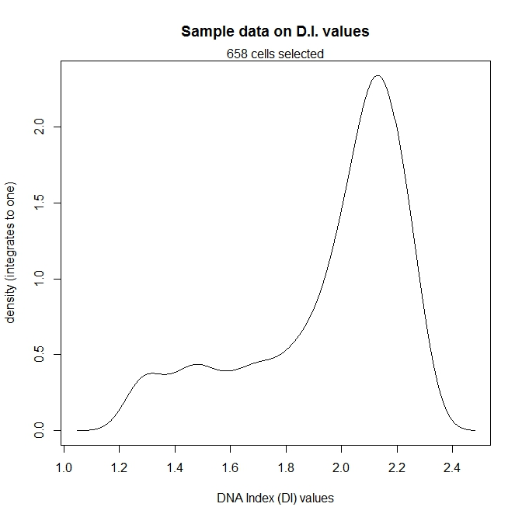
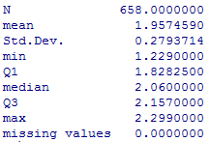
One sample data

Slide 14
Our first trial – step one
Three basic clusters of cell populations
D.I. value: 0.9 – 1.249
D.I. value: 1.250 – 2.299
D.I. value: > 2.300
Assuming equal C.V. across three populations, and estimated from “normal sample”:
Three means: 1.001, 2.002, 3.003

Slide 15
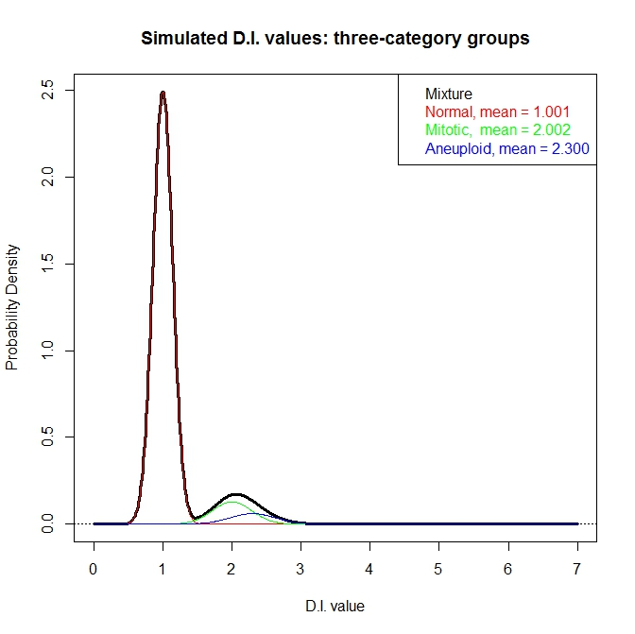

Slide 16
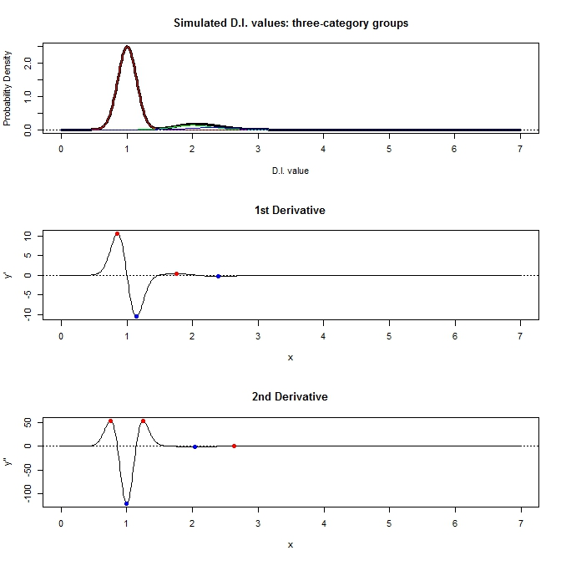

Slide 17
Our hurdle
Too much information from “normal” cluster
Possible to detect the “mitotic” stage
Impossible to detect “aneuploidy” stage
Need to strip out the “normal” information first, but how?
Don’t know
Don’t know
Don’t know

Slide 18
On-going effort and future goal
Get sufficient summary statistics from ten of thousands cells (i.e. D.I. values)
Evaluating the summary statistics
Reflect the mixture of distribution
Robust enough (enough information) to differentiation cell population
Capture cell population characteristics
Building the prediction model
Assess model performance
Provide accurate diagnosis guidance
Constantly improve the model

Slide 19
Raw dataDB

