Slide 1
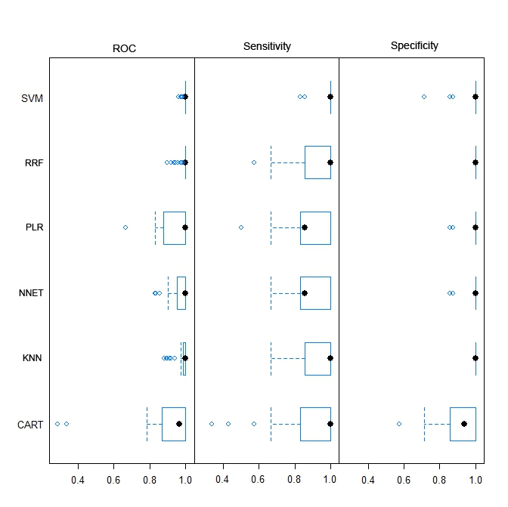
Figure 4
Liu, et al.

Slide 2
