Slide 1
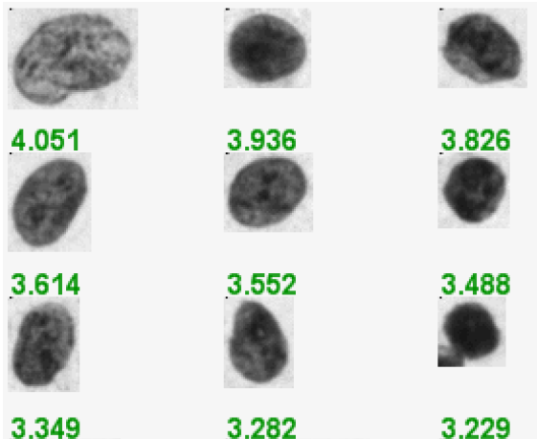
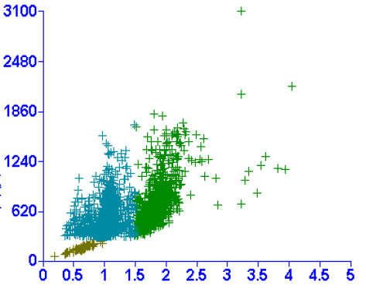
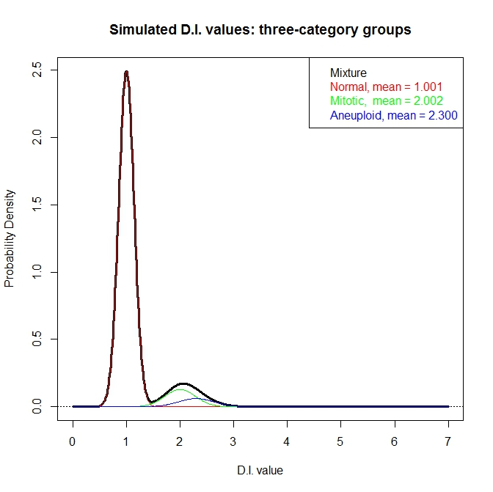
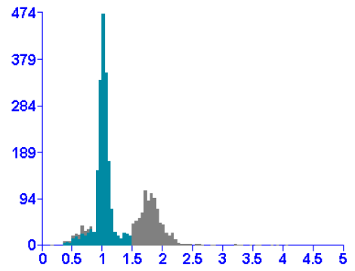
Notes:
Figure 1 DNA imaging data

Slide 2
Data reconstruction workflow

Slide 3
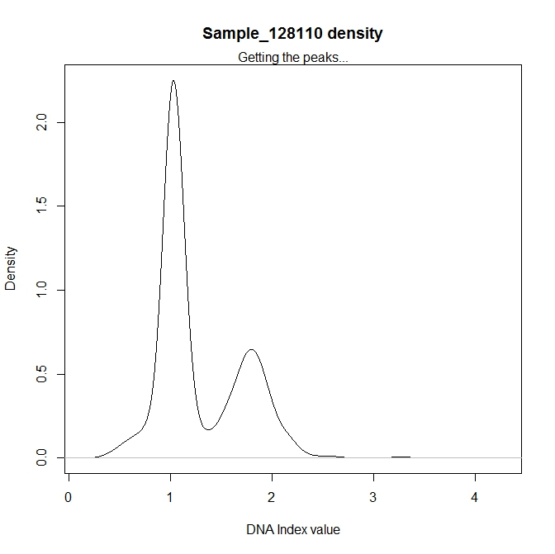
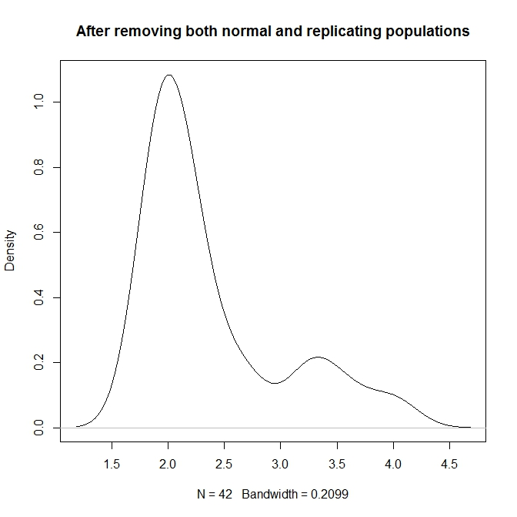
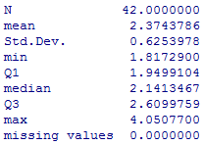
1.02
2.00
1.79
1788
3.33
3.25, 3.57, 3.99
Notes:
Figure 4 Data cleaning results from ExGCRn procedure

Slide 4
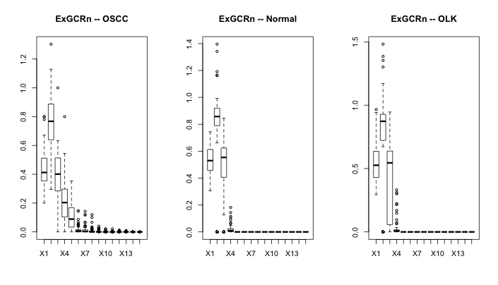

Slide 5
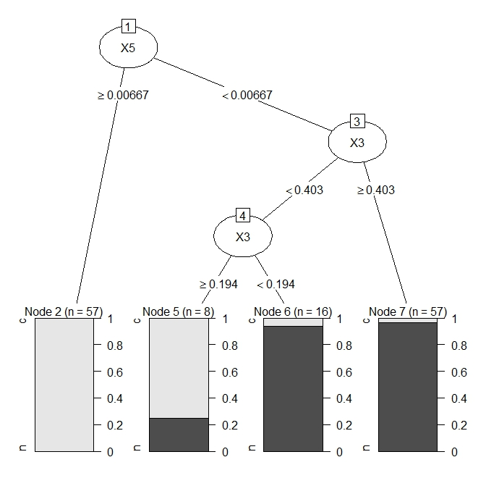
Notes:
Variables in rpart…

Slide 6
