Slide 1
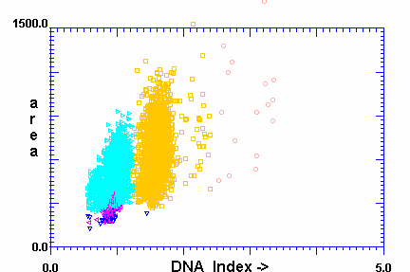
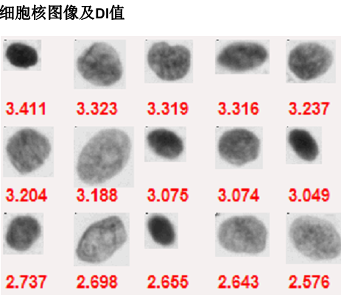
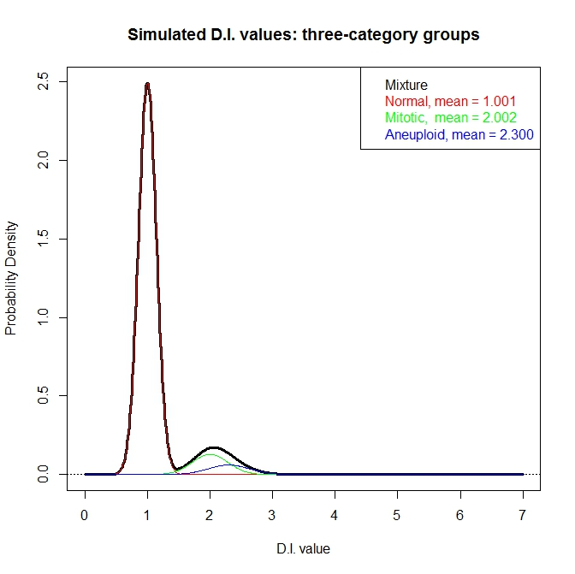
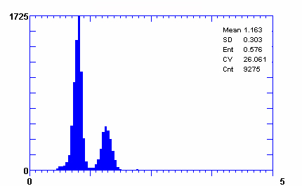
Figure 1
Liu, et al.
A
B
C
D
Notes:
Figure 1 DNA imaging data

Slide 2
Figure 2
Liu, et al.
D.I. values
Identification of candidate peaks in the distribution density
Extraction of the diploid cell population
Expert-guided
data transformation and reconstruction (EdTAR)
Extraction of the tetraploid cell population
Isolation of the aneuploid cell population (if present)
Reconstruction of data of all cell populations
Calculation of Oral Cancer Risk Index (OCRI)

Slide 3
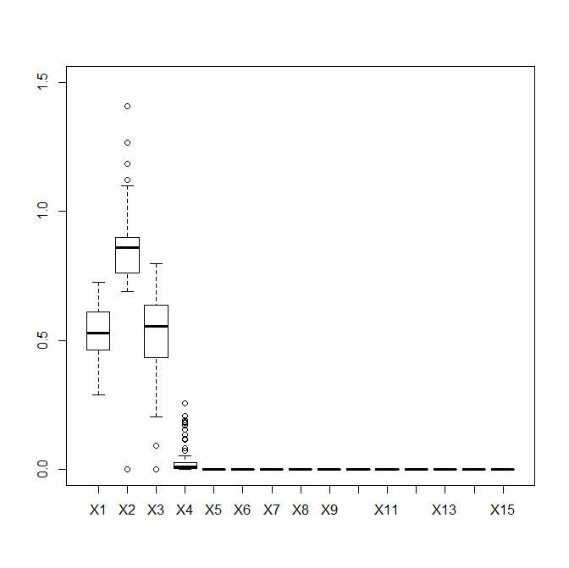
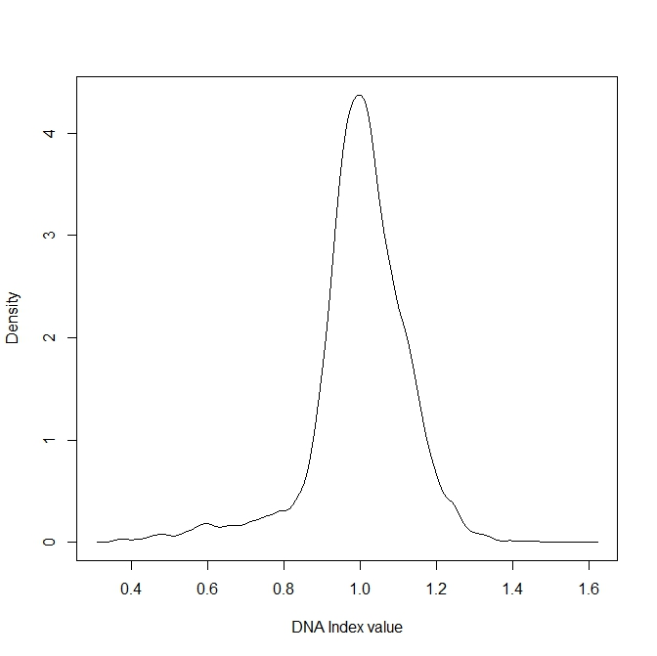
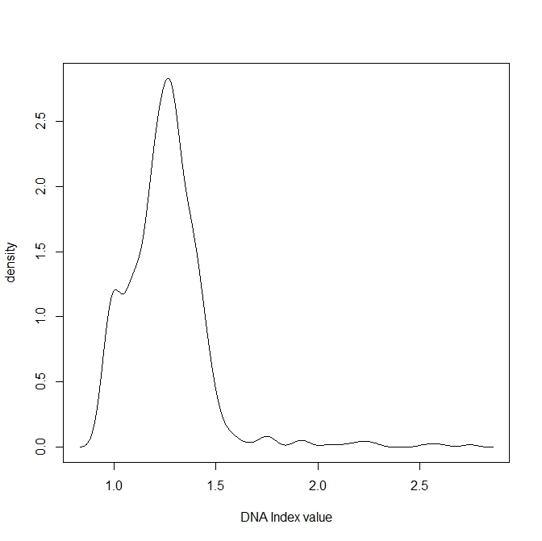
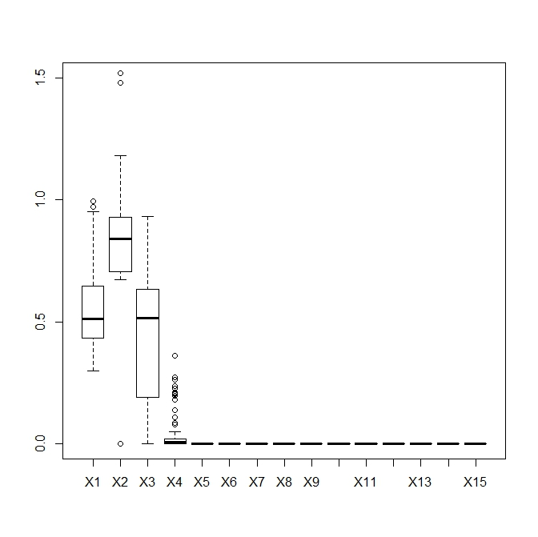
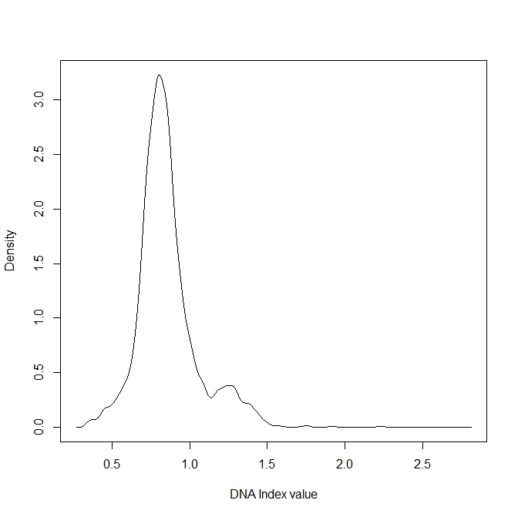
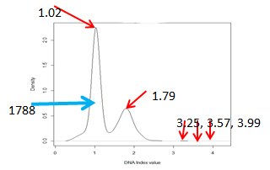
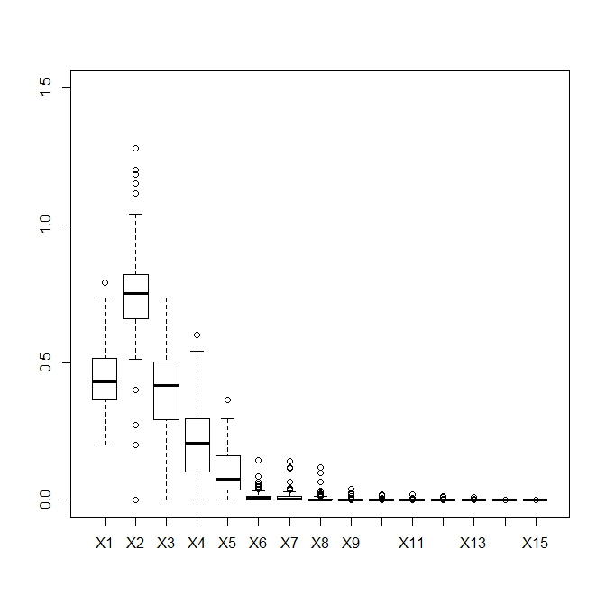
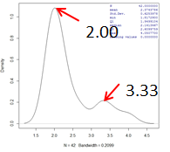
Figure 3
Liu, et al.
C
A
B
0.995
0.995
Normal
0.594
0.594
D
E
F
0.798
1.25
OLK
1.25
3590
1.75
2.22
1.75
2.22
2.74
2.74
G
H
I
OSCC
Before EdTAR
Revealing signals
After EdTAR

Slide 4
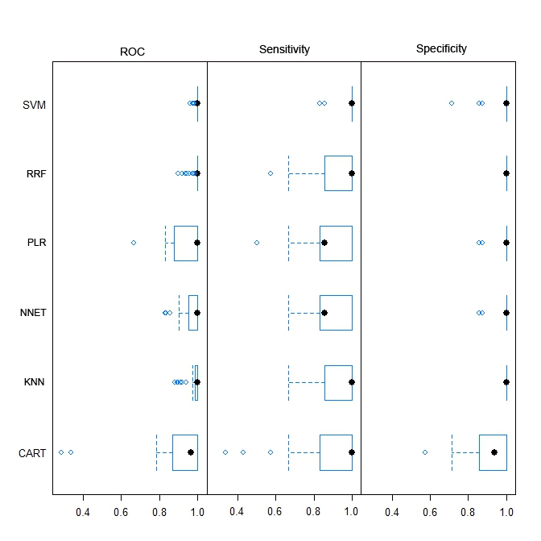
Figure 4
Liu, et al.

Slide 5
Figure 5
Liu, et al.

Slide 6
Figure 6
Liu, et al.
Case 128141
before EdTAR
after EdTAR
临床病损的照片（取脱落细胞时)
H&E病理图（取脱落细胞时）
临床病损的照片(肿瘤发生后)
H&E病理图（肿瘤发生后）
A
B
C
D
E
F

Slide 7
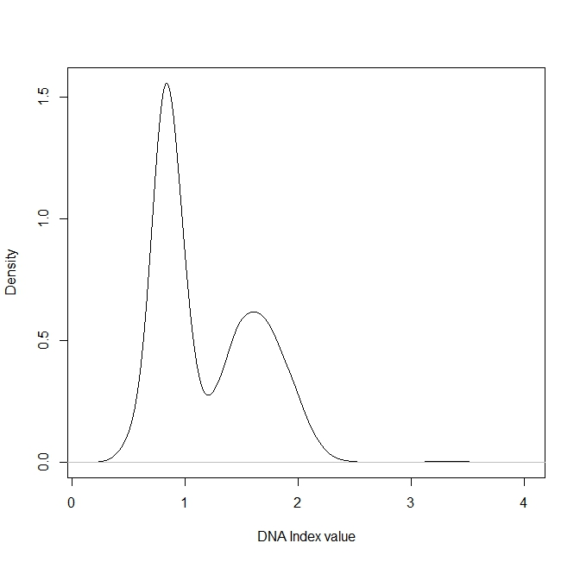

Figure 6
Liu, et al.
0.831
1.60
1.59
2472
2472
2.82
2.82
3.22
3.45
3.18
3.25
3.48
3.76
3.76
B
A

