Slide 1
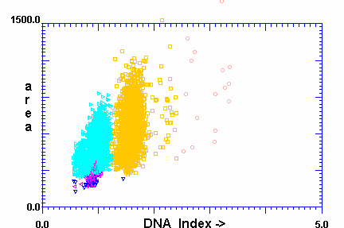
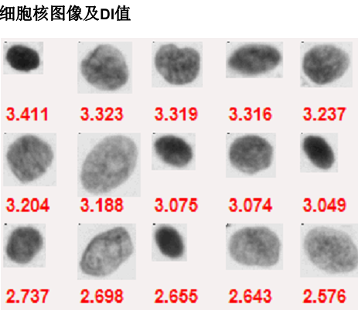
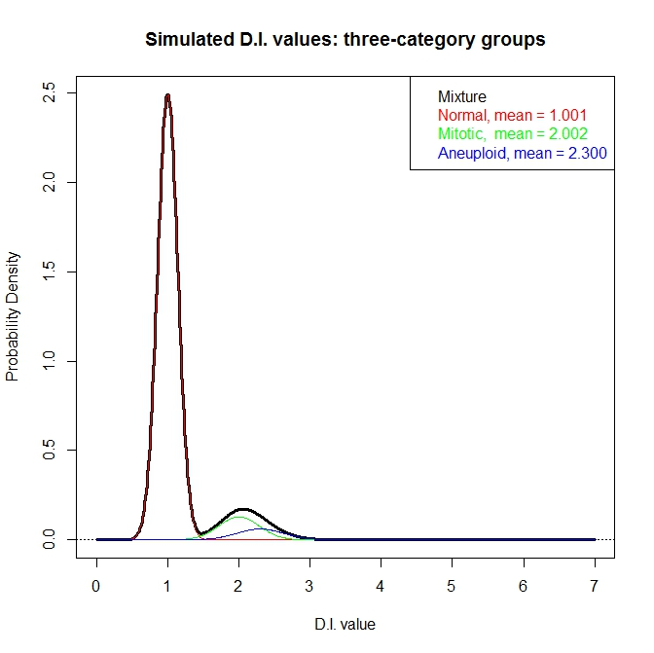
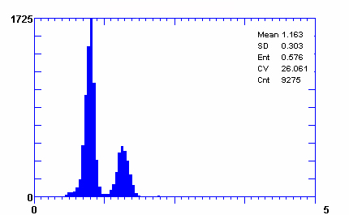
Figure 1
Liu, et al.
A
B
C
D
Notes:
Figure 1 DNA imaging data

Slide 2
Figure 2
Liu, et al.
D.I. values
Identification of candidate peaks in the distribution density
Extraction of the diploid cell population
Expert-guided
data transformation and reconstruction (EdTAR)
Extraction of the tetraploid cell population
Isolation of the aneuploid cell population (if present)
Reconstruction of data of all cell populations
Calculation of Oral Cancer Risk Index (OCRI)

Slide 3
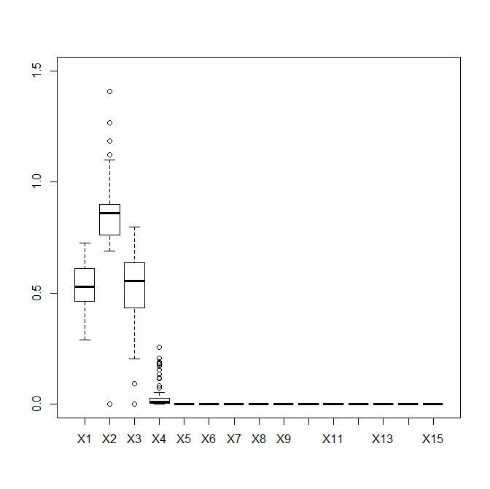
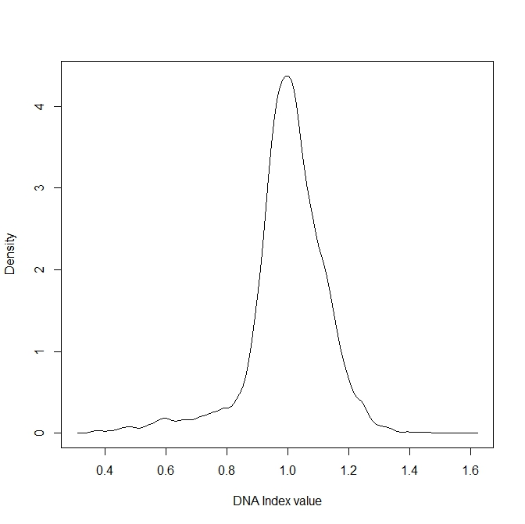
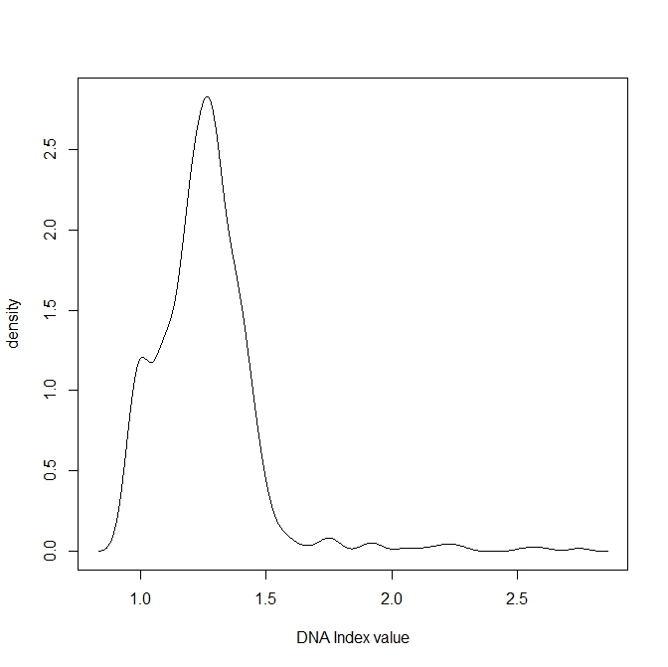
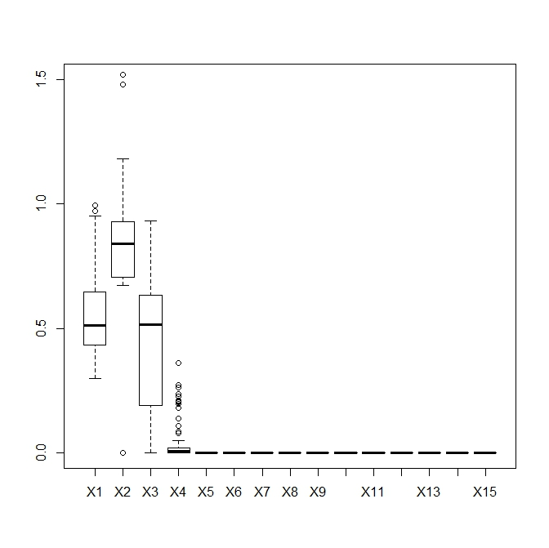
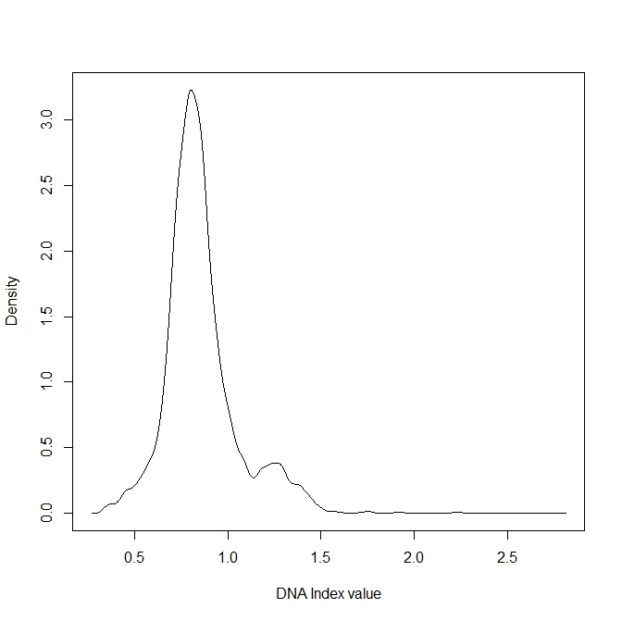
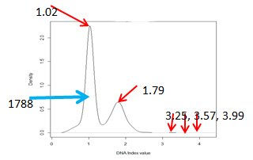
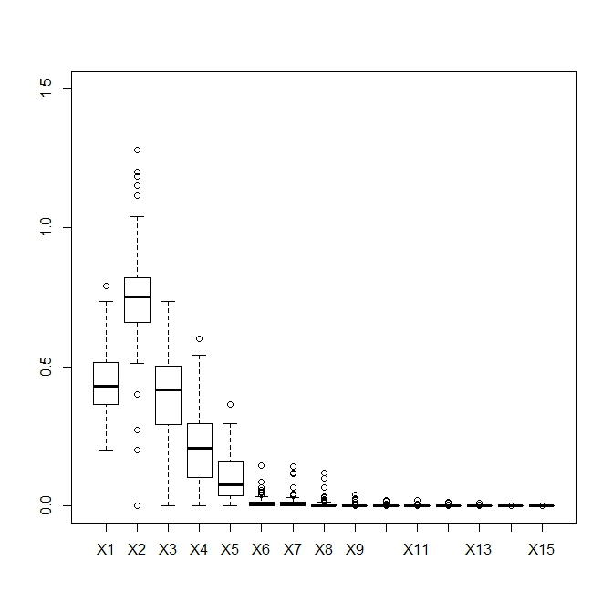
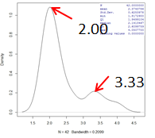
Figure 3
Liu, et al.
C
A
B
0.995
0.995
Normal
0.594
0.594
D
E
F
0.798
1.25
OLK
1.25
3590
1.75
2.22
1.75
2.22
2.74
2.74
G
H
I
OSCC
Before EdTAR
Signal amplification
After EdTAR

Slide 4
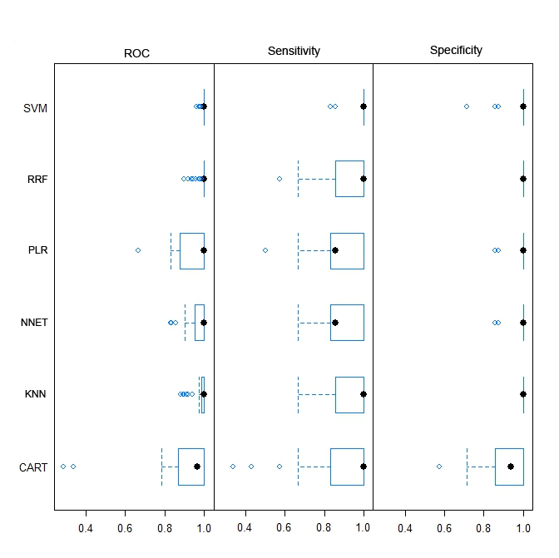
Figure 4
Liu, et al.

Slide 5
Figure 4
Liu, et al.
Please help to modify, thanks.

Slide 6
Figure 5
Liu, et al.
Note: FYI, this is newly made

Slide 7
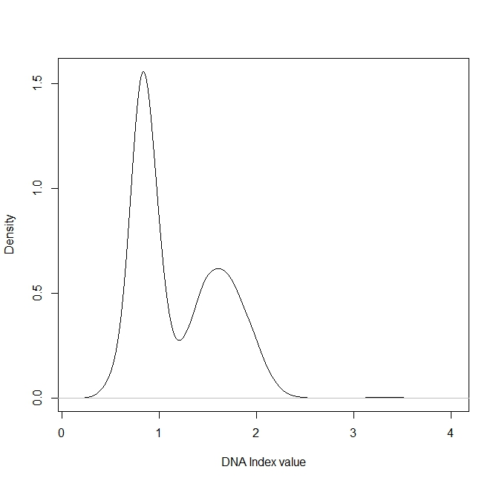

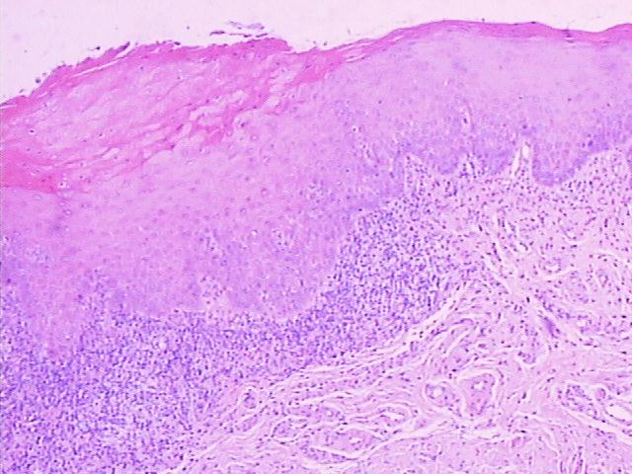
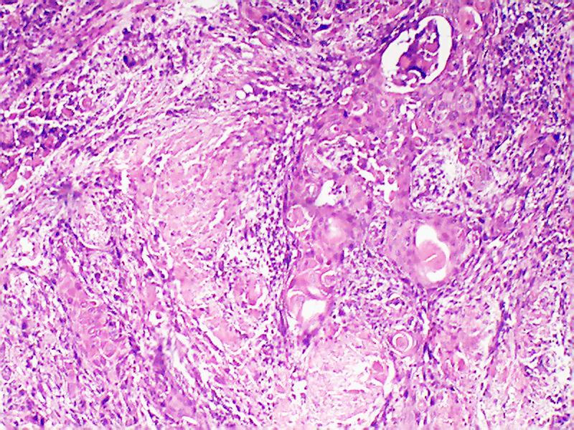
Figure 6
Liu, et al.
A
0.831
B
1.60
1.59
1608
1118
2.82
2.82
3.22
3.45
3.76
3.18
3.25
3.48
3.76
C
D

