Slide 1
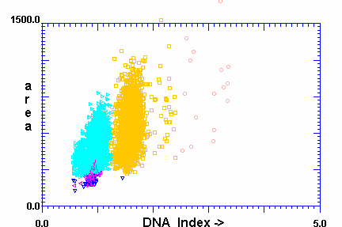
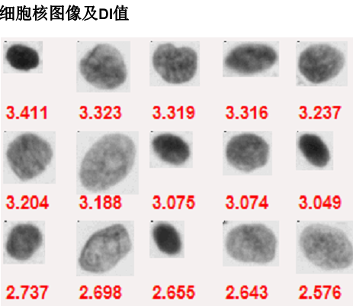
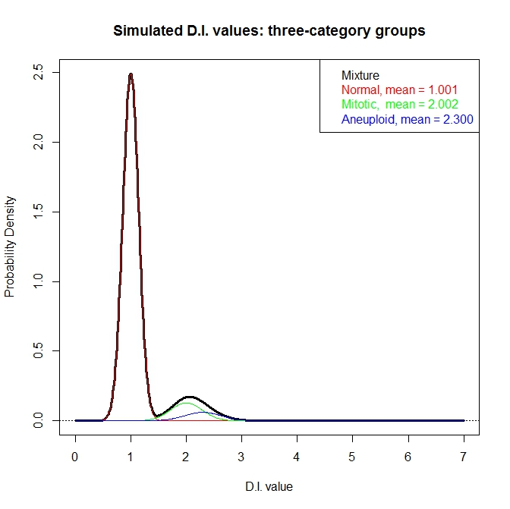
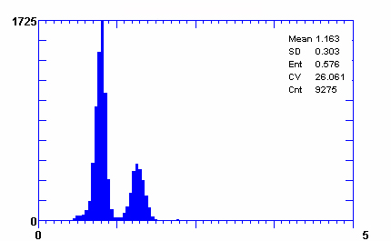
Figure 1
Liu, et al.
A
B
C
D
Notes:
Figure 1 DNA imaging data

Slide 2
Figure 2
Liu, et al.
DI values
Peak identification
Extraction of diploid/tetraploid and isolation of aneuploid peaks
Expert-guided
data transformation and reconstruction (EdTAR)
Signal amplification
Data reconstruction
Statistical modeling
Calculation of Oral Cancer Risk Index (OCRI)

Slide 3
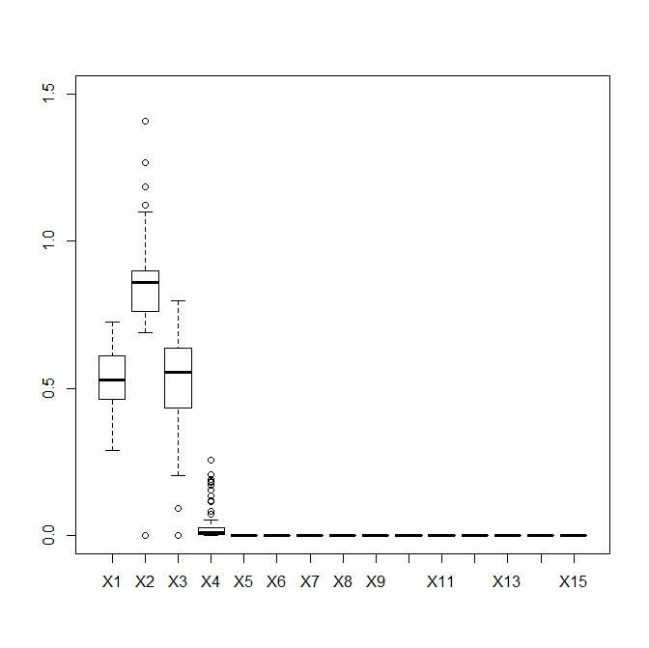
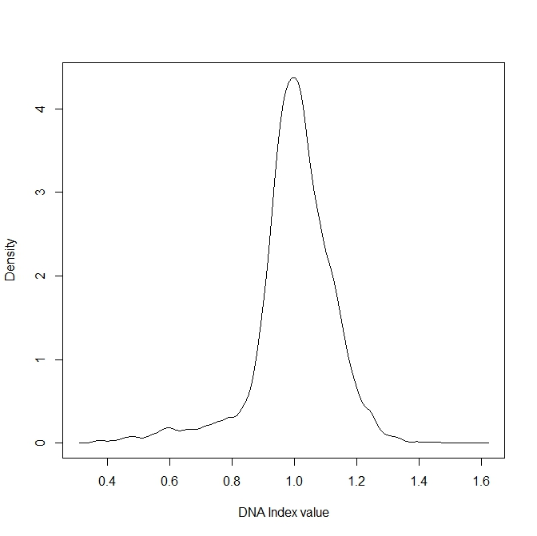
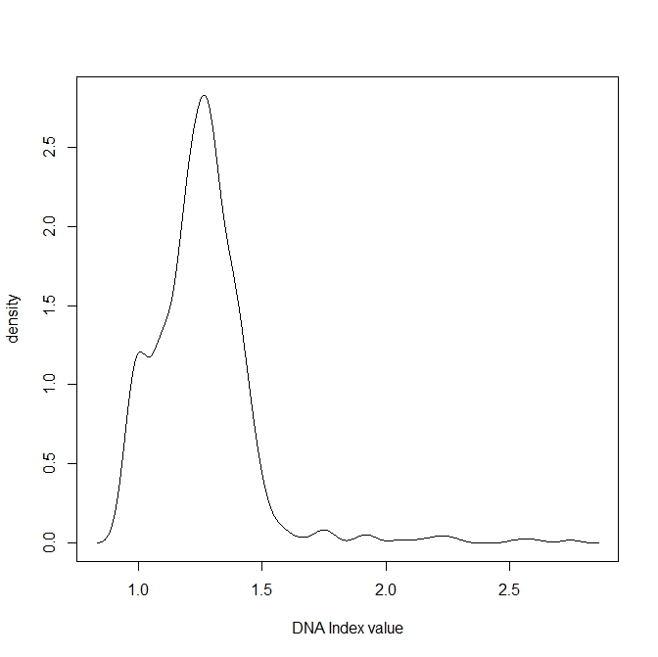
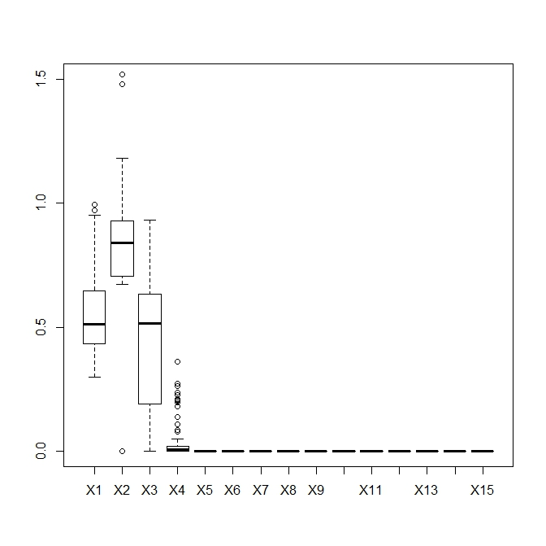
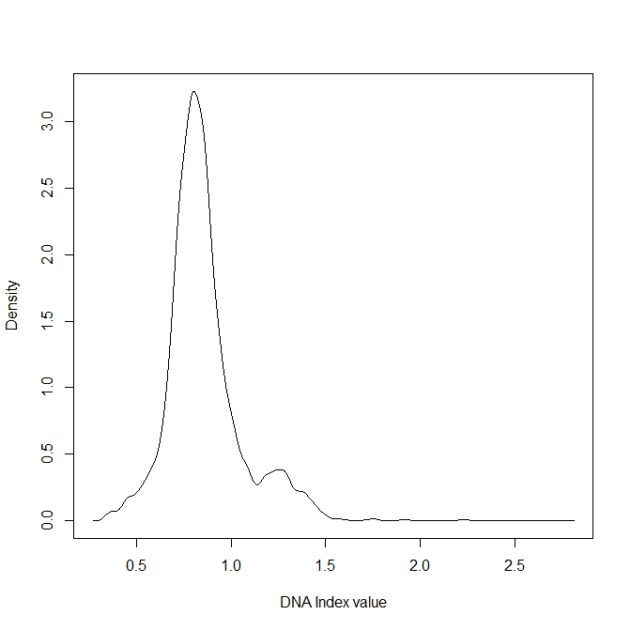
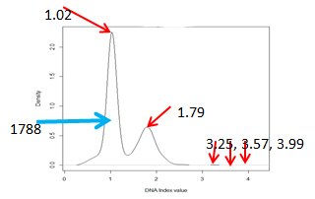
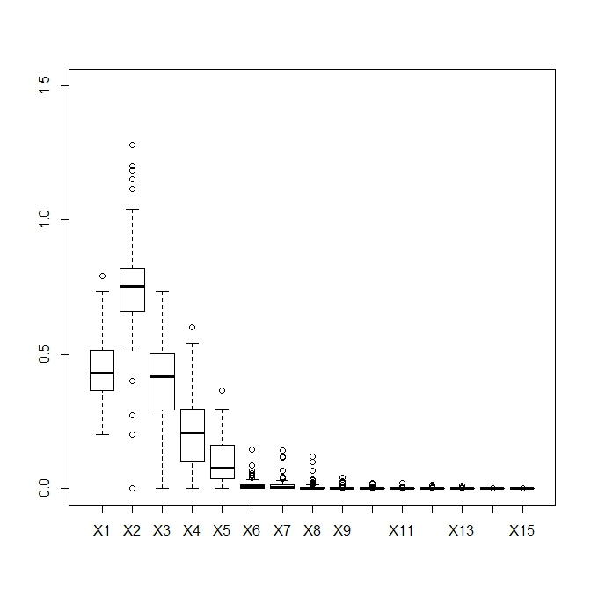
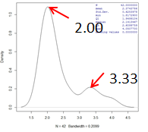
Figure 3
Liu, et al.
C
A
B
0.995
0.995
Normal
0.594
0.594
D
E
F
0.798
1.25
OLK
1.25
3590
1.75
2.22
1.75
2.22
2.74
2.74
G
H
I
OSCC
Before EdTAR
Signal amplification
After EdTAR

Slide 4
Figure 4
Liu, et al.

Slide 5
Figure 5
Liu, et al.

Slide 6
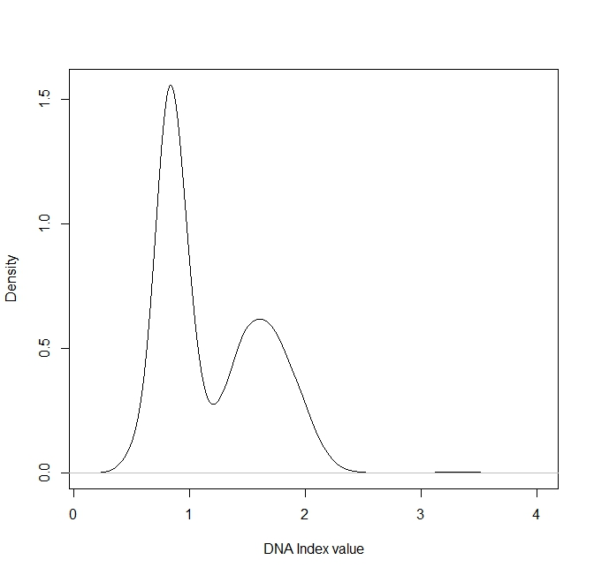

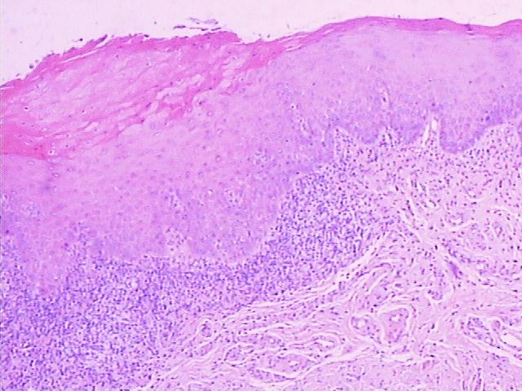
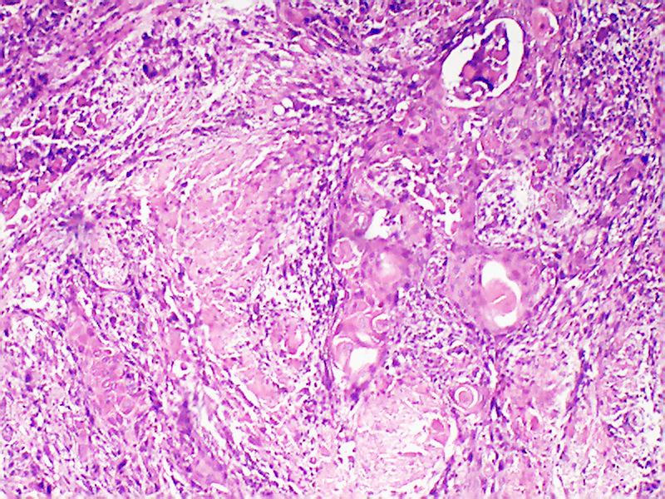
Figure 6
Liu, et al.
A
0.831
B
1.60
1.59
1608
1118
2.82
2.82
3.22
3.45
3.76
3.18
3.25
3.48
3.76
C
D

