Slide 1
Data (D.I. value) transformation
Three clusters of Gaussian distribution

Slide 2
Assumption
Three basic clusters of cell populations
  D.I. value: 0.9 – 1.249
  D.I. value: 1.250 – 2.299
  D.I. value: > 2.300
Assuming equal C.V. across three populations, and estimated from “normal sample”:
Three means: 1.001, 2.002, 2.300
And, corresponding s.d.: 0.1427

Slide 3
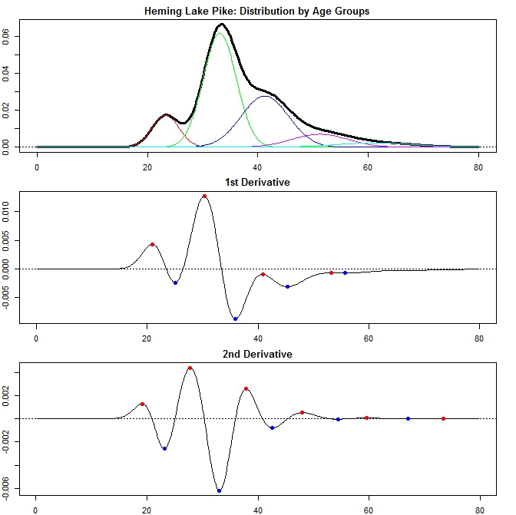

Slide 4
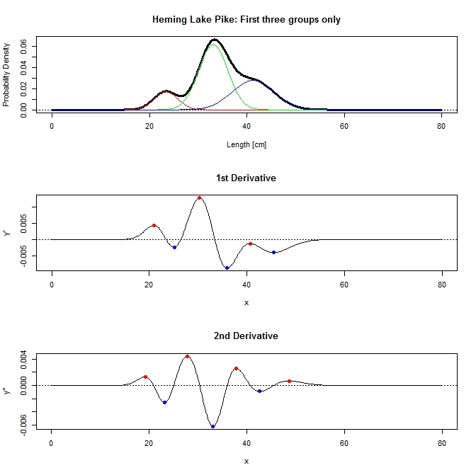

Slide 5
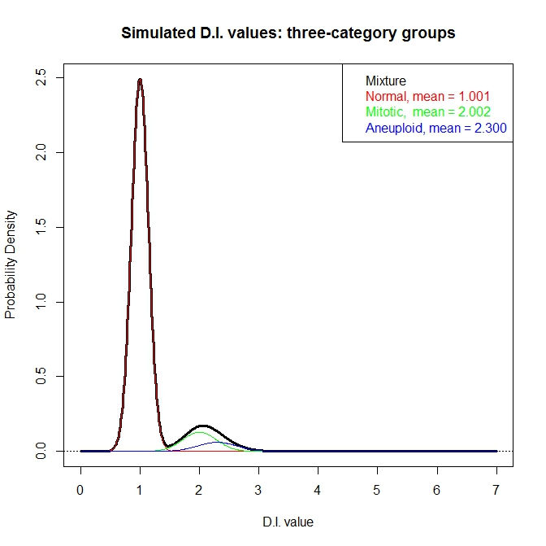

Slide 6
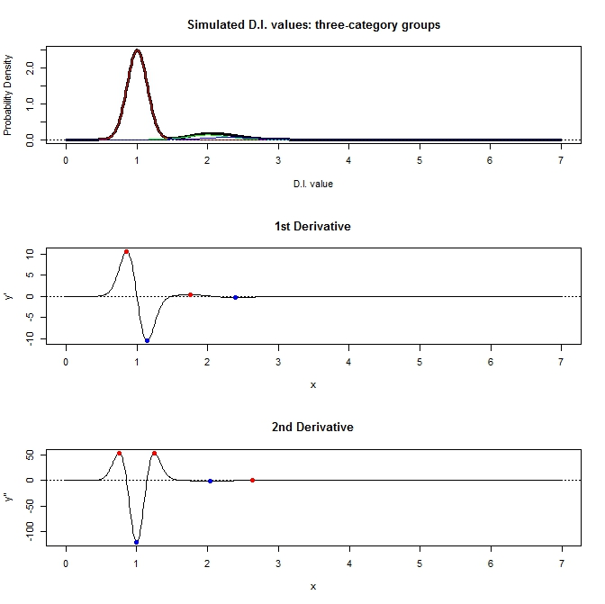

Slide 7
Our hurdle
Too much information from “normal” cluster
Possible to detect the “mitotic” stage
Impossible to detect “aneuploidy” stage
Need to strip out the “normal” information first, but how?
  Don’t know
  Don’t know
  Don’t know

Slide 8
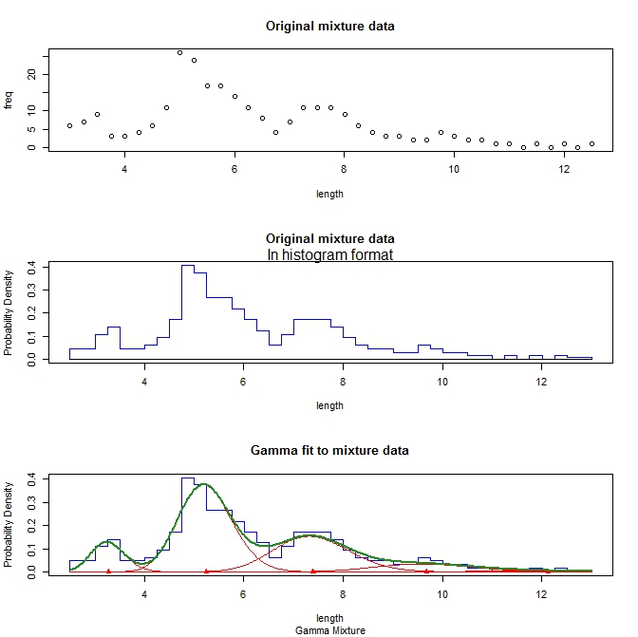

Slide 9
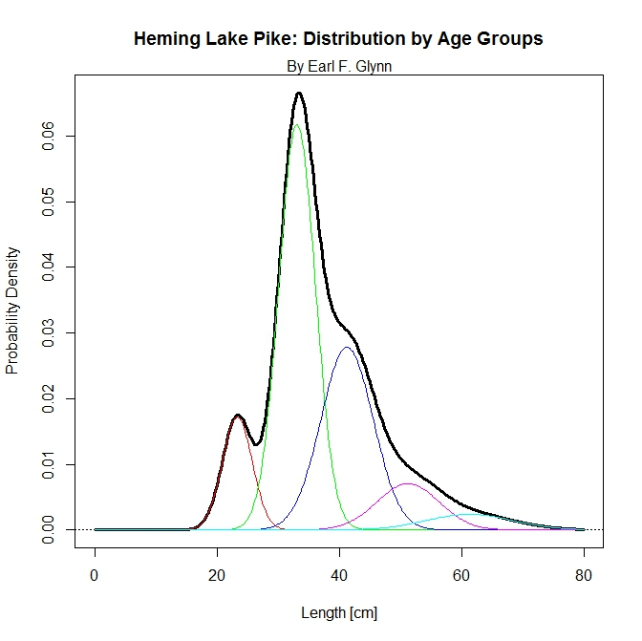
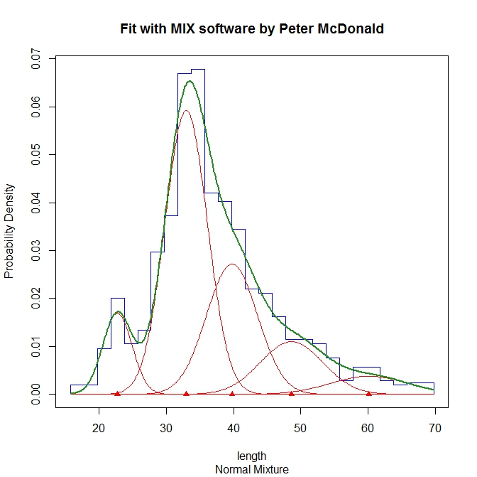
Mixture of five group data

