Slide 1

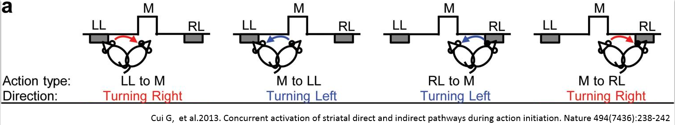
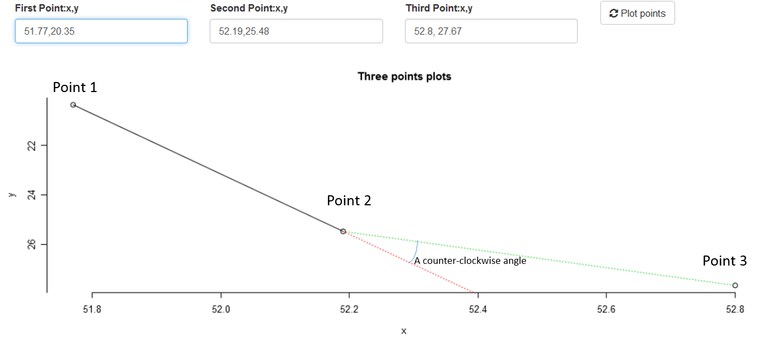
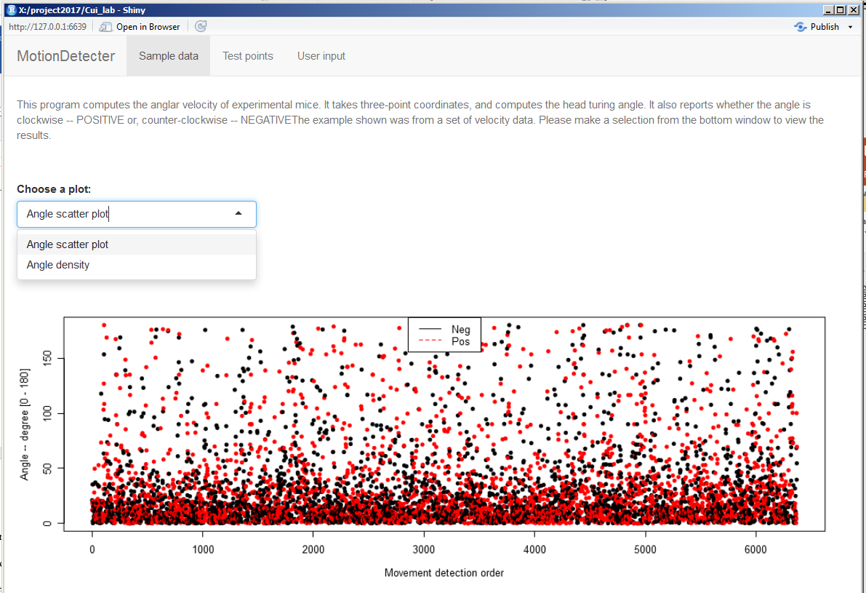
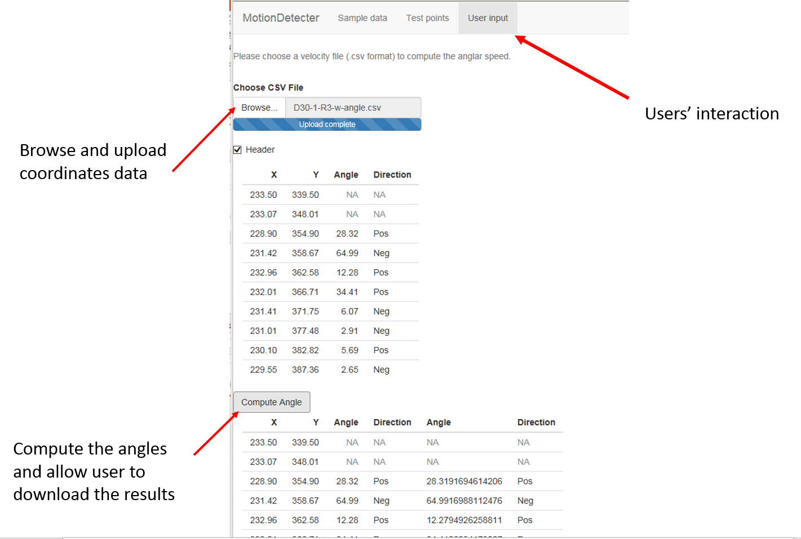
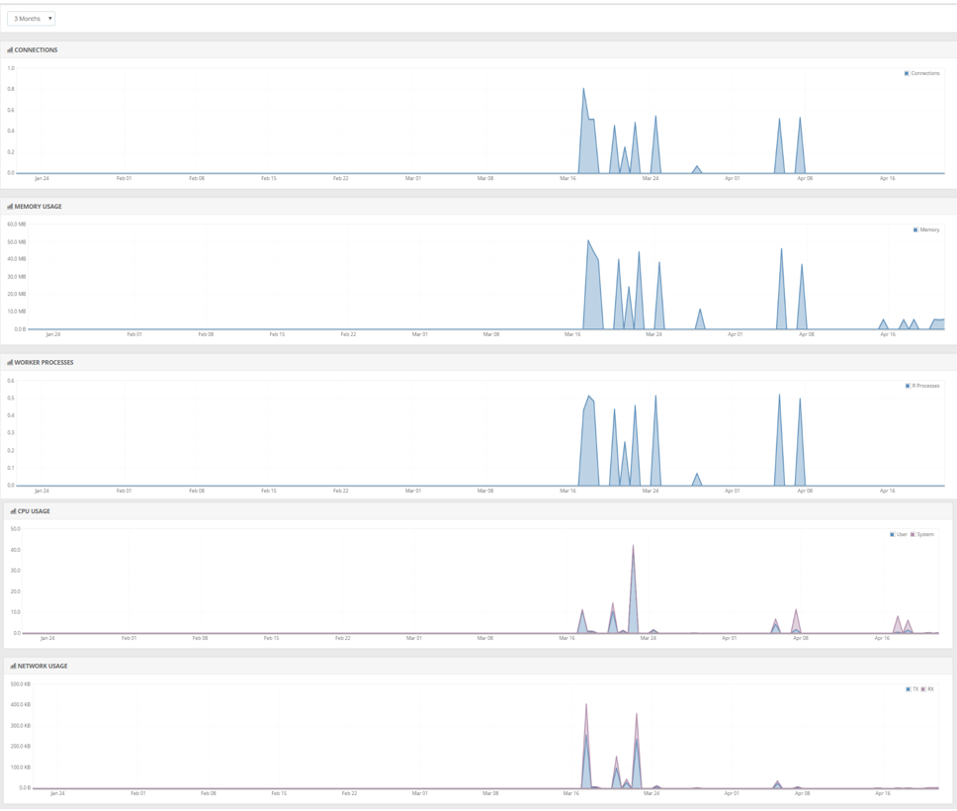

Bioinformatics advance: From static report to interactive data analysis
Jianying Li, James M. Ward
Results
Abstract
Motion Detection app
NanoString
Recent advances in data visualization techniques have inspired the creation of numerous software libraries that enable interactive visualizations. We describe two projects that apply and extend the R-shiny framework to deliver data directly from our Bioinformatics analysis desktops to web-based tools intended for project scientists. These tools enable scientists to explore and analyze data with greater control of the output, with the ability to drill down into specific details too difficult to uncover using Excel, and impractical to include in static figures. While not a replacement for face-to-face meetings, the web tools allow investigators interactive control over visual and analytical parameters, not only to reproduce the principal statistical results, but also to evaluate their own hypotheses and analyses independently. Custom visualizations can be saved as high-quality figures, and the underlying data can be exported into Excel for further review.
We demonstrate one example of interactive visuals for a large NanoString gene expression study on ex vivo cell reprogramming. The visualization enables the dynamic definition of sample groups, the exploration of various sample attributes via colorized points and multiple plot panels, and the display of the gene expression distribution across sample groups. Another application “MotionDetection” enables Dr. Chengbo Meng in the in vivo neurobiology group to test animal motion and validate the computations of head moving angular velocity. The web portal also allows her to run bulk analyses for future experiments.
The R-shiny framework produces a fully functional web-application, manages the HTML, CSS, and JavaScript components, along with a growing number of R packages that hook into numerous other innovative visual software libraries. There is a vast and rapidly growing library of dynamic visual tools available, including enhanced scatter and line plots, Circos type genome plots, heat maps, world maps, and network diagrams, each with ability to link with other figures in real-time. Our intent is to utilize these interactive visualizations as a core part of our Bioinformatics workflow, to extend our analysis capabilities and empower scientists to achieve maximum value from their experimental results.
.
Rationale
At Cui lab, an in vivo fiber-optics based photometry method was develop to measure the fluorescent signals in free moving mouse. Physical coordinates of mouse tail and head positions are used to determine the angular speed and direction of those free moving mouse under different neurological status to study the mouse behavior.
Method
Based on any given three consecutive point coordinates of a mouse head’s positions, we first compute the distance between each pair of the two points; then use the cosine formula to find the angle between point1-point2 and point2-point3. A linear function was derived using the first two points and was further used to determine the direction (clockwise or counter-clockwise) of the third point in respect to the extended the line.
Figure 1. A illustration of mouse head movement detected in unit time
Figure 2. An illustration of an angle formed by three consecutive points
App main features
.
Background
In this application design, a navigation page was used to host three parallel tabPanels. The first tabPanel provides a statics introduction about the application with a preloaded dataset and results. Users can explore features and view about 6000 angular results either from a scatter plot or density plot. The y-axis indicates the scaler angle and the color code indicates whether the angle was Negative (counter-clockwise) or Positive (clockwise). (Figure 3)
The second tabPanel allows the researcher to compute the angle from three consecutive point coordinates of a mouse head’s positions. This feature frees up manually measuring the angle on a sheet of graph paper, so that the researchers can test individual case (Figure 2).
The third tabPanel allows the researchers to upload new dataset and compute the results freely. The results can be downloaded and used in further analysis. (Figure 4)
Figure 3. A static tabPanel page of preload data
Conclusions
Objectives
Figure 4. User interaction through a tabPanel
App administration
The MotionDetection application is hosted on shinyapps.io, a public domain that hosts the shinyapps It provides full-length of administration capability to handle update and monitor usage over time. The project with Cui lab was initiation in early March and the application was deployed on March 17th.
.
References
Cora, M. C., D. King, et al. (2012). "Artifactual changes in Sprague-Dawley rat hematologic parameters after storage of samples at 3 degrees C and 21 degrees C." Journal of the American Association for Laboratory Animal Science : JAALAS 51(5): 616-621.
Cui G, Jun SB, Jin X, Pham MD, Vogel SS, Lovinger DM, Costa RM. 2013. Concurrent activation of striatal direct and indirect pathways during action initiation. Nature 494(7436):238-242
Farnan, L., A. Ivanova, et al. (2014). "Linear mixed effects models under inequality constraints with applications." PloS one 9(1): e84778.
Nelson, JW, Sklenar J, Barnes AP, Minnier J. (2016) “The START App: A Web-Based RNAseq Analysis and Visualization Resource.” Bioinformatics. doi: 10.1093/bioinformatics/btw624.
Jianying Li and Casey M. Jelsema (2015) Rshiny: Building an interactive web-application with R shiny package NIEHS Bioinformatics E-Bulletin
Shiny by RStudio: https://shiny.rstudio.com/
Figure 5. An administration feature to monitor the usage and computational resource consumed

