Slide 1
Create an R-shiny project
Within R studio

Slide 2
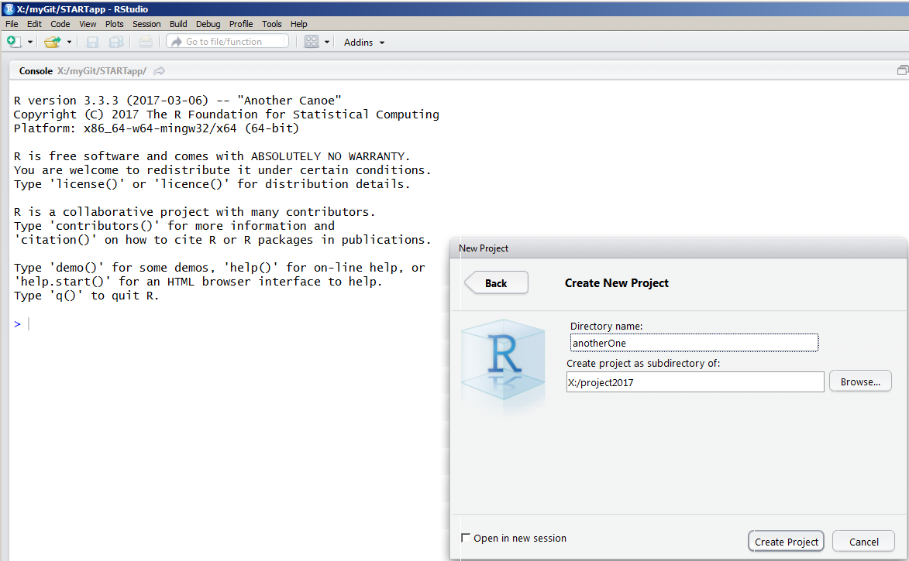
Create a project folder -- empty

Slide 3
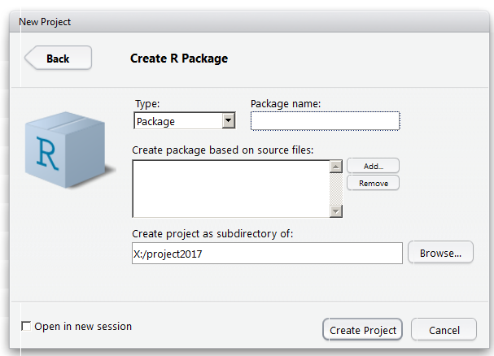
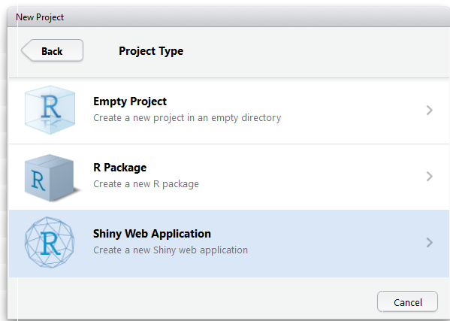
Or, creating a package or a shinyapp

Slide 4
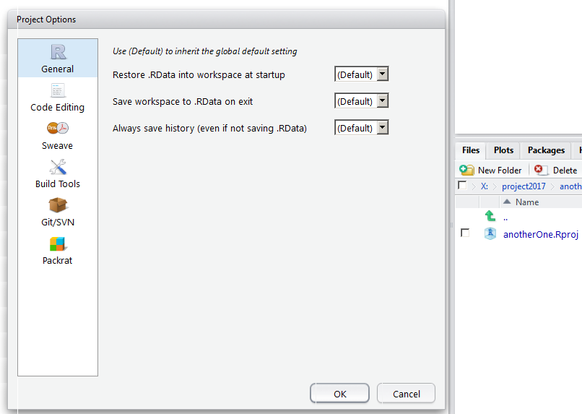
Examine the project property

