Slide 1
Create journal in R
With Rmarkdown

Slide 2
Getting the prerequisite
http://rmarkdown.rstudio.com/pdf_document_format.html#overview
Within Rstudio (assuming Rstudio is installed)
There is an R package called “rticles”
https://github.com/rstudio/rticles
Just following the tutorial session
Produce a Journal of Statistical Software

Slide 3
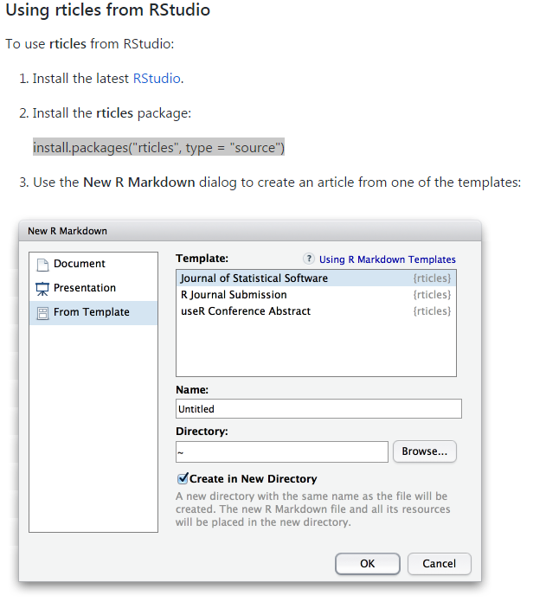
“rticles” installation – create first “rticles - jss”

Slide 4
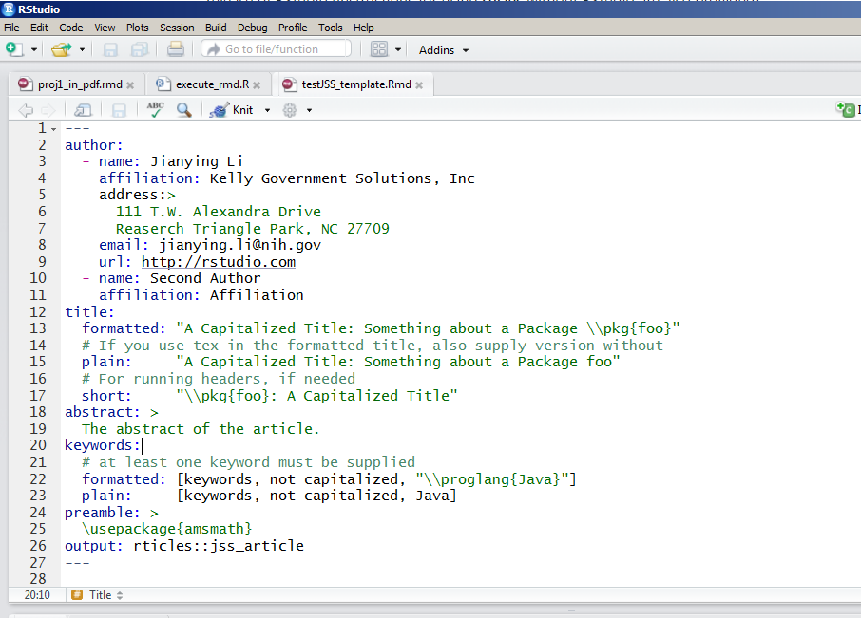
Generate the article using “knitr”

Slide 5
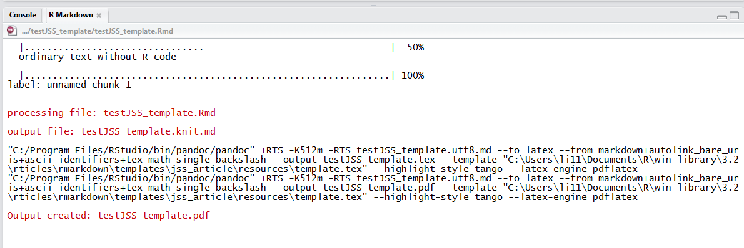
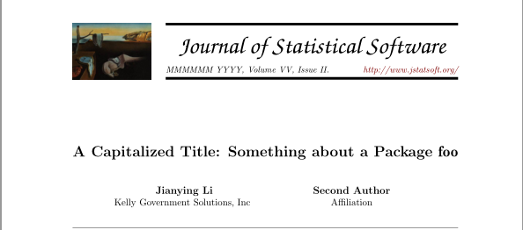
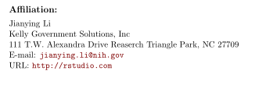

Slide 6
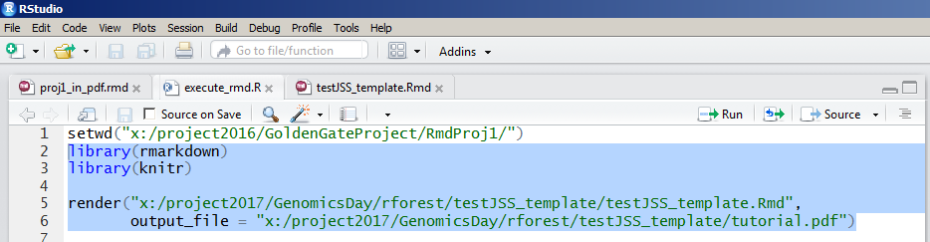
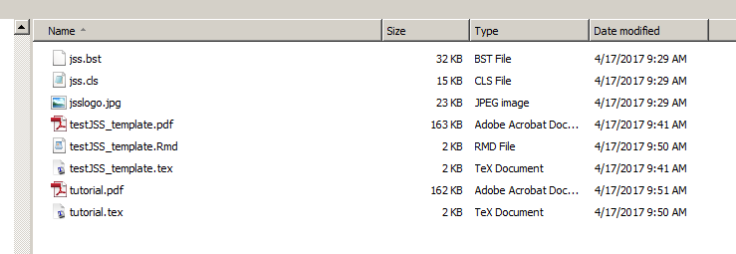
What behind the scene
Run the block of the code
It produces a LaTex file the converts to a .pdf file

Slide 7
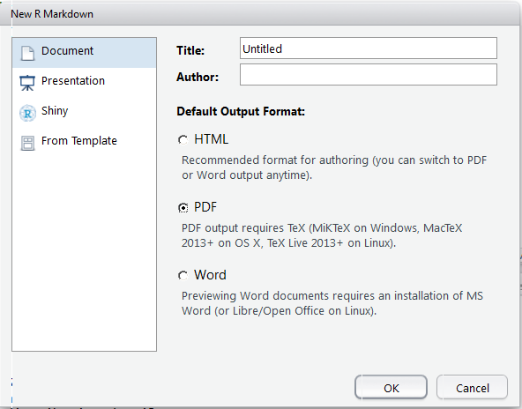
Almost forgot – pdf requires Tex

