Slide 1
Reflection and Refraction through Environment Mapping
Khyati Thakur, Rahul Chauhan, Lyle Franklin, Sasan Tavakkol

Slide 2
Our Results
HW 6 plus:
Skybox
Reflection
Refraction

Slide 3
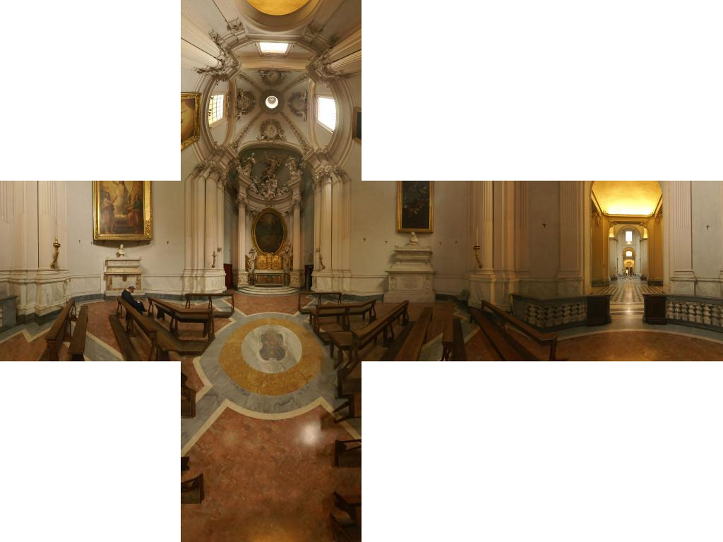
Skybox - 1
Start with a cube map->

Slide 4
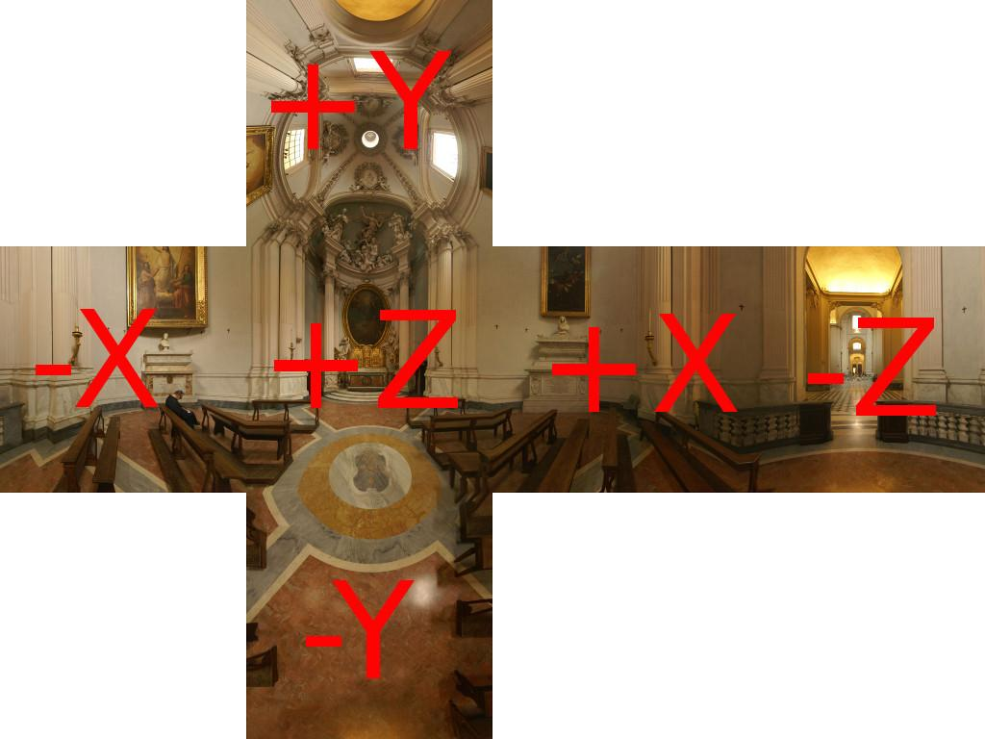
Skybox - 2
6 faces, 6 plane models

Slide 5
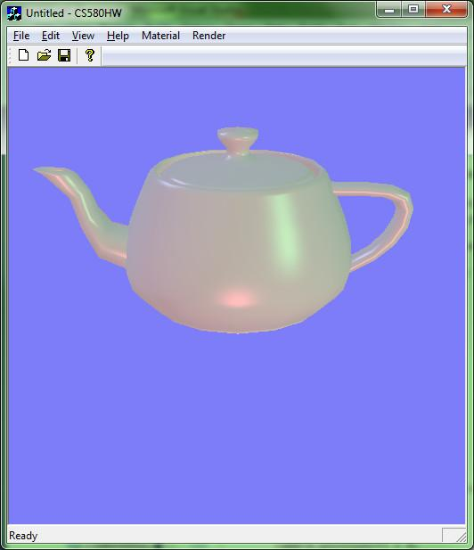
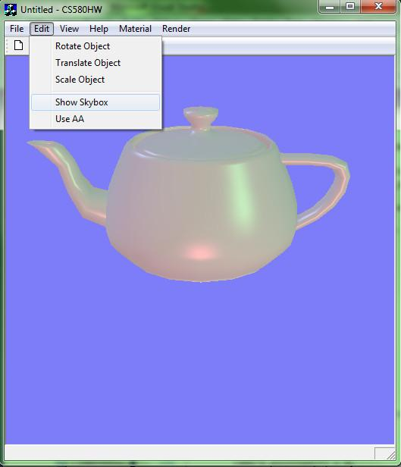
Skybox - 3

Slide 6
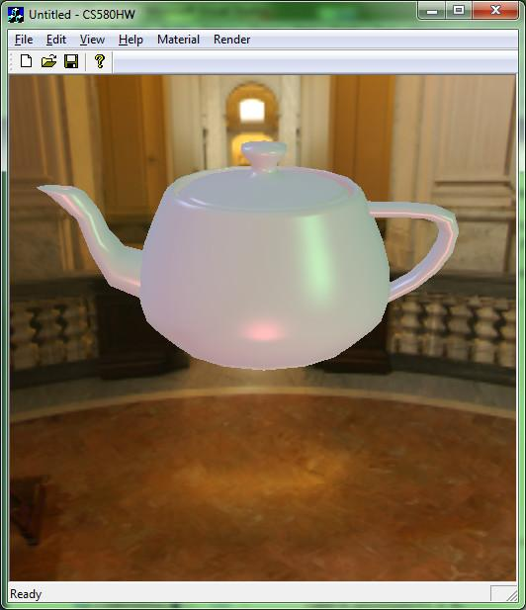
Skybox - 4

Slide 7
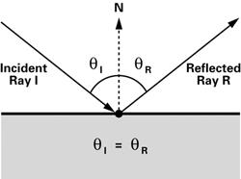
Reflection - 1
Computing reflection:
Need N, Pos., Eye in World Space
Interpolate N and Pos. for a given pixel
Compute I and normalize
Compute R
I = Pos - Eye
R = I - 2N(N• I)

Slide 8
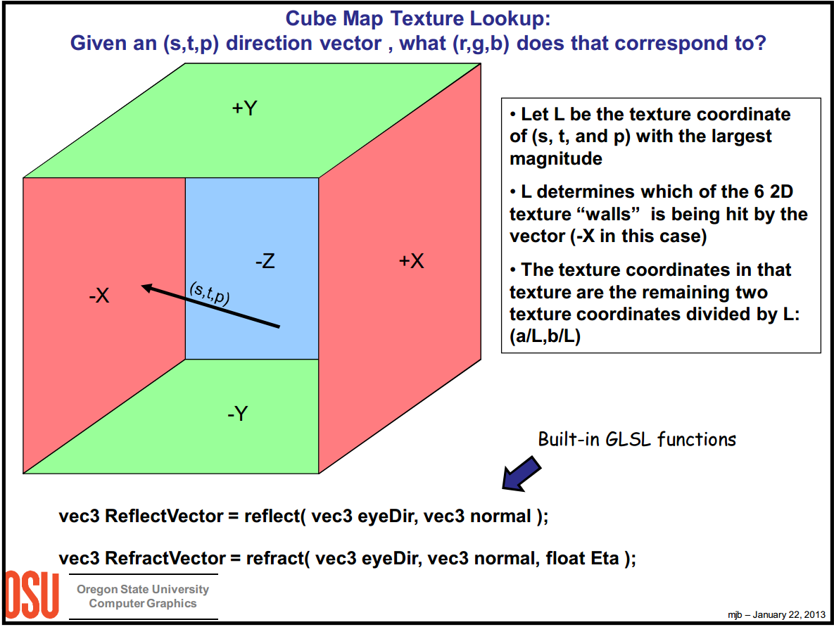
Reflection - 2
Lookup reflection vector in cube map

Slide 9
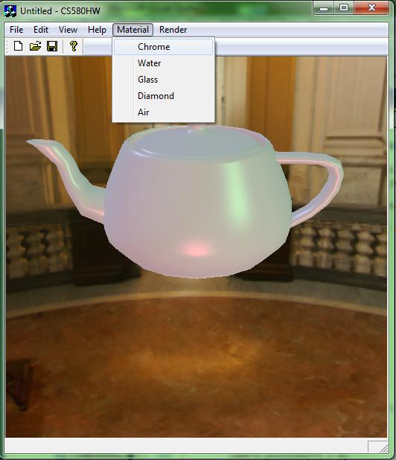
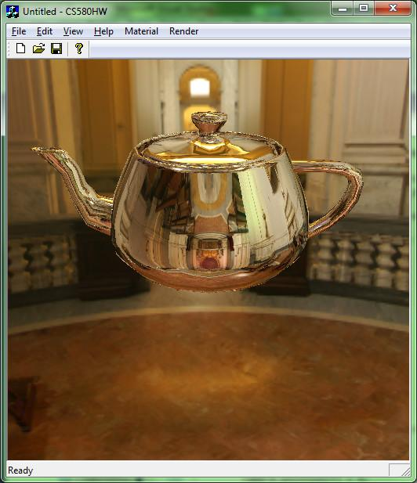
Reflection - 3

Slide 10
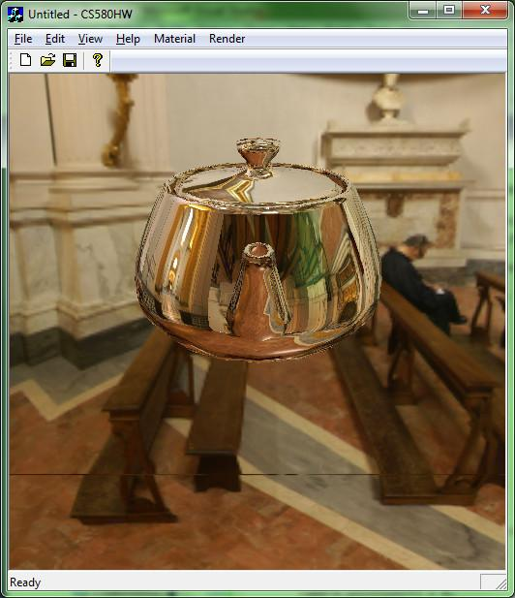
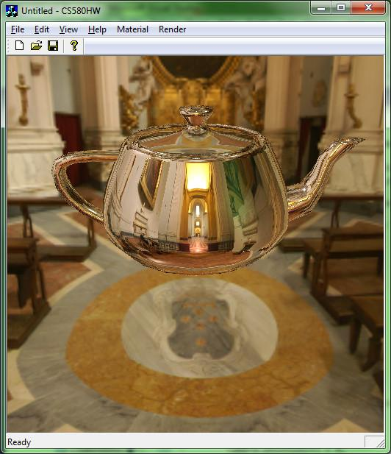
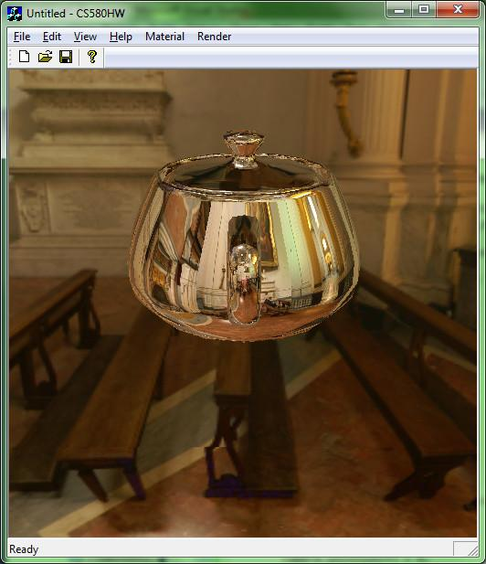
Reflection - 4
Other camera angles:

Slide 11
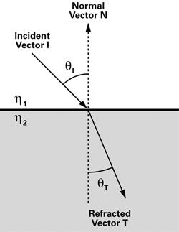
Refraction - 1
Computing refraction:
Setup I and N as with reflection
Compute refraction vector using Snell’s law
Perform cube map lookup as with reflection
h₁sin(θ_{I}) = h₂sin(θ_{T})

Slide 12
Refraction - 2
Index of Refraction:
Air = 1.0
Water = 1.325
Glass = 1.5
Diamond = 2.418

Slide 13

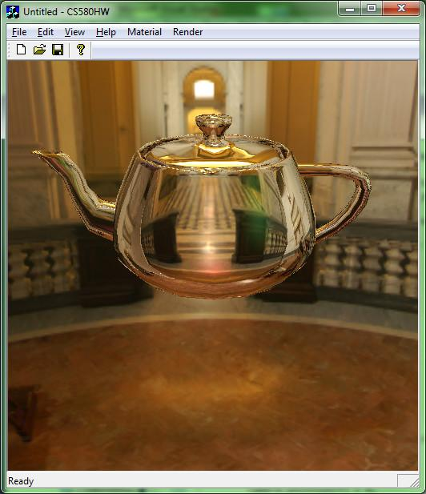
Refraction - 3

Slide 14

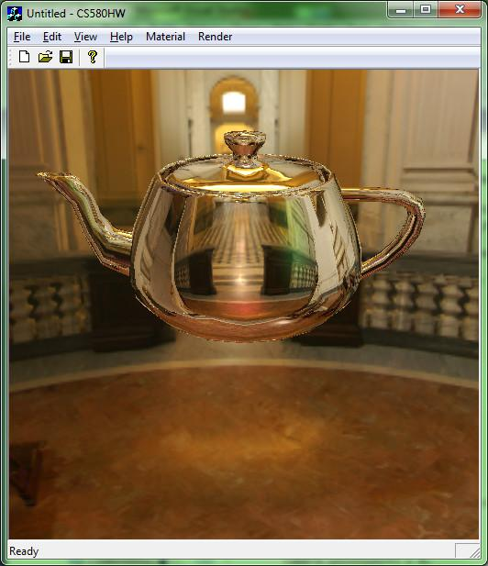
Refraction - 4

Slide 15


Refraction - 5

Slide 16
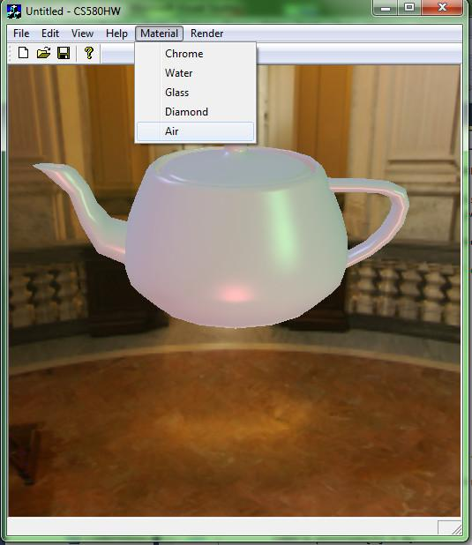
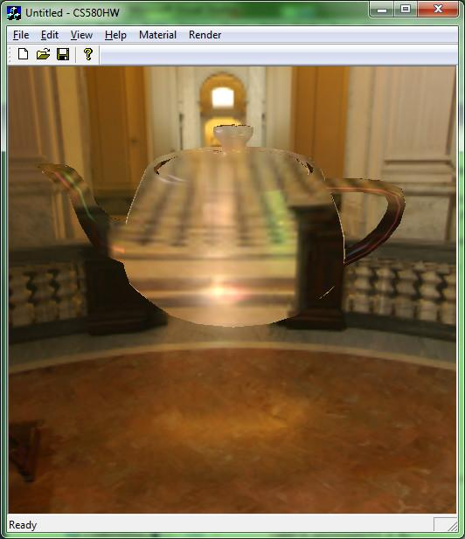
Refraction - 6

Slide 17


With AA

Slide 18
Future work
Fresnel effect
Multi-hop refraction
Chromatic Dispersion

Slide 19
Citations
Greene, N., "Environment Mapping and Other Applications of World Projections," Computer Graphics and Applications, IEEE , vol.6, no.11, pp.21,29, Nov. 1986. http://ieeexplore.ieee.org.libproxy.usc.edu/stamp/stamp.jsp?tp=&arnumber=4056759&isnumber=4056747
Douglas Scott Kay and Donald Greenberg. 1979. Transparency for computer synthesized images. InProceedings of the 6th annual conference on Computer graphics and interactive techniques (SIGGRAPH '79). ACM, New York, NY, USA, 158-164. http://doi.acm.org.libproxy.usc.edu/10.1145/800249.807438
Chris Wyman. 2005. An approximate image-space approach for interactive refraction. ACM Trans. Graph. 24, 3 (July 2005), 1050-1053. http://doi.acm.org.libproxy.usc.edu/10.1145/1073204.1073310
2011 Pixel and Poly, LLC. IOR - Index of Refraction values. http://www.pixelandpoly.com/ior.html
Han-Wei Sheen. Ohio State University. Environment Mapping. http://web.cse.ohio-state.edu/~whmin/courses/cse5542-2013-spring/17-env.pdf

