Slide 1

On Convolutional Neural Network
Zeng Huang
Brain-like Computing and Machine Intelligence Lab
Shanghai Jiao Tong University (China)
Interests: Vision, Graphics, Machine Learning
http://zeng.photography/

Slide 2
Outline
Basic concepts on Image classification
Ideas behind Convolutional Neural Network(CNN)
Technical details & tricks applying to CNN
Observations from experiments so far

Slide 3
The Problem
Each image belongs to one of several categories, such as ‘the image contains a cat’ or ‘the image represents a traffic jam’.
For training data, each image would assign a label indicating the category.
For test data, the goal is to classify each image to one of these categories.
More precisely, the goal is to determine the probability each image belongs to each of the categories.

Slide 4
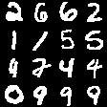
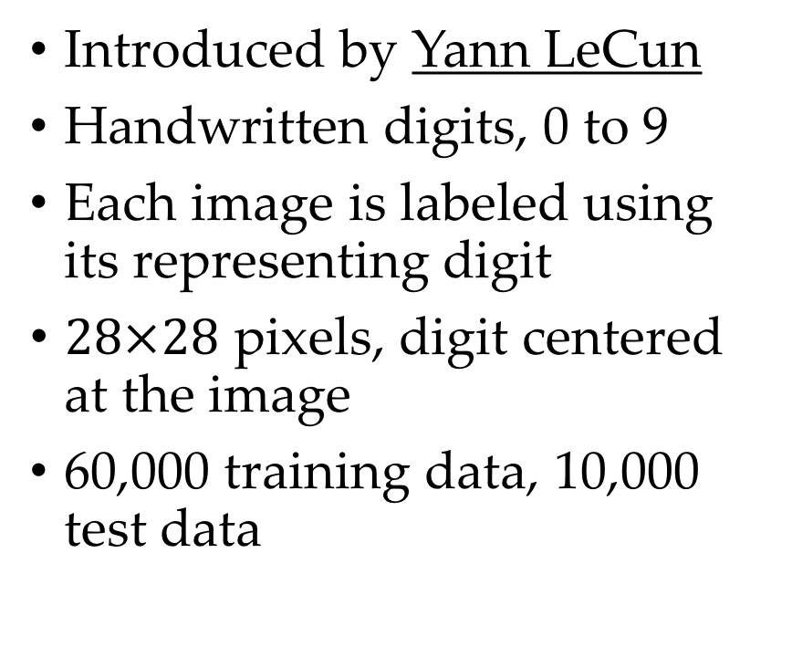
The MNIST Datasets
Introduced by Yann LeCun
Handwritten digits, 0 to 9
Each image is labeled using its representing digit
$28×28$ pixels, digit centered at the image
60,000 training data, 10,000 test data
16 test data images
shown in a 4-by-4 grid

Slide 5
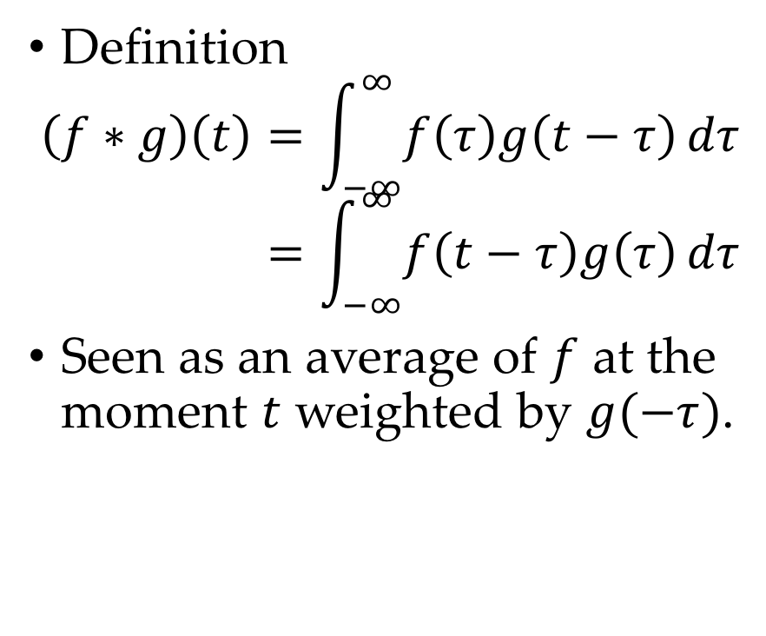
What is convolution?
Definition
$$\left(f∗g\right)\left(t\right)=\int_{−∞}^{∞}{f\left(τ\right)g\left(t−τ\right)}dτ=\int_{−∞}^{∞}{f\left(t−τ\right)g\left(τ\right)}dτ$$
Seen as an average of $f$ at the moment $t$ weighted by $g(−τ)$.

Slide 6
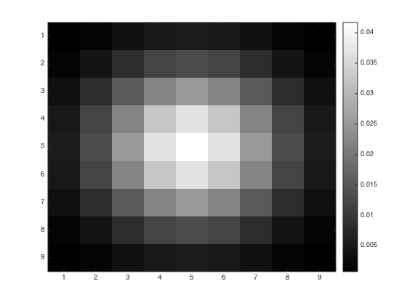
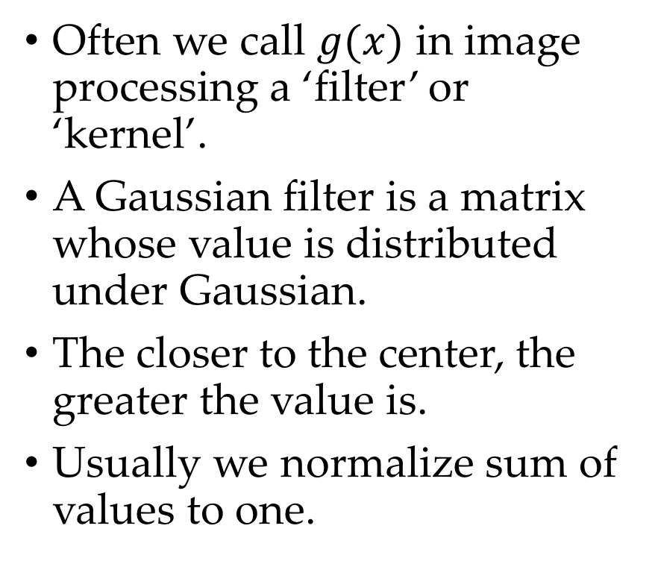
Example: Gaussian Filter
Often we call $g(x)$ in image processing a ‘filter’ or ‘kernel’.
A Gaussian filter is a matrix whose value is distributed under Gaussian.
The closer to the center, the greater the value is.
Usually we normalize sum of values to one.
A 9-by-9 Gaussian kernel
The center has the greatest value

Slide 7
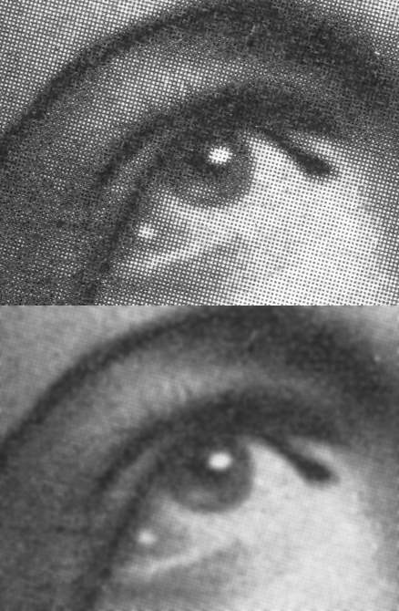
Example: Gaussian Filter
Gaussian filter acts as a smoothness filter

Slide 8
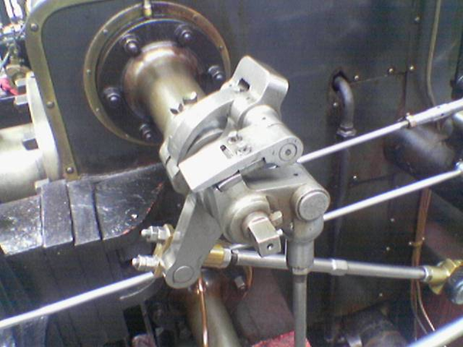
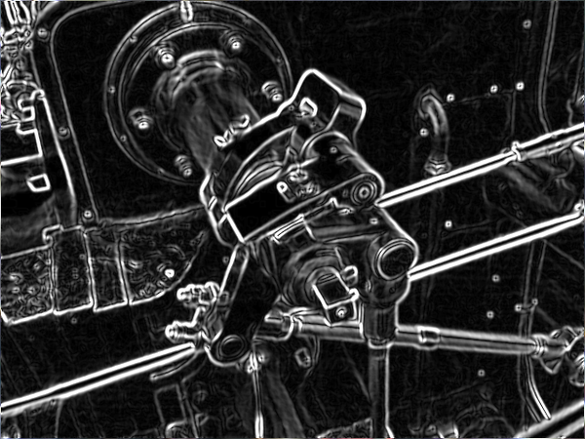
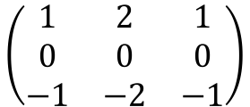
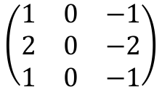

Example: Sober Filter
$$\left(\begin{matrix}1 & 0 & −1 \\ 2 & 0 & −2 \\ 1 & 0 & −1\end{matrix}\right)$$
$$\&$$
$$\left(\begin{matrix}1 & 2 & 1 \\ 0 & 0 & 0 \\ −1 & −2 & −1\end{matrix}\right)$$
Sober filter acts as an edge detector

Slide 9
Convolution in Neural Network
A neural cell is connected only to those pixels in a certain region.
All weights for cells on the same layer is the same.
The weights can hence be viewed as values for a convolutional kernel.
We wish CNN learns the kernels that do extract some features of the image.

Slide 10
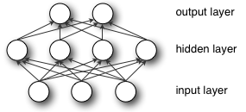
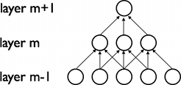
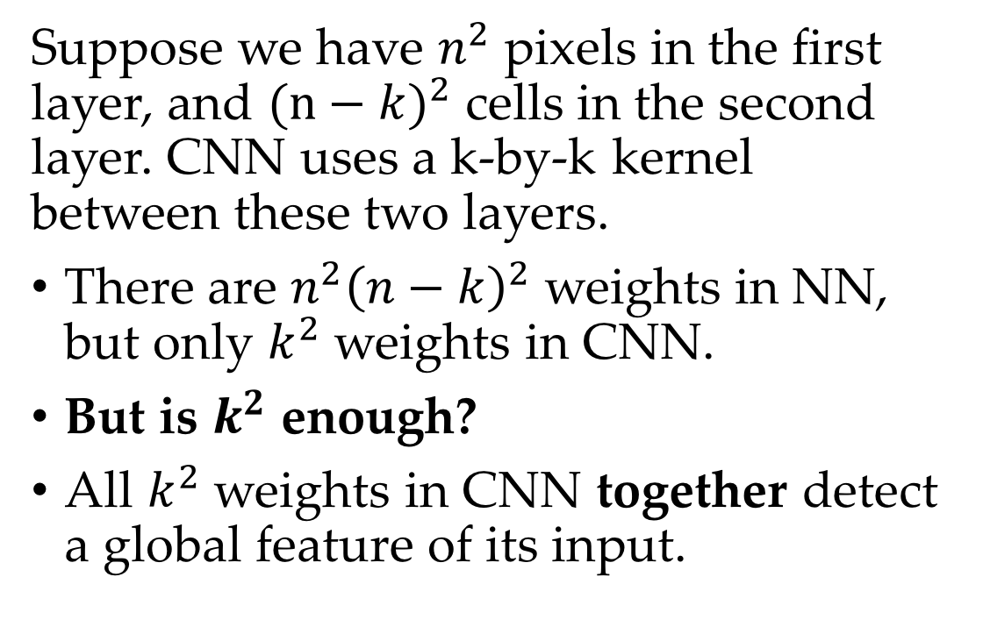
Comparison with NN
Suppose we have $n^{2}$ pixels in the first layer, and $(n−{k)}^{2}$ cells in the second layer. CNN uses a k-by-k kernel between these two layers.
There are $n^{2}{\left(n−k\right)}^{2}$ weights in NN, but only $k^{2}$ weights in CNN.
But is $k^{2}$ enough?
All $k^{2}$ weights in CNN together detect a global feature of its input.
Upside: NN connection
Downside: CNN connection

Slide 11
Comparison with NN
4(a): Write code to train a convolution network. Use 10×10 input, first level has 36, 5×5 convolution gates. Try tying weights in all the convolution gates together so you are only training 25 weights in this level. Also try letting gates learn different weights.
In this scenario, all CNN gates have shared 25 weights, while an NN gate has 100 weights.
But is 25 for all versus 100 for each enough?
Nope, since in CNN, gates with 25 shared weights actually learn the same thing, only applied to different regions.

Slide 12
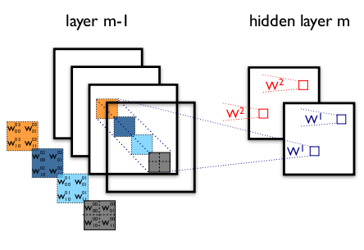
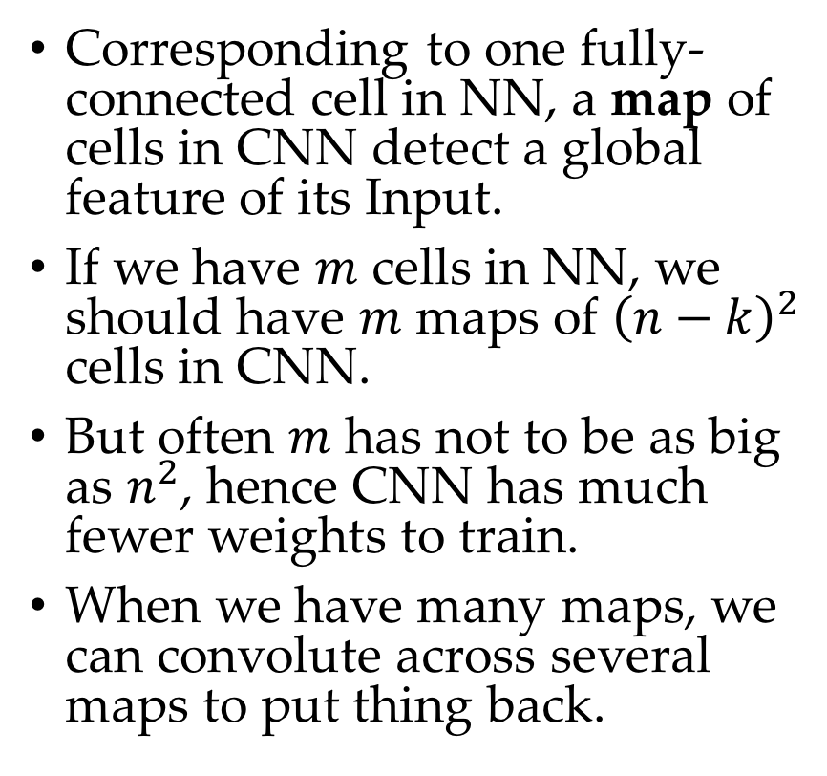
Feature Maps for CNN
Corresponding to one fully-connected cell in NN, a map of cells in CNN detect a global feature of its Input.
If we have $m$ cells in NN, we should have $m$ maps of ${\left(n−k\right)}^{2}$ cells in CNN.
But often $m$ has not to be as big as $n^{2}$, hence CNN has much fewer weights to train.
When we have many maps, we can convolute across several maps to put thing back.
To achieve some ‘correspondence’, we have 4 cells in layer 2 of NN, but 4 maps of cells in that of CNN.
However the weights for CNN is still fewer than those for NN.

Slide 13
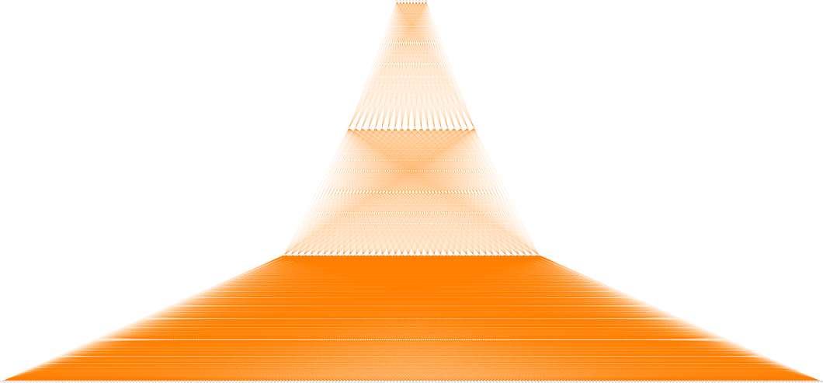
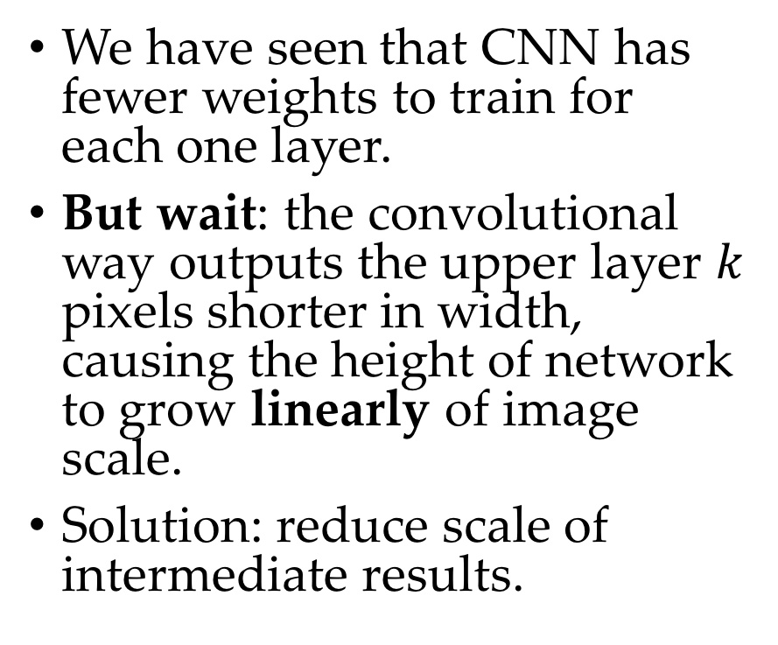
Height of CNN Network
We have seen that CNN has fewer weights to train for each one layer.
But wait: the convolutional way outputs the upper layer $k$ pixels shorter in width, causing the height of network to grow linearly of image scale.
Solution: reduce scale of intermediate results.
If we do nothing other than convolution, the height of the network will grow linearly of the input scale, causing too many connections and weights to train.

Slide 14
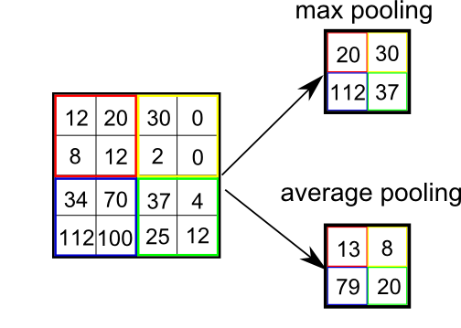
Subsampling and Pooling
At certain stage of CNN, we can reduce scale of intermediate layers by subsampling or pooling.
Recall that adjacent cells represent features of adjacent regions, it is reasonable to sample them to a single cell.
This cause the height of network to be logistic of image scale.

Slide 15
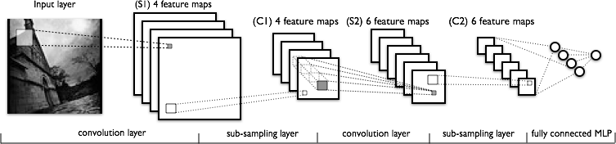
Overview of a CNN structure
A practical CNN structure is interleaving of convolution steps and sub-sampling steps.
A visualization

Slide 16
Compare performance between convolution and fully-connected
This can be done simply by using convolutional kernels as big as the original image.
But this causes the height of network to be three, since only one hidden layer is convoluted.
The problem lays in: if we want to compare, then what property should we keep unchanged?
Total number of gates? Total number of weights? Network height?
Some of these cannot be kept together.

Slide 17
Is it rather tricky or techy?
When should a CNN perform subsampling?
What size of kernel should it use in each stage?
The choice for parameters seems tricky in this area, but maybe we can count the results and find some interesting stories in it.
And another strategy is to start from small things. But I always doubt if model for rectangles are suitable for deep learning.
Also, it is of high value that somehow we see what the network is truly done. This can be achieved by visualization or statistics.

Slide 18
Tools & Ref.s I Got for Experiments
MNIST
Convolutional Neural Networks (LeNet) (Python)
DeepLearnToolbox (Matlab)
Visualization is the best thing for CV.
3D convolutional network visualization (css & Js & Json)
A visualization for fully-connected network. Might help Qizhe.

Slide 19
Thank you.
If you have any questions, please feel free to ask.
My e-mail is frequencyhzs@gmail.com, I’ll send you all materials after class.

