Slide 1
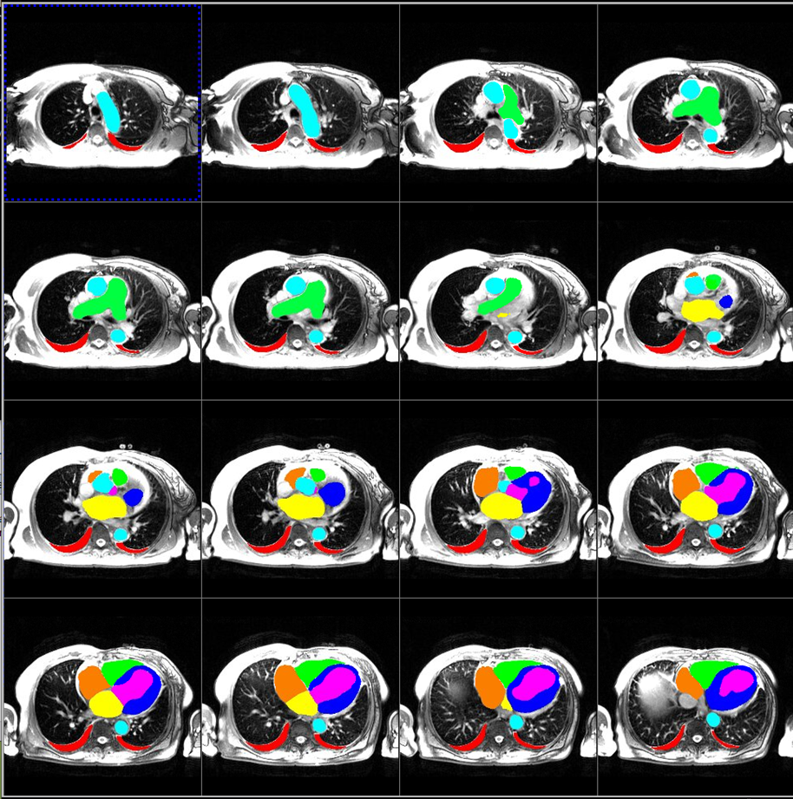
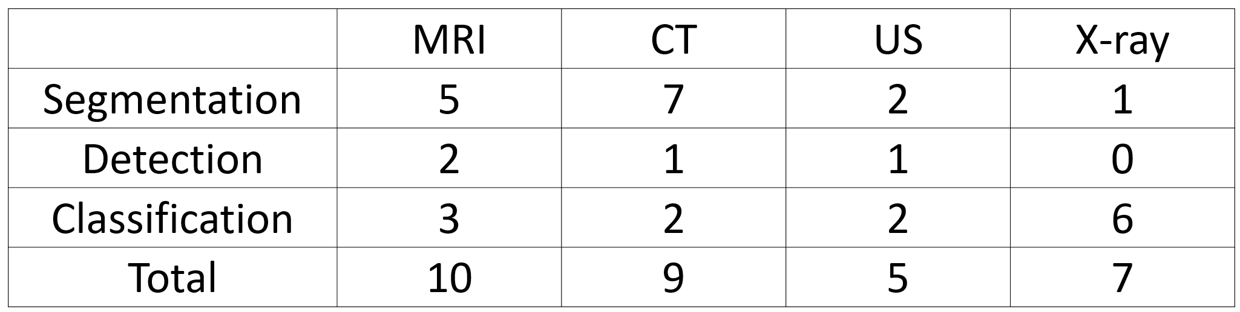
A new imaging task from a NIH team
A new requirement from clinical team
A new research idea ...
Collected imaging tasks, 100% non-identifiable
FM-Imaging
Report texts
Self-supervised learning
Mult-task meta learning
New-task fine-tuning
Dicom images
Phase 1
A model based on big NIH data !
Phase 2
Phase 3

