Slide 1

MINI PROJECT PRESENTATION
Estimation of SOC of a Battery using Machine Learning
Digital Twin Implementation
Project Team Members
Maanas S
Abrar M
Abhinav Pradeep
Varun Ladda
Department: Electrical & Electronics Engineering
Roll Numbers
CB.EN.U4ELC24052
CB.EN.U4ELC24005
CB.EN.U4ELC24004
CB.EN.U4ELC24062
Institution: Amrita School of Engineering, Amrita Vishwa Vidyapeetham

Slide 2
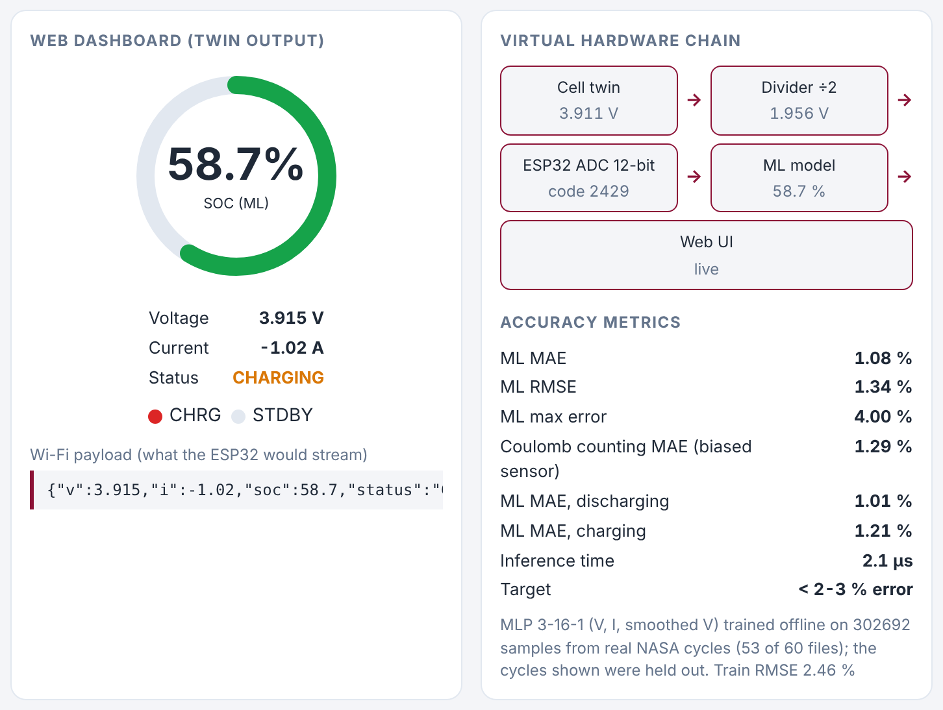
Motivation Slide 01
Relevance of the Topic
Scope of the ML Approach
IoT-Enabled BMS Growth: Rising EV and portable-electronics adoption has created strong demand for low-cost, connected battery monitoring.
Safety & Reliability: Inaccurate SOC estimation can cause overcharging or deep discharge; a live, always-on dashboard helps the user avoid both.
Safe, Repeatable, Zero-Cost Testing: A digital twin replays charge and discharge cycles as often as needed, with no cells to damage and no hardware to buy.
Model-Free Mapping: A trained ML model learns the voltage-to-SOC relationship directly from data, avoiding the need to derive cell-specific equivalent-circuit equations.
Real Data, Portable Model: The twin is driven by real NASA Li-ion cycling data, and the same ML model can later be ported to the ESP32.
2

Slide 3
Introduction Slide 02
Broad Domain: Smart BMS
Core Functions: Real-time voltage sensing, charge-status detection, live SOC estimation, and web-based telemetry.
State of Charge (SOC): Represents the available charge percentage relative to total nominal capacity.
SOC(t) = SOC₀ − (1/C_{n}) ∫ i(t) dt
SOC₀ = initial charge · Cₙ = nominal capacity · i(t) = current draw
Non-Linear Battery Behavior: The voltage-to-SOC relationship is non-linear and shifts with temperature, discharge rate, and cell aging, motivating a data-driven ML approach.
Battery Cell: Single-cell Li-ion battery (3.7V, 18650 form factor), represented in the twin by real NASA Li-ion cycling data.
The ML Model: An MLP (3-16-1, tanh hidden layer) trained on voltage, current, and smoothed voltage to directly predict SOC, replacing explicit equivalent-circuit equations.
Digital Twin Execution: A virtual ESP32 + TP4056 + 18650 chain replays the NASA data, adds ADC noise and a current offset, runs the ML model, and streams a Wi-Fi payload to the web dashboard.
3

Slide 4
State of the Art in Related Area Slide 03
Authors | Title & Venue (Year) | Key Contributions / Inference | Remarks
Panda et al. | Enhanced SOC estimation using ML algorithms, Sci. Rep. (2024) | Compared SVM, Neural Network, Ensemble, and Gaussian Process Regression on real-time driving data. | Gaussian Process Regression gave the lowest SOC prediction error.
Wang et al. | High-Fidelity SOC Estimation of Li-Ion Batteries using ML, arXiv (2019) | Trained a feedforward neural network on pulse-injection response data to map directly to SOC. | Showed pulse-based features improve ML SOC accuracy.
Zhang et al. | SOC Estimation using CNN-Bi-LSTM-AM under Low Temperature, PMC (2024) | Combined CNN, bidirectional LSTM, and attention to estimate SOC from voltage/current sequences. | MAE of 0.17-0.77% achieved across driving cycles.
Yang et al. | SOC Estimation using Residual CNNs, PMC (2022) | Used stacked multi-variable time-series inputs with residual CNN blocks to regress SOC. | Deep learning outperformed classical benchmarks at low temperatures.
4

Slide 5
Literature Review Summary Slide 04
🧮
🕓
🧠
Coulomb Counting
Open Circuit Voltage
Machine Learning (ANN / Regression)
Pros: Very simple, low computational footprint.
Cons: Drifts severely over time due to current sensor noise accumulation and unknown initial SOC.
Pros: Extremely accurate at equilibrium.
Cons: Unusable in real-time EV driving; requires hours of resting time for voltage stabilization.
Pros: Learns the non-linear voltage-to-SOC mapping directly from data and adapts well to aging.
Cons: Needs a labeled dataset and offline training before deployment.
5

Slide 6
Project Objective Slide 05
PRIMARY OBJECTIVE
To design and implement a digital twin of a low-cost, real-time, ESP32-based battery monitoring system that uses a Machine Learning model to estimate State of Charge and displays live voltage, charge percentage, and charging status on a web dashboard.
Sub-Objectives
Dataset Preparation: Average the NASA charge and discharge files to a 5 s grid and derive coulomb-counting SOC labels for the ML model.
Model Development: Train and evaluate an MLP (3-16-1) in Python to map voltage, current, and smoothed voltage to SOC.
Virtual ESP32 & Web Dashboard Integration: Run the model in a virtual ESP32 with ADC noise and a current offset, and build a real-time web dashboard with smooth animations for SOC and charging status.
Benchmarking on Held-Out Cycles: Evaluate SOC estimation accuracy on held-out NASA charge and discharge cycles against the coulomb-counting reference.
6

Slide 7
Methodology Slide 06
01
02
03
NASA Data Preparation
Preprocessing & Feature Engineering
Model Training
Load the 60 NASA charge/discharge CSV files, average the four cell voltages (Vbat1-4), and resample to a 5 s grid.
Derive coulomb-counting SOC labels per cycle; build inputs: voltage, current (discharge positive), and 60 s smoothed voltage.
Train a 3-16-1 tanh MLP offline in Python on 53 files with noise augmentation (302,692 samples); hold out 7 files for testing.
04
05
06
Virtual ESP32 Inference
Web Dashboard Integration
Validation & Benchmarking
Replay the cell signals through a virtual ESP32 (input divided by 2, 12-bit ADC, 5 mV noise, 30 mA offset) and run the model per sample.
Show the SOC ring, voltage, current, charging status, CHRG/STDBY LEDs, and the Wi-Fi payload live on a web dashboard.
Compare ML SOC with the coulomb-counting reference on held-out cycles; report mean, RMSE, and max error against the 2-3% target.
7

Slide 8
Expected Outcome & Deliverables Slide 07
🧩
📈
🖥️
Digital Twin
Target Metrics
Real-Time Telemetry
A working digital twin of the ESP32 + TP4056 + 18650 chain, driven by real NASA data, with an ML-based SOC model and a custom real-time web dashboard.
ML model SOC estimation error under 2-3% on held-out charge and discharge cycles; smooth, low-latency updates on the live web dashboard.
Live web dashboard showing voltage, charge percentage, and charging status (Charging / Discharging / Charged-Standby) with smooth animations.
8

Slide 9
System Overview & Block Diagram Slide 08
Digital Twin Block Architecture
Component | Specification
Data Source | NASA Li-ion cycling data (60 CSV files)
Virtual ESP32 ADC | 12-bit, input divided by 2, 5 mV noise, 30 mA offset
Virtual TP4056 | Charging / Discharging / Charged-Standby, CHRG and STDBY LEDs
ML Model | MLP 3-16-1 (tanh), about 7 µs per sample
Dashboard | SOC ring, voltage, current, plots, Wi-Fi payload
Data Source: Real NASA Li-ion charge and discharge data stands in for the 18650 cell.
Voltage Sensing: A virtual divider halves the cell voltage; the 12-bit ADC adds 5 mV noise on the pin.
Processing Unit: A virtual ESP32 adds a 30 mA current offset and runs the ML model for SOC.
Charge Status: A virtual TP4056 reports Charging / Discharging / Charged-Standby with CHRG and STDBY LEDs.
Web Dashboard: Animated SOC ring, voltage, current, status, plots, and the Wi-Fi payload.
Wi-Fi Payload
v: cell voltage (V)
i: current (A)
soc: ML-estimated SOC (%)
status: charging state streamed to the dashboard
NASA cell data
real Li-ion cycles
Voltage
divider (÷2)
Virtual ESP32
ADC + ML model
Wi-Fi payload
Web
Dashboard
Virtual TP4056
charge status
Signal / data flow: solid boxes = virtual hardware or software components · arrows = data path
9

Slide 10
Dataset & Data Preparation Slide 09
Type | Files | Rate (A) | Duration (s) | Capacity (Ah)
Discharge | 01-02 (2 files) | 0.5 | 20622-21138 | 2.59-2.65
Discharge | 03-11 (9 files) | 1 | 9572-10503 | 2.52-2.77
Discharge | 12-21 (10 files) | 2 | 4486-4964 | 2.34-2.62
Discharge | 22-30 (9 files) | 3 | 3072-3378 | 2.29-2.56
Charge (CC then CV) | 01-10 (10 files) | 1 | 10614-13530 | 2.74-3.02
Charge (CC then CV) | 11-21 (11 files) | 2 | 6125-7600 | 2.64-2.86
Charge (CC then CV) | 22-30 (9 files) | 3 | 4374-5252 | 2.45-2.72
Data Preparation
Train / Test Split
Columns: Time; Current; Temperature; Vbat1-4. Cell voltage = mean of Vbat1-4 on a 5 s grid; charge current is sign-flipped (discharge positive).
SOC reference: No SOC column exists, so SOC is coulomb counting normalised to each cycle's own measured capacity (discharge 100% to 0%, charge 0% to 100%).
Training: 53 of 60 files (26 discharge, 27 charge), noise-augmented to 302,692 samples.
Held out: discharge 02 and pairs 10, 20, 30 (7 files).
Source: NASA Ames Prognostics Center of Excellence, Li-ion Battery Aging Datasets (data.nasa.gov).
10

Slide 11
Results on Held-Out Cycles Slide 10
Cycle | ML mean (%) | ML RMSE (%) | ML max (%) | Coulomb counting mean (%)
1 A pair (discharge 10 + charge 10) | 1.13 | 1.46 | 4.8 | 1.56
2 A pair (discharge 20 + charge 20) | 1.16 | 1.57 | 4.5 | 0.90
3 A pair (discharge 30 + charge 30) | 2.24 | 2.83 | 7.0 | 0.67
0.5 A discharge only (02) | 1.70 | 1.93 | 5.0 | 3.11
Error in SOC percentage points vs the coulomb-counting reference, with 5 mV ADC noise and a 30 mA offset. All four cycles meet the 2-3% target.
ML vs Coulomb counting: ML has the lower mean error on the 1 A pair and the 0.5 A run (1.70 vs 3.11); Coulomb counting is lower on the 2 A and 3 A pairs.
Fair baseline: Coulomb counting starts from the true SOC, so short runs barely drift.
Generalisation: held-out cycles come from the same cells as training, so this shows generalisation across cycles, not across cells.
Label quality: SOC labels are only as good as the coulomb-counting reference.
11

Slide 12
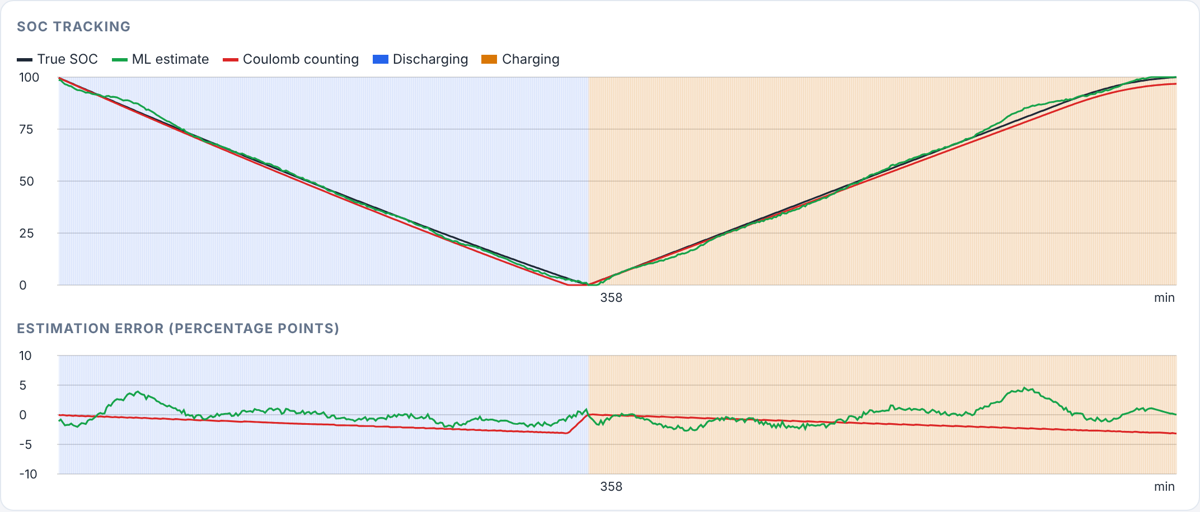
Twin Dashboard Output Slide 11
SOC vs time and estimation error for the same held-out 1 A pair.
What the Dashboard Shows
Live view: SOC ring, voltage, current, status, CHRG/STDBY LEDs, Wi-Fi payload.
Plots: True SOC, ML estimate, and Coulomb counting vs time, plus error.
Metrics: ML and Coulomb-counting error; adjustable ADC noise and offset.
Twin dashboard in NASA replay mode (held-out 1 A pair, charging phase).
12

Slide 13
Conclusion & Future Scope Slide 12
Conclusion
Future Scope
Digital Twin Delivered: A virtual ESP32 + TP4056 + 18650 chain driven by real NASA Li-ion data, with a live web dashboard for charging and discharging.
Accuracy: The 3-16-1 MLP gave a 1.13-2.24 percentage-point mean SOC error on held-out cycles (5 mV ADC noise, 30 mA offset), meeting the 2-3% target.
Real-Time Capable: Inference takes about 7 µs per sample in the dashboard.
Limits: Tested across cycles of the same cells; SOC labels rely on the coulomb-counting reference.
More Cells: Retrain on data from more cells to test generalisation across cells.
Temperature Input: Add temperature as a model input.
Unknown Starting SOC: Test the estimator when the initial SOC is not known.
Hardware-in-the-Loop: Port the model to the ESP32 and test it with the physical ESP32 + TP4056 setup.
13

Slide 14
References Slide 13
References
[1] Panda et al., "Enhanced SOC estimation using ML algorithms," Sci. Rep., 2024.
[2] Wang et al., "High-Fidelity SOC Estimation of Li-Ion Batteries using ML," arXiv, 2019.
[3] Zhang et al., "SOC Estimation using CNN-Bi-LSTM-AM under Low Temperature," PMC, 2024.
[4] Yang et al., "SOC Estimation using Residual CNNs," PMC, 2022.
[5] NASA Ames Prognostics Center of Excellence (PCoE), "Li-ion Battery Aging Datasets," NASA Open Data Portal (Dashlink resource 133), issued 2010. data.nasa.gov/dataset/li-ion-battery-aging-datasets
DATASET NOTE
The NASA page lists several Li-ion aging sets; the 60 constant-current charge and discharge files used here are from that collection.
14

