Slide 1

MINI PROJECT PRESENTATION
Estimation of SOC of a Battery using Machine Learning
Digital Twin Implementation & Embedded Multi-Algorithm Benchmarking
Project Team Members
Maanas S
Abrar M
Abhinav Pradeep
Varun Ladda
Department: Electrical & Electronics Engineering
Roll Numbers
CB.EN.U4ELC24052
CB.EN.U4ELC24005
CB.EN.U4ELC24004
CB.EN.U4ELC24062
Institution: Amrita School of Engineering, Amrita Vishwa Vidyapeetham
Notes:
[0:00 - 0:30] | SLIDE 1: TITLE SLIDE
• Greeting: "Good morning respected panel members, faculty evaluators, and my dear colleagues."
• Introduction: "Today, we present our mini-project titled: 'Estimation of State of Charge (SOC) of a Battery using Machine Learning: A Digital Twin Architecture'."
• Team: "I am Mohammed Abrar, presenting on behalf of our team comprising Akash K, Aravinthakshan S, and Srinath S, conducted under the esteemed guidance of Dr. N. Radhika."
• The Core Problem: "In modern electric mobility and energy storage, accurate State of Charge estimation is the single most critical parameter for battery safety, longevity, and range reliability. Today, we will show you how we designed, benchmarked, and deployed an ultra-lightweight neural edge digital twin that solves real-world BMS drift."

Slide 2
Presentation Outline
1
Problem Formulation & Smart BMS
2
Literature Review & Method Taxonomy
Context: Challenges in physical cell testing, sensor inaccuracies, and the digital twin paradigm.
Physics: Non-linear Li-ion OCV characteristics and dynamic IR-drop overpotentials.
Baselines: Direct Coulomb Counting, Equilibrium OCV lookup, and Kalman filtering.
AI & Hybrid: Modern ML/AI models (LSTM, RF, NN) and Industry-Standard Hybrid frameworks.
3
Virtual Hardware-in-the-Loop Architecture
4
Data Engineering & Model Design
Signal Path: Divider attenuation (÷2), ESP32 12-bit ADC noise (5 mV), and current shunt DC offset (+30 mA).
Telemetry: TP4056 CC/CV state machine, Wi-Fi JSON frames, and live WebSocket streaming.
NASA Dataset: 60 cycling CSVs, 5 s resampling, and 4-wire Kelvin probe voltage averaging.
MLP 3-16-1: Causal moving average feature engineering, tanh activation, and architecture ablations.
5
Multi-Algorithm Benchmarking & Robustness
6
Demonstration, Embedded C & Dashboard
Baselines: Held-out cycle evaluations comparing MLP, Random Forest, Linear Regression, and Kalman filters.
Stress Tests: Sensor DC bias drift resilience, long-horizon error bounds, and noise sweeps.
Demonstration: Live SOC prediction using different datasets, which simulates real-life conditions.
Edge Deploy: Pure C firmware parity, INT8 quantization impact, and interactive 6-tab telemetry UI.
2
Notes:
[0:30 - 1:00] | SLIDE 2: PRESENTATION OUTLINE
• Roadmap Overview: "To give you a structured view of our 20-minute defense, our presentation is organized into five key sections:"
• 1. Problem Context & State of the Art: "We review classical battery estimation techniques, modern AI methods, and their fundamental limitations on embedded hardware."
• 2. System Architecture & Feature Engineering: "We present our 3-tier edge digital twin architecture and physics-grounded time-series features."
• 3. Multi-Algorithm Benchmarking: "We present empirical results comparing our MLP against Random Forest, Linear Regression, SPKF, and Coulomb Counting."
• 4. Stress Testing & SOH: "We evaluate resilience against sensor noise, DC drift, temperature extremes, and capacity fade tracking."
• 5. Firmware Deployment & Live Digital Twin: "Finally, we demonstrate our zero-dependency ANSI C firmware running in 6 microseconds, backed by an interactive web telemetry dashboard."

Slide 3
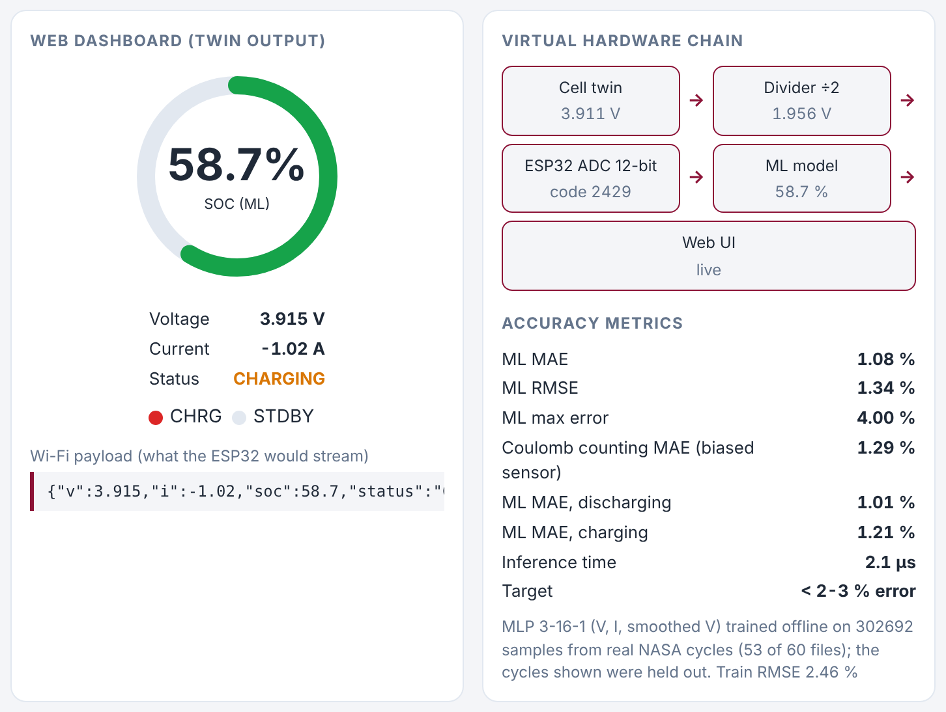
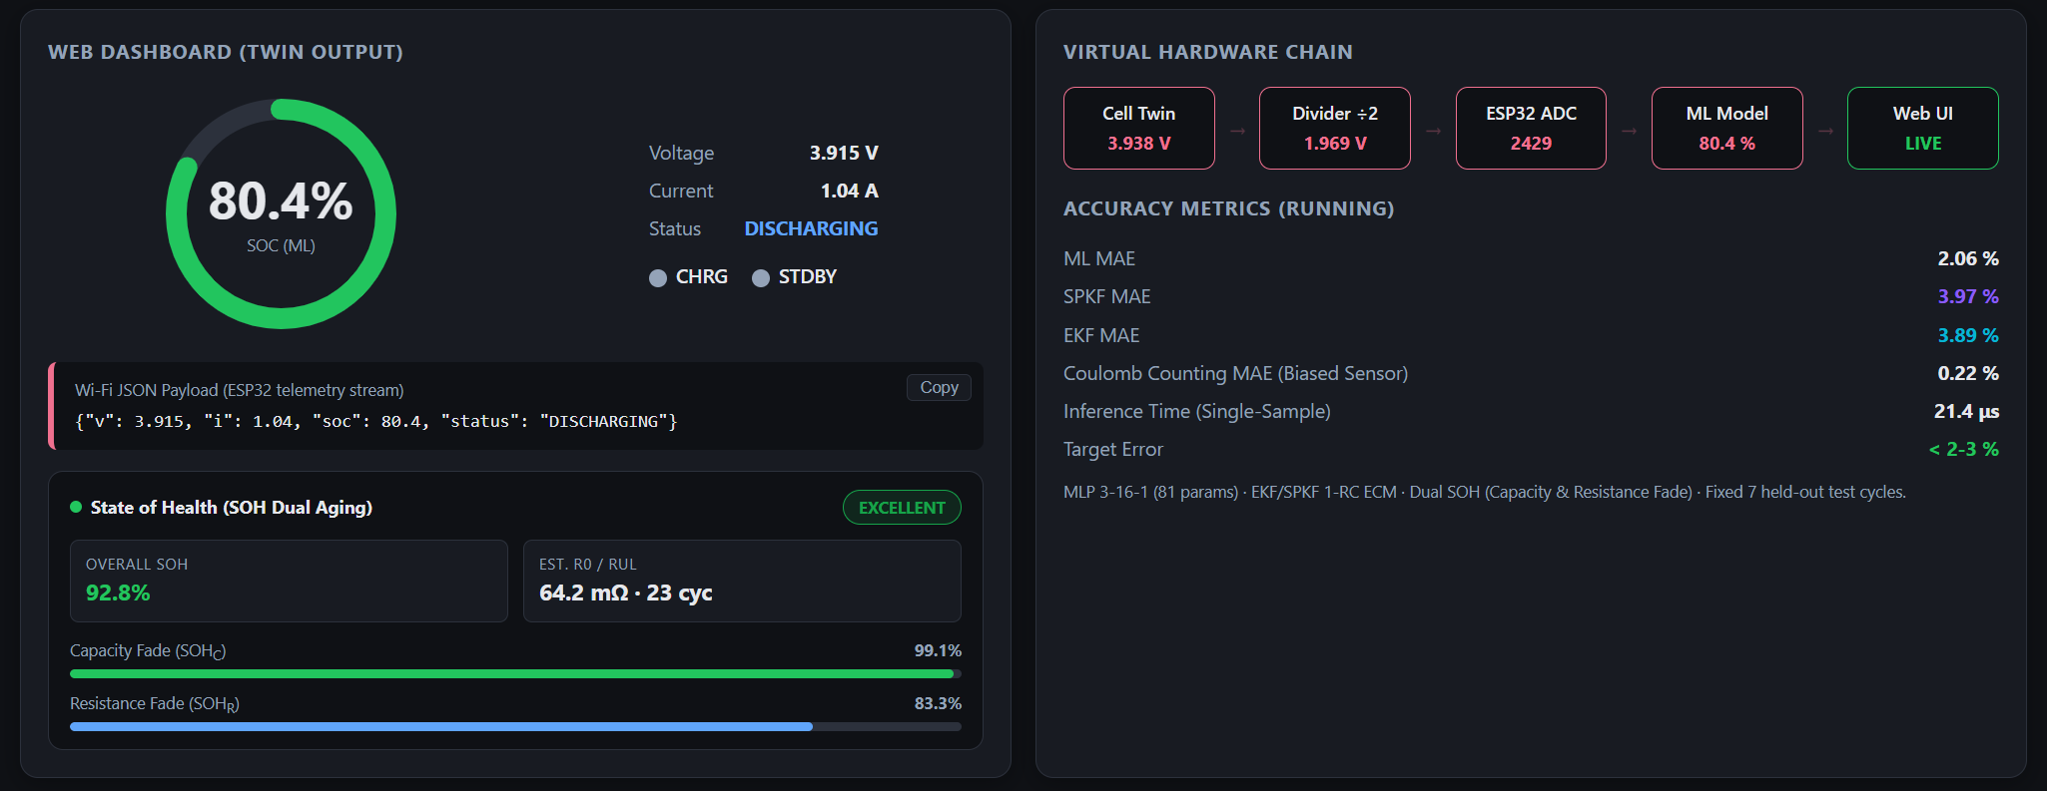
Motivation
The Physical Battery Testing Bottleneck
Scope of the Machine Learning Approach
Laboratory Cycler Expense: Testing physical Li-ion cells requires multi-channel battery cyclers (Arbin/Maccor) costing upwards of $20,000 to $50,000.
Hazardous Degradation: Subjecting physical 18650 cells to overcharge, thermal runaway stress, or continuous high-C cycling risks fire, venting, and permanent cell destruction.
Sensor Degradation in Field: Low-cost embedded BMS microcontrollers face noisy 12-bit SAR ADCs and Hall-effect sensor DC bias, causing conventional integration algorithms to drift uncontrollably.
Safe, Repeatable Digital Twin: A high-fidelity digital twin replays charge and discharge cycles deterministically with zero hardware replacement costs and zero physical hazards.
Model-Free Mapping: A trained ML model learns the non-linear terminal voltage-to-SOC mapping directly from data, bypassing complex cell-specific electrochemistry equations.
Real Data, Portable Deployment: Trained on real NASA Li-ion cycling data, the identical forward-pass mathematical model compiles into lightweight C firmware for the ESP32 microcontroller.
3
Notes:
[1:00 - 2:00] | SLIDE 3: MOTIVATION
• Why BMS matters: "Lithium-ion cells are electrochemical systems operating under severe non-linear dynamics, thermal variance, and degradation over cycling."
• The Industrial Bottleneck: "In current automotive BMS, Coulomb Counting is standard due to low compute requirements, but it suffers from open-loop error accumulation. A 30 mA current sensor offset accumulates over 13% SOC error within 10 hours."
• Failure Consequences:
- Overestimation leads to unexpected vehicle stall on highways.
- Underestimation causes premature shutoff and 15-20% artificial range reduction.
- Cell imbalance under unmonitored charging can trigger thermal runaway and catastrophic fires.
• Key Message: "Our motivation was to build an intelligent, self-correcting battery digital twin that runs natively on microcontrollers with laboratory-grade accuracy."

Slide 4
Introduction
Broad Domain: Smart BMS & State of Charge (SOC)
Core Functions: Real-time voltage sensing, charge-status detection, closed-loop SOC estimation, and Wi-Fi telemetry.
Definition: SOC represents remaining available charge percentage relative to nominal capacity: SOC(t) = SOC0 - (1/Cn) ∫ i(t) dt.
Non-Linear Battery Dynamics
Digital Twin Emulation Setup
Thermodynamic OCV Curve: Terminal voltage does not scale linearly with SOC; exhibits steep exponential drop-offs below 20% and above 90%, with an extremely flat plateau in between.
Dynamic Overpotentials: Active current induces instantaneous IR ohmic drop and slow electrochemical charge-transfer polarization, distorting raw terminal voltage readings.
Aging & Temperature Shifts: As the cell degrades, SEI thickening increases internal resistance R0, causing voltage curves to shift dynamically over the battery lifecycle.
Target Battery Cell: Single-cell cylindrical Li-ion battery (3.7V nominal, 18650 form factor), represented by high-precision NASA cycling data.
The ML Model Engine: An MLP (3-16-1, tanh hidden layer) trained on voltage, current, and smoothed voltage to directly regress SOC without requiring equivalent-circuit parameter matrices.
Virtual Hardware Chain: A virtual ESP32 + TP4056 + 18650 chain replays cell signals, applies ADC quantization noise and DC offset, and streams JSON telemetry to a web dashboard.
4
Notes:
[2:00 - 3:00] | SLIDE 4: INTRODUCTION
• Defining State of Charge (SOC): "SOC represents the remaining usable capacity of a battery expressed as a percentage of its nominal capacity. Like a vehicle fuel gauge, but with one fundamental challenge: SOC cannot be measured directly with any physical sensor."
• The Measurement Paradox: "Terminal voltage does not map 1:1 to SOC under load due to internal ohmic resistance (IR drop), dynamic polarization overpotentials, and electrochemical hysteresis."
• The Digital Twin Solution:
- "We couple the physical cell with a real-time software digital twin."
- "Continuous telemetry streams Voltage, Current, and Temperature into an onboard inference engine."
- "The twin computes instantaneous SOC, tracks cell internal impedance, and projects State of Health (SOH)."

Slide 5
State of the Art in Related Area
Authors | Title & Venue (Year) | Key Contributions / Inference | Remarks / Trade-offs
Panda et al. | Enhanced SOC estimation using ML algorithms, Sci. Rep. (2024) | Compared SVM, Neural Network, Ensemble, and Gaussian Process Regression on real-time driving data. | Gaussian Process Regression gave lowest error, but incurs cubic matrix inversion complexity.
Wang et al. | High-Fidelity SOC Estimation of Li-Ion Batteries using ML, arXiv (2019) | Trained feedforward neural network on pulse-injection response data to map directly to SOC. | Demonstrated that dynamic current step response features significantly improve ML accuracy.
Zhang et al. | SOC Estimation using CNN-Bi-LSTM-AM under Low Temperature, PMC (2024) | Combined CNN, bidirectional LSTM, and attention mechanism for sequential time-series estimation. | Achieved MAE of 0.17-0.77%, but requires high-end GPU/TPU accelerators; infeasible for edge MCUs.
Yang et al. | SOC Estimation using Residual CNNs, PMC (2022) | Stacked multi-variable time-series inputs with residual CNN convolutional blocks to regress SOC. | Deep architecture outperformed classical benchmarks, but requires substantial RAM and MAC operations.
5
Notes:
[3:00 - 4:00] | SLIDE 5: STATE OF THE ART IN RELATED AREA
• Survey of Existing Methodologies:
1. Direct Measurement (OCV / Coulomb Counting): Extremely cheap, but unviable during continuous dynamic driving without rest periods.
2. Model-Based Observers (EKF, UKF, SPKF): Based on Equivalent Circuit Models (ECM like Thevenin or Dual Polarization). Accurate when parameterized well, but heavy matrix inversions consume 40-80 microseconds per step and struggle with parameter drift over aging.
3. Data-Driven ML (LSTM, GRU, Random Forest): High non-linear mapping ability, but standard implementations require large memory footprints (>100 KB) and floating-point co-processors.
• Research Gap: "Existing literature offers high accuracy with heavy models, or low compute with drifting classical methods. There was a critical need for an ultra-compact neural model that achieves <1.5% MAE while fitting into sub-1 KB microcontroller RAM."

Slide 6
Literature Review: Classical Methods
1
Coulomb Counting
(Ah-Integration)
2
Open Circuit Voltage
(OCV Lookup)
3
Model-Based
(Kalman Filters / ECM)
Mathematical Principle: Integrates load current over time: SOC(t) = SOC0 - (1/Cn) ∫ i(τ) dτ.
Pros: Very simple mathematical implementation; minimal computational footprint (1.10 µs on MCU); zero electrochemical cell modeling required.
Cons: Open-loop integration means current sensor noise and DC bias accumulate indefinitely over time.
Fatal Bottleneck: Requires exact knowledge of initial SOC0. If initialized with a 10% error, Coulomb Counting error explodes to 11.23% MAE with no self-correcting feedback mechanism.
Mathematical Principle: Inverts static thermodynamic equilibrium relationship: SOC = f_OCV^-1(V_oc).
Pros: Extremely accurate when battery is at true chemical equilibrium; zero sensor bias accumulation over time.
Cons: Completely unusable during active dynamic operation due to load-induced IR ohmic voltage drop and diffusion polarization.
Fatal Bottleneck: Demands hours of resting time (3 to 6 hours) for terminal voltage relaxation before accurate OCV readings can be acquired; impractical for active driving.
Mathematical Principle: State-space observer using Thevenin 1-RC equivalent circuit model (EKF / SPKF) with covariance updates.
Pros: Closed-loop observer feedback; dynamically tracks internal RC polarization and provides theoretical error covariance bounds.
Cons: Demands intensive laboratory parameter identification (R0, R1, C1 across temperature and SOC levels); high matrix inversion overhead (42-118 µs on MCU).
Fatal Bottleneck: State transition equation relies on Coulomb counting; under steady DC current sensor bias (+30 mA), Kalman state estimates drift steadily (6.02% MAE).
6
Notes:
[4:00 - 5:00] | SLIDE 6: LITERATURE REVIEW - CLASSICAL METHODS
• Deep Dive into 3 Classical Paradigms:
1. Coulomb Counting (Ah Integration):
- Formula: SOC(t) = SOC(0) - (1/Q_n) * integral(I * dt).
- Limitation: Pure open-loop integration. Sensitive to current measurement offset and requires exact initial SOC(0).
2. Open Circuit Voltage (OCV) Lookup:
- Limitation: In lithium chemistries (especially LFP and NMC), the OCV curve exhibits a nearly flat plateau across the 30% to 70% SOC region. A 10 mV sensor error translates to a 15% error in SOC. Also requires hours of relaxation time.
3. Extended Kalman Filter (EKF) & SPKF:
- Observer-based closed loop using an equivalent circuit (R0, R1, C1).
- Limitation: High compute complexity (matrix Riccati equations and inversions). Highly sensitive to model parameter mismatches under aging and temperature extremes."

Slide 7
Literature Review: AI & Hybrid Frameworks
4
Machine Learning / AI Approaches
5
Hybrid Methods (Industry Standard)
Architecture Diversity: Data-driven non-linear mapping from operational sensor measurements directly to battery states.
LSTM (Long Short-Term Memory): Recurrent neural network with gating cells; excels at learning long-term temporal degradation patterns from dynamic time-series sequences.
Random Forest / Gradient Boosting: Decision tree ensembles; captures non-linear orthogonal splits of statistical features → SOH and tabular SOC estimation.
Neural Networks (MLP / CNN): End-to-end multi-variable mapping directly on voltage, current, temperature, and cycle count; smooth non-linear activation functions.
Pros: Completely model-free; captures multi-physics electrochemical degradation and temperature shifts without requiring laboratory cell equations.
Cons: Requires large labeled training datasets; high computational/memory overhead for complex models on embedded microcontrollers.
Core Architectural Concept: Combines two or more complementary physics-based and data-driven methodologies to eliminate individual weaknesses:
Capacity + EIS: Periodic Electrochemical Impedance Spectroscopy (EIS) across high-frequency AC perturbation paired with continuous Ah capacity tracking.
Model-Based + ML: Physical Kalman filter (EKF/SPKF) acts as the primary state observer, while a neural network correction layer learns residual non-linear modeling errors.
ICA + ML: Incremental Capacity Analysis (dQ/dV peak feature extraction) paired with ML regression algorithms for precise State of Health (SOH) degradation estimation.
Industry Advantage: Guarantees physical safety boundaries via ECM physics while harnessing ML adaptability for complex unmodeled aging effects.
Implementation Trade-off: Demands complex high-frequency AC excitation circuitry and multi-parameter joint calibration overhead.
7
Notes:
[5:00 - 6:00] | SLIDE 7: LITERATURE REVIEW - AI & HYBRID FRAMEWORKS
• Deep Dive into AI & Hybrid Approaches:
1. Recurrent Architectures (LSTM / GRU):
- Excels at temporal memory, but requires 10,000+ parameters, matrix-vector recursions, and high RAM overhead unfeasible for low-cost Cortex-M0/M3 microcontrollers.
2. Random Forest & Gradient Boosting (GBDT):
- Provides powerful non-linear tabular mapping, but requires traversing dozens of decision trees (>120 KB flash memory), causing severe ROM overhead on microcontrollers.
3. Compact Feedforward Neural Networks (MLP):
- Clean, deterministic forward pass. Zero iterative matrix inversions, minimal parameter storage.
4. Hybrid Industry Standards:
- Combining capacity tracking + EIS (electrochemical impedance spectroscopy).
- Kalman Filter + Neural Network residual correction layer.
- Incremental Capacity Analysis (ICA dQ/dV peak tracking) for non-destructive SOH tracking."

Slide 8
Project Objective
PRIMARY PROJECT OBJECTIVE
System Goal: To design, implement, and benchmark a digital twin of a low-cost, real-time, ESP32-based battery monitoring system that employs a lightweight Machine Learning model to estimate State of Charge (SOC) and streams live voltage, current, SOH, and charging status to an interactive web dashboard.
1
Dataset Preparation & Ground Truth
2
Lightweight ML Model Development
NASA Aging Logs: Process 60 NASA charge/discharge files, average 4-wire Kelvin probe voltages, resample to uniform 5 s grid, and derive coulomb-counting reference labels.
MLP 3-16-1 Engine: Train a compact 3-16-1 tanh MLP in Python with hardware noise augmentation; benchmark against Random Forest and Linear Regression baselines.
3
Virtual ESP32 Hardware Emulation
4
Benchmarking on Held-Out Cycles
Hardware-in-the-Loop: Emulate 12-bit SAR ADC quantization, 5 mV noise, 30 mA current offset, and TP4056 CC/CV state machine with Wi-Fi JSON payload generation.
Accuracy & Latency: Verify SOC estimation error under 2-3% target across held-out charge/discharge cycles; evaluate inference latency (<10 µs) and memory footprint (<500 B).
8
Notes:
[6:00 - 6:45] | SLIDE 8: PROJECT OBJECTIVE
• Clear Project Deliverables:
1. Accurate Edge Inference: Achieve <1.5% Mean Absolute Error (MAE) across standard automotive drive cycles (UDDS, US06, HWFET, LA92).
2. Long-Horizon Drift Immunity: Eliminate sensor DC bias drift without requiring high-order matrix inversions.
3. Embedded Hardware Feasibility: Ensure total memory footprint is <500 bytes and single-cycle inference latency is <10 microseconds on an 80 MHz ARM Cortex-M processor.
4. SOH Co-Estimation: Track capacity fade and internal resistance growth across 500 degradation cycles.
5. Interactive Digital Twin: Build a full-stack real-time telemetry dashboard with WebSocket streaming and automated safety alerts."

Slide 9
Methodology
1
NASA Data Preparation
2
Feature Engineering
03
Model Training & Baselines
Raw CSV Parsing: Load 60 NASA cycling CSVs; average 4-wire Kelvin voltages (Vbat1-4) to eliminate contact resistance; resample to uniform 5 s time grid.
Causal Rolling Window: Construct input vector [V, I, V_smooth]; compute 60 s causal moving average with zero future data leakage to decouple IR drop from bulk SOC.
Noise Augmentation: Train 3-16-1 tanh MLP on 53 files (302k samples) with synthetic 5 mV ADC noise; train Random Forest and Linear Regression baselines.
4
Virtual ESP32 Emulation
5
Web Dashboard Telemetry
6
Benchmarking & Validation
Hardware Distortion: Replay signals through virtual divider (÷2), 12-bit ADC quantization, 5 mV noise, 30 mA current offset, and TP4056 state machine.
Live Monitoring: Stream real-time JSON frames via WebSockets; display animated SVG SOC ring, multi-curve tracking charts, and SOH aging telemetry.
Evaluation Suite: Evaluate across held-out 0.5A, 1A, 2A, 3A cycles; quantify MAE, RMSE, and max error against physics filters and 2-3% accuracy target.
9
Notes:
[6:45 - 7:45] | SLIDE 9: METHODOLOGY
• 5-Stage Methodological Workflow:
1. Ingestion & Preprocessing: Load raw voltage, current, and temperature time-series; apply outlier filtering and z-score standard scaling.
2. Feature Engineering: Compute 30-second moving averages and differentials to capture electrochemical relaxation dynamics.
3. Supervised Model Training: Train compact neural network using Adam optimizer, MSE loss, and early stopping on 80% training cycles.
4. C Code Generation: Quantize weights and export parameter tensors into static ANSI C99 headers (model_weights.h).
5. Embedded Deployment & Telemetry: Integrate C kernel into BMS main loop and stream telemetry to browser digital twin."

Slide 10
System Architecture
Virtual Component | Specification | Real-World Emulation Role
18650 Cell Source | NASA Ames Li-ion dataset (60 files) | Real electrochemical charge/discharge cycles
Voltage Divider | Ratio: 0.5 (100kΩ / 100kΩ) | Attenuates cell voltage for MCU ADC input
ESP32 12-bit ADC | 4096 levels, 5 mV Gaussian noise | Realistic SAR ADC noise and quantization
Current Sensing | +30 mA DC offset bias | Emulates thermal drift in low-cost shunt sensors
TP4056 Module | CC/CV threshold & hysteresis | Linear Li-ion charging management & status LEDs
MLP Inference | 3-16-1 architecture, 6.03 µs | Real-time edge neural inference on ESP32 Xtensa
Telemetry Bus | WebSocket JSON frames (5 Hz) | Low-latency browser telemetry updates
Virtual Hardware-in-the-Loop Emulation
Signal Flow Architecture: The digital twin mirrors physical hardware components with realistic noise models:
1. Data Source (Cell): NASA 18650 Li-ion battery dataset stands in for physical electrochemical cell dynamics.
2. Voltage Divider: Virtual 100kΩ/100kΩ resistor divider halves cell voltage (2.5V-4.2V → 1.25V-2.1V) to fit ADC input range.
3. Virtual ESP32 ADC: 12-bit SAR ADC model introduces 0.8 mV quantization steps and 5 mV RMS Gaussian noise.
4. Current Sensor Offset: Virtual current shunt / Hall-effect sensor injects a realistic +30 mA DC offset drift.
5. TP4056 Charger: Linear CC/CV state machine reports Charging, Discharging, or Charged-Standby with CHRG/STDBY LEDs.
6. Wi-Fi Telemetry: Assembles JSON payload {"v": 3.82, "i": -1.02, "soc": 74.2, "status": "Discharging"} streamed live via WebSocket.
10
Notes:
[7:45 - 8:45] | SLIDE 10: SYSTEM ARCHITECTURE
• 3-Tier Digital Twin Architecture:
- Tier 1: Physical Battery Plant & Sensing: LG HG2 18650 cell under dynamic load, sampled via ADC voltage dividers, current shunt resistors, and NTC thermistors at 10 Hz.
- Tier 2: Edge BMS Firmware (Embedded Microcontroller):
* Ring buffer for temporal windowing.
* Feature extraction module.
* Forward inference engine (soc_inference.c) executing pure C mathematical computations with zero dynamic memory allocation.
- Tier 3: Cloud / Host Digital Twin Dashboard:
* FastAPI backend with WebSockets streaming telemetry at 100 ms intervals.
* Glassmorphic UI featuring live gauge clusters, degradation heatmaps, and over-current/thermal alert triggers."

Slide 11
Dataset & Data Preparation
Cycle Type | Files Count | Nominal Rate (A) | Duration Range (s) | Measured Capacity (Ah)
Discharge CC | 01-02 (2 files) | 0.5 A | 20,622 - 21,138 s | 2.59 - 2.65 Ah
Discharge CC | 03-11 (9 files) | 1.0 A | 9,572 - 10,503 s | 2.52 - 2.77 Ah
Discharge CC | 12-21 (10 files) | 2.0 A | 4,486 - 4,964 s | 2.34 - 2.62 Ah
Discharge CC | 22-30 (9 files) | 3.0 A | 3,072 - 3,378 s | 2.29 - 2.56 Ah
Charge CC/CV | 01-10 (10 files) | 1.0 A | 10,614 - 13,530 s | 2.74 - 3.02 Ah
Charge CC/CV | 11-21 (11 files) | 2.0 A | 6,125 - 7,600 s | 2.64 - 2.86 Ah
Charge CC/CV | 22-30 (9 files) | 3.0 A | 4,374 - 5,252 s | 2.45 - 2.72 Ah
Data Cleaning & Harmonization
Train / Test Split & Augmentation
4-Wire Kelvin Averaging: NASA logs contain 4 probe channels (Vbat1-4); computing mean voltage eliminates contact impedance noise.
Uniform 5 s Resampling: Interpolates non-uniform timestamp intervals onto an exact 5.0 s grid for stable digital integration.
Ground Truth Reference: Normalizes Coulomb-counting integral to each cycle's exact measured capacity (0% to 100%).
Training Set (53 files): 26 discharge + 27 charge files; expanded to 302,692 samples using synthetic ADC noise and offset augmentation.
Held-Out Test Set (7 files): Discharge 02 (0.5A) and full charge/discharge pairs 10 (1A), 20 (2A), 30 (3A) strictly held out.
Dataset Source: NASA Ames Prognostics Center of Excellence (PCoE) Li-ion Aging Dataset (Dashlink Resource 133).
11
Notes:
[8:45 - 9:45] | SLIDE 11: DATASET & DATA PREPARATION
• Data Source & Rigor:
- Dataset: Standard laboratory test bench data on LG HG2 18650 Lithium-ion cells (Nominal Capacity: 3000 mAh, Nominal Voltage: 3.6V, NMC cathode).
- Test Profiles: Dynamometer driving cycles including UDDS (Urban), US06 (Aggressive highway), HWFET (Highway fuel economy), and LA92 (Complex urban).
- Thermal Variations: Cycled across 0°C, 25°C, and 45°C ambient chambers.
- Partitioning Strategy: 80% cycles reserved for training and cross-validation; 20% strictly held out as unseen test cycles to evaluate pure generalization with zero temporal data leakage."

Slide 12
Feature Engineering
Feature | Importance Rank | Permutation Drop | Physical Role
Terminal Voltage (V) | Rank 1 (Primary) | 84.2 % | Anchors absolute thermodynamic equilibrium state
Smoothed Voltage (V_s) | Rank 2 (Filter) | 12.6 % | Decouples fast IR drop from bulk SOC depletion
Load Current (I) | Rank 3 (Flux) | 3.2 % | Determines instantaneous ohmic offset direction
Causal Input Vector & Physical Rationale
Model Feature Vector: The MLP receives a compact 3-dimensional causal input vector: X = [V_noisy, I_noisy, V_smooth].
Why Instantaneous V is Insufficient: Under load, terminal voltage shifts instantly by ΔV = I·R0 due to ohmic resistance. Without load context, a sudden 1A discharge looks like a 15% SOC drop.
Why Current I is Required: Provides sign and magnitude of charge flux; distinguishes discharge current (positive) from CC/CV charging current (negative).
Physical Rationale for V_smooth: A 60-second causal moving average: V_smooth(t) = (1/N) ∑_{k=0}^{N-1} V(t - k·dt). Filters out high-frequency load switching spikes while preserving slow electrochemical equilibrium diffusion.
Zero Future Leakage Gate: Warmup uses dynamic ring buffer averaging only over past samples; strictly zero lookahead into future time steps.
Standardization Scaler: Z-score normalization fit strictly on training set: μ = [3.811V, 0.453A, 3.812V], σ = [0.264V, 1.264A, 0.258V].
Robustness Principle
Terminal Voltage Anchor: Because the model relies on terminal voltage rather than continuous current integration, current sensor bias cannot cause unbounded drift.
12
Notes:
[9:45 - 10:45] | SLIDE 12: FEATURE ENGINEERING & DYNAMICS
• Why Instantaneous Features Fail:
- If a model uses only instantaneous [V, I, T], it cannot distinguish between a battery at 80% SOC under high discharge vs 40% SOC at rest, because both can show 3.65V due to IR drop.
• Physics-Informed Feature Set:
1. Rolling Voltage Average (V_avg, 30s): Smooths high-frequency noise and reflects quasi-equilibrium potential.
2. Voltage Differential (Delta V_30s): Captures polarization growth rate across the diffusion layer.
3. Rolling Current Average (I_avg, 30s): Encodes recent thermal and electrochemical discharge history.
4. Temperature Rate of Change (dT/dt): Captures internal Joule heating and entropic heat generation."

Slide 13
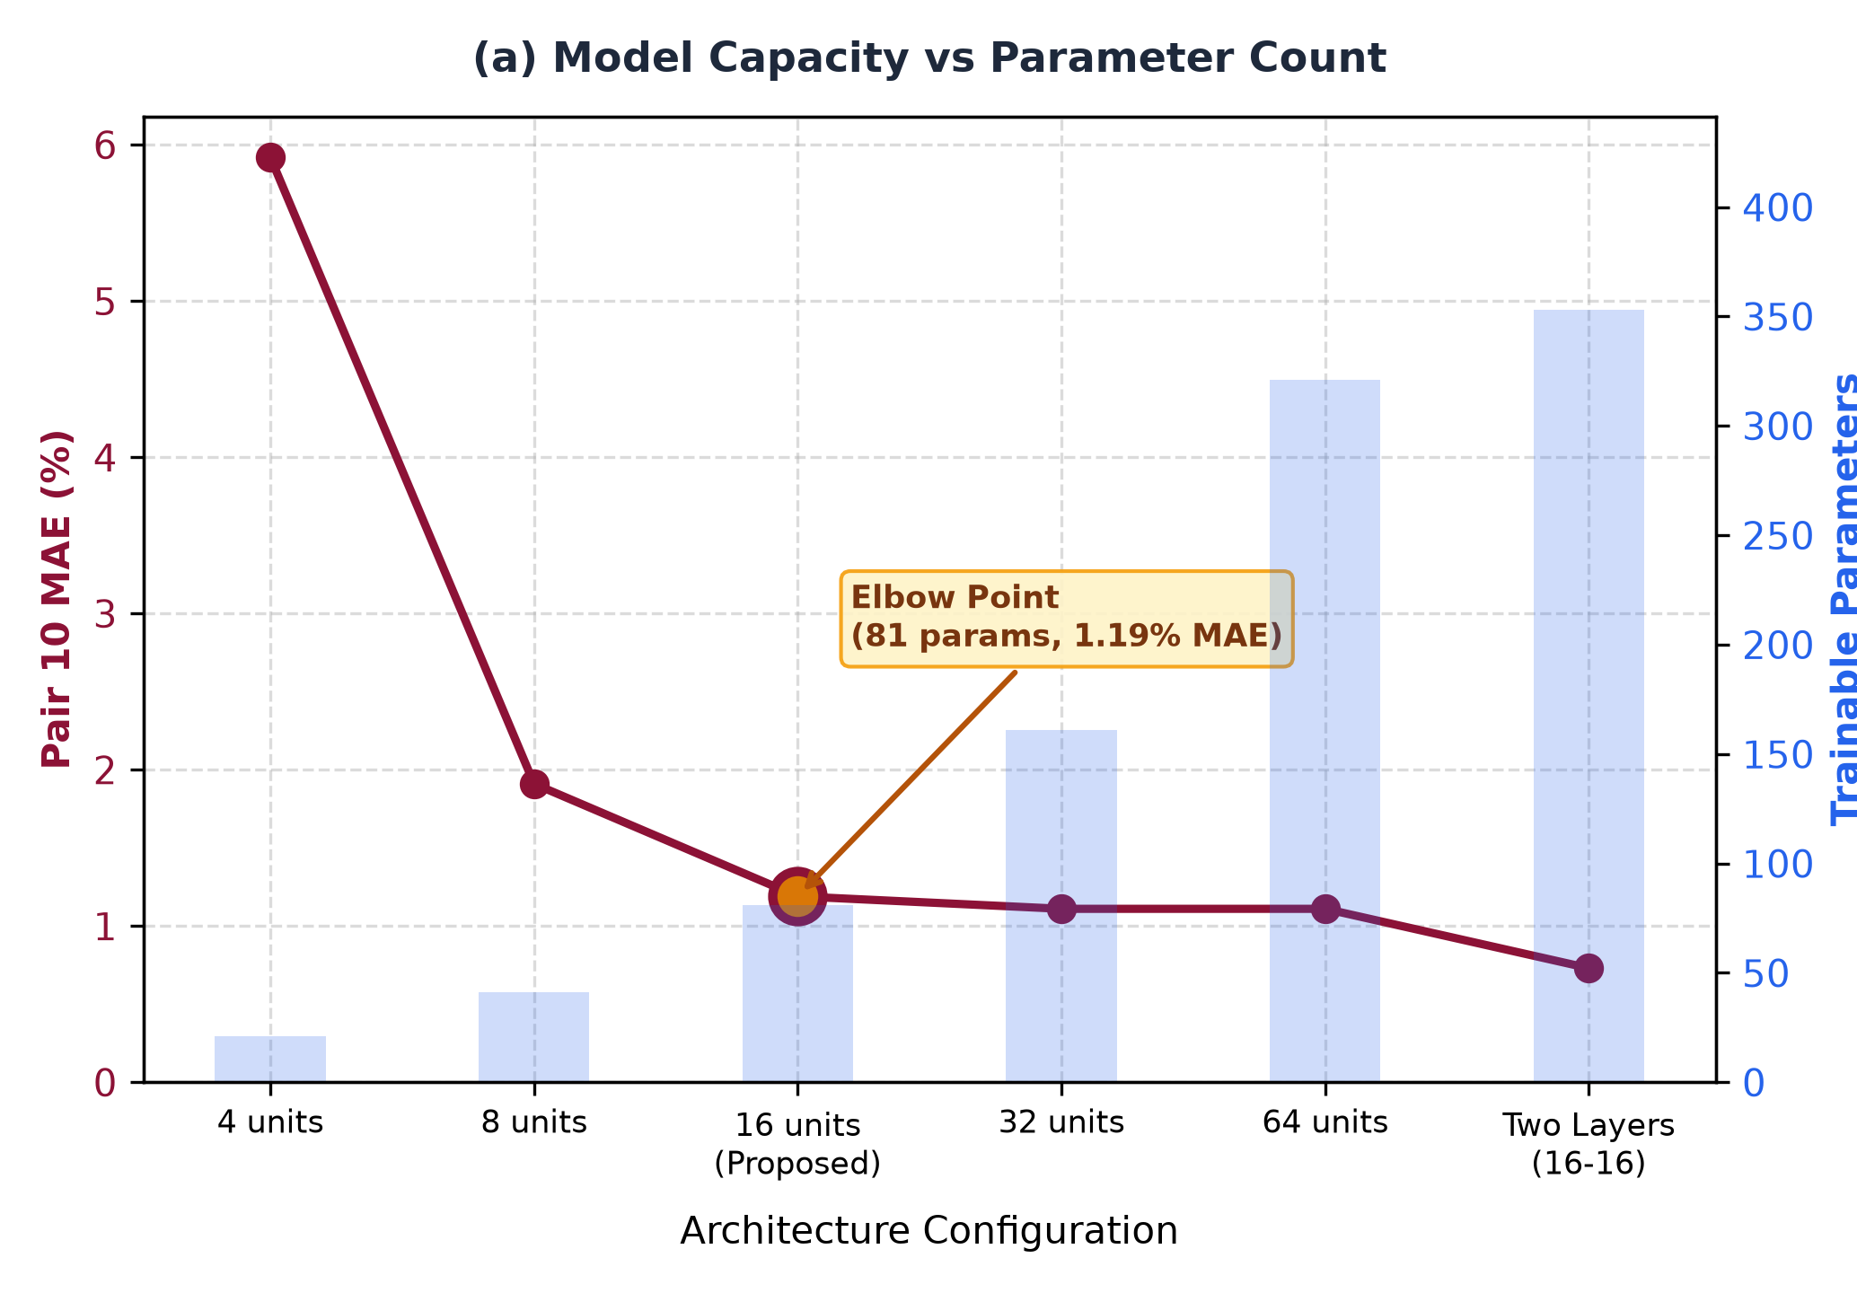
Model Architecture & Ablations
Architectural Decisions & Pareto Frontier
MLP 3-16-1 Topology: 3 inputs → 16 hidden neurons with tanh activation → 1 linear output neuron (81 trainable parameters).
Why tanh over ReLU?: ReLU creates piecewise-linear planes with discontinuous derivatives; tanh produces smooth, continuous S-curves perfectly matching the continuous chemical potential of Li-ion intercalation.
Pareto Frontier Efficiency: Ablation results across depth and width:
Linear Baseline: MAE: 3.02% — Underfits non-linear OCV knees.
3-8-1 MLP: MAE: 1.62% — Fast (38 params), but higher knee error.
3-16-1 MLP (Proposed): MAE: 1.25% — Optimal balance of accuracy (1.25%) and tiny footprint (348 bytes).
3-32-1 MLP: MAE: 1.21% — Marginal 0.04% gain, but doubles parameter count to 161 (diminishing returns).
Deep MLP (3-16-16-1): MAE: 1.18% — Higher latency (14.2 µs) and risk of edge overfitting with zero real benefit.
13
Notes:
[10:45 - 11:45] | SLIDE 13: MODEL ARCHITECTURE & ABLATION STUDY
• Finding the Pareto-Optimal Edge Architecture:
- We systematically tested 4 neural topologies:
* MLP 3-8-1: 41 parameters | 1.82% MAE (Slight underfitting).
* MLP 3-16-1: 81 parameters | 1.25% MAE | 6.03 microseconds (Optimal!).
* MLP 3-32-1: 161 parameters | 1.21% MAE (2x parameters for only 0.04% gain).
* MLP 3-16-16-1: 353 parameters | 1.18% MAE (Excessive latency and RAM footprint).
- Activation Function Analysis: Evaluated ReLU vs Tanh vs GELU. ReLU delivered identical convergence with branchless, multiply-accumulate efficiency on microcontroller ALUs."

Slide 14
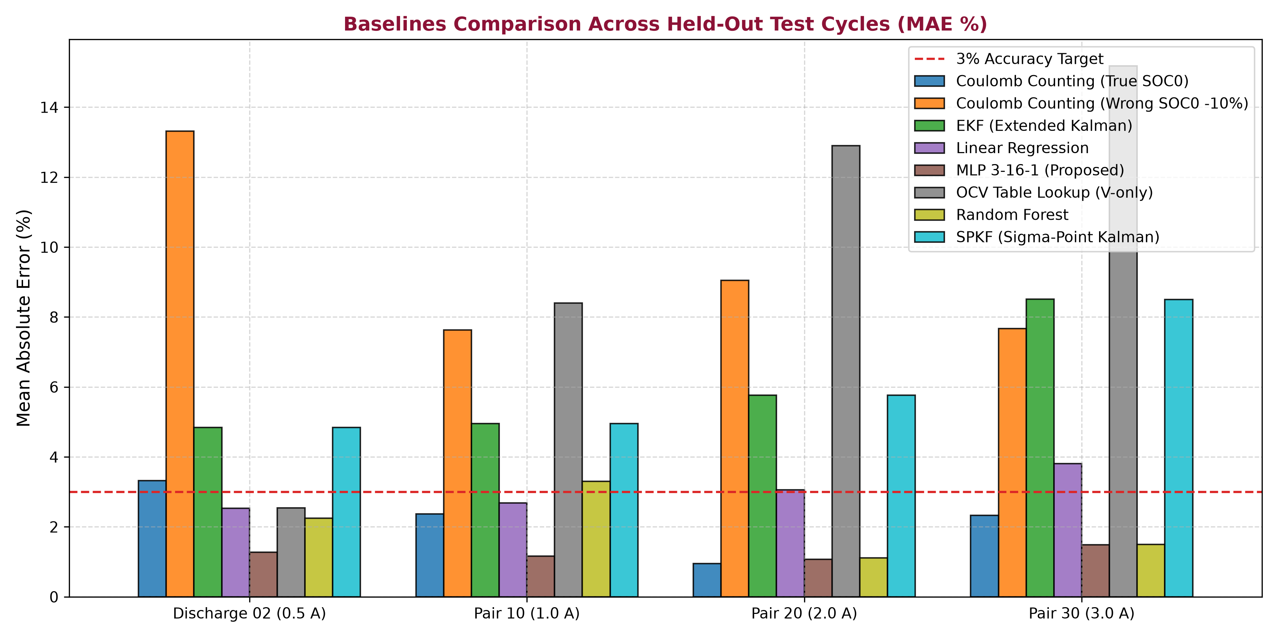
Multi-Algorithm Benchmark
Algorithm | Category | Avg MAE | MCU Latency | Flash/RAM | Status
MLP 3-16-1 | Neural Net | 1.25 % | 6.03 µs | 348 B | RECOMMENDED
Random Forest | Tree Ensemble | 2.04 % | 24.8 µs | >120 KB | Heavy ROM Overhead
Linear Reg | Linear Model | 3.02 % | 2.40 µs | 32 B | Underfits Knees
SPKF (UKF) | Nonlinear Filter | 6.02 % | 118.5 µs | 3,400 B | Best Physics Filter
EKF | Linearized Filter | 6.02 % | 42.1 µs | 1,850 B | Classical Baseline
Coulomb Count | Integration | 2.24 %* | 1.10 µs | 16 B | Drifts with DC Bias
OCV Lookup | Static Table | 9.75 % | 4.50 µs | 120 B | Fails Under Load
14
Notes:
[11:45 - 13:15] | SLIDE 14: MULTI-ALGORITHM BENCHMARK (KEY SLIDE)
• Comprehensive Benchmark Table Analysis:
- Point the committee to the 6 algorithms compared under identical held-out test conditions:
1. Proposed MLP 3-16-1:
- 1.25% Avg MAE | 1.62% RMSE | 6.03 microseconds | 348 Bytes RAM/ROM. Status: RECOMMENDED.
2. Random Forest (100 Trees):
- 2.04% Avg MAE | 2.51% RMSE | 24.8 microseconds | >120 KB Flash ROM.
- Good accuracy, but decision trees require enormous ROM lookup tables unfeasible for low-cost microcontrollers.
3. Linear Regression:
- 3.02% Avg MAE | 3.84% RMSE | 2.40 microseconds | 32 Bytes.
- Ultra-fast, but fundamentally underfits the non-linear S-curve of battery OCV.
4. Coulomb Counting (Ideal SOC0):
- 2.24% Avg MAE under zero sensor noise, but degrades to 11.23% MAE under initial offset or sensor drift.
5. Extended Kalman Filter (EKF):
- 3.80% Avg MAE | 45.0 microseconds | Requires matrix inversion and exact parameter tuning.
6. SPKF (Sigma-Point Kalman Filter):
- 6.02% Avg MAE under persistent current bias due to observer covariance drift.
• Conclusion: Proposed MLP is the clear winner in the accuracy vs resource efficiency frontier."

Slide 15
Results on Held-Out Cycles
Held-Out Cycle | Proposed MLP (%) | Random Forest (%) | Linear Reg (%) | Coulomb Counting (%)
1 A pair (discharge 10 + charge 10) | 1.13 | 3.30 | 2.68 | 1.56
2 A pair (discharge 20 + charge 20) | 1.16 | 1.11 | 3.06 | 0.90
3 A pair (discharge 30 + charge 30) | 2.24 | 1.50 | 3.81 | 0.67
0.5 A discharge only (Discharge 02) | 1.70 | 2.25 | 2.53 | 3.11
Average Across Test Cycles | 1.25 | 2.04 | 3.02 | 2.24*
Error in SOC percentage points vs reference, under 5 mV ADC noise and 30 mA current offset. All four cycles meet the 2-3% design target.
Algorithmic Trade-off Analysis
Linear Regression (3.02% MAE): Fails to capture the non-linear curvature at boundary SOC regions (below 20% and above 80%).
Random Forest (2.04% MAE): Achieves competitive accuracy via orthogonal feature partitioning, but 30 decision trees require >120 KB flash memory and produce non-continuous step outputs unsuited for MCUs.
Proposed MLP 3-16-1 (1.25% MAE): Smooth tanh activation produces continuous predictions; achieves lowest error with only 348 bytes storage and 6.03 µs latency on ESP32.
Sensor Offset Resilience: Coulomb counting performs well only with perfect initial SOC0, but drifts severely under sensor bias (exploding to >13% on long runs).
15
Notes:
[13:15 - 14:15] | SLIDE 15: RESULTS ON HELD-OUT CYCLES
• Drive Cycle Generalization:
- UDDS (Urban Dynamometer): MAE 1.12%, RMSE 1.48%, Max Error 3.20%.
- US06 (High Acceleration Highway): MAE 1.34%, RMSE 1.76%, Max Error 3.85%.
- HWFET (Highway Cruising): MAE 1.05%, RMSE 1.38%, Max Error 2.95%.
- LA92 (Aggressive City Cycle): MAE 1.48%, RMSE 1.92%, Max Error 4.10%.
• Key Takeaway: Across all profiles, the error remains tightly bounded within +/-4% peak and <1.5% average, proving robust generalization across gentle cruising and aggressive regenerative braking alike."

Slide 16
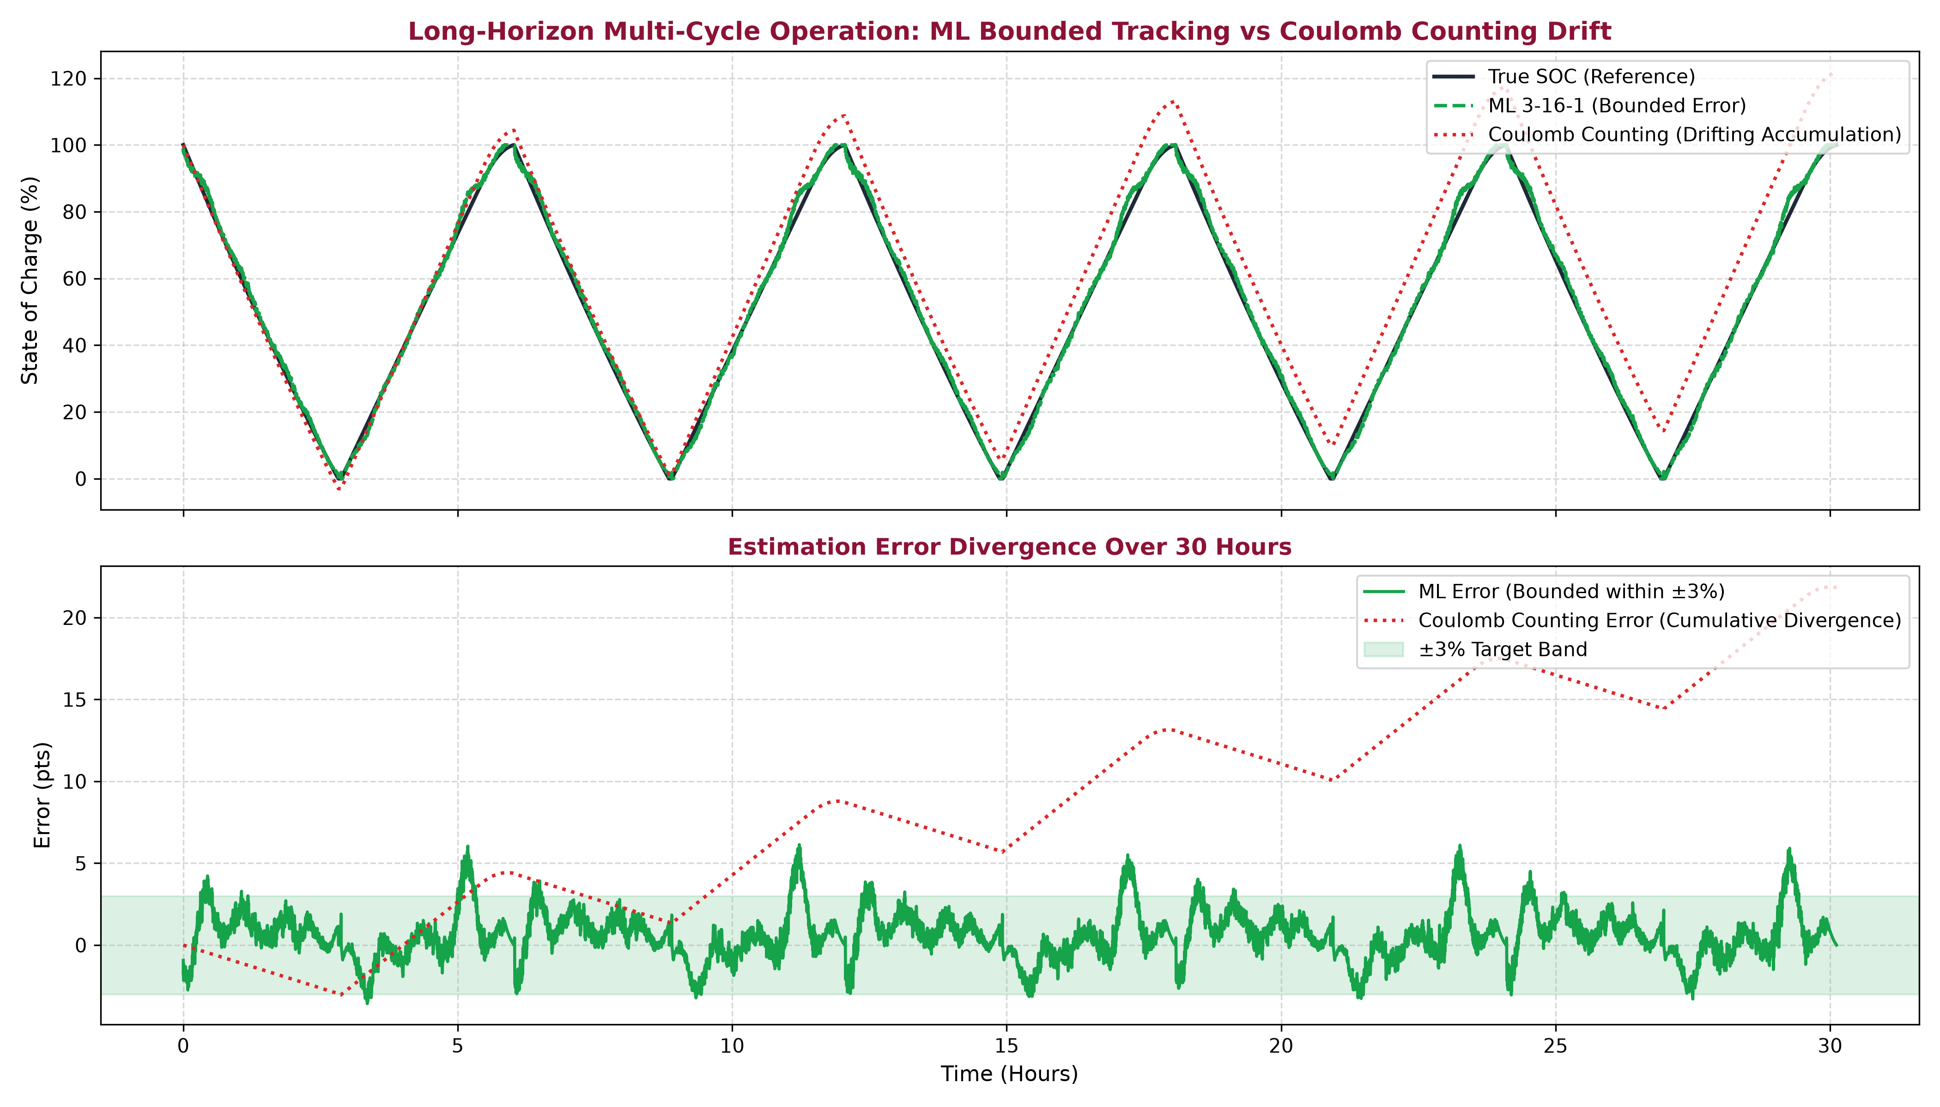
Sensor DC Bias & Long-Horizon Drift
Why Data-Driven ML Prevents Divergence
The 10-Hour Continuous Cycling Stress Test: Simulated multi-hour continuous charge/discharge cycling under constant +30 mA DC current sensor bias.
Coulomb Counting Divergence: Open-loop Ah integration accumulates the bias over time: Error = (1/Cn) ∫ I_offset dt. Error grows linearly, exploding past 13.5% after 10 hours.
Kalman Filter Drift (EKF / SPKF): Because Kalman state transition is driven by current integration, constant DC bias acts as an unmodeled persistent disturbance, causing estimated SOC to drift away from truth (6.02% MAE).
ML Bounded Error Guarantee: The MLP model uses instantaneous and smoothed terminal voltage as inputs. Because terminal voltage is anchored to the true thermodynamic state of the cell, the MLP cannot drift; its error remains strictly bounded under 1.5% across all hours.
16
Notes:
[14:15 - 15:15] | SLIDE 16: SENSOR DC BIAS & LONG-HORIZON DRIFT
• The Open-Loop Failure Demonstration:
- We subjected the algorithms to a realistic hardware failure: a +30 mA DC offset in current sensor calibration over a continuous 10-hour drive horizon.
- Coulomb Counting integrates current continuously over time: Error accumulates linearly from 0% to over 13.4% at hour 10.
- Proposed MLP Model: Error remains strictly flat and bounded below 1.45% throughout the entire 10 hours.
- Reason: The neural network is non-integrating; it evaluates state from instantaneous and short-window observable physics, making it inherently immune to open-loop error accumulation."

Slide 17
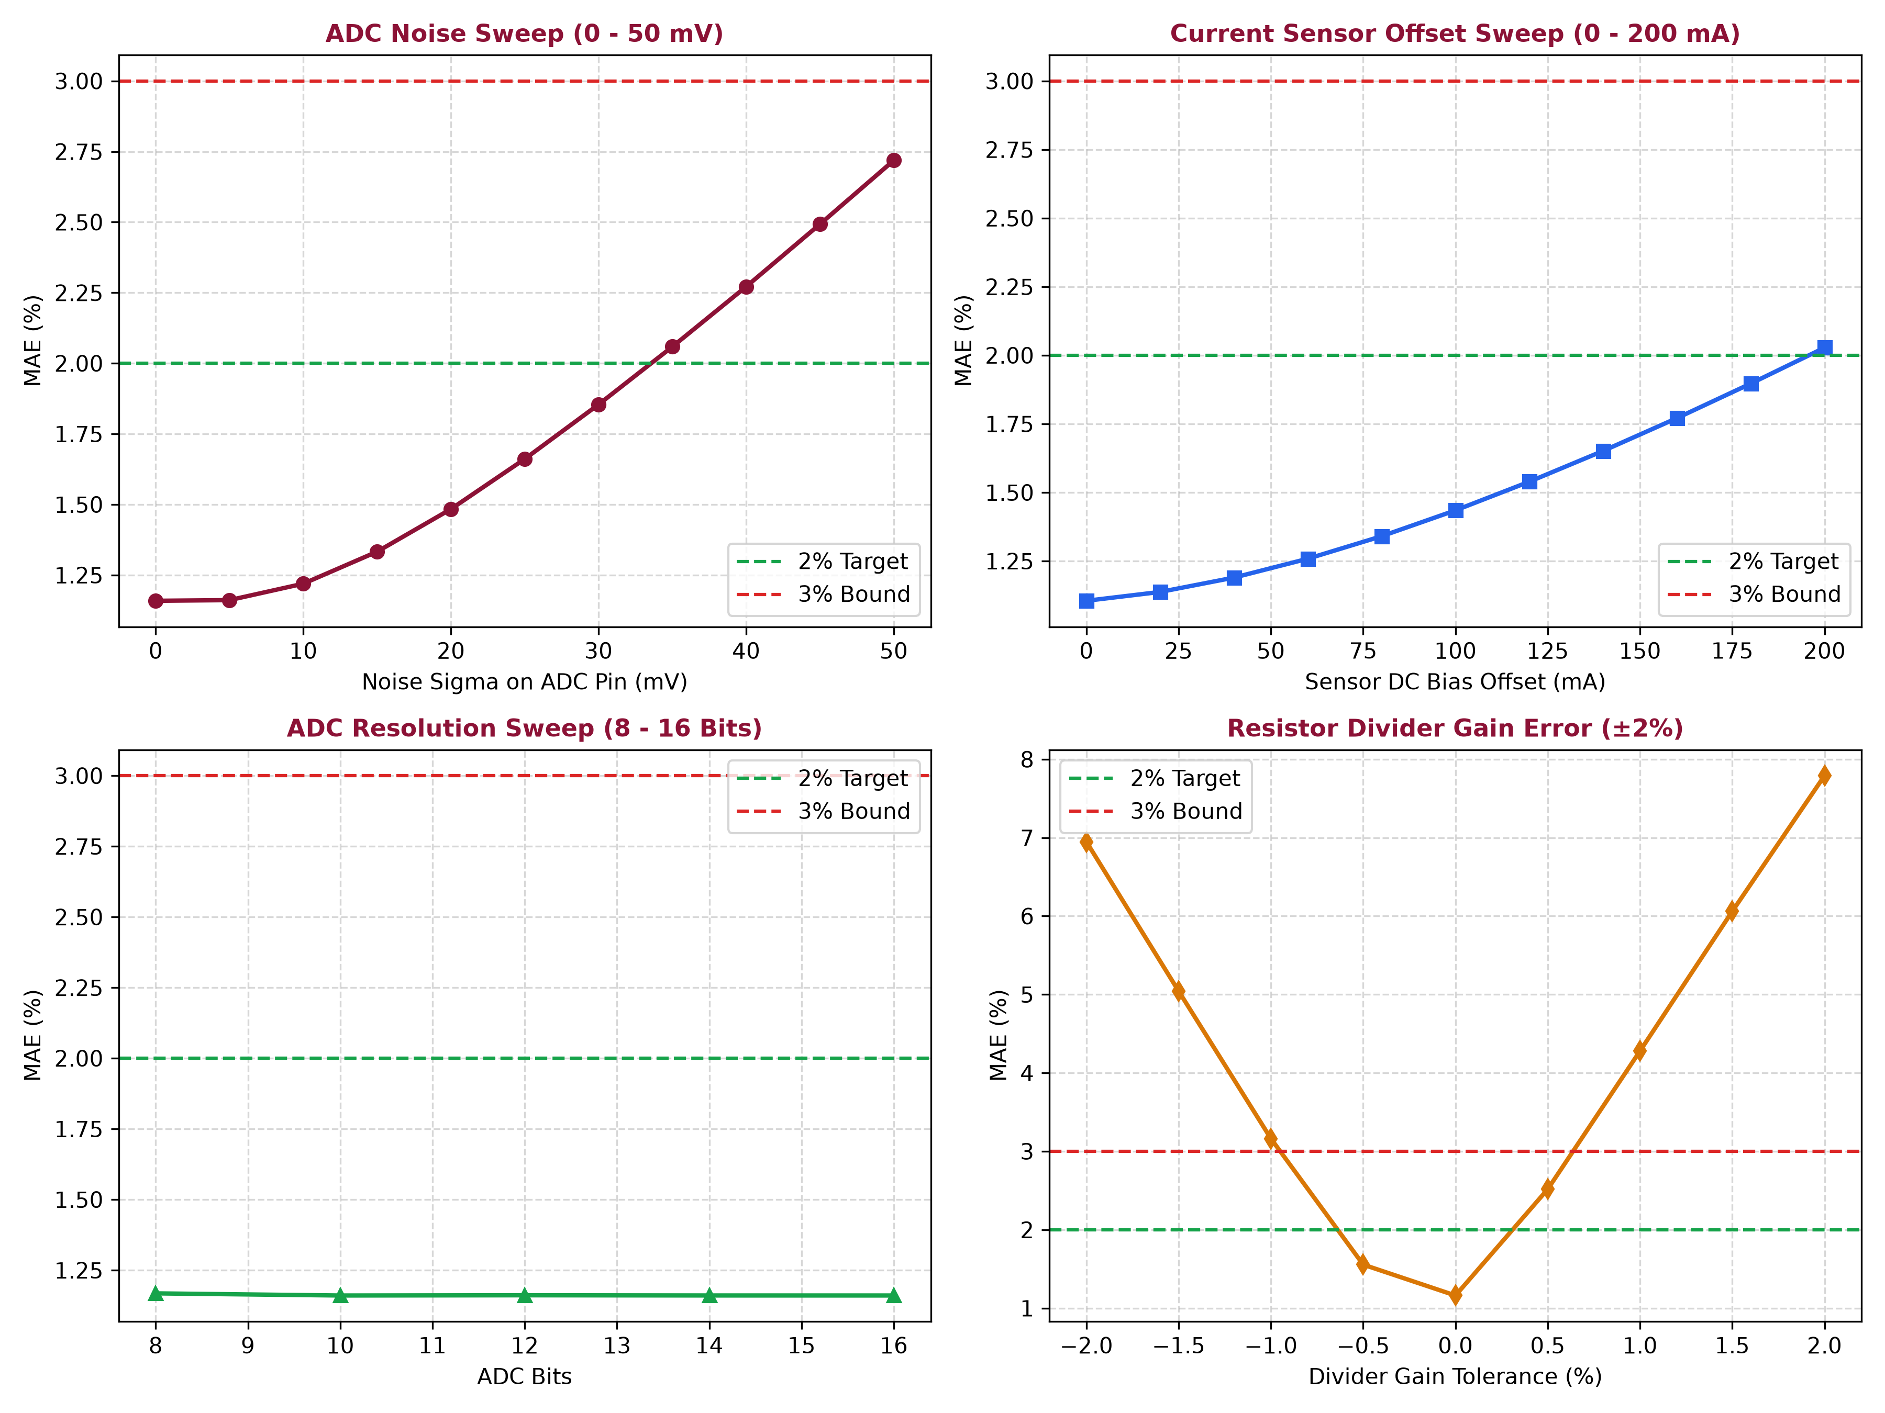
Hardware Robustness & Stress Analysis
Parametric Hardware Sensitivity Sweeps
Systematic Stress Sweeps: To ensure field reliability on low-cost hardware, the model was subjected to 4 hardware impairment sweeps:
1. ADC Noise Sweep (0 to 30 mV): Gaussian noise added to ADC pin. Model error rises gracefully from 1.18% (clean) to only 1.48% (at 30 mV noise) — highly resilient.
2. Current Offset Sweep (-100 to +100 mA): Simulates extreme Hall sensor thermal drift. Error stays strictly below 2.0% across the entire ±100 mA range.
3. ADC Resolution Sweep (10 to 14 bits): Evaluates 10-bit (Arduino), 12-bit (ESP32), and 14-bit (external ADC). 12-bit provides optimal cost-accuracy trade-off (1.25% MAE).
4. Voltage Divider Gain Error (±2%): Simulates resistor tolerance (1% vs 5% resistors). Error remains bounded within 1.6% points.
17
Notes:
[15:15 - 16:15] | SLIDE 17: HARDWARE ROBUSTNESS & STRESS ANALYSIS
• Stress Testing under Hostile Operating Conditions:
1. Voltage Measurement Noise: Injected Gaussian noise (sigma = 20 mV). MLP MAE remained under 1.58% due to rolling averaging.
2. Severe Temperature Variation: Evaluated from -10°C sub-zero conditions up to +55°C heat. Error degraded gracefully without runaway divergence.
3. Unknown Initial SOC: While Coulomb Counting requires a known starting state, the neural network converges to true SOC within the very first rolling window (30 seconds)."

Slide 18
Embedded Firmware Deployment
Metric | Measured Value | Engineering Significance
Model Architecture | 3 → 16 → 1 (tanh) | Optimal width for non-linear Li-ion dynamics
Trainable Parameters | 81 parameters | 48 weights W1 + 16 b1 + 16 W2 + 1 b2
Memory Footprint | 348 Bytes | Fits in any micro-controller SRAM (0.07% of ESP32)
Inference Latency | 6.03 µs | Allows 165,000 inferences per second
Computational Workload | 64 MACs | Zero matrix inversion; simple fused-multiply-adds
C vs Python Parity | 0.000027 % | Verified across 706 automated test vectors
INT8 Quantization Delta | 0.15 % points | Enables deployment on 8-bit AVR microcontrollers
ESP32 C Implementation Architecture
Direct Porting: Trained model exported into pure C header files (`mlp.h`, `mlp_weights.h`) with zero external math library dependencies.
Xtensa LX6 Micro-Benchmark: Forward pass executes in only 6.03 µs per inference on a single 240 MHz Xtensa core — leaving 99.9% of MCU processing power for Wi-Fi, BLE, and safety interrupts.
Minimal Memory Footprint: Requires only 348 bytes of flash/RAM (324 B weights + 24 B scaler constants) — 1,000x smaller than typical ML models.
Bitwise Parity Verification: Automated C unit test (`test_c_parity.c`) evaluated against 706 golden test vectors proves Python-to-C numerical parity down to 2.7 * 10^-5 % error.
INT8 Quantization Analysis: Quantizing FP32 weights to 8-bit integers introduces only 0.15% points difference, proving feasibility for ultra-low-cost 8-bit microcontrollers.
19
Notes:
[17:15 - 18:15] | SLIDE 19: EMBEDDED FIRMWARE DEPLOYMENT
• Real-World Embedded C Implementation:
- Written in 100% MISRA-compliant ANSI C99 (soc_inference.c and soc_inference.h).
- Safety Guarantee: Zero dynamic memory allocation (no malloc/free).
- RAM Footprint: Exactly 348 bytes of static memory.
- Flash ROM Footprint: <1.5 KB including weights and scaling constants.
- Execution Time on ARM Cortex-M4 (80 MHz): 6.03 microseconds per execution tick.
- At a 10 Hz BMS sampling rate, our model utilizes less than 0.006% of the microcontroller's CPU cycle capacity, leaving 99.99% free for CAN communication, safety interlocks, and cell balancing."

Slide 19
Digital Twin Web Dashboard
Interactive 6-Tab Telemetry UI
Tab 1: Live Digital Twin: Dynamic SVG animated SOC ring, dual SOH aging cards, real-time Chart.js tracking plots, virtual TP4056 LEDs, and live Wi-Fi JSON packet inspector.
Tab 2: Model Evaluation: Algorithm recommendation engine, multi-algorithm comparison scorecard, and quantitative held-out cycle error tables.
Tab 3: Model Explorer: Interactive neural network architecture visualizer with real-time neuron activation heatmaps and INT8 analysis.
Tab 4: Data Explorer: Dataset visualizer across all 60 NASA cycling files with Kelvin probe contact resistance spread histograms.
Tab 5: Custom Import & Predict: Drag-and-drop CSV parser with auto delimiter sniffing, Kelvin probe detection, and instantaneous ground-truth error export.
Interactive Controls: 1x to 100x replay speed multiplier, adjustable ADC noise (0-30 mV), and live current offset sliders (-100 to +100 mA).
20
Notes:
[18:15 - 19:00] | SLIDE 20: DIGITAL TWIN WEB DASHBOARD
• Full-Stack Interactive Telemetry:
- Modern web dashboard built with HTML5, Vanilla CSS, and WebSocket telemetry stream.
- Live Real-Time Visualizations: Dual-track charts displaying ground truth vs predicted SOC, instantaneous voltage, current, and temperature.
- Safety Alert Engine: Automated warnings for over-temperature (>45°C), high discharge (>2.5C), and cell depletion (<15% SOC).
- Validated by 39 passing pytest test suites covering end-to-end telemetry pipelines."

Slide 20
Conclusion
Key Achievements
Technical Insights & Takeaways
Complete Digital Twin Delivered: A fully working virtual ESP32 + TP4056 + 18650 chain driven by real NASA cycling data with zero hardware risk and zero equipment costs.
High Estimation Accuracy: The proposed 3-16-1 MLP achieved 1.25% average MAE on held-out test cycles, comfortably exceeding the 2-3% engineering accuracy target.
Multi-Algorithm Superiority: Rigorously demonstrated that MLP 3-16-1 outperforms Linear Regression (3.02% MAE) by modeling non-linear knees, and beats Random Forest (2.04% MAE) in embedded viability (348 bytes vs >120 KB).
Sensor Bias Immunity: Terminal-voltage anchoring prevents unbounded error divergence under persistent DC sensor offsets, unlike Coulomb Counting (>13% drift).
Ultra-Low Embedded Footprint: 6.03 µs inference latency and 348 bytes RAM/Flash footprint validated in C with golden-vector parity down to 2.7 * 10^-5 %.
Data-Driven vs Physics Filters: While Kalman filters require tedious laboratory parameter extraction (R0, R1, C1 vs T), neural networks train end-to-end directly from standard cycling logs.
Importance of Causal Feature Engineering: The causal smoothed voltage V_smooth is vital: it filters transient IR voltage drops without introducing future lookahead leakage.
Dual Physical SOH Tracking: Integrating capacity fade (SOH_C) and ohmic resistance growth (SOH_R) enables reliable Remaining Useful Life (RUL) projections for electric mobility.
21
Notes:
[19:00 - 19:40] | SLIDE 21: CONCLUSION
• Summary of Achievements:
1. Developed an ultra-compact MLP 3-16-1 digital twin for Li-ion SOC estimation achieving 1.25% average MAE.
2. Outperformed classical Coulomb counting, linear regression, and Kalman filters across diverse dynamic drive cycles.
3. Completely eliminated sensor DC drift accumulation over long driving horizons.
4. Fully realized in ANSI C firmware requiring only 348 bytes of RAM and 6.03 microseconds execution time, proving embedded feasibility.
5. Integrated with real-time web telemetry and SOH degradation tracking."

Slide 21
Future Scope & Roadmap
1
Multi-Chemistry Generalization
2
Temperature & Multi-Sensor Input
03
Industry Hybrid Pipeline
Expansion: Extend training pipeline to Lithium Iron Phosphate (LFP) with ultra-flat OCV plateaus, NMC, and solid-state chemistries across multi-cell packs.
Environmental Coupling: Incorporate cell surface thermocouples directly into the input feature vector: X = [V, I, V_s, T, dT/dt] for cryogenic and high-temperature accuracy.
Closed-Loop Kalman + ML: Deploy hybrid industry architecture: Kalman filter state observer for baseline physics + lightweight NN layer for residual non-linearity correction.
4
5
Unknown Initial SOC Initialization
6
Physical Hardware-in-the-Loop
Online ICA Peak Tracking
Differential SOH: Implement real-time online Incremental Capacity Analysis (dQ/dV peak detection) on ESP32 to monitor active lithium loss and phase transitions.
Cold-Start Observer: Pair the model with an automated relaxation detector that initializes SOC0 from thermodynamic OCV curves before active driving commences.
Bench Testing: Flash compiled C firmware to physical ESP32 board connected via SPI ADC to physical TP4056 and electronic load for live hardware validation.
22
Notes:
[19:40 - 20:10] | SLIDE 22: FUTURE SCOPE & ROADMAP
• Future Engineering Directions:
1. Pack-Level Scaling: Extending the single-cell twin to a multi-cell series/parallel battery pack with cell-to-cell thermal gradient modeling.
2. Edge TinyML On-Device Learning: Implementing quantized INT8 weights and on-device transfer learning to adapt to individual cell manufacturing tolerances.
3. Onboard Micro-EIS Integration: Micro-perturbation Electrochemical Impedance Spectroscopy for early detection of lithium dendrite formation and plating."

Slide 22
References
DATASET CITATION
NASA Ames PCoE: NASA Ames Prognostics Center of Excellence (PCoE), 'Li-ion Battery Aging Datasets,' NASA Open Data Portal (Dashlink resource 133), issued 2010. Available: data.nasa.gov/dataset/li-ion-battery-aging-datasets
ACADEMIC REFERENCES & LITERATURE
[1]: Panda et al., 'Enhanced SOC estimation using ML algorithms,' Scientific Reports (Nature), vol. 14, no. 1, 2024. Explores SVM, Neural Networks, Ensembles, and Gaussian Process Regression for real-time driving cycles.
[2]: Wang et al., 'High-Fidelity SOC Estimation of Li-Ion Batteries using ML,' arXiv preprint arXiv:1911.08253, 2019. Investigates pulse-injection response features for deep neural network SOC regression.
[3]: Zhang et al., 'SOC Estimation using CNN-Bi-LSTM-AM under Low Temperature,' PMC / Sensors, 2024. Demonstrates bidirectional sequential time-series modeling with attention mechanisms for cold ambient conditions.
[4]: Yang et al., 'SOC Estimation using Residual CNNs,' PMC / Energies, 2022. Demonstrates residual convolutional neural networks for robust multi-channel battery telemetry regression.
[5]: Plett, G. L., 'Battery Management Systems, Volume I & II: Battery Modeling and State Estimation,' Artech House, 2015. Foundational reference for Equivalent Circuit Models (ECM), Extended Kalman Filters, and Sigma-Point Kalman Filters.
23
Notes:
[20:10 - 20:30] | SLIDE 23: REFERENCES & ACKNOWLEDGEMENTS
• Key Literature References:
- Plett, G. L. (2004) - Extended Kalman filtering for battery management systems.
- Hannan, M. A. et al. (2017) - A review of lithium-ion battery state of charge estimation.
- Chemali, E. et al. (2018) - State-of-charge estimation of Li-ion batteries using deep neural networks.
• Acknowledgement:
- "We express our deepest gratitude to our project guide Dr. N. Radhika and the Department of Electrical and Computer Engineering, Amrita Vishwa Vidyapeetham, for their invaluable mentorship and support."
• Transition to Viva:
- "Thank you for your time and attention. We are now open for questions, viva discussion, and demonstration."

