Slide 1
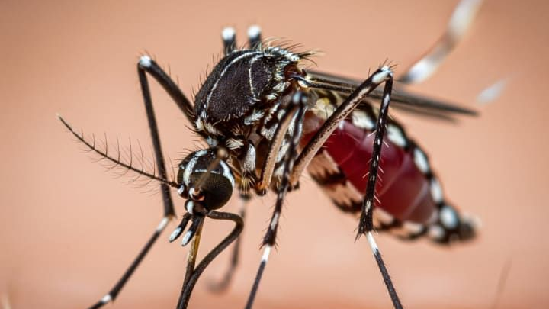
Machine Learning-Based Dengue Outbreak Prediction System for Colombo District
Project ID: R26-IT-061 | Year: 2026

Slide 2

Team Members
Supervisor : MS. Shashika Lokuliyana
Co-Supervisor: Ms. Narmada Gamage
Student Name | Student ID
Wickramarachchi T.T. | IT22243980
Hettiarachchi A.T. | IT22165848
Keenavinna K.A.I.U. | IT22214034
Adithya A.A.H. | Adithya A.A.H.

Slide 3
Indroduction
Dengue Outbreak Prediction and Intervention Optimization System
Dengue is a major health issue in Sri Lanka, especially in high-risk areas like Colombo District.
Our system uses dengue case data and weather data to predict outbreak risk early.
It also recommends the best prevention action using a Reinforcement Learning agent.
Goal:
To support health officers in taking early and effective dengue prevention actions.

Slide 4
Problem
Current dengue control methods are mostly reactive.
Public health actions are usually taken after dengue cases increase.
Existing systems mainly analyze past data, but they do not clearly support future action planning.
Key Problems
Dengue risk changes with rainfall, temperature, and humidity.
Traditional methods cannot handle complex dengue patterns.
Many ML systems predict risk only, but do not recommend actions.
PHI officers need localized support for Colombo MOH areas.
Manual warnings can delay dengue prevention actions.

Slide 5

Our Solution
AI-Based Dengue Risk Prediction and Intervention Recommendation System
Our solution combines Machine Learning, Reinforcement Learning, and a Flutter mobile app to support dengue prevention.
The system uses dengue case data and weather data to identify risk levels and recommend the best action.
Main Components
ML Prediction
Predicts dengue risk level using dengue and weather data.
RL Intervention Agent
Q-Learning agent recommends the best prevention action.
Mobile App
Health officers can enter MOH area, cases, rainfall, and temperature.
PHI Warning System
Sends warning emails when high risk is detected.

Slide 6

Recommended Actions
Intervention Actions Recommended by the AI Agent
The Reinforcement Learning agent selects the most suitable action based on the dengue risk situation.
Recommended Actions
Monitor Only
Deploy Fumigation Teams
Issue Public Health Alert
Increase Hospital Readiness
Community Cleanup Campaign
Purpose
To help PHI officers and health authorities take quick, effective, and data-driven dengue prevention actions.

Slide 7


Tools and Technologies
Frontend / Mobile App
Flutter
Dart
Mobile UI Screens
Dashboard and Recommendation Forms
Backend
Python
Flask API
REST API Integration
Machine Learning and AI
Explainable AI (XAI)
Q-Learning Reinforcement Learning
Trained Q-Table Model
Dengue Risk Prediction Model
Historical Dengue and Weather Dataset

Slide 8


Data and Visualization
Dengue case data
Rainfall, temperature, humidity data
Charts and heatmaps
Risk level visualization
Communication
Email alert system
PHI warning notification

Slide 9
Commercialization
Target Users
Public Health Inspectors
MOH Offices
Municipal Councils
Healthcare Decision Makers
Dengue Control Units
Commercial Value
The system can be used as a decision-support tool for dengue prevention and outbreak management.
It helps health authorities plan interventions earlier and use resources more effectively.

Slide 10
Possible Deployment Options
Mobile app for PHI officers
Web dashboard for health administrators
API integration with existing health systems
District-level dengue monitoring platform
Benefits
Faster dengue risk identification
Better intervention planning
Less manual decision-making delay
Localized support for Colombo MOH areas
Can be expanded to other districts in Sri Lanka

Slide 11
IT22214034 | Imal Udayanga
Data Engineering & Machine Learning Prediction
Dengue Outbreak Level Prediction using Weather and Time-Based Features

Slide 12
Problem Gap
Dengue outbreak risk is influenced by weather and time-based patterns.
Raw dengue-weather data contains missing values and requires preprocessing.
Manual analysis of rainfall, humidity, temperature, and weekly trends is difficult.
A machine learning model is required to classify dengue outbreak risk as Low, Medium, or High.

Slide 13
Solution
Developed a supervised machine learning model to predict dengue outbreak risk level.
Used weather and time-based features such as rainfall, humidity, temperature, wind speed, cloud cover, visibility, solar radiation, UV index, year, week, and month.
Handled missing numeric values using interpolation, forward fill, and backward fill.
Encoded the target variable outbreak_level into Low, Medium, and High classes.
Trained and compared Random Forest and XGBoost models.
Selected Random Forest as the final model based on better performance.

Slide 14
Implementation
Flutter Mobile App
↓
FastAPI Backend
↓
Trained Random Forest Model
↓
Risk Prediction + Class Probabilities
Current Progress
Cleaned and prepared ML-ready dataset.
Trained Random Forest model.
Saved model, label encoder, and feature list.
Created /predict API endpoint using FastAPI.
Connected Flutter mobile app with backend.
Displayed predicted risk level with High, Medium, and Low probabilities.

Slide 15
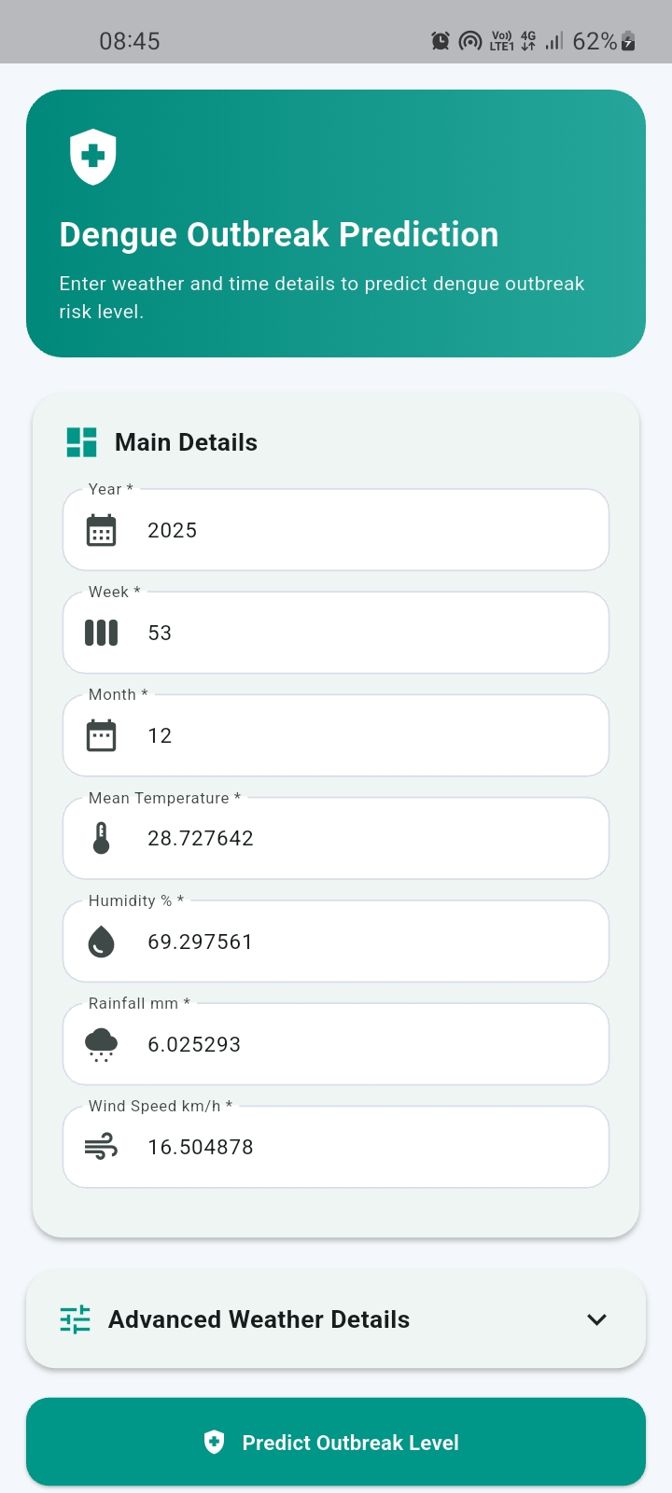
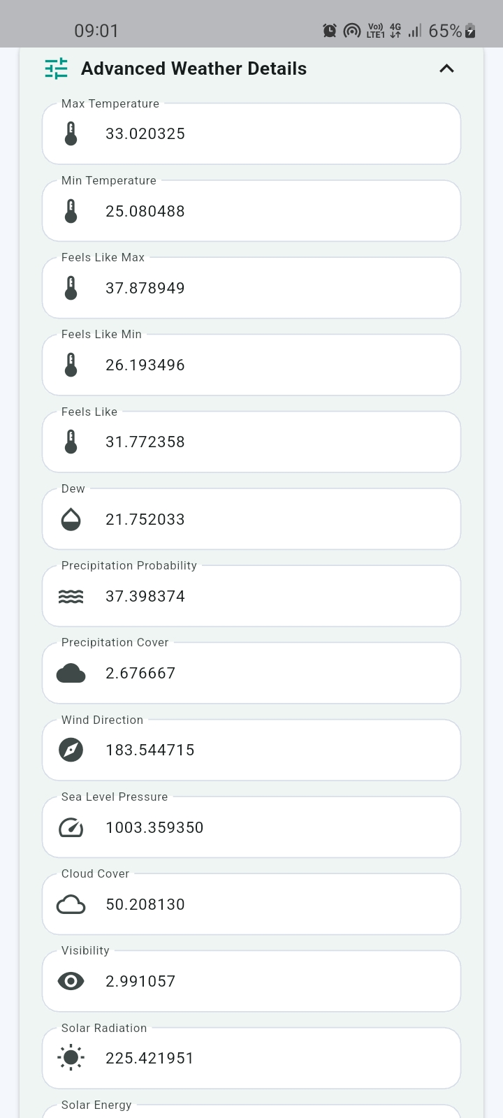
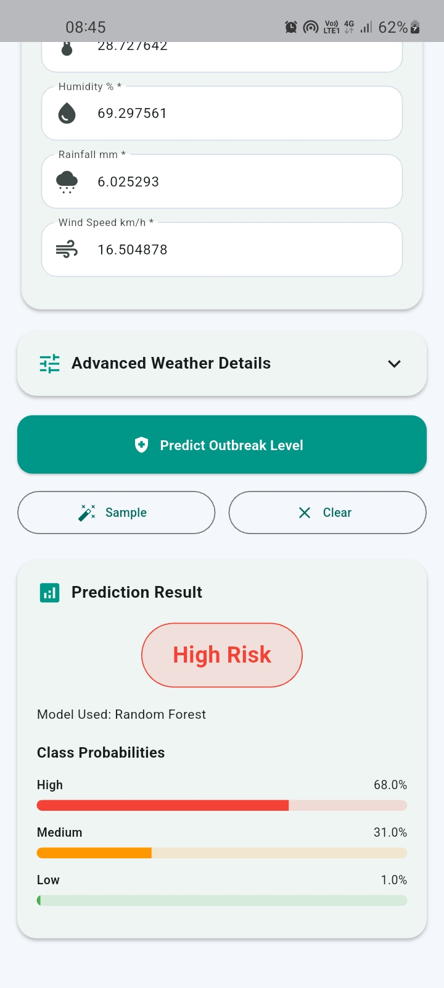
Design Prototype

Slide 16
IT22165848 | Hettiarachchi A.T.
Data Visualization & Research Integration Developer in VS Code

Slide 17
Problem Gap
Lack of Explainable Dengue Risk Visualization
Existing systems mainly show only the final dengue risk result.
Most ML models work like a black-box, so users cannot understand why the risk was predicted.
Health officers need to know the key factors behind the risk, not only the prediction.
Current systems have limited explanation of factors like dengue cases, rainfall, temperature, humidity, and MOH area.
Therefore, an XAI-based visualization dashboard is needed to improve trust and support early dengue prevention.

Slide 18
Solutions
Develop an explainable dashboard/mobile interface to present dengue risk
prediction results clearly.
Display predicted dengue risk levels as Low, Medium, or High for quick decision - making.
Use Explainable AI (XAI) to explain the reason behind each dengue risk
prediction.
Identify the most influential risk factors, such as dengue cases, wind speed,
temperature, humidity.
Provide feature importance / SHAP-based visual explanations to improve
model transparency.
Visualize dengue patterns using trend charts, summary cards, and climate-
related graphs.
Help health officers identify high-risk situations early and take suitable preventive actions.

Slide 19
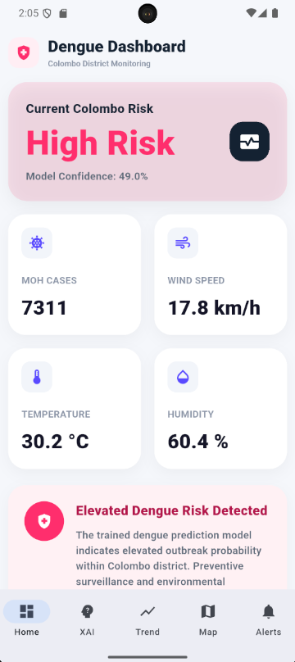
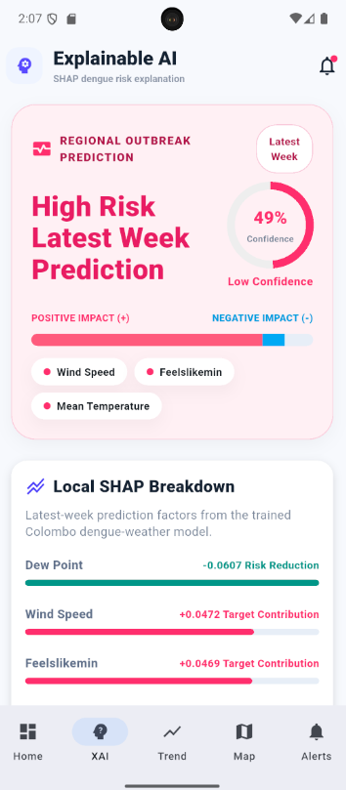
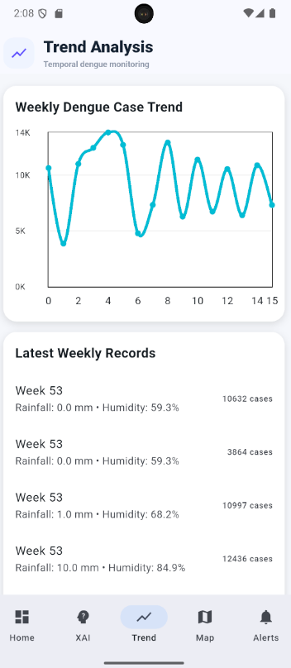
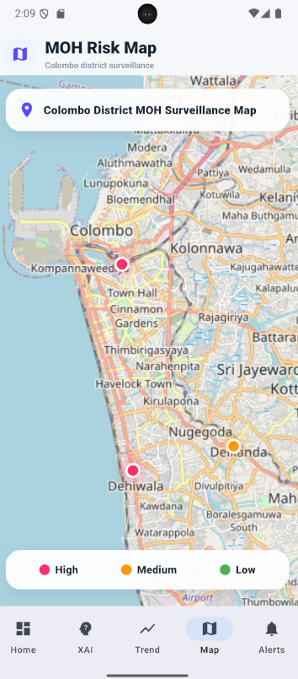
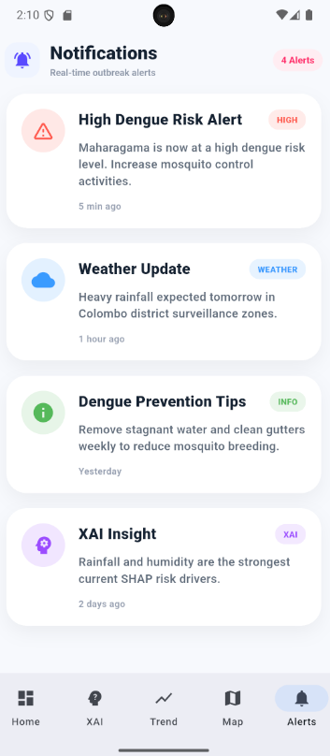

Slide 20
IT22243980|Wickramarachchi T.T.
Reinforcement Learning Based Dengue Intervention Optimization Agent

Slide 21
Problem Gap
Existing dengue systems mainly predict risk, but do not recommend the next action.
PHI/MOH officers still need to decide interventions manually.
Manual decision-making can delay dengue prevention actions.
Different dengue situations need different actions, not one fixed solution.
Current systems do not use Reinforcement Learning to optimize dengue intervention decisions.
There is a need for an AI agent that can recommend the best action based on cases, rainfall, and temperature.

Slide 22
Solution
Recommend the best dengue intervention action using 5 RL-based decisions.
1. Monitor Only → Monitor Action
2. Deploy Fumigation Teams → Fumigation Action
3. Issue Public Health Alert → Public Alert
4. Increase Hospital Readiness → Hospital Readiness
5. Community Cleanup Campaign → Cleanup Campaign

Slide 23
Selected when dengue risk is HIGH.
Considers dengue cases, rainfall, and temperature.
Helps PHI/MOH officers take fast preventive action.
Q-Learning agent chooses the best action from trained Q-table.
Automatic PHI email is sent for HIGH-risk situations.
APIs:
/recommend
/send-warning
/test-email

Slide 24
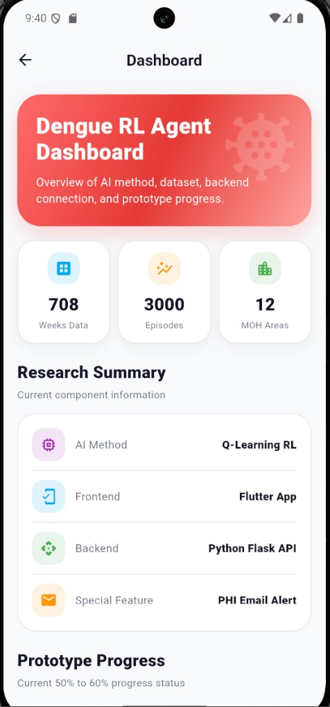
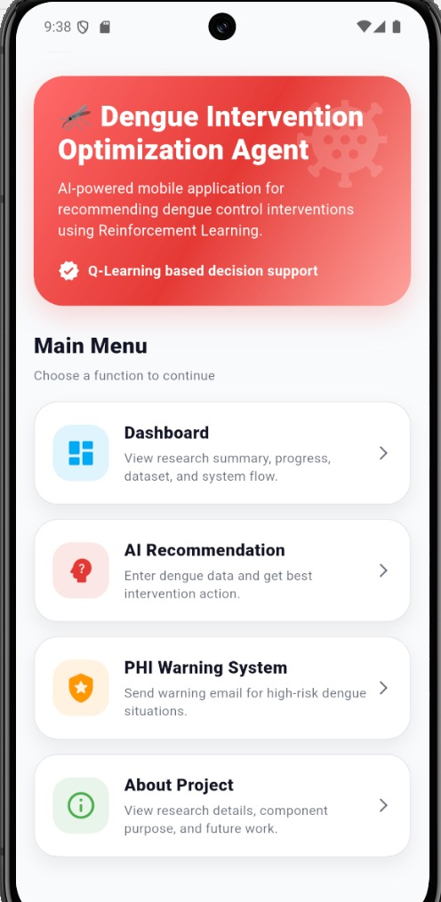
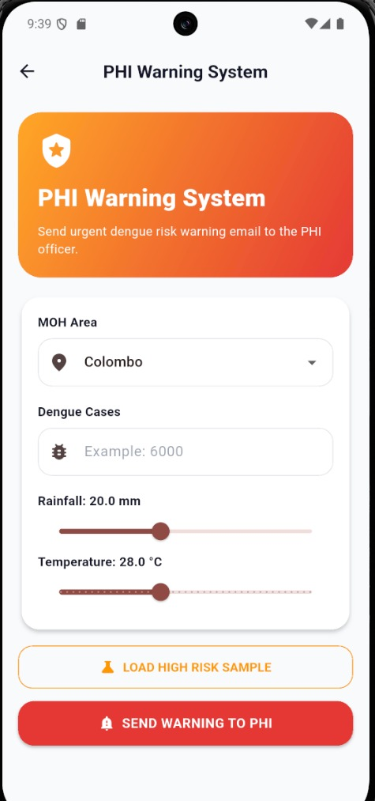
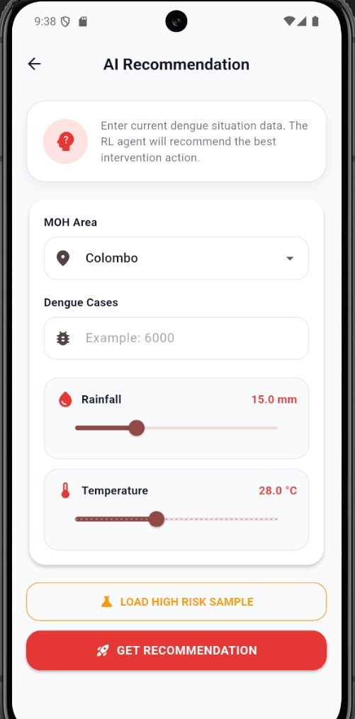

Slide 25
IT22281982-Adithya A.A.H
Natural Language Processing

Slide 26
Problem Gap
Current dengue monitoring systems are mainly reactive.
They mostly focus on past case analysis or basic prediction.
They do not clearly explain why a risk level is predicted.
They do not detect dengue-related misinformation.
They do not analyze dengue reports using NLP-based report analysis.
They do not support “what-if” risk simulation based on weather changes.
Therefore, they provide limited support for proactive dengue prevention and decision-making.

Slide 27
Solution
1. App Functions
Home Dashboard
Shows the current dengue risk status.
Displays quick summary details such as cases, trend, hotspots, and prevention status.
Provides easy navigation to all main app features.
AI Chatbot
Allows users to ask dengue-related questions.
Provides answers about symptoms, prevention, risk factors, and dengue awareness.
Shows confidence, evidence, location, and time-based context.

Slide 28
2: NLP-Based Functions
Report Upload & Analysis
Allows users to upload dengue-related reports.
Reads the report content and detects dengue-related keywords.
Identifies terms such as dengue, fever, rainfall, mosquito, outbreak, and risk.
Generates a risk-level summary from the uploaded report.
Misinformation Detection
Checks whether dengue-related health claims are reliable or misleading.
Detects false claims such as instant dengue cures.
Provides explanation and recommendation for the user.

Slide 29
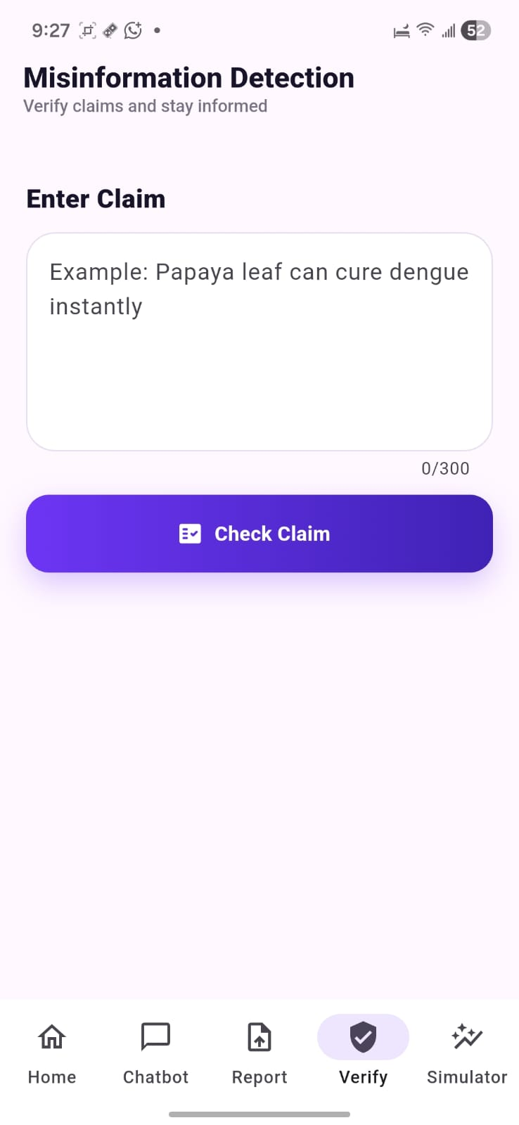
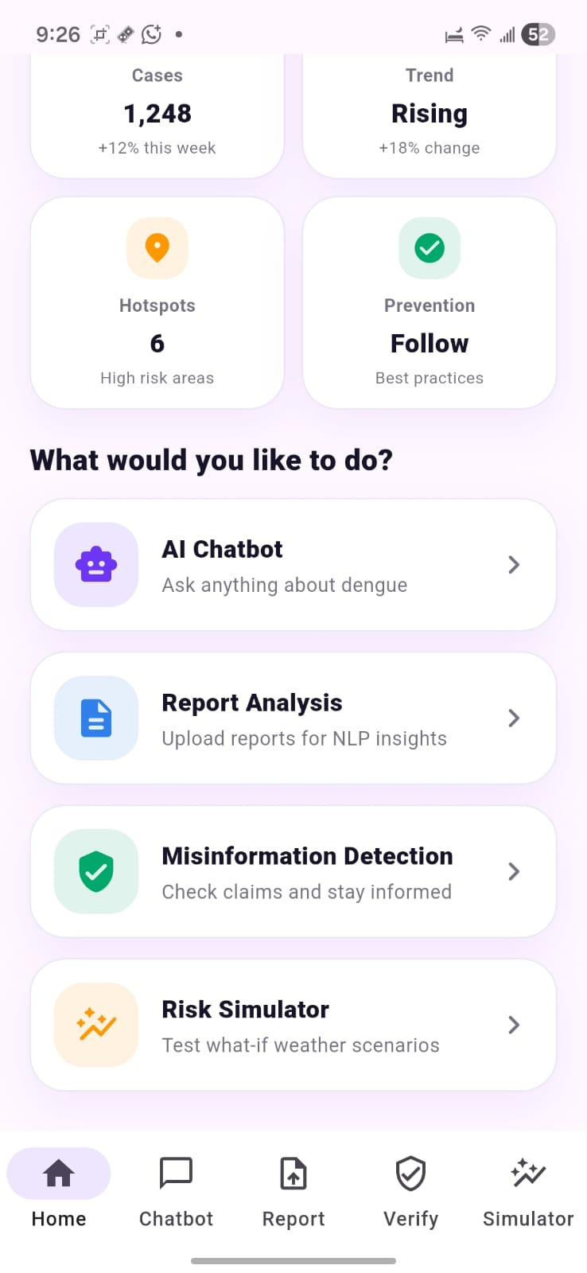
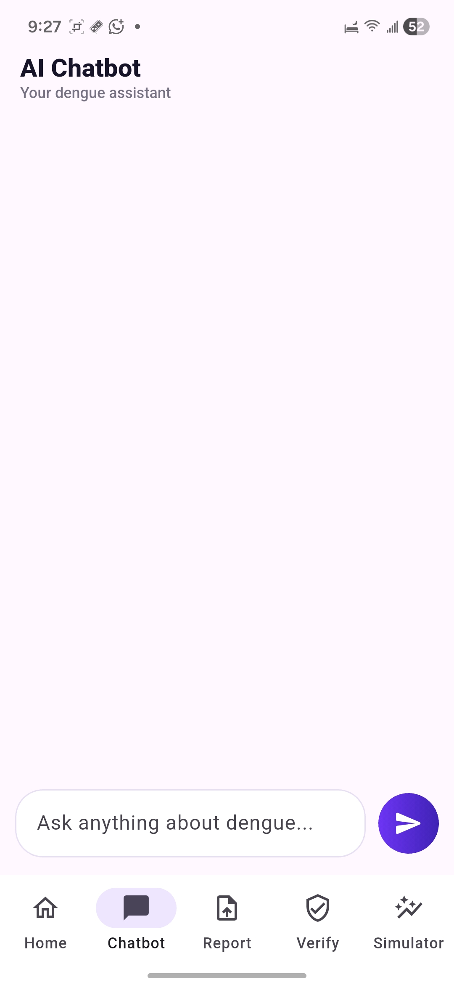
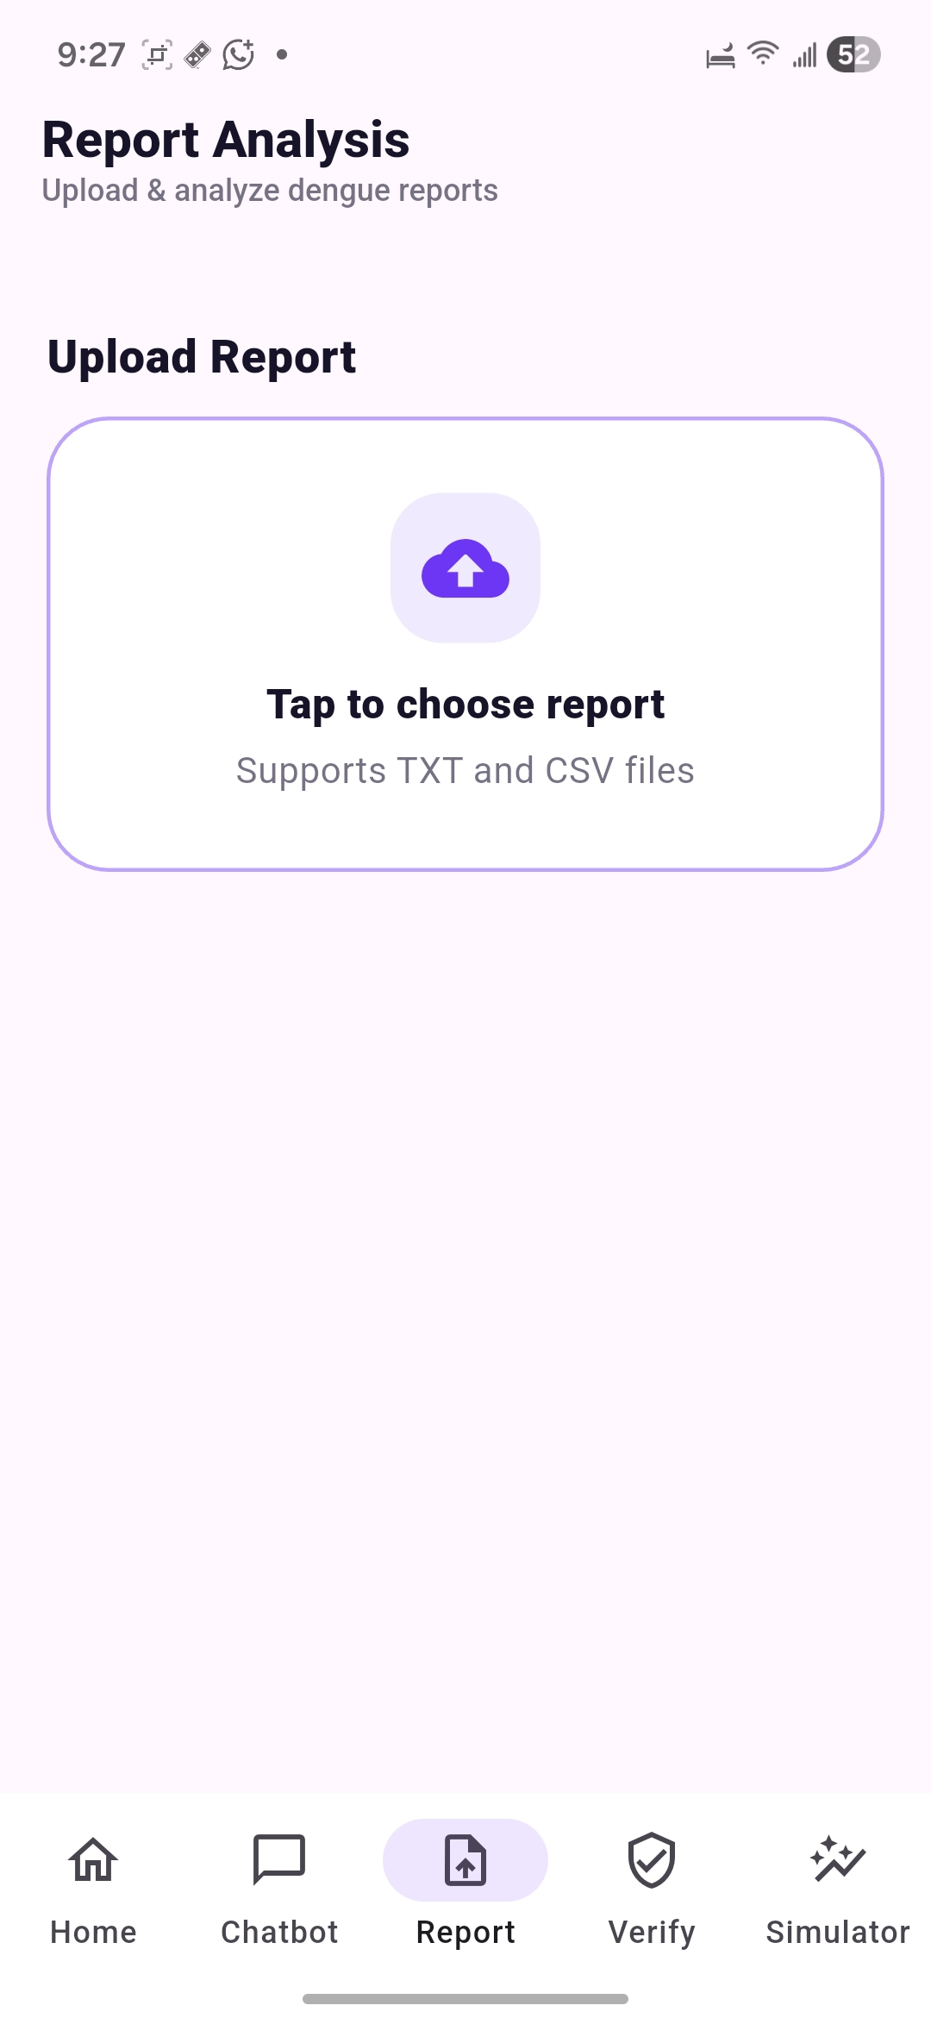

Slide 30
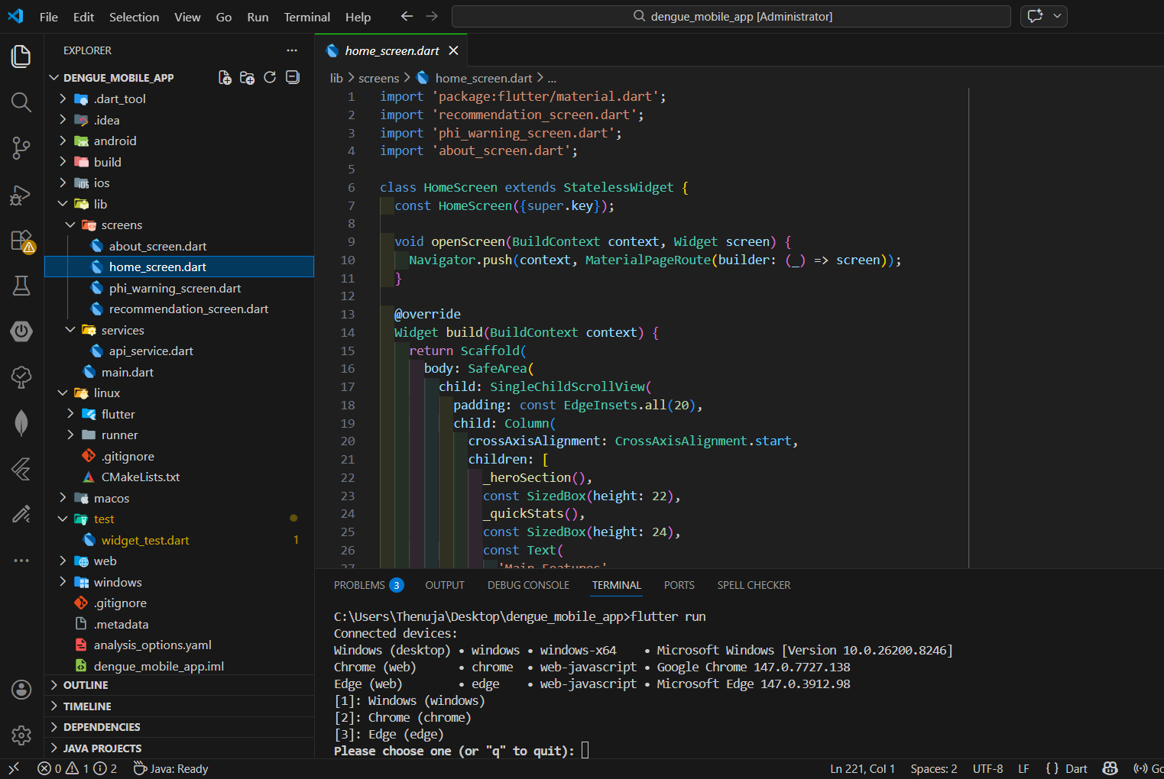
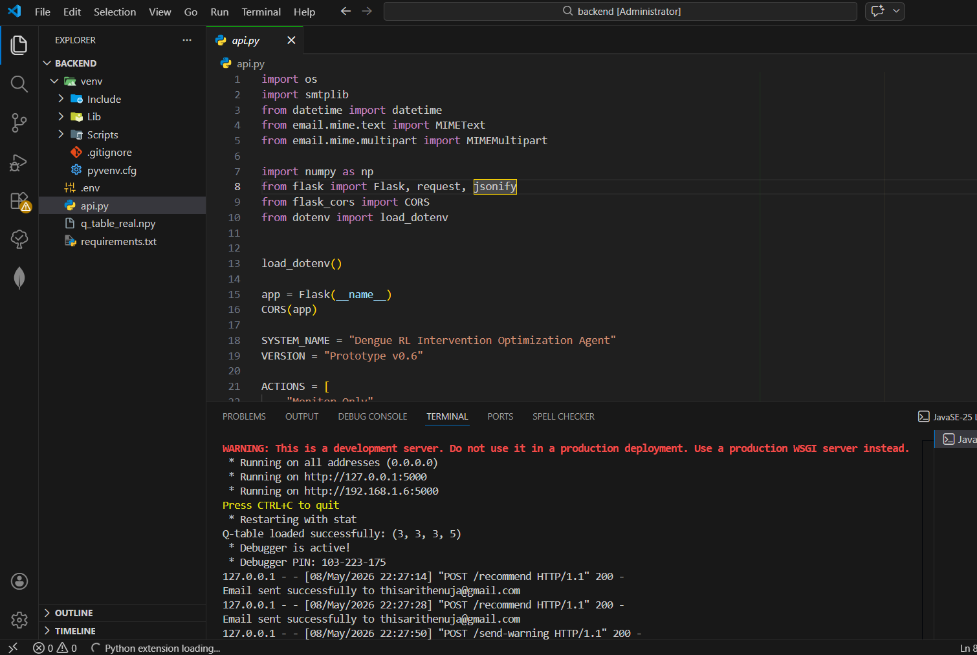
Demo

Slide 31
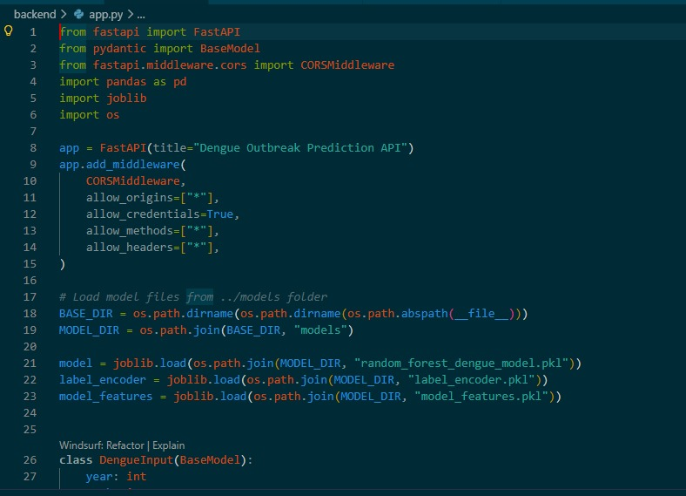
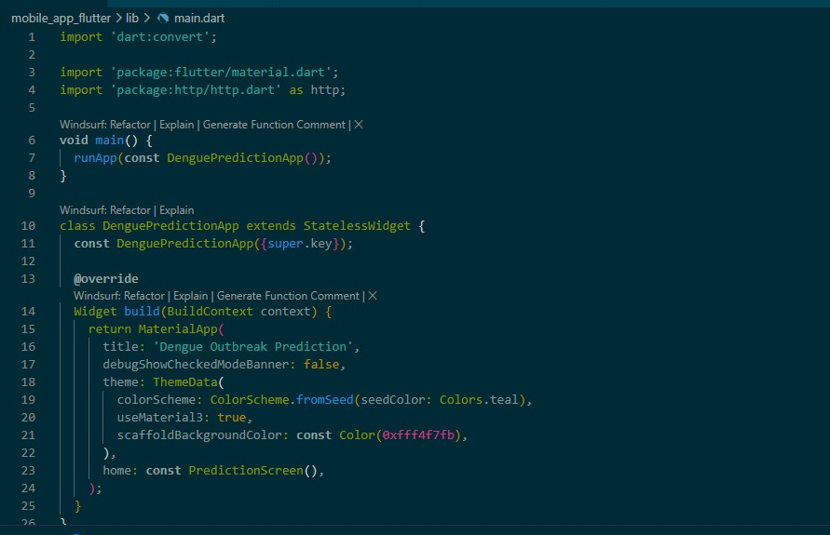

Slide 32
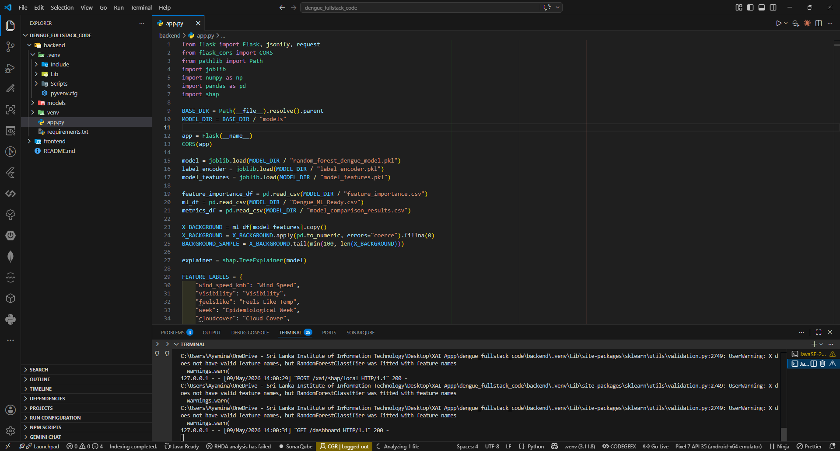
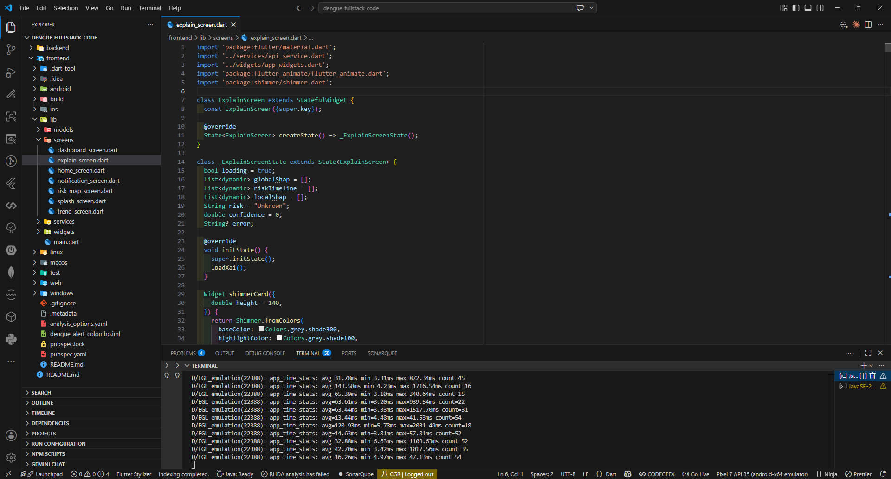

Slide 33
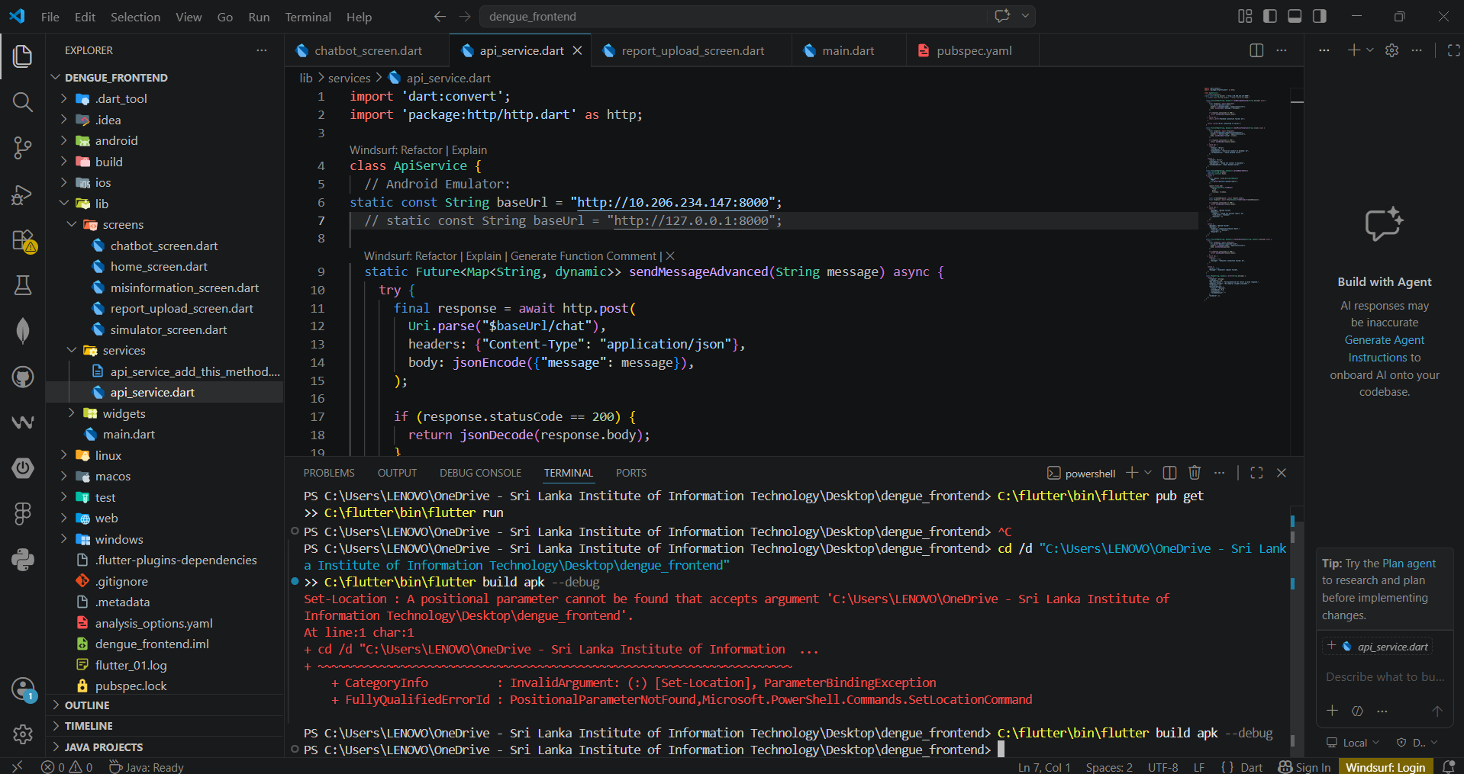
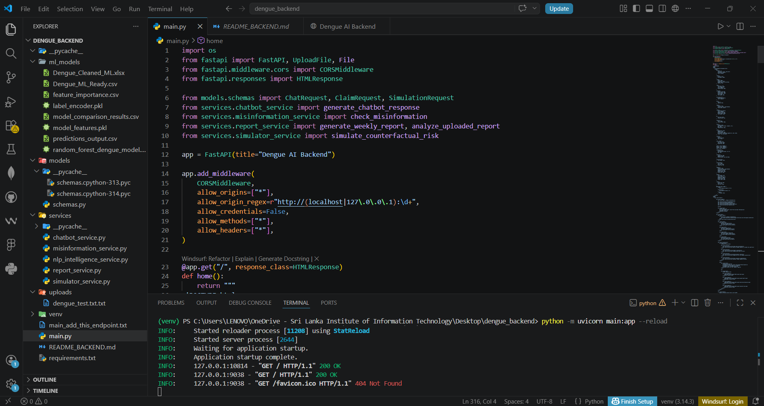

Slide 34
Thank You !

