Slide 1

An AI-Based Dengue Outbreak Prediction and Intervention Optimization System for the Colombo District, Sri Lanka
Project ID: R26-IT-061
SLIIT | IT4010-2026
R26 - IT - 085 | Mobile App for Drug Addiction Recovery SLIIT | IT4010-2026

Slide 2






Team
Supervisor
Co-Supervisor
Ms. Shashika Lokuliyana
Ms. Narmada Gamage
Wickramarachchi T.T.
IT22243980
Hettiarachchi A.T.
IT22165848
Keenavinna K.A.A.I.U
IT22214034
Adithya A.A.H.
IT22281982
R26 - IT - 061 | An AI-Based Dengue Outbreak Prediction and Intervention Optimization System for the Colombo District, Sri Lanka

Slide 3
Comments received & Improvements
IT Number | Comments Received | Improvements Made
IT22243980 | Moderate progress. The RL component should not be hard-coded. A feedback loop is required for the reinforcement learning part. | Implemented Q-learning using a Q-table instead of fixed rules. Added the Intervention Follow-up page, reward calculation, and Q-table update loop.
IT22165848 | The component works, but the candidate could not clearly explain the code to the panel. | Improved understanding of the component logic, dataset flow, model process, and source code. Prepared architecture diagrams and explanations for PP2.
IT22214034 | Good progress. Need to mirror the mobile screen to PC during PP2. Risk prediction should be based on the selected area. | Integrated area-based risk assessment. Users select the MOH area and receive relevant weather context and risk results. Prepared the Flutter application for live demonstration and screen mirroring.
IT22281982 | Low progress. The chatbot is not a major research contribution. The demo analysis was not proper; it only counted words. | Improved the component as Dengue Health Intelligence and AI-Assisted PHI Inspection. Added multilingual NLP, misinformation detection, evidence-based guidance, inspection image upload, location details, and AI-assisted breeding-risk assessment.
R26 - IT - 061 | An AI-Based Dengue Outbreak Prediction and Intervention Optimization System for the Colombo District, Sri Lanka

Slide 4

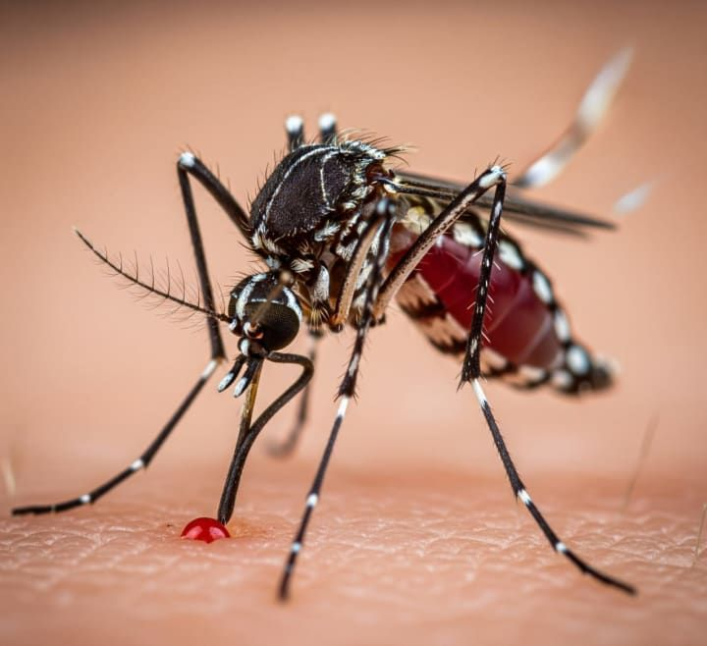
Introduction
Dengue is a major public-health concern in Sri Lanka. Timely risk identification, understandable predictions, appropriate interventions, and reliable public-health information are required to support dengue prevention and control.
Our research proposes an integrated AI-based mobile decision-support system for the Colombo District.
R26 - IT - 061 | An AI-Based Dengue Outbreak Prediction and Intervention Optimization System for the Colombo District, Sri Lanka

Slide 5
Proposed System Overview
AI-Based Dengue Decision Support Platform
The proposed system integrates:
Dengue outbreak risk prediction
SHAP-based prediction explanations
RL-based intervention recommendations
Multilingual dengue health intelligence
PHI field inspection support
Mobile dashboard, alerts, and follow-up records
R26 - IT - 061 | An AI-Based Dengue Outbreak Prediction and Intervention Optimization System for the Colombo District, Sri Lanka

Slide 6
The Problem
Dengue outbreak management requires timely and informed decisions
KEY PAIN POINTS IN CURRENT DENGUE MANAGEMENT
Early Risk Identification – Ability to identify possible dengue-risk conditions before an outbreak becomes severe.
Explainable Predictions – Ability to understand the factors that influence the predicted risk level.
Intervention Guidance – Ability to receive a suitable recommended action based on dengue and weather conditions.
Timely PHI Alerts – Ability to notify the responsible PHI officer for HIGH-risk advisory situations.
Continuous Learning – Ability to record intervention outcomes and improve future recommendations through the RL feedback loop.
Dengue risk is often identified only after cases have increased.
Weather conditions and historical dengue patterns are difficult to analyze manually.
Existing prediction systems may show a risk level but do not explain the reasons clearly.
PHI/MOH officers must manually decide which intervention is most suitable.
Follow-up outcomes are not consistently used to improve future intervention decisions.
USER REQUIREMENTS FOR DENGUE RESPONSE
R26 - IT - 061 | An AI-Based Dengue Outbreak Prediction and Intervention Optimization System for the Colombo District, Sri Lanka

Slide 7
Research Gap
Existing dengue solutions focus on separate functions
Risk prediction only
No clear prediction explanation
Manual intervention selection
Limited PHI follow-up support
No integrated health-information support
CURRENT LIMITATIONS
OUR RESEARCH GAP
Integrated AI-based dengue decision-support system
Explainable risk predictions
RL-based intervention recommendations
PHI alerts and follow-up feedback
Multilingual dengue health intelligence
R26 - IT - 085 | Mobile App for Drug Addiction Recovery SLIIT | IT4010-2026
R26 - IT - 061 | An AI-Based Dengue Outbreak Prediction and Intervention Optimization System for the Colombo District, Sri Lanka

Slide 8
Research Objectives
Predict dengue outbreak risk as Low, Medium, or High.
Explain factors influencing dengue predictions using SHAP.
Recommend suitable interventions using Q-Learning.
Provide multilingual dengue health information and misinformation analysis.
Support PHI officers with AI-assisted field inspection.
Integrate all components into one Flutter mobile application.
R26 - IT - 061 | An AI-Based Dengue Outbreak Prediction and Intervention Optimization System for the Colombo District, Sri Lanka

Slide 9
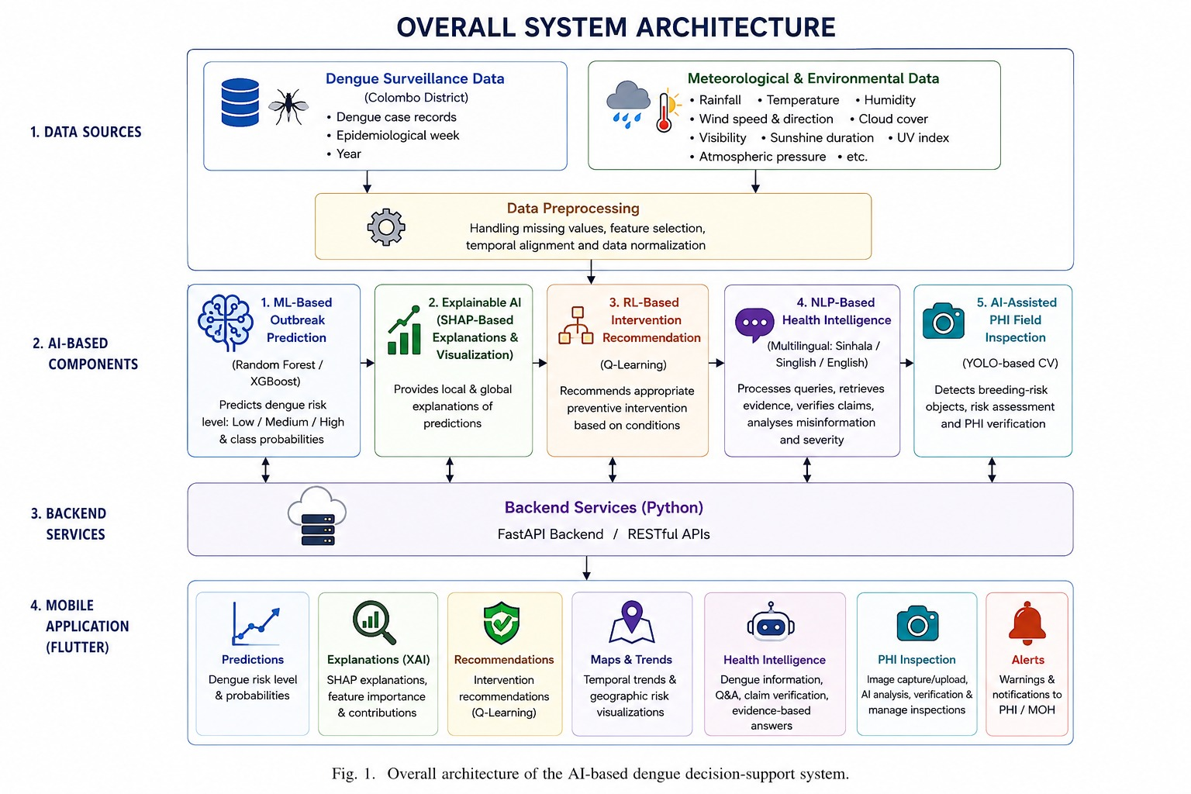
R26 - IT - 061 | An AI-Based Dengue Outbreak Prediction and Intervention Optimization System for the Colombo District, Sri Lanka

Slide 10
Machine Learning-Based Dengue Outbreak Prediction
Keenavinna K.A.A.I.U | IT22214034
SPECIALIZATION : INFORMATION TECHNOLOGY
IT22214034| Keenavinna K.A.A.I.U. | R26 - IT - 061

Slide 11
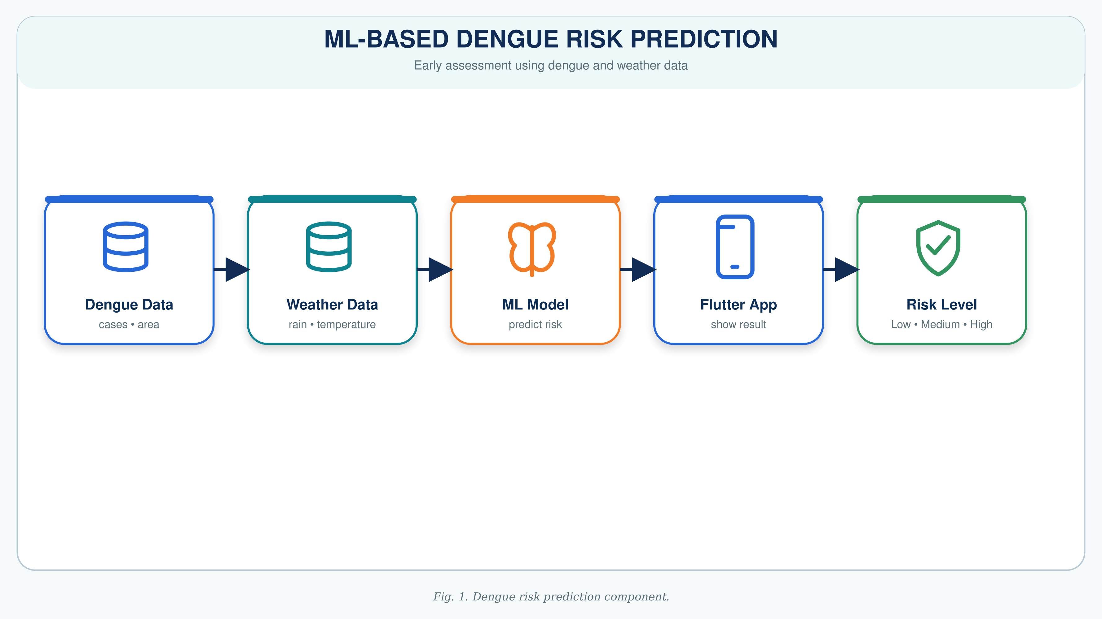
Dengue Outbreak Risk Prediction
Uses historical dengue surveillance and weather data.
Inputs include dengue patterns, rainfall, humidity, temperature, year, week, and month.
Random Forest model predicts:
  Low Risk
  Medium Risk
  High Risk
Results are displayed through the mobile application.
IT22291714 | Bandara V.K.J |R26 - IT - 085 SLIIT | IT4010-2026

Slide 12
  SHAP-Based Explainable Artificial Intelligence
Hettiarachchi A.T.| IT22165848
SPECIALIZATION : INFORMATION TECHNOLOGY
IT22165848 | Hettiarachchi A T | R26 - IT - 061

Slide 13
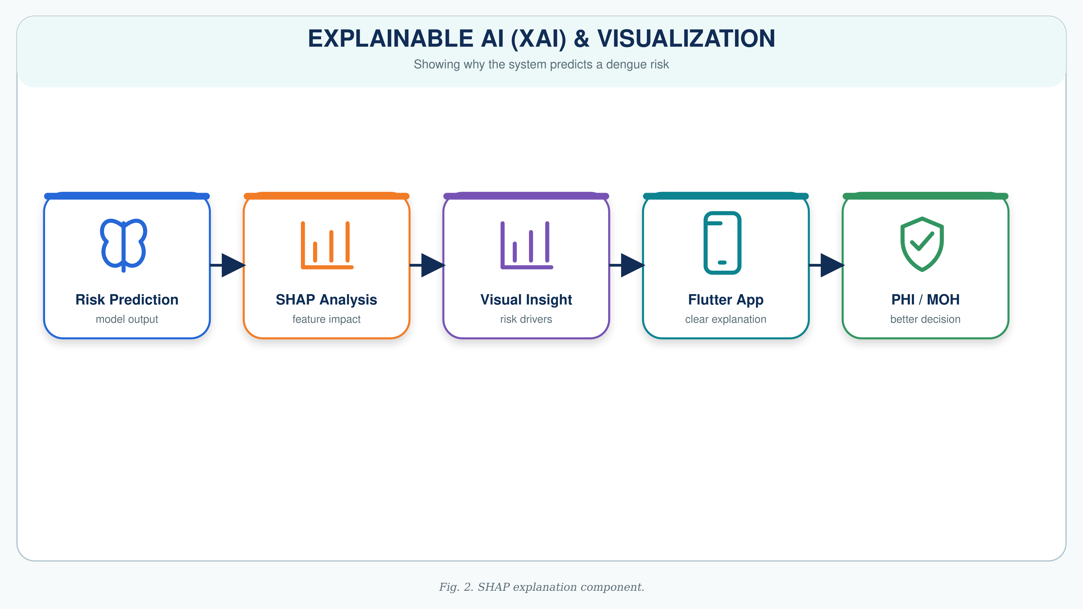
Explainable AI Using SHAP
SHAP explains why the ML model produced a risk prediction.
Local explanation: factors affecting one specific prediction.
Global explanation: most important features across the model.
Improves transparency and trust in AI-generated predictions.
IT22165848 | Hettiarachchi A T | R26 - IT - 061

Slide 14
Reinforcement Learning-Based Intervention Recommendation
Wickramarachchi T.T.| IT22243980
SPECIALIZATION : INFORMATION TECHNOLOGY
IT22243980 | Wickramarachchi T T | R26 - IT - 061

Slide 15
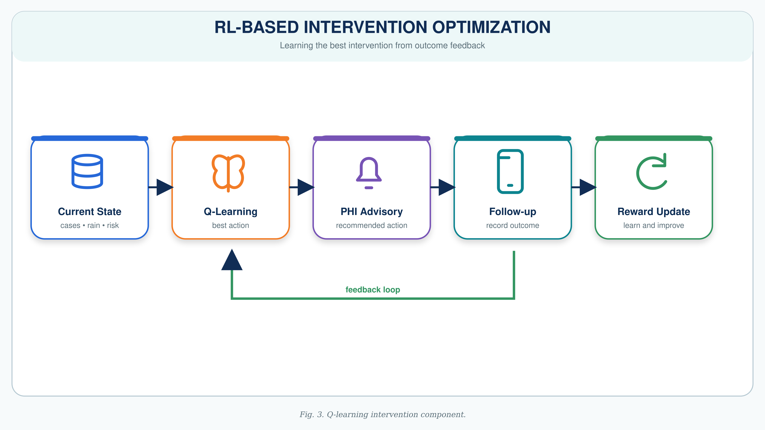
Reinforcement Learning-Based Intervention Optimization
Uses Q-Learning to recommend suitable dengue interventions.
State context includes:
  Dengue cases
  Rainfall
  Temperature
The agent selects the best intervention based on previous rewards.
Possible actions:
Monitor Only
Deploy Fumigation Teams
Issue Public Health Alert
Increase Hospital Readiness
Community Cleanup Campaign
IT22243980 | Wickramarachchi T T | R26 - IT - 061

Slide 16
NLP-Based Dengue Health Intelligence
Adithya A.A.H.| IT22281982
SPECIALIZATION : INFORMATION TECHNOLOGY
IT22281982 | Adithya A A H | R26 - IT - 061

Slide 17
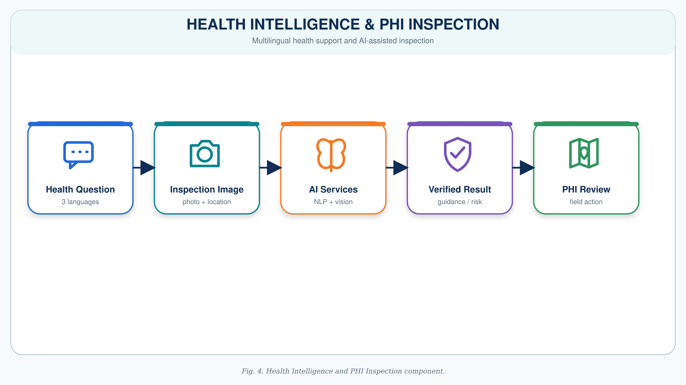
Multilingual Dengue Health Intelligence and AI-Assisted PHI Field Inspection
Supports dengue-related questions and health claims in English, Sinhala, and Singlish.
Uses NLP and DistilBERT-based classification to provide dengue health information.
Covers symptoms, prevention, treatment-related information, risk factors, official guidelines, and misinformation detection.
PHI officers can capture or upload multiple inspection images for one inspection record.
Officers add the location and relevant inspection details.
The AI vision service identifies possible mosquito breeding-risk conditions from images.
The PHI officer reviews the AI result and takes the final field action.
IT22281982 | Adithya A A H | R26 - IT - 061

Slide 18
Technology and Implementation
Area | Technology
Programming | Python, Dart
Data Processing | Pandas, NumPy
ML Prediction | Scikit-learn, Random Forest
Explainable AI | SHAP
RL | Q-Learning
NLP | DistilBERT
Backend | FastAPI
Mobile Application | Flutter
Database | Supabase
Version Control | GitHub
R26 - IT - 061 | An AI-Based Dengue Outbreak Prediction and Intervention Optimization System for the Colombo District, Sri Lanka

Slide 19
Evaluation and Validation
ML Prediction
Accuracy
Precision
Recall
F1-score
Confusion Matrix
System Validation
API testing
Flutter mobile application testing
Database integration testing
Usability feedback from potential users
Supervisor and stakeholder validation
R26 - IT - 061 | An AI-Based Dengue Outbreak Prediction and Intervention Optimization System for the Colombo District, Sri Lanka

Slide 20
Future & Potential Impact
Expected Impact
Earlier awareness of potential dengue risks
More understandable AI predictions
Faster intervention recommendations
Better PHI/MOH decision support
Improved follow-up record keeping
Better access to dengue health information
Support for proactive dengue prevention in Sri Lanka
R26 - IT - 061 | An AI-Based Dengue Outbreak Prediction and Intervention Optimization System for the Colombo District, Sri Lanka

Slide 21
Commercialization
Commercialization Approach
Centralized dengue decision-support platform
Faster and more informed intervention planning
Explainable AI outputs
Mobile access for field officers
Expandable to other districts in Sri Lanka
Target Market
Value Proposition
Ministry of Health
National Dengue Control Unit
MOH offices
Public Health Inspectors
Hospitals and local authorities
R26 - IT - 061 | An AI-Based Dengue Outbreak Prediction and Intervention Optimization System for the Colombo District, Sri Lanka

Slide 22
CONCLUSION
This research proposes an integrated AI-based dengue decision-support platform for the Colombo District.
It combines:
ML-based outbreak risk prediction
SHAP-based explanations
RL-based intervention optimization
Multilingual health intelligence
AI-assisted PHI field inspection
Flutter mobile application and backend integration
The system aims to support more proactive, transparent, and data-driven dengue prevention and control.
R26 - IT - 061 | An AI-Based Dengue Outbreak Prediction and Intervention Optimization System for the Colombo District, Sri Lanka

Slide 23
THANK YOU
R26 - IT - 061 | An AI-Based Dengue Outbreak Prediction and Intervention Optimization System for the Colombo District, Sri Lanka

