Slide 1

An AI-Based Dengue Outbreak Prediction and Intervention Optimization System for the Colombo District, Sri Lanka
Final Presentation
Project ID: R26-IT-061
SLIIT | IT4010-2026

Slide 2

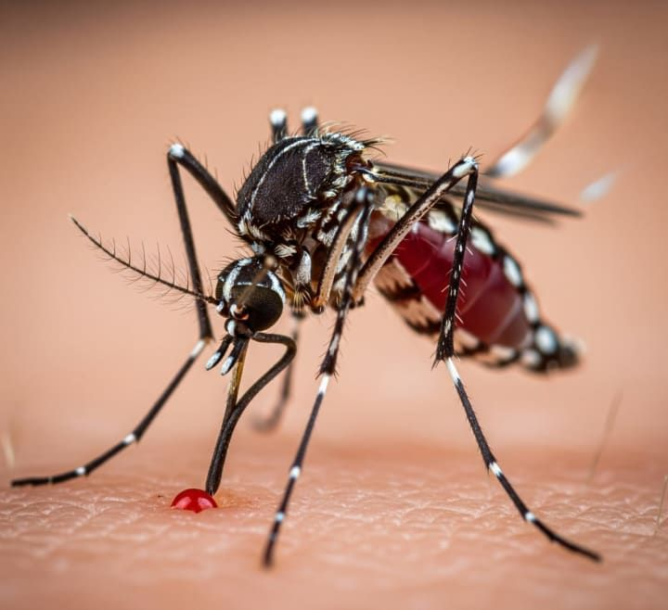
Introduction
Dengue is a major public-health concern in Sri Lanka. Timely risk identification, understandable predictions, appropriate interventions, and reliable public-health information are required to support dengue prevention and control.
Our research proposes an integrated AI-based mobile decision-support system for the Colombo District.
R26 - IT - 061 | An AI-Based Dengue Outbreak Prediction and Intervention Optimization System for the Colombo District, Sri Lanka

Slide 3
PP2 Panel Comments
IT Number | Panel Comments | Actions Taken
IT2243980 | Good progress for the PP2 milestone. Work on the research paper. | Finalized the component and continued working on the research paper.
IT22165848 | Moderate progress for the PP2 milestone. Address component overlap and use XAI to explain the changes in the three values. | Corrected the overlapping functionality and improved the XAI component to clearly explain the factors influencing changes in the three values.
IT22214034 | Good progress for the PP2 milestone. Work on the research paper. | Finalized the component and continued working on the research paper.
IT22281982 | Good progress for the PP2 milestone. Work on the research paper. | Finalized the component and continued working on the research paper.

Slide 4
Proposed System Overview
AI-Based Dengue Decision Support Platform
The proposed system integrates:
Dengue outbreak risk prediction
SHAP-based prediction explanations
RL-based intervention recommendations
Multilingual dengue health intelligence
PHI field inspection support
Mobile dashboard, alerts, and follow-up records
R26 - IT - 061 | An AI-Based Dengue Outbreak Prediction and Intervention Optimization System for the Colombo District, Sri Lanka

Slide 5
The Problem
Dengue outbreak management requires timely and informed decisions
KEY PAIN POINTS IN CURRENT DENGUE MANAGEMENT
Dengue risk is often identified only after cases have increased.
Weather conditions and historical dengue patterns are difficult to analyze manually.
Existing prediction systems may show a risk level but do not explain the reasons clearly.
PHI/MOH officers must manually decide which intervention is most suitable.
Follow-up outcomes are not consistently used to improve future intervention decisions.
USER REQUIREMENTS FOR DENGUE RESPONSE
Early Risk Identification – Ability to identify possible dengue-risk conditions before an outbreak becomes severe.
Explainable Predictions – Ability to understand the factors that influence the predicted risk level.
Intervention Guidance – Ability to receive a suitable recommended action based on dengue and weather conditions.
Timely PHI Alerts – Ability to notify the responsible PHI officer for HIGH-risk advisory situations.
Continuous Learning – Ability to record intervention outcomes and improve future recommendations through the RL feedback loop.
R26 - IT - 061 | An AI-Based Dengue Outbreak Prediction and Intervention Optimization System for the Colombo District, Sri Lanka

Slide 6
Research Gap
Existing dengue solutions focus on separate functions
Risk prediction only
No clear prediction explanation
Manual intervention selection
Limited PHI follow-up support
No integrated health-information support
CURRENT LIMITATIONS
Integrated AI-based dengue decision-support system
Explainable risk predictions
RL-based intervention recommendations
PHI alerts and follow-up feedback
Multilingual dengue health intelligence
OUR RESEARCH GAP
R26 - IT - 061 | An AI-Based Dengue Outbreak Prediction and Intervention Optimization System for the Colombo District, Sri Lanka

Slide 7
Research Objectives
Predict dengue outbreak risk as Low, Medium, or High.
Explain factors influencing dengue predictions using SHAP.
Recommend suitable interventions using Q-Learning.
Provide multilingual dengue health information and misinformation analysis.
Support PHI officers with AI-assisted field inspection.
Integrate all components into one Flutter mobile application.
R26 - IT - 061 | An AI-Based Dengue Outbreak Prediction and Intervention Optimization System for the Colombo District, Sri Lanka

Slide 8
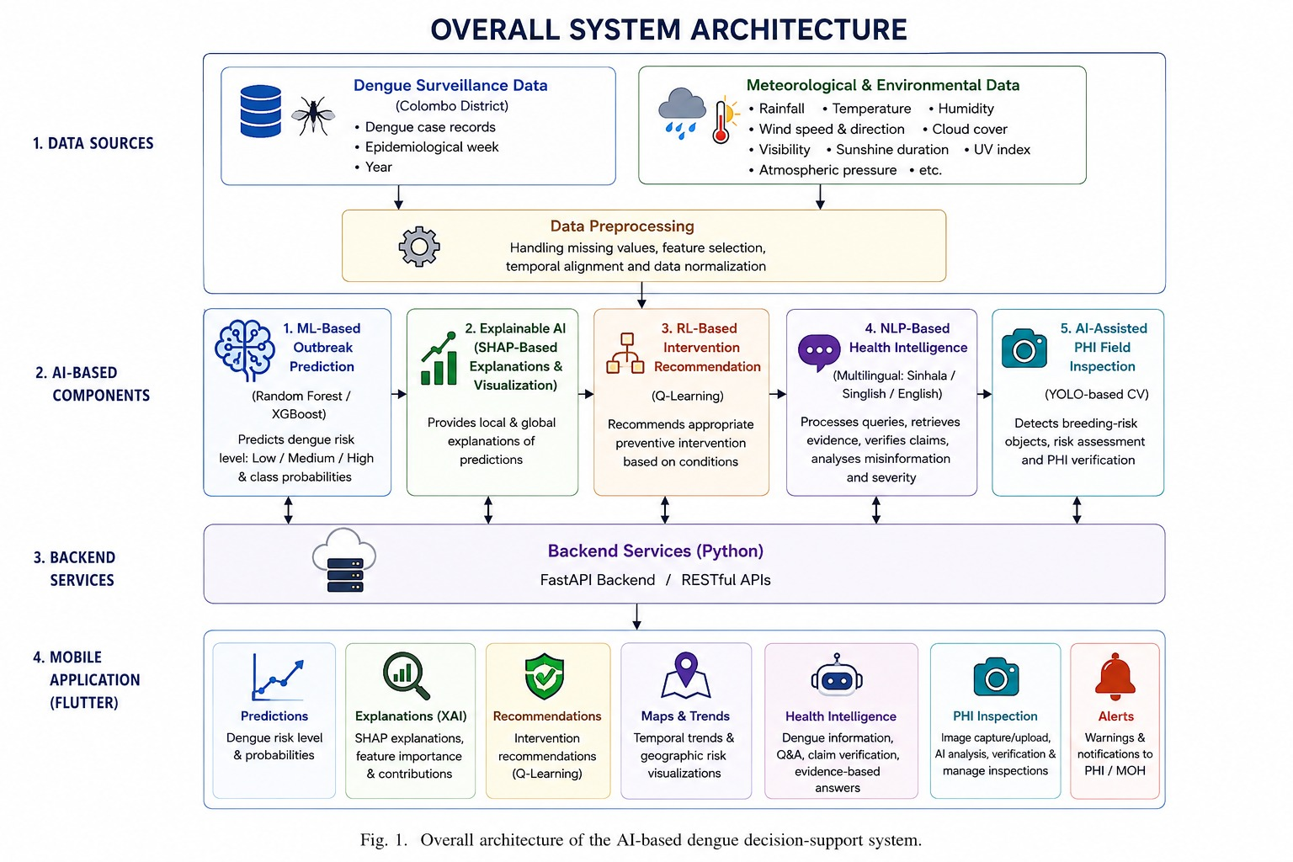
R26 - IT - 061 | An AI-Based Dengue Outbreak Prediction and Intervention Optimization System for the Colombo District, Sri Lanka

Slide 9

Machine Learning-Based Dengue Outbreak Prediction
Keenavinna K.A.A.I.U | IT22214034
SPECIALIZATION : INFORMATION TECHNOLOGY
IT22214034| Keenavinna K.A.A.I.U. | R26 - IT - 061

Slide 10
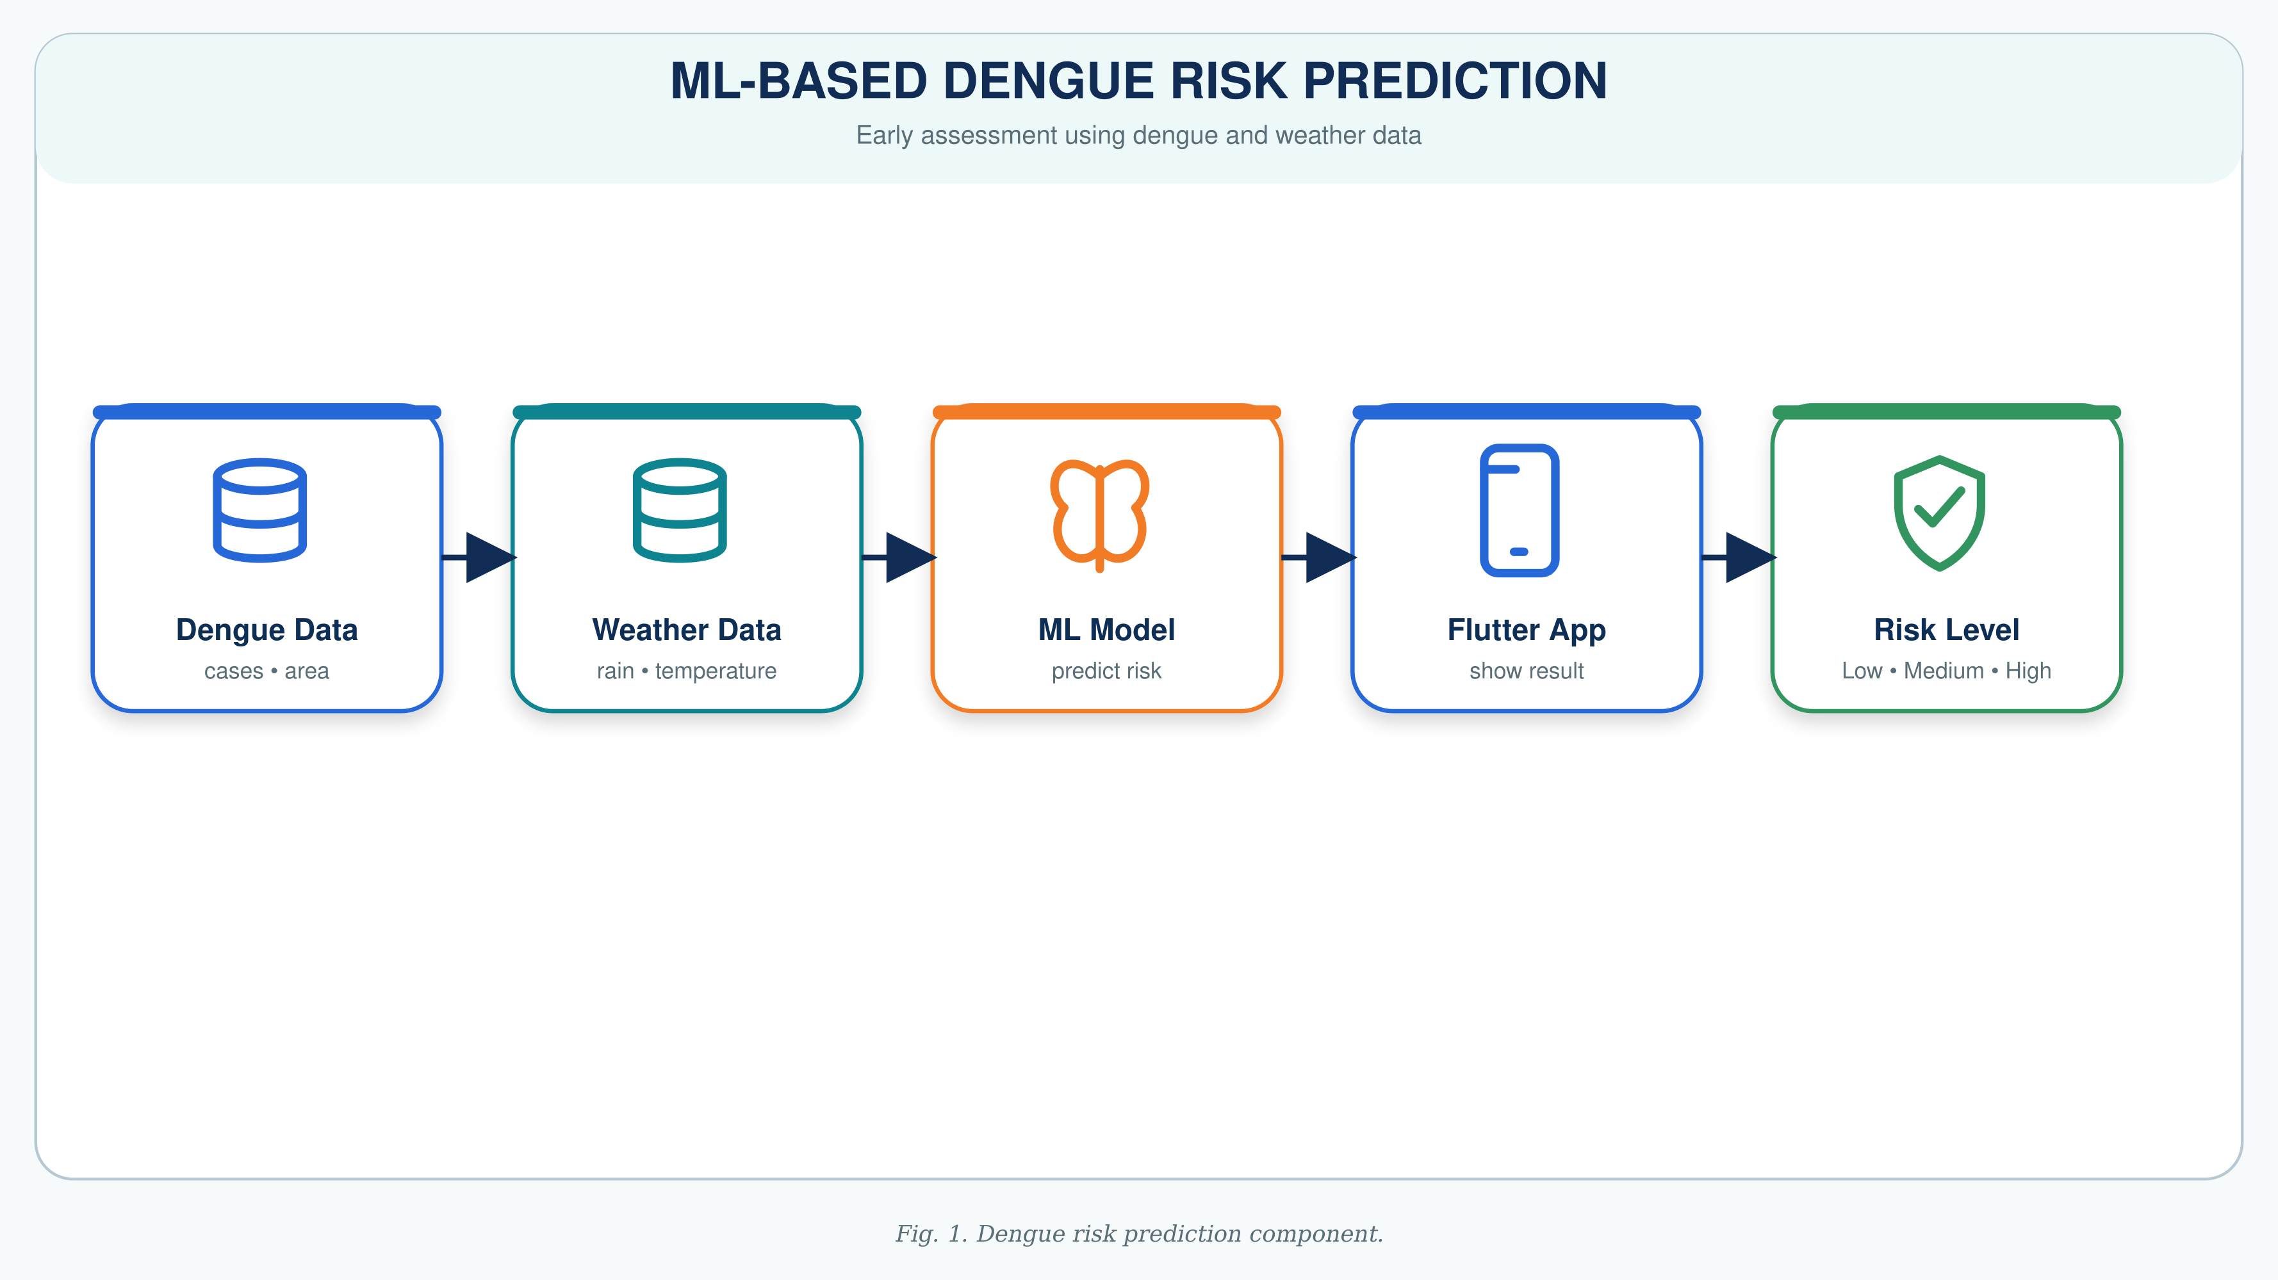
Dengue Outbreak Risk Prediction
Uses historical dengue surveillance and weather data.
Inputs include dengue patterns, rainfall, humidity, temperature, year, week, and month.
Random Forest model predicts:
  Low Risk
  Medium Risk
  High Risk
Results are displayed through the mobile application.
IT22214034| Keenavinna K.A.A.I.U. | R26 - IT - 061

Slide 11

  SHAP-Based Explainable Artificial Intelligence
Hettiarachchi A.T.| IT22165848
SPECIALIZATION : INFORMATION TECHNOLOGY
IT22165848 | Hettiarachchi A T | R26 - IT - 061

Slide 12
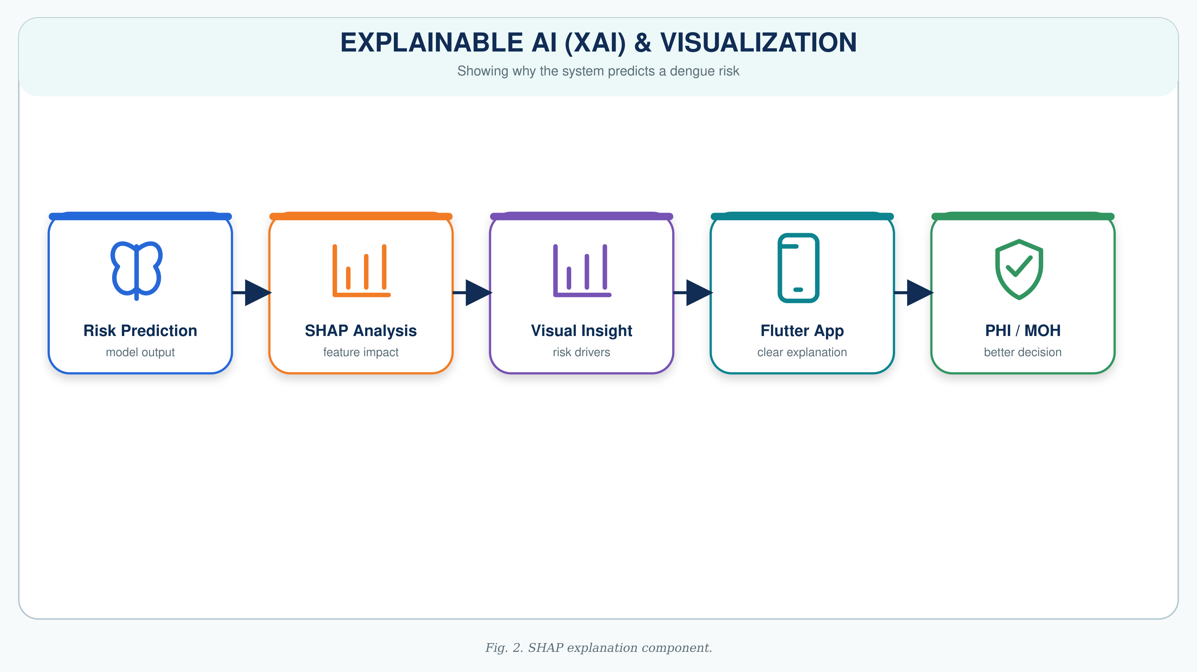
Explainable AI Using SHAP
SHAP explains why the ML model produced a risk prediction by showing each feature’s contribution.
Local explanation identifies factors affecting one specific prediction and their positive or negative impact.
Highlights important factors such as historical dengue cases and environmental conditions.
Improves transparency, interpretability, and trust in AI-generated predictions.
IT22165848 | Hettiarachchi A T | R26 - IT - 061

Slide 13

Reinforcement Learning-Based Intervention Recommendation
Wickramarachchi T.T.| IT22243980
SPECIALIZATION : INFORMATION TECHNOLOGY
IT22243980 | Wickramarachchi T T | R26 - IT - 061

Slide 14
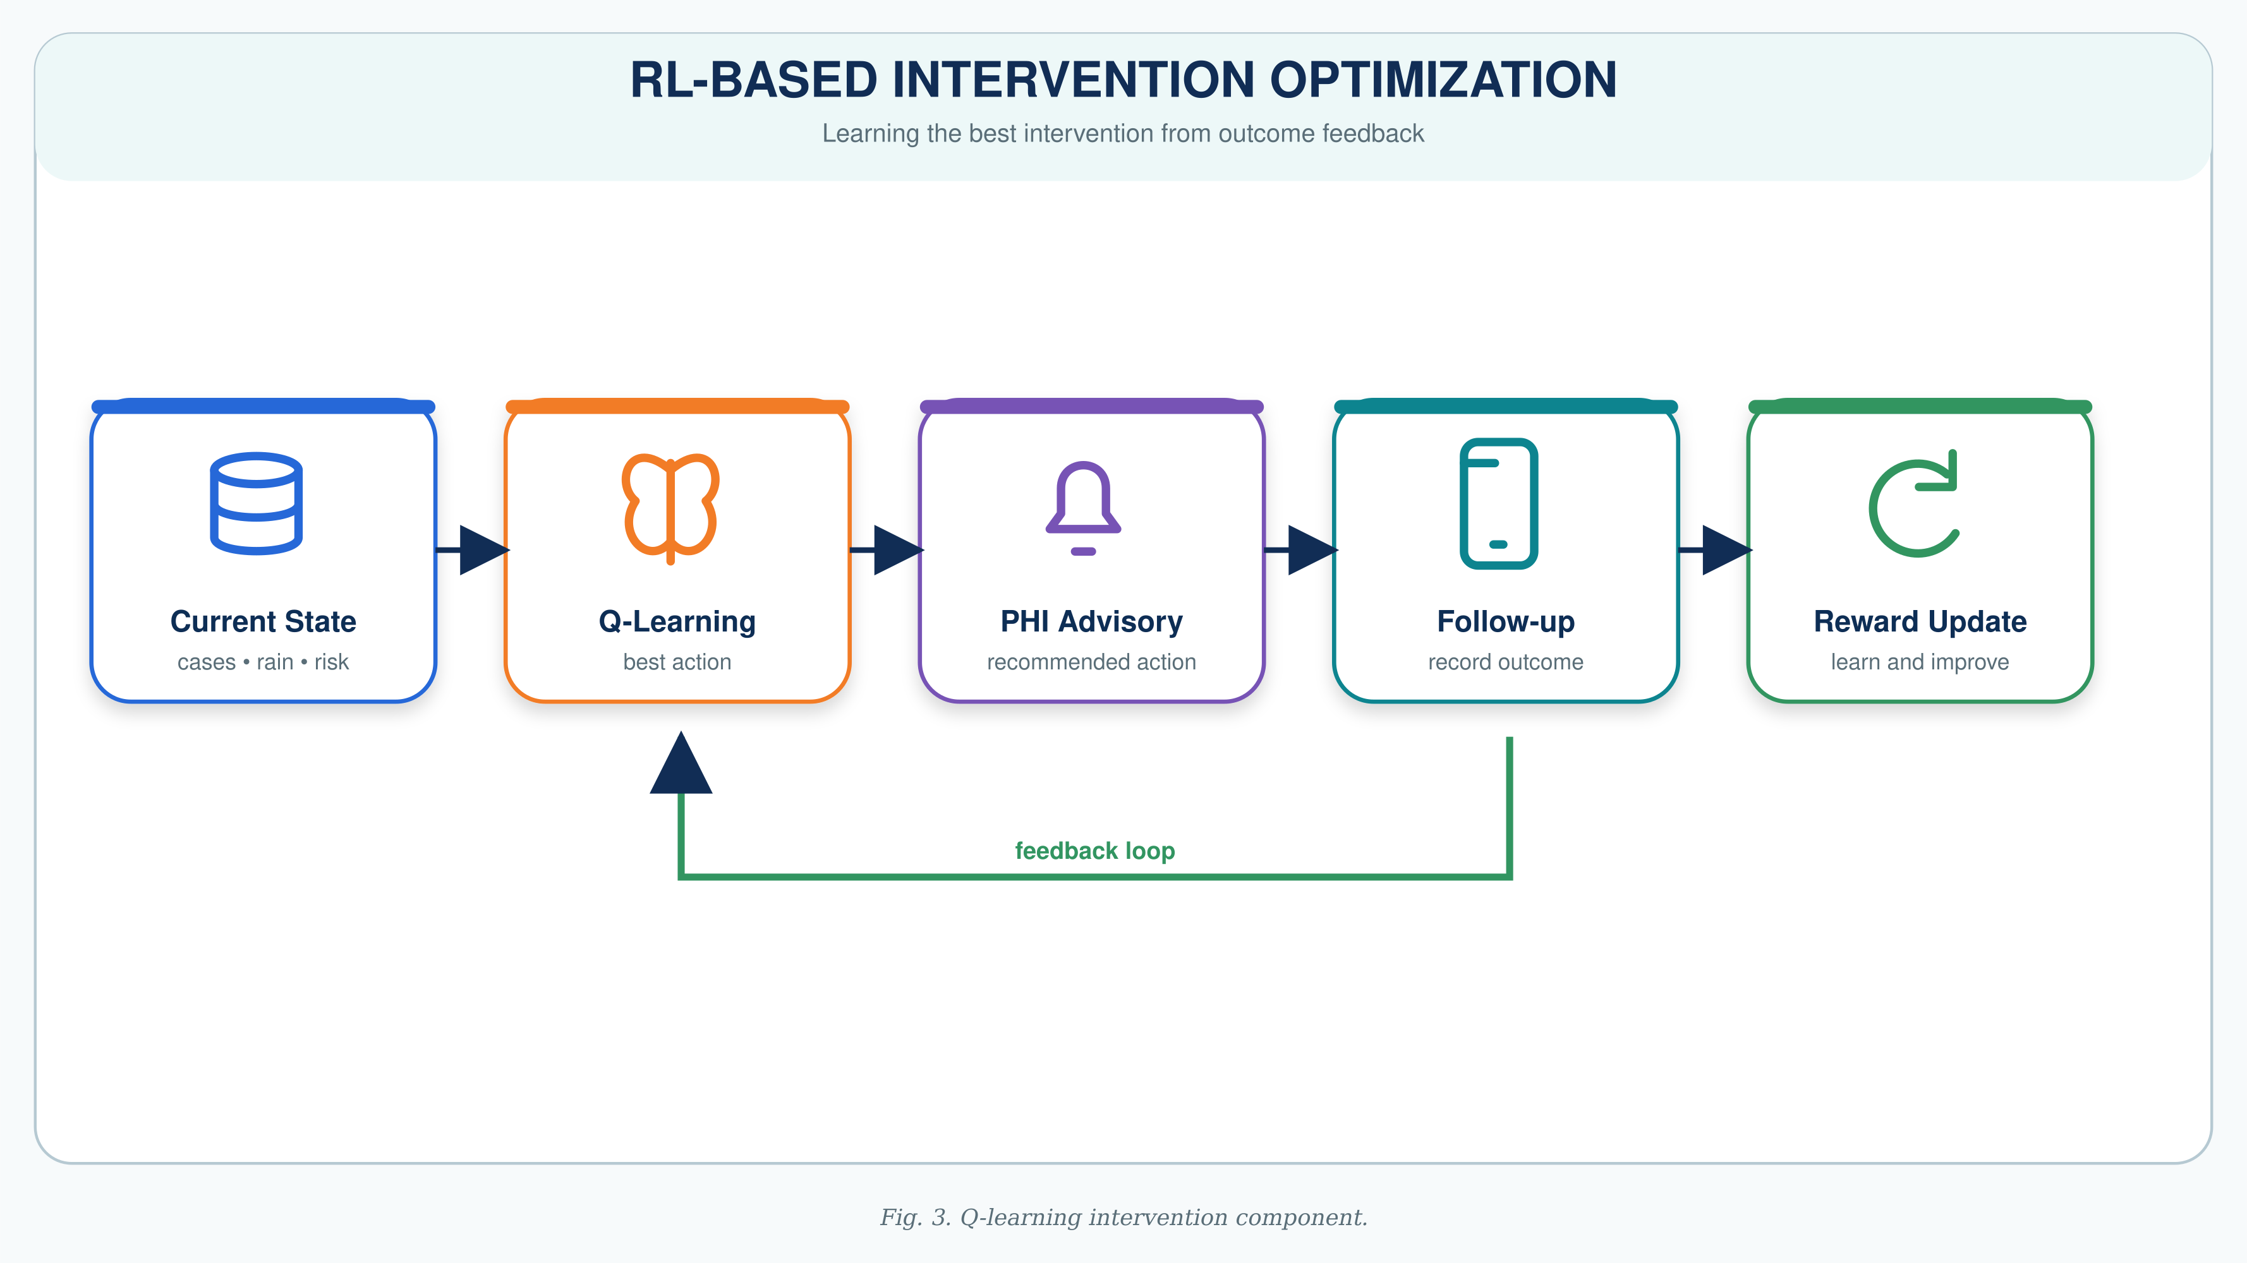
Reinforcement Learning-Based Intervention Optimization
Uses Q-Learning to recommend suitable dengue interventions.
State context includes:
  Dengue cases
  Rainfall
  Temperature
The agent selects the best intervention based on previous rewards.
Possible actions:
Monitor Only
Deploy Fumigation Teams
Issue Public Health Alert
Increase Hospital Readiness
Community Cleanup Campaign
IT22243980 | Wickramarachchi T T | R26 - IT - 061

Slide 15

PHI Field Inspection Multilingual Dengue Health Intelligence
Adithya A.A.H.| IT22281982
SPECIALIZATION : INFORMATION TECHNOLOGY
IT22281982 | Adithya A A H | R26 - IT - 061

Slide 16
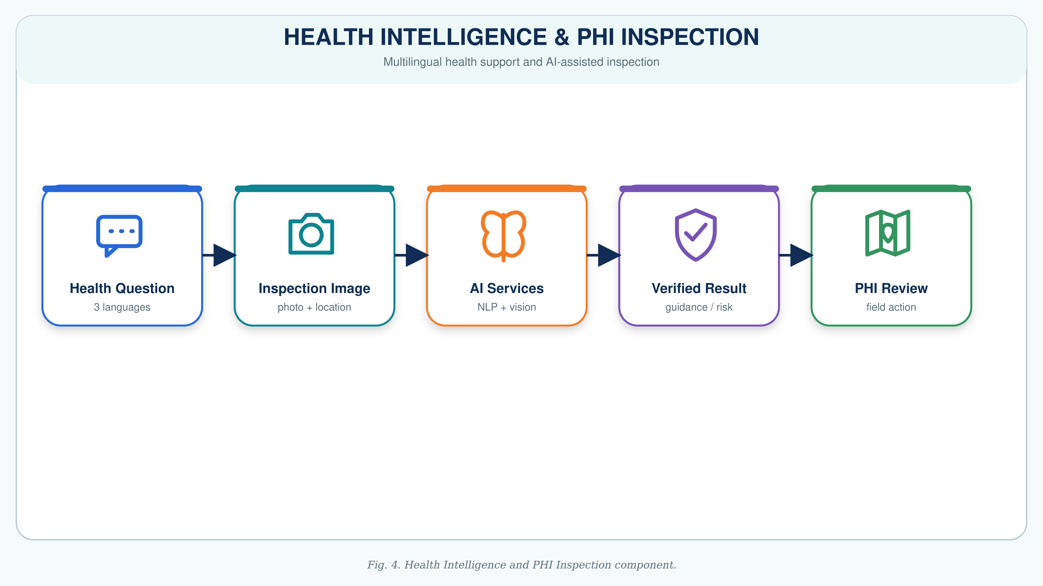
Multilingual Dengue Health Intelligence and AI-Assisted PHI Field Inspection
Covers symptoms, prevention, treatment-related information, risk factors, official guidelines, and misinformation detection.
PHI officers upload multiple inspection images with location and inspection details.
AI vision identifies possible mosquito breeding-risk conditions, while PHI officers review results and take final field action.
IT22281982 | Adithya A A H | R26 - IT - 061

Slide 17
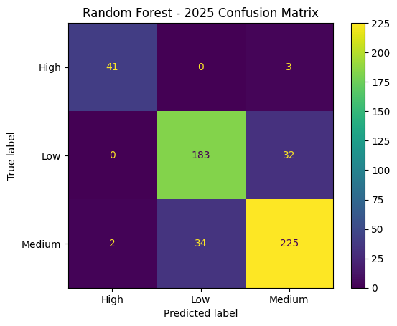
Results and Testimonials
Model Performance
Model | Accuracy | Precision | Recall | F1-Score
Random Forest | 86.35% | 86.37% | 86.35% | 86.36%
XGBoost | 85.58% | 85.65% | 85.58% | 85.60%
R26 - IT - 061 | An AI-Based Dengue Outbreak Prediction and Intervention Optimization System for the Colombo District, Sri Lanka

Slide 18


Feedback from Users
Medical Student – national institute of health sciences (nihs)
Science undergraduate - university of Plymouth , uk

Slide 19
Future & Potential Impact
Expected Impact
Earlier awareness of potential dengue risks
More understandable AI predictions
Faster intervention recommendations
Better PHI/MOH decision support
Improved follow-up record keeping
Better access to dengue health information
Support for proactive dengue prevention in Sri Lanka
R26 - IT - 061 | An AI-Based Dengue Outbreak Prediction and Intervention Optimization System for the Colombo District, Sri Lanka

Slide 20
Commercialization
Commercialization Approach
Value Proposition
Centralized dengue decision-support platform
Faster and more informed intervention planning
Explainable AI outputs
Mobile access for field officers
Expandable to other districts in Sri Lanka
Target Market
Ministry of Health
National Dengue Control Unit
MOH offices
Public Health Inspectors
Hospitals and local authorities
R26 - IT - 061 | An AI-Based Dengue Outbreak Prediction and Intervention Optimization System for the Colombo District, Sri Lanka

Slide 21
CONCLUSION
This research proposes an integrated AI-based dengue decision-support platform for the Colombo District.
It combines:
ML-based outbreak risk prediction
SHAP-based explanations
RL-based intervention optimization
Multilingual health intelligence
AI-assisted PHI field inspection
Flutter mobile application and backend integration
The system aims to support more proactive, transparent, and data-driven dengue prevention and control.
R26 - IT - 061 | An AI-Based Dengue Outbreak Prediction and Intervention Optimization System for the Colombo District, Sri Lanka

Slide 22
THANK YOU.
R26 - IT - 061 | An AI-Based Dengue Outbreak Prediction and Intervention Optimization System for the Colombo District, Sri Lanka

