Slide 1

Machine Learning-Based Dengue Outbreak Prediction System for Colombo District
Project ID: R26-IT-061 | Year: 2026

Slide 2

Team Members
Supervisor : MS.Shashika Lokuliyana
Co-Supervisor: Ms. Narmada Gamage
Student Name​ | Student ID​
Wickramarachchi T.T. | IT22243980
Hettiarachchi A.T. | IT22165848
Keenavinna K.A.I.U. | IT22214034
Adithya A.A.H. | IT22281982

Slide 3

Introduction
Dengue fever is a major public health problem in many tropical countries, including Sri Lanka.
It continues to affect thousands of people every year.
A large number of dengue cases are reported annually.
This creates significant pressure on the healthcare system.
Dengue transmission is strongly influenced by climate factors.
Rainfall, temperature, and humidity affect mosquito breeding.

Slide 4

Environmental conditions create favorable habitats for mosquitoes.
This increases the risk of dengue transmission in communities.
Existing dengue monitoring systems rely mainly on historical data analysis.
They mostly use statistical reports and past case trends.
Most current systems respond only after cases increase.
This makes early prevention and preparedness difficult.

Slide 5
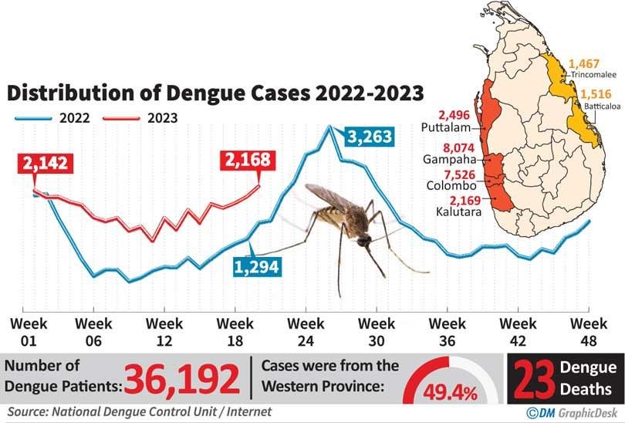
The relationship between weather factors and dengue outbreaks is complex.
These effects often appear after several weeks.
Traditional analytical approaches struggle to capture these complex patterns.
Therefore, accurate outbreak prediction becomes challenging.
This research proposes a machine learning–based dengue prediction system.
It focuses on the Colombo District to provide early and interpretable warnings.

Slide 6
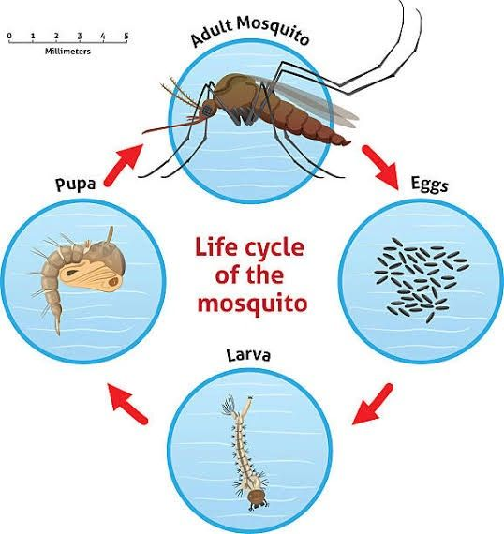
The Journey of Dengue

Slide 7

Problem
Dengue Outbreak Challenge
Dengue is a major public health problem in Sri Lanka. Colombo District records high dengue incidence. Current dengue monitoring mainly uses retrospective analysis. Problem Existing systems cannot predict outbreaks early and mainly analyze past trends.

Slide 8
Users & Stakeholders
Ministry of National Health
Dengue Control Unit
Medical Officer of Health (MOH) offices
Public health researchers
Impact
Late dengue prevention actions
Inefficient resource allocation
Difficulty identifying high-risk areas

Slide 9
Existing Systems & Limitations
Existing approaches include:
Linear regression
ARIMA time-series models
Statistical trend analysis
Limitations:
Cannot model complex climate relationships
Limited local prediction capability
ML systems often behave as black-box models without explanations.

Slide 10
Proposed Solution
AI-Based Dengue Prediction
Our system integrates:
Machine Learning prediction models
Weather + dengue historical data
Explainable AI techniques
NLP intelligence
Interactive dashboards
Outcomes
Generate localized dengue risk predictions for Colombo District.

Slide 11
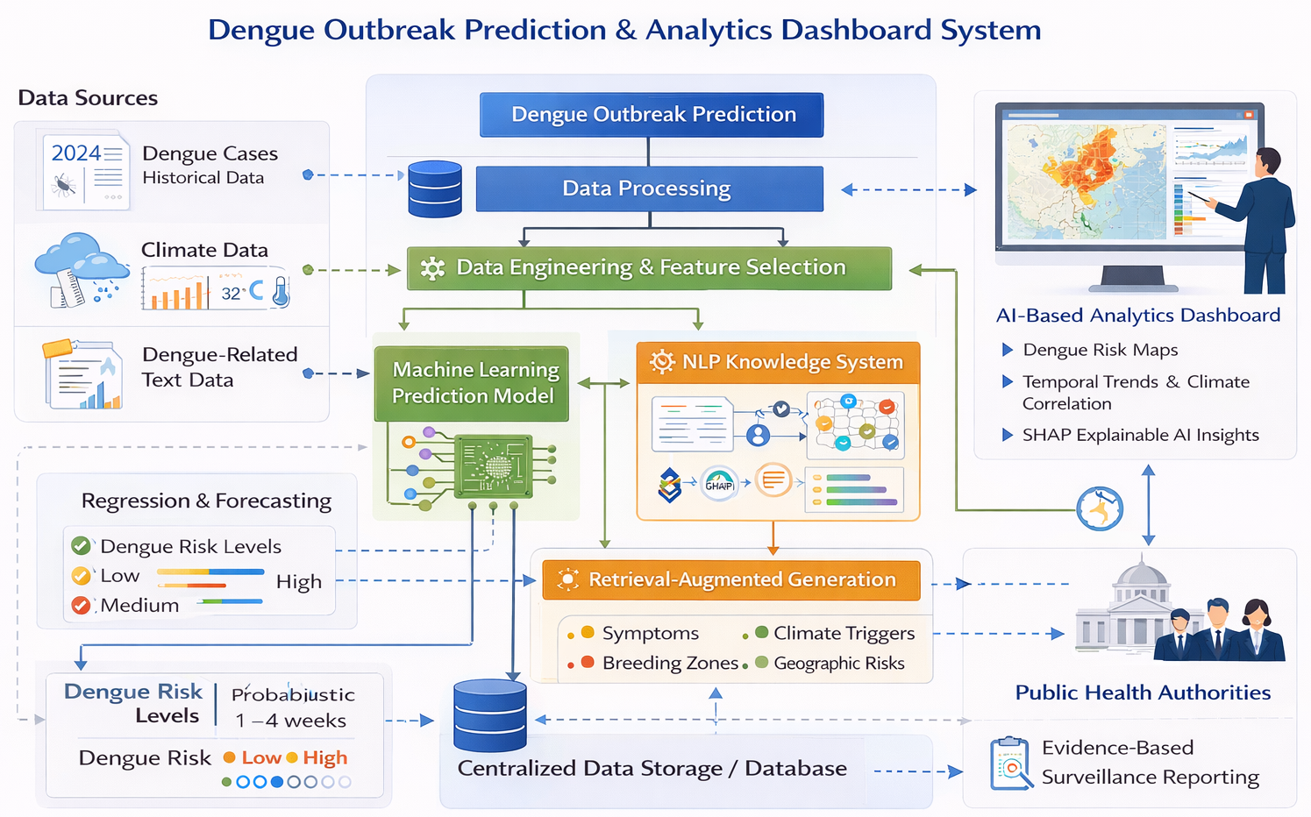
System Diagram

Slide 12

IT22243980 | Wickramarachchi T.T
Data Engineering for Dengue Outbreak Prediction
IT22243980 |Wickramarachchi T.T. |R26-IT-061

Slide 13
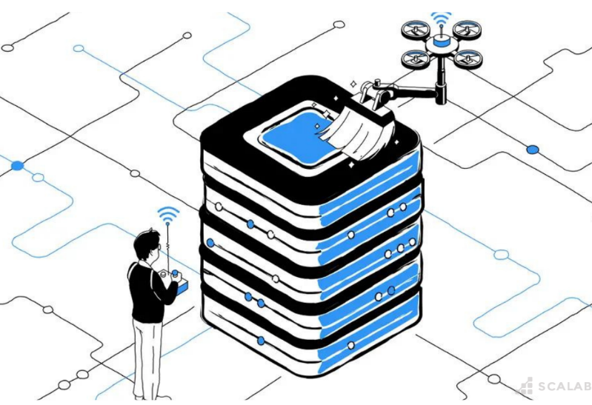
Problem Definition
Reliable dengue outbreak prediction requires high-quality datasets that accurately capture climate-driven transmission dynamics. However, raw dengue surveillance and weather datasets often contain:
Missing values
Inconsistent records
Noise and outliers Temporal and spatial misalignment
These issues significantly reduce the performance and reliability of machine learning models used for dengue prediction.
IT22243980 |Wickramarachchi T.T. |R26-IT-061

Slide 14
Research Objective
To design, analyze, and optimize a reliable, spatially and temporally consistent dataset that accurately represents dengue outbreaks and climate-driven transmission dynamics for machine learning–based prediction in Colombo District.
Sub-Objectives
• Collect dengue case data and climate data.
• Perform exploratory data analysis (EDA).
• Clean and preprocess datasets.
• Engineer biologically meaningful temporal features.
• Produce optimized machine-learning-ready datasets.
IT22243980 |Wickramarachchi T.T. |R26-IT-061

Slide 15
Novelty
This component treats data engineering as a standalone research problem rather than a routine preprocessing step, exploring multiple preprocessing, normalization, feature engineering, and feature selection strategies to determine how each affects dengue outbreak prediction performance.
IT22243980 |Wickramarachchi T.T. |R26-IT-061

Slide 16
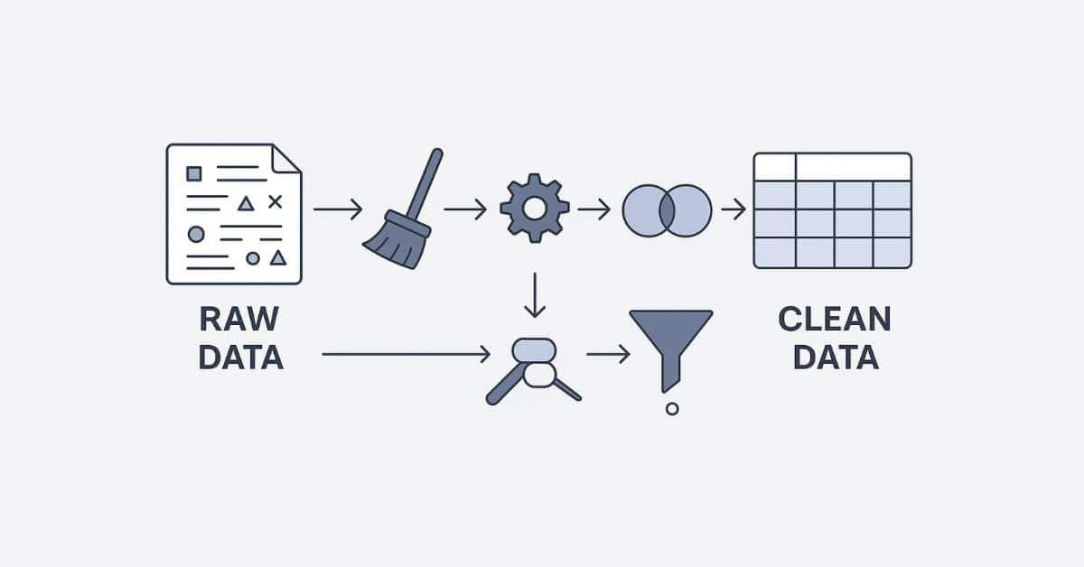
Research Methodology
Data Collection
• Historical dengue case data from National Dengue Control Unit
• Climate data from Department of Meteorology
Exploratory Data Analysis (EDA)
Analyze datasets to identify:
Seasonal dengue patterns
Data quality issues
Climate–dengue relationships
Data Preprocessing
• Handle missing values and inconsistencies
• Detect and remove outliers
• Normalize and scale climate variables
IT22243980 |Wickramarachchi T.T. |R26-IT-061

Slide 17
Feature Engineering
Generate biologically informed time-lag features (1–4 weeks) based on mosquito life cycle dynamics.
Feature Selection
Apply techniques such as:
Correlation analysis
Mutual information
Model-based feature importance to identify the most influential climate and temporal feature
IT22243980 |Wickramarachchi T.T. |R26-IT-061

Slide 18


Technologies, Validation & Data
Technologies Used
Data Processing
• Python
• Pandas
• NumPy
Feature Engineering & Analysis
• Scikit-learn preprocessing tools
• Statistical analysis libraries
Validation Strategy
• Compare prediction performance across multiple dataset variants.
• Evaluate the influence of different preprocessing strategies.
• Analyze feature importance to identify critical climate variables.
IT22243980 |Wickramarachchi T.T. |R26-IT-061

Slide 19
Data Availability
• National Dengue Control Unit (Sri Lanka)
• Department of Meteorology (Sri Lanka)
Security & Ethical Considerations
• Use publicly available government datasets
• Ensure responsible handling of epidemiological data
• Maintain ethical standards in health data research.
IT22243980 |Wickramarachchi T.T. |R26-IT-061

Slide 20
Implementation Overview
System Role
The Data Engineering component prepares clean, structured, and optimized datasets for the machine learning outbreak prediction module.
Key Tasks
• Perform geospatial data linking at district and MOH area levels.
• Conduct spatial resolution sensitivity analysis to evaluate geographic effects on prediction accuracy.
• Generate multiple machine-learning-ready dataset variants for experimental evaluation.
IT22243980 |Wickramarachchi T.T. |R26-IT-061

Slide 21
Dependencies
This module interacts with:
• Machine Learning Prediction Module
• Central Data Storage
• Climate and dengue surveillance datasets
Output
The component produces:
• Clean dengue surveillance dataset
• Climate feature dataset
• Multiple ML-ready datasets for model training and evaluation.
IT22243980 |Wickramarachchi T.T. |R26-IT-061

Slide 22
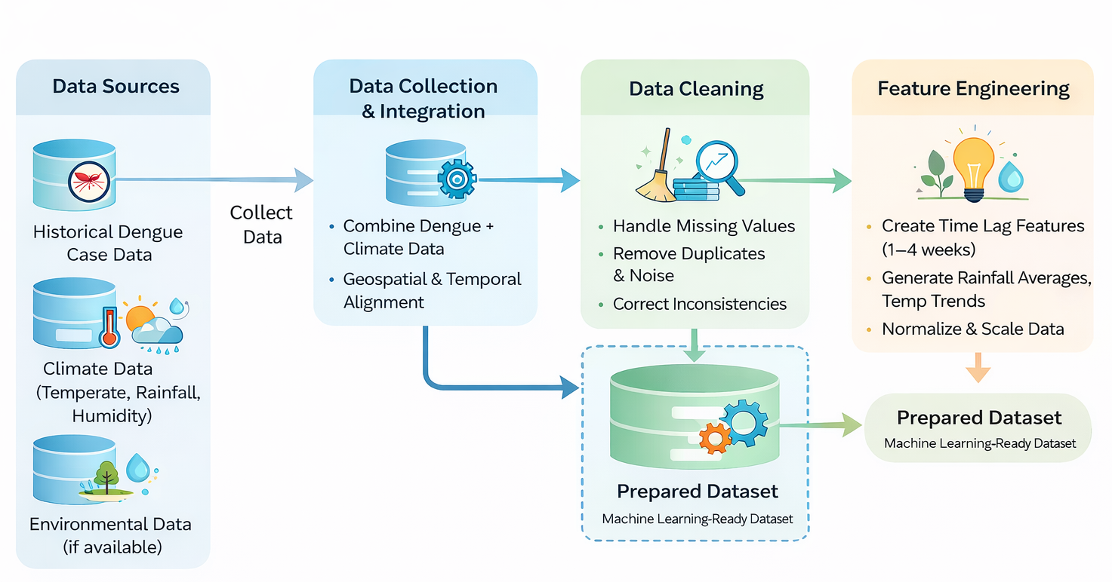
System Overview
IT22243980 |Wickramarachchi T.T. |R26-IT-061

Slide 23

Data Visualization & Research Integration Developer
IT22165848 | Hettiarachchi A.T
IT22165848 | Hettiarachchi A.T | R26-IT-061

Slide 24
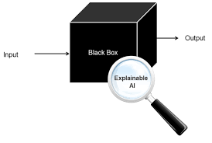
Problem Definition
Most existing dengue prediction systems function as black-box machine learning models, providing predictions without meaningful explanations.
As a result, public health authorities cannot clearly understand why dengue risk increases in certain locations or time periods, limiting the practical usability of prediction systems.
IT22165848 | Hettiarachchi A.T | R26-IT-061

Slide 25
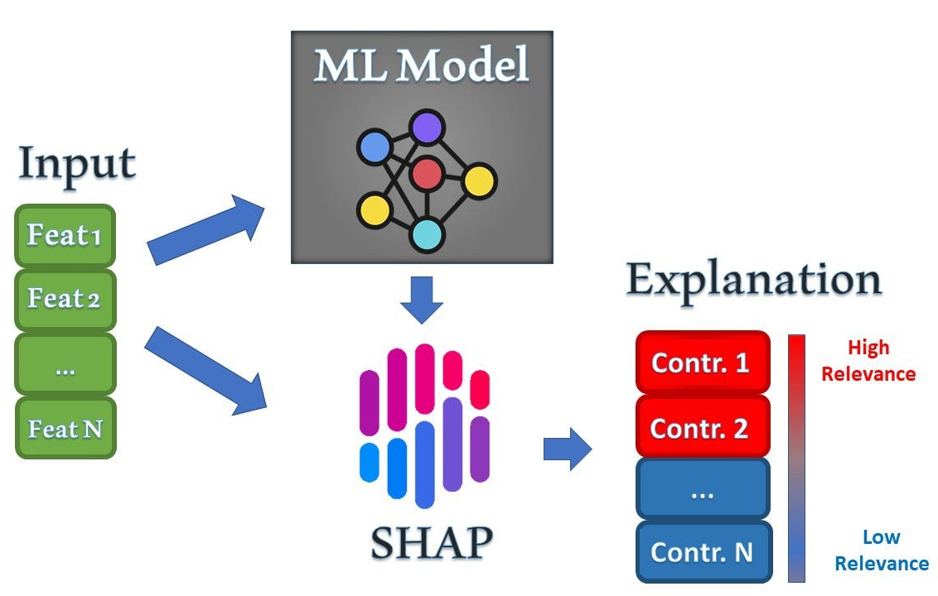
Research Objective
To design an advanced analytics and explainable dashboard that transforms machine learning prediction outputs into interpretable and actionable insights for dengue outbreak monitoring in Colombo District.
Sub-Objectives
• Perform data analysis of dengue cases and climate variables to identify trends and relationships.
• Develop temporal trend visualizations and climate–dengue correlation analysis.
• Integrate machine learning prediction outputs into an interactive analytics dashboard.
• Apply Explainable AI techniques such as Feature Importance and SHAP to explain predictions.
• Develop spatial visualization tools to identify high-risk dengue regions.
IT22165848 | Hettiarachchi A.T. | R26-IT-061

Slide 26
Novelty
Integrates data analysis, Explainable AI, and spatial visualization within a single analytical platform.
Converts machine learning predictions into transparent and interpretable insights for public health decision-makers.
Enhances practical usability of dengue prediction systems through interactive dashboards and spatial intelligence.
IT22165848 | Hettiarachchi A.T. | R26-IT-061

Slide 27
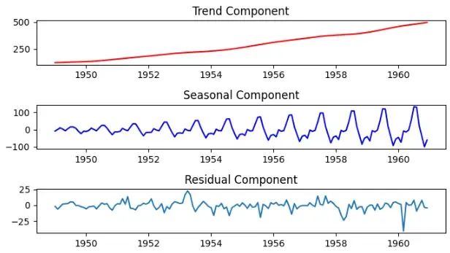



Research Methodology
Data Analysis Methods
The component focuses on advanced data analysis techniques to identify dengue risk patterns.
1. Exploratory Data Analysis (EDA)
• Identify dengue outbreak trends and seasonality in Colombo District.
2. Temporal Trend Analysis
• Analyze changes in dengue cases across time periods.
3. Climate–Dengue Correlation Analysis
• Examine relationships between dengue cases and climate variables such as:
- Rainfall
- Temperature
- Humidity
IT22165848 | Hettiarachchi A.T. | R26-IT-061

Slide 28
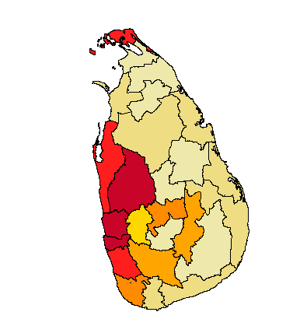
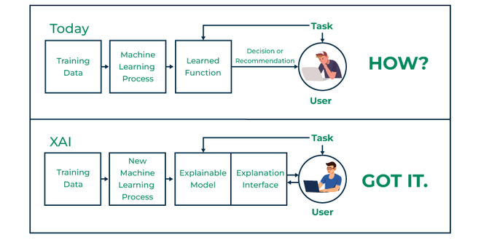
4. Spatial Pattern Analysis
• Identify geographic dengue risk patterns across MOH areas in Colombo District.
5. Explainable AI Analysis
• Feature Importance analysis
• SHAP explanations for individual predictions
IT22165848 | Hettiarachchi A.T. | R26-IT-061

Slide 29
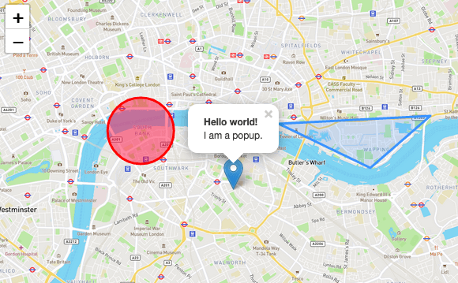

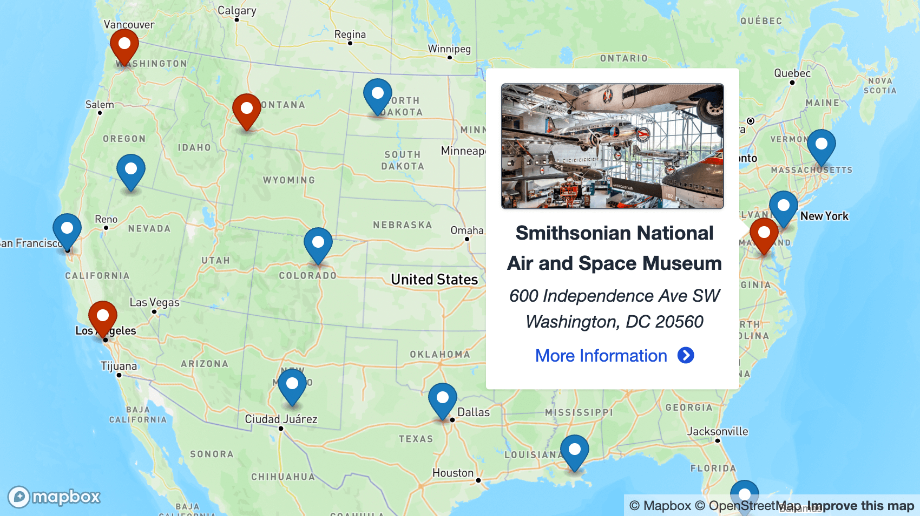
Technologies, Validation & Data
Technologies Used
Data Analysis
• Python
• Pandas
• NumPy
Explainable AI
• SHAP
Dashboard Development
• React
• Plotly / Chart.js
Spatial Visualization (GIS Mapping Tools )
• Leaflet.js / Mapbox
IT22165848 | Hettiarachchi A.T. | R26-IT-061

Slide 30
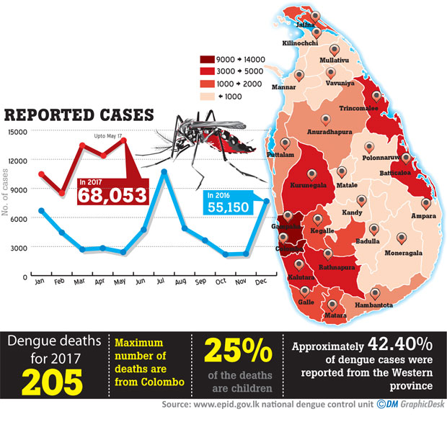
Validation Strategy
• Compare predicted dengue risk levels with historical dengue case data.
• Evaluate spatial accuracy of dengue risk maps.
• Assess the interpretability of Explainable AI outputs.
Data Availability
Data used in this component includes:
• Historical dengue case data from National Dengue Control Unit (Sri Lanka)
• Climate data from Department of Meteorology (Sri Lanka)
Security & Ethical Considerations
• Use publicly available government datasets
• Ensure secure handling of epidemiological data
• Maintain responsible use of public health information.
IT22165848 | Hettiarachchi A.T. | R26-IT-061

Slide 31


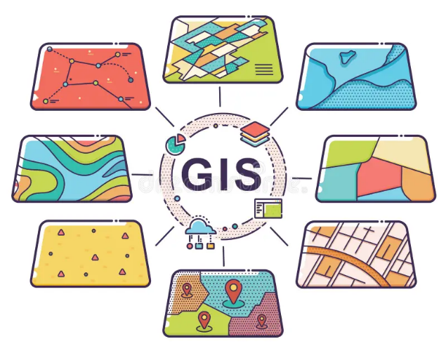
Dependencies and Common Components
ML Prediction Module
• Provides dengue outbreak risk predictions
Central Database
• Stores dengue case data and weather data
Data Processing Layer
• Python-based preprocessing and feature extraction
Frontend Dashboard
• React-based interactive interface
GIS Tools
• Leaflet.js / Mapbox for dengue risk maps
IT22165848 | Hettiarachchi A.T. | R26-IT-061

Slide 32
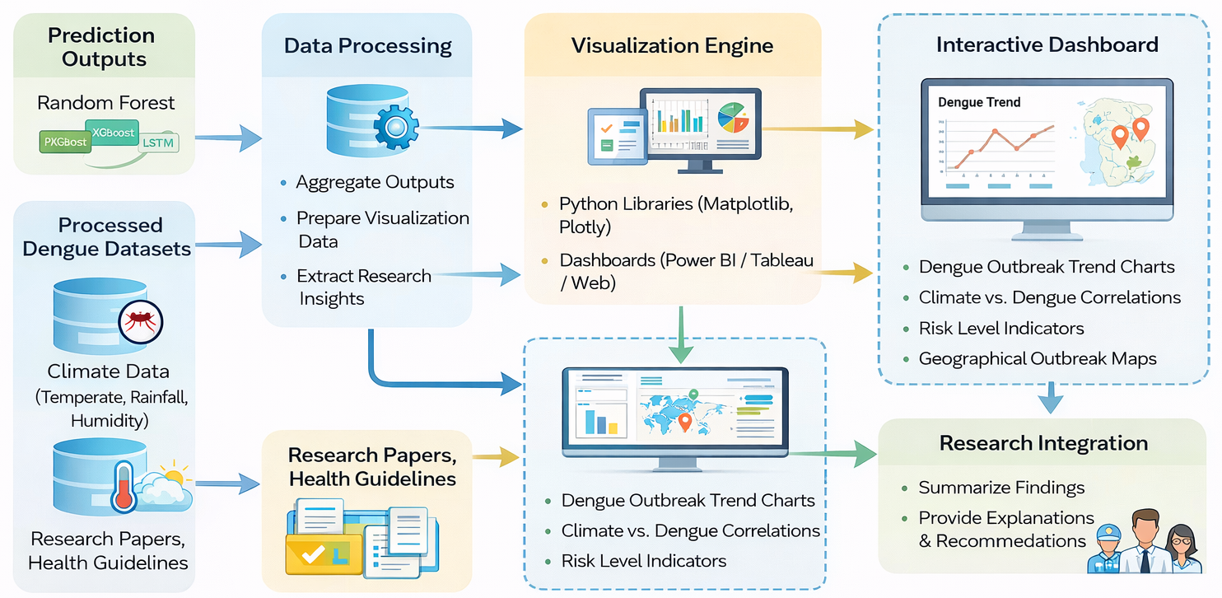
System Overview
IT22165848 | Hettiarachchi A.T. | R26-IT-061

Slide 33

IT22281982 | Adithya A.A.H
Knowledge-Augmented NLP Framework for Dengue Intelligence
IT22281982 | Adithya A.A.H

Slide 34
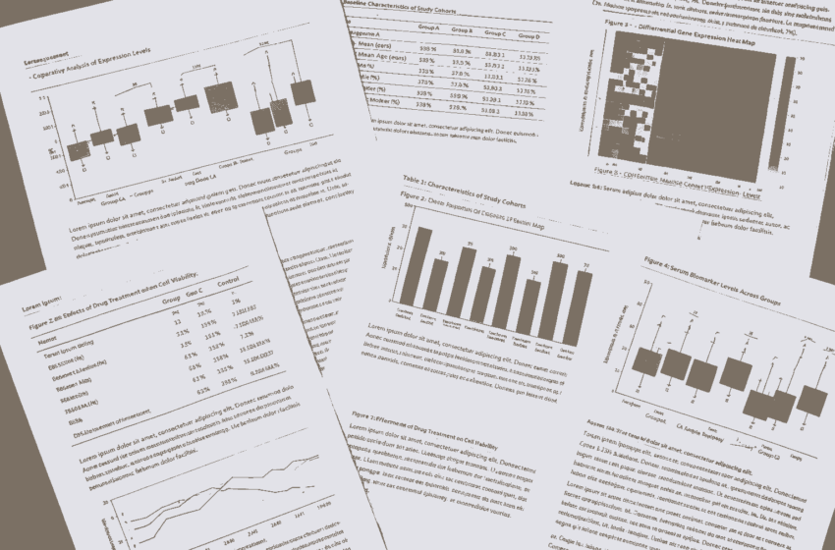
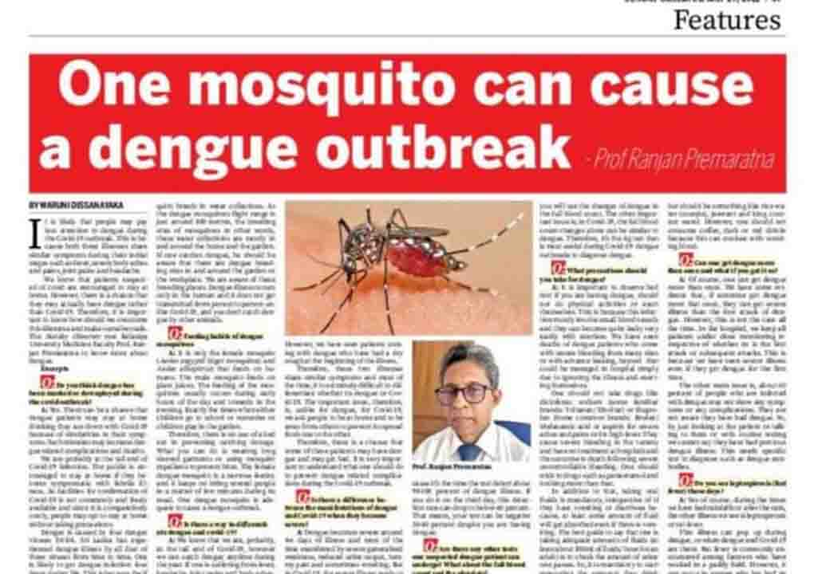
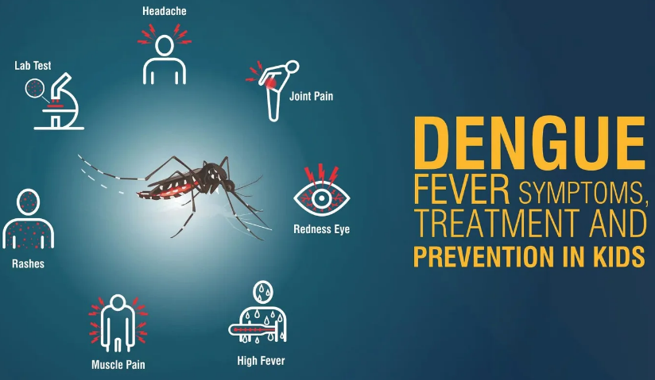
Problem Definition
Public health decision makers require reliable and interpretable information about dengue outbreaks, but existing surveillance systems mainly focus on numerical prediction outputs.
These systems lack mechanisms to extract knowledge from textual sources such as:
- public health guidelines
- research publications
- news reports
- public advisories
IT22281982 | Adithya A.A.H

Slide 35
Research Objective
To design and implement a Knowledge-Augmented Natural Language Processing (NLP) framework that integrates transformer-based intelligence with a dynamic dengue knowledge base to support evidence-based risk communication and automated surveillance reporting.
Sub-Objectives
• Build a multi-modal dengue knowledge base using authoritative textual sources.
• Store semantic representations of dengue knowledge in a vector database.
• Construct a dengue knowledge graph linking symptoms, environmental triggers, mosquito breeding patterns, and geographic risk zones.
• Implement transformer-based NLP models for domain-specific knowledge extraction.
IT22281982 | Adithya A.A.H

Slide 36
Novelty
Unlike traditional rule-based chatbots or purely generative models, this component introduces a hybrid intelligence layer that integrates:
• Transformer-based language models
• Vector-based semantic retrieval
• Structured knowledge graphs
This hybrid approach produces accurate, explainable, and verifiable dengue intelligence, bridging the gap between numerical outbreak predictions and human-interpretable health knowledge.
IT22281982 | Adithya A.A.H

Slide 37
Research Methodology
Knowledge Base Construction
Collect and curate dengue-related textual data from:
• National health guidelines
• Clinical research publications
• Public health advisories
• Local news reports
Semantic Representation
Convert textual knowledge into vector embeddings and store them in a vector database to support similarity-based retrieval.
Vector Database Options:
• ChromaDB
• Pinecone
IT22281982 | Adithya A.A.H

Slide 38

Knowledge Graph Development
Design a Dengue Knowledge Graph using graph databases to represent relationships between:
• Dengue symptoms
• Mosquito breeding conditions
• Environmental triggers
• Geographic risk zones
Graph database technology:
• Neo4j
IT22281982 | Adithya A.A.H

Slide 39

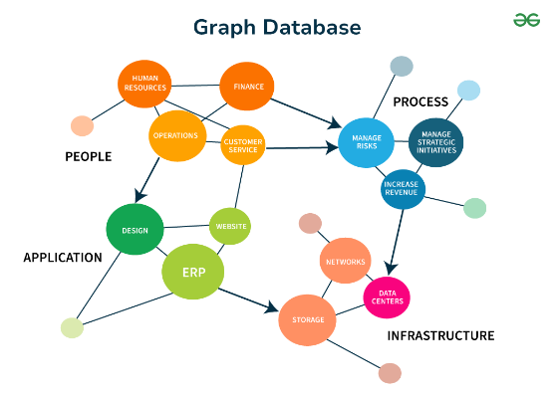
Technologies, Validation & Data
Technologies Used
Natural Language Processing
• BERT
• DistilBERT
• GPT-based modelsa
Knowledge Storage
• Vector Database (ChromaDB / Pinecone)
• Graph Database (Neo4j)
NLP Processing
• Python
• HuggingFace Transformers
IT22281982 | Adithya A.A.H

Slide 40
Retrieval-Augmented Generation (RAG)
Implement RAG architecture that combines:
• transformer language models
• vector knowledge retrieval
This ensures responses are grounded in verified dengue knowledge sources, reducing hallucinations and misinformation.
Data Sources
• National health guidelines
• Dengue research articles
• Public advisories
• Local news sources related to dengue outbreaks
Security & Ethics
• Use trusted public health sources
• Prevent medical misinformation
• Ensure responsible dissemination of health information.
IT22281982 | Adithya A.A.H

Slide 41

Implementation Overview
System Role
The NLP component provides knowledge-based intelligence and automated insights that complement numerical outbreak predictions.
Key Functionalities
• Develop automated NLP pipelines to extract emerging dengue trends from news and public sources.
• Update a surveillance knowledge database with extracted insights.
• Perform cross-database synthesis by linking:
- NLP-derived insights
- Historical dengue case data
- Climate data
Output
The system produces:
• Evidence-based dengue intelligence
• Automated surveillance reports
• Structured health bulletins and situational reports
IT22281982 | Adithya A.A.H

Slide 42
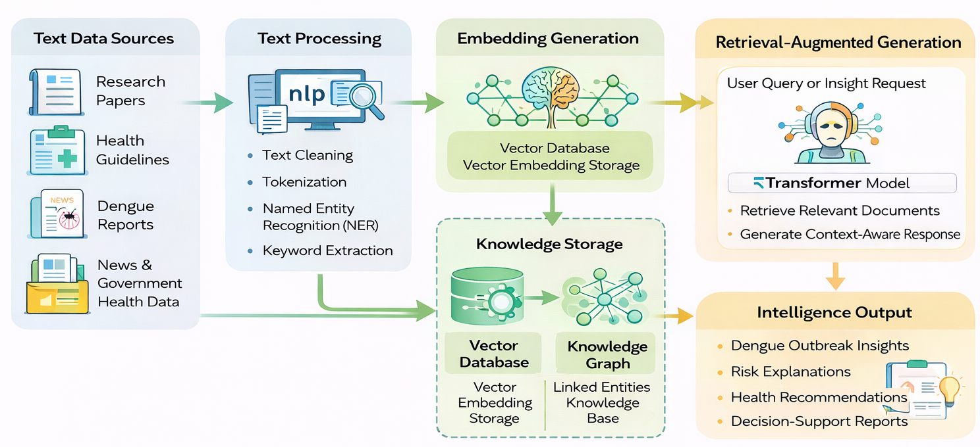
System Overview
IT22281982 | Adithya A.A.H

Slide 43

IT22214034 | Keenavinna K.A.I.U
Machine Learning–Based Dengue Outbreak Prediction
IT22214034 | Keenavinna K.A.I.U

Slide 44
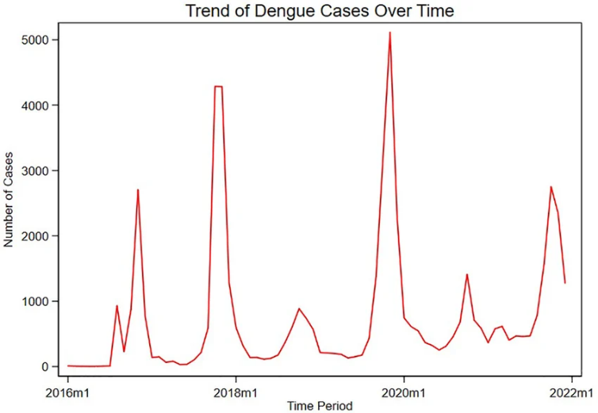
Problem Definition
Accurate dengue outbreak prediction requires models that can capture complex temporal relationships between climate variables and dengue case patterns.
However, many existing dengue prediction studies rely on single algorithms or national-level datasets, which may not effectively represent localized outbreak dynamics.
IT22214034 | Keenavinna K.A.I.U

Slide 45

Research Objective
To develop, evaluate, and optimize machine learning models capable of predicting dengue outbreak risk levels and outbreak probabilities in advance using historical dengue surveillance and climate data from Colombo District.
Sub-Objectives
• Formulate dengue outbreak prediction as both
- A time-based classification problem (Low / Medium / High risk)
- A probabilistic forecasting task for outbreak likelihood.
• Analyze temporal dengue patterns and seasonality.
• Train and compare multiple machine learning and deep learning models.
IT22214034 | Keenavinna K.A.I.U

Slide 46
Novelty
This component isolates and studies the temporal outbreak prediction problem, focusing on when dengue risk will increase rather than combining spatial and temporal modeling simultaneously.
It conducts a structured comparison between classical machine learning models and deep learning time-series models using localized Sri Lankan data, providing a robust early warning mechanism for dengue outbreaks.
This component isolates and studies the temporal outbreak prediction problem, focusing on when dengue risk will increase rather than combining spatial and temporal modeling simultaneously.
It conducts a structured comparison between classical machine learning models and deep learning time-series models using localized Sri Lankan data, providing a robust early warning mechanism for dengue outbreaks.
IT22214034 | Keenavinna K.A.I.U

Slide 47
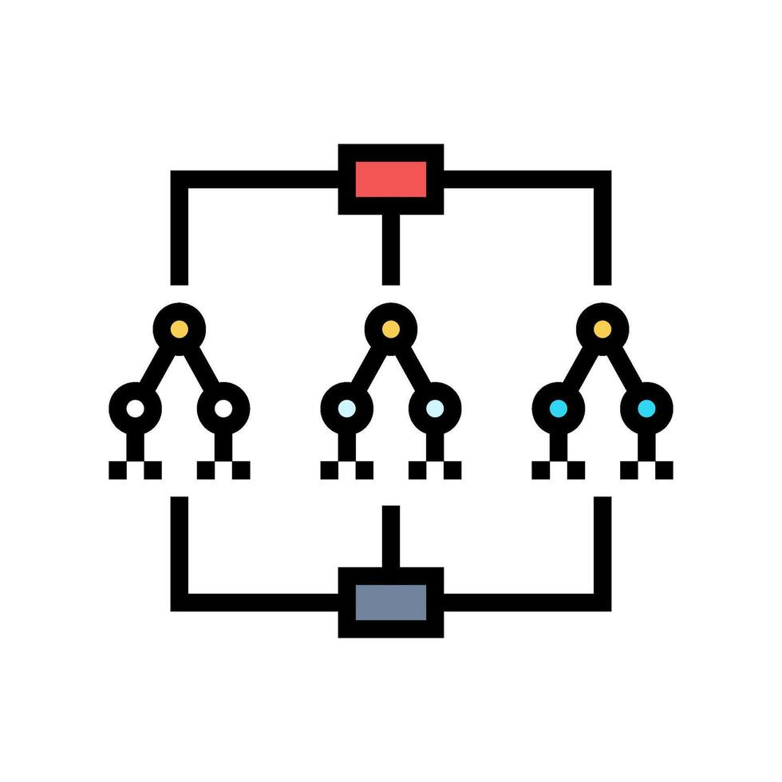

Research Methodology
Temporal Data Analysis
• Perform exploratory analysis to identify seasonality and outbreak cycles in dengue cases.
Machine Learning Model Development
Train and compare multiple models:
• Random Forest
• XGBoost
• LSTM (Long Short-Term Memory)
Time-Series Validation Strategy
Apply time-series-aware data splitting techniques:
• Walk-forward validation
• Rolling window validation
IT22214034 | Keenavinna K.A.I.U

Slide 48

Technologies, Validation & Data
Technologies Used
Machine Learning
• Python
• Scikit-learn
• XGBoost
• TensorFlow / PyTorch (for LSTM)
Data Processing
• Pandas
• NumPy
IT22214034 | Keenavinna K.A.I.U

Slide 49

Hyperparameter Optimization
Model performance is optimized using:
• Grid Search
• Random Search
Model Evaluation Metrics
Models are evaluated using:
• Accuracy
• Recall
• F1-Score
• ROC-AUC
• RMSE
IT22214034 | Keenavinna K.A.I.U

Slide 50
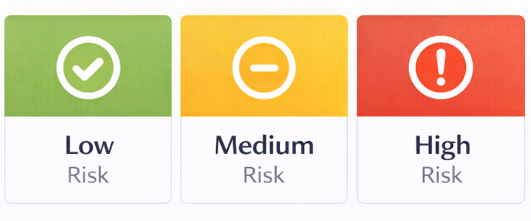
Implementation Overview
System Role
The Machine Learning module generates early dengue outbreak predictions based on climate and dengue surveillance data.
Forecasting Strategy
• Analyze prediction reliability across different forecast horizons (1–4 weeks).
• Identify the most stable and accurate prediction model.
Dependencies
This component depends on:
• Data Engineering Module (clean dataset)
• Central Database
• Climate and dengue datasets
Output
The module produces:
• Dengue outbreak risk classification (Low / Medium / High)
• Probabilistic outbreak predictions
• Optimized model used by the analytics dashboard for visualization
IT22214034 | Keenavinna K.A.I.U

Slide 51
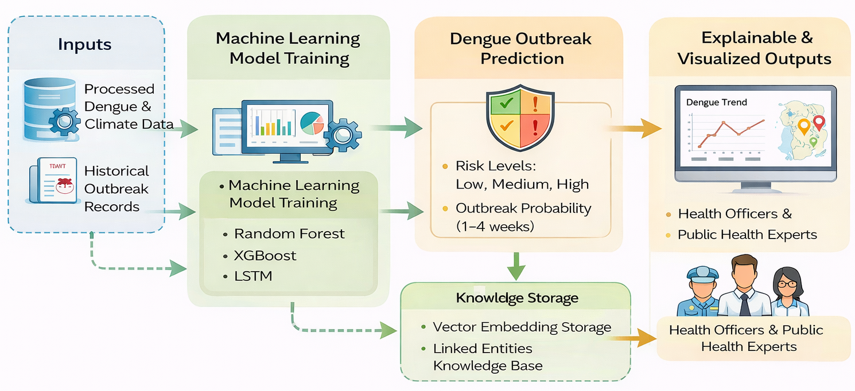
System Overview
IT22214034 | Keenavinna K.A.I.U

Slide 52



Commercialization Potential
Target Market
• Ministry of Health – Sri Lanka
• National Dengue Control Unit (NDCU)
• Medical Officer of Health (MOH) offices
• Public health research institutions
• Smart city and public health monitoring systems
Customer Profile
• Public health decision-makers
• Epidemiologists and researchers
• Government health surveillance units
R26-IT-061

Slide 53
Value Proposition
• Early dengue outbreak prediction using machine learning
• Data-driven decision support for public health authorities
• Interactive dashboards with spatial dengue risk visualization
• Explainable AI insights for understanding outbreak causes
Intellectual Property (IP)
• Machine learning prediction framework
• Knowledge-augmented dengue intelligence system
• Interactive analytics dashboard architecture
• Potential for software licensing and research innovation
R26-IT-061

Slide 54

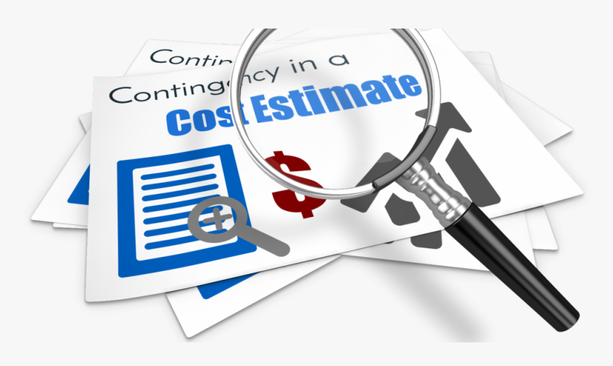
Investment / Cost Estimation
Labour Cost
• Data Engineers
• Machine Learning Engineers
• NLP Engineers
• Data Visualization Developers
• System integration and testing personnel
Material / Infrastructure Cost
• Cloud computing infrastructure
• Data storage and database systems
• API and server hosting
• Visualization and mapping tools
R26-IT-061

Slide 55

Revenue / Cost Recovery (Pricing Model)
• Government health system implementation projects
• Licensing of the dengue prediction analytics platform
• Public health data analytics consulting services
• Subscription-based analytics dashboards for health organizations
Commercial Value
This system can serve as an AI-based public health decision support platform that helps authorities detect dengue outbreaks early and implement preventive measures, reducing public health risks and improving disease surveillance efficiency.
R26-IT-061

Slide 56
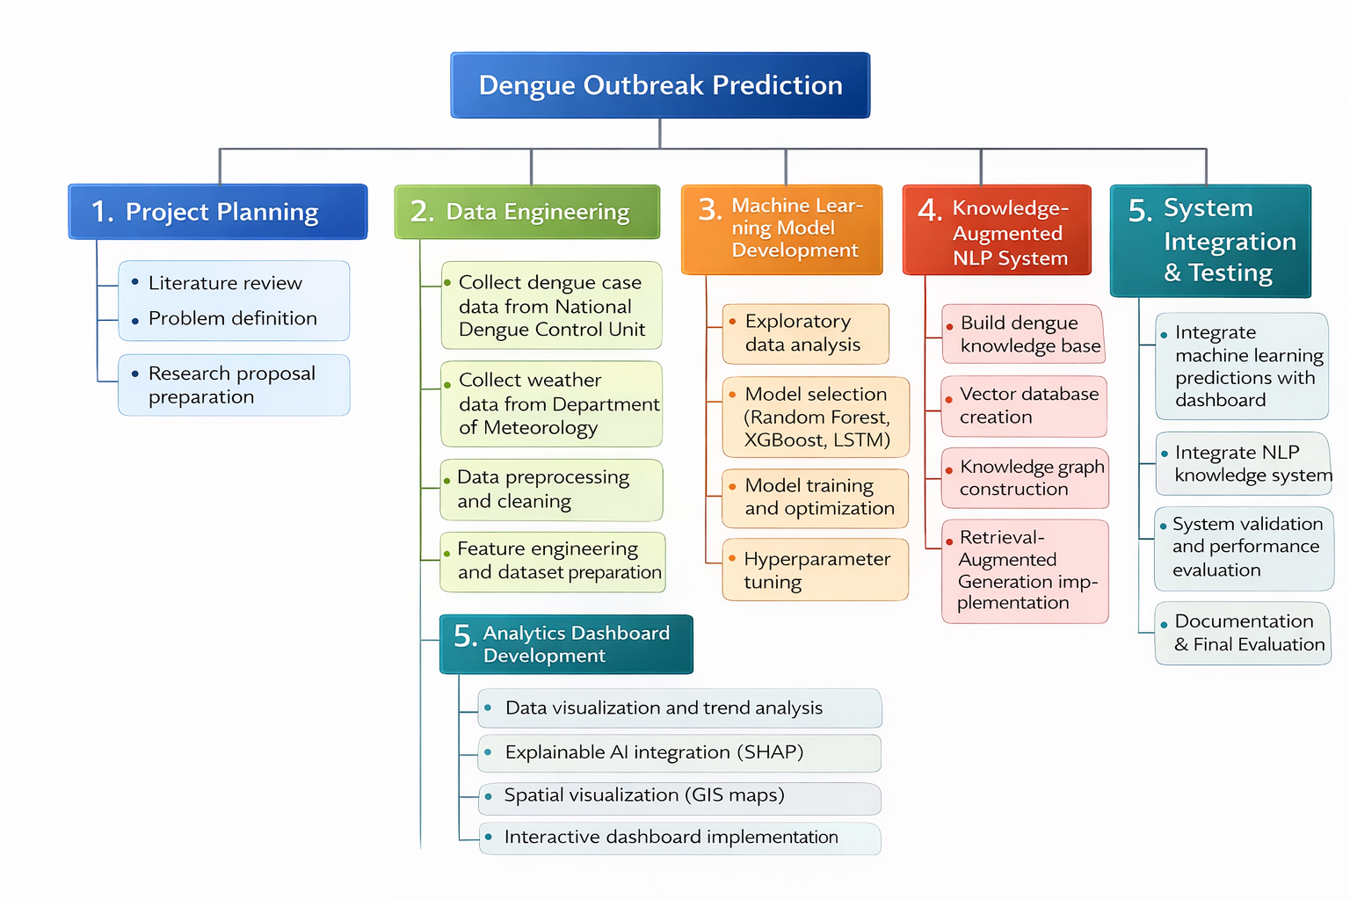
Work Breakdown Structure
R26-IT-061

Slide 57
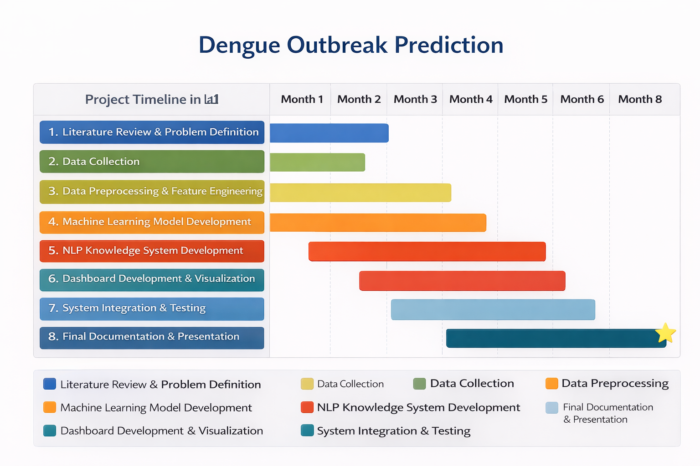
Gantt Chart
R26-IT-061

Slide 58

Thank You!
R26-IT-061

