Slide 1

Welcome to Our Presentation
Course Title : Statistics For Data Science
Course Code : CSE 303
Section : 03
Presented To : Dr. Mohammad Manzurul Islam,
Associate Professor,
Department of Computer science & Engineering

Slide 2


Presented By
Sifat Noor Siam
ID: 2022-1-60-368
Al-Imam Uddin
ID: 2021-3-60-260
Tasnim Saima Raita
ID: 2022-1-60-291

Slide 3


Table of contents
01
02
03
04
Introduction
Presenting Key Details
Handling Missing Values
Visualization
05
ML Model
06
Conclusion

Slide 4




Introduction
This dataset focuses on crop recommendations based on various environmental factors, including soil nitrogen (N), phosphorus (P), and potassium (K) content, as well as temperature, humidity, pH, and rainfall. The goal of this analysis is to identify patterns and insights that can assist in recommending the most suitable crops based on these environmental parameters. The target column in the dataset is the 'level' data, which plays a key role in improving agricultural decision-making. By leveraging this data, farmers can make informed choices about which crops are best suited for the conditions of their land and climate.

Slide 5

Presenting Key Details
N, P, K: | Soil content of Nitrogen, Phosphorus, and Potassium (integers)
Temperature, Humidity, pH, Rainfall: | Environmental factors such as temperature (°C), humidity (%), soil pH, and rainfall (mm) (floats).
Label: | The recommended crop type (categorical). |  |  | Level
The dataset contains 2,200 rows and 8 columns, each representing different environmental scenarios with the following features:
N, P, K
Temperature,Humidity,
pH, Rainfall

Slide 6


Handling Missing Values
For the analysis, no missing values were found in the dataset as all columns contain complete data.
For analysis:
No need for any step taken since all values were present.
The categorical values in the label column represent different crops, and these need to be encoded into numerical values.

Slide 7
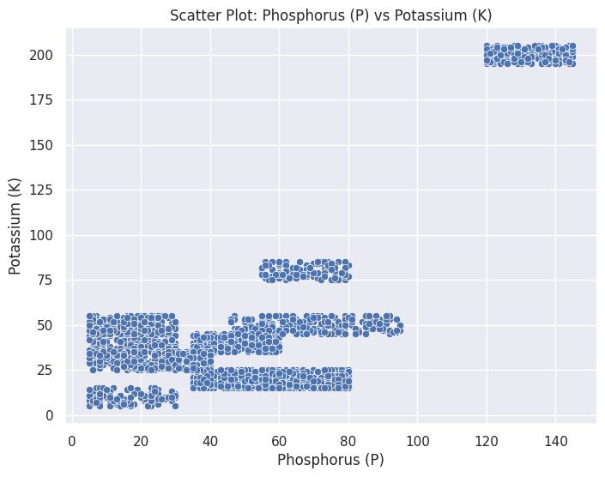
Visualization
The scatter plot of Phosphorus (P) versus Potassium (K) shows two main clusters. The larger cluster has P values between 0-50 and K values between 0-100, while the smaller cluster centers around P ≈ 140 and K between 75-100. Potassium values mostly stay under 100, while Phosphorus has a wider range, indicating some variability.

Slide 8
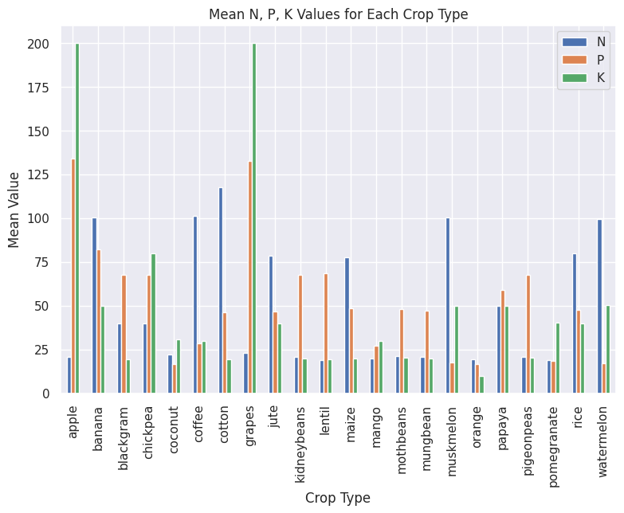

Visualization
The bar chart shows that Nitrogen (N) levels are generally higher across crops compared to Phosphorus (P) and Potassium (K). Grapes and cotton have high Nitrogen, while watermelon shows elevated Potassium. Phosphorus remains more consistent across crops, highlighting different nutrient requirements for each crop.

Slide 9
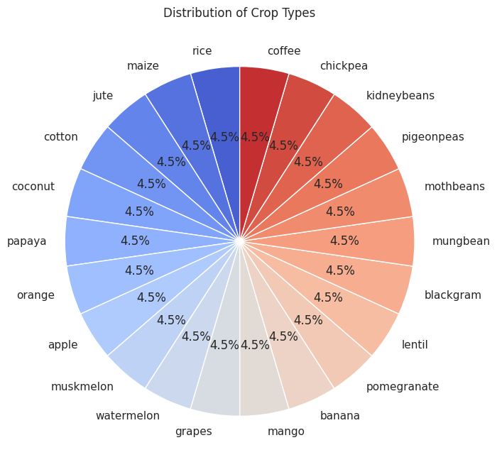
Visualization
The pie chart displays an equal distribution of crop types, with each of the 22 crops represented occupying 4.5% of the total.

Slide 10
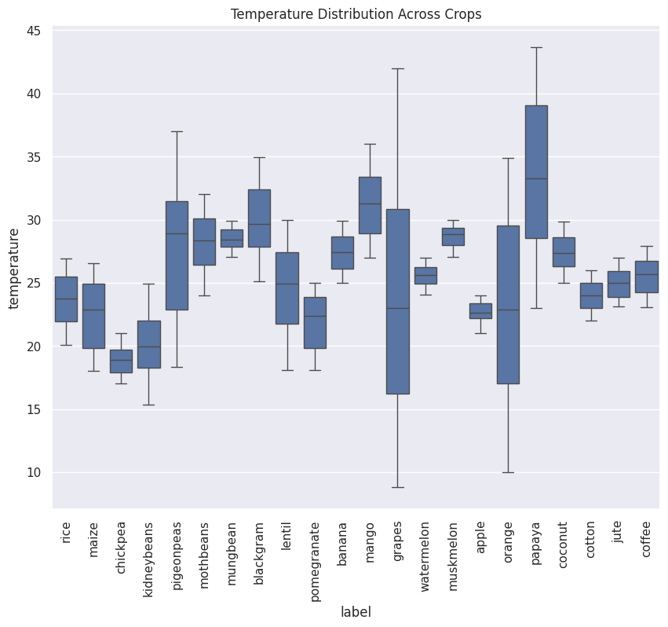
Visualization
The box plot shows temperature variation across crops, with wide ranges for watermelon and coconut, and narrower ranges for muskmelon and apple. Most crops have temperatures between 20-35°C, with medians around 25-30°C.

Slide 11
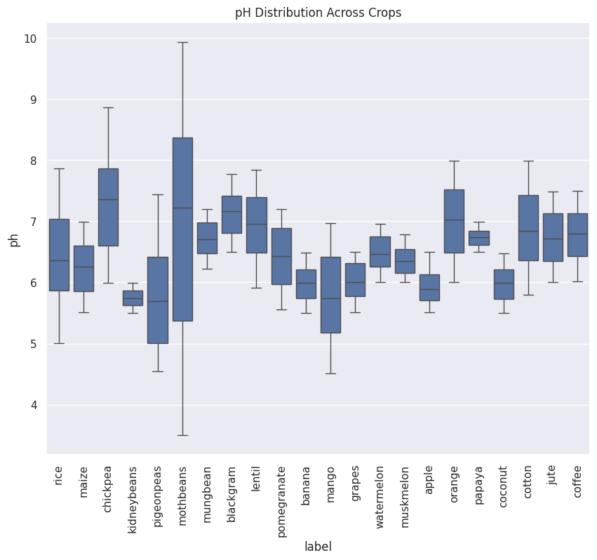
Visualization
The box plot shows diverse pH preferences across crops. Most crops favor slightly acidic to neutral pH (6-7). Pigeonpeas and mothbeans tolerate wider pH ranges, while muskmelon and apple prefer narrower ranges. Coffee, jute, and coconut lean towards higher pH, while rice and maize have lower median values. The pH range spans from 4.5 to 10, reflecting varied soil needs.

Slide 12
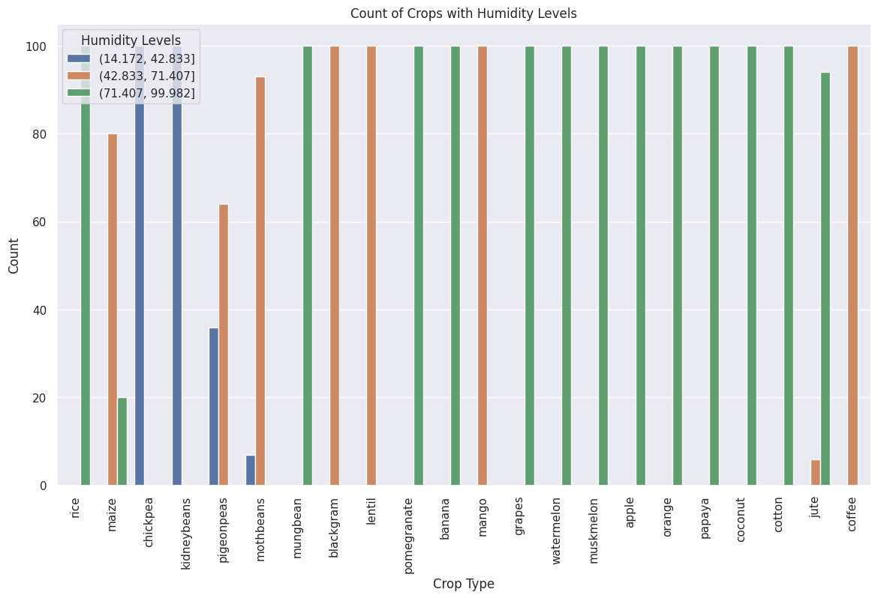
Visualization
The count plot shows humidity distribution across crops, categorized into low, medium, and high ranges. Most crops prefer medium to high humidity, with rice and maize spanning all categories. Watermelon, muskmelon, and apple favor high humidity, while chickpea and kidneybean prefer lower levels.

Slide 13
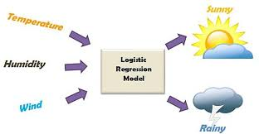
Machine Learning Model
Logistic Regression:
Why Logistic Regression?
Handles Categorical Data: Ideal for predicting crop types.
Multiclass Support: Can classify multiple crops using One vs Rest.
Probabilistic Output: Provides likelihood of each crop recommendation.
Interpretability: Easy to understand and analyze.
Efficient: Performs well with smaller datasets, perfect for our needs.

Slide 14
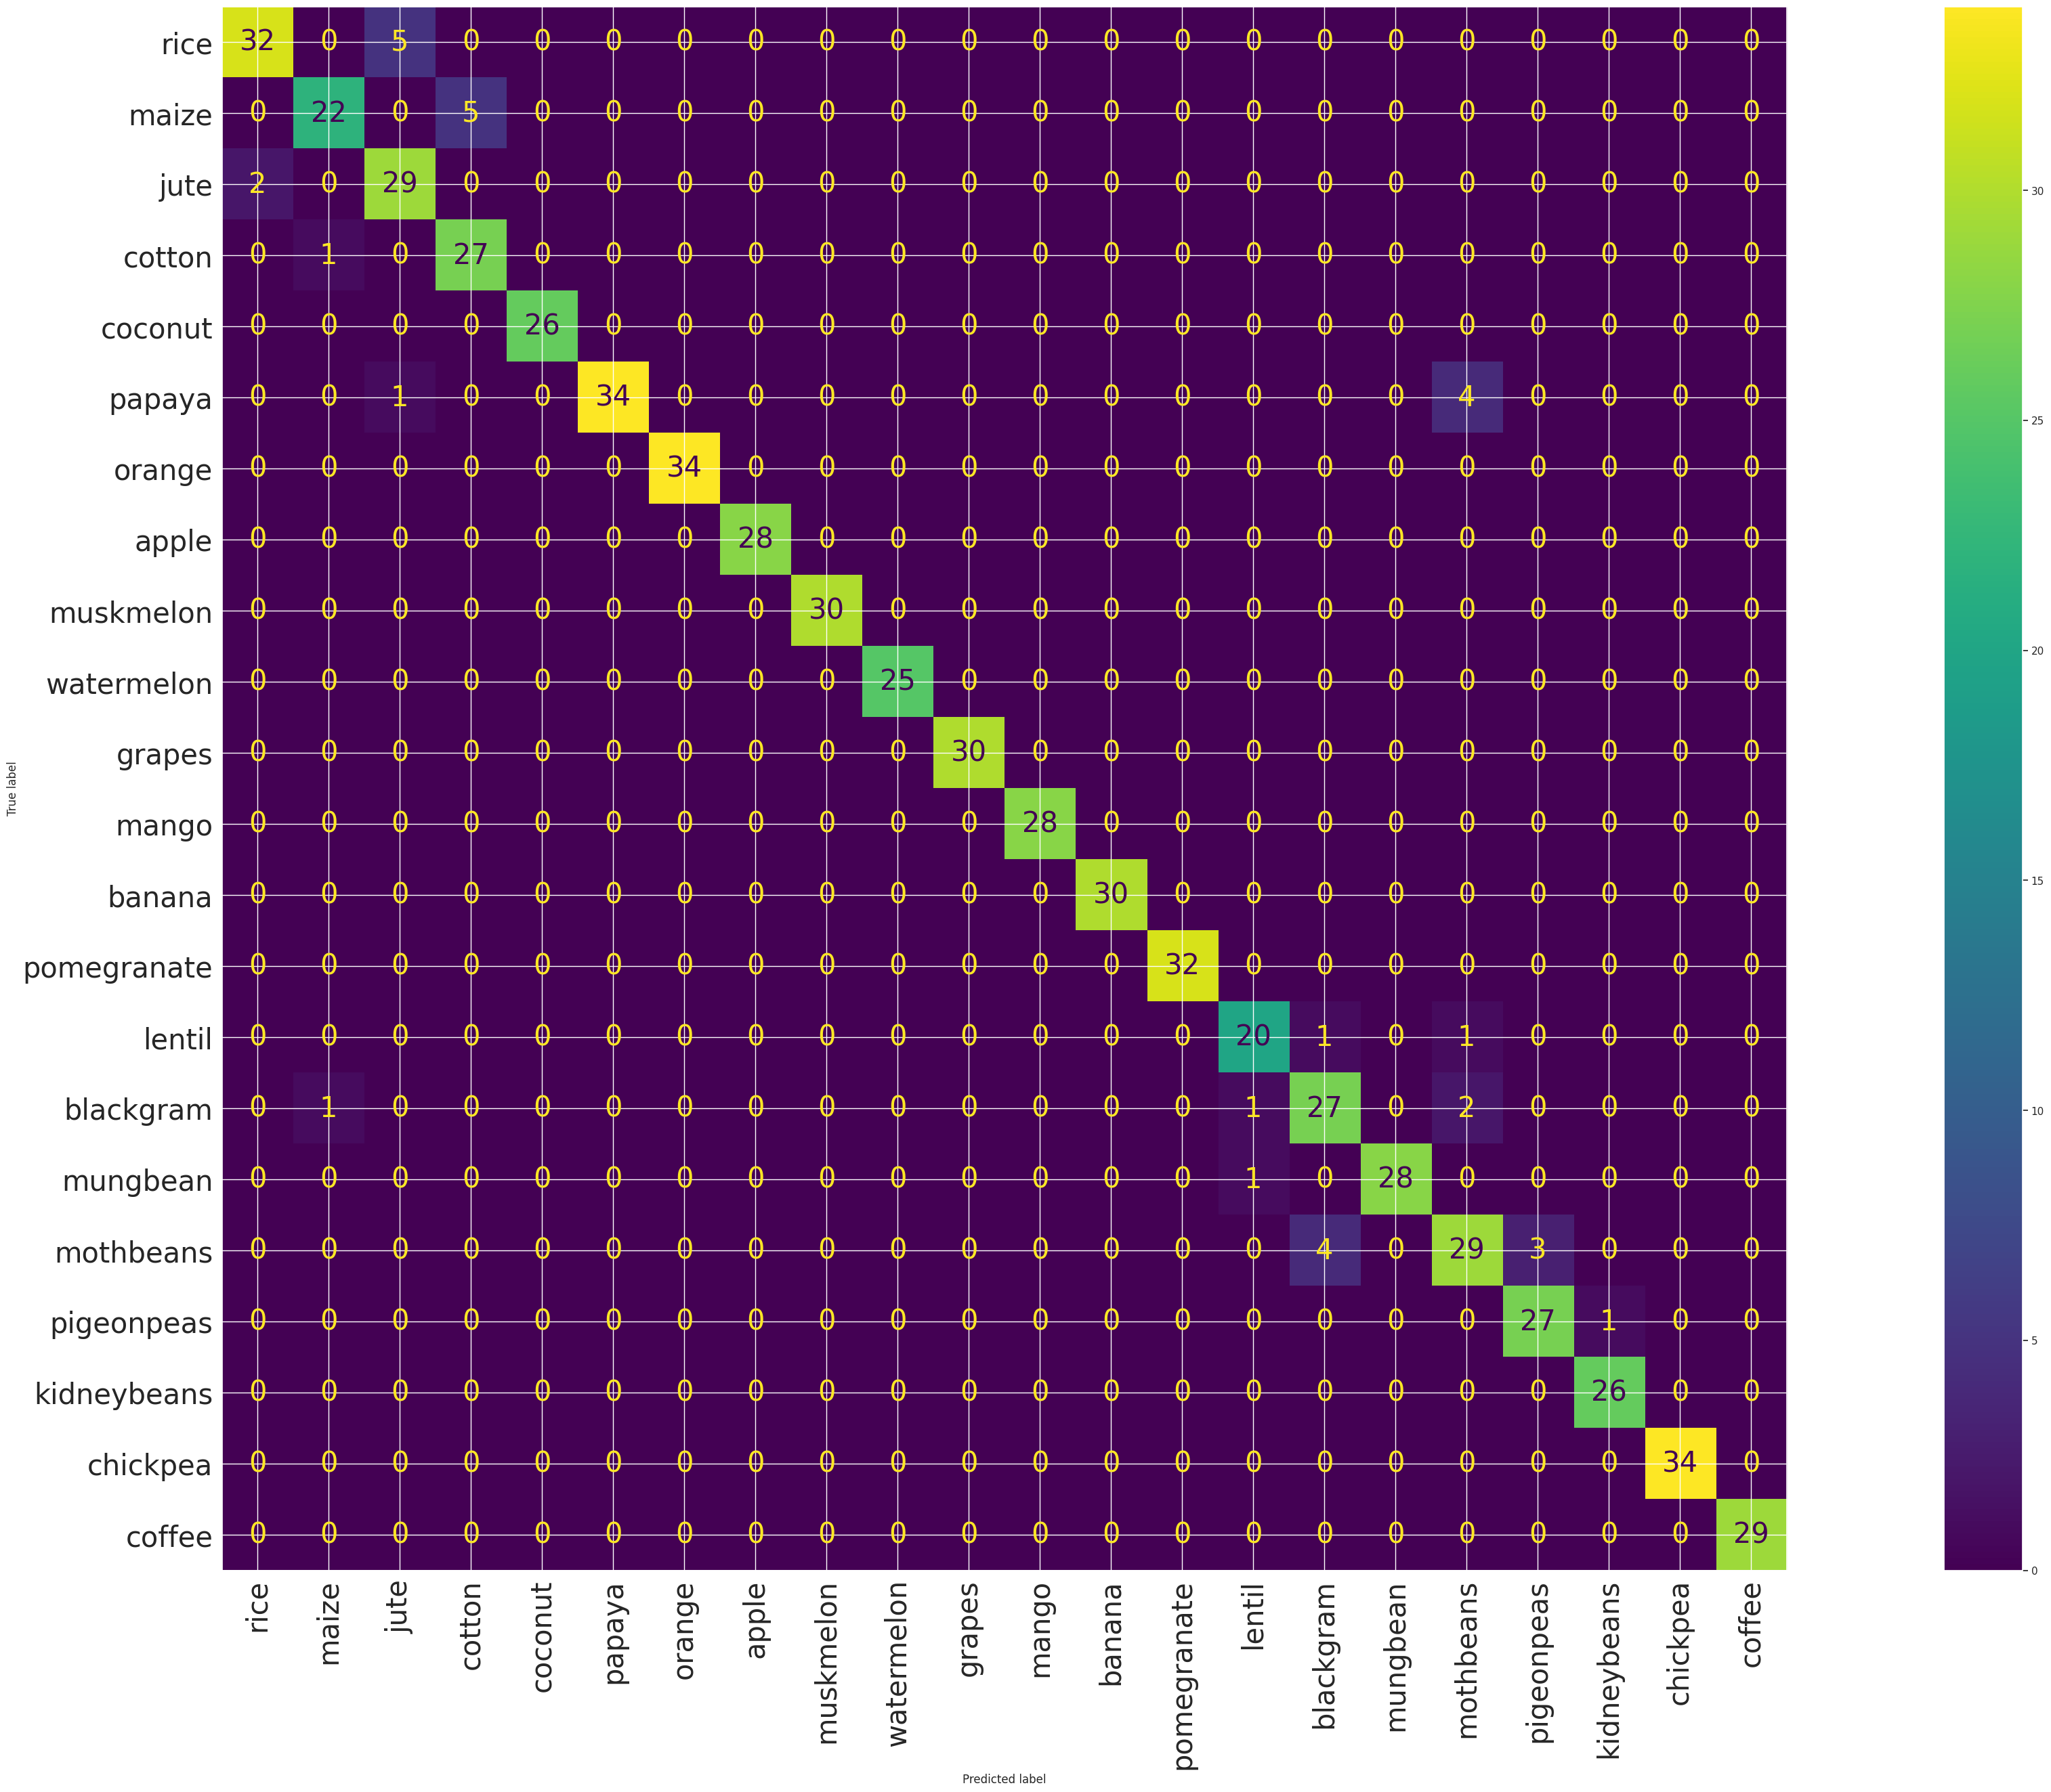
Machine Learning Model
Confusion Matrix:
The diagonal values indicate that the model predicts correctly, and the Off-diagonal values indicate misclassifications. For example, 1 instance of maize was misclassified as jute. Overall, the model exhibits strong performance in classifying all the crops.

Slide 15
Conclusion
The crop recommendation dataset highlights that crop success is linked to factors like soil nutrients, temperature, humidity, pH, and rainfall. Each crop thrives under specific conditions; for instance, rice prefers high humidity and heavy rainfall. This data aids in making informed crop recommendations, promoting sustainable farming by aligning crops with their environmental needs.

Slide 16


