Slide 1
DAG

Slide 2
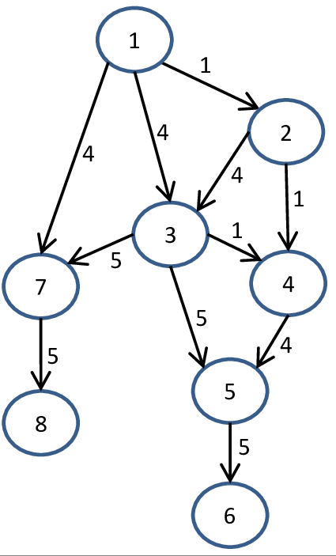
DAG
Directed Acyclic Graph

Slide 3
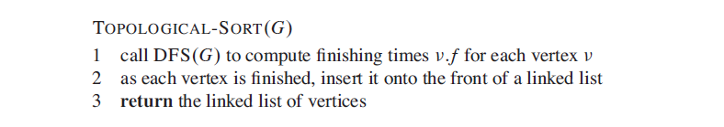
Topological Sort

Slide 4
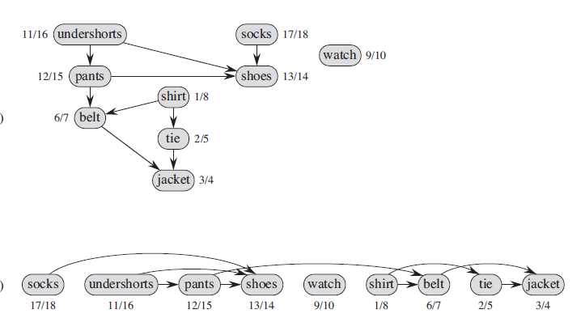
Topological Sort

Slide 5
Time Complexity
O(V+E)
This is because DFS takes O(V+E) and inserting an element in the front of a linked list takes O(1) time.

Slide 6
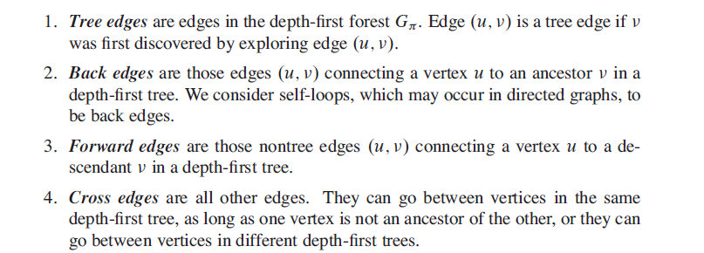
Classification of EDGES

Slide 7
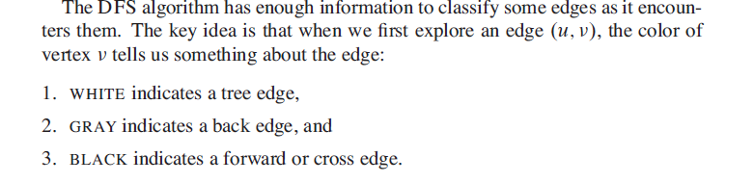

Slide 8
Strongly Connected Components
a strongly connected component of a directed
graph G =(V,E) is a maximal set of vertices C ⊆ V such that for every pair of vertices u and in C, we have both u - -> v and v - -> u; that is, vertices u and are reachable from each other.

Slide 9
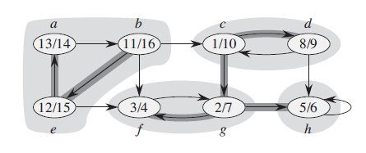
Strongly Connected Components

Slide 10
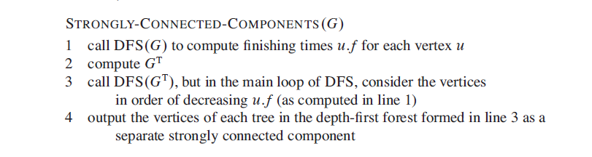
Algorithm

Slide 11
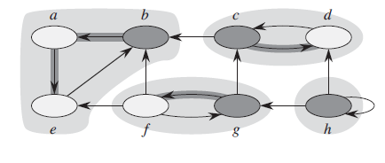

Slide 12
