Slide 1
Bellman-Ford Algorithm
Single Source Shortest Path

Slide 2
Algorithm
BELLMAN-FORD (G,w,s)
INITIALIZE-SINGLE-SOURCE(G,s)
for i =1 to |G.V| -1
for each edge (u,v) ∈ G.E
RELAX(u,v,w);
for each edge (u,v) ∈ G.E
if v.d > u.d+w(u,v)
return FALSE
return TRUE

Slide 3
INITIALIZE-SINGLE-SOURCE(G, s)
for each vertex 2 G:V
v. d =∞
v. π =NIL
s.d=0

Slide 4
RELAX(u,v,w)
if v.d > u.d+w(u,v)
v.d = u.d+w(u,v)
v. π =u

Slide 5
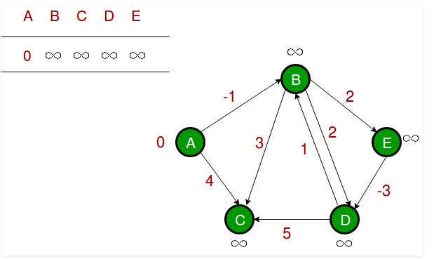
Example
(B, E),
(D, B),
(B, D),
(A, B),
(A, C),
(D, C),
(B, C),
(E, D)

Slide 6
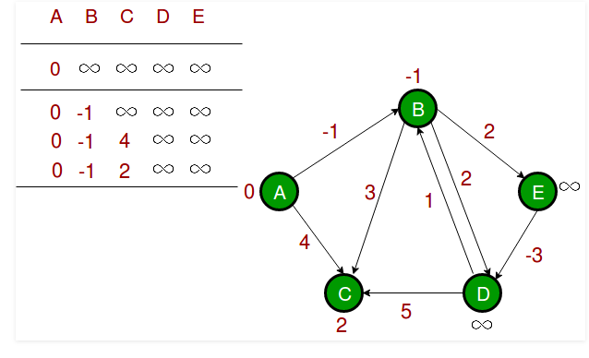
(B, E),
(D, B),
(B, D),
(A, B),
(A, C),
(D, C),
(B, C),
(E, D)

Slide 7
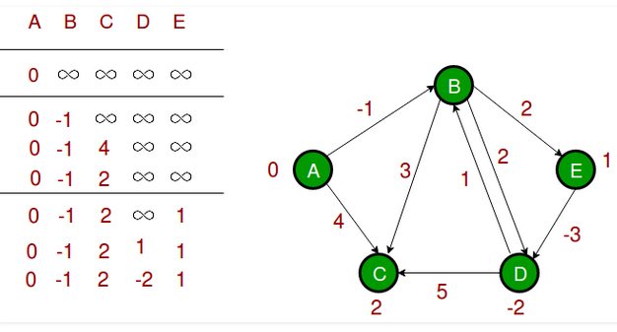
(B, E),
(D, B),
(B, D),
(A, B),
(A, C),
(D, C),
(B, C),
(E, D)

