Slide 1
Huffman Coding
A greedy approach

Slide 2
Introduction
Huffman codes compress data very effectively: savings of 20% to 90% are typical, depending on the characteristics of the data being compressed. We consider the data to be a sequence of characters.

Slide 3

Suppose we have a 100,000-character data file that we wish to store compactly.

Slide 4
Prefix codes
No codeword is also a prefix of some other
codeword

Slide 5
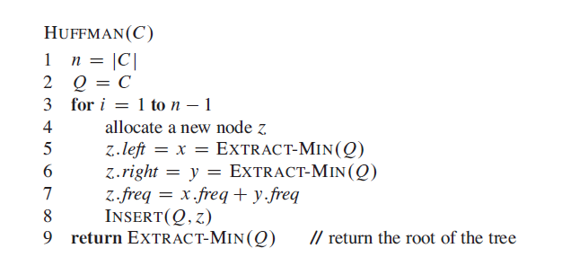
Algorithm

Slide 6
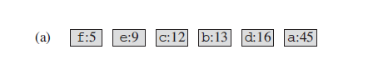
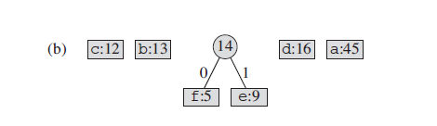
Simulation

Slide 7
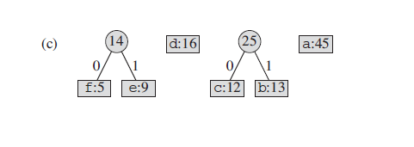
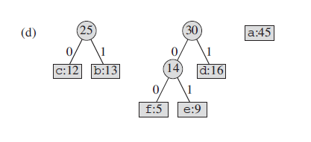
Simulation

Slide 8
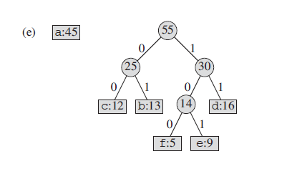
Simulation

Slide 9
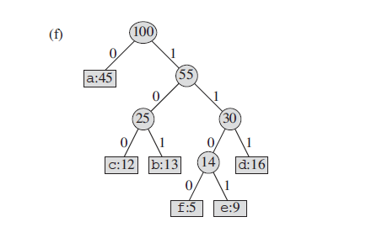
Simulation

