Slide 1
Longest Common Subsequence (LCS)
Problem: Given sequences x[1..m] and y[1..n], find a longest common subsequence of both.
Example: x=ABCBDAB and y=BDCABA,
  BCA is a common subsequence and
  BCBA and BDAB are two LCSs

Slide 2
LCS
Brute force solution
Writing a recurrence equation
The dynamic programming solution
Application of algorithm

Slide 3
Brute force solution
Solution: For every subsequence of x, check if it is a subsequence of y.
Analysis :
  There are 2^{m} subsequences of x.
  Each check takes Ο(n) time, since we scan y for first element, and then scan for second element, etc.
  The worst case running time is Ο(n2^{m}).

Slide 4
Writing the recurrence equation
Let X_{i} denote the ith prefix x[1..i] of x[1..m], and
X₀ denotes an empty prefix
We will first compute the length of an LCS of X_{m} and Y_{n}, LenLCS(m, n), and then use information saved during the computation for finding the actual subsequence
We need a recursive formula for computing LenLCS(i, j).

Slide 5
Writing the recurrence equation
If X_{i} and Y_{j} end with the same character x_{i}=y_{j}, the LCS must include the character. If it did not we could get a longer LCS by adding the common character.
If X_{i} and Y_{j} do not end with the same character there are two possibilities:
  either the LCS does not end with x_{i},
  or it does not end with y_{j}
Let Z_{k} denote an LCS of X_{i} and Y_{j}

Slide 6
X_{i} and Y_{j} end with x_{i}=y_{j}
X_{i}
x₁ x₂ … x_{i-1} x_{i}
Y_{j}
y₁ y₂ … y_{j-1} y_{j}=x_{i}
Z_{k}
z₁ z₂…z_{k-1} z_{k} =y_{j}=x_{i}
Z_{k} is Z_{k -1} followed by z_{k} = y_{j} = x_{i} where
Z_{k-1} is an LCS of X_{i-1} and Y_{j -1} and
LenLCS(i, j)=LenLCS(i-1, j-1)+1

Slide 7
X_{i} and Y_{j} end with x_{i} ≠ y_{j}
X_{i}
x₁ x₂ … x_{i-1} x_{i}
X_{i}
x₁ x₂ … x_{i-1} x _{i}
Y_{j}
y₁ y₂ … y_{j-1} y_{j}
Y_{j}
y_{j} y₁ y₂ …y_{j-1} y_{j}
Z_{k}
z₁ z₂…z_{k-1} z_{k} ≠y_{j}
Z_{k}
z₁ z₂…z_{k-1} z_{k} ≠ x_{i}
Z_{k} is an LCS of X_{i} and Y_{j -1}
Z_{k} is an LCS of X_{i -1} and Y_{j}
LenLCS(i, j)=max{LenLCS(i, j-1), LenLCS(i-1, j)}

Slide 8
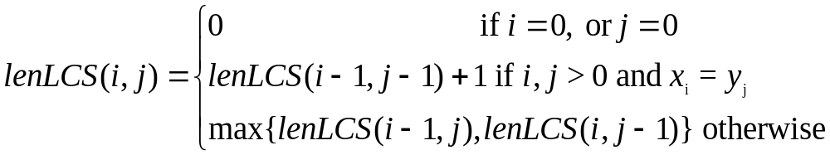
The recurrence equation

Slide 9
The dynamic programming solution
Initialize the first row and the first column of the matrix LenLCS to 0
Calculate LenLCS (1, j) for j = 1,…, n
Then the LenLCS (2, j) for j = 1,…, n, etc.
Store also in a table an arrow pointing to the array element that was used in the computation.
It is easy to see that the computation is O(mn)

Slide 10
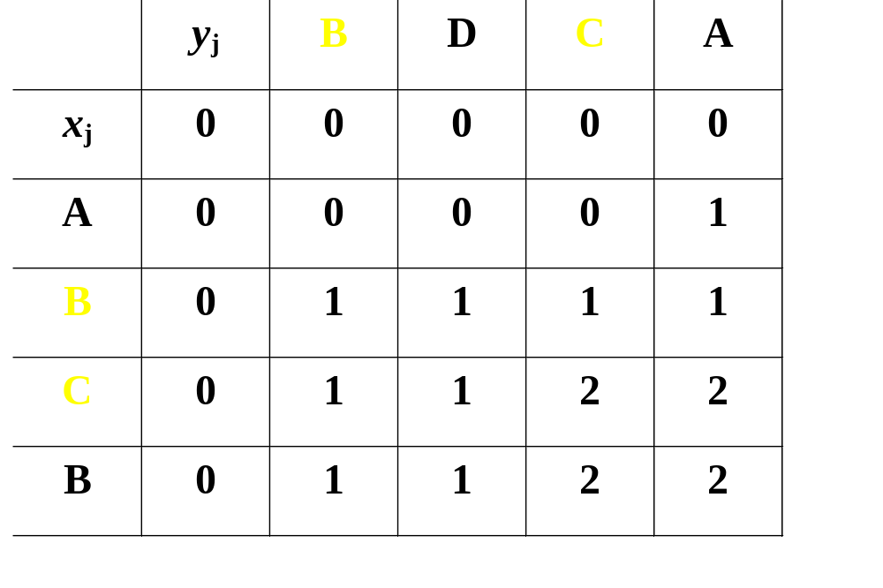
Example
To find an LCS follow the arrows, for each
diagonal arrow there is a member of the LCS

Slide 11
LCS-Length(X, Y)
m ← length[X}
n ← length[Y]
for i ← 1 to m do
c[i, 0] ← 0
for j ← 1 to n do
c[0, j] ← 0

Slide 12
LCS-Length(X, Y) cont.
for i ← 1 to m do
for j ← 1 to n do
if x_{i} = y_{j}
c[i, j] ← c[i-1, j-1]+1
b[i, j] ← “D”
else
if c[i-1, j] ≥ c[i, j-1]
c[i, j] ← c[i-1, j]
b[i, j] ← “U”
else
c[i, j] ← c[i, j-1]
b[i, j] ← “L”
return c and b

Slide 13
Questions
How do we find the LCS?
Do we need B?
Do we need whole C (for finding longest length)?

