Slide 1
Vodaphone
By Hussain
7022103963
fivegteck@gmail.com

Slide 2
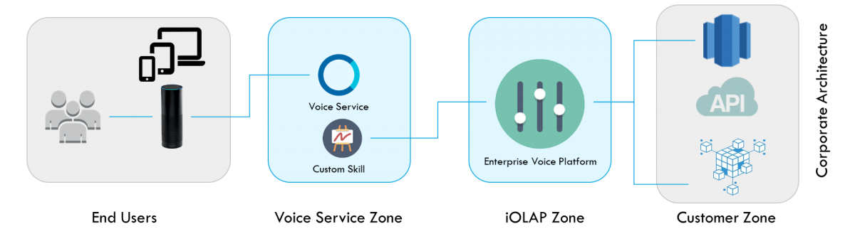
Technical Requirement
1- Cloud ERP, 2- Cloud ESB, 3- Integration Cloud Enterprise Service Bus

Slide 3
Technical Implementation
1- Cloud ERP
2- Cloud ESB 2
3- Cloud Integration
Youth Self Services(AWS-BI) (liv.ai)-indian language speech based input
Client--Cordova+ASL Alexa
Server--Acumaatica Cloud ERP, https://www.acumatica.com/
Database--AWS+Splunk Enterprise/Spark + Cassandra ,https://www.splunk.com/
Integrration Cloud BigData, iOLAP, Tact, https://iolap.com/, https:/tact.ai/
Payment Gateway :BlockChain
https://www.blockchain.com/
https://fluence.one/
Blockchain database
Cloud Talend, BEAM
https://integrationcloud.talend.com/
https://beam.apache.org/
Database
http://cassandra.apache.org/
https://spark.apache.org/
Enterprise Database warehouse as a service
https://www.snowflake.com/

Slide 4
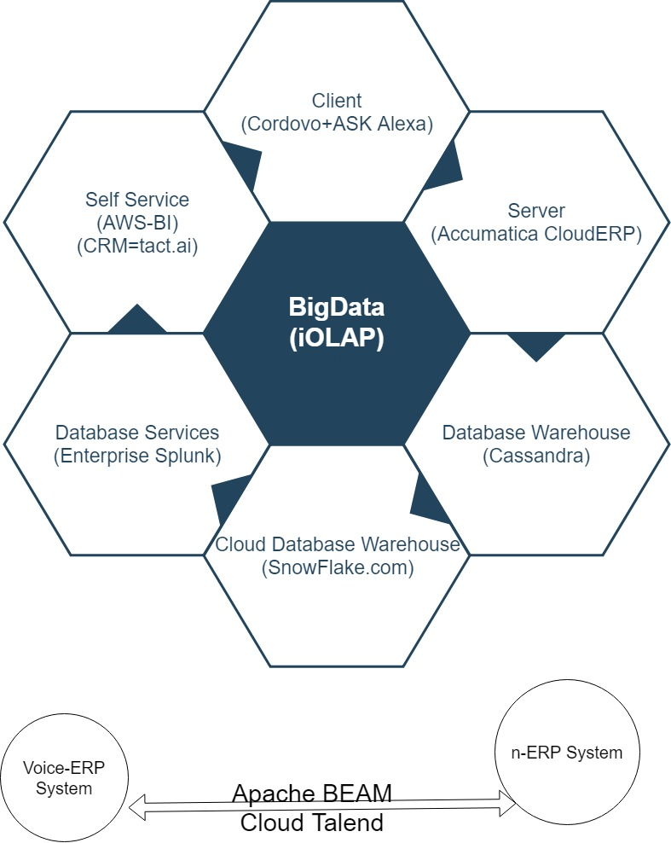

Slide 5
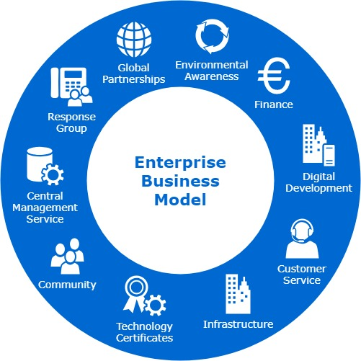
1- Cloud ERP
2- Cloud ESB 2
3- Cloud Integration

Slide 6
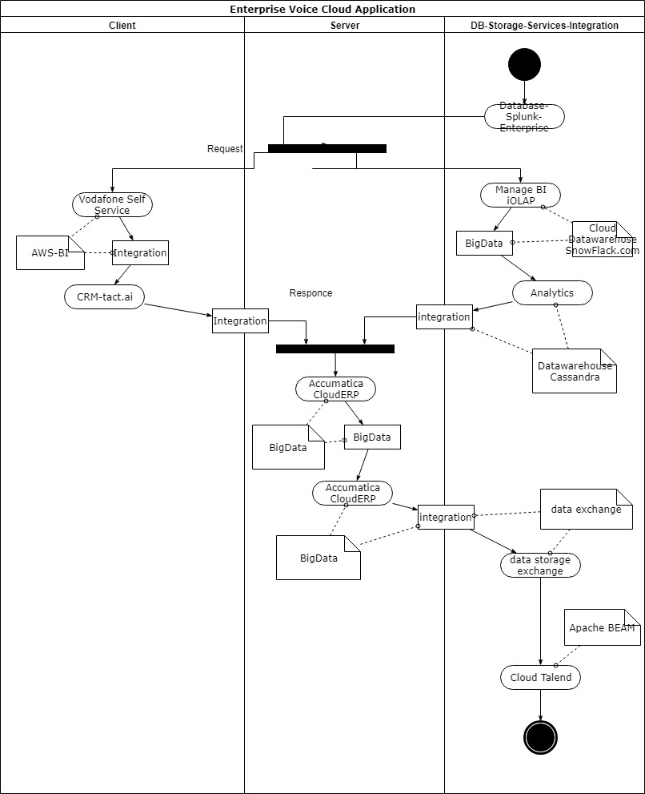
1- Cloud ERP
2- Cloud ESB 2
3- Cloud Integration

Slide 7
Project objective:
Voice enable enterprise with business microservices Apps api

Slide 8
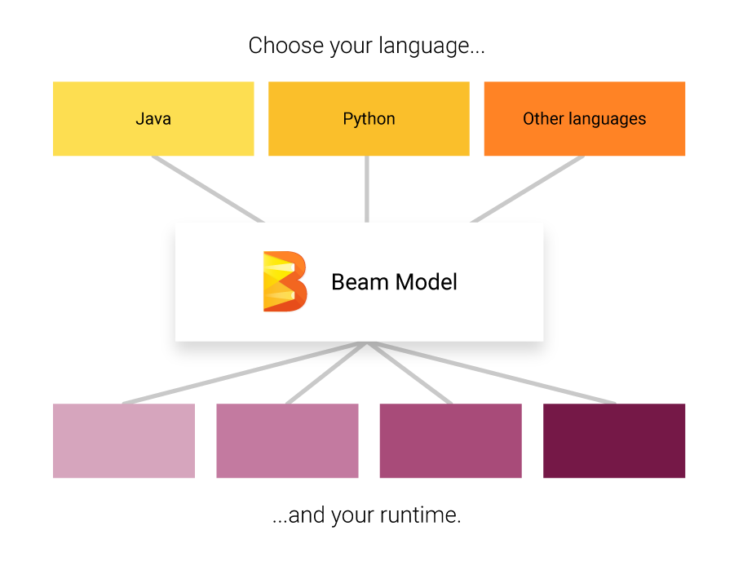
tact.ai
Accelerate sales, customer flow with the human-friendly AI Assistant, Smart Data Access
Understanding the market:
iOLAP
Big Data,
Hadoop,
MDM,
Strategy,
Analytics,
Enterprise Voice,
Managed Services,
Strategic Assessment,
Reporting & Visualization,
DataScience

Slide 9
Target audience
Demographic: We divide our youth segment into two broad sub segments – College Goers and Early Jobbers, Since, they are at two different life stages, the kind of resources they lack are different
b. Interests: Basis, the offers they redeem , we customize the rest of the offers that are being shown to them

Slide 10
Market trends
Trend 1
1. The new app wireframes to be created (designing the layout, howwill the app flow etc)
2. Creating a backend dashboard, tracking the user behaviour bybucketing him in geographically,demographically and basis hisinterest level.
Trend 2
3. Backedn API Generated which sits on the main app and does thesefunctions
4. Voice based discovery of discounts and deals wherein users just askthe app and using alexa api, the responses are metted out to the users basis the questions

Slide 11
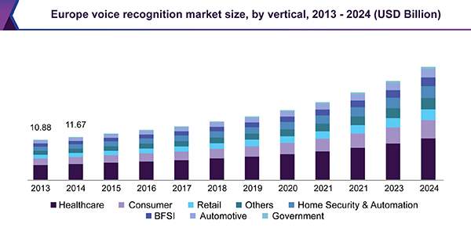
Business Growth Analysis
Findings
35
25
22
15

Slide 12
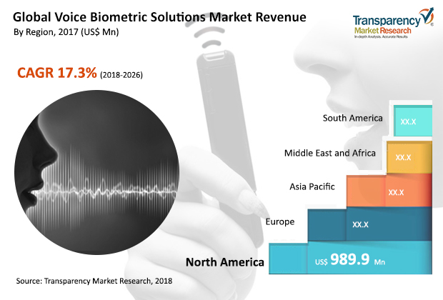
Business Growth Analysis
Findings
35
25
22
15

Slide 13


The Team
Imam Hussain, CTO
Max, CDO

