Slide 1
What is PKI?
Public Key Infrastructure (PKI) is a framework of technologies, policies, and processes used to create, manage, distribute, store, and revoke digital certificates and public-key encryption pairs. In simpler terms, PKI is the system that makes secure communication possible over untrusted networks (like the internet).

Slide 2
Introduction
PKI relies on asymmetric cryptography, meaning each user or device has:
A public key (shared openly), and
A private key (kept secret).
Digital certificates—issued by trusted Certificate Authorities (CAs)—bind public keys to the identities of individuals, devices, or organizations.

Slide 3
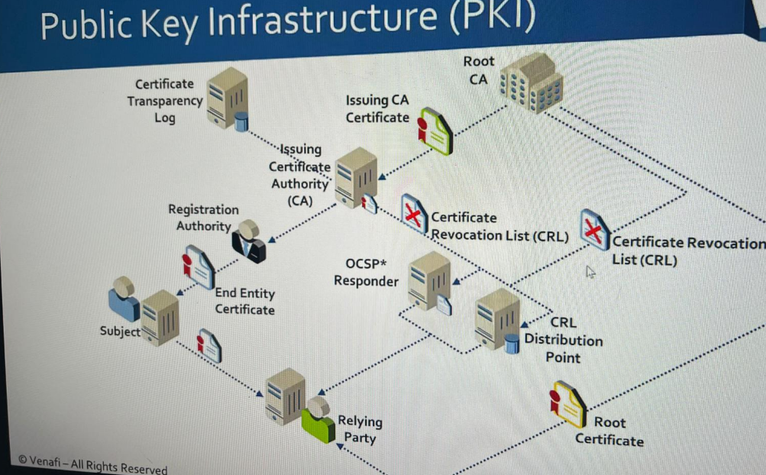

Slide 4
Key Components of PKI
Certificate Authority (CA)
Issues and signs digital certificates, acting as a trusted third party.
Registration Authority (RA)
Verifies user or device identity before certificates are issued.
Digital Certificates (e.g., X.509)
Contain the public key and identifying information.
Certificate Revocation Lists (CRLs) / OCSP
Mechanisms to check whether certificates are revoked or still valid.
Key Pairs (Public & Private Keys)
Enable encryption, decryption, digital signatures, and verification.

Slide 5
Why PKI
Authentication
Confirms the identity of users, servers, and devices.
Example: A web browser trusts a website with “HTTPS” because its certificate is validated via PKI.
2. Data Encryption
Encrypts data during transmission so only authorized parties can read it.
Example: Secure online banking, email encryption, and VPNs.
3. Integrity
Ensures that data has not been altered in transit.
Digital signatures—enabled by PKI—alert you if data is tampered with.
4. Non-repudiation
Prevents a sender from denying that they sent a message.
Digital signatures provide legal and technical proof of origin.

Slide 6
HTTPS on Websites (Secure Web Browsing)
When you visit a website like https://amazon.com, your browser checks the site’s SSL/TLS certificate, which is issued by a trusted Certificate Authority (CA).
How PKI is used:
The website proves its identity using a digital certificate.
Your browser uses the site’s public key to establish an encrypted connection.
This ensures confidentiality, integrity, and trust.
Why it matters:
Without PKI, online shopping, banking, and secure website login wouldn’t be safe.

Slide 7
Secure Email Communication (S/MIME)
Companies and government agencies often secure emails using S/MIME certificates.
How PKI is used:
Users digitally sign emails (proves authenticity and integrity).
Emails can be encrypted so only the intended recipient can read them.
Example:
Law firms, hospitals, or financial institutions sending sensitive documents securely.

Slide 8
Smart Cards and ID Cards
Governments use PKI in digital identity cards (e.g., national ID cards, e-passports).
How PKI is used:
Secure chips store private keys.
Certificates prove identity during authentication.
Examples:
E-passports at international borders.

Slide 9
IoT Device Authentication
Many smart home devices and industrial IoT systems use PKI to ensure only trusted devices connect.
How PKI is used:
Each device has its own certificate.
Servers verify the certificates to avoid rogue devices.
Example:
Smart meters, medical devices, or industrial sensors connecting securely to a cloud platform.

Slide 10
Examples of CAs
IBM Cloud,
Amazon Web Services,
Cloudflare, and
Google Cloud Platform.

Slide 11
Examples of Root CAs
DigiCert
A large commercial Certificate Authority that issues a variety of certificates, including root certificates like the DigiCert Global Root CA.
GlobalSign
Another major commercial Certificate Authority that is widely used.
Sectigo
A commercial Certificate Authority that is also a significant player in the market.
Amazon Root CAs
A set of root certificates used by Amazon Web Services (AWS) and other Amazon services.
ActalisS
The Actalis Authentication Root CA is another example of a root CA that is trusted by some systems, such as Apple's.

