Slide 1
ElGamal Cryptography
public-key cryptosystem related to D-H
uses exponentiation in a finite field
with security based difficulty of computing discrete logarithms, as in D-H
each user (eg. A) generates their key
  chooses a secret key (number): 1 < x_{A} < q-1
  compute their public key: y_{A} = a^{xA} mod q
Notes:
In 1984, T. Elgamal announced a public-key scheme based on discrete logarithms, closely related to the Diffie-Hellman technique [ELGA84, ELGA85]. The ElGamal cryptosystem is used in some form in a number of standards including the digital signature standard (DSS) and the S/MIME email standard. As with Diffie-Hellman, the global elements of ElGamal are a prime number q and a, which is a primitive root of q. User A generates a private/public key pair as shown. The security of ElGamal is based on the difficulty of computing discrete logarithms, to recover either x given y, or k given K (next slide).

Slide 2
ElGamal Message Exchange
Bob encrypts a message to send to A computing
  represent message M in range 0 <= M <= q-1
    longer messages must be sent as blocks
  chose random integer k with 1 <= k <= q-1
  compute one-time key K = y_{A}^{k} mod q
  Encryption: encrypt M as a pair of integers (C₁,C₂) where
    C₁ = a^{k} mod q ; C₂ = KM mod q
A then recovers message by
  recovering key K as K = C₁^{xA} mod q
  computing M as M = C₂ K⁻¹ mod q
a unique k must be used each time
  otherwise result is insecure
Notes:
Any user B that has access to A's public key can encrypt a message as shown. These steps correspond to Figure 9.1a in that Alice generates a public/private key pair; Bob encrypts using Alice's public key; and Alice decrypts using her private key. See text for details of why these steps result in M being recovered. Note that K functions as a one-time key, used to encrypt and decrypt the message. If a message must be broken up into blocks and sent as a sequence of encrypted blocks, a unique value of k should be used for each block. If k is used for more than one block, knowledge of one block m of the message enables the user to compute other blocks as shown in the text.
The basic idea with El Gamal encryption is to choose a random key, protect it, then use it to scramble the message by multiplying the message with it. Two bits of info have to be sent: the first to recover this temporary key, the second the actual scrambled message. See that El Gamal encryption involves 1 modulo exponentiation and a multiplication (vs 1 exponentiation for RSA).

Slide 3
ElGamal Example1
use field GF(19) q=19 and a=10 (primitive root of 19)
Alice computes her key:
  A chooses x_{A}=5 (private key) & computes y_{A}=10⁵ mod 19 = 3 (public key)
Encryption: Bob send message m=17 as (11,5) by
  choosing random k=6
  computing K = y_{A}^{k} mod q = 3⁶ mod 19 = 7
  computing C₁ = a^{k} mod q = 10⁶ mod 19 = 11;
  C₂ = KM mod q = 7.17 mod 19 = 5
Decryption: Alice recovers original message by computing:
  recover K = C₁^{xA} mod q = 11⁵ mod 19 = 7
  compute inverse K⁻¹ = 7⁻¹ = 11
  recover M = C₂ K⁻¹ mod q = 5.11 mod 19 = 17
Notes:
Here is an example of ElGamal from the text using the prime field GF(19); that is, q = 19. It has primitive roots {2, 3, 10, 13, 14, 15}, as shown in Table 8.3. We choose a = 10. Alice generates a key pair as shown. Suppose Bob wants to send the message with the value M = 17. Then he computes the ciphertext pair (11, 5) and sends this to Alice. Alice recovers the message by first recovering K, then computing its inverse (using the Extended Euclids Algorithm – see Ch 4), and finally recovering M.

Slide 4
RSA Algorithm
Invented in 1978 by Ron Rivest, Adi Shamir and Leonard Adleman
  Published as R L Rivest, A Shamir, L Adleman, "On Digital Signatures and Public Key Cryptosystems", Communications of the ACM, vol 21 no 2, pp120-126, Feb 1978
Security relies on the difficulty of factoring large composite numbers
Essentially the same algorithm was discovered in 1973 by Clifford Cocks, who works for the British intelligence.

Slide 5
RSA Algorithm
It is a public key cryptography algorithm, which was proposed by Diffie and Hellman. RSA can be used for key exchange, digital signatures and the encryption of small blocks of data.
RSA is primarily used to encrypt the session key used for secret key encryption (message integrity) or the message's hash value (digital signature).
RSA's mathematical hardness comes from the ease in calculating large numbers and the difficulty in finding the prime factors of those large numbers.

Slide 6
RSA Key
Key generation:
1. Select 2 large prime numbers of about the same size, p and q but p and q has not equal values.
  Typically each p, q has between 512 and 2048 bits
2. Compute n = pq, and Φ(n) = (q-1)(p-1)
3. Select e, s.t. gcd(e, Φ(n)) = 1
  Typically e=3 or e=65537
4. Compute d, s.t. ed ≡ 1 mod Φ(n)
  Knowing Φ(n), d easy to compute.
Public key: (e, n)
Private key: (d,n)

Slide 7
RSA: Choosing keys
1. Choose two large prime numbers p, q.
(e.g., 1024 bits each)
2. Compute n = pq, Φ = (p-1)(q-1)
3. Choose e (with e<n) that has no common factors
with Φ. (e, Φ are “relatively prime”).
4. Choose d such that ed-1 is exactly divisible by Φ.
(in other words: ed mod Φ = 1 ).
5. Public key is (n,e). Private key is (n,d).
+
K
-
B
K
B

Slide 8
RSA Algorithm
Encryption
Given a message M, 0 < M < n M ∈ Z_{n}− {0}
use public key (e, n)
compute C = Me mod n C ∈ Z_{n}− {0}
Decryption
Given a ciphertext C, use private key (d)
Compute C^{d} mod n = (Me mod n)^{d} mod n = M^{ed} mod n = M

Slide 9
RSA: Encryption, decryption
0. Given (n,e) and (n,d) as computed above
1. To encrypt bit pattern, m, compute
c = m^{e} mod n
e
(i.e., remainder when m is divided by n)
2. To decrypt received bit pattern, c, compute
m = c^{d} mod n
(i.e., remainder when c^{d} is divided by n)
d
m = (m^{e} mod n)
mod n
c

Slide 10
RSA Algorithm
C = Me mod (n=pq)
Plaintext: M
Ciphertext: C
C^{d} mod n
From n, difficult to figure out p,q
From (n,e), difficult to figure d.
From (n,e) and C, difficult to figure out M s.t. C = Me

Slide 11
RSA Example
P=5 & q=7(prime and p ≠q)
n=5*7=35 n=p*q and Φ(n)=(4)*(6) = 24 Φ= (p-1)(q-1)
e = 5 1<e< Φ(n), s.t. gcd(e, Φ(n)) = 1
d = 29 , (29x5 –1) is exactly divisible by 24
Keys generated are
  Public key: (35,5) (n,e)
  Private key is (35, 29) (n,d)
Encrypt the word lo using (c = m^{e} mod n)
  Assume that the alphabets are between 1 & 26
Plain Text | Numeric Representation | m^{e} | Cipher Text (c = m^{e} mod n)
l | 12 | 248832 | 17
o | 15 | 759375 | 15
Notes:
1. Must have done this as an assignment last year.

Slide 12
Decrypt the word love using (m = c^{d} mod n)
  n = 35, d=29
Cipher Text | c^{d} | (m = c^{d} mod n) | Plain Text
17 | 481968572106750915091411825223072000 | 17 | l
15 | 12783403948858939111232757568359400 | 15 | o
Notes:
1. Must have done this as an assignment last year.

Slide 13
RSA Example
p = 11, q = 7, n = 77, Φ(n) = 60
d = 13, e = 37 (ed = 481; ed mod 60 = 1)
Let M = 15. Then C ≡ Me mod n
  C ≡ 15³⁷ (mod 77) = 71
M ≡ C^{d} mod n
  M ≡ 71¹³ (mod 77) = 15

Slide 14
RSA Example 2
Parameters:
  p = 3, q = 5, n= pq = 15
  Φ(n) = ?
Let e = 3, what is d?
Given M=2, what is C?
How to decrypt?

Slide 15
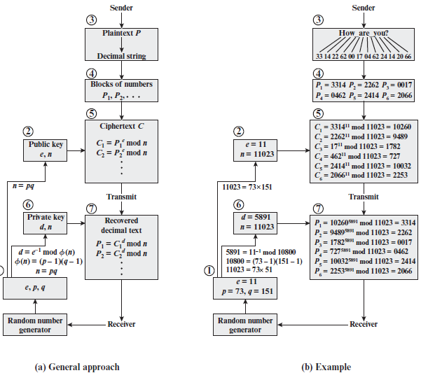
RSA Example

Slide 16
RSA Application
Encryption/decryption: The sender encrypts a message with the recipient’s public key, and the recipient decrypts the message with the recipient’s private key.
Digital signature: The sender “signs” a message with its private key.
Key exchange: Two sides cooperate to exchange a session key.

