Slide 1



CL2005 Database Systems
PL/SQL – Lec2

Slide 2


PL/SQL (Embedded SQL)
Procedures
Functions
Packages

Slide 3
Take input from User
In Oracle Database, a bind variable is a placeholder for a value that you want to use in a SQL or PL/SQL statement.
It allows you to pass values into a SQL statement or a PL/SQL block dynamically.
Bind variables are prefixed with a colon (:) in PL/SQL code.
You may use the “Substitution Variable” (e.g: x:=:y) temporary variable to take input from user and assign to actual variable.
Notes:
You may use the “Substitution Variable” (e.g: x:=:y) temporary variable to take input from user and assign to actual variable.

Slide 4
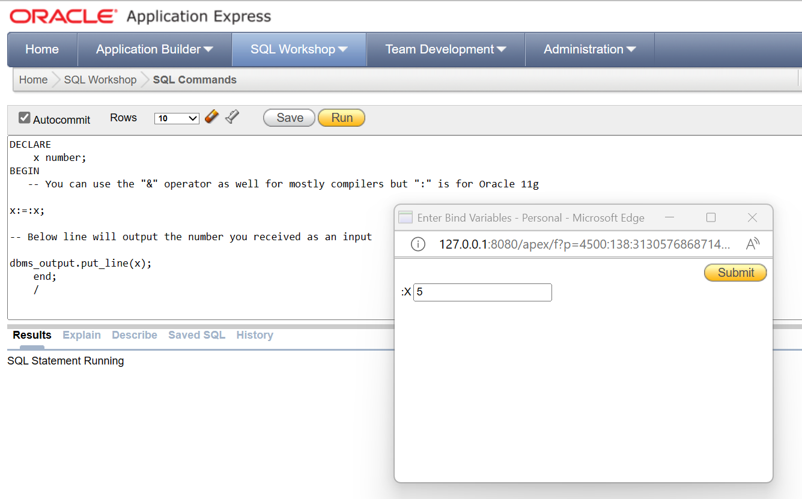
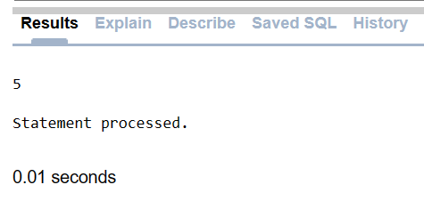
Take input from User
Notes:
You may use the “Substitution Variable” (e.g: x:=:y) temporary variable to take input from user and assign to actual variable.

Slide 5
- SubProgram
Subprograms are named PL/SQL blocks that can take parameters and be invoked.
Subprograms allow decomposition of a program into logical units.
PL/SQL has two types of subprograms called procedures and functions.
Generally, you use a procedure to perform an action and a function to compute a value.
Like PL/SQL blocks, subprograms have a declarative part, an executable part, and an optional exception-handling part.

Slide 6
- Types of Functions and Procedures
Local Procedure OR Function
Stored Procedure OR Function

Slide 7
- Local Procedures OR Functions
Local procedures and functions are defined and stored within the scope of a PL/SQL block or a PL/SQL package.
They are not stored in the database schema as standalone objects; instead, they exist only for the duration of the block or package in which they are defined.
local_procedure is defined within the scope of the anonymous PL/SQL block and can be called only within that block.

Slide 8
- Local Procedures OR Functions
Example
DECLARE
-- Local procedure
PROCEDURE local_procedure IS
BEGIN
DBMS_OUTPUT.PUT_LINE('This is a local procedure.');
END local_procedure;
BEGIN
-- Call the local procedure
local_procedure;
END;

Slide 9
- Stored Procedures OR Functions
Stored procedures and functions are standalone database objects that are stored in the database schema.
They are created using a CREATE PROCEDURE or CREATE FUNCTION statement and can be called from any PL/SQL block or application that has the necessary privileges.
Stored_procedure is stored in the database schema and can be called from any PL/SQL block or application that has access to it.

Slide 10
- Stored Procedures OR Functions
Example
  CREATE OR REPLACE PROCEDURE stored_procedure IS
  BEGIN
  DBMS_OUTPUT.PUT_LINE('This is a stored procedure.');
  END stored_procedure;

Slide 11
- Procedure
Is a block with a name
Parameters can be
  IN
  OUT
  IN OUT
Is stored (USER_SOURCE)

Slide 12
What Is a Procedure?
A procedure:
Is a type of subprogram that performs an action
Can be stored in the database as a schema object
Promotes reusability and maintainability

Slide 13
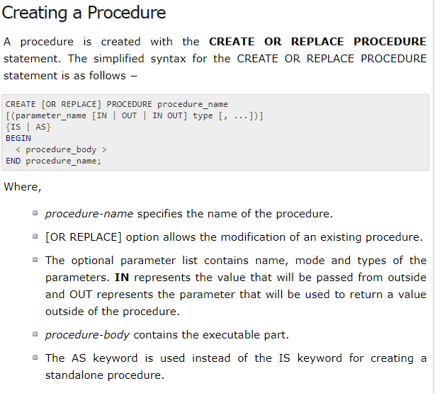

Slide 14
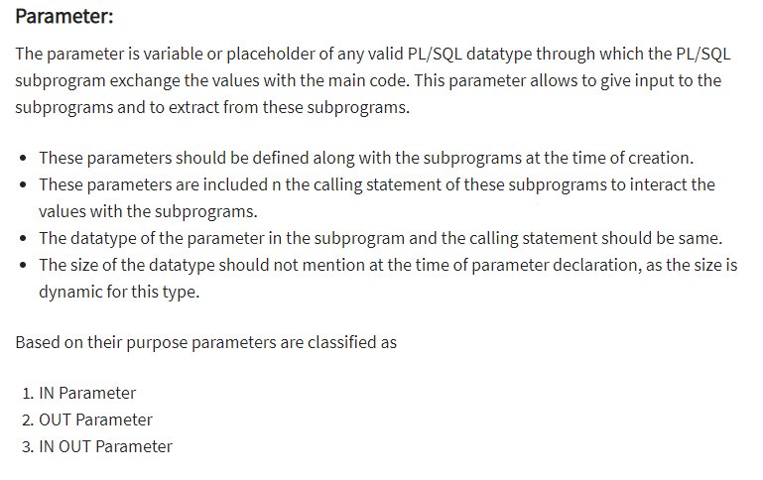

Slide 15
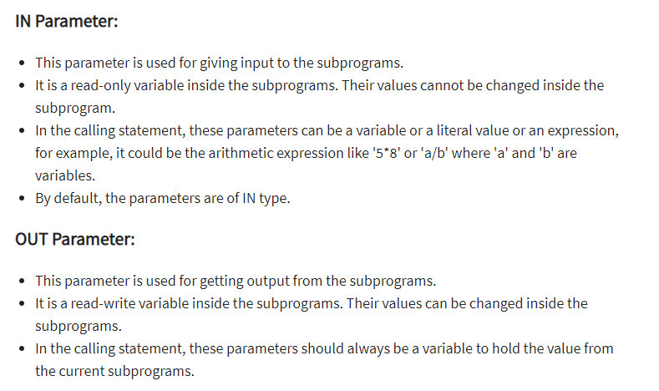
a
Notes:
OUT- write only

Slide 16
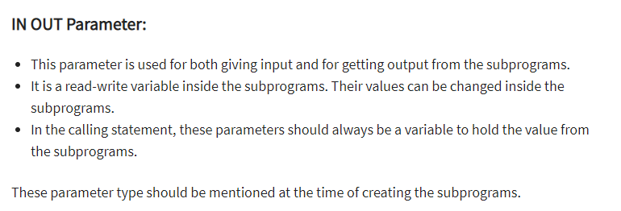

Slide 17
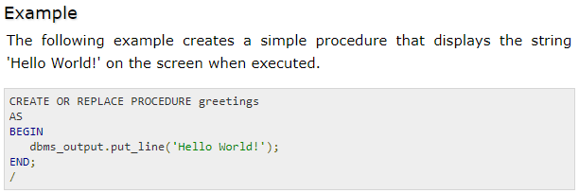

Slide 18

-- IS
The keyword IS is traditionally used in PL/SQL for declaring the specification (or interface) of a procedure or function.
The specification defines the parameters, return type (for functions), and other details about how the procedure or function can be called.

Slide 19
-- AS
The keyword AS is used in some contexts, particularly in anonymous PL/SQL blocks or when defining the body of a procedure or function.
It specifies the beginning of the body of the procedure or function, where the actual implementation is provided.
Used for standalone functions or procedures

Slide 20
-- IS/AS are Interchangeable
While IS and AS are often interchangeable for function and procedure declarations.
It's common to see IS for declaring the specification and AS for the implementation.
However, some developers may use AS throughout, and both are generally accepted in most Oracle databases.

Slide 21
-- Creating or Replacing a Procedure …
CREATE OR REPLACE PROCEDURE pname( ) IS
BEGIN
EXCEPTION
END;
/

Slide 22
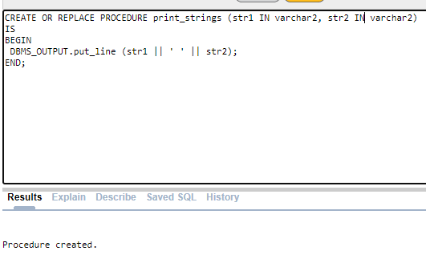
- Creating a Procedure
Notes:
The procedure prints concatenation of two strings.
Create or replace, the or replace clause allows the compiler to replace a procedure if a procedure of the same name is already in the database schema. This aspect of the Oracle CREATE OR REPLACE procedure is handy during development as you do not have to drop the procedure each time before recreating.
We can OIT “IN” keyword , IN mode is default.
We are able to use positional, named and mixed notation when calling subroutine in PL/SQL program units.

Slide 23
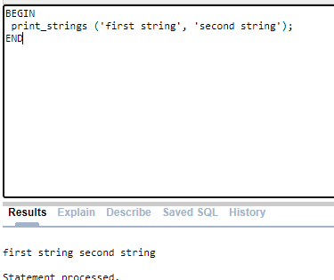
- Calling a Procedure
Notes:
Positional notation means that you provide a value for each variable in the formal parameter list. The values must be in sequential order and must also match the datatype.

Slide 24
- Symbol =>
In PL/SQL, the => symbol is used as a named parameter association operator.
It's employed to associate a formal parameter name with its actual parameter value in a procedure or function call.
Notes:
Positional notation means that you provide a value for each variable in the formal parameter list. The values must be in sequential order and must also match the datatype.

Slide 25
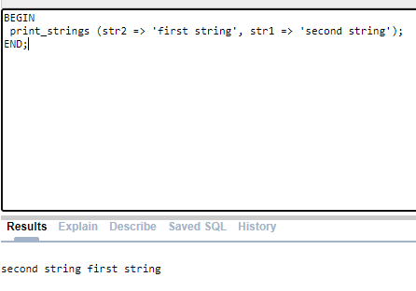
Notes:
Named notation means that you pass actual parameters by using their formal parameters name, the association operator (=>), and the value.
Named notation lets you only pass values to required parameters, which means you accept the default values for any optional parameters.

Slide 26
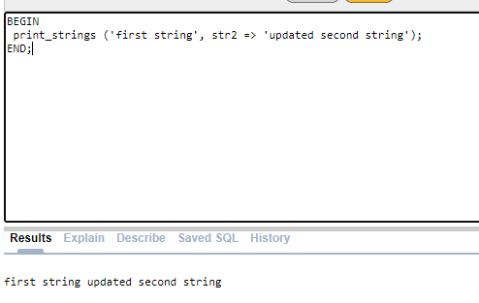
Notes:
Mixed notation means that you can now call subroutines by a combination of positional and named notation. This becomes very handy when parameters lists are defined with all mandatory parameters first, and optional parameters next. It lets you name or avoid naming the mandatory parameters, and it lets you skip optional parameters where their default values work.

Slide 27
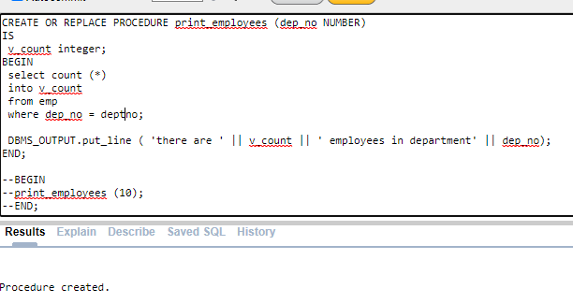
Notes:
A parameter definition parallel closely the syntax for declaring variables in the declaration section of a PL/SQL block. There is one important distinction:
a parameter declaration must be unconstrained. A constrained declaration is one that constrains or limits the kind of values that can be assigned to a variable declared with that datatype. An unconstrained declaration is one that does not limit values in this way.

Slide 28
- Function
Is a block with a name
Returns one value only.
Parameters can only be IN
Is stored

Slide 29
Stored Functions
A function:
Is a named PL/SQL block that returns a value
Can be stored in the database as a schema object for repeated execution
Is called as part of an expression or is used to provide a parameter value

Slide 30
Syntax for Creating Functions
The PL/SQL block must have at least one RETURN statement.
CREATE [OR REPLACE] FUNCTION function_name [(parameter1 [mode1] datatype1, ...)] RETURN datatype IS
[local_variable_declarations; …]
BEGIN
-- actions;
RETURN expression; END [function_name];
PL/SQL Block

Slide 31

-- Creating or Replacing a Function …
CREATE OR REPLACE FUNCTION fname( )
RETURN datatype IS
BEGIN
EXECPTION
END;
/

Slide 32
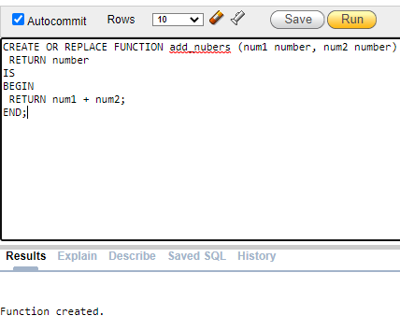
Notes:
Functions-
Pass-by-value functions receive copies of values when they are called. These functions return a single output variable upon completion, and they can perform external operations. The external operations can be physical reads and writes to the operating system or SQL statements against the database.
The basic structure of a pass-by-value program takes a list of inputs, which are also known as formal parameters. Function return a single output variable.
Function output values can be any SQL or PL/SQL datatype. You can use functions that return SQL datatypes inside SQL statements. Functions returning PL/SQL datatypes only work inside PL/SQL blocks.

Slide 33
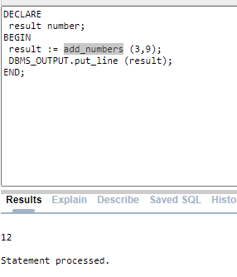
Notes:
You call functions by providing any required parameters as a list of arguments inside opening and closing parentheses. No parentheses are required when functions aren’t defined with required parameters.

Slide 34
- Pass by Value
In PL/SQL, parameters are always passed by value.
But when a parameter is declared as IN OUT (or OUT), it essentially allows the function or procedure to modify the value of the parameter.
And these modifications are visible outside the function or procedure.

Slide 35
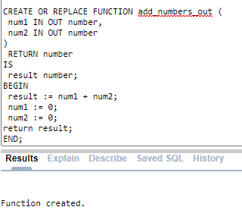

Slide 36
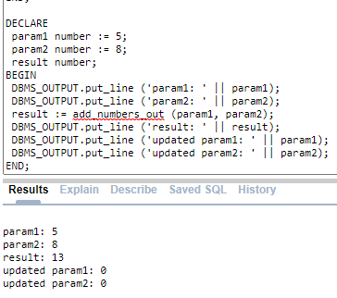

Slide 37
- IN OUT parameter might modify input Variables
The pass-by-reference function demonstrates returning a value while altering the input variable. Parameters values have been changed.
A write-only (OUT mode) formal parameter can’t work in this type of call because the new value is never read.
If you want to keep original values of the variables unchanged, you may want to reconsider whether using IN OUT parameters is appropriate for your specific use case.
If you only want to add the values and keep the original values intact, consider using IN parameters and returning the result as shown in the earlier examples.

Slide 38
- Return Statement
A function must have at least one RETURN statement in its execution section of statements.
It can have more than one RETURN, but only one of these statements is executed each time the function is called.
The RETURN statement that is executed by the function determines the value that is returned by that function.
When a RETURN statement is processed, the function terminates immediately and returns control to the calling PL/SQL block.

Slide 39
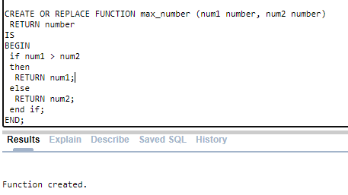
Notes:
A function must have at least one RETURN statement in its execution section of statements.
It can have more than one RETURN, but only one of these statements is executed each time the function is called.
The RETURN statement that is executed by the function determines the value that is returned by that function. When a RETURN statement is processed, the function terminates immediately and returns control to the calling PL/SQL block.

Slide 40
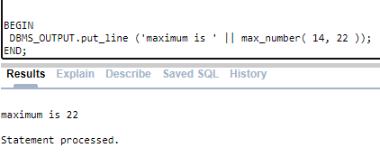

Slide 41
- Packages
Package
  Package Specification
  Package Body
Invoking Package subprogram

Slide 42
- Package
Packages are group of procedures, functions, variables, constants, cursors and SQL statements grouped together into a single unit.
Similar types of Procedures/Functions are placed in one package.
Supports Function Overloading
Whole Package Can not be executed, only members can be.
Procedures/Functions defined in a package are private to it.
Component of an Oracle Package
    Package specification
    Package Body

Slide 43
-- Package Specification
A package’s specification declares the memory variables, constants, cursors and subprograms that are available for use.
      Create or replace package package_name as
      Function function_name(list of arguments) return datatype;
      Procedure procedure_name(list of arguments);
      End package_name;
  /

Slide 44

-- Package Body
Create or replace package body package_name as
Function function_name(list of arguments) return datatype{is|as}
[local declaration of function]
Begin
--code of function;
End function_name;
Procedure procedure_name(list of arguments){is|as}
[local declaration of procedure]
Begin
--code of procedure;
End procedure_name;
End package_name;

Slide 45
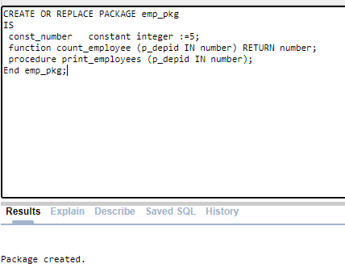
Notes:
Packages:
The above package specification declares a constant, and modules: function and procedure.

Slide 46
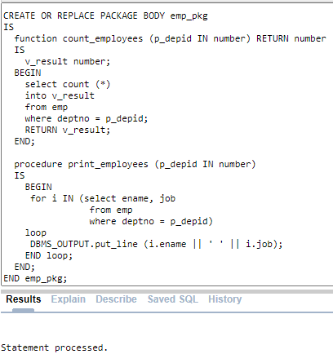
Notes:
Use const_number as 10.

Slide 47
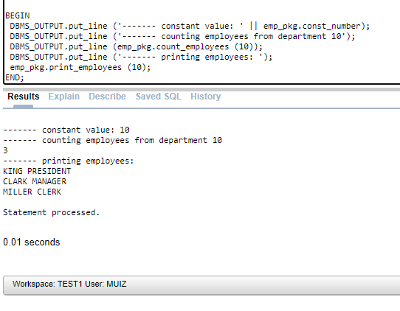
Notes:
The rule for referencing package elements is simple and clear: to reference a stored package element, use dot notation.

