Slide 1
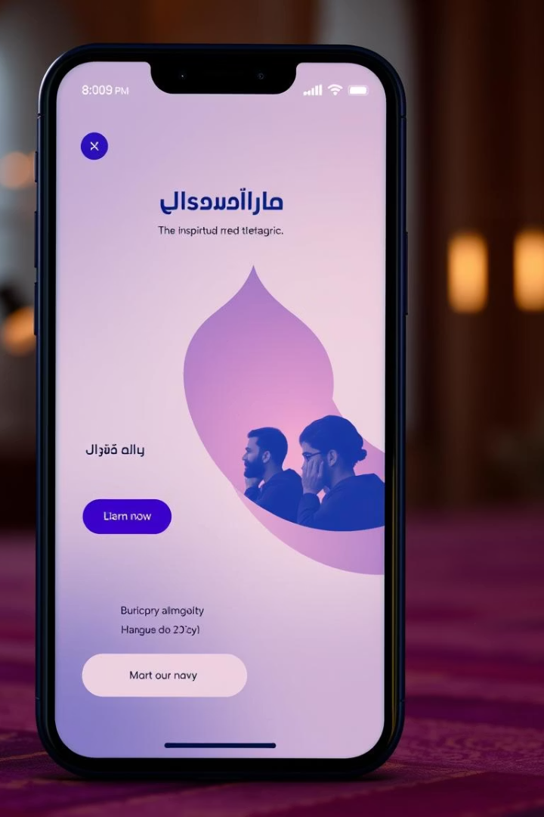
Noor Ul Eman – A Full-Stack Islamic Web Application
Noor Ul Eman is a MERN stack application designed as a spiritual digital companion. It supports Qur’an reading, Azkar, Namaz tracking, Ramazan reflections, Tasbih counting, and community interaction. The app aims to provide accessible Islamic content with recitations and translations, enable worship habit tracking, support spiritual growth through journaling, and foster a respectful digital Islamic community.
Targeted at practicing Muslims, it offers structured worship tracking and community-based learning to enhance daily spiritual discipline.

Slide 2
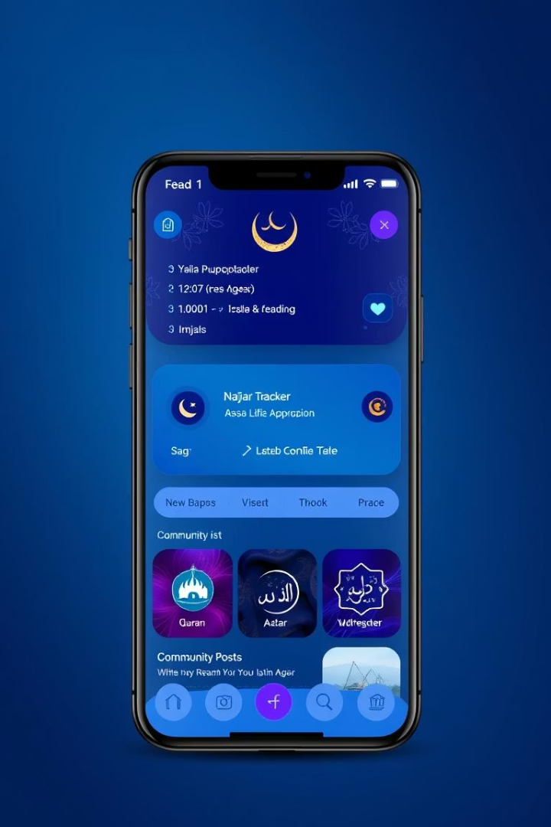
Core Modules and Features
Qur’an Module
Read Ayat-by-Ayat with English/Urdu translation, audio recitations from 7 Qaris, bookmarking, and personalized playback settings.
Azkar Module
Includes Morning, Evening, and Post-Prayer Azkar with translations, repetition counts, bookmarks, notes, and custom collections.
Namaz Tracker
Auto-location prayer timings, daily toggle tracking, streak monitoring, and visual analytics with charts and heatmaps.
Additional Features
Ramazan goals with progress tracking and journaling
Tasbih counter with custom counts and categories
Community posts with likes, dislikes, and comments
Dual Hijri/Gregorian calendar with Islamic events

Slide 3
Software Architecture (Layered Design)
Frontend
Backend
Database & Integrations
React with Vite powers a modular UI including routing, authentication, Qur’an player, Azkar tabs, and community feed.
Node.js with Express API handles controllers for authentication, Azkar, Qur’an, Namaz, community, calendar, and goals.
MongoDB Atlas stores user data, bookmarks, reflections, and logs. Integrations include Google OAuth, reCAPTCHA, Nodemailer, and Qur’an audio streaming.
Data flows from browser to frontend, API, database, and services, updating the UI accordingly.

Slide 4
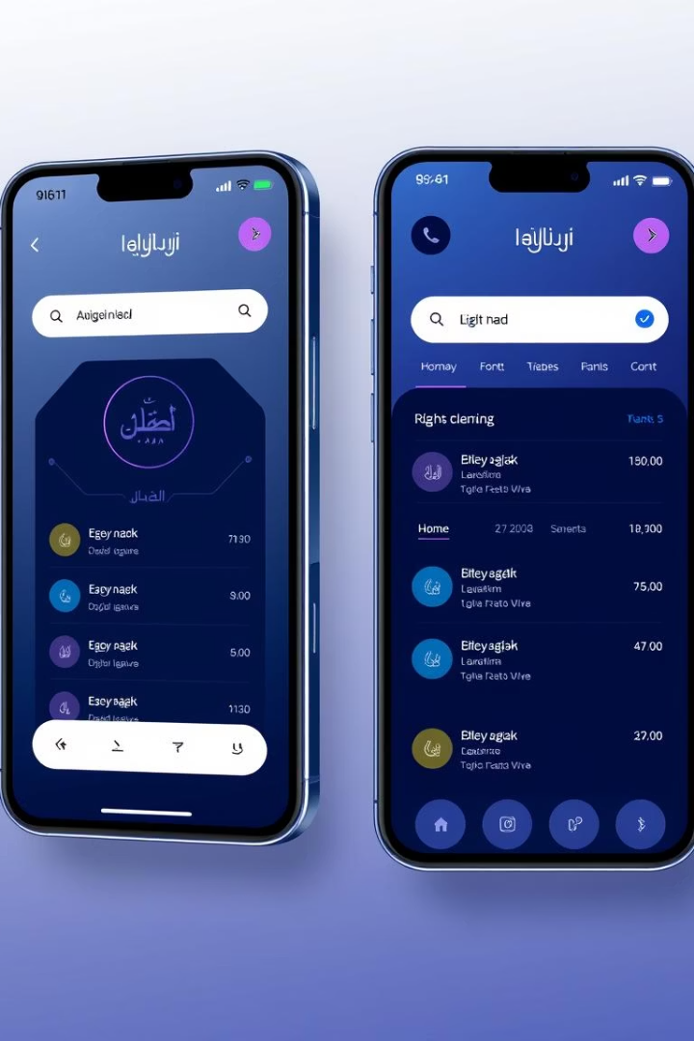
UI/UX Design and Personalization
Clean, Responsive Design
Built with Tailwind CSS, the UI adapts seamlessly across mobile, tablet, and desktop devices.
Personalization Features
Users can choose light, dark, or sepia themes and scale fonts from small to XL for accessible reading.
Focused Interfaces
Ayat-by-Ayat reading avoids overload, while modular tabs organize Azkar, Tasbih, Goals, and Reflections by category.
Custom Settings
Import and export personalized configurations to tailor the app experience.

Slide 5





Technical Decisions & Tradeoffs
Stack Choice
MERN stack enables single-language JavaScript development and rapid iteration.
Performance
Vite with React offers faster builds and better performance compared to alternatives like Webpack.
State Management
Context API was chosen over Redux for simpler state handling in this medium-scale app.
Security & Testing
JWT authentication combined with reCAPTCHA ensures lightweight security; testing is limited but includes Jest for UI.
Tradeoffs
OAuth and audio streaming improve user experience but require synchronization efforts; modular folder structure balances isolation and coupling.

Slide 6
Deployment & Hosting Details
Frontend
Backend
Database & Assets
Configuration
Deployed via Netlify and Vercel with CI/CD pipelines from GitHub for continuous integration and delivery.
Hosted on Render or Heroku, using Node.js with route-based API segregation for scalability.
Environment variables manage API URLs, secrets, and keys; custom domain support with SSL is available.
MongoDB Atlas hosts data with replica sets; Qur’an audio streams externally, and static files are cached for performance.

Slide 7

Challenges and Problem-Solving
Deployment Issues
Misconfigured environment variables caused failures, fixed by reviewing build logs and restructuring .env files.
API Integration
Syncing audio Qari selector and history tracking with backend state required careful coordination.
Security Conflicts
reCAPTCHA API key conflicts between development and production environments necessitated key isolation.
Performance & Testing
Chart rendering bugs were resolved with conditional rendering; limited test coverage due to time constraints; lazy loading deferred for future updates.

Slide 8
Future Improvements and Closing
Planned Features
UI/UX & Security
Admin panel with moderation controls
Animations for smoother transitions
Real-time Qur’an progress syncing
Voice-assisted navigation
Multi-language user interface
Role-based access control
Offline mode with PWA support
Rate-limiting and IP logging for security
Noor Ul Eman successfully blends Islamic values with modern technology, designed to support spiritual discipline, daily worship, and meaningful reflection through an engaging digital environment.

