Slide 1
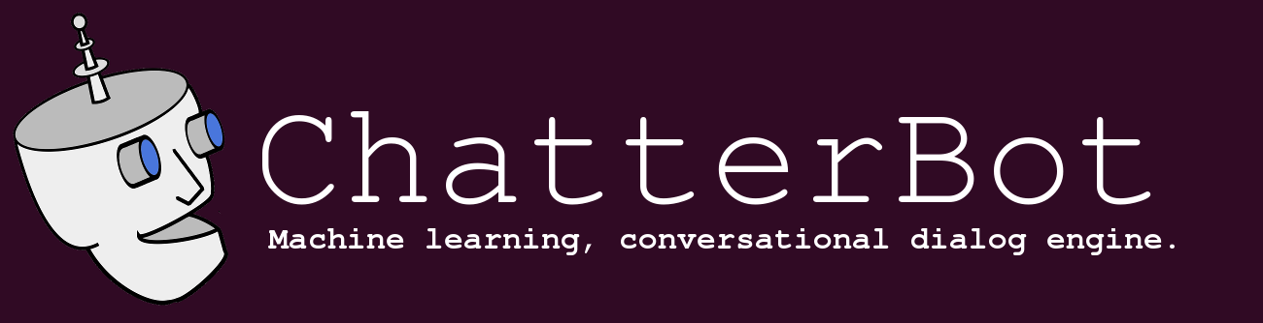
What are chatbots?
A chatbot is a conversational agent that interacts with users using natural language.
ChatterBot is a machine-learning based conversational dialog engine build in Python.
It generate responses based on collections of known conversations

Slide 2
Real time examples of ChatBot
Phone-based Personal Assistants
SIRI, Cortana, Google Now
Talking to your car
Communicating with robots
Chatting for fun

Slide 3
Need for chatbots?
Widespread use of personal machines
Better Human Computer Interaction
“To express their interest, wishes, or queries directly and naturally, by speaking, typing, and pointing”.

Slide 4
Need for chatbots?
Example conversation:
You: Hello
Op: Hi. This is Railway Enquiry
You: What is the status of train 2803?
Op: It’s right on time. The train will leave CST at 5:45 pm. Is there anything else I could assist you with?
You : No, thank you
Op: You are welcome. Indian railways wishes a nice and happy journey.

Slide 5
How Do Chatbots Work
Don’t have a good understanding of conversation
Are based on pattern matching
Chatterbots have a set of input and output rules
Recognize cue words from user and responds with a pre-calculated response
For e.g.:- Human: “I am feeling very worried today.”
Chatterbot: “Why are you feeling worried lately?”
Other chatterbots learn through user interactions

Slide 6
What is RASA NLU
Rasa NLU (Natural Language Understanding) is a tool for understanding what is being said in short pieces of text.
For example, taking a short message like:
"I'm looking for a Mexican restaurant in the center of town“
And returning structured data like:
intent: search_restaurant
entities:
- cuisine : Mexican
- location : center

Slide 7
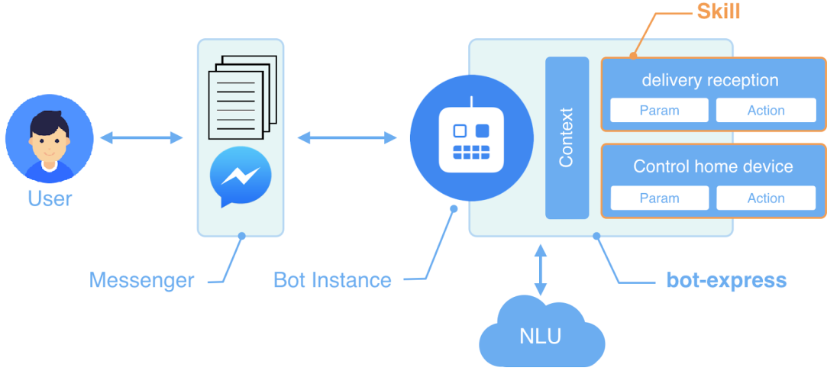
How Chatbot works:

Slide 8
Requirements:
Operating System : windows 7/8/10
Programing language : Python
IDE : Anaconda, pycharm
Packages : Rasa NLU,Rasa Core
API : Weather API

