Slide 1
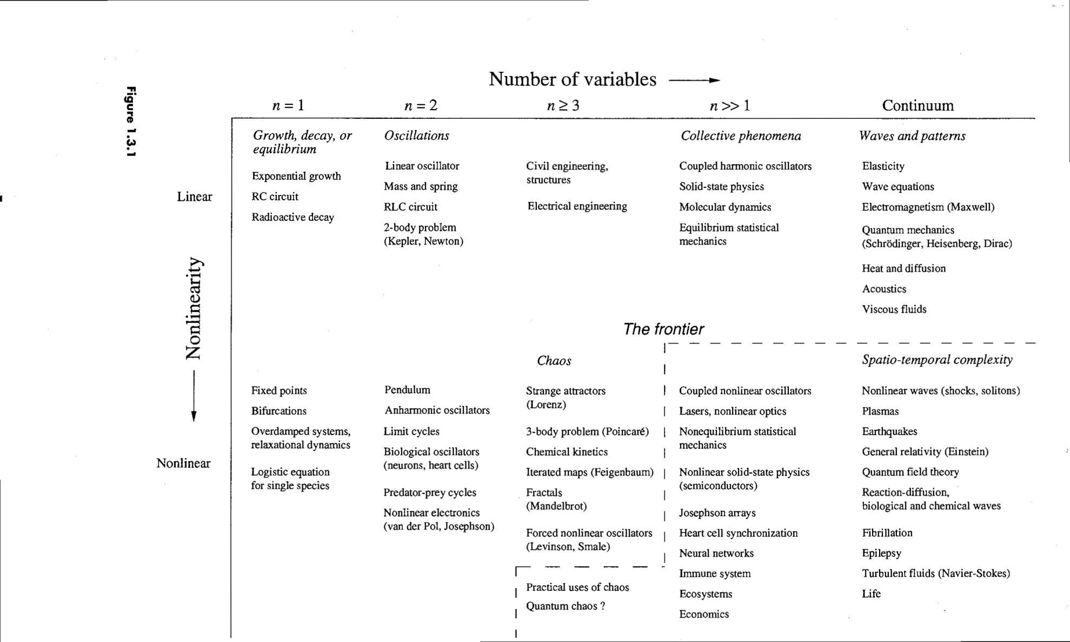
Nonlinear Dynamics
Bifurcation theory , Fixed points, Limit Cycle and Chaos

Slide 2
Bifurcation in 1-d systems
Eigenvalues 2-d linear systems
Romeo vs Juliet
Stability of fixed points: Jacobian analysis
Rabbit vs Sheep

Slide 3

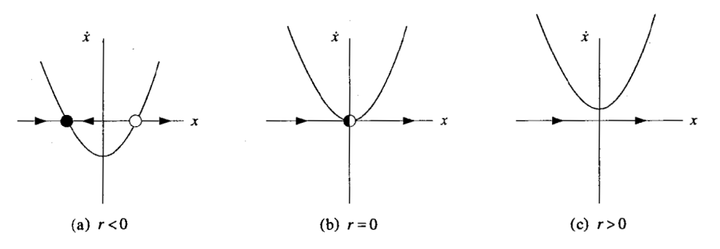


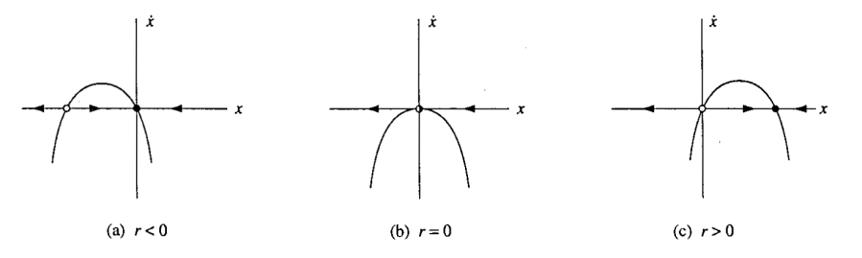


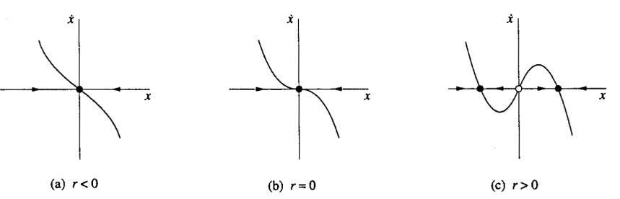

Nonlinear Dynamics
Bifurcation theory , Fixed points, Limit Cycle and Chaos
1-D Flow Three types of Bifurcation
2-D Flow: Birth of Limit Cycle
3-D Flow: Chaotic Oscillation

Slide 4

Classification of linear systems

Slide 5

Classification of linear systems
$$x\left(t\right)=e^{λt}v$$

Slide 6

Classification of linear systems
$$x\left(t\right)=e^{λt}v$$

Slide 7

Classification of linear systems
$$x\left(t\right)=e^{λt}v$$

Slide 8
Classification of linear systems
$$x\left(t\right)=e^{λt}v$$

Slide 9
Solving Initial Value Problem (Model 7)

Slide 10
Solving Initial Value Problem

Slide 11
Solving Initial Value Problem

Slide 12
Solving Initial Value Problem

Slide 13
Love Affairs (Model 8)

Slide 14
Love Affairs

Slide 15
Love Affairs
Never ending cycles of love and hate
Governing system has center at (0,0)
They manage love simultaneously one quarter of time

Slide 16
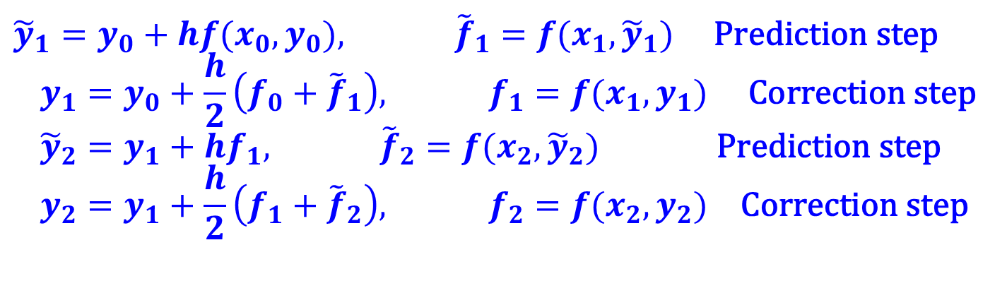
Improved Euler Method
Similar in concept to the trapezoid rule in quadrature, by utilizing an average of the start and end point derivatives we can better approximate the change in y over the interval
This is the simplest example of so called “Predictor-Corrector” methods, (which includes Runge-Kutta methods)
$${\tilde{y}}_{1}=y_{0}+hf(x_{0},y_{0}), {\tilde{f}}_{1}=f(x_{1},{\tilde{y}}_{1}) \text{Prediction} \text{step} \\ y_{1}=y_{0}+\frac{h}{2}\left(f_{0}+{\tilde{f}}_{1}\right), f_{1}=f(x_{1},y_{1}) \text{Correction} \text{step} \\ {\tilde{y}}_{2}=y_{1}+hf_{1}, {\tilde{f}}_{2}=f(x_{2},{\tilde{y}}_{2}) \text{Prediction} \text{step} \\ y_{2}=y_{1}+\frac{h}{2}\left(f_{1}+{\tilde{f}}_{2}\right), f_{2}=f(x_{2},y_{2}) \text{Correction} \text{step}$$

Slide 17


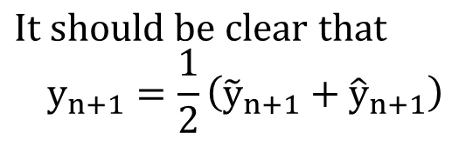
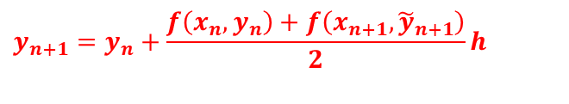

Improved Euler method graphically
y(x)
$${\tilde{y}}_{n+1}=y_{n}+hf(x_{n},y_{n})$$
$$y_{n+1}=y_{n}+\frac{f\left(x_{n},y_{n}\right)+f\left(x_{n+1},{\tilde{y}}_{n+1}\right)}{2}h$$
y_{n}
$${\hat{y}}_{n+1}=y_{n}+f(x_{n+1},{\tilde{y}}_{n+1})h$$
$$\text{It} \text{should} \text{be} \text{clear} \text{that} \\ y_{n+1}=\frac{1}{2}\left({\tilde{y}}_{n+1}+{\hat{y}}_{n+1}\right)$$
x_{n} x_{n+1}
Can show that errors in this method are also
$$e_{i}∝O(h^{3}) {\text{E}}_{n}∝O(h^{2})$$

Slide 18
Example : Rabbit Vs Sheep, Lotka-Volterra, SIR dynamics

Slide 19
Jacobian analysis

Slide 20
Jacobian analysis

Slide 21
Jacobian analysis

Slide 22
Jacobian analysis

Slide 23
Rabbit Vs Sheep
Classic Lotka-Volterra model
Note :
Each species would grow to its carrying capacaity in absence of the other.
( Recall Logistic growth equations : one self linear and the other negative nonlinear terms)
Both eat grass.
Rabbits have legendary ability to reproduce : thus higher intrinsic growth rate.
Sheep usually beat rabbits when fighting for same tuft of grass.

Slide 24
Rabbit Vs Sheep
Classic Lotka-Volterra model
Note :
Each species would grow to its carrying capacaity in absence of the other.
( Recall Logistic growth equations : one self linear and the negative nonlinear terms.)
Both eat grass.
Rabbits have legendary ability to reproduce : thus higher intrinsic growth rate
Sheep usually beat rabbits when fighting for same tuft of grass.

Slide 25
Rabbit Vs Sheep
Classic Lotka-Volterra model

Slide 26
Rabbit Vs Sheep
Classic Lotka-Volterra model
Fast reproduction. Higher carrying capacity. Sheep threaten them.
Slower reproduction. Lower carrying capacity. Rabbits threaten less.

Slide 27
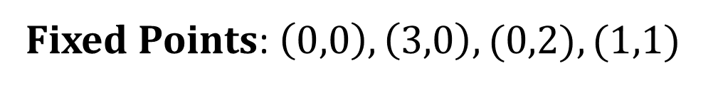
Rabbit Vs Sheep
Classic Lotka-Volterra model
Fixed Points: $\left(0,0\right), \left(3,0\right), (0,2), (1,1)$

Slide 28
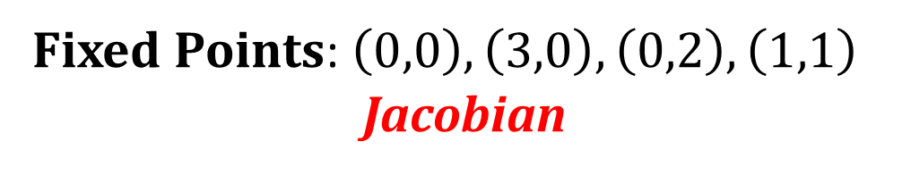
Rabbit Vs Sheep
Classic Lotka-Volterra model
Fixed Points: $\left(0,0\right), \left(3,0\right), \left(0,2\right), \left(1,1\right)$
Jacobian

Slide 29
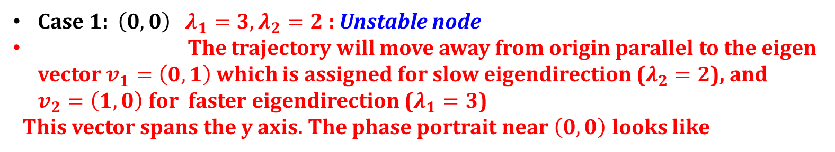

Rabbit Vs Sheep
Classic Lotka-Volterra model
Fixed Points: $\left(0,0\right), \left(3,0\right), \left(0,2\right), \left(1,1\right)$
Jacobian
Case 1: $\left(0,0\right)$ $λ_{1}=3, λ_{2}=2$ : Unstable node
The trajectory will move away from origin parallel to the eigen vector $v_{1}=\left(0,1\right)$ which is assigned for slow eigendirection ($λ_{2}=2$), and $v_{2}=\left(1,0\right)$for faster eigendirection ($λ_{1}=3$)
This vector spans the y axis. The phase portrait near $\left(0,0\right)$ looks like

Slide 30

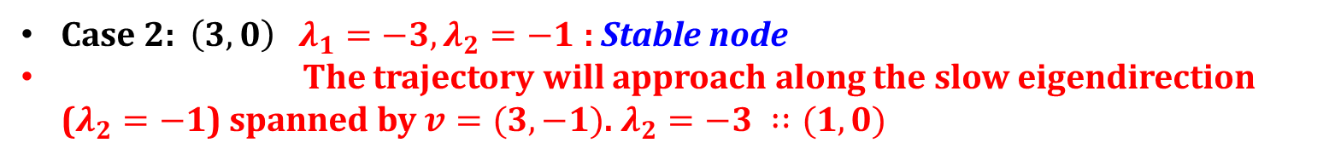

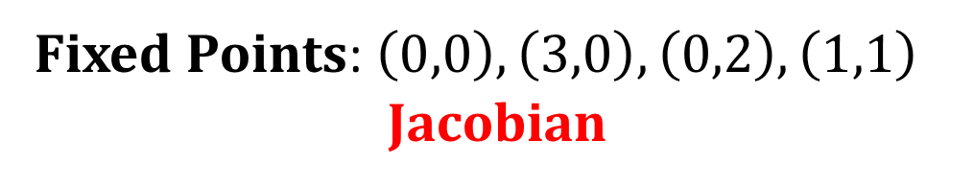

Rabbit Vs Sheep
Fixed Points: $\left(0,0\right), \left(3,0\right), \left(0,2\right), \left(1,1\right)$
Jacobian
Case 1: $\left(0,0\right)$ $λ_{1}=3, λ_{2}=2$ : Unstable node
The trajectory will move away from origin parallel to the eigen vector $v_{1}=\left(0,1\right)$ which is assigned for slow eigendirection ($λ_{2}=2$), and $v_{2}=\left(1,0\right)$for faster eigendirection ($λ_{1}=3,$)
This vector spans the y axis. The phase portrait near $\left(0,0\right)$ looks like
Case 2: $\left(3,0\right)$ $λ_{1}=−3, λ_{2}=−1$ : Stable node
The trajectory will approach along the slow eigendirection ($λ_{2}=−1$) spanned by $v=(3, −1)$. $λ_{2}=−3 ∷(1,0)$
$$\left(\begin{matrix}−3 & −6 \\ 0 & −1\end{matrix}\right)$$

Slide 31
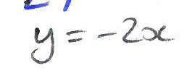
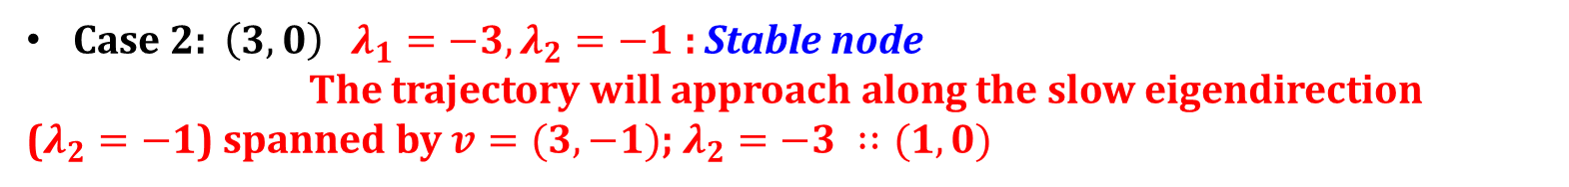

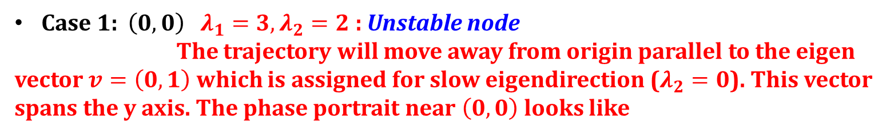
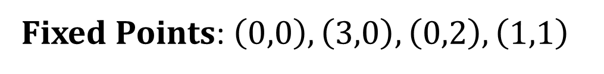
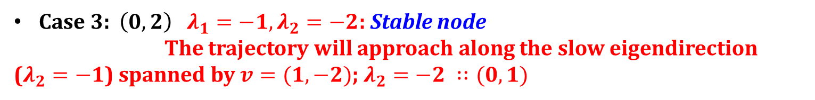
Rabbit Vs Sheep
Fixed Points: $\left(0,0\right), \left(3,0\right), \left(0,2\right), \left(1,1\right)$
Case 1: $\left(0,0\right)$ $λ_{1}=3, λ_{2}=2$ : Unstable node
The trajectory will move away from origin parallel to the eigen vector $v=\left(0,1\right)$ which is assigned for slow eigendirection ($λ_{2}=0$). This vector spans the y axis. The phase portrait near $\left(0,0\right)$ looks like
Case 2: $\left(3,0\right)$ $λ_{1}=−3, λ_{2}=−1$ : Stable node
The trajectory will approach along the slow eigendirection
($λ_{2}=−1$) spanned by $v=(3, −1)$; $λ_{2}=−3 ∷(1,0)$
Case 3: $\left(0,2\right)$ $λ_{1}=−1, λ_{2}=−2$: Stable node
The trajectory will approach along the slow eigendirection ($λ_{2}=−1$) spanned by $v=(1,−2)$; $λ_{2}=−2 ∷(0,1)$
$$\left(\begin{matrix}−1 & 0 \\ −2 & −2\end{matrix}\right)$$

Slide 32
Rabbit Vs Sheep
Fixed Points: $\left(0,0\right), \left(3,0\right), \left(0,2\right), \left(1,1\right)$
Jacobian
Saddle point.

Slide 33
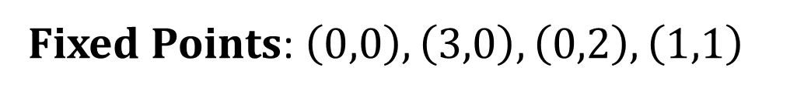
Rabbit Vs Sheep
Fixed Points: $\left(0,0\right), \left(3,0\right), \left(0,2\right), \left(1,1\right)$
Stable Manifold

Slide 34
Rabbit Vs Sheep
Fixed Points: $\left(0,0\right), \left(3,0\right), \left(0,2\right), \left(1,1\right)$
Stable Manifold
One species generally drives other species to extinction
Below stable manifold, the trajectories lead to the sole existence of all rabbits
Above the stable manifold, the trajectories lead to the extinction of rabbits.
Principle of competitive exclusion: Two species competing for same
limited resource cannot coexist!!!!

