Slide 1

Gistify: Unlock the Power of PDFs, Instantly
The ultimate PDF summarization tool. Get key insights without the time commitment.

Slide 2
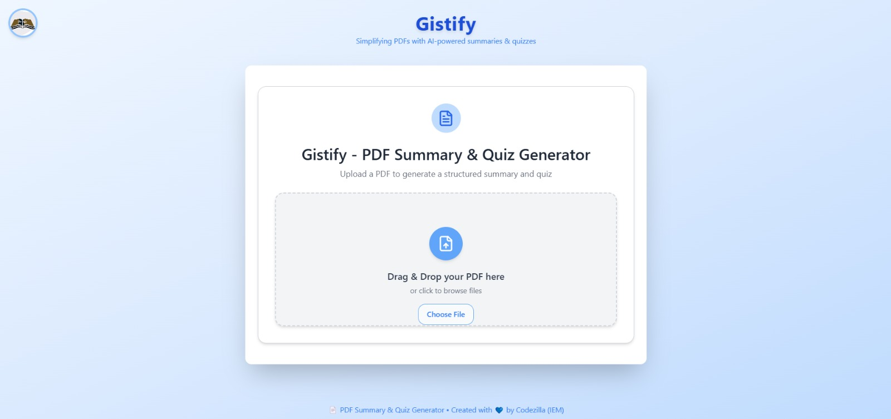
The Problem: PDF Overload
Professionals spend ~4 hours/day reading (Forrester). Lengthy reports, research papers, legal documents consume valuable time. Difficulty extracting key information quickly. Information overload leads to decreased productivity & missed insights (McKinsey).
Professionals spend ~4 hours/day
reading (Forrester).
Lengthy reports, research papers, legal
documents consume valuable time.
Difficulty extracting key information
quickly.

Slide 3
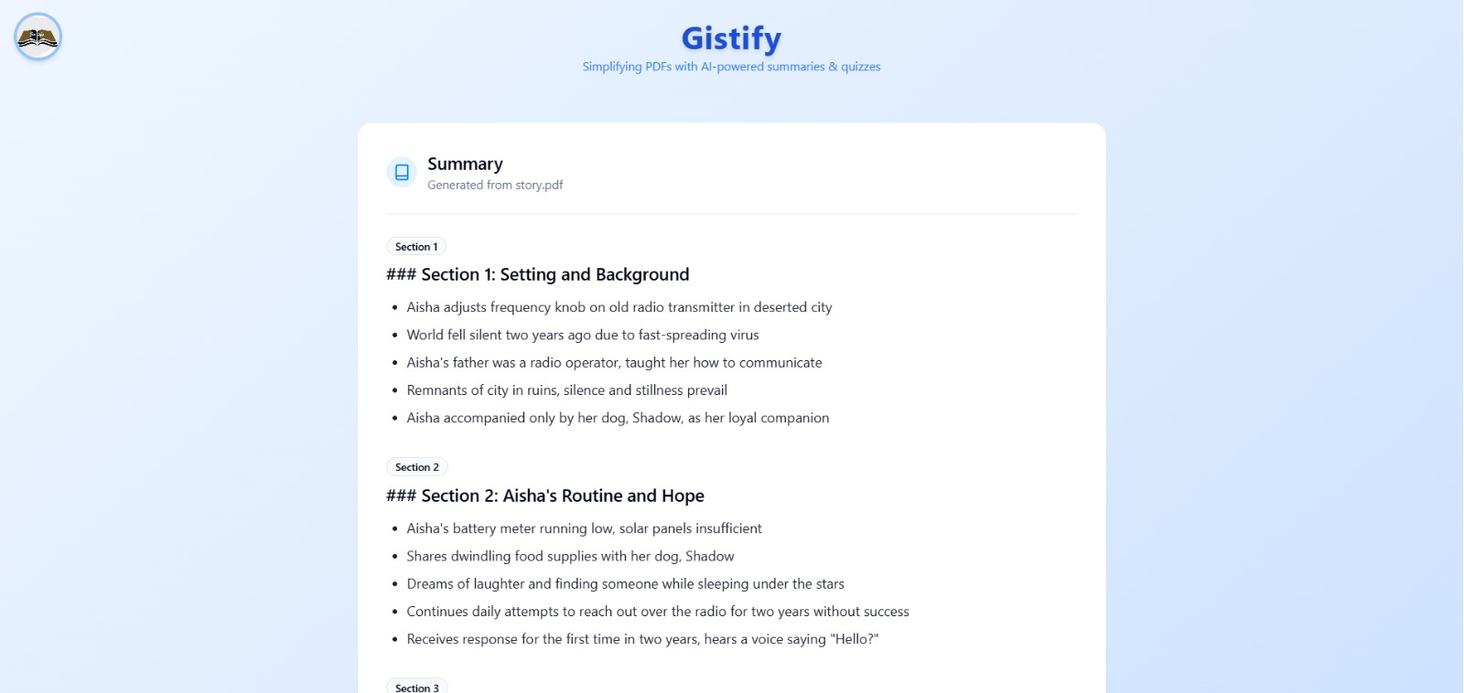



Introducing Gistify: Your AI- Powered PDF Summarizer
Upload any PDF, get a concise summary in seconds. AI algorithms extract key insights and takeaways. Saves time, increases efficiency, improves comprehension .
Upload any PDF
Get a concise su mm ar y
Save time

Slide 4
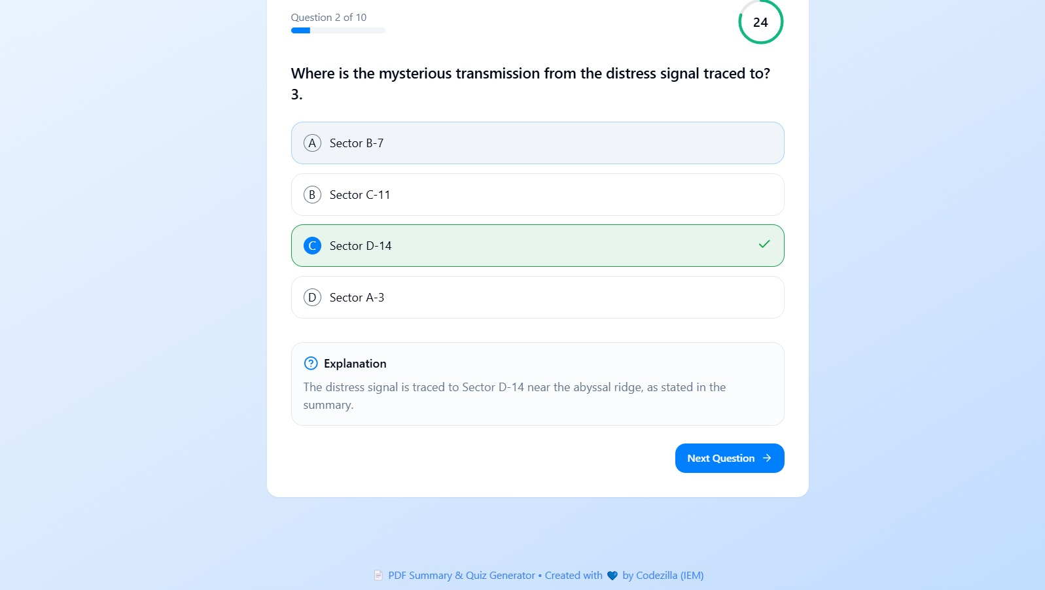
How Gistify Works: 3 Easy Steps
1. Upload: Drag and drop your PDF file.
2. Summarize: Click the "Gistify" button.
3. Read: Review the concise, AI-generated summary.
1. Upload
2. Summarize
3. Read

Slide 5


Key Features & Benefits
AI-Powered Summarization: Accurate & insightful summaries powered by advanced AI. Time Savings: Reduce reading time by up to
90%. Customizable Summary Length: Control the level of detail. Multi-Language Support: Summarize PDFs in any language. Secure & Private: Your documents are always safe and confidential. Cost Savings: Eliminating need for multiple employees to read the same fil es.
1
2
AI-Powered Summarization
Time Savings
3
4
Customizable Summary Length
Multi-Language Support
5
6
Secure & Private
Cost Savings

Slide 6



Gistify in Action: Real-World Use Cases
Researchers: Quickly analyze research papers and academic articles. (e.g., Analyze 20 research papers in the time it takes to read one). Lawyers: Extract key information from legal documents and contracts. (e.g., Review contracts in 1/10th of the time). Students: Summarize textbooks and lecture
notes for efficient studying. (e.g., Condense 300 page textbooks into 20 page summaries). Business Professionals: Stay informed on industry reports and market analysis. (e.g., Review competitor analysis in minutes).
Researchers
Lawyers
Students
Business Professionals

Slide 7
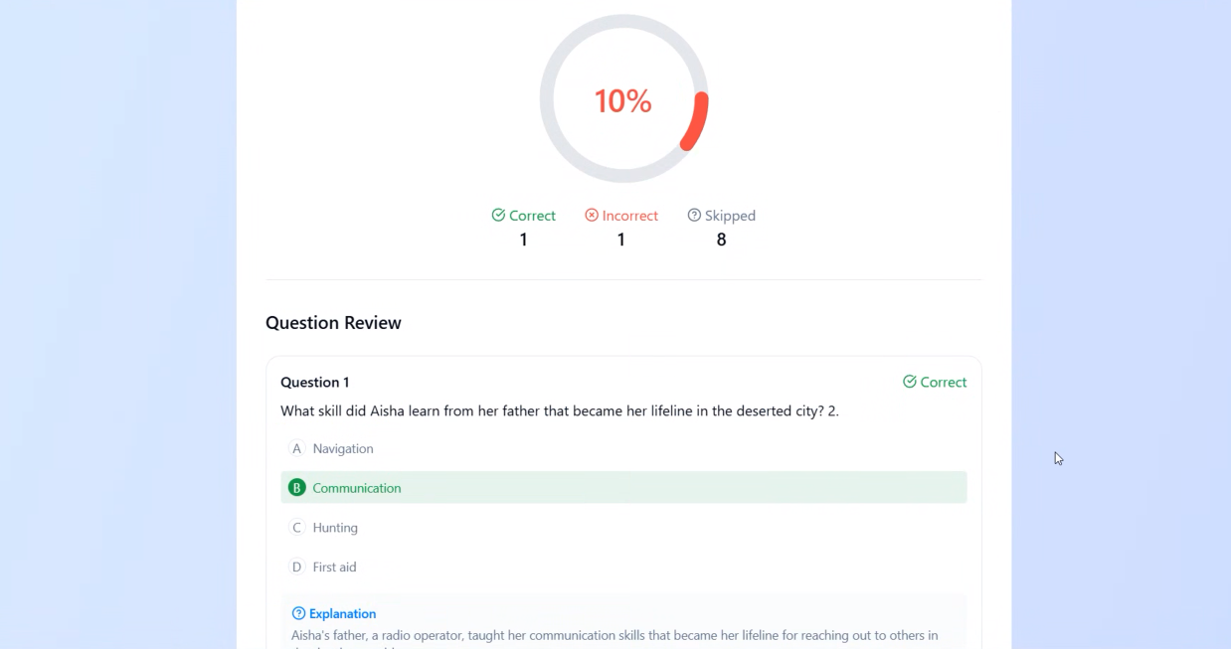

Gistify vs. Traditional Methods
Feature | Gistify | Traditional Reading --- Time | Seconds | Hours --- Accuracy | High | Variable --- Key Insights | Guaranteed | Dependent on Reader --- Cost | Low Subscription/Pay-per-use | High (Employee Time)
Time
Seconds
H ours
Accuracy
High
Va riable
Key Insights
Guara nteed
Dependent on
R eader
Cost
Low
High (Employee
Subscr ip tion/P ay- per-use
Time)

Slide 8
Get Started with Gistify Today!
Visit our website: [Gistify Website URL] --- Sign up for a free trial and experience the power of AI-powered PDF summarization. --- Follow us on social media: [Social Media Links] --- Unlock insights, save time, and boost your productivity with Gistify!
Visit our website
Upload your website
Get your summary

