Slide 1
Daily Based Rain Predictor Using Classical ML Techniques
Iman Hindi
Data Science Course.
HTU, Amman Jordan.
Feb 16,2023

Slide 2
Outline
Problem Statement
Dataset Description
Dataset Exploration
Data Preprocessing
Main Results and Recommendations

Slide 3

Problem Statement
Design a simple predictive model with the use of machine learning algorithms to forecast whether or not it will rain tomorrow in Australia (Yes or No).
2
Notes:
These systems is controlled by regional programs are implemented where numerous renting locations are set.
creating a network of locations where bicycles can be borrowed from and returned.
bike-sharing systems provide a discrete and limited
number of bikes, whose distribution can vary throughout a
City.
supply the stations with sufficient number of bicycles such
that one person's usage does not encroach upon another's use of the good, and thus make the rental bike available and
accessible to the public at the right time as it lessens the
waiting time.
providing each station with a stable supply of rental bikes that can cover the varied demand became a major concern. The crucial part here is the prediction of bike count required at each day or hour for the stable supply of rental bikes by taking into considerations all the factors that can affected the rental bikes demand.

Slide 4
Dataset Description
Data set is taken from Kaggle, Daily weather observations from many locations across Australia.
number of records: 145,460 days.
number of features: 22features , binary class Output (yes or No) as follows:
6 Categorical Features 16 Numerical Features 1 Binary Output
Date | Location | Min Temp | Max Temp | Rainfall | Evaporation | Sunshine | Wind Gust Dir | WindGust Speed | WindDir9am | ... | Humidity9am | Humidity 3pm | Pressure9am | Pressure3pm | Cloud9am | Cloud3pm | Temp9am | Temp3pm | Rain Today | Rain Tomorrow
2008-12-01 | Albury | 13.4 | 22.9 | 0.6 | NaN | NaN | W | 44.0 | W | ... | 71.0 | 22.0 | 1007.7 | 1007.1 | 8.0 | NaN | 16.9 | 21.8 | No | No
2008-12-02 | Albury | 7.4 | 25.1 | 0.0 | NaN | NaN | WNW | 44.0 | NNW | ... | 44.0 | 25.0 | 1010.6 | 1007.8 | NaN | NaN | 17.2 | 24.3 | No | No
2008-12-03 | Albury | 12.9 | 25.7 | 0.0 | NaN | NaN | WSW | 46.0 | W | ... | 38.0 | 30.0 | 1007.6 | 1008.7 | NaN | 2.0 | 21.0 | 23.2 | No | No
2008-12-04 | Albury | 9.2 | 28.0 | 0.0 | NaN | NaN | NE | 24.0 | SE | ... | 45.0 | 16.0 | 1017.6 | 1012.8 | NaN | NaN | 18.1 | 26.5 | No | No
2008-12-05 | Albury | 17.5 | 32.3 | 1.0 | NaN | NaN | W | 41.0 | ENE | ... | 82.0 | 33.0 | 1010.8 | 1006.0 | 7.0 | 8.0 | 17.8 | 29.7 | No | No
4
Notes:
These systems is controlled by regional programs are implemented where numerous renting locations are set.
creating a network of locations where bicycles can be borrowed from and returned.
bike-sharing systems provide a discrete and limited
number of bikes, whose distribution can vary throughout a
City.
supply the stations with sufficient number of bicycles such
that one person's usage does not encroach upon another's use of the good, and thus make the rental bike available and
accessible to the public at the right time as it lessens the
waiting time.
providing each station with a stable supply of rental bikes that can cover the varied demand became a major concern. The crucial part here is the prediction of bike count required at each day or hour for the stable supply of rental bikes by taking into considerations all the factors that can affected the rental bikes demand.

Slide 5
Dataset Exploration
Check Null Values and Check Duplications
Check imbalances in dataset output
Check features range values, distributions, means and medians
Check Outliers in the samples’ values
Calculate and plot the counts of each categorical features values
Check the relation of bikes counts with each feature using boxplot.
5

Slide 6
Dataset preprocessing
Null Values treatments for both numerical and categorical features using SimpleImputer
Normalize numerical features using StandardScaler
Categorical features encoding using OneHotEncoder
Remove skewness in the distribution for skewed features’ distribution using Log fun
5

Slide 7
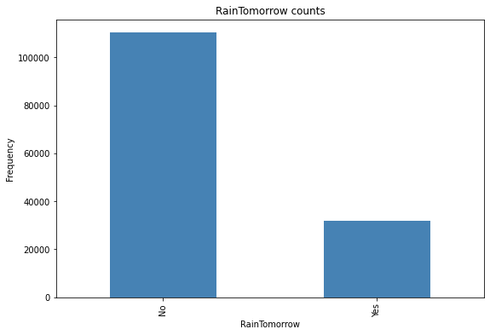
Dataset Splitting
Since the data set is imbalanced towards the RainTomorrow Output we split the data set to train and test using stratified split with respect to the Target “RainTomorrow “ to ensure that the data set is representative to all sample values, and thus lead to more accurate performance results.
6

Slide 8
Logistic Regressor as Model
Training Accuracy 84.7%
Training Precision 72.7%
Testing Accuracy 84.6%
Testing Precision 72.6%
No Overfitting
9
Notes:
GridSearchCV from Scikit learn to find the best hyper parameters to enhance the model performance.
The n_iter_no_change hyper parameter is adjust to an integer value= 10, this help the Gradient Boosting Regressor to automatically stop adding more trees during training if it sees that the last 10 estimators didn’t help. This is simply early stopping, but with a little bit of patience: it tolerates having no progress for a few iterations before it stops [5]
When n_iter_no_change is set, the fit() method automatically splits the training set into a smaller training set and a validation set: this allows it to evaluate the model’s performance each time it adds a new estimator. The size of the validation set is controlled by the validation_fraction hyper parameter, which is 10% by default. The tol hyper parameter determines the maximum performance improvement that still counts as negligible. It sets to defaults 0.0001. The Gradient Boosting Regressor class also supports a subsample hyper parameter, which specifies the fraction of training instances to be used for training each tree. If subsample=0.25, then each tree is trained on 25% of the training instances, selected randomly [5].
The best values of hyper parameters found by the GridSearchCv, which give the highest performance, are listed in the following table:

Slide 9
Result and Conclusion
We can enhance the model performance by applying hyper parameter tuning using GridSearch
We can apply more feature engineering and preprocessing to increase the accuracy.
The data is imbalanced and this can lead to a biased model and to solve that we can apply data augmentation to reach to more accurate results.
17

Slide 10
THANK YOU
Jan 16,2023

