Slide 1

JAA JVM Arm Accelerator

Slide 2
The Team
Seyed Iman Hosseini Zavaraki
Ali Jafari
Mahdi Hassanzadeh
Seyed Alireza Fatemi Jahromi
Reza Baharloei

Slide 3
1.
Why JAA?
JVM bytecode vs Arm

Slide 4
Multi-platform convenienve comes at a price

Slide 5
Prior work
Jazelle DBX (Direct Bytecode eXecution)
Open JIT
Jaguar Coprocessor patent (Google)
Jazelle motivation was Java EE games on mobiles

Slide 6
Jazelle
specifications are very incomplete
Requires Jazelle-aware JVM
implemented as an extra stage between the fetch and decode stages in the processor instruction pipeline. Recognised bytecodes are converted into a string of one or more native ARM instructions.
Jazelle was state-based, succeeded by Thumb EE

Slide 7
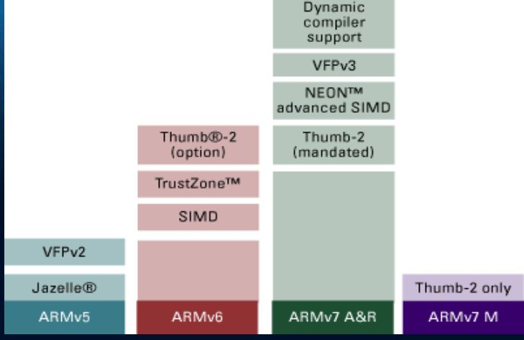
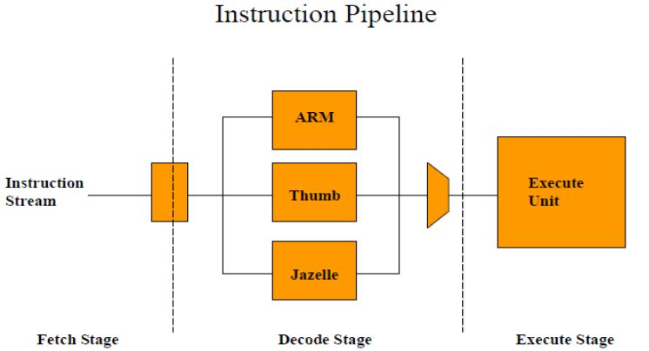
Jazelle

Slide 8
ARM Registers
ARM has 37 32-bit registers
1 dedicated PC
1 dedicated current program status register (CPSR)
5 dedicated saved program status registers (SPRS)
30 general purpose registers

Slide 9
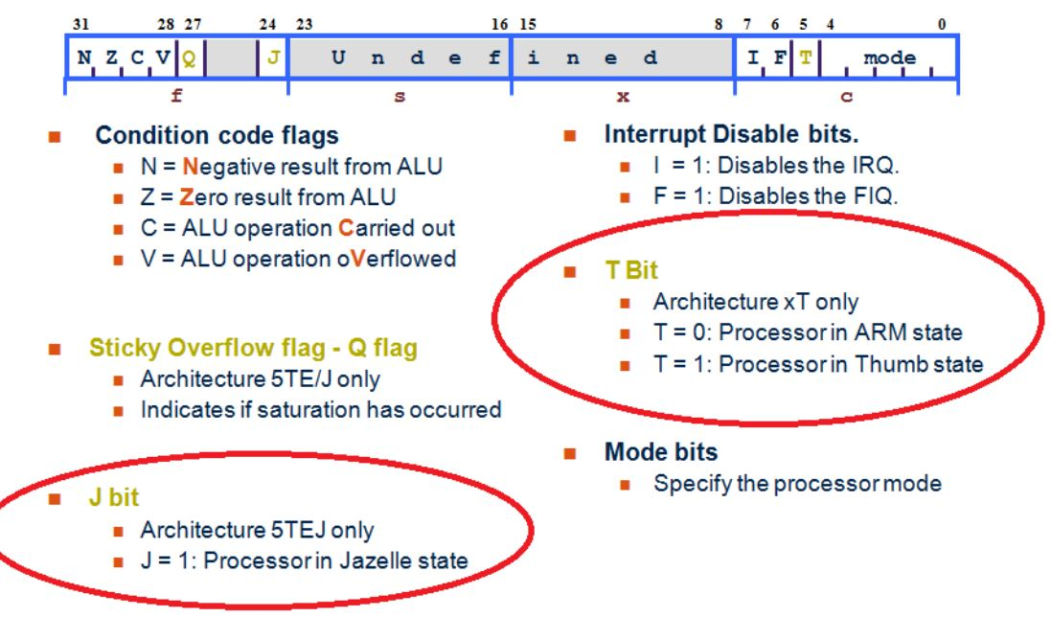
CPSR

Slide 10
1) direct interpretation
-> bytecode translated directly into machine code
-> pro: memory efficient
-> con: low performance
2) JIT (Just in time) compiler
-> compiled, profiled into most executed instructions -> translated
to native ARM code
-> con: compiler requires extra power, memory resources
slow start-up, application pauses due to profiling
3) AOT (Ahead of time) compiler
-> compiled while downloading/ installation
-> pro: performance
-> con: large memory requirement
4) Jazelle
-> combined Hardware/ Software solution interpreting bytecode
-> high quality, low memory + power consumption, fast application

Slide 11
JAA Architecture
Laying out the foundation

Slide 12
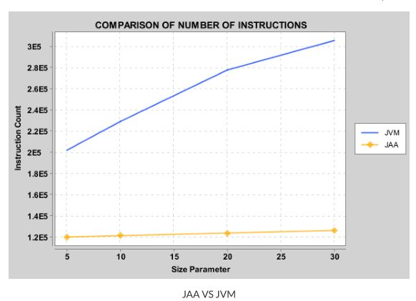
Head to Head

Slide 13
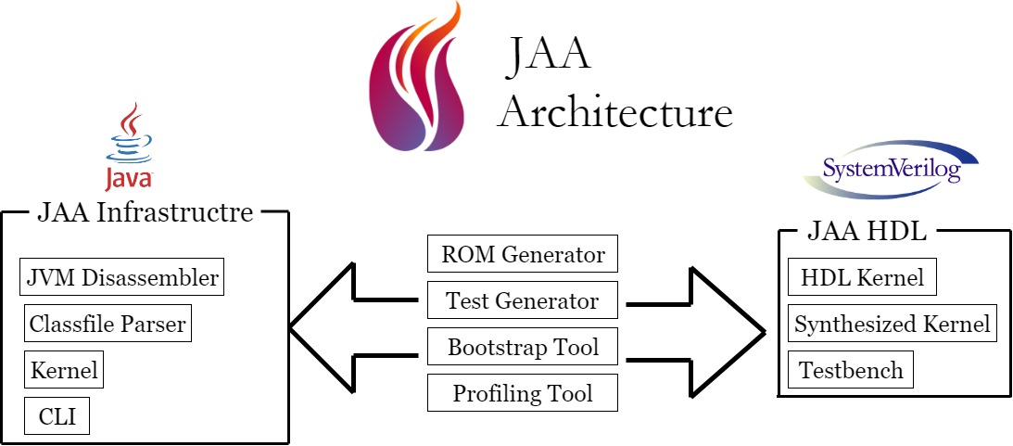

Slide 14
Key considerations
Extensible
Easily extensible with new features e.g. other assemblies, Graal VM, etc.
Tool oriented
Having all the tools we need to tweak and evaluate
Testability
Testable on Raspberry Pi, which can be easily extended to emulators

Slide 15
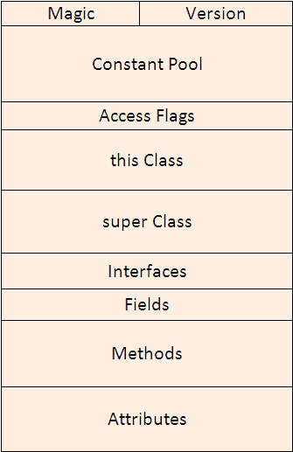
.class format
Very Complex
We do not need all of it
Apache BCEL (Byte Code Engineering Library) has toolset to work with JVM, but we developed our own tool

Slide 16
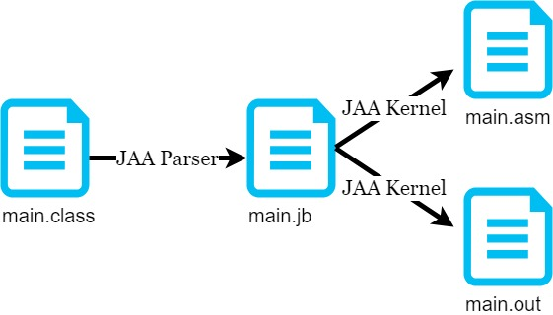
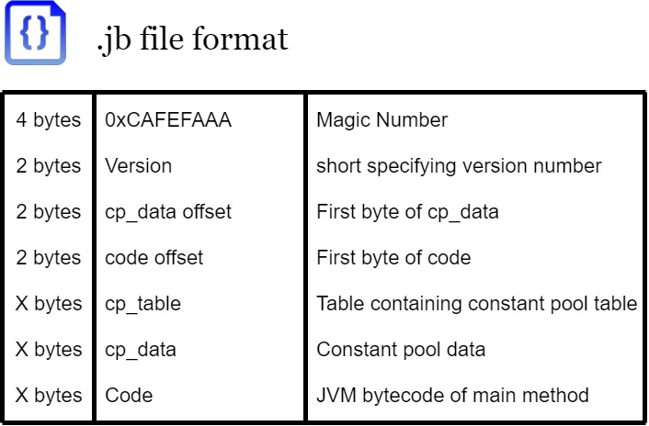

Slide 17

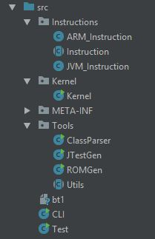
4000+ lines of code
Meticulous attention to detail
Model generator
‘-q’ switch

Slide 18
public void JB2ASM(String in,String out) throws Exception{ byte[] jb_file = readFile(in); int code_offset = ((jb_file[8]&0xFF)<<8) | (jb_file[9]&0xFF); byte[] code = new byte[jb_file.length-code_offset]; System.arraycopy(jb_file,10,code,0,jb_file.length-code_offset); input_bytes = new byte[code.length]; System.arraycopy(code,0,input_bytes,0,code.length); int i = 0; output = new ARM_Instruction[MAXINST]; // Bytecode translation for (input_cursor = 0; input_cursor < input_bytes.length; input_cursor++) { translateToARM(input_cursor); } writeOutputAsm(out_asm.getBytes(),out); }

Slide 19
public enum JVM_Mnemonic{iadd,iload,iload_0,iload_1,iload_2,iload_3,iconst_m1,iconst_0,iconst_1,iconst_2,iconst_3, iconst_4,iconst_5,istore,istore_0,istore_1,istore_2,istore_3,returnn,nop,swap,pop,pop2,isub,bipush}
dup 0x59:
pop {r0}
push {r0}
push {r1}
dup_x1 0x5a:
pop {r0,r1}
push {r1}
push {r0,r1}

Slide 20
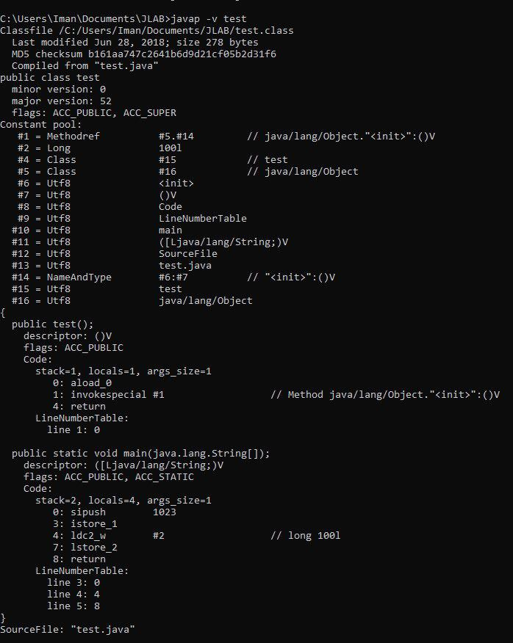
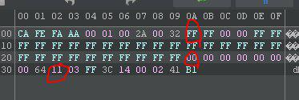

Slide 21
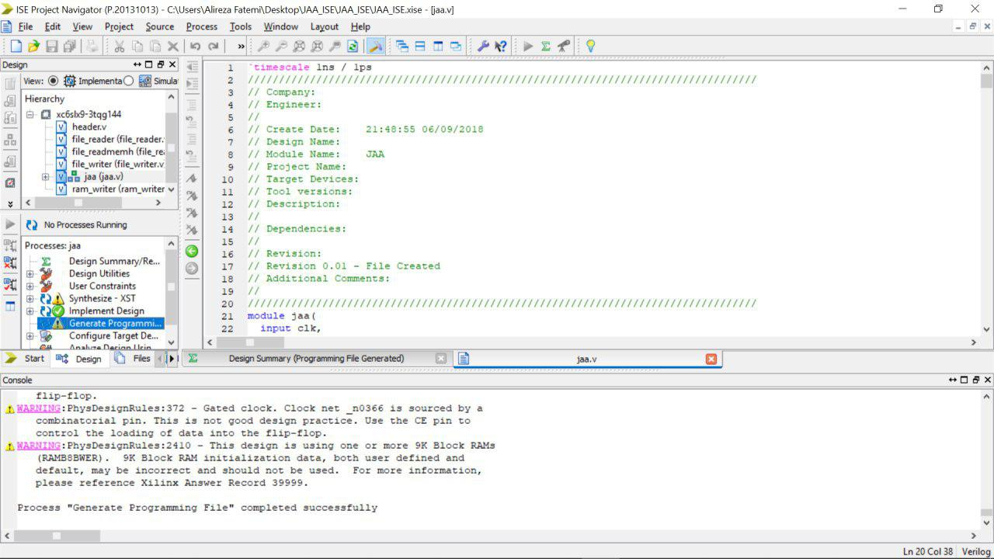
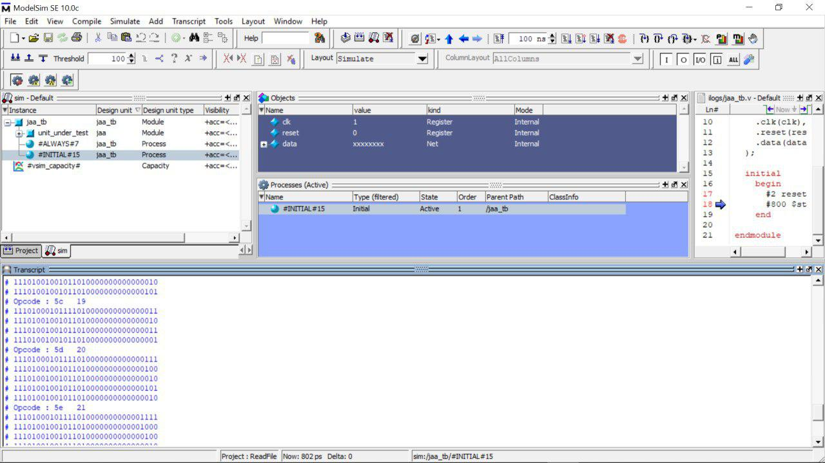
Synthesis and Verilog

Slide 22
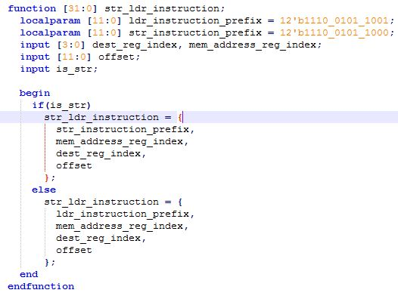
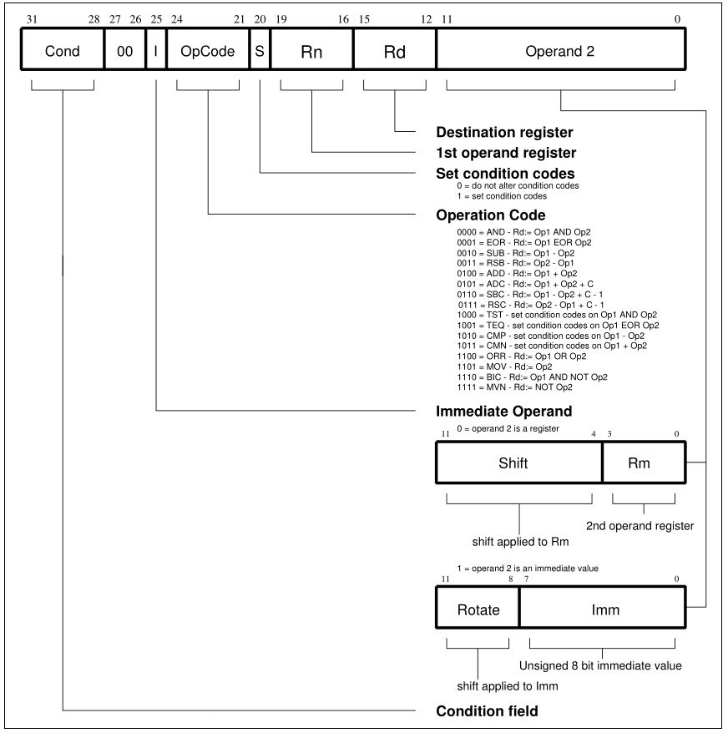

Slide 23

How to evaluate?

Slide 24
Thank you for your time!

