Slide 1


Mpi @ Home: solving laplace equation
Iman Hosseini
https://engineering.nyu.edu/student/iman-hosseini

Slide 2
MPI @ home
How can we get the “feel” of actually having multiple machines?
Docker!

Slide 3
Docker
Docker Engine hosts containers
Containers are lightweight, standalone environments
Containers come from immutable templates called images
A Dockerfile is like a recipe to create an image

Slide 4

MPI @ home
Docker configuration: 2 machines (can be extended to N)
They are connected via a bridged network
You can throttle each container with ‘cpus’ option
my_net
[bridged network]
S0
S1

Slide 5
Build image from Dockerfile
$docker build -t s0 .
This should point to dir where the Dockerfile exists
I’ve assumed you run this from that dir - so the dot
Spin up based on compose file
$docker compose up
You should run this from the dir where the compose file is

Slide 6
Why?
It’s fun
To learn MPI

Slide 7
PART I: The problem

Slide 8
Laplace equation
∇²f=0 Electromagnetism in the absence of charge (free space)
Also assuming no time-dependence: everything is static
Dirichlet boundary condition: some “boundary” in space is kept at a constant (wrt. time) voltage
For points r in that boundary, f(r) = h(r) where h(r) is a known function

Slide 9
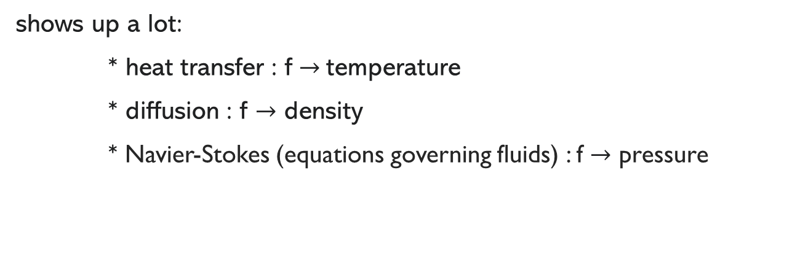
Laplace equation
∇²f=ρ
Nomenclature point:
the more general equation with a source on the RHS is called Poisson equation
The operator ∇² is called the Laplacian
∇²f
shows up a lot:
* heat transfer : f $→$temperature
* diffusion : f $→$ density
* Navier-Stokes (equations governing fluids) : f $→$ pressure

Slide 10
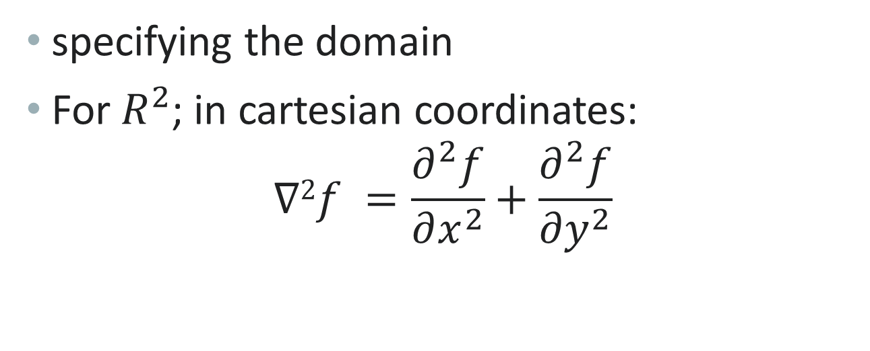
Laplace equation
specifying the domain
For $R^{2}$; in cartesian coordinates: $∇2f =\frac{∂^{2}f}{∂x^{2}}+\frac{∂^{2}f}{∂y^{2}}$

Slide 11
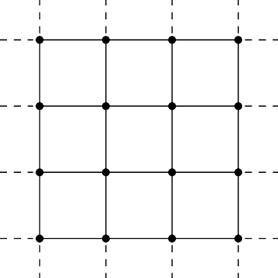
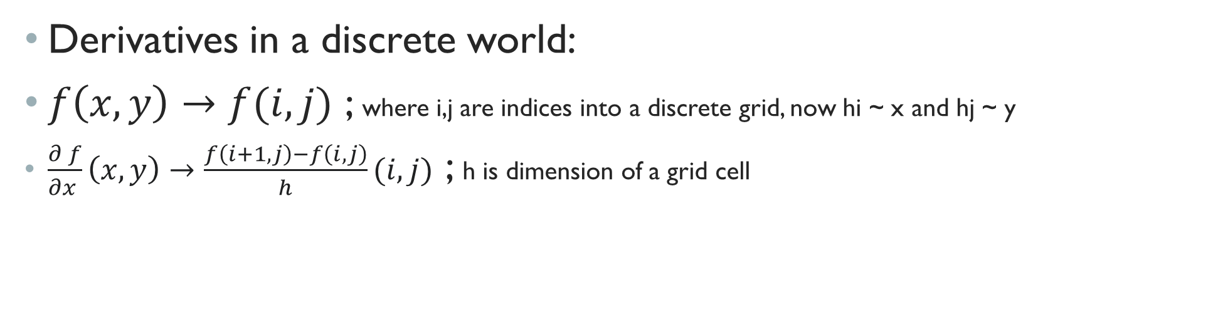
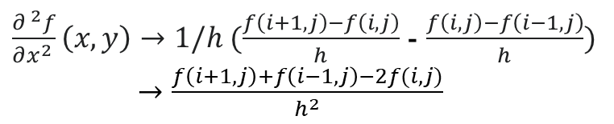

Derivatives in a discrete world:
$f\left(x,y\right)→f(i,j)$ ; where i,j are indices into a discrete grid, now hi ~ x and hj ~ y
$\frac{∂^{ }f}{∂x^{ }}\left(x,y\right)→\frac{f\left(i+1,j\right)−f\left(i,j\right)}{h}(i,j)$ ; h is dimension of a grid cell
$$\left(x,y\right)=\left(ih, jh\right)=\left(i,j\right)h$$
h
$\frac{∂^{ 2}f}{∂x^{2 }}\left(x,y\right)→1/h (\frac{f\left(i+1,j\right)−f\left(i,j\right)}{h}$ - $\frac{f\left(i,j\right)−f\left(i−1,j\right)}{h})$
$→\frac{f\left(i+1,j\right)+f\left(i−1,j\right)−2f(i,j)}{h^{2}}$

Slide 12
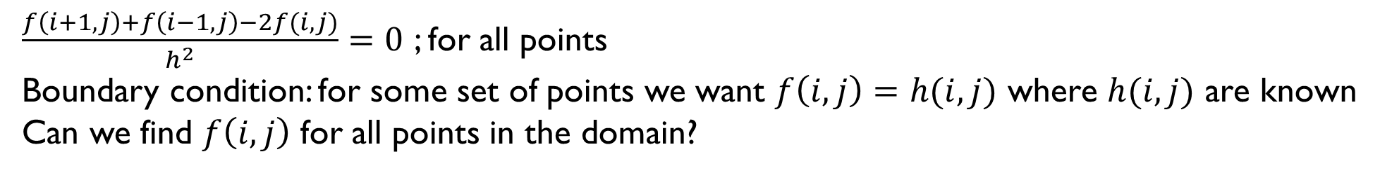
$\frac{f\left(i+1,j\right)+f\left(i−1,j\right)−2f(i,j)}{h^{2}}=0$ ; for all points
Boundary condition: for some set of points we want $f\left(i,j\right)=h(i,j)$ where $h(i,j)$ are known
Can we find $f\left(i,j\right)$ for all points in the domain?
$$boundary cond. :f=1.0 for the lines in red$$

Slide 13
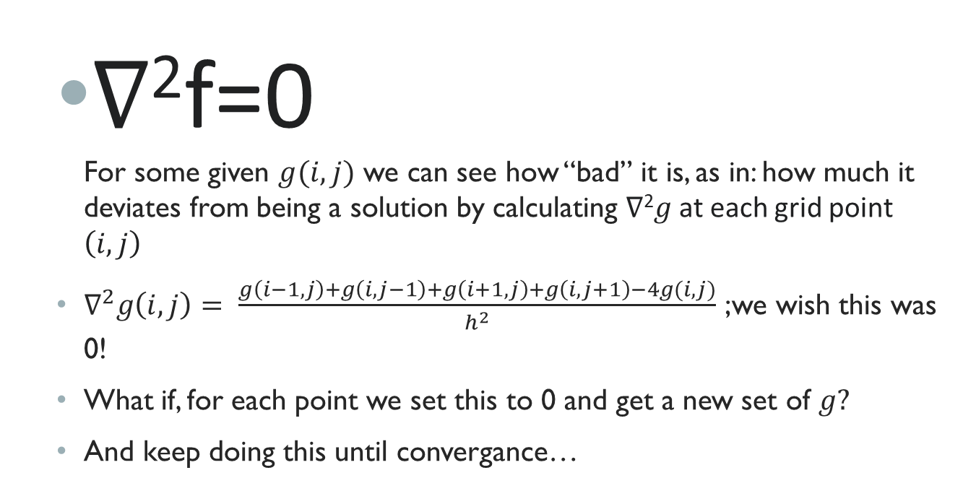
Laplace equation
∇²f=0 For some given $g(i,j)$ we can see how “bad” it is, as in: how much it deviates from being a solution by calculating ∇²$g$at each grid point $\left(i,j\right)$
$∇^{2}g\left(i,j\right)= \frac{g\left(i−1,j\right)+g\left(i,j−1\right)+g\left(i+1,j\right)+g\left(i,j+1\right)−4g(i,j)}{h^{2}}$ ;we wish this was 0!
What if, for each point we set this to 0 and get a new set of $g?$
And keep doing this until convergance…

Slide 14
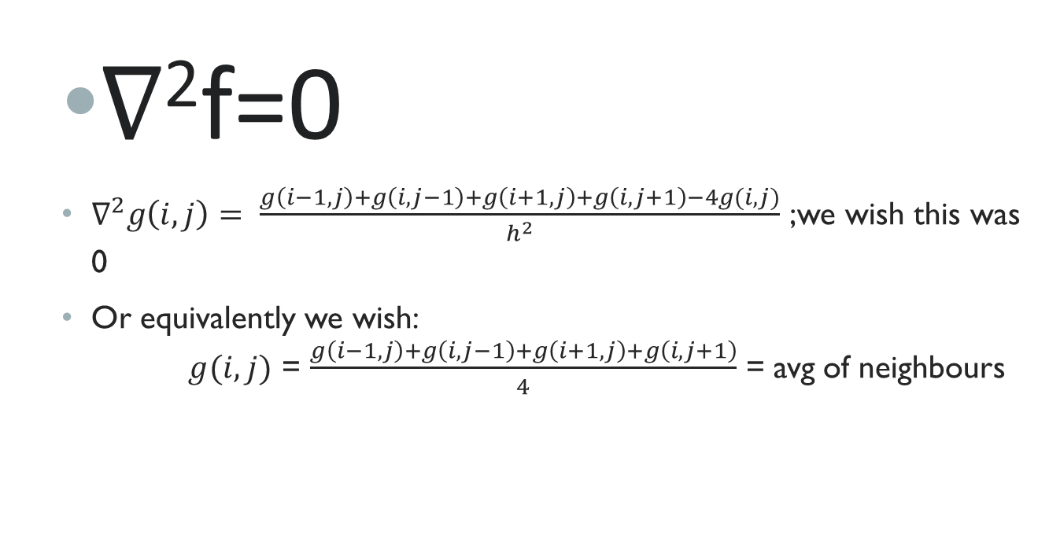
Laplace equation
∇²f=0
$∇^{2}g\left(i,j\right)= \frac{g\left(i−1,j\right)+g\left(i,j−1\right)+g\left(i+1,j\right)+g\left(i,j+1\right)−4g(i,j)}{h^{2}}$ ;we wish this was 0
Or equivalently we wish: $g(i,j)$ = $\frac{g\left(i−1,j\right)+g\left(i,j−1\right)+g\left(i+1,j\right)+g\left(i,j+1\right)}{4}$ = avg of neighbours

Slide 15
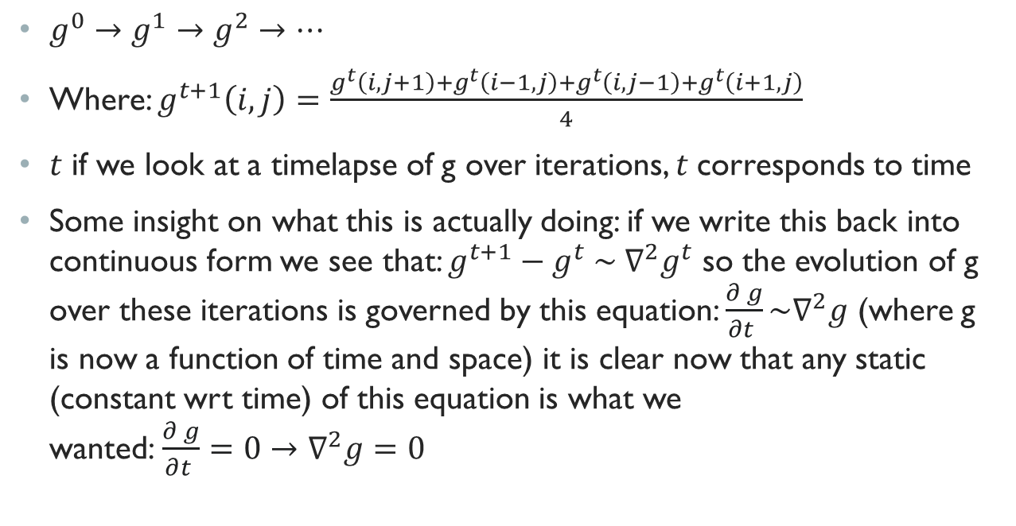
Laplace equation
$g^{0}→g^{1}→g^{2}→…$
Where: $g^{t+1}\left(i,j\right)=\frac{g^{t}\left(i,j+1\right)+g^{t}\left(i−1,j\right)+g^{t}\left(i,j−1\right)+g^{t}\left(i+1,j\right)}{4}$
$t$ if we look at a timelapse of g over iterations, $t$corresponds to time
Some insight on what this is actually doing: if we write this back into continuous form we see that: $g^{t+1}−g^{t} \sim ∇^{2}g^{t}$ so the evolution of g over these iterations is governed by this equation: ${\frac{∂^{ }g}{∂t^{ }}\sim ∇}^{2}g$ (where g is now a function of time and space) it is clear now that any static (constant wrt time) of this equation is what we wanted:${ \frac{∂^{ }g}{∂t^{ }}=0→∇}^{2}g=0$

Slide 16
PART II: The Solution

Slide 17
MPI has ENTERED THE Chat…
If problem size is too large it might not fit on a single machine
To solve a problem faster: chop it up into smaller parts (that can run in parallel)
The more parts -> the faster you get
It’s not overhead-free though: communication/ synchronization/ etc.
It used to be the case that a faster single-core processor would show up, until it didn’t: Power Wall ™ !
Now we get newer processors with more cores, GPUs with more cores etc.
MPI – Message Passing Interface: standardized way to well, as the name says: pass messages ☺ (between cores/ computers)

Slide 18
MPI has ENTERED THE Chat…
High-Level steps:
Initialize array(s)
Make sure every ‘rank’ has the data it requires
Compute / synchronize as required
Finalize (Make sure ‘main’ rank has _all_ the data)

Slide 19


Result
INITIAL CONDITION
RESULT

Slide 20
MPI has ENTERED THE Chat…
High-Level steps:
Initialize array(s)
Make sure every ‘rank’ has the data it requires
Compute / synchronize as required
Finalize (Make sure ‘main’ rank has _all_ the data)
What to do at the boundary?

Slide 21
MPI has ENTERED THE Chat…
RANK 0
Zoom in
They depend on the other side
-> each rank needs that layer before computation
-> share that before every step
RANK 1

Slide 22
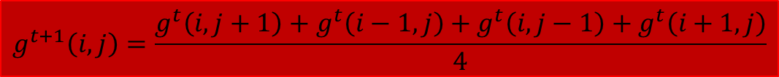
Let’s look @ the code
Main part
$$g^{t+1}\left(i,j\right)=\frac{g^{t}\left(i,j+1\right)+g^{t}\left(i−1,j\right)+g^{t}\left(i,j−1\right)+g^{t}\left(i+1,j\right)}{4}$$
void step(const float* phi, int nx, int ny, float * phi_new){
for(int xi = 1; xi < nx-1; xi++){
for(int yi = 1; yi < ny-1; yi++){
int idx = xy2fid(xi, yi);
int iw = xy2fid(xi-1, yi);
int ie = xy2fid(xi+1, yi);
int is = xy2fid(xi, yi+1);
int in = xy2fid(xi, yi-1);
phi_new[idx] = 0.25f*(phi[iw] + phi[ie] + phi[in] + phi[is]);
}
}
// apply boundary condition
constraint(phi_new);
}

Slide 23
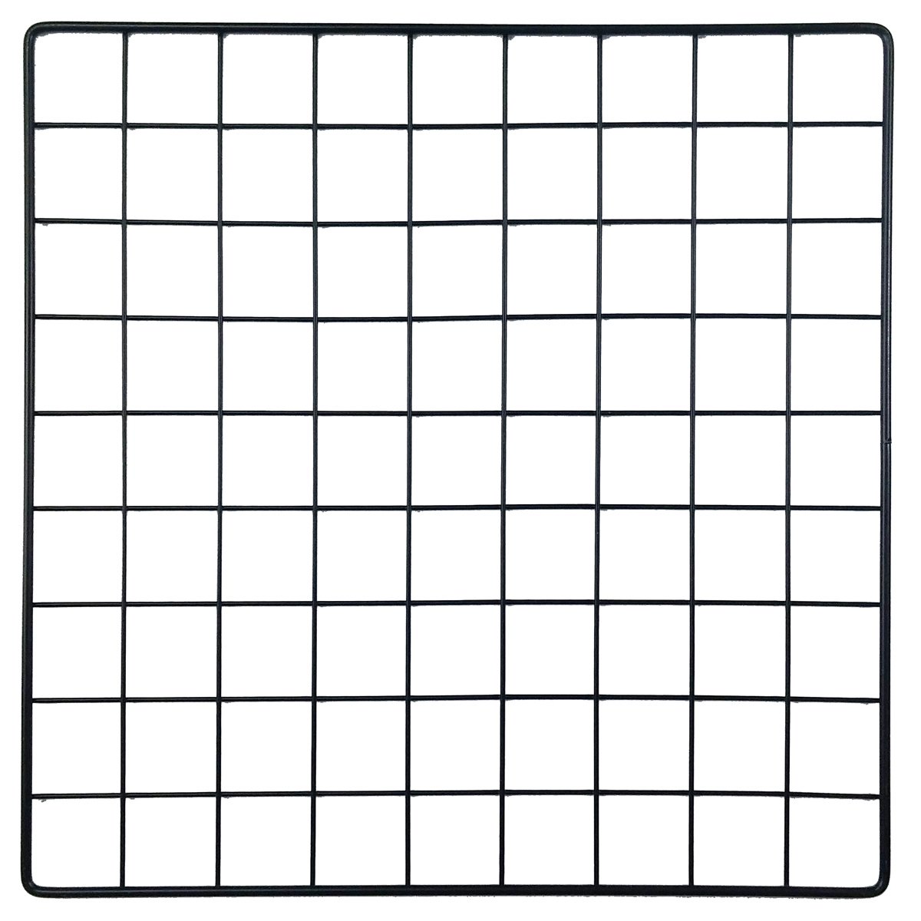
Let’s look @ the code
Index conversions
HW-1
// convert flat id to xi, yi & vice-versa
void fid2xy(int idx, int& xi, int& yi){
yi = idx / W;
xi = idx % W;
}
void xy2fid(int xi, int yi, int& idx){
idx = yi * W + xi;
}
2W
…
W
w+1
…
0
1
2
…
W-1

Slide 24
Let’s look @ the code
Halo sync
void halosync(){
MPI_Status status;
if(rank == 0){
MPI_Send(phi + K*W, W, MPI_FLOAT, 1, 0, MPI_COMM_WORLD);
MPI_Recv(phi + K*W + W, W, MPI_FLOAT, 1, 0, MPI_COMM_WORLD, &status);
}
if(rank == 1){
MPI_Recv(phi, W, MPI_FLOAT, 0, 0, MPI_COMM_WORLD, &status);
MPI_Send(phi + W, W, MPI_FLOAT, 0, 0, MPI_COMM_WORLD);
}
}

Slide 25
Let’s look @ the code
Halo sync
W = 3, H = 2
φ₀
φ₁
φ₂
φ₃
φ₄
φ₅
float* phi

Slide 26
Let’s look @ the code
Halo sync
W = 3, H = 2
φ₀
φ₁
φ₂
φ₃
φ₄
φ₅

Slide 27
TroubleShooting/DEBUG tips
Can you ssh to other machines?
- use ‘-v’ flag to get verbose info from ssh
‘mpirun –mca plm_base_verbose 10’ -> you can see the exact ssh command being executed by MPI and more verbose output
MPI needs ssh AND more
It will open tcp connections at ports other than SSH’s 22
Compile with –g and use gdb:
mpirun -n 2 xterm -hold -e gdb -ex run --args ./poisson_1
You can see source line number where error occurs
If you are on Windows checkout WSL: https://learn.microsoft.com/en-us/windows/wsl/install

