Slide 1

Unity For Academia
C# Data Structures & Functions
Spring 2025 – Week 2
Iman Noferesti

Slide 2
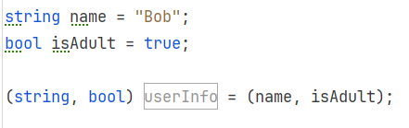
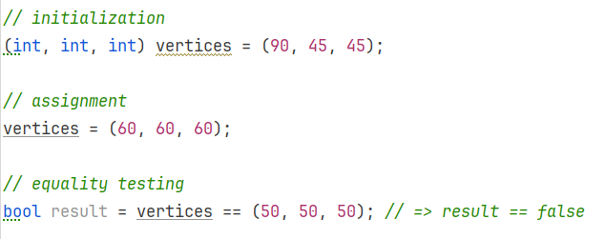
Tuples
A tuple is typically created by placing 2 or more expressions separated by commas, within a set of parentheses.
A tuple, like any other expression, can be used in various ways: for assignments, initializing fields or variables, returning values from methods, and passing as parameters. Tuples can also be tested for equality.

Slide 3
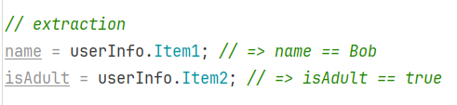
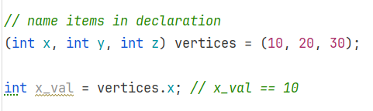
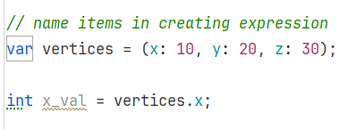
Fields are extracted using dot (.) syntax.
By default, the first field is Item1, the second Item2, etc.
Naming
Field names Item1 etc. don’t make for a readable code. There are 2 ways provide names to the fields:
In the type declaration
In the expression that creates it

Slide 4
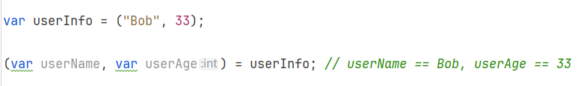
Deconstruction
Sometimes it is convenient to take a tuple and assign the fields to multiple variables and initialize them if appropriate.

Slide 5
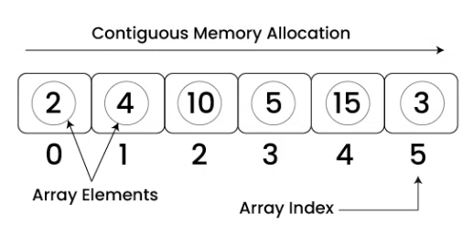
Arrays
An array is a fixed-size, strongly typed collection of elements of the same data type.
Arrays are zero-based, meaning the first element is at index 0.
They are part of the System namespace and are instances of the System.Array class.
Properties and Methods
Property / Method | Description
Length | Returns the total number of elements in the array
Clear(array, start, count) | Sets a range of elements in the array to their default values (null, 0, false, etc.).
Copy(source, dest, length) | Copies elements from one array to another. Both arrays must have compatible types.
CopyTo(destArray, index) | Copies the entire array to another array starting at a specified index.
Exists(array, predicate) | Checks if any element in the array satisfies the given condition (predicate).
Sort(array) | Sorts the array in ascending order.

Slide 6
Property / Method | Description
Find(array, predicate) | Returns the first element that matches a given condition.
FindAll(array, predicate) | Returns all elements that match a given condition as a new array.
FindIndex(array, predicate) | Returns the index of the first element that matches a given condition.
IndexOf(array, value) | Returns the first index of a specified value (or -1 if not found).
TrueForAll(array, predicate) | Returns true if all elements satisfy a given condition.

Slide 7
List<T>
A List represents a dynamically-sized array, allowing you to store objects of a specific type.
Unlike arrays, lists in can grow or shrink in size as elements are added or removed, making them more flexible than static arrays.
Properties and Methods
Property / Method | Description
Capacity | Capacity refers to the number of elements the list can hold before resizing.
Count | Count is the actual number of elements currently stored.
Contains | Checks if an element is present in the list.
Add() | Adds an item to the end of the list.
AddRange() | Adds multiple elements to the end of the list.
Clear() | Removes all elements from the list, making it empty.
Remove() | Removes the first occurrence of a specified element.

Slide 8
Property / Method | Description
RemoveAt() | Removes an element at a specific index.
RemoveAll() | Removes all elements that match a condition.
Insert() | Inserts an element at a specific index in the list.
InsertRange() | Inserts a collection of elements at a specific index.
CopyTo() | Copies the elements of the list to an array.
Exists() | Checks if any element in the list satisfies a condition.
Remove() | Removes the first occurrence of a specified element.
Find() | Finds the first element matching a condition.
FindAll() | Finds all elements that match a condition and returns them in a new list.
FindIndex() | Finds the index of the first element matching a condition.
IndexOf() | Finds the index of the first occurrence of a specified element.
Sort() | Sorts the elements in ascending order.
ToArray() | Converts the list into an array.

Slide 9
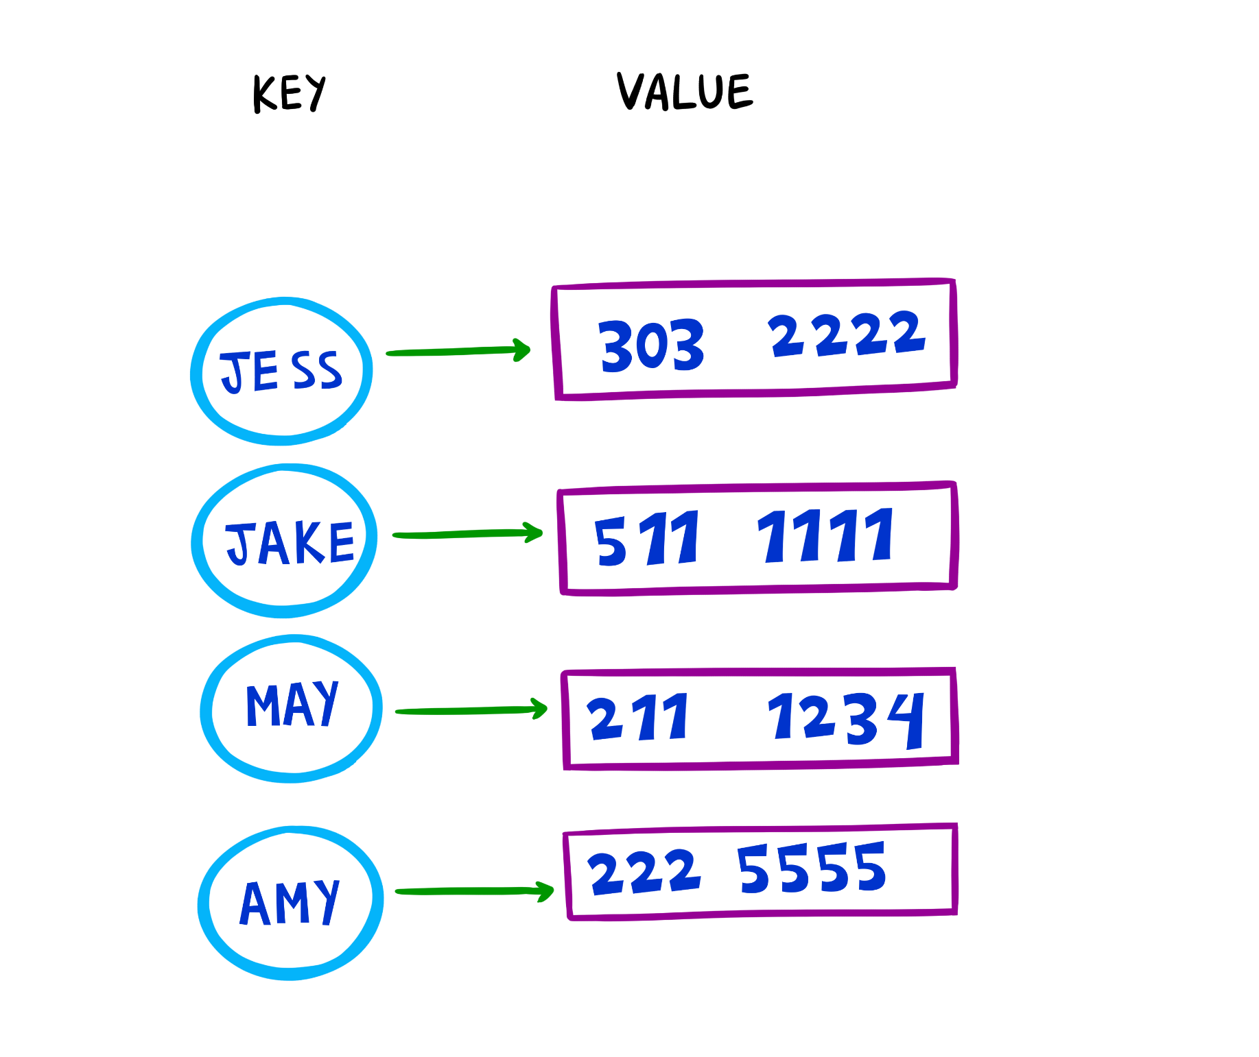
Dictionary<TKey, TValue>
A Dictionary is a collection that stores key-value pairs, providing fast lookups, additions, and removals based on keys.
Each key in a Dictionary must be unique.
Values are accessed efficiently using their associated keys.
The dictionary resizes itself as elements are added.
Properties and Methods
Property / Method | Description
Count | Returns the number of key-value pairs in the dictionary.
Keys | Returns a collection containing all the keys in the dictionary.
Values | Returns a collection containing all the values in the dictionary.
Add(TKey key, TValue value) | Adds a key-value pair to the dictionary; throws an exception if the key already exists.
Clear() | Removes all key-value pairs from the dictionary.
ContainsKey(TKey key) | Checks if the specified key exists in the dictionary.
ContainsValue(TValue value) | Checks if the specified value exists in the dictionary.
Remove(TKey key) | Removes the key-value pair associated with the given key; returns true if successful, and false if the key is not found.

Slide 10
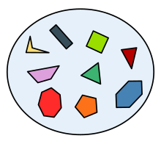
HashSet<T>
A HashSet is a collection that stores unique elements, meaning it does not allow duplicate values.
It does not guarantee any specific order of elements.
Supports mathematical set operations such as:
UnionWith(): Combines two sets, removing duplicates.
IntersectWith(): Keeps only elements that exist in both sets.
ExceptWith(): Removes elements present in another set.
SymmetricExceptWith(): Keeps elements that are unique between two sets.
Properties and Methods
Property / Method | Description
Count | Returns the number of elements in the HashSet.
Add() | Adds an element to the HashSet.
Clear() | Removes all elements from the HashSet.
Contains() | Checks if a specific element exists in the HashSet.
CopyTo(array) | Copies all elements of the HashSet into a specified array.
Remove() | Removes a specific element from the HashSet.

Slide 11
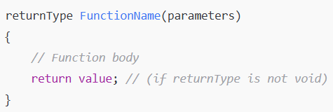
Functions
Sometimes, you want to perform the same task multiple times in a program.
If you find yourself writing the same statements over and over again, you can turn those statements into a function.
Functions help organize code, improve reusability, and make debugging easier.
Defining a Function
Calling a Function
To use a function, call it by its name and provide required parameters
Function Types
Void functions (no return values)
Functions with return values
Functions optional parameters

