Slide 1

Unity For Academia
Sounds & Animations
Spring 2025 – Week 7
Iman Noferesti

Slide 2
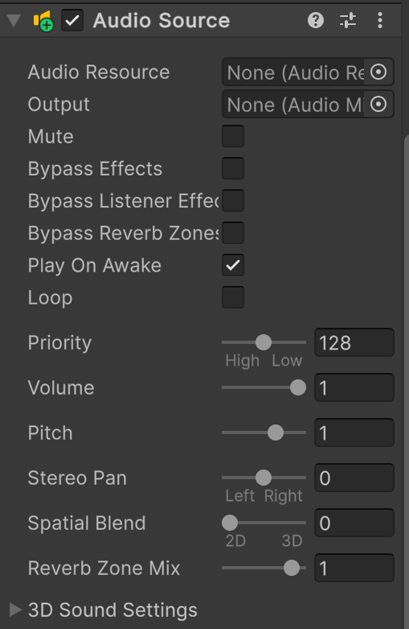
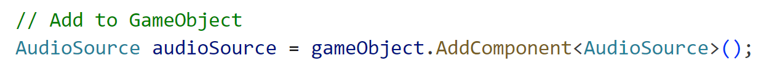
Unity Audio System
Unity has a strong sound system that helps developers add music, voiceovers, and sound effects to their games and apps. The main parts of this system are AudioSource, AudioClip, and AudioListener, which work together to create a good listening experience.
1. AudioSource
It is a part of Unity that plays a sound clip in the game or app scene.
Properties | Description
clip | The audio file to play (AudioClip)
loop | Whether to loop the clip (bool)
playOnAwake | Whether to play automatically when the scene starts (bool)
volume | Volume level (0.0 to 1.0)
pitch | Playback speed (-3.0 to 3.0)
mute | Whether the audio is muted (bool)

Slide 3
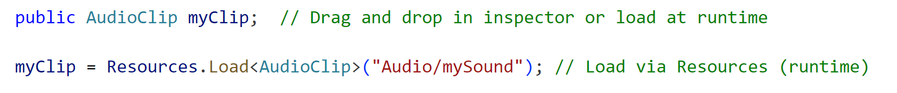
Unity Audio System
Methods | Description
Play() | Start playback
Stop() | Stop playback
Pause() | Pause playback
UnPause() | UnPause playback
PlayOneShot() | Play a sound without interrupting
2. AudioClip
It is a sound file that holds the real audio data used in a game or app.
3. AudioListener
It is the spot where sounds are heard in a game, usually on the main camera.
Only one AudioListener should be active at a time.

Slide 4
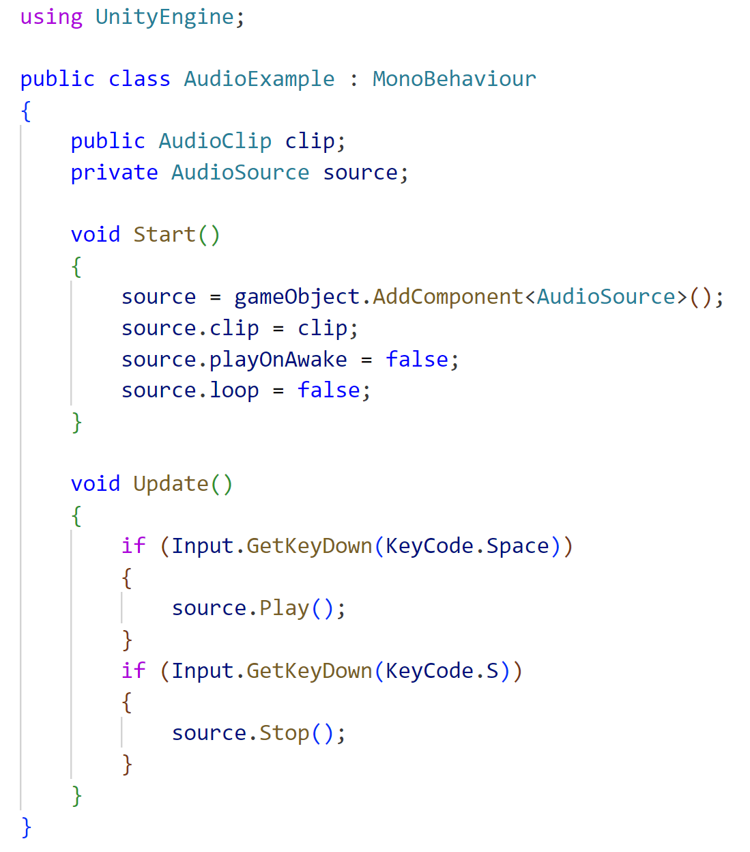
Sample Script Example

Slide 5
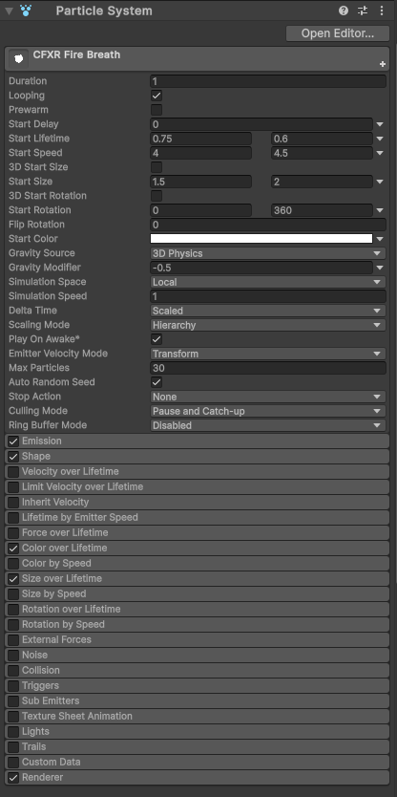
Unity Particle Systems
Particle Systems are used to create complex visual effects like fire, smoke, sparks, snow, and magic effects. They work by generating and controlling a large number of small particles over time.
Properties | Description
emission | Controls the rate and burst of particles.
main | Manages core properties like lifetime, speed, size, color, and gravity.
Methods | Description
Play() | Starts the particle system.
Stop() | Stops the particle system.
Pause() | Pauses the particle system without clearing it.
Clear() | Clears all active particles.

Slide 6
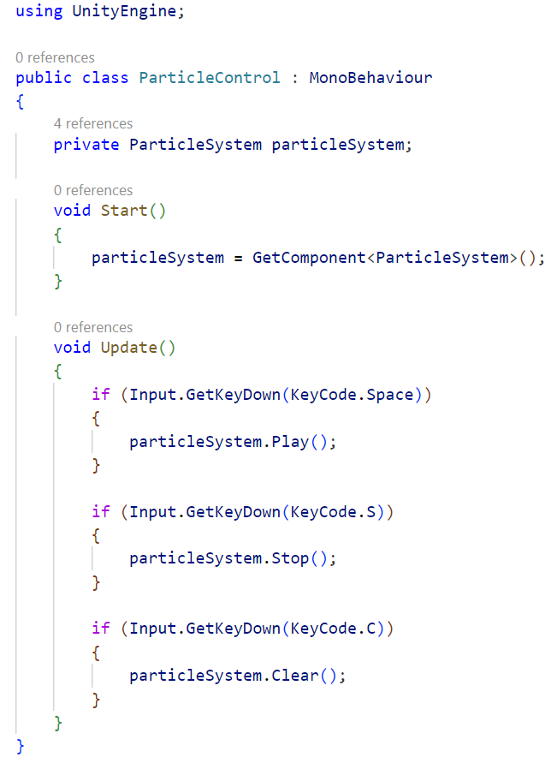
Sample Script Example

Slide 7
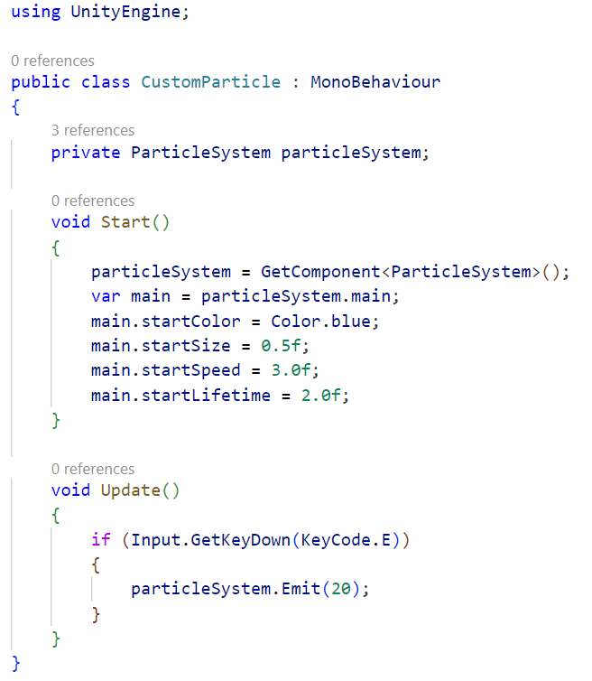
Sample Script Example

Slide 8
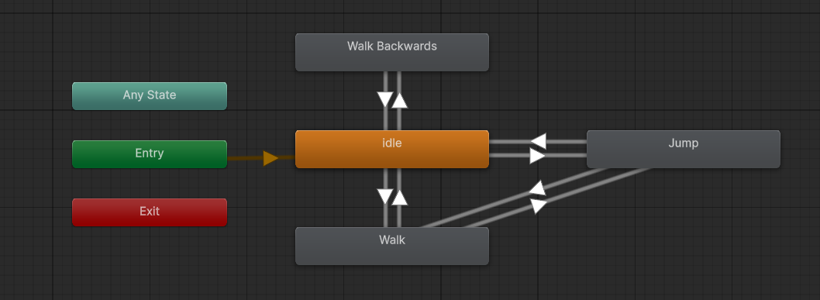
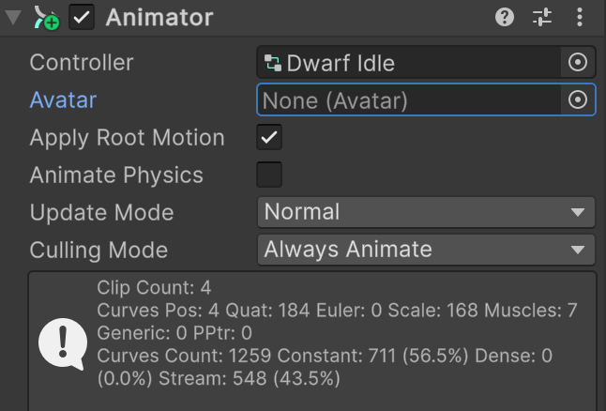
Unity Animation
The Animator in Unity works with the Animator Controller to control how a character or object moves. It defines different actions like
States (e.g., idle, walk, jump)
Transitions between states
Conditions (based on parameters)
Properties | Description
applyRootMotion | Applies movement from animation to GameObject.
speed | Multiplies playback speed
Methods | Description
SetTrigger(string name) | Fires a trigger parameter to cause a transition.
ResetTrigger(string name) | Resets a trigger.
SetBool(string name, bool value) | Sets a boolean parameter
SetFloat(string name, float value) | Sets a float parameter
SetInteger(string name, int value) | Sets an integer parameter
GetBool, GetFloat, GetInteger | Gets parameter values
Play(string stateName) | Plays a specific state

Slide 9
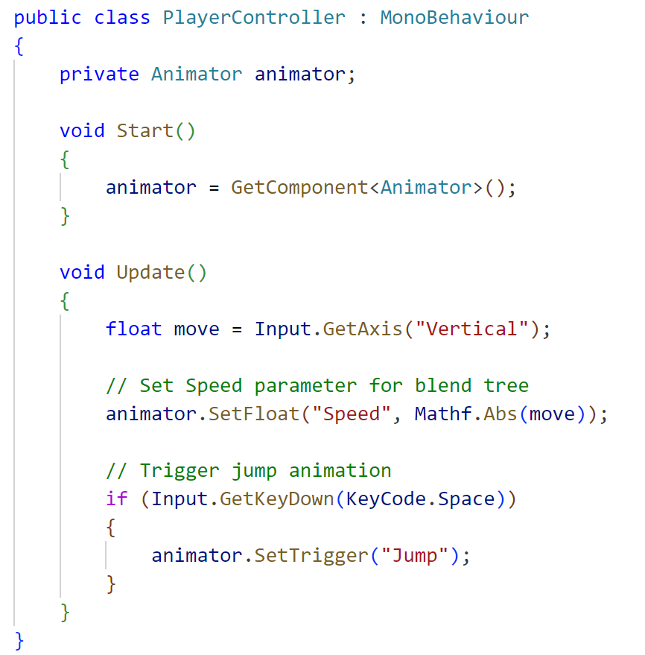
Sample Script Example

