Slide 1

Unity For Academia
C# Classes
Spring 2025 – Week 3 & 4
Iman Noferesti

Slide 2
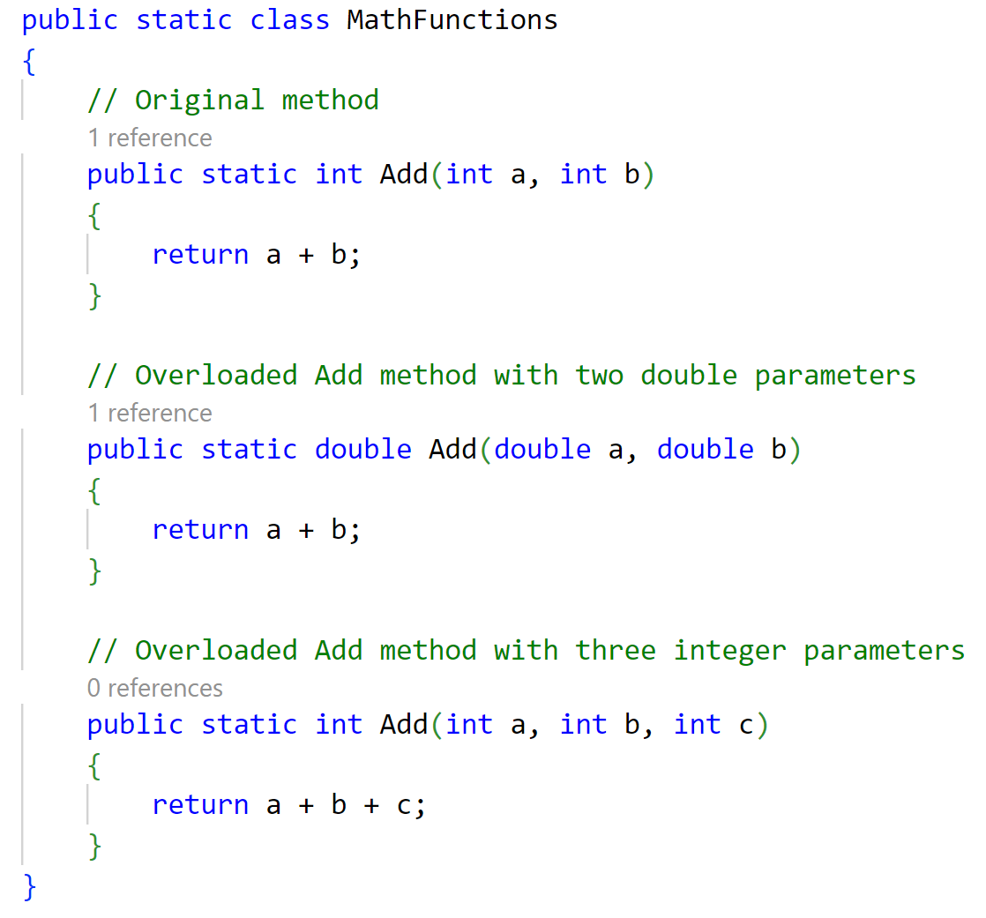
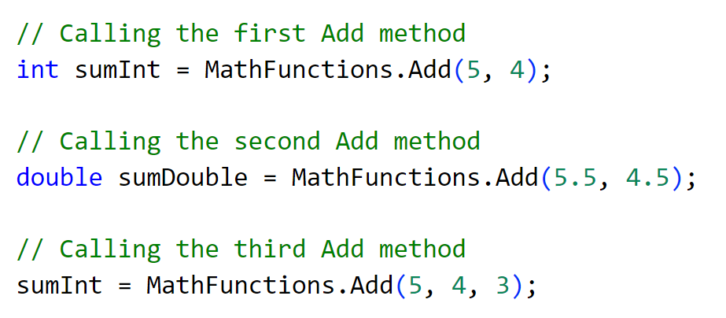
Method Overloading
Method overloading allows you to define multiple methods in the same class with the same name but different parameters.
The key differences between these methods can be in the number of parameters, the types of parameters, or both.
You cannot overload methods only by return type. The method signatures must differ in the number or types of parameters.

Slide 3
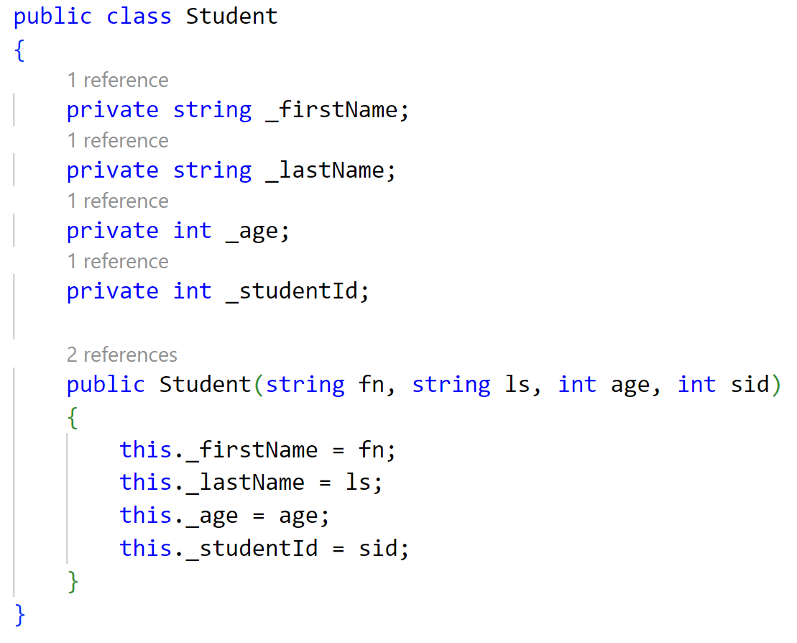
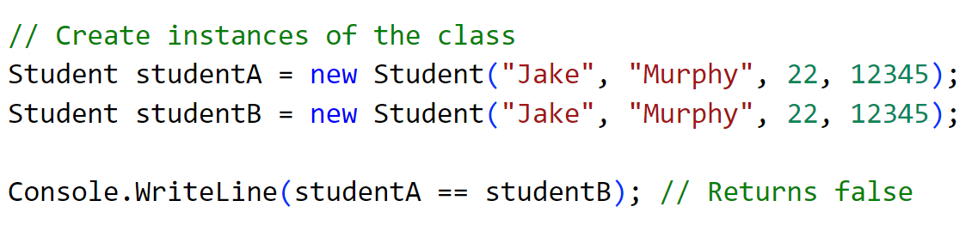
Operator Overloading
Operator overloading allows you to define custom implementations for standard operators (such as +, -, *, /, etc.) for your own custom classes and structs.
This means you can make operators behave in a way that is intuitive for the types you create.
Common operators that can be overloaded include:
+, -, *, /, %, ==, !=, >, <, >=, <=, ++, --

Slide 4
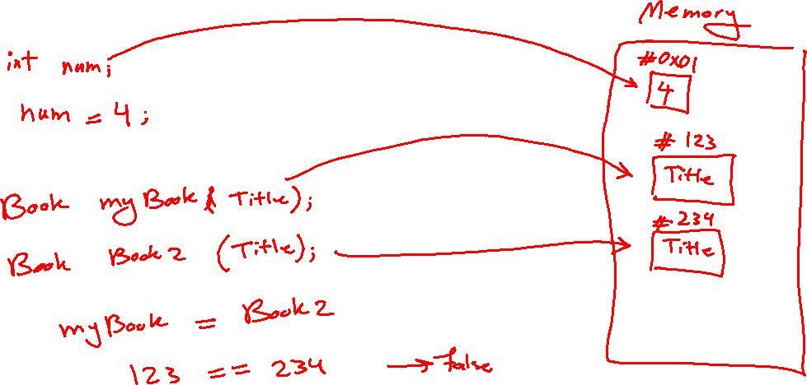

Slide 5
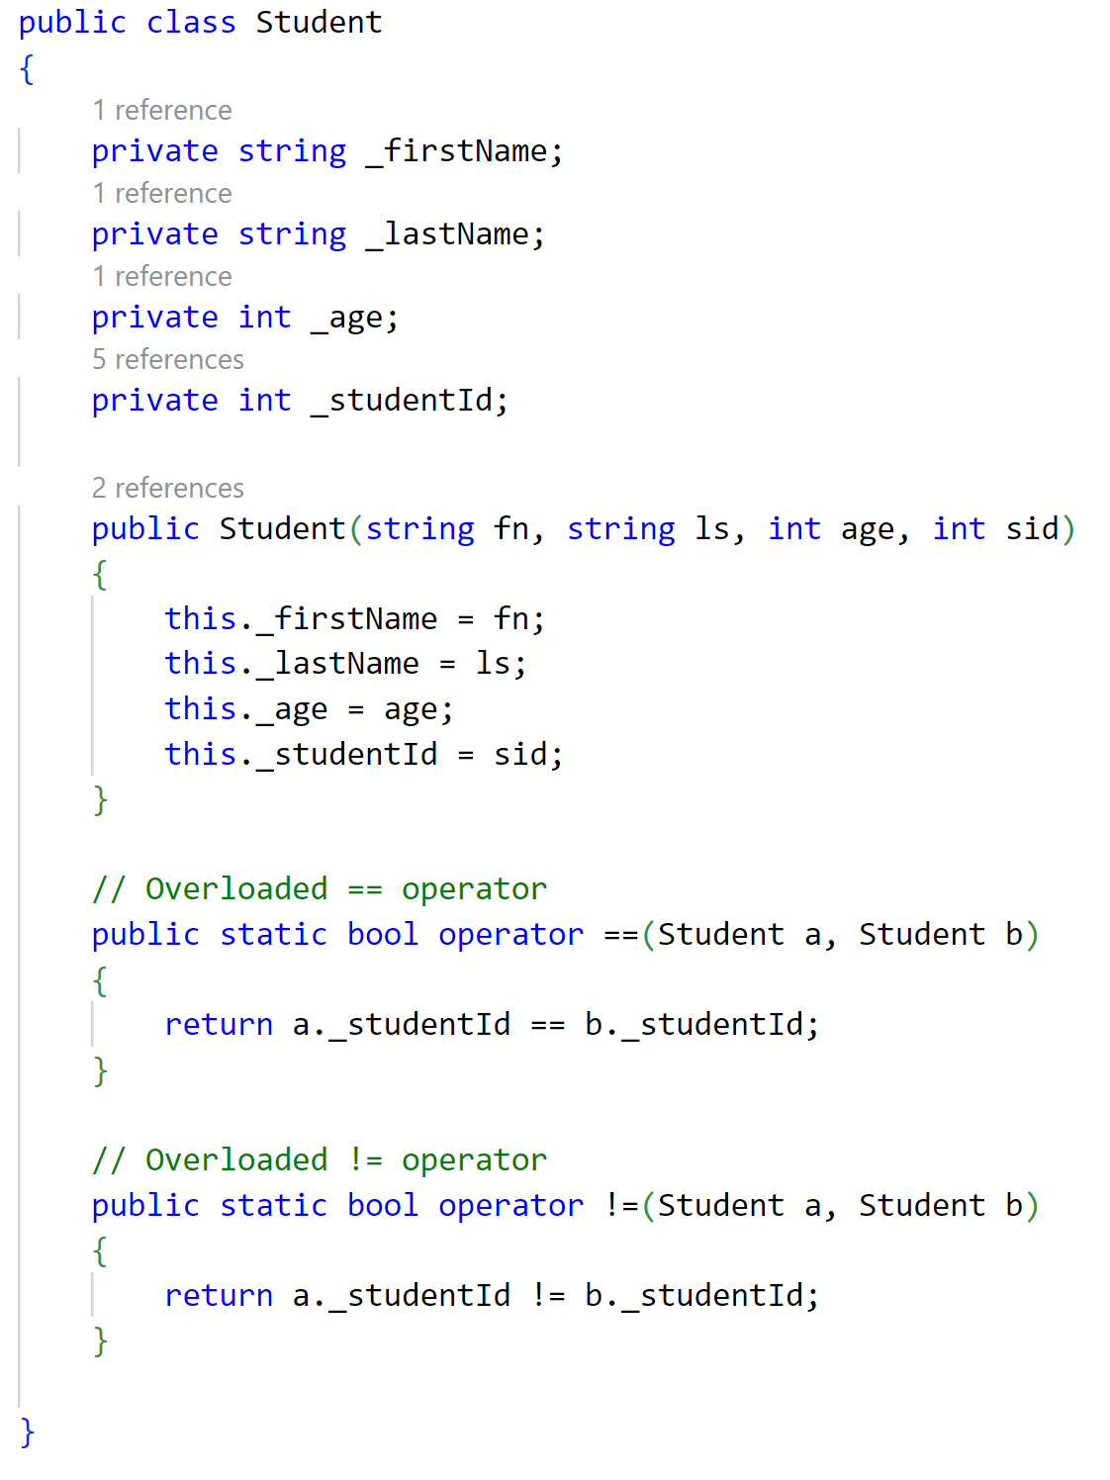
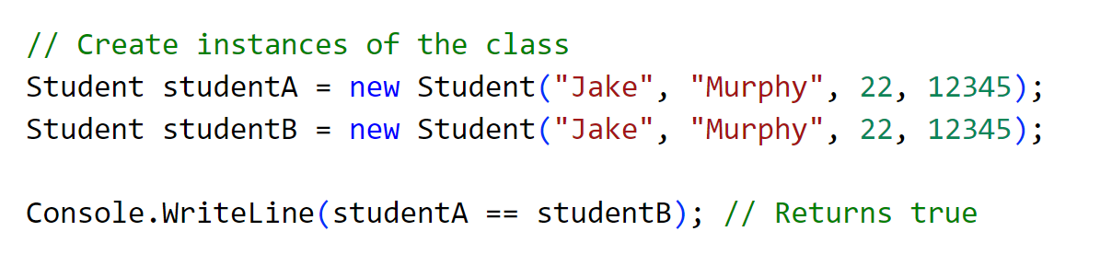

Slide 6
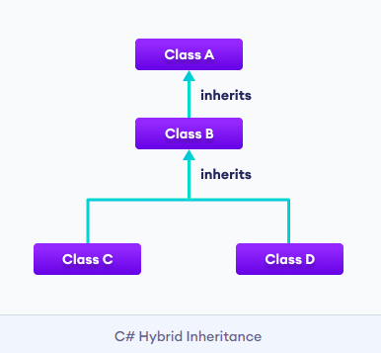
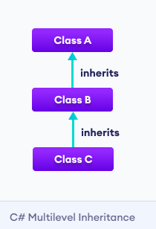
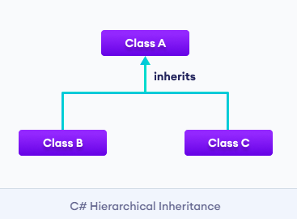
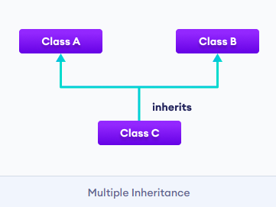
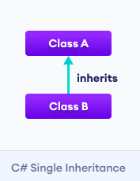
Inheritance
Inheritance allows a class (child/derived class) to inherit properties and methods from another class (parent/base class).
Inheritance is an is-a relationship. We use inheritance only if there is an is-a relationship between two classes.
Apple is a Fruit
Car is a Vehicle
Types of inheritance in C#
C# doesn't support multiple inheritance.
(can achieve through interfaces)

Slide 7
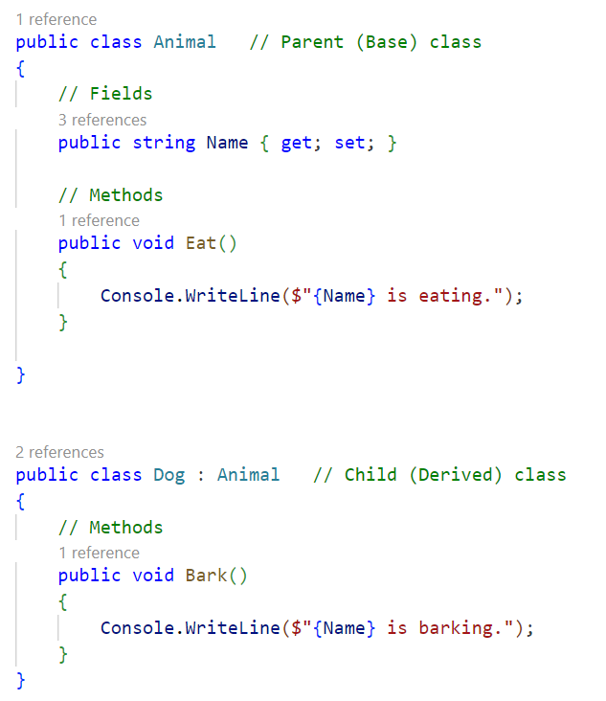
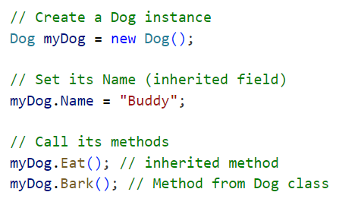

Slide 8
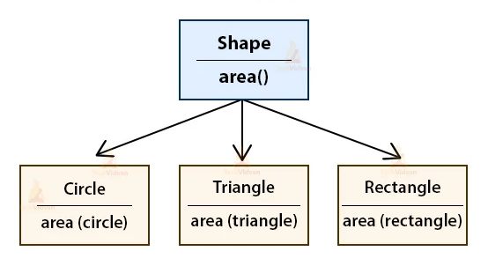
Polymorphism (Method Overriding)
Polymorphism allows a derived class to override a method in the base class to provide a new behavior.
virtual keyword in the base class allows method overriding.
override keyword in the derived class provides a new implementation.

Slide 9
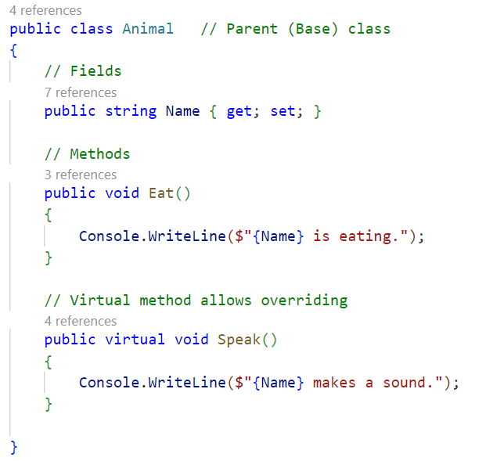
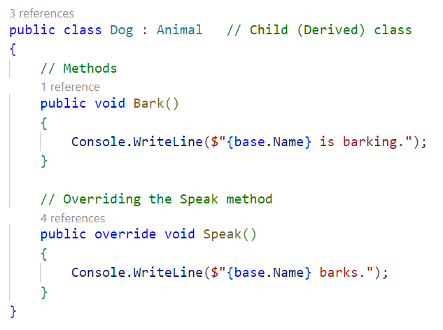
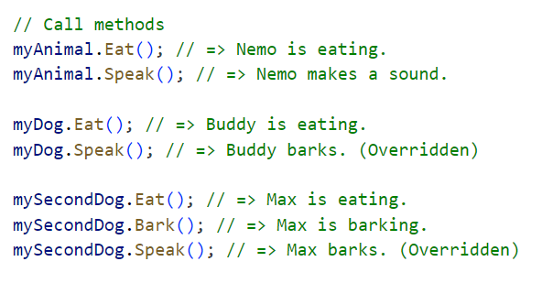
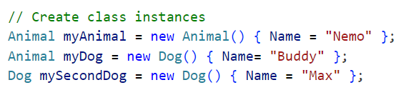

Slide 10
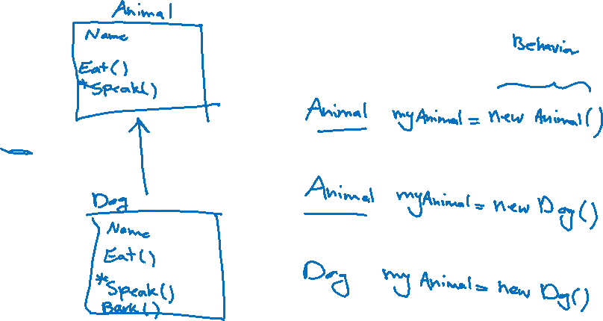

Slide 11
Abstraction
Data abstraction means keeping the complicated parts hidden and only showing the important bits that people need to use.
Abstraction can be achieved with either abstract classes or interfaces.
The abstract keyword is used for classes and methods:
Abstract class: is a special kind of class that you can't use to make objects directly.
Instead, you need to create a subclass that inherits from the abstract class to use it.
Abstract method: is a special method that can only exist within an abstract class.
It doesn't have any code inside it; the actual code (or "body") for the method is provided by a subclass that inherits from the abstract class.
An abstract class can have both abstract and regular methods.
Why And When To Use Abstract Classes and Methods?
To achieve security. We hide certain details and only show the important details of an object.

Slide 12
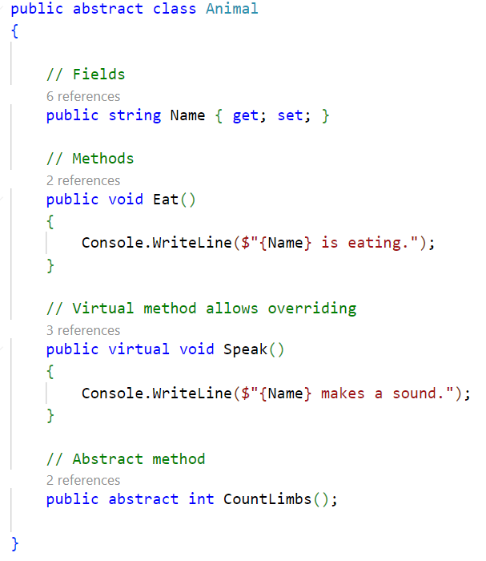
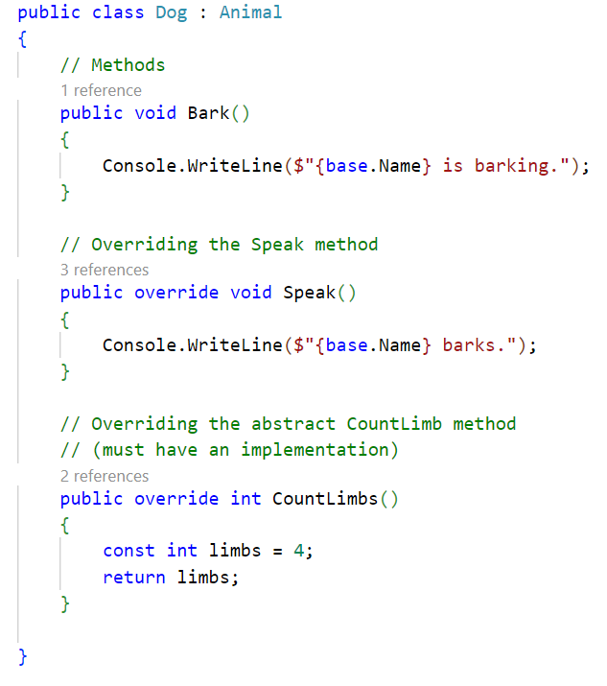
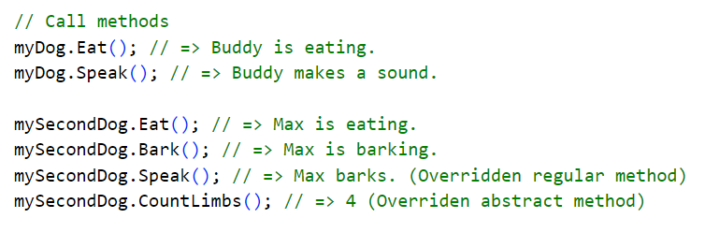


Slide 13
Interface
Another way to achieve abstraction is with interfaces.
An interface is like a fully abstract class.
It can only have methods without any actual code inside them. (No fields / variables)
The real code for these methods and properties is provided by the classes that use the interface.
It is considered good practice to start with the letter "I" at the beginning of an interface, as it makes it easier for yourself and others to remember that it is an interface and not a class.
By default, members of an interface are abstract and public.
On implementation of an interface, you must override all of its methods.
An interface cannot contain a constructor (as it cannot be used to create objects).
Why And When To Use Interfaces?
To achieve security. We can hide certain details and only show the important details of an object.
To have "multiple inheritance“.

Slide 14
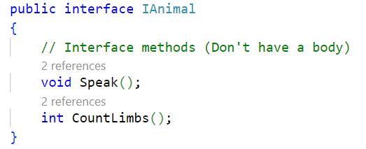
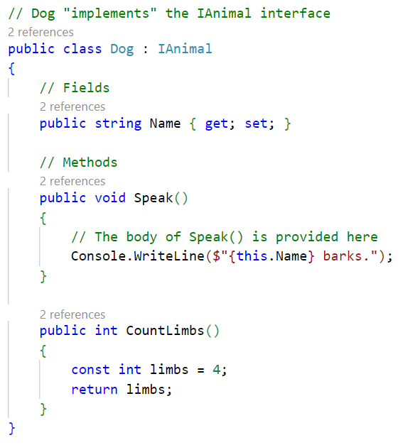
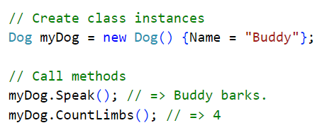

Slide 15
Abstract Class vs. Interface
Feature | Abstract Class | Interface
Fields Allowed? | Yes | No
Constructor? | Yes | No
Method Implementation? | Yes | No
Multiple Inheritance? | No | Yes
Access Modifiers? | Yes (private, protected, etc.) | No (Everything is public)

Slide 16
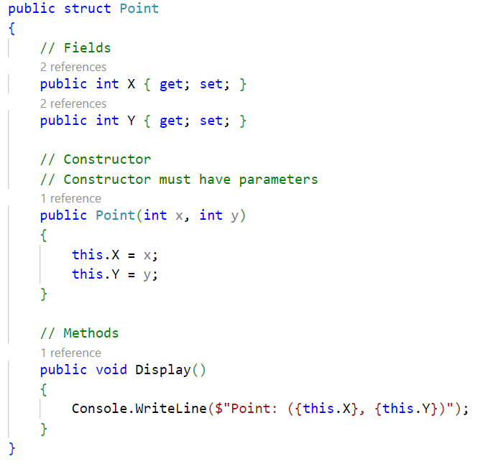
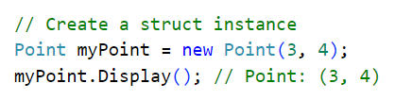
Struct vs. Class
Classes and structs look similar. However, there are some differences between them.
A class is a reference type whereas a struct is a value type (a copy is made when assigned to another variable).
A struct is typically used for small, lightweight objects that do not require inheritance. (but can implement interfaces)
A struct cannot have explicit parameterless constructors.

Slide 17
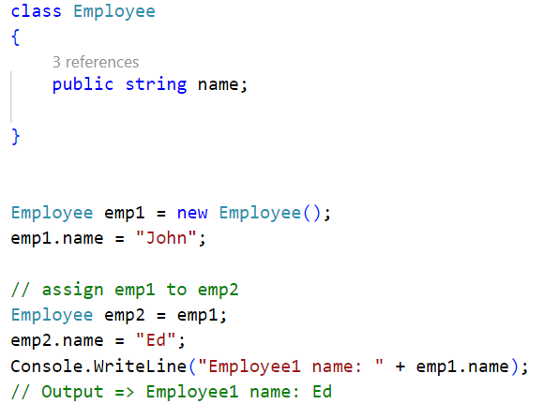
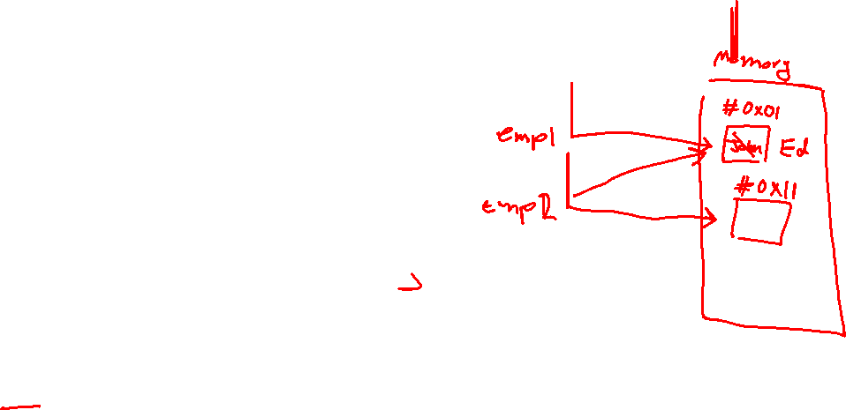
Reference Type

Slide 18
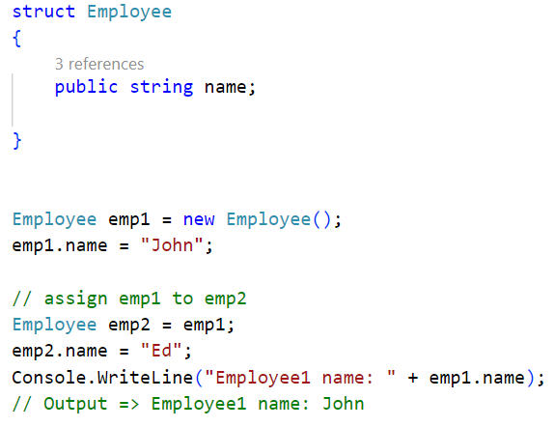
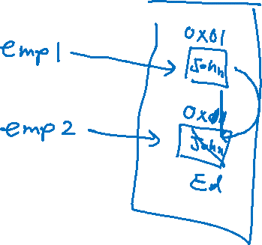
Value Type

