Slide 1
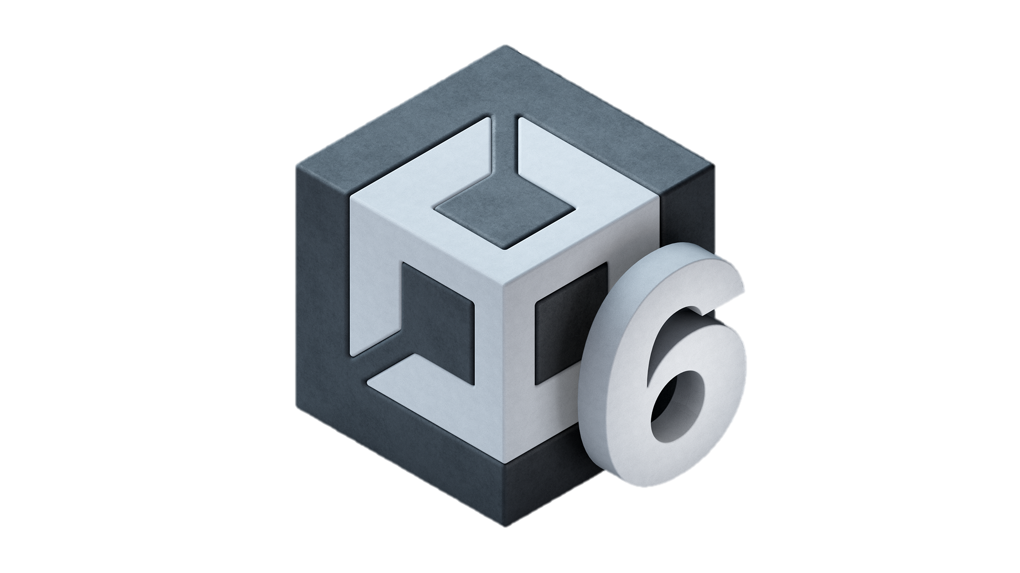
Unity For Academia
Input & Interaction
Spring 2025 – Week 5
Iman Noferesti

Slide 2
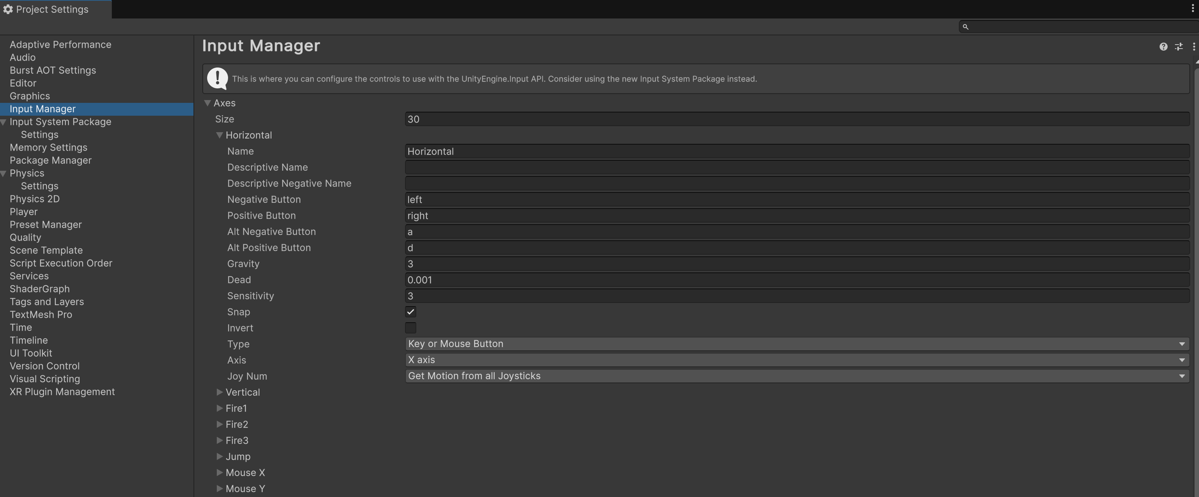
Input Manager
The Input Manager is Unity's older input framework. It allows you to configure input axes like movement or buttons through a dedicated settings menu.
You configure inputs in the Unity Editor under Edit -> Project Settings -> Input Manager.
Inputs are assigned as "axes" (e.g., horizontal/vertical movement) or buttons (e.g., jump or fire).

Slide 3
Name | Description
Name | Axis name. You can use this to access the axis from scripts.
Negative Button, Positive Button | The controls used to move an axis in the negative or positive direction can include keyboard keys, joystick buttons, or mouse buttons.
Gravity | Defines how quickly the axis returns to its neutral position, measured in units per second, when there is no input applied.
Dead | Specifies the distance an analog stick must be moved before the application detects the input. Any input within this threshold from analog devices will be ignored during runtime.
Sensitivity | Defines the rate, measured in units per second, at which the axis adjusts toward the target value. This applies exclusively to digital input devices.
Snap | When activated, pressing a button assigned to the opposite direction will automatically reset the axis value to zero.
Type | The type of input that controls the axis. Select from these values: - Key or Mouse button - Mouse Movement - Joystick Axis
Axis | The axis of a connected device that controls this axis.

Slide 4
To access an axis, use Input.GetAxis() with one of these built-in options:
Horizontal and Vertical: Associated with joystick movement, as well as the A, W, S, D keys and arrow keys.
Mouse X and Mouse Y: Linked to the movement of the mouse (delta).
GetKey(), GetKeyDown(), and GetKeyUp() are 3 methods widely used to detect keyboard input.
GetKey() detects if a specific key is being held down.
Returns true every frame while the key is pressed.
Use this for continuous actions, like moving a character when a key is held.
GetKeyDown() detects the moment a key is initially pressed down.
Returns true only in the exact frame the key is pressed.
Use this for triggering actions that happen once per key press, like jumping.
GetKeyUp() detects when a key is released.
Returns true only in the exact frame the key is released.
Use this for actions triggered upon key release.

Slide 5
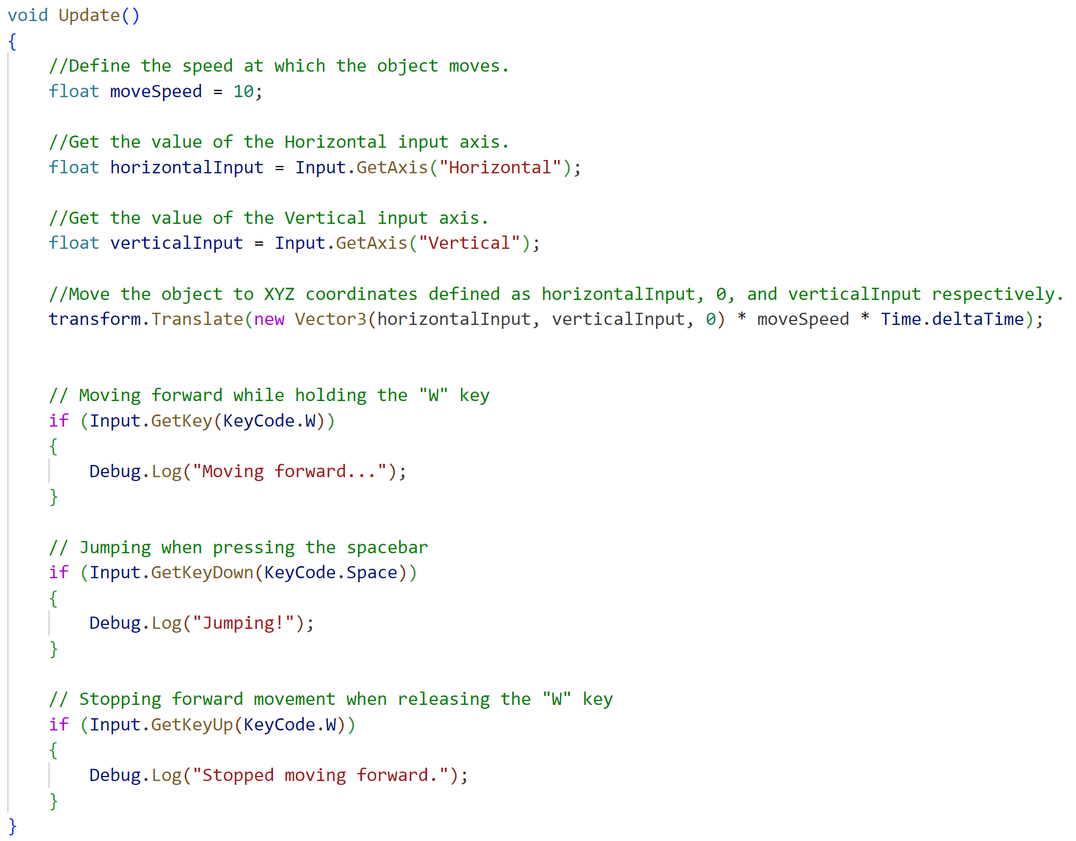

Slide 6
Physics
Unity enables you to simulate physics in your project, ensuring objects move accurately and react appropriately to collisions, gravity, and other forces.
Rigidbody Physics:
In physics simulation, rigidbodies enable physics-based behavior such as movement, gravity, and collision.
If paired with a Collider, it interacts with other GameObjects that also have Colliders.
The Rigidbody offers a scripting API to apply forces and manage motion realistically. To achieve accurate physics, avoid directly altering Transform properties like position and rotation; instead, apply forces and let the physics engine compute the results.
Physics-based movement operates in global space rather than local space. When a GameObject with a Rigidbody moves using physics, it acts independently of its parent or child GameObjects.
For scripting, using the FixedUpdate() method is recommended over Update() when applying forces, as physics calculations occur at consistent time intervals that may not align with frame updates.
In certain cases, when physics-based motion isn't desired but a Rigidbody is needed for trigger detection, you can use kinematic motion. This type of motion is script-driven and not controlled by the physics engine.

Slide 7
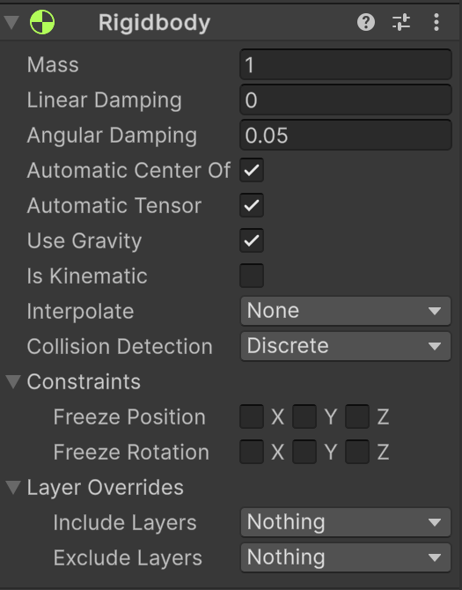
Property | Description
mass | The mass of a GameObject is specified in kilograms, with a default value of 1. Similar to real-world physics, the mass does not influence the rate at which an object falls due to gravity.
linearDamping | The decay rate of a Rigidbody's linear velocity represents the gradual reduction of its speed over time, mimicking the effects of drag, air resistance, or friction.
angularDamping | The decay rate of a Rigidbody's rotational velocity determines the gradual reduction in its angular speed over time. This simulates effects such as drag, air resistance, or friction acting against the object's rotation.
automaticCenterOfMass centerOfMass | By enabling Automatic Center of Mass, the physics system calculates the Rigidbody’s center of mass automatically, based on its shape and scale. If disabled, you can manually specify the X, Y, and Z coordinates to define the center of mass according to your preferences.
useGravity | You can enable or disable the effects of gravity on a Rigidbody. When enabled, the physics system applies a force that moves the GameObject in the direction of simulated gravity, which, by default, is along the negative y-axis.

Slide 8
Property | Description
isKinematic | Toggle between physics-based and kinematic movement for the GameObject. When enabled, the GameObject is exempt from physics forces, meaning the physics system cannot move or rotate it. Instead, its motion and rotation are managed exclusively through changes to its Transform.
collisionDetectionMode | Define how the physics system detects collisions between this Rigidbody’s collider and other colliders in the scene. Discrete: If this Rigidbody is not involved in any fast-moving collisions. Continuous Speculative: If collision accuracy is not important for this Rigidbody. Continuous Dynamic: If this Rigidbody is involved in fast-moving collisions with any colliders except for those that are set to Discrete collision detection. Continuous: If this Rigidbody is involved in fast-moving collisions with static colliders.
constraints | Place restrictions on the Rigidbody’s movement. Freeze Position: Stops the Rigidbody moving in the world X, Y and Z axes selectively. Freeze Rotation: Stops the Rigidbody rotating around the local X, Y and Z axes selectively.

Slide 9
Method | Description
AddForce (Vector3 force, ForceMode mode = ForceMode.Force) | Adds a force to the Rigidbody. ForceMode.Force ForceMode.Acceleration ForceMode.Impulse ForceMode.VelocityChange
AddRelativeForce (Vector3 force, ForceMode mode = ForceMode.Force) | Adds a force to the rigidbody relative to its coordinate system. ForceMode.Force ForceMode.Acceleration ForceMode.Impulse ForceMode.VelocityChange
AddTorque (Vector3 torque, ForceMode mode = ForceMode.Force) | Adds a torque to the rigidbody. ForceMode.Force ForceMode.Acceleration ForceMode.Impulse ForceMode.VelocityChange
AddRelativeTorque (Vector3 torque, ForceMode mode = ForceMode.Force) | Adds a torque to the rigidbody relative to its coordinate system. ForceMode.Force ForceMode.Acceleration ForceMode.Impulse ForceMode.VelocityChange

Slide 10
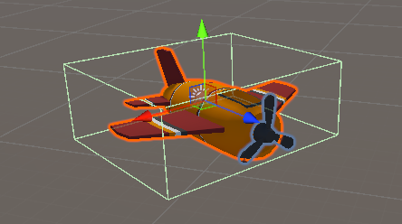
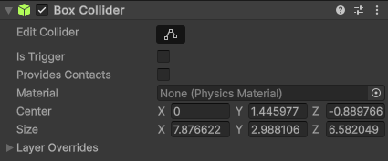
Colliders:
Colliders are used to outline the shape of an object for handling physical collisions.
The type of a collider is determined by how its GameObject's Collider and Rigidbody components are configured. This setup defines the collider's behavior and its interactions with other colliders.
Static colliders: The GameObject has a collider but no Rigidbody.
Rigidbody colliders: The GameObject has a collider and a Rigidbody.
Dynamic colliders: The Rigidbody is dynamic (that is, it has Is Kinematic disabled).
Kinematic colliders: The Rigidbody is kinematic (that is, it has Is Kinematic enabled).
A Trigger collider is a specialized type of collider that doesn't engage in physical collisions with other colliders. Instead, they detect other Colliders that pass through them, and call functions that you can use to initiate events.
For a trigger collider to function, at least one of the GameObjects involved in the interaction needs to have a Rigidbody component. To convert a collider into a trigger collider, simply activate the Is Trigger property within the Collider component's settings.

Slide 11
Property | Description
enabled | Enabled Colliders will collide with other Colliders, disabled Colliders won't.
isTrigger | Specify if this collider is configured as a trigger.

